Slide 1
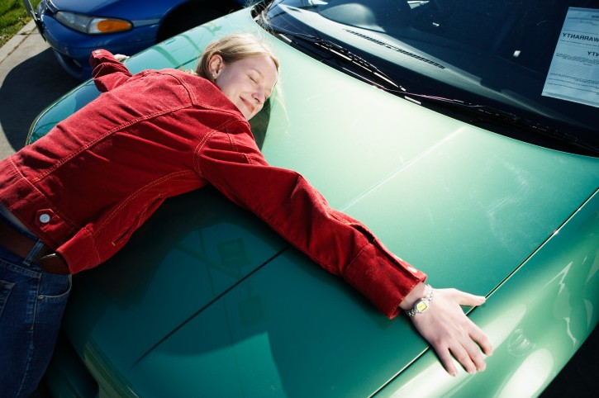
This is a love story…

Slide 2
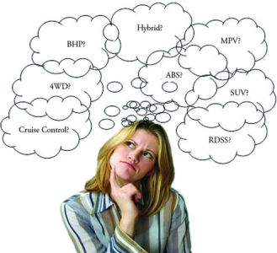
Here’s the problem…
Consumers can’t find the information that’s important to them …
…and car companies
and dealers can’t engage with consumers in a way that resonates…

Slide 3
KarMatch “Discover the car you’ll Love”
Introducing…
Our Theory: Deeper user engagement creates highly qualified leads and moves the metal
At KarMatch, here’s how we’re different and why people will use us:
We’re bringing data together in a compelling way…..
How you act..
We learn as we go
What other information is out there…
Aggregates existing information
What you tell us…
Create user profile and pull in social
We start with the user as the focus, not brand or model
We create a seamless experience across the social web
We get to know you over time, informing recommendations
We pull information from established brands to get the user the best value
Notes:
What you tell us…
Initial profile tailored by time to purchase
Unobtrusive questions up front
Keep it fun; explain why we’re gathering this
How you act…
Micro-engagement along the way
Geolocation
Adaptive questions based on behaviors
What else is out there…
Social site APIs
OEM data
Edmunds API
Makes/Models/Options/Cost to own/Maintenance/Inventives

Slide 4


KARMatch
Discover the
car you’ll love

Slide 5
Welcome back Christopher!
A few quick questions before we get started:
When are you looking
to buy your next car?
0-3
Months
4-6
Months
6-12
Months
Over a
year

Slide 6
Which is most you?

Slide 7
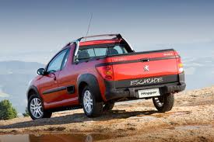
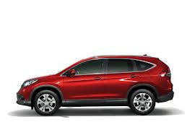
Thanks! Let’s Start KARGazing!
Which is more you?

Slide 8
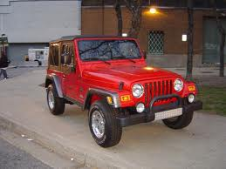
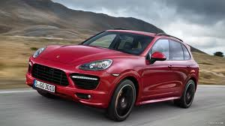
Which is more you?

Slide 9
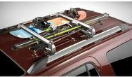
How important is to put your snowboard on your car?
Eh,
not me
Nice to
have
Must
have
Gross

Slide 10
Thanks! I think I’ve got some cars you’ll love!

Slide 11
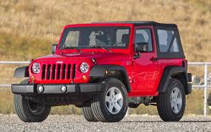
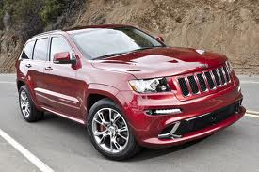
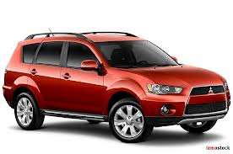
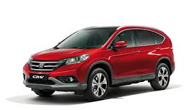
2012 Jeep Wrangler:
MSRP $21,622
2012 Jeep Grand Cherokee:
MSRP$ 27,229
2013 Mitsubishi Outlander SUV:
MSRP $21,737
2013 Honda CR-V:
MSRP $22,795

Slide 12
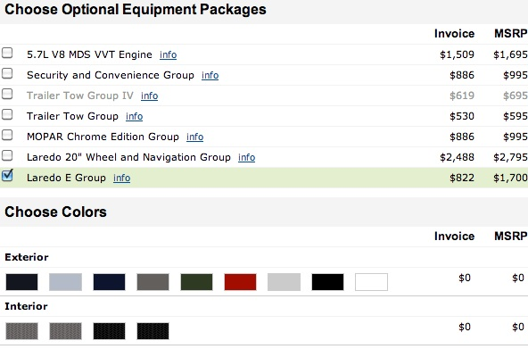
KarMatch: We found your match!
2013 Jeep Grand Cherokee
MSRP: $ 27,695 – $60,295
Why We’d Think You’d Like It:
Price falls within your range
High Safety Ratings
Room for the whole family
Active Lifestyle
Cool Features:
Wide variety of powertrains
Off road prowess
Innovative technology
Wildly fast SRT 8 Model
Notes:
Customized

Slide 13
So…you might be thinking..
How do we drive adoption?
Seamless integration with social
Relentless focus on user experience (user-centric not auto-centric)
Target the household CFO first
Influence: More than 70% of car buying decision are influenced by women¹
Engagement: Women produce 60 percent of all User Generated Content²
Adoption: Primary research suggested 80% of women would create profiles and allow for behavioral data to be gathered³
SOURCE: (1) Influence: How Women's Soaring Economic Power Will Transform Our World for the Better; (2) "The Conversation Index Vol. 1,"Bazaarvoice, September 2011; (3) Phone survey conducted 2/27 – 2/28

Slide 14
So…you might be thinking..
Is Karmatch valuable?
Value along every step
To reach the end goal
OEM
Dealer
Consumer
High fidelity Consumer Behavior data
Higher quality leads
Discovery of a vehicle that fits into your needs AND behavior
Better Data -> Better Conversations -> More Qualified Leads -> Deeper Engagement -> More Revenue -> Move the metal

Slide 15
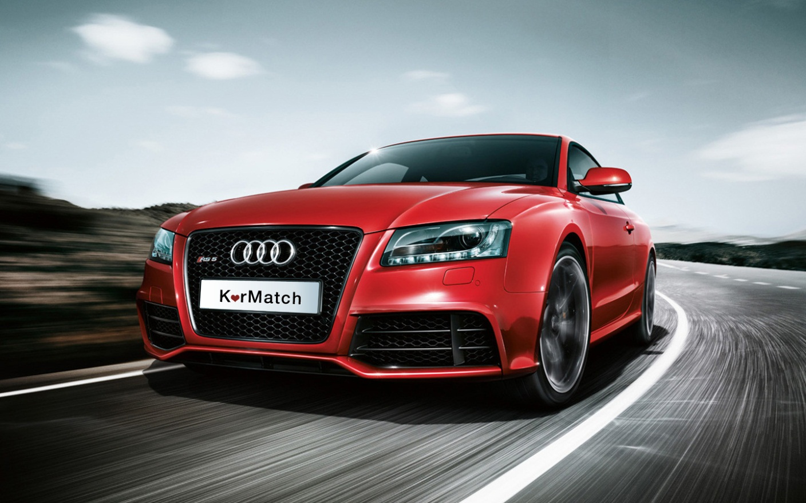
Thank You!
Discover the car you’ll love
A discovery engine that drives better car purchases

