Slide 1




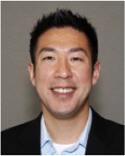
Team CarHound
Problem: Hard to find car reviews that match my lifestyle.
Ivo
Michael
Andrew
Find out what others like me are saying!

Slide 2
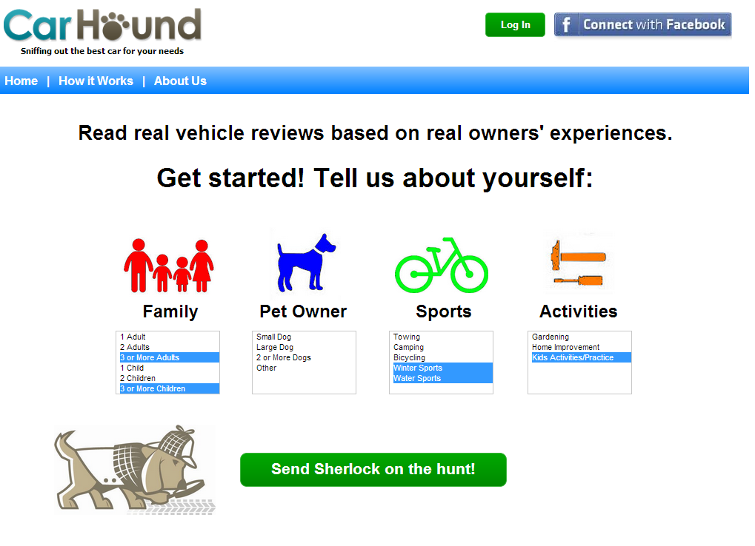

Slide 3
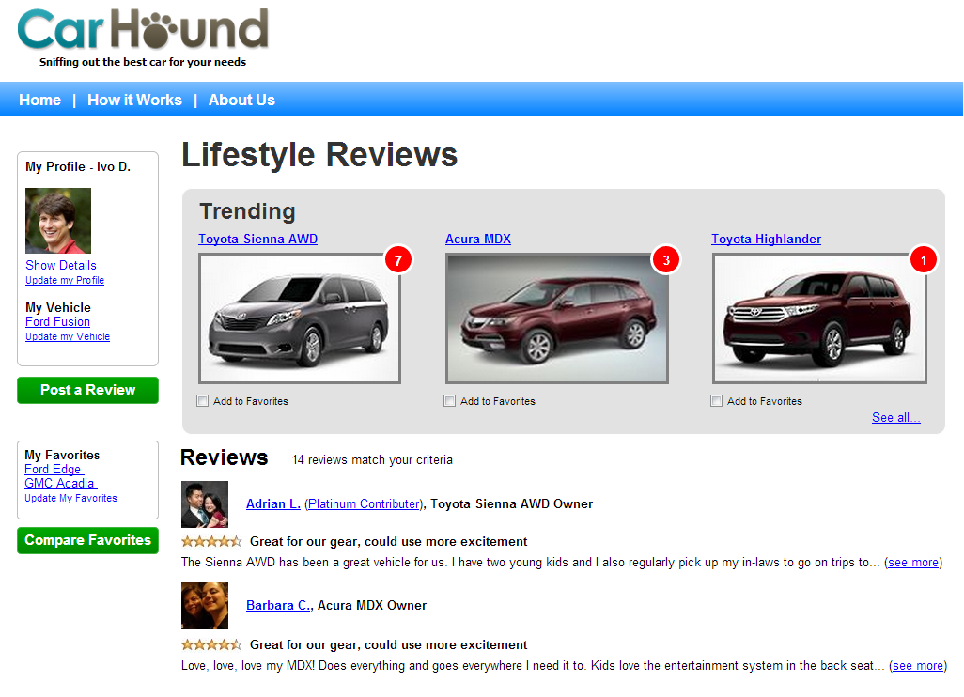

Slide 4



Customer Acquisition
Sample Segment: Parents with young children
Reviewers
Audience
Mommy Blogs
Mommy blog links
Free
Reach decision makers
Search Engine Optimization
Peer reviews = Relevant content
Free & highly scalable
Social
Paid Ads
Organic
Influencers with large following of household decision makers

Slide 5

Business Impact
The Three Pillars
Customers
Manufacturers
Dealers
True social buying!
Market research
& brand awareness
Local leads &
marketing insight

Slide 6
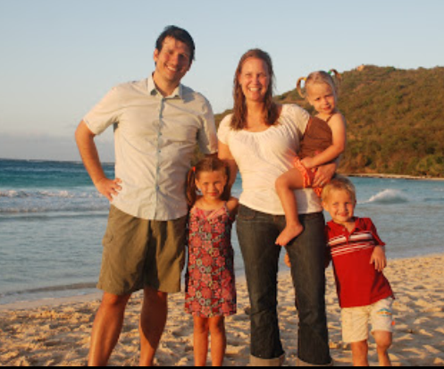
Let Sherlock sniff out the best car for your lifestyle.

