Slide 1
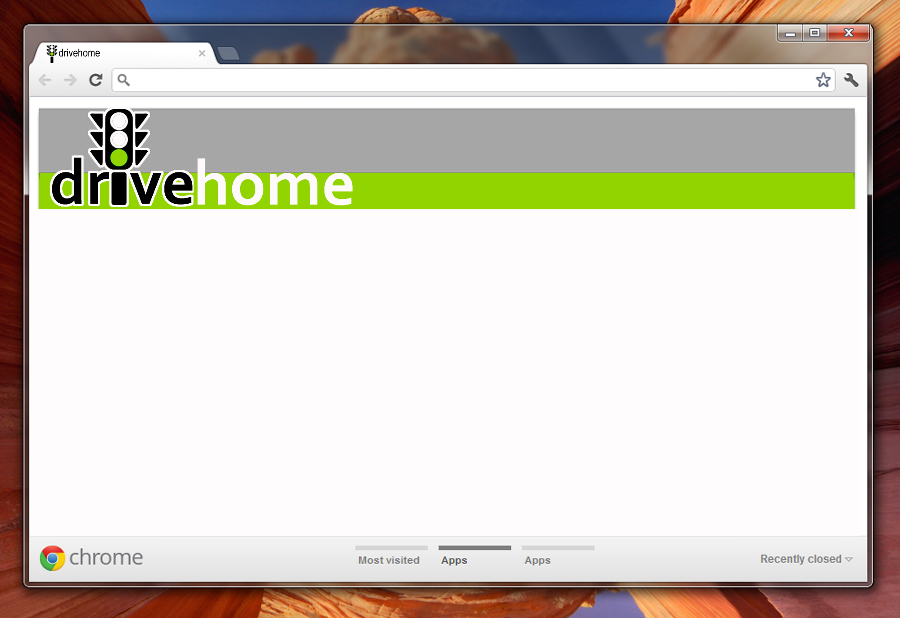
Team 5: NU Control
“I’m not in control of the shopping experience.”
OR
How to turn 3 hours into 15 minutes
Hackomotive
February 28, 2013

Slide 2
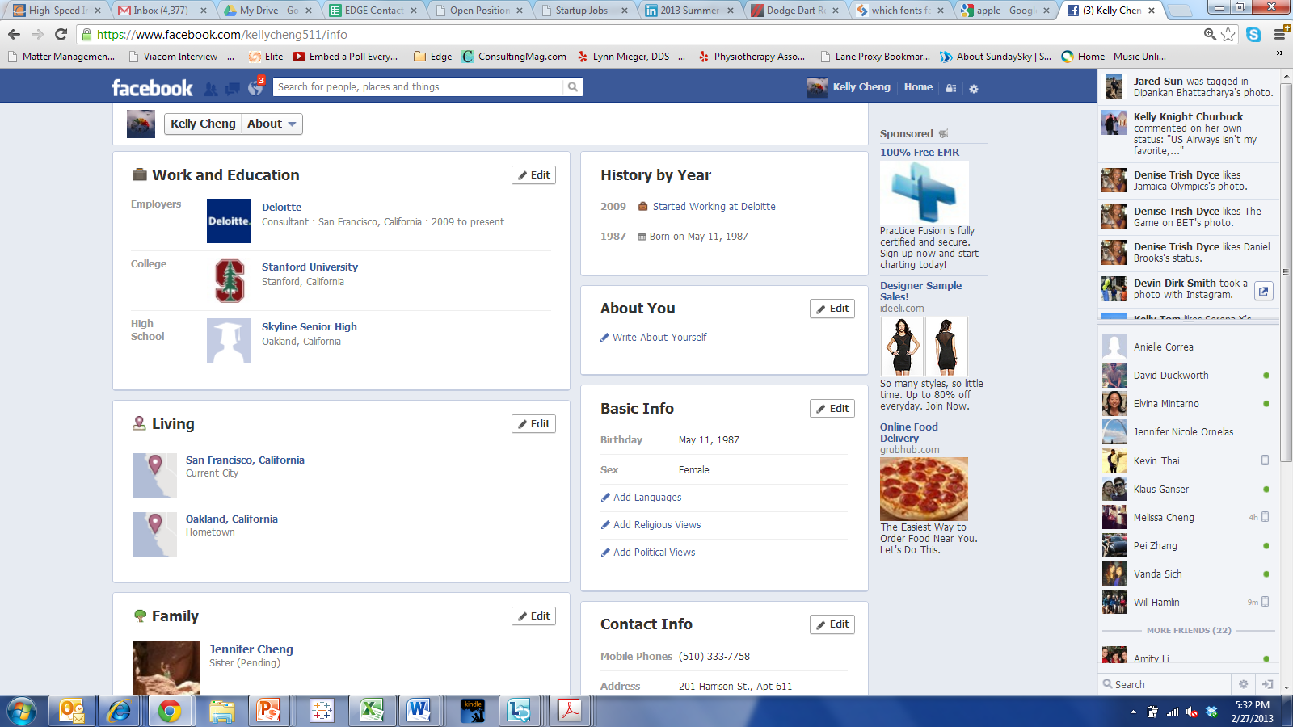
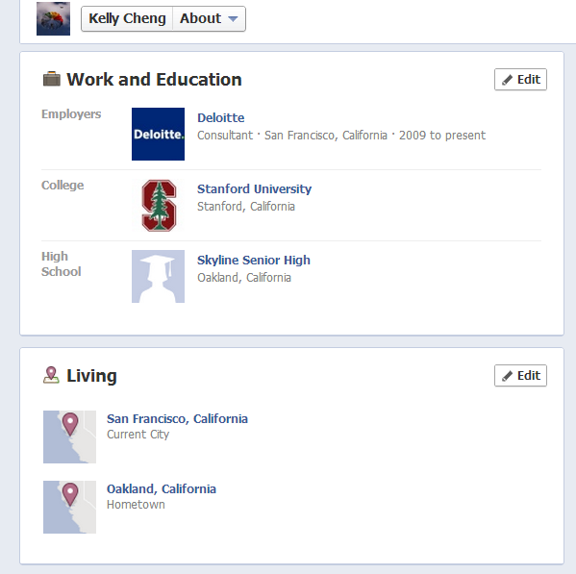
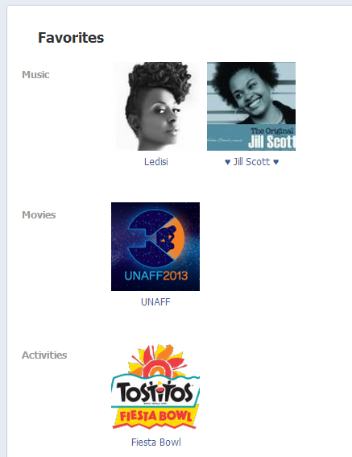






Why do I have to waste my time at the financing office?
Interests
Notes:
Kelly: I love the way the internet makes it so easy nowadays to find all the information about a vehicle. I thought I wanted a Prius, but when I started reading up reviews, I found several useful comparisons and expert opinions that led me to consider a Focus and a Jetta Hybrid. After looking at all the options and opinions, I test drove both and I just loved the way the Jetta drove. I know exactly what color I want, the model and the accessories. I was able to even find invoice price and average price paid online. But now comes the hard part. I have to go into the dealership and negotiate the deal. And I’m dreading it. Last time I went, they just assumed I didn’t know anything and tried to sell me something I didn’t even want.

Slide 3

Research, Test Drive, Compare
At the dealer:
Negotiation
Financing
Paperwork
Hassle
Time
Notes:
As we research, narrow down and compare our potential future vehicles, we are becoming more and more excited about owning the new car. However, this process breaks down for many at the point we enter the dealership. Our customer trusts technology and buys products online often. They are urban, tech savvy and educated. He or she thinks that she should be able to buy everything online and not have to set foot at the dealership. She wants to avoid the frustration of haggling and save time.
*

Slide 4

SOLUTION: drivehome.com puts the buyer in control
Notes:
Selected vehicle
Negotiated price with dealer
Dealer submits model and price info to drivehome.com
drivehome.com sends Kelly personal link
Instant communication and immediate access to information have empowered consumers in most places, but not car buying.
We want to change how the deal is done.

Slide 5



Kelly receives a personal link via e-mail from drivehome.com
www.drivehome.com/index/kc203292
Welcome, Kelly Cheng! Not Kelly? Click here
Your vehicle
2013 VW Jetta Hybrid
Your price
$24,450
Your dealer
VW of Sunny Hills
24353 State College Blvd
Brea, CA 98281
(714) 240-2322
CREDIT APPLICATION
PICKUP

Slide 6
She fills out her credit application and reviews F&I add-ons
www.drivehome.com/index/kc203292
Welcome, Kelly Cheng! Not Kelly? Click here
CREDIT APPLICATION
First Name
Last Name
SSI#
Employer
EXTENDED WARRANTY/MAINTENANCE

Slide 7


She receives financing offers to review on her own time
www.drivehome.com/index/kc203292
Welcome, Kelly Cheng! Not Kelly? Click here
YOUR FINANCING AND LEASE OFFERS
Your Best Financing Deal
Bank of America
2.9% APR for 60 months
First and last payment Free
Details
Offer 2
Chase Bank
3.0% APR for 60 months
$200 cash back
Details
Notes:
She receives electronic copy of all paperwork to review at home on her own time

Slide 8
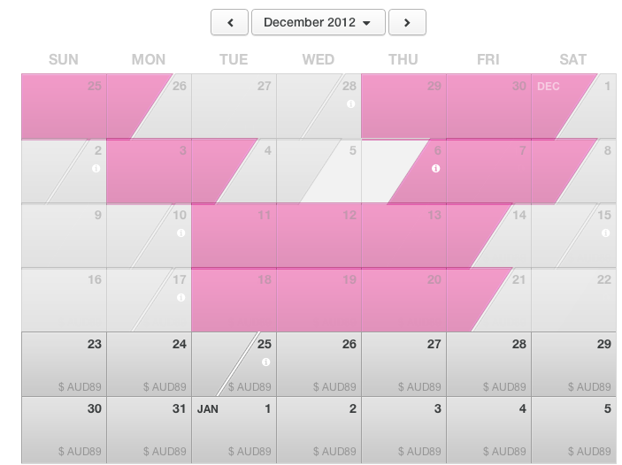
Kelly selects her 15-minute appointment
www.drivehome.com/index/kc203292
Welcome, Kelly Cheng! Not Kelly? Click here
SCHEDULE PICK UP APPOINTMENT

Slide 9
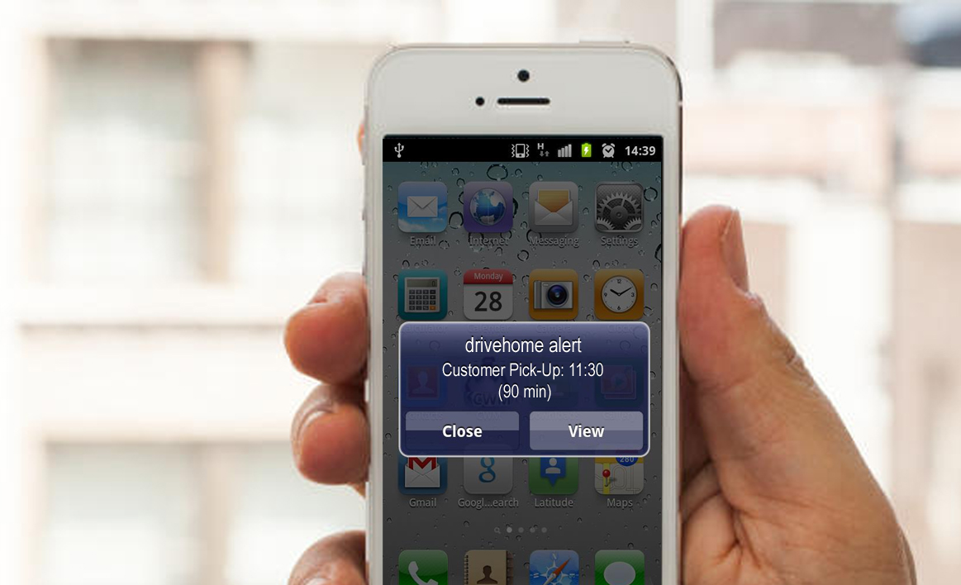
All relevant dealer personnel is notified 90 min prior to appointment via app notifications
Notes:
The close takes 15 mins at the dealership and means one last form, the final acceptance.
Dealer verifies and countersigns, delivers vehicle.

Slide 10

Kelly signs paperwork and gets her keys in 15 minutes
Notes:
The close takes 15 mins at the dealership and means one last form, the final acceptance.
Dealer verifies and countersigns, delivers vehicle.

Slide 11


The Bottom Line
Buyer:
Control over the experience
Transparent, trust-building process
Fast, convenient delivery
Dealer:
Increased sales volume
Qualified, satisfied, loyal customers
Increased scheduling efficiency

