Slide 1

Team Hammer
Hackomotive 2013
Ylondia Portis
Steve Tu
Shuman Mukherjee
Jon Salzberg
Damian Geddry

Slide 2
The Goal
To address the fractured shopping experience through aggregation, personalization, and preparation

Slide 3

The Situation
80% of shoppers begin online looking for Knowledge and Efficiently
52% start with only SOME or NO idea of what they want
What shoppers Actually encounter is Too Much information across Too Many different places and Not Enough Consultation
The impact on the average shopper
18 hours researching
10 different search queries
13 different sources consulted
THIS IS A PROBLEM!

Slide 4

We Envision Something Better For Shoppers
Meaningful Connections
Gets you to the car you want based on the cars that people just like you love
Research in Less Time
Delivers the kind of research a customer really cares about
Ease into Buying Stage
Matches the consumer to a dealer and delivery model that suits them
All In One Location…
INTRODUCING

Slide 5


Meaningful Connections
Shoppers are asked to provide details that go beyond just NEEDS
Values, such as ecological footprint
Lifestyle, such as being able to find a vehicle that supports your daily activities
The shoppers characteristics are then matched to buyers who share similar characteristics and Love the vehicle they purchased
The PAYOFF
‘Starter List’ of vehicles that BEST reflects the users Needs, Values, and Lifestyle

Slide 6
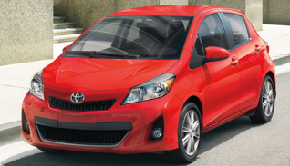
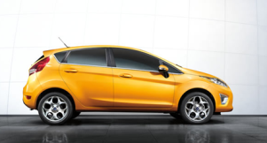
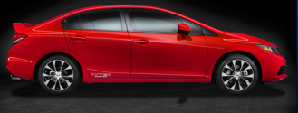
Research in Less Time
User selects up to three vehicles of interest
eCarmony Provides Selected Vehicle Information
Unlike other spaces, eCarmony:
Aggregates objective content proven to be MOST valuable to shoppers
Personalizes by preselecting and elevating categories based on the user’s profile
Empowers by allowing the user to either continue with pre-selected categories or adjust as desired
The PAYOFF:
Relevancy and Efficiency – Shoppers move quickly to the content that they really want, all in one location

Slide 7
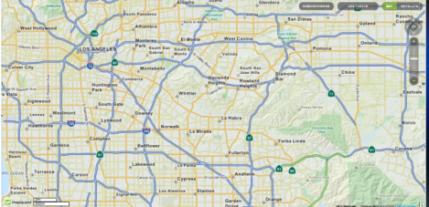

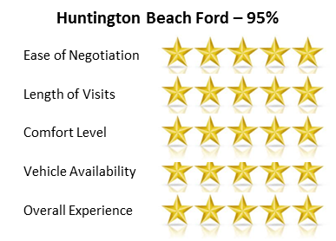
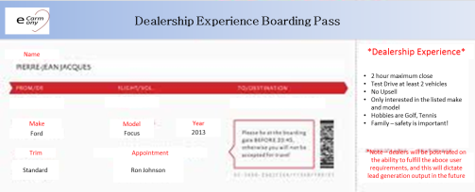
Ease into Buying Stage
Maps dealers with desired vehicles within a radius, down to trim preferences
Rank order dealers by consumer ratings, and attributes important to the user
Qualified Dealerships | % Match
Huntington Beach Ford | 95%
Santa Monica Ford | 78%
Inglewood Ford | 47%
Airport Marina Ford | 19%
With permission, passes user profile, preferences, and expectations to dealer
Sample Boarding Pass
Car Preference
Test Drive Preference
Desired Dealership Time
Package Options
Desire to be upsold
Disclaimer that feedback of dealer compliance with consumer preferences will drive future lead generation
The PAYOFF:
User begins the Buying process Informed and Confident

Slide 8
In Summary…
Feasible because all information needed to populate experience currently exist and is accessible or can be provided by the User
Desirable because it resolves the business issue of unifying scattered information. And, a growing number of consumers are requesting a more brokered car shopping experience:
One Example: 87,000 people, during a single Month, requested referrals to recommended dealers through Costco Wholesale Corp’s car-buying service
Unique matches consumers to vehicles through crowd sourcing, customizes and streamline the process, and arms the consumer with knowledge preparing them for their dealer experience

