Slide 1
PROBLEM STATEMENT
Most consumers have a negative, anxiety-filled mindset when it comes to car buying.

Slide 2
MINDSET
n.
1. A fixed mental attitude or disposition that predetermines a person's responses to and interpretations of situations.
2. An inclination or a habit.

Slide 3
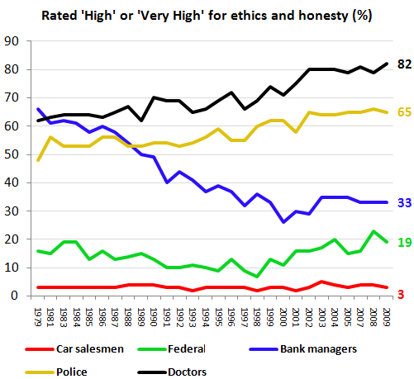
Car Buying Experience
Public Perception & Negative Mindset
The car sales experience was rated significantly higher than meth labs and the ebola virus but almost on par with going for a root canal or colonoscopy in an online poll

Slide 4
WHY SO NEGATIVE?
13-18 Hours of Research
High Anxiety Regarding Sales Process
Most Costumers don’t feel comfortable Negotiating
Feelings of Buyers Remorse even if they feel they got a Good Deal

Slide 5
How do we change the Negative Mindset?
Start at the very beginning.
The Discovery and Research phase of the car buying experience.
And
CHANGE THE STORY FOCUS…

Slide 6

Current story: single females ages 22-35 slaying the “dragon” of car buying…

Slide 7

We change it to the Love Story of a single female in the 22-35 target demographic falling in love.

Slide 8


How to change the Story -

Slide 9
CAR CUPID
Fall in love again and discover your car “soul mate”
Car Cupid is a fun, qualitative, social tool that matches each individual with the car that is right for them based on their lifestyle and aspiration.

Slide 10
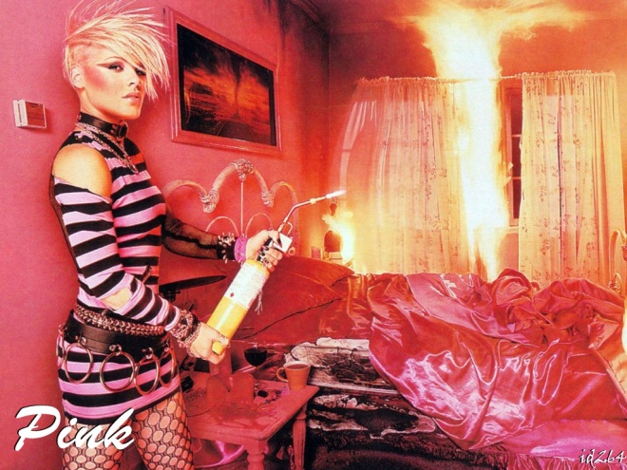
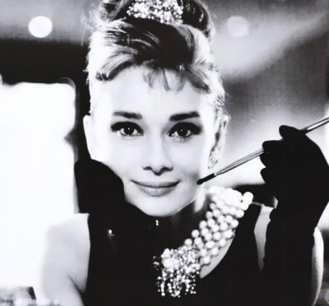


CAR CUPID – EXAMPLE QUESTION Pick an image…

Slide 11
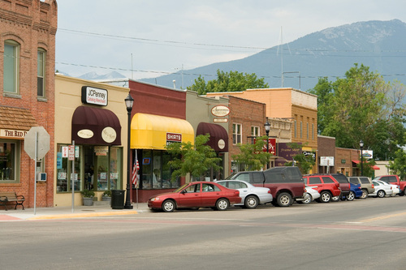



CAR CUPID – EXAMPLE QUESTION Pick an image…

Slide 12
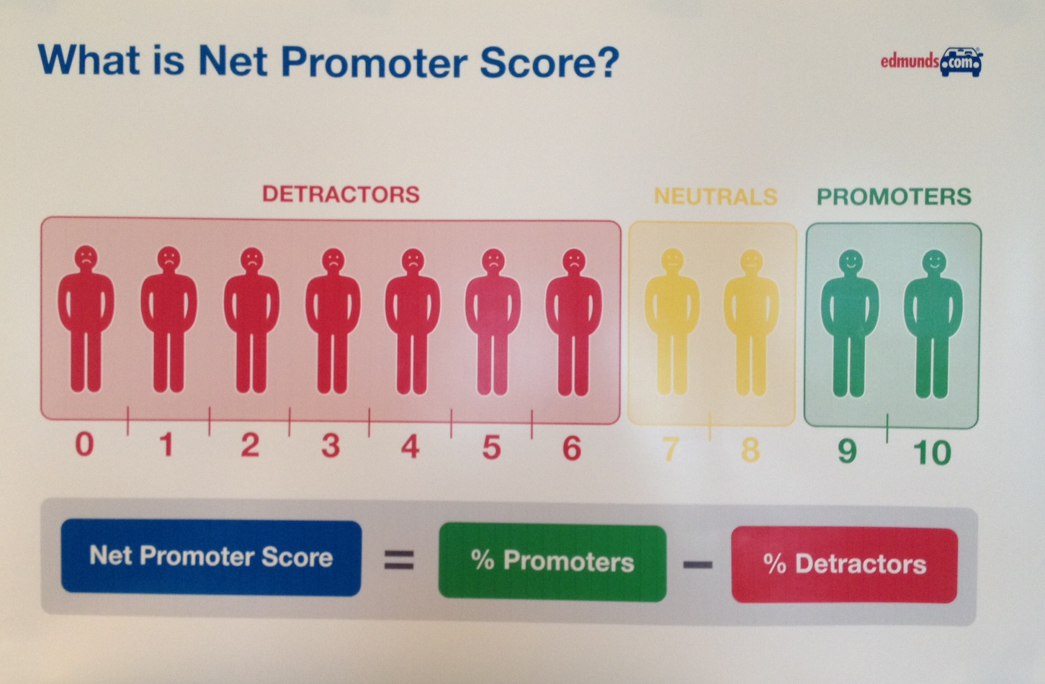
CAR CUPID BUSINESS IMPACT
Reduce Research time
Eliminate boredom for buyer
Confirmation of Choice
Eliminate Buyers Remorse
Social Media Aspect
Users will tell their car buying love story
Share with friends or world

Slide 13
CAR CUPID BUSINESS IMPACT
Car Cupid is fun activity that will drive traffic to Edmunds.com and convert neutrals to promoters
Car Cupid will send happy buyers to dealers. Buyers that are not going to be focused on positive experience of having a car meant for them.
Car Cupid will be an antidote for buyers remorse. “Maybe I could have bargained for 500 lower price, but it doesn’t matter, I have a car that is meant for me.”
Car Cupid increases engagement through social media, by sharing matches and uploading photos of consumers in their vehicle, and sharing their new love story.

Slide 14

IMPLEMENTATION
3-6 Months for –
Engineering
Marketing effort
Design & Layout
Applied to Site Home Page
Manufacturer website to design and personalize your vehicle
As an option on Edmunds.com
Rich Media Ad
Facebook App
Pinterest Post

Slide 15
Change the Story
CAR CUPID
Fall in love again and discover your car “soul mate”
Turn the car buying experience into a Love Story again.
Then let the users tell the story for you.
Rather than complain on Yelp.

