Slide 1


Slide 2

2

Slide 3
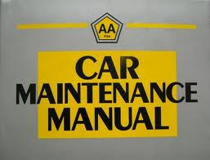
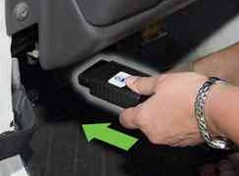
Realtime Vehicle Diagnostics
Today
Best Guess Service Schedule
Realtime Service Monitoring and Notification
Tomorrow

Slide 4
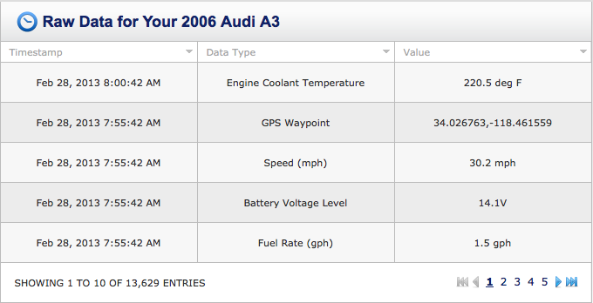
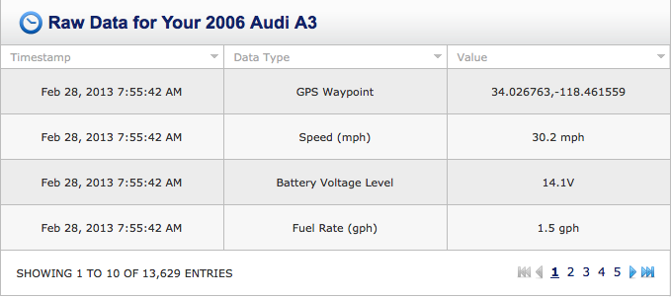
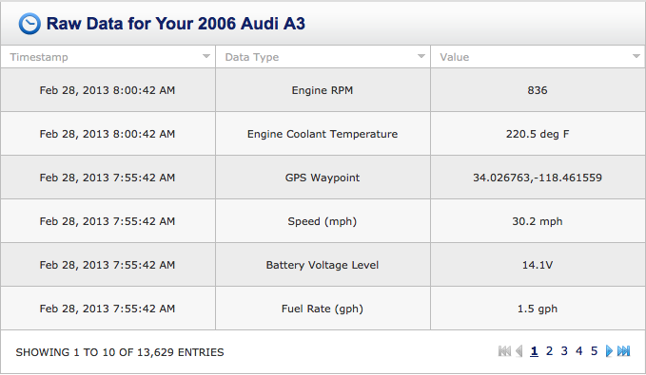
Instant Insights

Slide 5


Slide 6

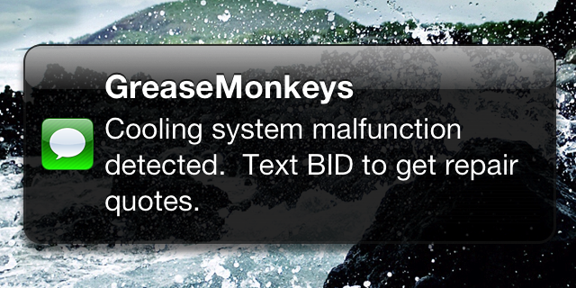
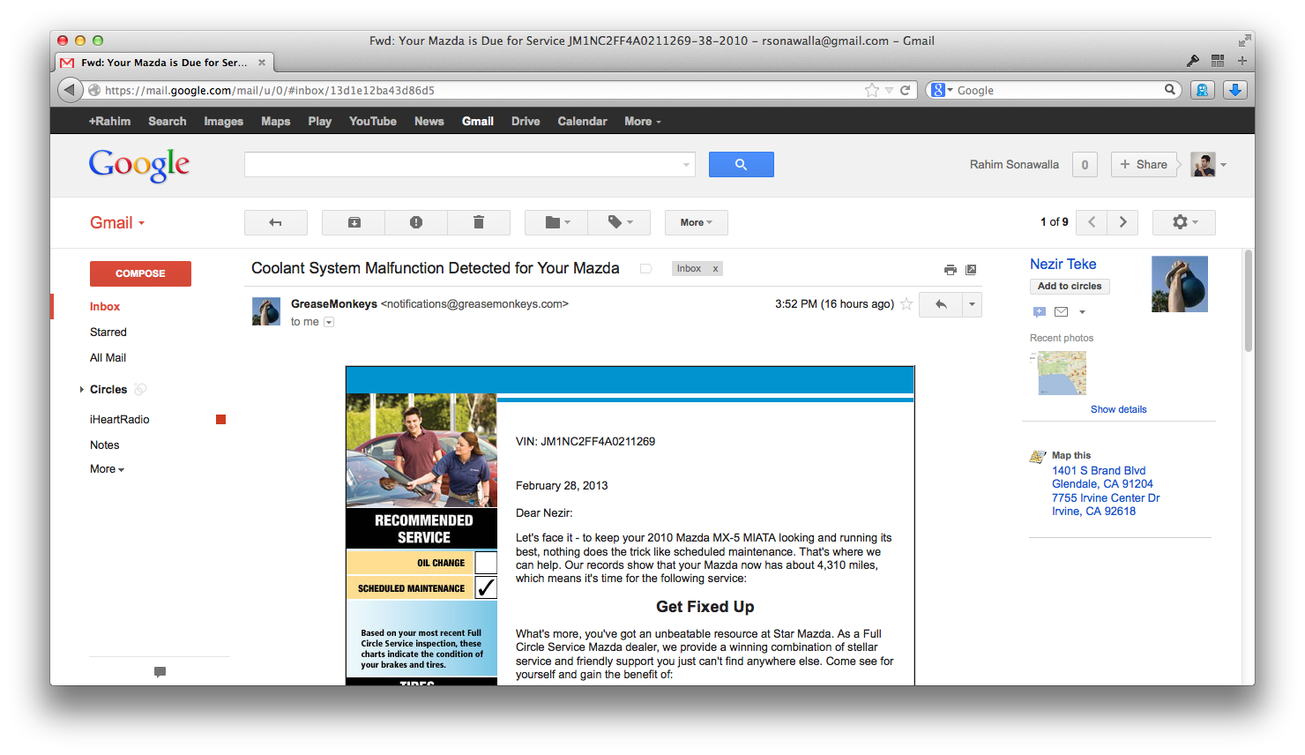
Alert Me to My Service Needs
Jargon-free Diagnosis
Possible Quick Fixes
Vetted Service Shops

Slide 7
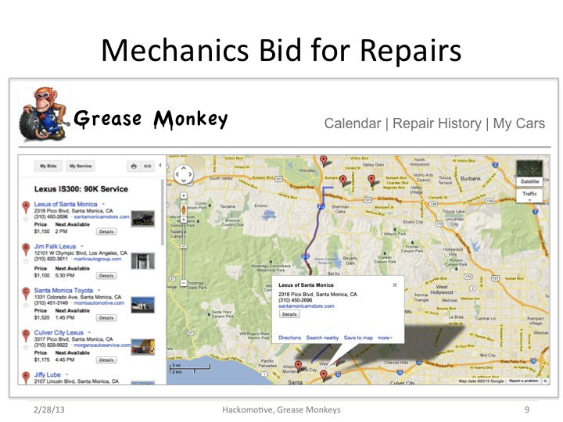

Slide 8


Improve Service Department ROI
Incremental Revenue
Marketing Efficiency

Slide 10
Future Revenue Streams
Data Opportunities
Vehicle Lead Generation
Recommended Next Vehicle Purchase
Other Car Industry Business Models
Extended Warranty
Insurance

Slide 11
