Slide 1


Slide 2

“I don’t understand car jargon”

Slide 3
“I don’t know the features I need”

Slide 4
“I am not addressed because I am a woman”

Slide 5
“My neighbor always gets a better deal than me”

Slide 6
“I don’t feel comfortable shopping for cars alone”

Slide 7


Slide 8

“Safety in Numbers”
Notes:
At CarTell and we bring together car shoppers that are looking for the same vehicle to discuss, debate and decide on their future purchase together

Slide 9
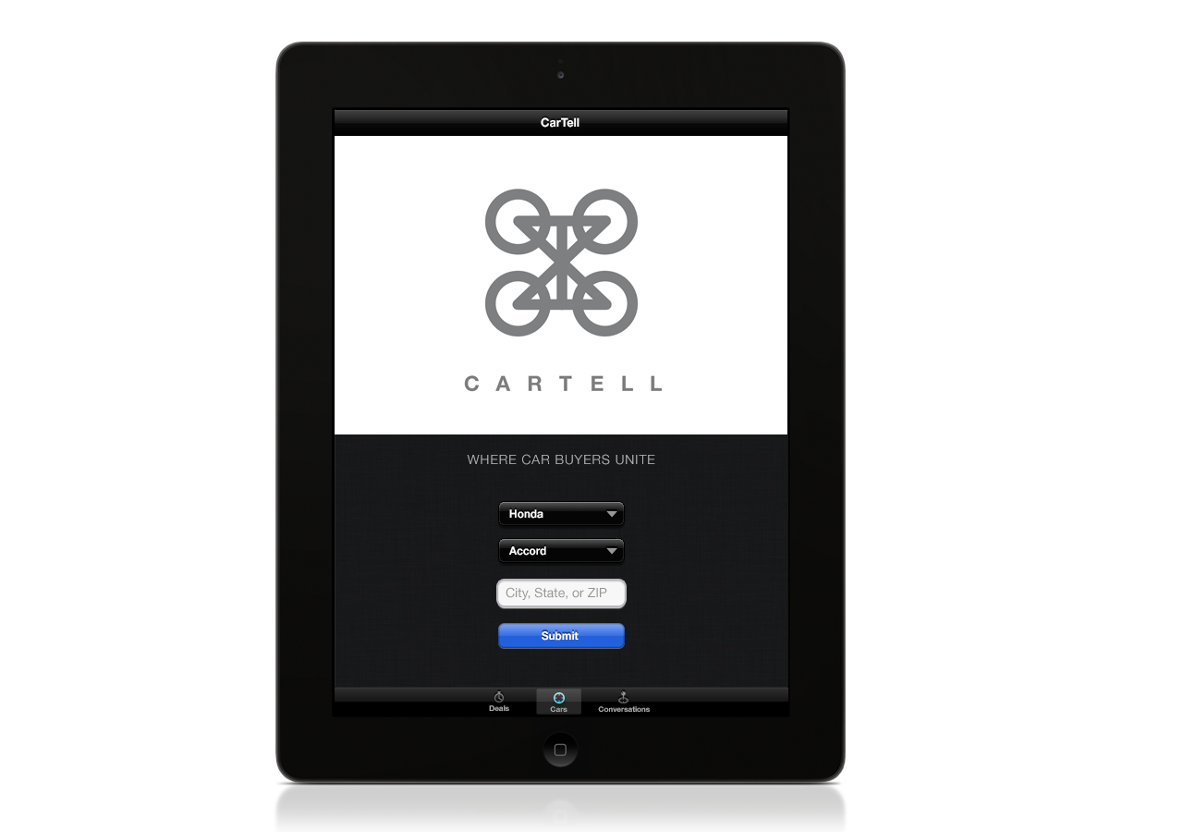
Notes:
We have developed a multi-platform solution to link car buyers. After you select the vehicle you are looking for and your location

Slide 10
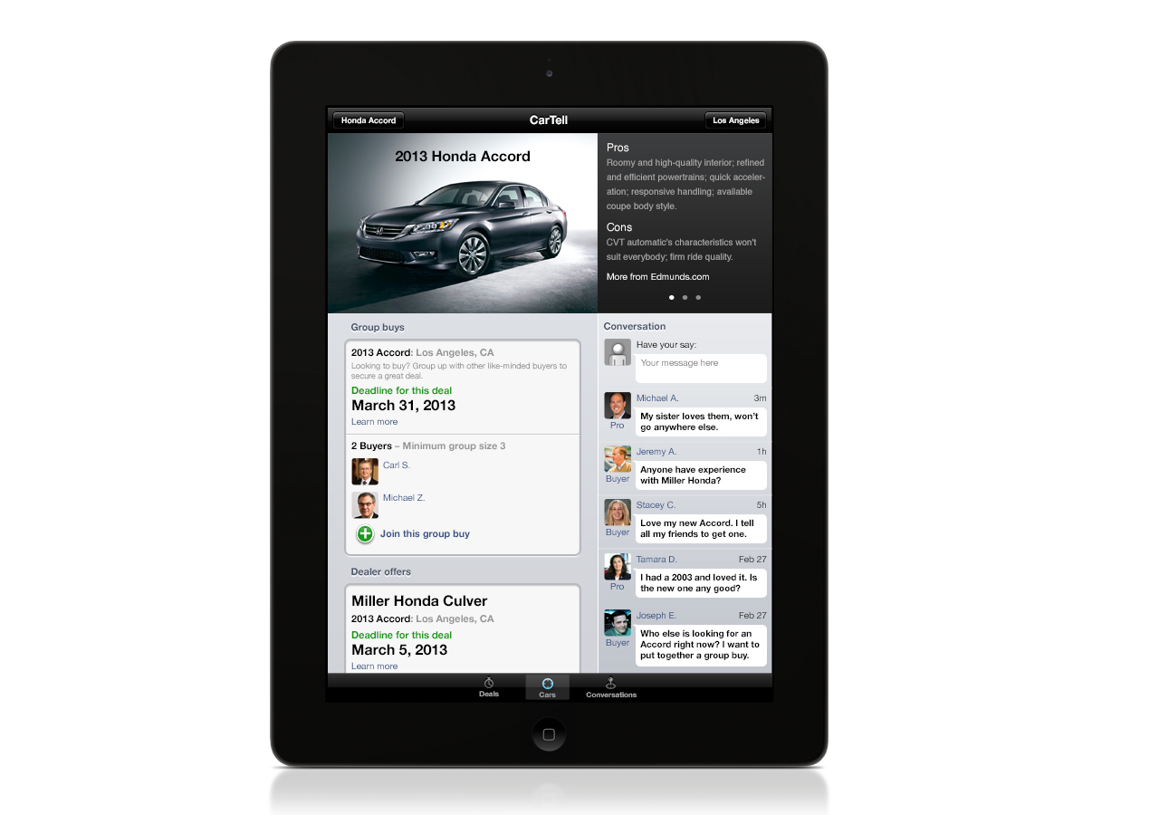
Notes:
You arrive at a list of the available deals and customers that are discussing the selected model.

Slide 11
Notes:
One of the truly unique features is the conversation. The conversation brings together individuals with different levels of automotive knowledge to ask, answer and advise the group on the new car. We market this application to It is an up to date conversation

Slide 12
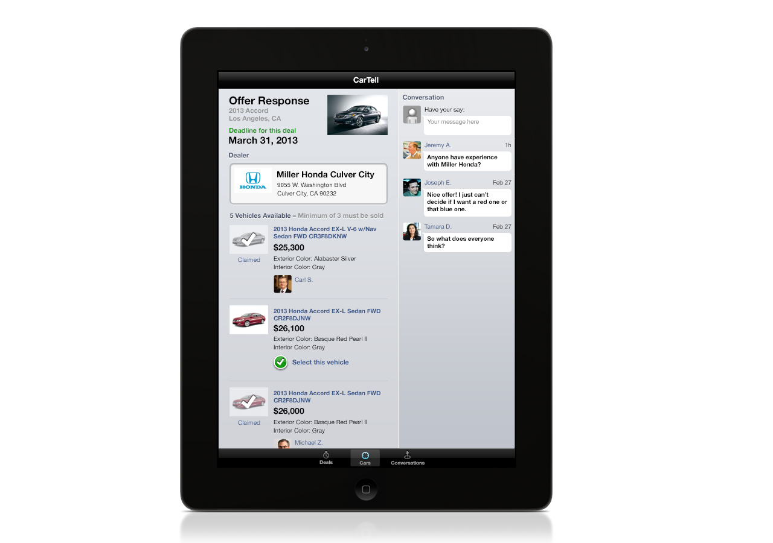

Slide 13
Is it feasible?

Slide 14
Car Shopper Buy-In
48%
Notes:
We polled our facebook friends and 48% would use CarTell to buy a car

Slide 15
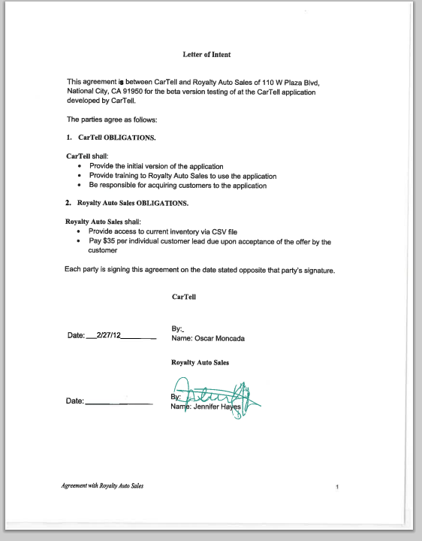
Dealership Buy-In
Car Dealership
Letter of Intent

Slide 16
Business Impact
Financially Committed Buyers
Lower Customer Acquisition Cost by 60%
5% of New Car Market….$280M Cost Saving
Where Car Buyers Unite!

Slide 17
Nathaniel Bolton
Johnny Chu
Ulrich Lange
Michael Lucki
Oscar Moncada
Sergey Znutin

