Slide 1

MobileManual

Slide 2
What is this mobile manual?
A live manual that will guide you to the level of info you want
Always available when you need it
No searching through the yellow pages of manuals
Customized for your specific car – not one that is a different trim level
It’s appealing to manufacturers, dealers and customers

Slide 3
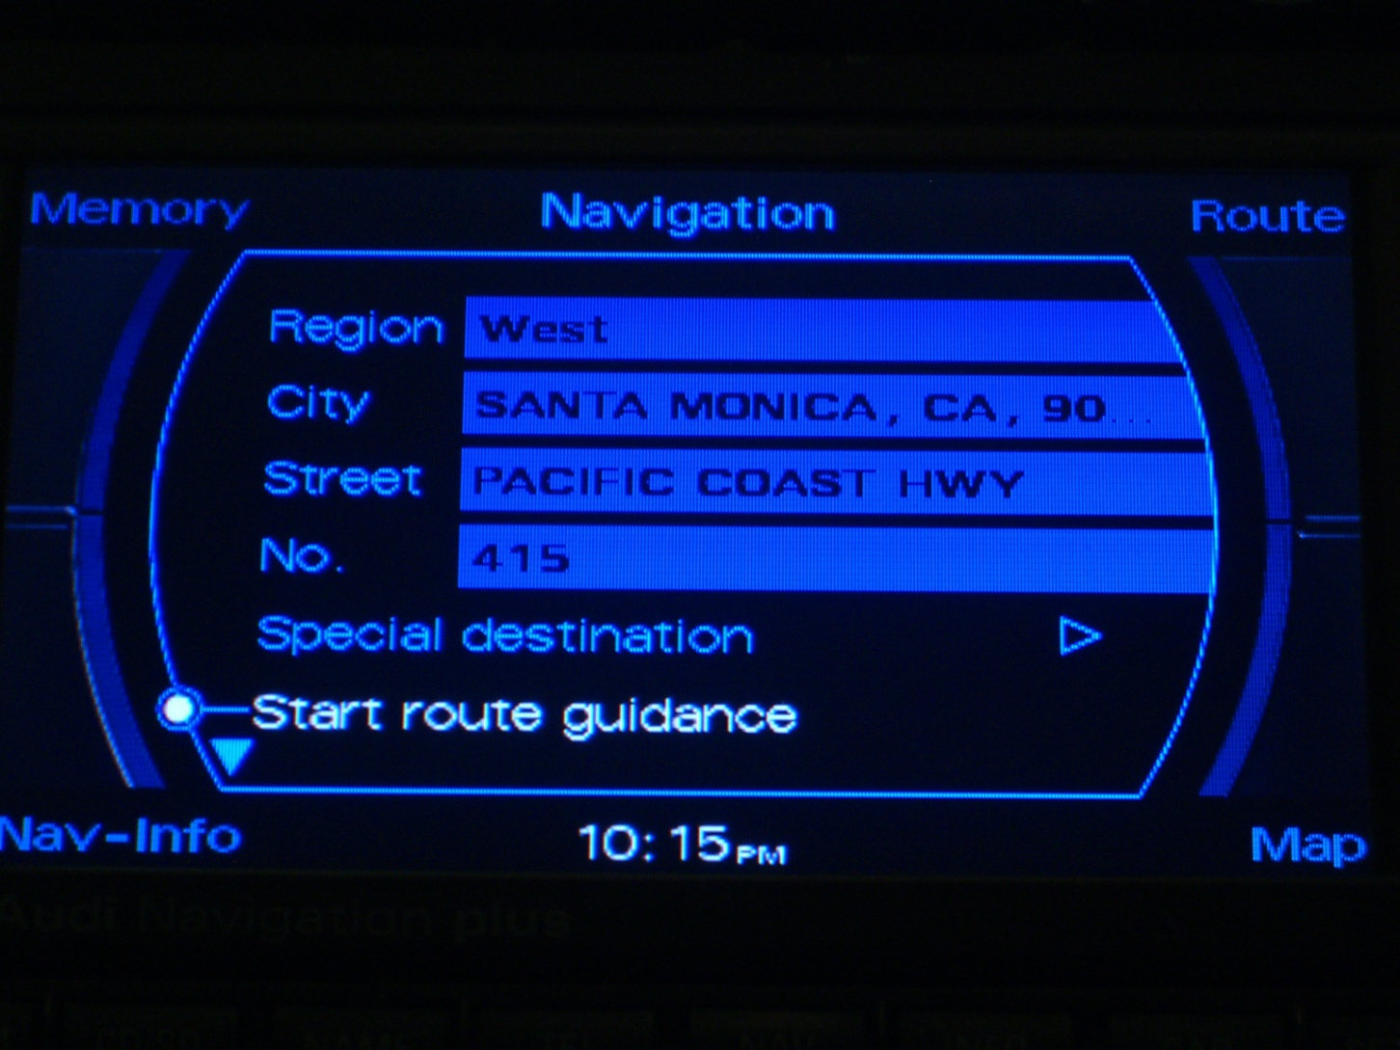
Typical Features in new cars that people often find confusing

Slide 4
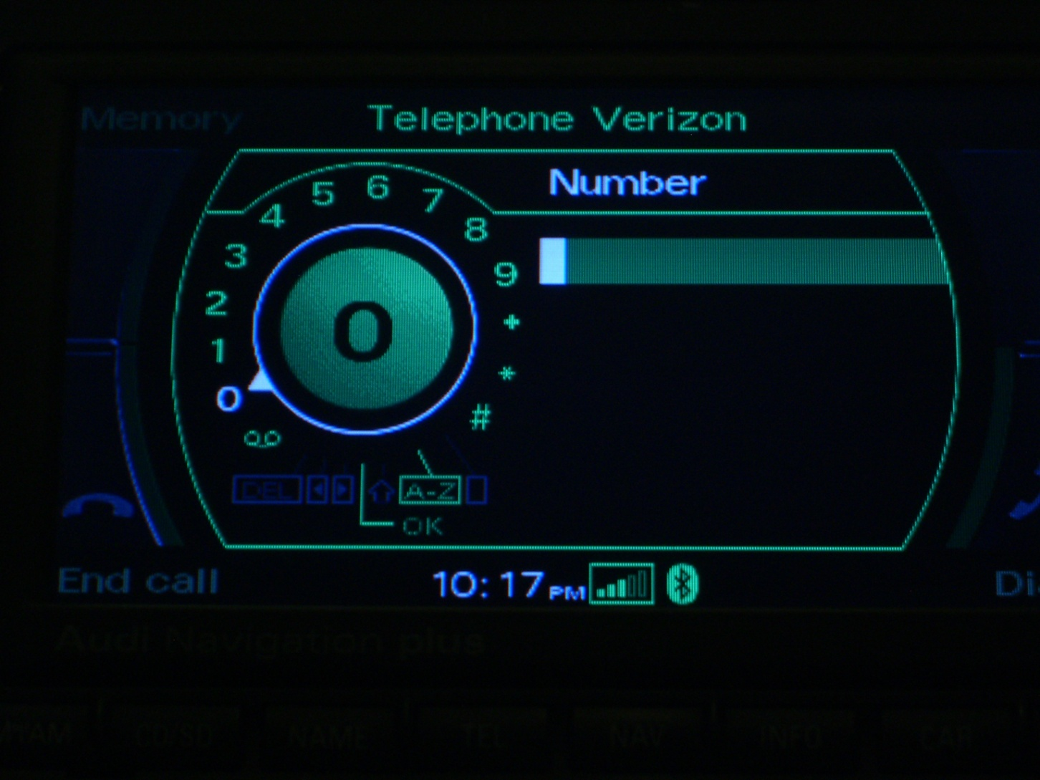
Another Feature

Slide 5
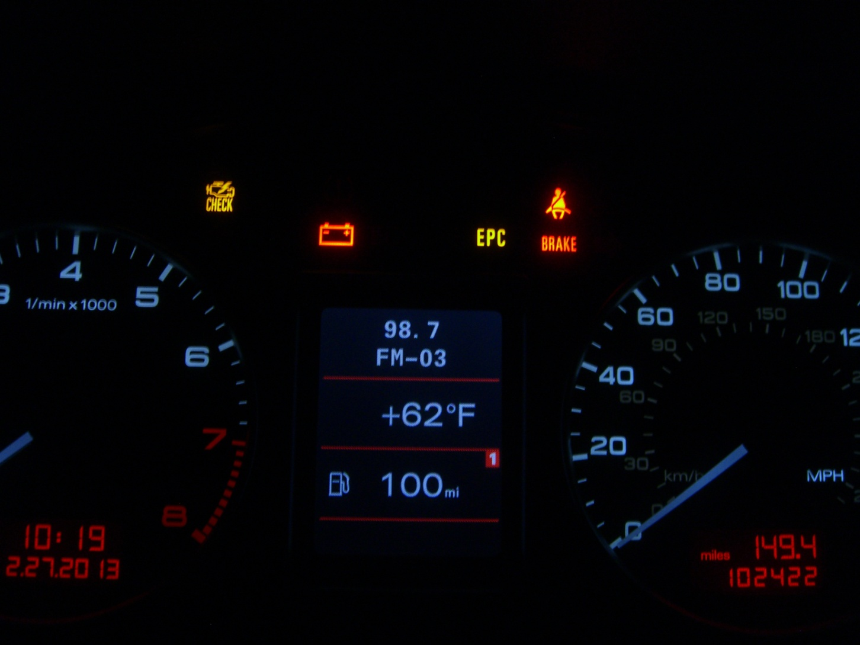
Help! What do these lights mean?

Slide 6
The Problem: Jargon
New features keep popping up in new cars
How do we keep up?
How do I help my significant other learn how to use these hi-tech or new features?

Slide 7
The Solution
A mobile manual for every car right down to the specific version of each model
Connection between the manufacturer, dealer and customer
Utilize idle resources
Fun experience!

Slide 8
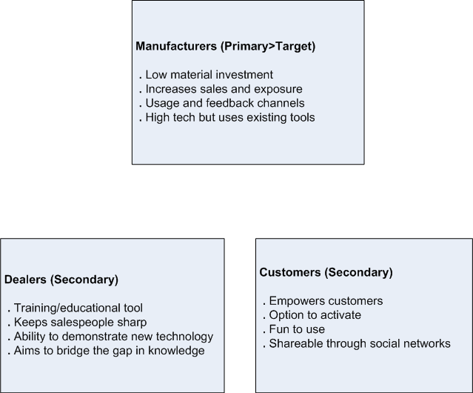
Mobile Manual
PRIMARY
SECONDARY

Slide 9
When will this work?
We provide an in-car app and supplemental mobile app that has all the info usually found in the owners manual
We address questions such as
How does this feature work?
What does it do?
How do I adjust settings?

Slide 10
Show me how this works
Suppose you want to use the adaptive cruise control on the fly. You have options…
While driving, only voice recognition is available:
Ask the MobileManual, “How do I use the cruise system”
If you are stopped:
Using NFC (Near Field Communication) hover your phone over the controls
Maintain compliance with safety standards
Option to queue instructions for later viewing

Slide 11
Technology
NFC device integration via tags (hidden)
Integration with any social network
Simple illustrations and videos
Mobile data integration
Voice command/ text to speech
Original content is trustworthy and provided by the manufacturer

Slide 12
Feasibility
NFC is simple data recognition and classification of objects and voice command is already available – we build off existing technology
Touch screen devices are also available
Role based security
Restricting information maintains integrity and will not interfere with the emotional aspect of buying a new car
Infrastructure is in place, we provide framework

Slide 13
Business Impact
Educational tool for salespeople and the technicians
Dealers can activate as a feature to buyers as an added option.
Technicians can learn new technology faster
Usage statistics and feedback for analytics
Field research supports our concept

Slide 14
Adoption
Dealers/salespeople we talked to liked the idea
They see it as a way to bring in more sales
Train the salesman because the customer usually knows more through research
It can highlight selling points in comparison with other competitors
Address known concerns customers may have

Slide 15
Implemention
Pre-program all cars and use the apps as a KEY
Tier based information – based on user access
1. Technician version
– Detailed with repair diagrams and schematics
2. Dealer version – Available for the dealer to use it while learning or explaining the features to the customer
3. Customer version – Activated only by dealer upon purchase

Slide 16
Customer Benefits (Ultimate USER)
Very easy to use
Just speak or tap
Allow 2 way communication for support
Low cost option $99 and a great gift idea!
Custom tailored/instant info
In rental cars – helps them find the trunk release
Don’t need to remember how stuff works
Only relevant info is supplied
Unlimited potential!

Slide 17
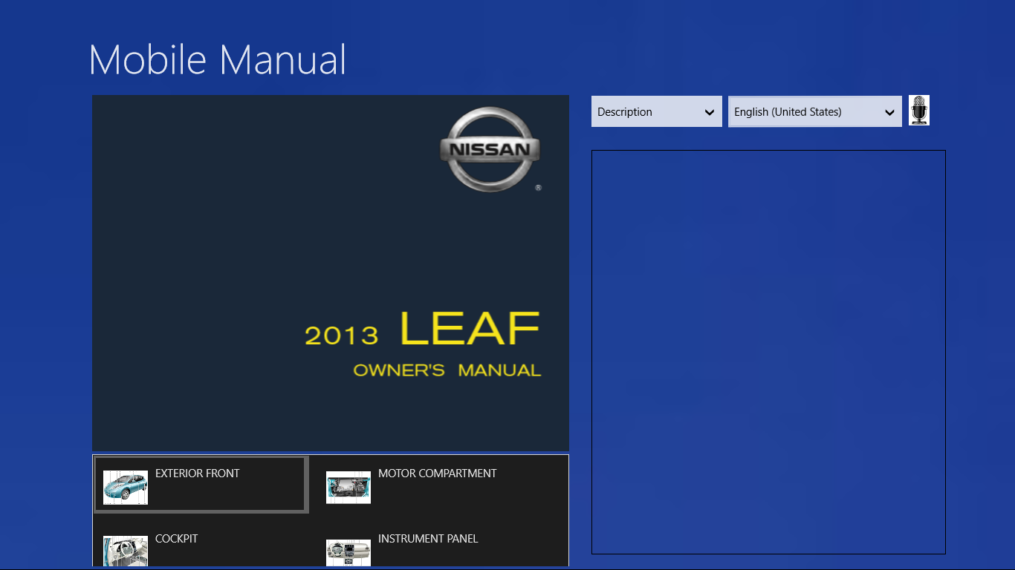

Slide 18
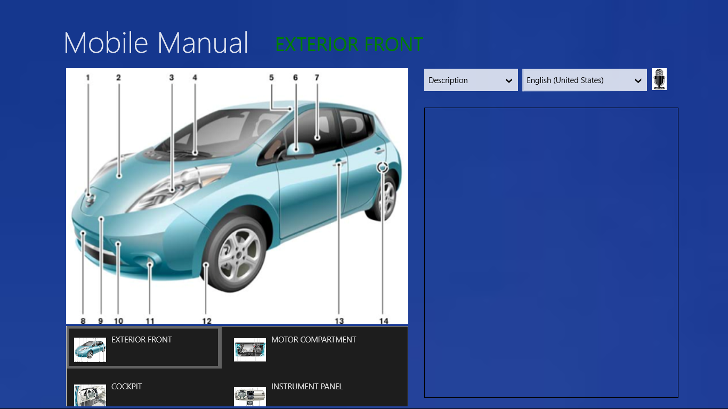

Slide 19
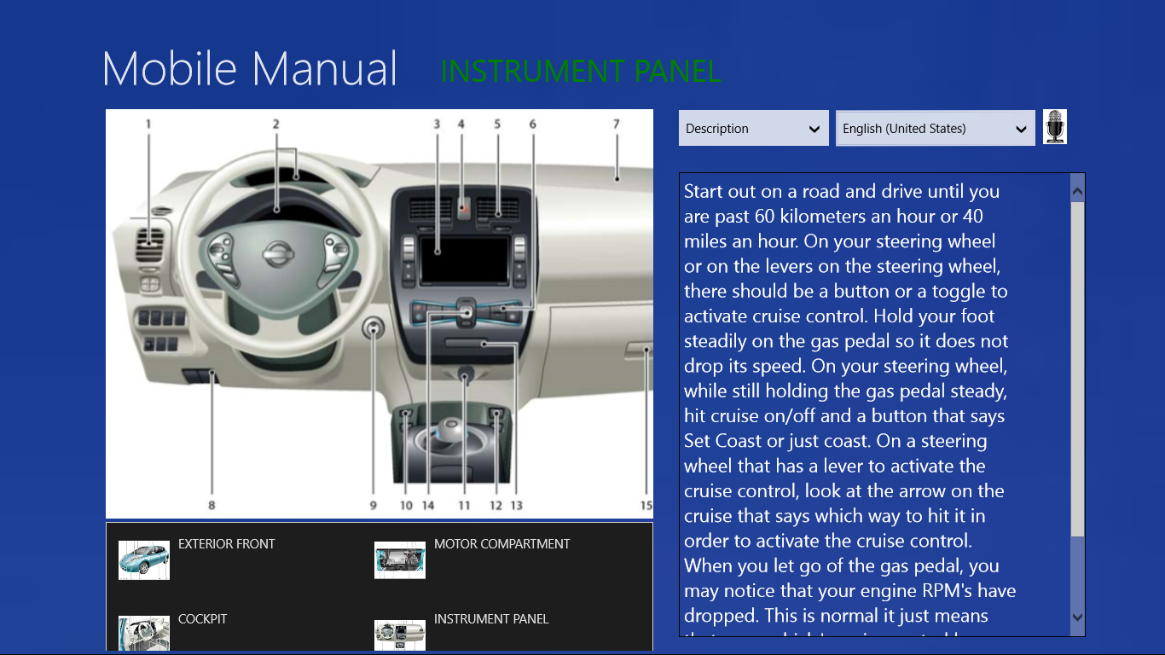

Slide 20
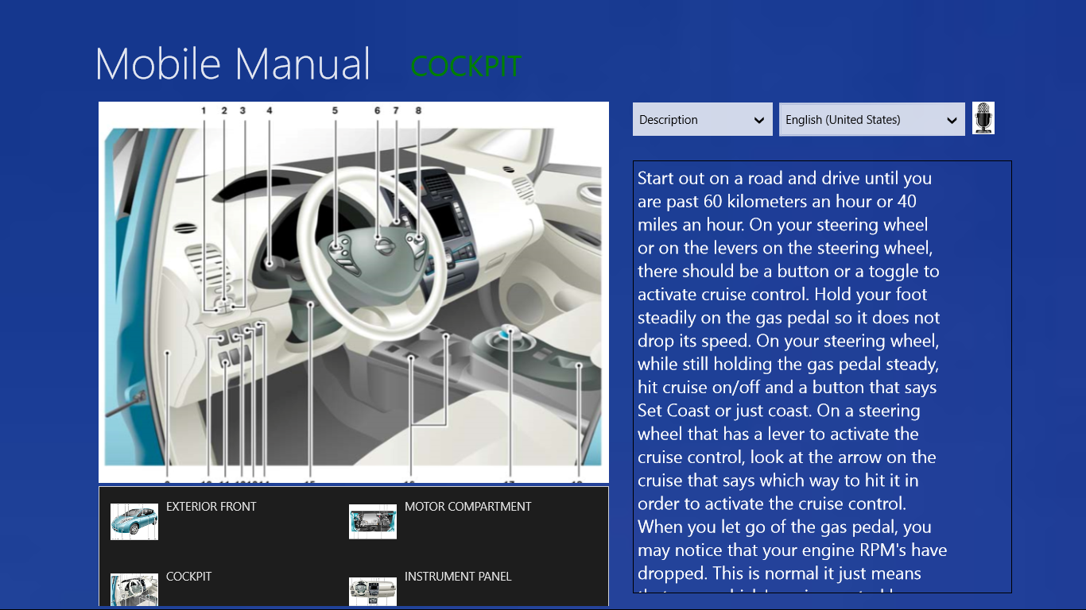

Slide 21
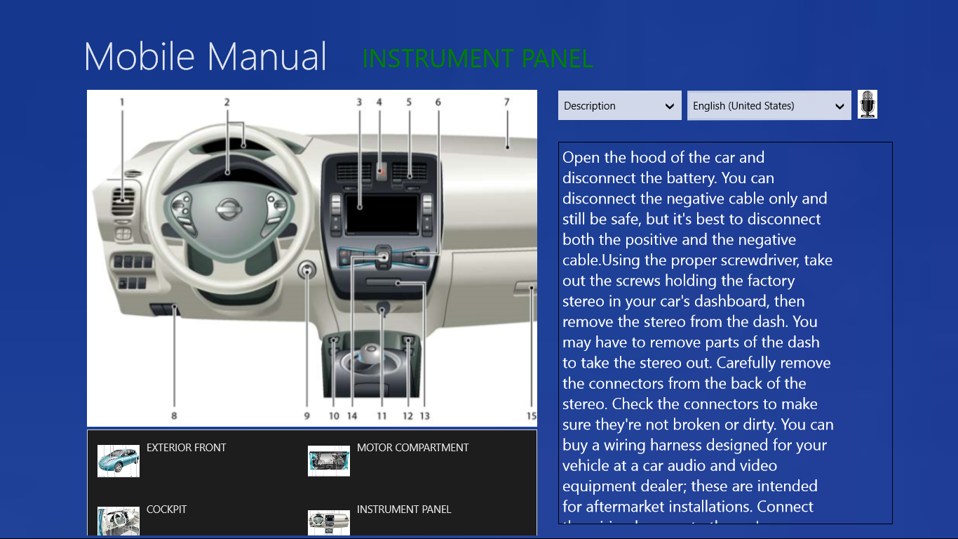

Slide 22
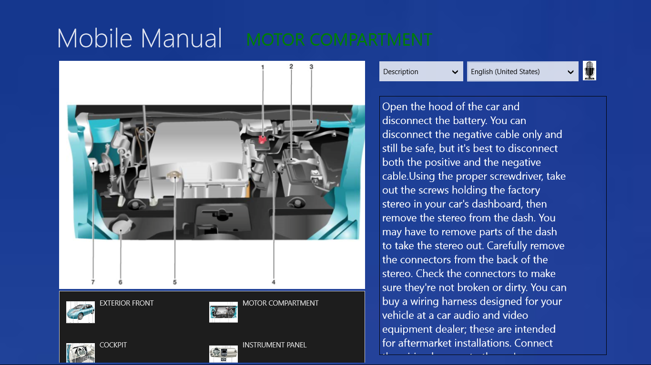

Slide 23
