Slide 1


Slide 2


Slide 3
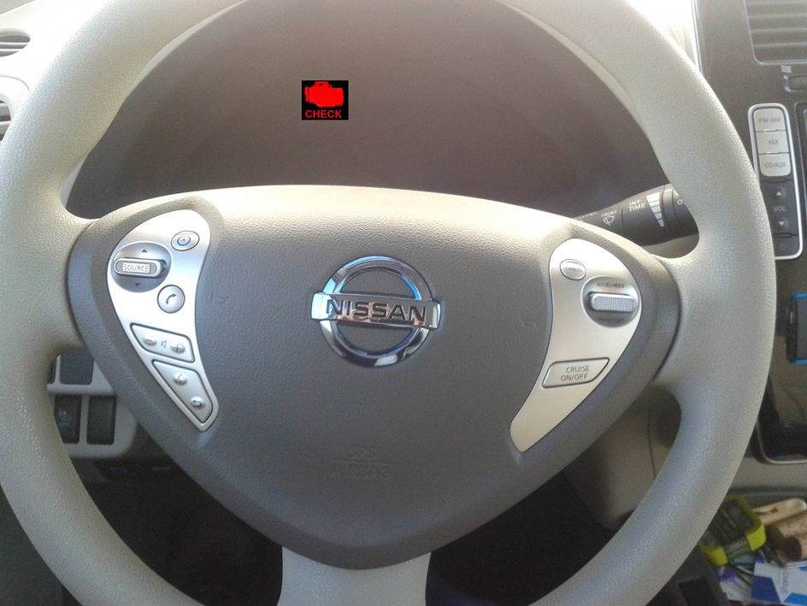
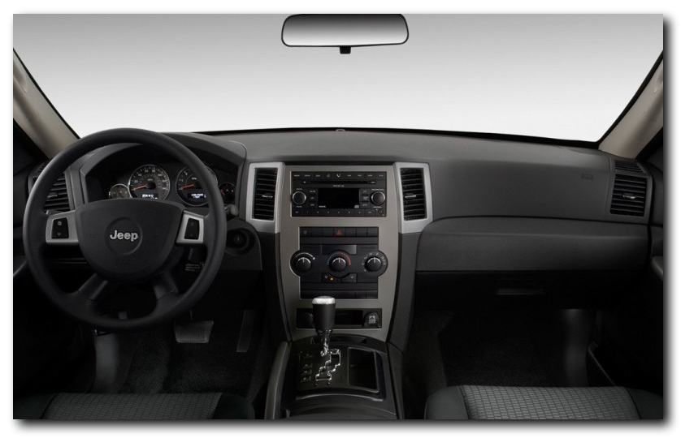


Slide 4
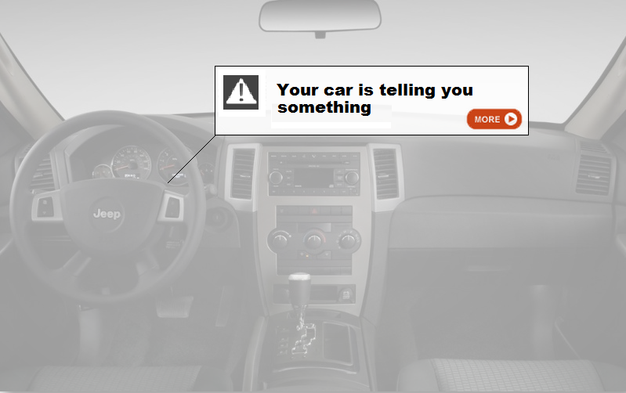

Slide 5


Slide 6


Slide 7

Notes:
prices

Slide 8


Slide 9
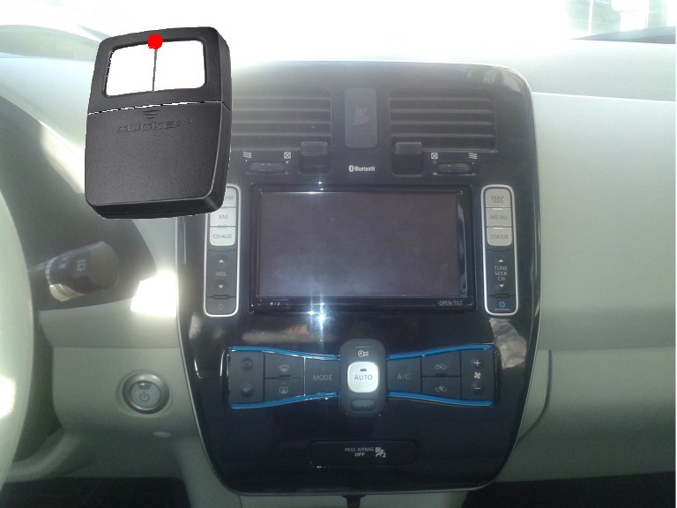

Slide 10
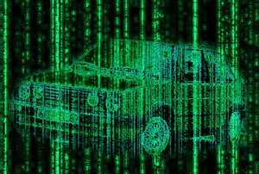

Slide 11
Nuri Halperin, Hattan Shobokshi, Timothy Strimple, Lu Tiong

