Slide 1

“I can’t figure out what My car Needs when it’s time for service …”
The Service Crew
Notes:
“I can't figure out what my car needs when it's time for service …”
There is a severe problem out there with service needs that leads to anxiety and unnecessary conflict between consumers and dealers.
Let's set there expectations right my educating and empowering the consumer

Slide 2
Introduce It …
Edmunds EEE Service Experience: Empower & Educate to set expectations
What is the Edmunds EEE Service Experience?
An unbiased checklist to empower and educate consumers to effectively set expectations
An opportunity to engage and educate consumers through their automotive maintenance experience with sponsorship and promotional offers reconnect OEM and Third Party Service Providers to consumers throughout the ownership experience
EMPOWER
EDUCATE
EXPECTATIONS
To enable; to promote the self-actualization or influence of
To develop; to provide one with information
Anticipation; a strong belief that something will happen or be the case in the future
The Service Crew
”Empower." Merriam-Webster.com. Merriam-Webster, 2013. Web. 27 February 2013
”Educate." Merriam-Webster.com. Merriam-Webster, 2013. Web. 27 February 2013
“Expectations.” Merriam-Webster.com. Merriam-Webster, 2013. Web. 27 February 2013
1
Notes:
Utilizing an Edmunds Service Notification experience, EEE, we are there for the consumer educating, empowering and setting appropriate expectations with a proactive outreach to pre-serve them.
This is a benefit to dealers as well as we can reconnect OEM and Third party service providers to consumers with trust, confidence, and promotional offers.
We enabling a healthy conversation between the consumer and vendor, and removing the anxiety and conflict that can occur with that conversation.

Slide 3
Explain It …
Edmunds EEE Service Experience: Empower & Educate to set expectations
EMPOWER
Educate
Expectations
A personalized notification identifies a checklist of service elements based on vehicle service manual’s RSI
Enabling a healthy conversation removing the anxiety in the service experience
Coupon or Promotional Offering Sponsored through vendor, dealer or affiliate
Checklist detailing service to expect based on Edmunds data (i.e., RSI, TSB, Recalls)
Two categories define urgency of user actions
Perform: “Must be done …”
Inspect: “Engage the service technician with provided Edmunds EEE questions …”
Expectations are set prior to arriving at the service location through the service checklist and pricing information
Expectations are maintained throughout the service experience as the consumer references the Edmunds EEE Service Guide
The Service Crew
2
Notes:
So what does this look like?
It's a notification you only receive when you need it,
It's personal, based on facts of what you need versus what you might do.
It has pricing, so expectations are set prior to visiting a service location.
Dealers can even offer you perks.
If a service tech tells you, you need a new rotary gerder, you are informed to respond.
It has convenience with a simple click scheduling mechanism.
It's also multi-platform, capable of being delivered to phones, facebook, or email.

Slide 4
Detail IT …
Edmunds EEE Service Experience: Empower & Educate to set expectations
DMS
Edmunds Vehicle Owners
Edmunds Dealer & 3rd Party Vendors
Edmunds Maintenance API
Edmunds Ad & Affiliate API
Owners with Service Needs
Vendors with Service & Parts, Offering & Promos
Actual Car Owners
Using a base of owners and maintenance needs … simple analysis will generate a list of service needs to car owners
Vendors are given the ability with a new API t be able to target offerings and advertisements to specific customers profiles
Combining need and ability, Edmunds can target customers with specific needs, referrals, and promotions from local dealers
The Service Crew
3

Slide 5
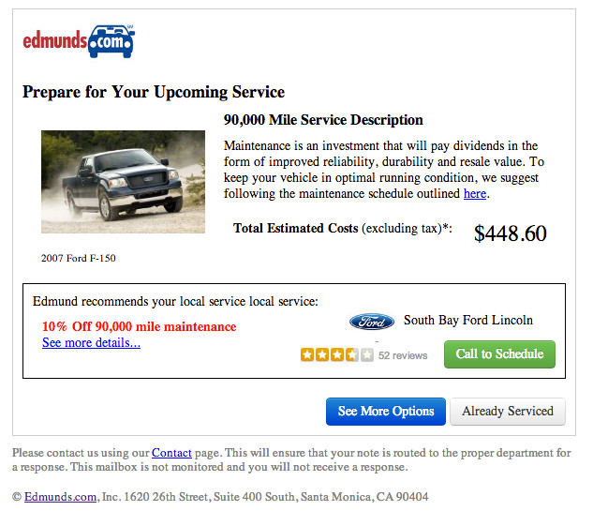
Experience IT …
Edmunds EEE Service Experience: Empower & Educate to set expectations
The Service Crew
4

Slide 6
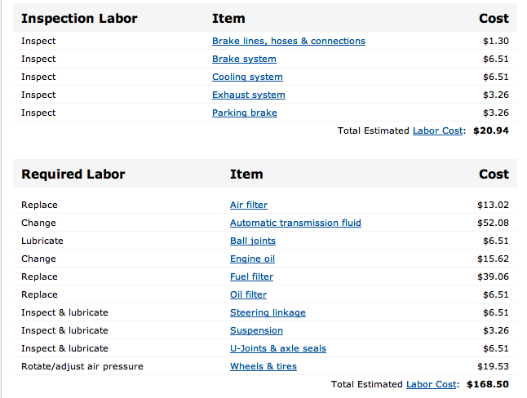
Experience IT …
Edmunds EEE Service Experience: Empower & Educate to set expectations
Here is how to address questions regarding your Cooling System:
Which part of the cooling system ?
Do I need to replace it right now or do I have time to way
The Service Crew
5

Slide 7
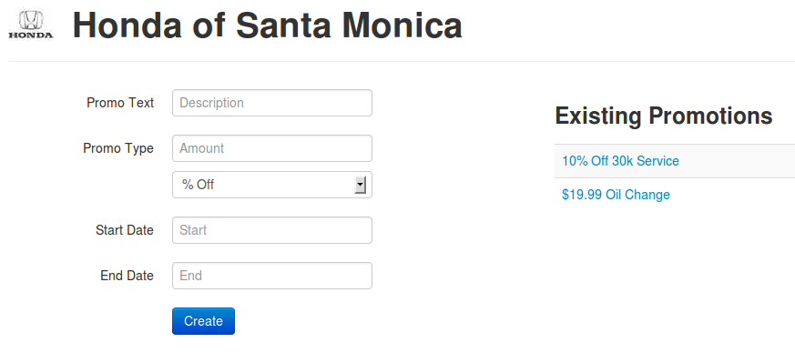
Promote IT …
Edmunds EEE Service Experience: Empower & Educate to set expectations
The Service Crew
6

Slide 8
Get BEHIND IT…
Edmunds EEE Service Experience: Empower & Educate to set expectations
Consumer Benefits
Personalized notifications only when needed
Convenient
Educating
Empowering
Encouraging trust
Dealer Benefits
New Customers Traffic
Extends relationships from the car buying experience into the ownership experience for both the consumer and deal
Vendor Benefits
Vendors are given the ability with a new API to be able to target offerings and advertisements to specific customers profiles
The Service Crew
7
Notes:
Who are we
Who is the customer
What problem is solved for the customer - NSDB – national service database for …recalls as well … if you’re just helping me track maintenance, but if you can get me new customers
How solve it and make money
Real data from customers … not just opinion …

Slide 9


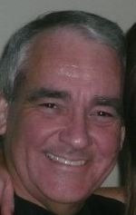
Consume it …
Edmunds EEE Service Experience: Empower & Educate to set expectations
Mark D. Swanson – Lotus Elise
Lea Glasser – Honda Odyssey Owner
Ray Whitman – Toyota Owner
What would make you love this service (Edmunds EEE Service Experience)?
“… Educate me on why I need service and make it worth my while … Ignorant people waste money …”
What would make you love this service (Emunds EEE Service Experience)?
“If it (notification) was very brief, only when necessary, my personal info wasn't shared with others, it offered 3 features: what needs to be done and when, a brief clear explanation of why, a link to more detailed explanation with diagrams/ pictures/ stats/ terminology glossary, and the best deal from my list of preferred vendors that was valid for the window of time in which I needed my maintenance…”
What would make you love this service (Emunds EEE Service Experience)?
“… The more the party can provide on what is being done and why is always welcome and a way to build trust…”
The Service Crew
8
Survey of Edmunds EEE Service Experience Concept provided to 25 individuals

Slide 10
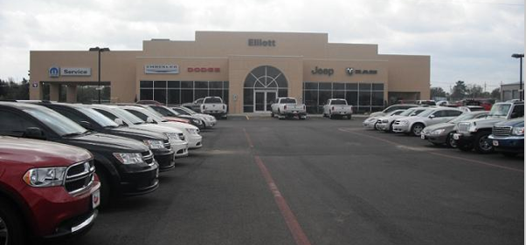
Deal it …
Edmunds EEE Service Experience: Empower & Educate to set expectations
Provides new customers
Provides opportunity for relationships leading to new car sales
Assists in conversation with customers
Encourages you as a trusted advisor
Elliott Motors Sales Representative
From a dealer perspective, is this valuable?
“Dealers often manage their own consumer database … having the opportunity to target people outside of our internal customer list would be helpful…”
“… Especially if we could get people in around the 36K marker … provide them service and work to get them into a new car …”
The Service Crew
9

Slide 11
Return for it …
Edmunds EEE Service Experience: Empower & Educate to set expectations
RETURN ON INVESTMENT
There are 50,000 dealerships nationwide and 85,000 repair shops within the dealership and repair shop database
If 5% of the dealerships pursue this opportunity, Edmunds sees
$1.5M each year
If 3% of the repair shops pursue this opportunity, Edmunds sees $1.5M each year
Service is needed …
Cars are being made better which means they last longer
This is a 29 billion dollar industry
customers want to have a positive experience
Dealers should ensure they show up at their door
Dealer Monthly fee
Dealers would likely pay $50 month
The Service Crew
10
Notes:
Cars are being made better which means they last longer, this is a 29 billion dollar industry, customers want to have a positive experience, and dealers should ensure they show up at their door.
We have a solution which Educates, Empowers and Set Expectations while providing dealers a new outlet to reach them and run campaigns. Conversation not Conflict.
This is not just vapor ware either, test drive the system at http://hija.cx

Slide 12
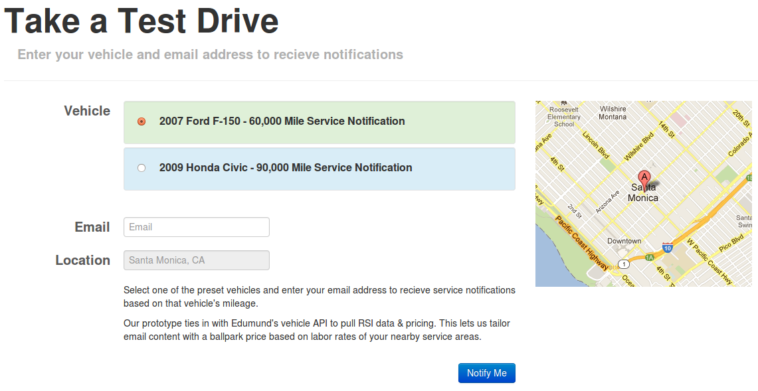
Test Drive IT …
Edmunds EEE Service Experience: Empower & Educate to set expectations
Test drive the system at http://hija.cx
11
The Service Crew
Notes:
This is not just vapor ware either, test drive the system at http://hija.cx

Slide 13
Thank you
Edmunds EEE Service Experience: Empower & Educate to set expectations
The Service Crew

