Slide 1
LET’S REINVENT THE AUTO SHOPPING EXPERIENCE
BY EMPOWERING & REBRANDING SALES PEOPLE

Slide 2
Stop Service Commoditization...
Internet
Trust
Integrity
Respect
Our solution
Price pressure
Poor experience
...Start an Enhanced Experience

Slide 3



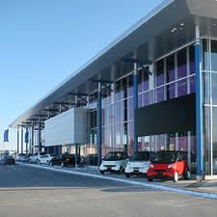

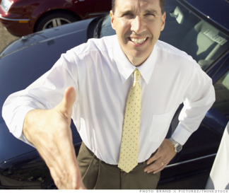


Severe information disparity online
Customer
25-34
$$$$
Dealer
Sales Person
???

Slide 4
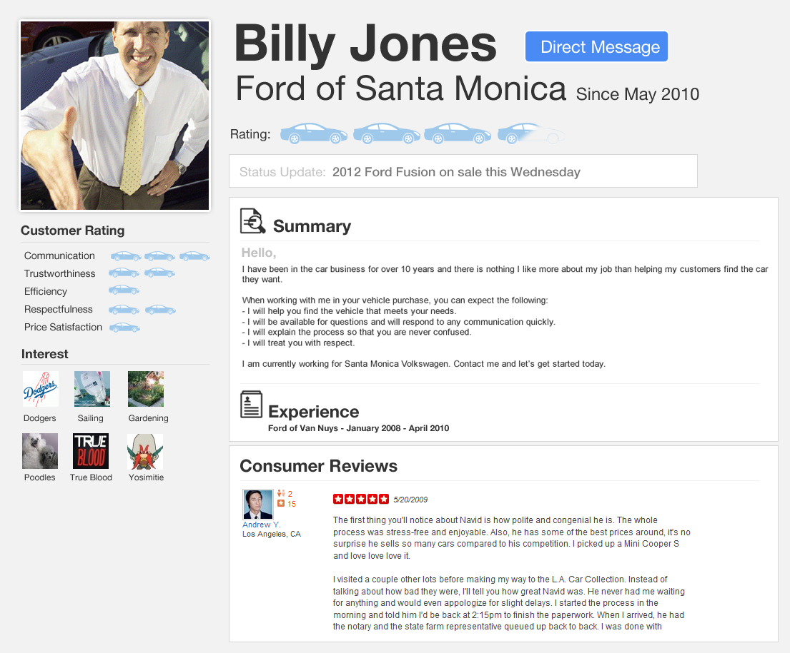





Tegrity demystifies and humanizes sales person, gives them a reputation and identity
IM
email
call
text

Slide 5
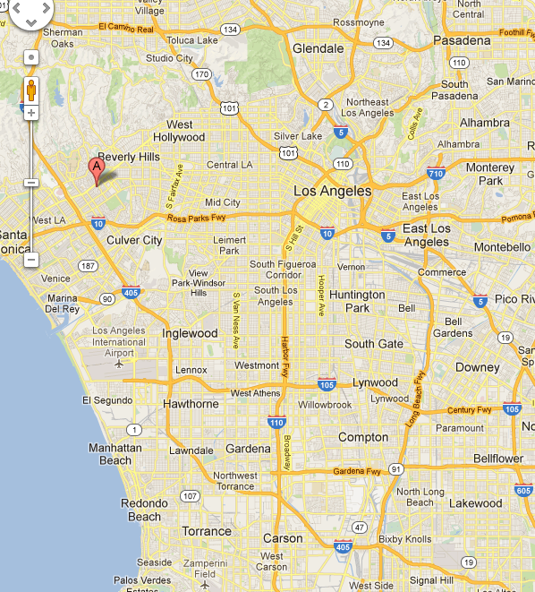
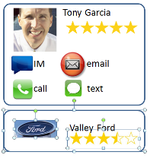

Individualized and localized recommendations
People like you liked.....
Customer
25-34
$$$$
Demographic filtering
Social Media filtering

Slide 6

Meaningful benefits to each party
Customer
Customer satisfaction
Trusted relationship
Sales Person
Dealer
Satisfaction = more business
Career path
Responsibility
Powerful lead generation
Personnel management
Recruitment

Slide 7



Growing the ecosystem and
reaching critical mass
Dealer & Salesperson Acquisition
Customer Acquisition
Affiliate Marketing
Best Sales People
Best Lead Generation
Point of Purchase Incentive
Improved Sales &
Reputation
Awareness and High Adoption

