Slide 1

US Life Expectancy Across US Counties After AGE 50
Michael Tyler
DATA 606 – Data Science Capstone

Slide 2

Overview
US Life Expectancy Lags behind other developed countries and varies by more than 20 years across US Counties
Which social, economic, behavioral, and healthcare factors predict county life expectancy
Live expectancy overall is studied well this will focus on Life Expectancy after age 50.
Will use five data sources that include 3079 Counties

Slide 3
Data Sources
IHME County Life Expectancy Data File (University of Washington): The Institute for Health Metrics and Evaluation published life expectancy for each age group, sex, year, and racial-ethnic group. We will use this for are over 50 age group and at birth group as a comparison.
County Health Rankings Analytic Data (University of Wisconsin): Non-Census predictors: smoking, obesity, physical inactivity, excessive drinking, sleep, food environment, exercise access, uninsured adults, provider supply (primary care, dentists, mental health), preventable hospital stays, screening and flu vaccination by county.
Census American Community Survey: Standard for county socioeconomic data. Includes data such as: household income, income inequality home values, poverty, unemployment, educational level.
USDA ERS Rural-Urban Continuum Codes: Give a score from one to nine on the rurality of a county. From Urban Center, Suburb to Extremely Rural.
CMS Medicare Geographic Variation: Has Medicare and Medicaid Spending per Beneficiary, Medicare Advantage enrollment rates, Emergency Room Visits etc.

Slide 4

Attributes Dropped
Insufficient Data :
Disconnect Youth 37%
High School Graduation 75%
Juvenile Arrests 63%
Residential Segregation 67%
Not related to over age 50:
Low Birthweight, Teen Births, Child Care Cost Burden, Child Care Centers, School Funding Adequacy, Reading Scores, Math Scores, School Segregation, Children Eligible for Free or Reduced Price Lunch

Slide 5
Highest Life Expectancy Counties at 50
 | County Name | State | Life Expectancy Years | Life Expectancy Males | Life Expectancy Femails | Total Population
 | Summit County | CO | 44.5 | 43.4 | 45.6 | 30649
 | Pitkin County | CO | 43.8 | 42.1 | 45.4 | 17926
 | Eagle County | CO | 41.0 | 39.6 | 42.3 | 54681
 | San Miguel County | CO | 39.2 | 37.8 | 40.7 | 8049
 | Collier County | FL | 38.3 | 36.2 | 40.3 | 371453
 | Aleutians West CA | AK | 38.3 | 39.0 | 37.0 | 9083
 | Mono County | CA | 38.2 | 36.9 | 39.8 | 14310
 | Presidio County | TX | 37.9 | 36.1 | 40.0 | 6975
 | Teton County | WY | 37.9 | 37.1 | 38.7 | 23280
 | Haines Borough | AK | 37.5 | 34.6 | 40.4 | 2518
Lowest Life Expectancy Counties at 50
 | County Name | State | Life Expectancy Years | Life Expectancy Males | Life Expectancy Femails | Total Population
 | Martinsville city | VA | 22.9 | 20.8 | 24.8 | 12852.0
 | Union County | FL | 22.9 | 20.3 | 29.7 | 15303.0
 | Galax city | VA | 24.1 | 21.5 | 26.6 | 6517.0
 | Perry County | KY | 24.3 | 22.8 | 25.9 | 26624.0
 | Shannon County | SD | 24.4 | 21.5 | 27.3 | 14335.0
 | Petersburg city | VA | 25.1 | 22.0 | 27.9 | 31362.0
 | Harlan County | KY | 25.3 | 23.0 | 27.6 | 26699.0
 | Leslie County | KY | 25.3 | 23.6 | 27.0 | 10283.0
 | Powell County | KY | 25.5 | 23.6 | 27.6 | 12304.0
 | Clay County | KY | 25.6 | 23.8 | 27.4 | 20368.0

Slide 6
Health Features
Health Access Features
Feature | Description
chr_adult_smoking | % of adults who smoke
chr_adult_obesity | % of adults with BMI ≥ 30
chr_physical_inactivity | % of adults reporting no leisure-time physical activity
chr_excessive_drinking | % of adults reporting binge or heavy drinking
chr_insufficient_sleep | % of adults sleeping under 7 hours
chr_food_environment_index | Index (0–10) of food access and food insecurity
chr_access_to_exercise_opportunities | % with access to places for physical activity
Feature | Description
chr_uninsured_adults | % of adults under 65 without insurance
chr_primary_care_physicians | Primary care physicians per population
chr_mental_health_providers | Mental health providers per population
chr_dentists | Dentists per population
chr_preventable_hospital_stays | Hospital stays for conditions treatable in outpatient care
chr_mammography_screening | % of female Medicare enrollees screened
chr_flu_vaccinations | % of Medicare enrollees vaccinated
cms_std_spending_per_capita | Standardized Medicare spending per beneficiary
cms_pct_dual_eligible | % of beneficiaries also eligible for Medicaid
cms_ma_participation_rate | Medicare Advantage participation rate
cms_er_visits_per_1000 | ER visits per 1,000 beneficiaries
cms_readmission_pct | 30-day hospital readmission rate

Slide 7
Environment Features
Demographic Features
Feature | Description
chr_air_pollution_particulate_matter | Average daily PM2.5
chr_severe_housing_problems | % of households with overcrowding, high costs, or poor facilities
chr_long_commute_driving_alone | % of solo commuters driving more than 30 minutes
chr_drinking_water_violations | Whether a water violation was reported
chr_pct_rural | % of the population living in rural areas
rucc | Rural-Urban Continuum Code (1 = large metro, 9 = remote rural)
Feature | Description
chr_pct_65_and_older | % of the population age 65+
chr_pct_female | % of the population that is female
acs_pct_nh_black | % non-Hispanic Black
acs_pct_hispanic | % Hispanic or Latino
acs_pct_nh_aian | % non-Hispanic American Indian/Alaska Native
acs_pct_nh_asian | % non-Hispanic Asian
acs_pct_foreign_born | % foreign born
acs_log_pop | Log of total population
Additional Possible Features:
chr_poor_or_fair_health,
chr_poor_physical_health_days,
chr_poor_mental_health_days,
chr_frequent_physical_distress,
chr_frequent_mental_distress,
chr_diabetes_prevalence

Slide 8
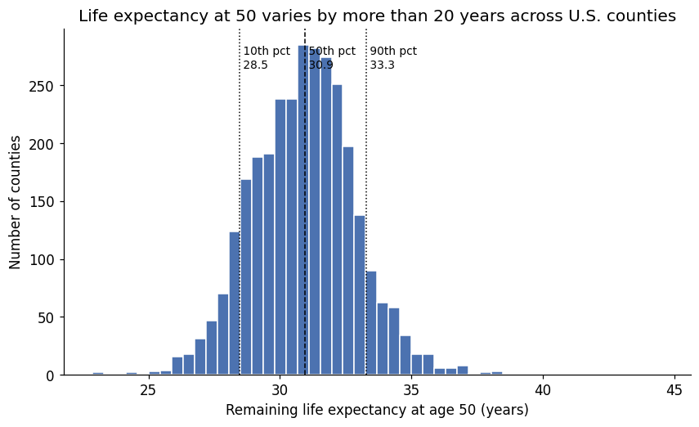

Slide 9
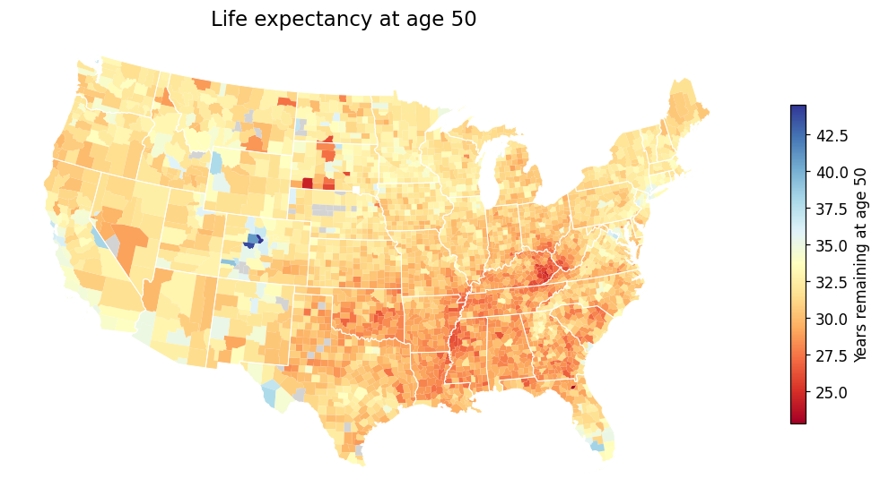

Slide 10
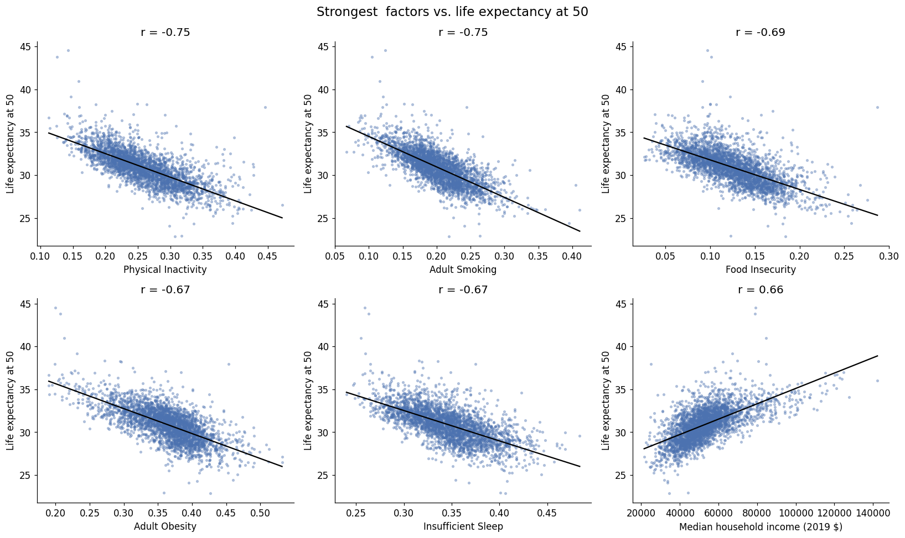

Slide 11
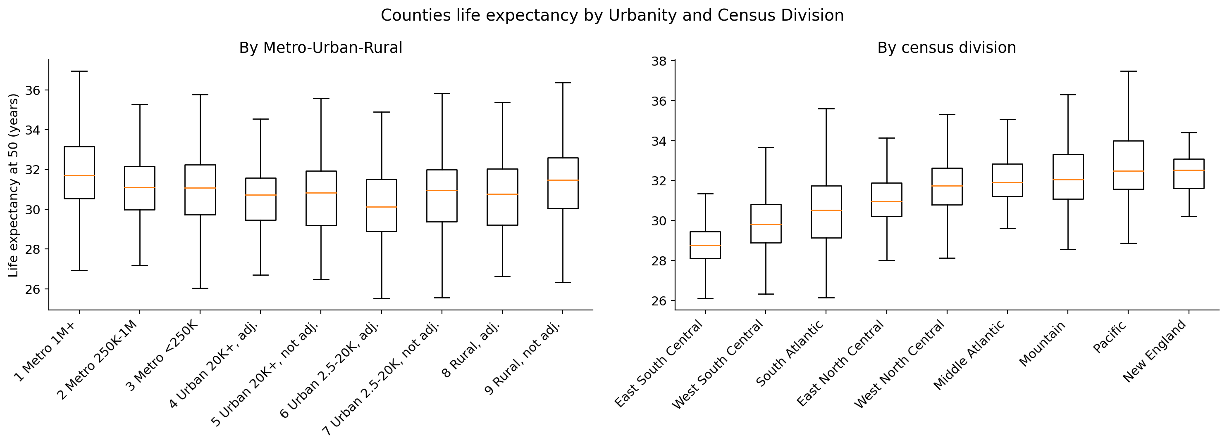

Slide 12

Next PhaseS
Pick final list of metrics based on correlation results.
Potentially add new data sources: IRS migration data. BLS QCEW – Show occupation level data, Opportunity Insights Social Capital Atlas – how much low and high income residents interact.
Run multiple models.
Create Website with map with counties selectable. Provide details of each county when selected. Things that are red warnings that could be causing higher than norm of life expectancy.
Comparison to total life expectancy metrics.

