Slide 1

US Life Expectancy Across US Counties After AGE 50
Michael Tyler
DATA 606 – Data Science Capstone

Slide 2

Overview
US Life Expectancy Lags behind other developed countries and varies by more than 20 years across US Counties
Which social, economic, behavioral, and healthcare factors predict county life expectancy
Live expectancy overall is studied well this will focus on Life Expectancy after age 50.
Eight data sources were loaded and seven feed the model. 3079 Counties
Models get within one year for 71% of counties in states that were not used to train.
Smoking is the strongest factor a county can change.

Slide 3
Data Sources
IHME County Life Expectancy Data File (University of Washington): The Institute for Health Metrics and Evaluation published life expectancy for each age group, sex, year, and racial-ethnic group. We will use this for are over 50 age group and at birth group as a comparison.
County Health Rankings Analytic Data (University of Wisconsin): Non-Census predictors: smoking, obesity, physical inactivity, excessive drinking, sleep, food environment, exercise access, uninsured adults, provider supply (primary care, dentists, mental health), preventable hospital stays, screening and flu vaccination by county.
Census American Community Survey: Standard for county socioeconomic data. Includes data such as household income, income inequality home values, poverty, unemployment, educational level.
USDA ERS Rural-Urban Continuum Codes: Give a score from one to nine on the rurality of a county. From Urban Center, Suburb to Extremely Rural.
CMS Medicare Geographic Variation: Has Medicare and Medicaid Spending per Beneficiary, Medicare Advantage enrollment rates, Emergency Room Visits etc.
IRS SOI County Migration Data: Tax returns moving in and out of each county, plus the returns that stayed. Used to build net migration, total moves and the income of arrivers versus leavers. Added because retirement and resort counties were living longer than the model predicted.
Opportunity Insights Social Capital Atlas: Measures how much low and high income residents interact, how clustered friendships are, and volunteering rates. Built from Facebook friendship data by Harvard, NYU and Stanford researchers.
BLS Quarterly Census of Employment and Wages: Jobs and wages by industry for each county. Loaded and tested as an eighth source. It did not improve the model, so it is not one of the 51 features.

Slide 4
IHME Life Expectancy: The Outcome
What it is. Life expectancy for every county by age, sex, year and race, from the Institute for Health Metrics and Evaluation. This is what the model predicts. Nothing from it is used as a predictor.
Used (4)
Life expectancy at 50, both sexes. The outcome. Years a 50 year old can expect to live.
At 50 for men and for women. Reported next to it. Women outlive men by 3.7 years at 50.
At birth. Kept as a comparison with the usual measure.
Left out and why
Years before 2019. The predictors describe 2015 to 2019, so the one matching year is used.
Estimates by race and ethnicity. The predictors are not split by race, so there is nothing to match them to.
Other ages. The project is about life after 50.
What had to be fixed. IHME reports 54 counties as 22 combined units, mostly Virginia cities joined to the county around them. Every other source was combined the same way. 3,118 county rows became 3,079.
Notes:
From the 2015 to 2019 IHME file, filtered to 2019 and all races. 3,127 counties in the file, 3,118 after retired county codes were mapped to current ones. Seven retired codes with no Census data were dropped and 54 counties were combined into 22 units with population weighting, leaving 3,079.

Slide 5
County Health Rankings: What Went In
What it is. The 2020 release from the University of Wisconsin. It gathers county measures from many agencies in one file. 79 measures were loaded and 28 are in the model, more than from any other source.
In the model (28)
Health behaviors (7). Smoking, obesity, physical inactivity, excessive drinking, insufficient sleep, food environment index, access to exercise.
Health care (7). Uninsured adults, primary care physicians, mental health providers, dentists, preventable hospital stays, mammography screening, flu vaccinations.
Social and housing (7). Children in single parent households, social associations, homeownership, severe housing cost burden, severe housing problems, broadband access, gender pay gap.
Environment (3). Air pollution, long commutes, drinking water violations.
Demographics (4). Share 65 and older, share female, share not proficient in English, share rural.
Why so many. It is the only source with health behaviors, and those are what a county can act on. Smoking is 1st and physical inactivity 3rd of all 51 features.
One change to the data. Provider counts were rescaled to per 100,000 residents so they read as whole numbers.
Notes:
28 of the 51 model features come from County Health Rankings: 16 modifiable, 8 structural and 4 fixed. Coverage is above 95% for all 28 except mental health providers at 93.6%.

Slide 6
County Health Rankings: What Was Left Out
51 of the 79 measures stayed out of the model. Each group was left out for a different reason.
Built from deaths. Premature death, child and infant mortality and three more were dropped at load. Six cause of death rates were kept for testing only. They are the outcome measured another way.
Health status (6). Poor or fair health, poor health days, frequent distress, diabetes. Too close to the outcome. A county that is already sick is a result, not a cause. Tested on their own they moved R² from 0.713 to 0.725.
Too little data (7). Living wage 0%, disconnected youth 39%, homicides 43%, overdose deaths 58%, juvenile arrests 63%, residential segregation 67%, high school graduation 75%. Missing mostly in small rural counties.
Same as a Census measure. Household income, unemployment, education, income inequality, race shares, population. The Census version was used so each idea is counted once.
Too close to a kept feature. Food insecurity and limited access to healthy foods are parts of the food environment index. Traffic volume was acting as a third measure of rurality.
Child and youth measures (13). Teen births, children in poverty, school scores and others. Tested as their own group. See the childhood slide.
Notes:
Dropped at load as death-based: premature death, alcohol-impaired driving deaths, life expectancy, premature age-adjusted mortality, child mortality, infant mortality. Kept for testing: injury, motor vehicle, suicide, firearm, drug overdose and homicide deaths; adding them moved spatial R² from 0.713 to 0.725, the same small step as health status. A few others were simply not used: voter turnout, census participation, sexually transmitted infections, HIV prevalence, other primary care providers, uninsured children, driving alone to work.

Slide 7
Census American Community Survey
What it is. The Census Bureau's 5 year file for 2015 to 2019, pulled through the Census API. It is the standard for county income, education and race, and it is complete for every county.
In the model (11)
Income and work (4). Median household income, share below poverty, Gini index of inequality, unemployment rate.
Education (2). Share with a high school diploma or more, share with a bachelor's degree or more.
Demographics (5). Share Black, Hispanic, American Indian or Alaska Native, and Asian, plus population on a log scale.
Left out and why
Median home value and home value to income. Home value was dropped for tracking the ratio above 0.8. The ratio was then tested as an add-on. R² on held out regions went from 0.713 to 0.719, which is inside the noise, so it was not kept.
Share foreign born. Moves together with share Hispanic and English proficiency, and those two are easier to read.
Share non-Hispanic White. It is what is left after the other groups, so it adds nothing new.
Median age. Share 65 and older already describes age.
What it added. Bachelor's degree is 4th and household income is 7th of all 51 features. Income and poverty correlate at 0.83 and both were kept because they measure different things.
Notes:
16 variables pulled, 11 in the model. Total population is used on a log scale because a handful of very large counties would otherwise dominate. Affordability test: elastic net 0.713 to 0.719, gradient boosting 0.708 to 0.704 on spatial cross-validation. Scores vary by about 0.05 between held out regions, so neither change is real.

Slide 8
USDA Rural-Urban Continuum Codes
What it is. One code per county from 1 to 9. 1 is a metro area of a million or more and 9 is fully rural and not next to a metro. From the USDA Economic Research Service.
In the model (1)
Rural-urban code. A fixed feature. It is one of the things used to find each county's 25 similar counties, so a rural county is compared with rural counties.
How much the model uses it. 42nd of 51. Share rural from County Health Rankings ranks 19th and carries most of the same idea.
Left out and why
Metro or not flag. Built from the same code, so it repeats it.
The 2023 codes. The 2013 version was used. The outcome is 2019 and the 2013 codes describe the counties as they were then.
Traffic volume. From another source, but dropped for the same reason. It was acting as a third measure of rurality.
Why it matters more than its rank. Mean error is larger in small rural counties, and peers have to be matched on rurality for the comparisons to be fair.
Notes:
RUCC 2013. Codes 1 to 3 are metro counties by size, 4 to 9 are nonmetro by urban population and adjacency.

Slide 9
CMS Medicare Geographic Variation
What it is. The 2019 county file from the Centers for Medicare and Medicaid Services. It describes people on traditional Medicare, which means mostly people 65 and older. That fits a study of life after 50.
In the model (5)
ER visits per 1,000 beneficiaries. 6th of 51. Modifiable.
Standardized spending per beneficiary. 8th of 51. Higher spending goes with shorter lives, because sicker counties cost more.
Medicare Advantage participation. 22nd.
Share also eligible for Medicaid. 25th. A measure of low income among older residents.
30 day hospital readmission rate. 36th. Modifiable.
Left out and why
Average beneficiary age. Share 65 and older already describes age.
Average risk score. Not used. It measures how sick beneficiaries already are, which is too close to the outcome.
One limit. It leaves out people in Medicare Advantage plans, so in counties where those plans are popular it describes fewer people.
Notes:
Six variables loaded, five in the model. The risk score column was not in this release under the expected name and would have been excluded in any case. Coverage is 97.9% or higher for all five.

Slide 10
IRS County Migration Data
What it is. Tax returns that moved into each county, moved out, or stayed, between 2018 and 2019. Added because resort and retirement counties were living longer than the model predicted.
In the model (3)
Total moves per 1,000 residents. In plus out. 15th of 51.
Net migration per 1,000 residents. In minus out. 23rd.
Income of arrivers against leavers. Above 1 means the people moving in earn more. 39th.
All three are fixed features. They are used to find similar counties and never changed in a scenario.
Left out and why
Moving in rate and moving out rate. They are the two halves of net migration and total moves.
Share of filers who stayed. Close to the reverse of total moves, and almost no link to life expectancy on its own.
Raw counts of returns. They mostly measure the size of the county.
It helped but did not close the gap. Eagle County, Colorado and Collier County, Florida are still the model's largest misses. Healthy retirees moving in is only partly captured by counting moves.
Notes:
Two loading problems were fixed. Rows for people who did not move were being counted as moves, which inflated migration about tenfold. And small county to county flows are pooled, so the file's own total migration row is read instead of adding up the listed flows. Income ratio is left blank where aggregate income is negative.

Slide 11
Opportunity Insights Social Capital Atlas
What it is. County measures of who is friends with whom, built from Facebook friendship data by researchers at Harvard, NYU and Stanford. Nine measures were loaded and three are in the model.
In the model (3)
Economic connectedness. The share of a low income person's friends who are high income. 9th of 51, the only measure from this source in the top ten.
Cohesiveness. How often a person's friends are also friends with each other. 47th.
Volunteering rate. Share who belong to volunteering or activism groups. 43rd.
Left out and why
Connectedness within groups, exposure to high income people, friending bias. These are the pieces economic connectedness is built from.
Connectedness among children. Only 88% of counties have it, and it tracks the adult measure.
Support ratio. Nearly the same idea as cohesiveness.
Civic organizations. Overlaps social associations from County Health Rankings, which is already in.
The rule was one measure for each idea. Keeping all nine would have had the model splitting credit between near copies.
Notes:
Correlations with life expectancy at 50: exposure +0.63, economic connectedness +0.62, child connectedness +0.60, connectedness within groups +0.60, support ratio -0.43, cohesiveness -0.35, civic organizations +0.36, volunteering +0.24, friending bias -0.05.

Slide 12
BLS Employment and Wages: Tested, Not Kept
What it is. The Bureau of Labor Statistics count of jobs and wages by industry for 2019. Seventeen measures were built: the share of jobs in each of eleven industries, weekly wage, jobs per resident and others.
What the test showed
It did not improve the model. With 15 industry features added, R² on held out regions went from 0.713 to 0.707 for elastic net and from 0.708 to 0.700 for gradient boosting.
It is weak on its own. The typical industry measure correlates 0.23 with life expectancy, the second lowest of seven groups.
The expected ones were small. Manufacturing share is −0.23 and mining and farming share is −0.06.
Why it was left out
Already covered. Income, education and rurality say the same thing about a county more directly.
Jobs are counted where the job is. It describes the local economy more than the people who live there.
Small counties are hidden. BLS hides an industry with too few employers. Information jobs are missing for 23% of counties.
Industry, not occupation. It says 18% of jobs are in manufacturing, not what work residents do.
It still counts as a result. Eight sources were loaded and seven feed the model. The main model stays at 51 features.
Notes:
Strongest single measure: employer establishments per 1,000 residents at +0.49, 33rd of 101 features in the EDA. Counties missing an industry share have a median population of about 5,000 to 9,500 against about 30,000 for those with data. The differences in R² are inside the fold to fold variation, so read them as no gain, not as harm.

Slide 13
Childhood Features: Strong Alone, Little Added
What they are. Thirteen child and youth measures from County Health Rankings, such as teen births, children in poverty, low birthweight and school test scores. Seven were tested in the model as their own group.
How they affected the model
Strong on their own. Teen births correlates −0.72 with life expectancy at 50, 5th of 101 features. Children in poverty is −0.66, 11th.
Little added on top. Adding the seven raised R² on held out regions from 0.713 to 0.722. That is one hundredth.
The reason is overlap. Children in poverty correlates 0.84 with adult poverty, which is already in the model.
Why they are not in the main model
Wrong generation. Today's children are not today's 50 year olds. The measure describes a different group of people than the outcome.
Nothing to act on. A county cannot change the childhood its adults already had, so they do not fit the scenarios.
Missing data. Math scores cover 87% of counties and free lunch eligibility 82%.
Where the link goes. 82% of the tie between children in poverty and life at 50 runs through adult obesity, road deaths and food environment. That is the childhood poverty slide later in the deck.
Notes:
Gradient boosting moved from 0.708 to 0.719 with the youth set. Other correlations: free or reduced price lunch -0.61, low birthweight -0.53, school funding adequacy +0.48, reading and math scores +0.32. Overlap with adult poverty: free lunch 0.74, teen births 0.66, low birthweight 0.55.

Slide 14
Highest Life Expectancy Counties at 50
 | County Name | State | Life Expectancy Years | Life Expectancy Males | Life Expectancy Femails | Total Population
 | Summit County | CO | 44.5 | 43.4 | 45.6 | 30649
 | Pitkin County | CO | 43.8 | 42.1 | 45.4 | 17926
 | Eagle County | CO | 41.0 | 39.6 | 42.3 | 54681
 | San Miguel County | CO | 39.2 | 37.8 | 40.7 | 8049
 | Collier County | FL | 38.3 | 36.2 | 40.3 | 371453
 | Aleutians West CA | AK | 38.3 | 39.0 | 37.0 | 9083
 | Mono County | CA | 38.2 | 36.9 | 39.8 | 14310
 | Presidio County | TX | 37.9 | 36.1 | 40.0 | 6975
 | Teton County | WY | 37.9 | 37.1 | 38.7 | 23280
 | Haines Borough | AK | 37.5 | 34.6 | 40.4 | 2518
Lowest Life Expectancy Counties at 50
 | County Name | State | Life Expectancy Years | Life Expectancy Males | Life Expectancy Femails | Total Population
 | Martinsville city | VA | 22.9 | 20.8 | 24.8 | 12852.0
 | Union County | FL | 22.9 | 20.3 | 29.7 | 15303.0
 | Galax city | VA | 24.1 | 21.5 | 26.6 | 6517.0
 | Perry County | KY | 24.3 | 22.8 | 25.9 | 26624.0
 | Shannon County | SD | 24.4 | 21.5 | 27.3 | 14335.0
 | Petersburg city | VA | 25.1 | 22.0 | 27.9 | 31362.0
 | Harlan County | KY | 25.3 | 23.0 | 27.6 | 26699.0
 | Leslie County | KY | 25.3 | 23.6 | 27.0 | 10283.0
 | Powell County | KY | 25.5 | 23.6 | 27.6 | 12304.0
 | Clay County | KY | 25.6 | 23.8 | 27.4 | 20368.0

Slide 15
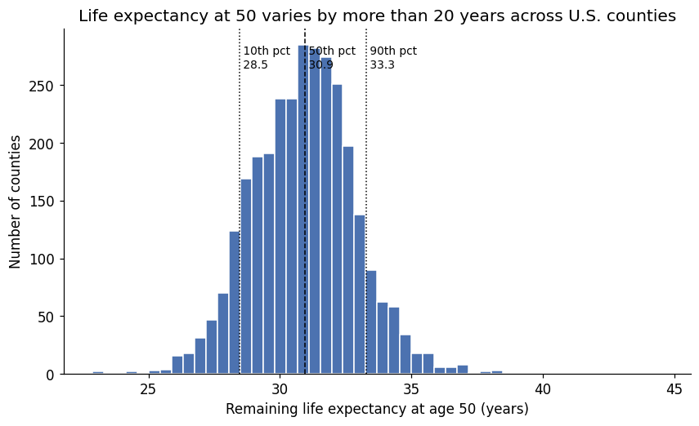

Slide 16
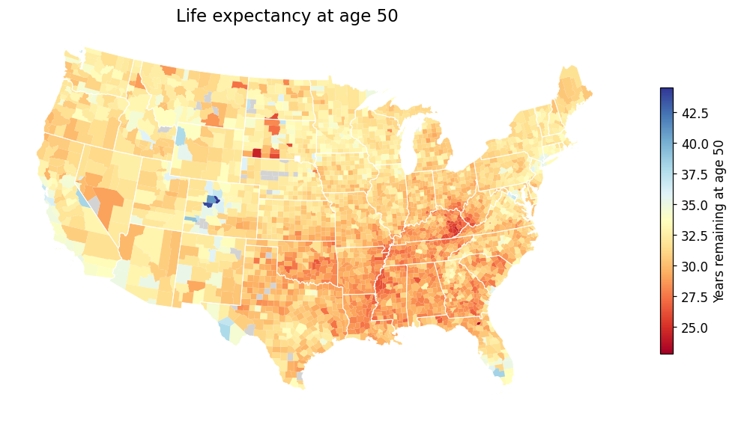

Slide 17
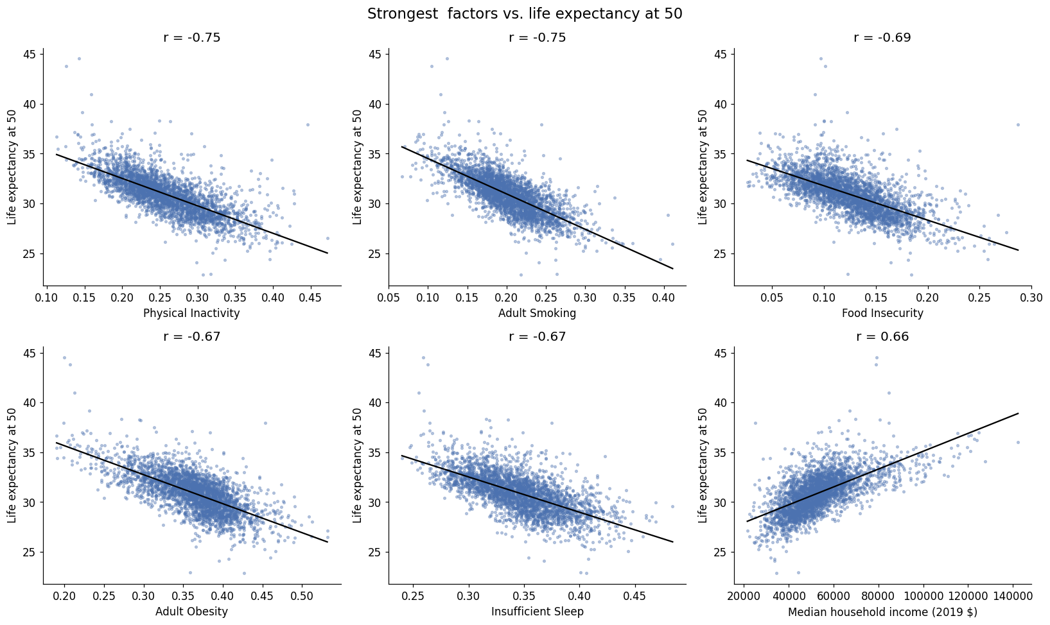

Slide 18
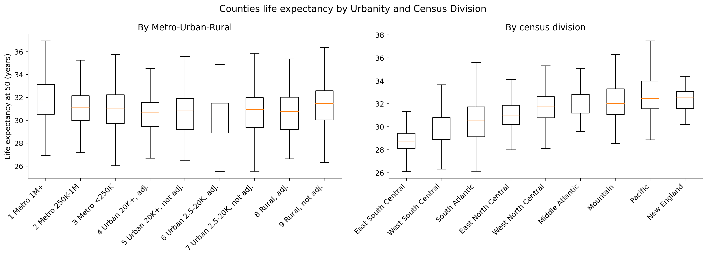

Slide 19
Models Run
Baseline (predict the mean): gives every other score something to beat.
Linear Regression: the plainest model. Shows what the penalty is buying.
Elastic Net: linear with a penalty. Handles features that move together and drops weak ones on its own.
Random Forest: picks up non-linear patterns with almost no tuning.
Gradient Boosting (XGBoost): usually the best on data shaped like this. Handles missing values on its own.
Every model was scored two ways. Random folds mix neighbouring counties into both training and testing. Spatial folds hold out a whole census division, so the test counties have no neighbours in training.
Spatial folds are the honest number here. A county's life expectancy correlates 0.76 with the average of its five nearest neighbours, and state alone explains 42% of the variation.
Notes:
Four model families plus a baseline. The comparison is itself a result - we cannot know in advance whether the relationships are linear.

Slide 20
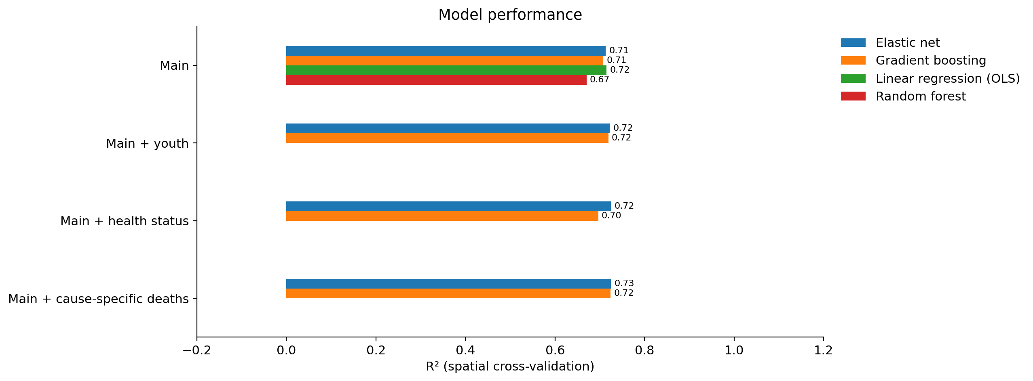
Model Results
Hold Out Test | R² | Error | Within 1 Year
Random 80/20 | 0.78 | 0.95 | 79%
State Blocked | 0.68 | 1.05 | 71%
Against a baseline error of 2.0 years the model cuts the error roughly in half, and gets 71% of counties within one year in eleven states it never saw.
Adding features helps a little. Each held back group moves R² by about a hundredth. All of them together raise it from 0.71 to 0.76, split between the child measures and the health status and cause of death measures that sit next to the outcome.
Notes:
Spatial cross-validation, so each bar is scored on counties in a census division the model never trained on. The four feature sets are nearly indistinguishable, which is why the main upstream set is the one reported.

Slide 21
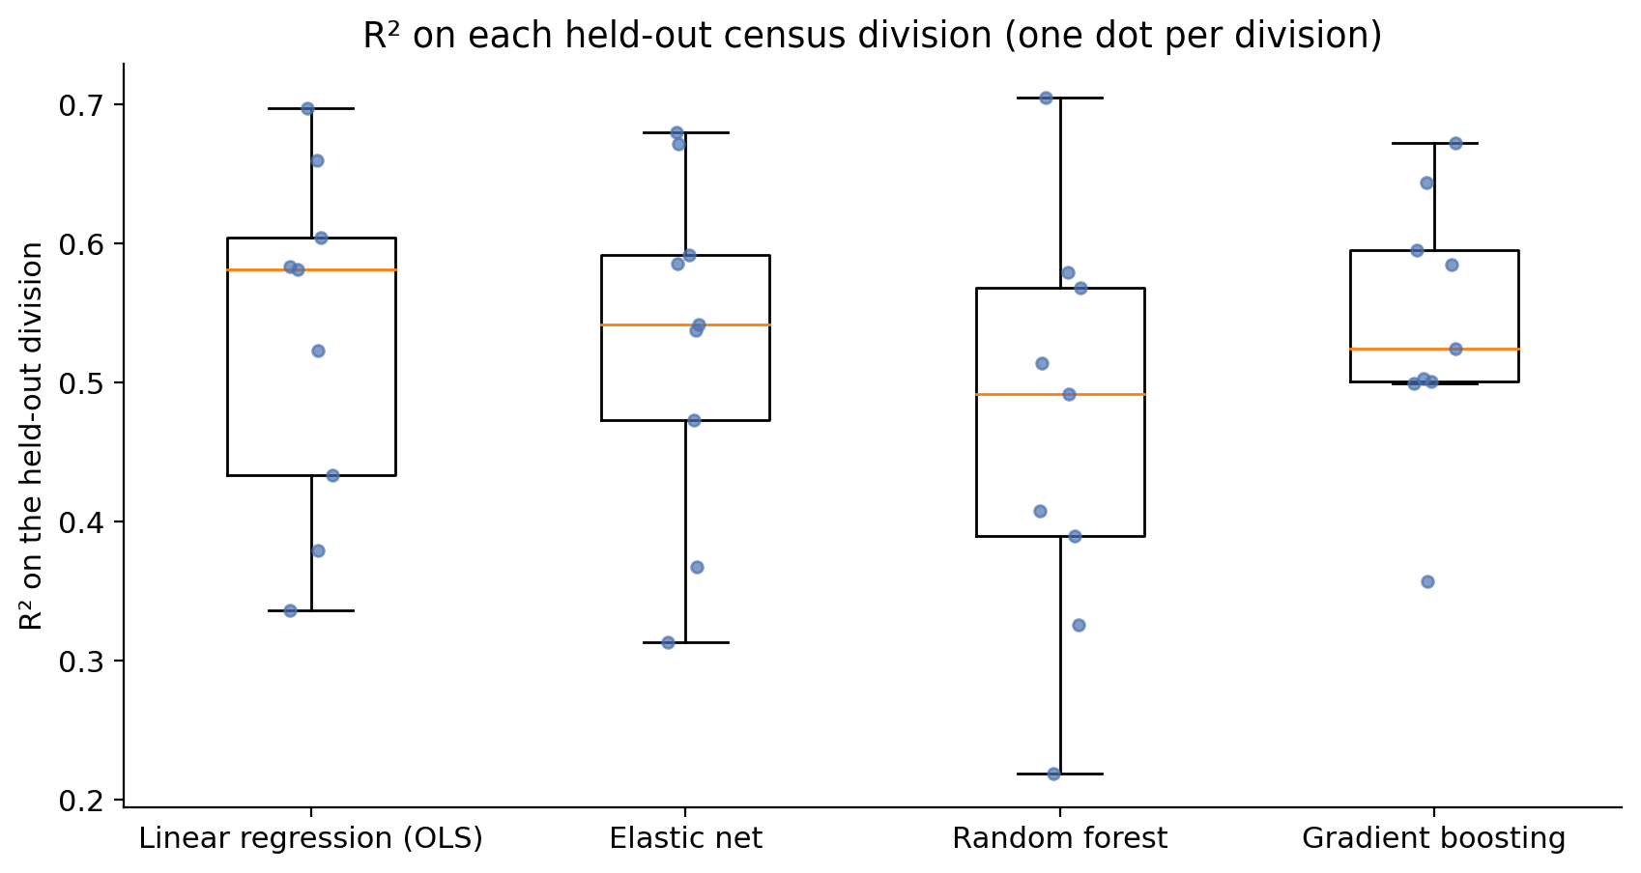
Do the Models Actually Differ?
The models tie. Gradient boosting beats elastic net by 0.013 on average across the nine census divisions, with a spread of 0.052. It wins in five of nine. The difference is smaller than the swing between regions, so the two cannot be told apart.
Plain linear regression holds up too. Its median is the highest of the four, though the spread is wide enough that it is not a real lead either.
Why that matters. County life expectancy is close to a straight additive line through these features. There is no hidden non-linear pattern for the complex model to find, so the simple model can carry the explanation and we can report coefficients instead of only importance scores.
Random forest is the one laggard, and it also swings the most from region to region.
Notes:
Each dot is one held-out census division. Scores vary more between regions than between models, which is the point of the slide. Note these per-division R2 values are lower than the pooled 0.71 because each is measured against its own division's mean, not the national mean.

Slide 22
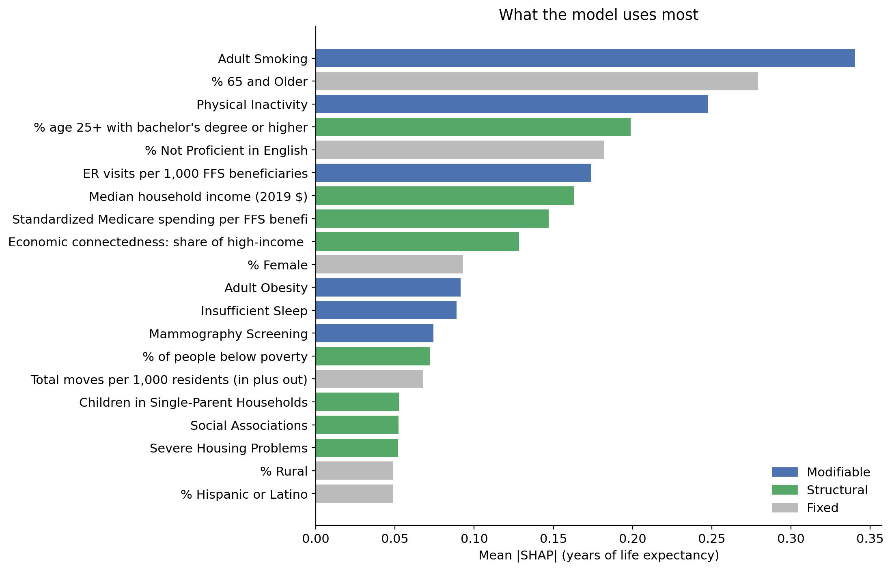
What Drives Life Expectancy After 50
SHAP is not a model. It is a way to explain one. Gradient boosting gives a prediction but no reason for it. SHAP splits each county's prediction into a contribution from every feature, and those add back up to the prediction. That is what the county pages on the website will need.
Smoking comes out first. That matches decades of published research, which is a good sign the model learned something real.
Colour shows what a county could act on. Blue is modifiable, green is slow moving, grey is fixed. Two of the top three are things a county can work on.
A caution. Features that move together split the credit between them, so SHAP describes how the model works, not an isolated effect of one factor.
Notes:
Mean absolute SHAP value, in years of life expectancy. The elastic net coefficients rank these features similarly (Spearman 0.73), which is a robustness check: the ranking is a property of the data, not of one model.

Slide 23
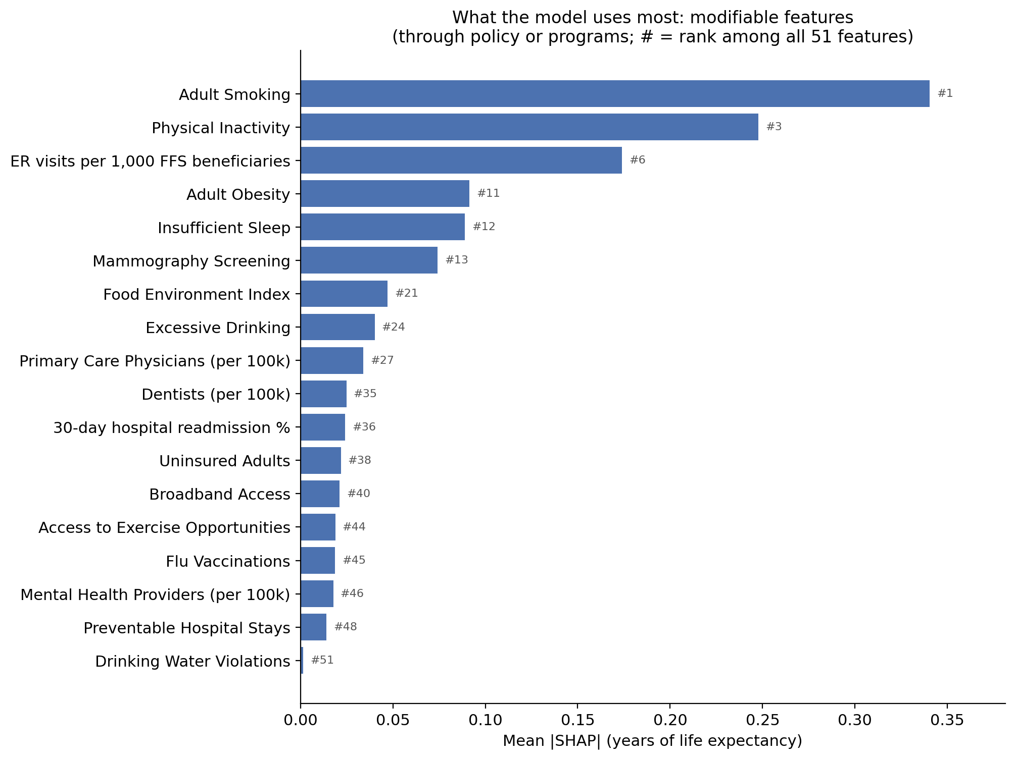
What the Model Uses Most: Modifiable
38% of what the model relies on. 18 features a county could act on through policy or programs.
Smoking is first of all 51 features. Physical inactivity is third. Together those two are almost half of this category.
ER visits rank sixth. It measures how care gets used, not how much care there is.
Provider counts sit near the bottom. Doctors, dentists and mental health providers per person add little once behaviors are known.
The # is the rank among all 51. All three category charts share one scale so the bars can be compared.
Notes:
Mean absolute SHAP in years, gradient boosting, all 3,079 counties. Modifiable total 1.30 of 3.40 years, which is 38%. Smoking 0.34 and physical inactivity 0.25 sum to 45% of the category. Excessive drinking ranks 24th and is the one factor where the data runs against common sense: wealthier, longer-lived counties report more of it.

Slide 24
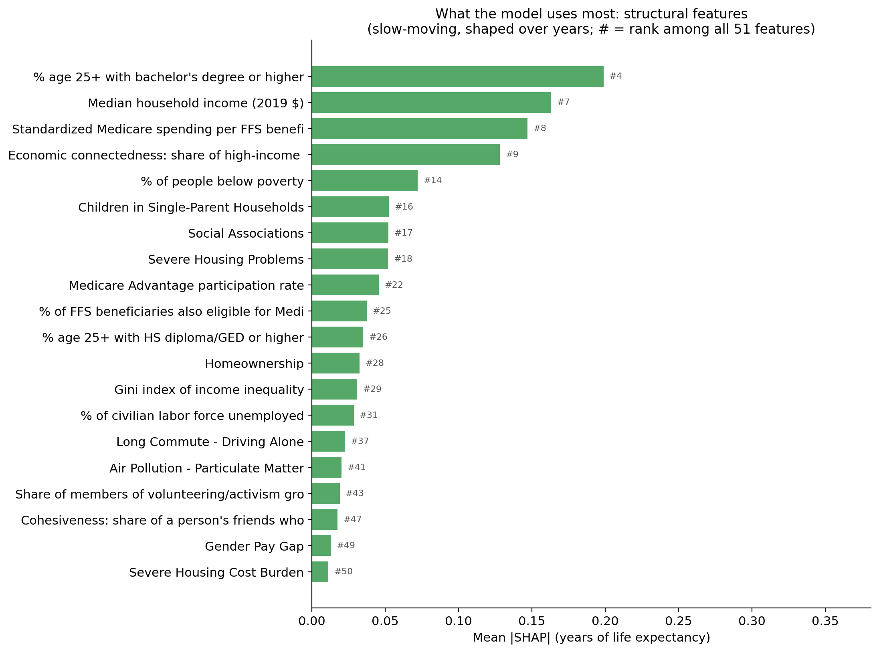
What the Model Uses Most: Structural
35% of what the model relies on. 20 features that move over years, not through one program.
Education and income lead. Bachelor's degree is 4th overall and household income is 7th.
Economic connectedness is 9th. It is the one Social Capital Atlas measure in the top ten. It counts how many friends of low income residents are high income.
Poverty is 14th, below income and education. The three move together, so they share the credit.
Housing cost and the pay gap add almost nothing. They rank 49th and 50th.
Notes:
Structural total 1.18 of 3.40 years, 35%. Medicare spending per beneficiary ranks 8th; higher spending goes with shorter lives, which reflects sicker populations rather than spending causing harm. Correlated features share SHAP credit, so poverty's rank understates its importance on its own.

Slide 25
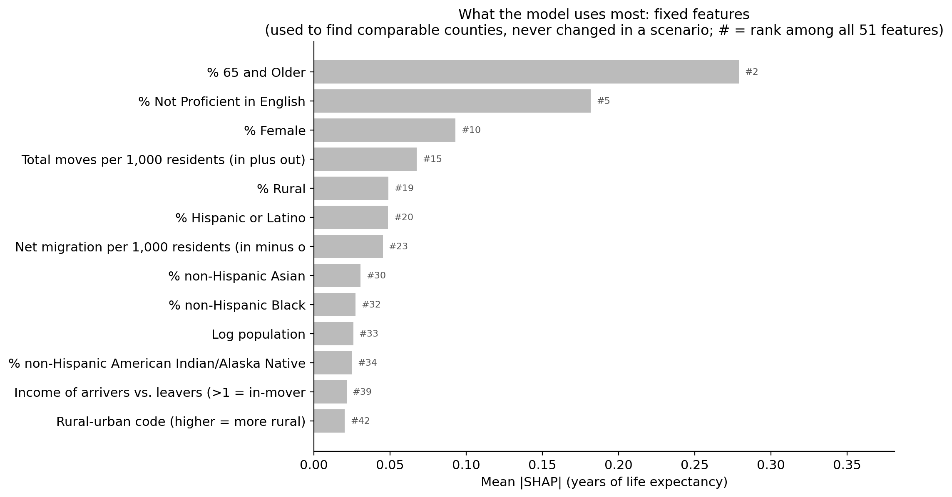
What the Model Uses Most: Fixed
27% of what the model relies on. 13 features a county cannot change. They are never moved in a scenario.
Share of residents 65 and older is 2nd overall. That is who lives there, not what the county does. Retirement counties draw healthy older movers.
Limited English is 5th. Counties with more immigrants tend to live longer than their income suggests.
Race and ethnicity rank 20th to 34th. Once income, education and behavior are in the model they add little.
Their job is matching. These are used to find each county's 25 similar counties.
Notes:
Fixed total 0.92 of 3.40 years, 27%. Put together with the other two slides: nearly three quarters of what the model leans on is modifiable or structural. The 65 and older share picks up selective migration of healthy retirees, the same pattern the residual analysis found in resort counties.

Slide 26
Where the Model Misses
Living Shorter Than Predicted
Living Longer Than Predicted
County | Actual | Predicted | Difference
Madison County, MS | 28.9 | 32.3 | -3.4
District of Columbia | 31.3 | 34.6 | -3.3
Walker County, AL | 26.3 | 29.0 | -2.8
Carson City, NV | 28.9 | 31.6 | -2.7
County | Actual | Predicted | Difference
Eagle County, CO | 41.0 | 35.8 | +5.1
Collier County, FL | 38.3 | 33.7 | +4.6
Pinal County, AZ | 35.2 | 31.7 | +3.5
Highlands County, FL | 32.6 | 29.5 | +3.1
High inequality counties come in short. Madison County, MS and Washington DC are both wealthy and well educated on paper, and both are split sharply inside. Madison County holds wealthy Madison and Ridgeland next to much poorer Canton. The model sees a county average and predicts a long life. A county level model cannot see inequality inside the county.
Retirement counties come in long. Nearly every large miss on the other side is a place healthy retirees move to. People who arrive are healthier than average and people who get seriously ill often move away. The IRS migration features pick up part of this but not all of it.
Notes:
These two patterns are findings, not failures. The DC and Madison County misses are the clearest illustration of the ecological fallacy this project can offer, and the retirement counties show migration selection at work.

Slide 27
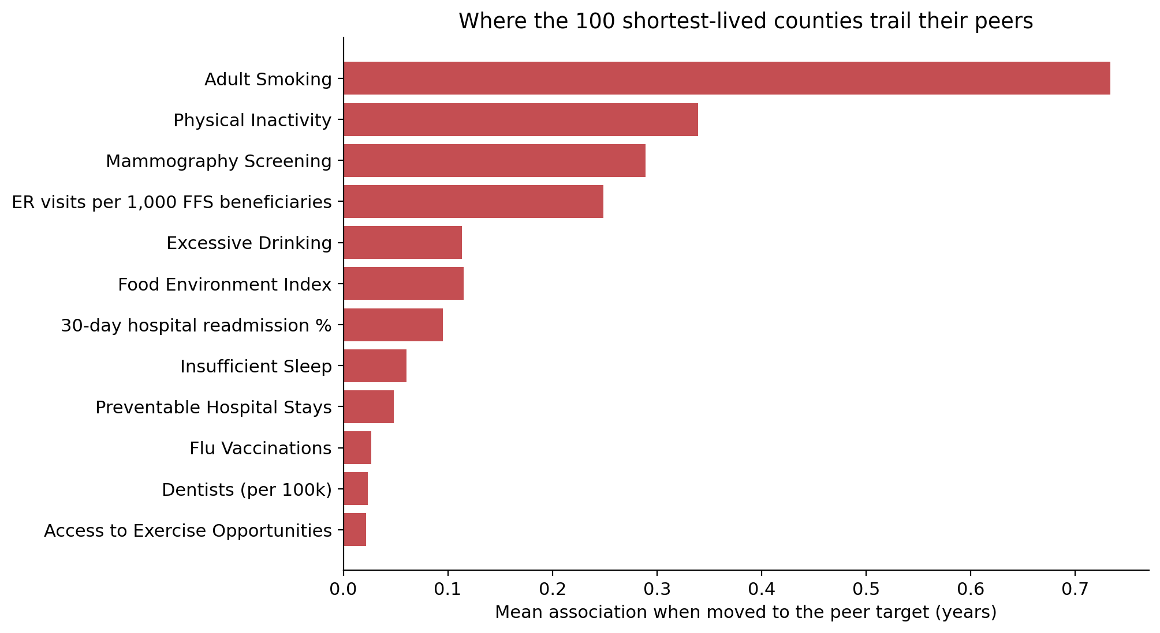
What Could a County Change?
The method. Each county is matched to its 25 nearest peers on things it cannot change: size, rurality, age, race and migration. For each factor it can change, the target is what the top quarter of those peers already reach. The feature is moved to that target and the model is run again.
The 100 shortest lived counties average 26.6 years at 50 against a national median of 30.9. Matching every peer target at once is worth +1.5 years, which closes about a third of that gap.
Smoking runs away with it, at more than double the next factor and behind in 95 of the 100 counties.
The modest size is the result. The rest of the gap sits in conditions and history a county cannot move quickly.
These are comparisons, not promises. Counties like this one with lower smoking live longer. That is not the same as saying this county would gain 1.5 years by cutting smoking.
Notes:
Guardrails: targets never go past what peer counties already reach, and the combined figure changes every gap at once rather than adding up the individual gains. Hitting the top quarter on every factor at once is a bundle no single peer county achieves, so treat the combined number as an upper bound.

Slide 28
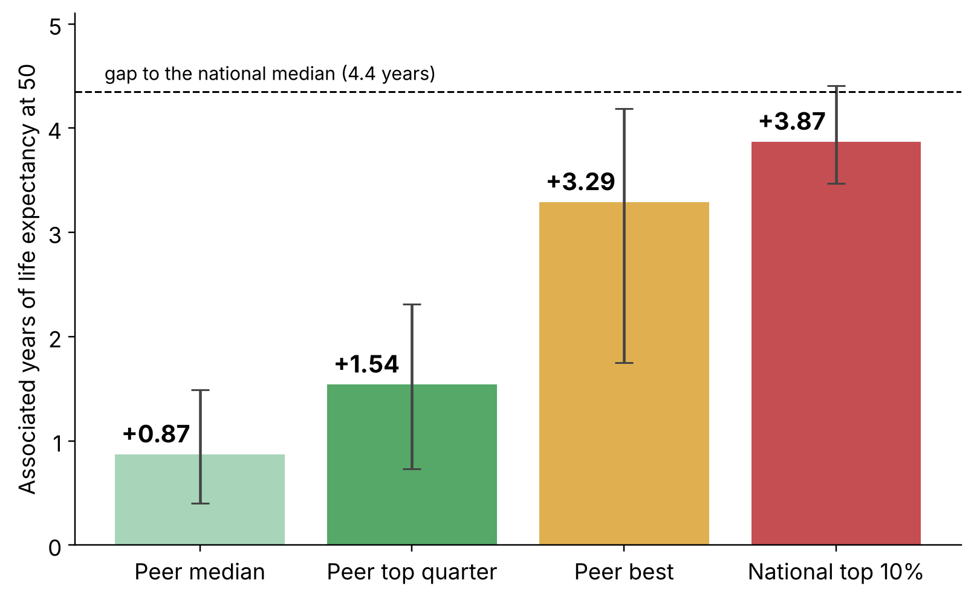
What If the Bar Is Set Higher?
Same 100 counties, four targets. They sit 4.4 years below the national median. Bars are the median county and the lines cover the middle half.
Realistic range: +0.9 to +1.5 years. Catch the typical similar county, or the top quarter of them. That closes 20% to 35% of the gap.
Ceiling: +3.3 to +3.9 years. Match the single best similar county, or the national top 10%.
Why the top rung is a ceiling. 59% of those targets are levels no similar county has reached. The model has hardly seen a county like that.
Still association. Similar counties at that level live this much longer. It is not a forecast.
Notes:
Peer median +0.87 (20% of the gap), peer top quarter +1.54 (35%), peer best +3.29 (75%), national top 10% +3.87 (89%). Every other scenario in the deck uses the peer top quarter. Peer targets are by construction values that a similar county has reached; the national target is not, and 59% of its values fall outside the peer range.

Slide 29
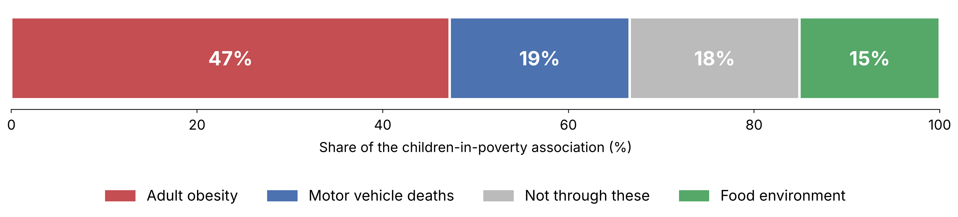
How Does Childhood Poverty Reach Age 50?
The question. Children in poverty did not survive into the final model because it overlaps adult poverty, education and smoking. That is a modelling answer, not an answer about the world. Splitting the association shows where it travels.
Obesity carries nearly half. Childhood poverty accounts for 45% of the variation in adult obesity, and that route alone is 47% of the total.
Food access shows up most, matters least. Childhood poverty explains 57% of the food environment index, more than any other condition, yet it carries 15%.
Crime is not a step. Homicides were tested on the same counties, with errors clustered by state. No independent association, p = 0.68.
Read it as association, not a chain. A pathway and a common cause predict the same split. County averages cannot tell the two apart.
Notes:
Mediation decomposition on standardised variables. The raw coefficient on children in poverty is -0.676 standard deviations of life expectancy per standard deviation. Each route is the product of two legs: how strongly childhood poverty predicts the condition, and how strongly that condition predicts life expectancy with poverty held fixed. The four routes sum back to -0.676 exactly, which is the arithmetic check. All models use the same 1,305 counties, the ones that report homicides, so nothing here is a sample effect. With standard errors clustered by state, obesity, motor vehicle deaths and food environment all hold at p < 0.01 while homicides sit at p = 0.68. The hypothesis going in was childhood disadvantage to crime to grocery store closures to obesity; the food and obesity half holds up and the crime half does not. On the wider, more rural sample of 2,648 counties the same three conditions account for 60% rather than 82%, so the pathway is less complete outside metro areas.

Slide 30

Project Status
Done
Final feature list is set. 51 features after dropping ones that overlapped.
BLS industry data was added and tested. Eight sources loaded, seven feed the model.
Models are run and compared. Elastic net and gradient boosting tie.
County data for the web app is built. Grades, percentiles, peers and what each of the 3,079 counties could change.
The Streamlit web app is built. A map and a list of every county with filters, and a popup for each county showing its report card, its drivers and what it could change.
Still to do
Add warnings on the county pages for factors well behind peer counties.
Compare against life expectancy at birth to show what changes after 50.

