Slide 1

ADVANCED DATA MINING TECHNIQUES
by Group 4

Slide 2
INTRODUCTION
Data mining is the process of finding useful patterns in large datasets. Advanced methods like ensemble learning, NLP, time-series analysis, and graph mining make it possible to handle complex data and apply insights to real-world problems such as business, healthcare, and social networks.

Slide 3
LEARNING OUTCOMES
At the end of the lesson, the student will be able to:
Explain advanced data mining techniques such as ensemble learning and deep learning.
Apply text mining and NLP methods to extract insights from textual data.
Analyze time-series data and identify sequential patterns in datasets.
Interpret graph structures and social network data to uncover relationships and communities.
Relate these techniques to real-world applications in business, healthcare, and social media.

Slide 4
ADVANCED DATA MINING TECHNIQUES
Ensemble Learning
Ensemble learning is a method where we use many small models instead of just one. Each of these models may not be very strong on its own, but when we put their results together, we get a better and more accurate answer. It's like asking a group of people for advice instead of just one person—each one might be a little wrong, but together, they usually give a better answer.

Slide 5
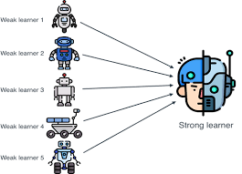

Slide 6
Bagging
Bagging, also known as bootstrap aggregating, is the aggregation of multiple versions of a predicted model. Each model is trained individually, and combined using an averaging process. The primary focus of bagging is to achieve less variance than any model has individually.

Slide 7
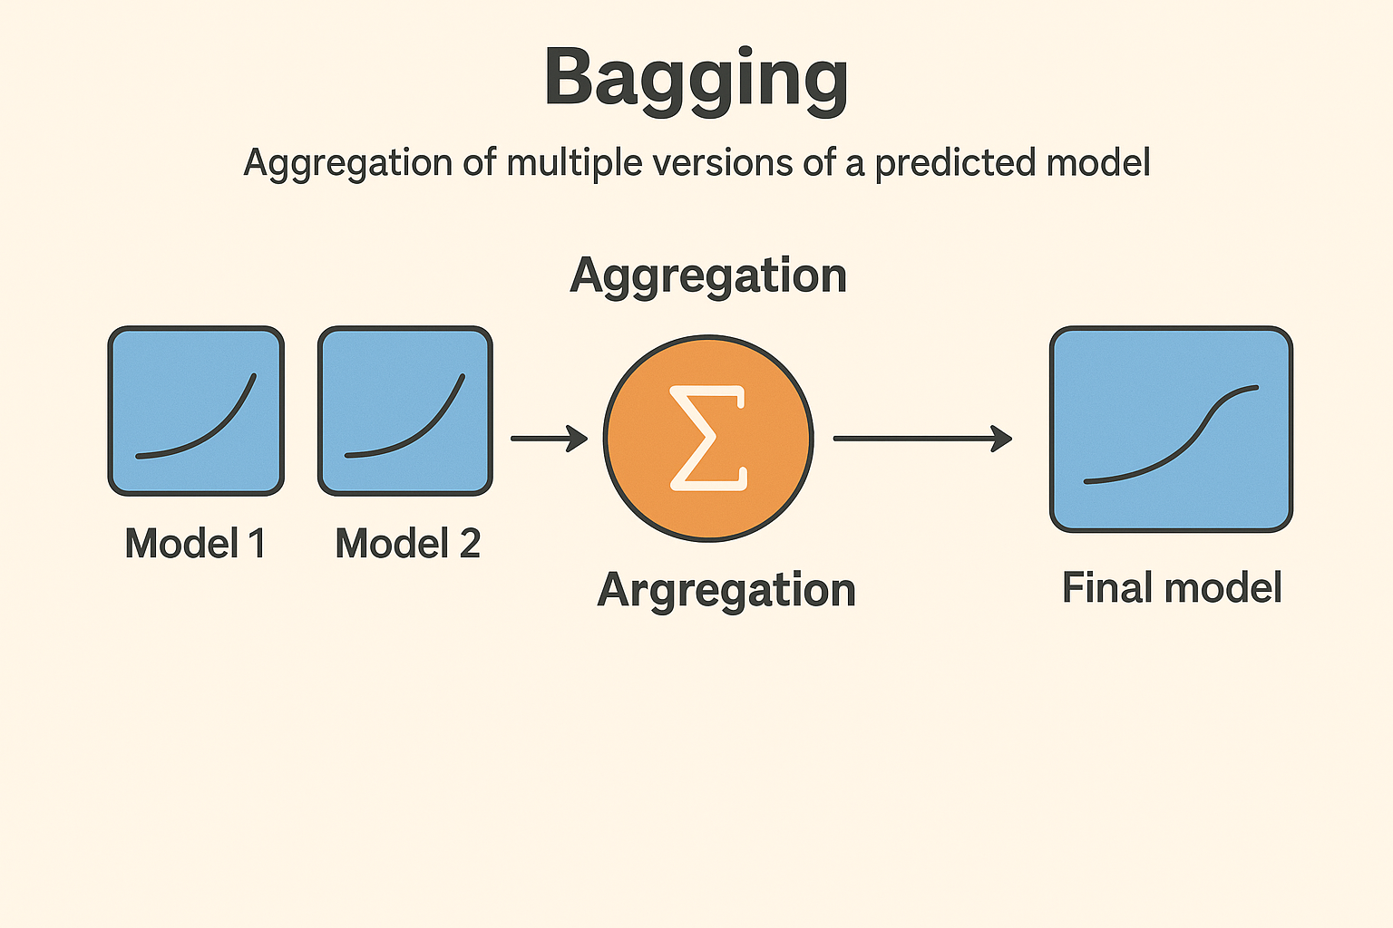

Slide 8
Boosting
Boosting is an ensemble learning method that sequentially combines several weak learners (simple models) into a single, strong model by having each new learner focus on correcting the previous ones' mistakes. This process improves overall predictive accuracy, reducing errors by focusing on misclassified data points.

Slide 9
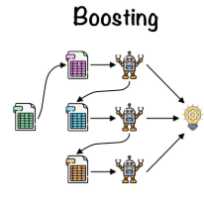

Slide 10
Random Forest
Random forest is a supervised learning algorithm. The “forest” it builds is an ensemble of decision trees, usually trained with the Bagging method. The general idea of the bagging method is that a combination of learning models increases the overall result.

Slide 11
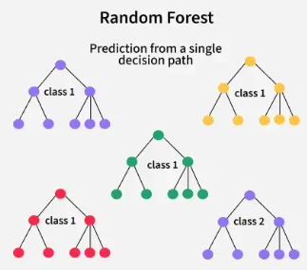

Slide 12
Time-Series MIning
It is the process of analyzing data collected over time (daily, weekly, monthly, yearly) to find patterns, trends, or predictions.
The order of data is important because past values affect future values.
Examples:
Stock market prices each day
Daily temperature recordings
Monthly sales revenue

Slide 13
Sequential Pattern Mining
A data mining technique used to discover frequent sequences of events or items in a dataset. It finds patterns in the order of events, not necessarily tied to fixed time intervals.
Examples:
In a shopping district: customers often buy milk → bread → butter
In website logs: many users visit homepage → product page → checkout
In medical records: patients often experience symptom A → test B → diagnosis C

Slide 14
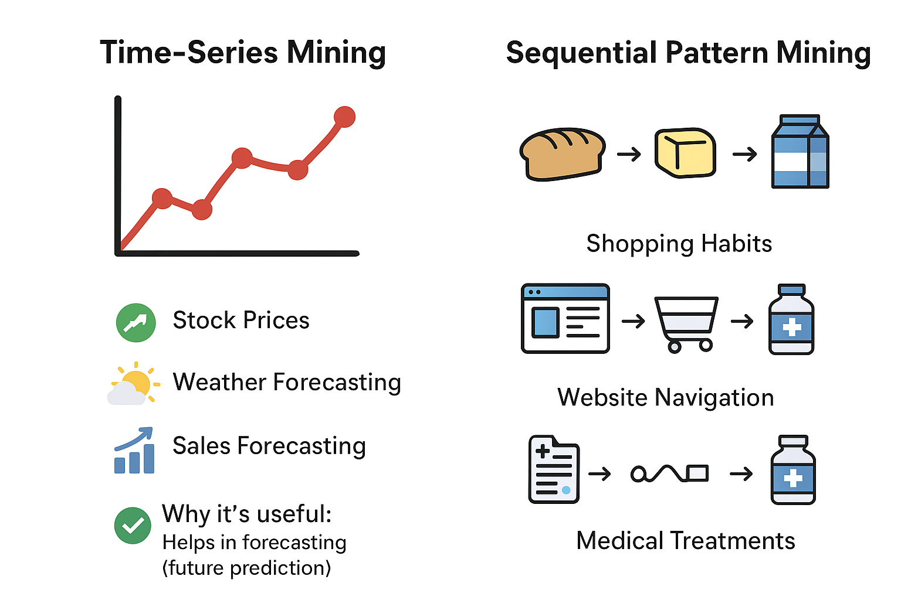

Slide 15
Graph Mining
Graph mining deals with data represented as nodes (points) and edges (connections).
It looks for patterns, structures, and relationships inside a graph.

Slide 16
Social Network Mining
A specialized type of graph mining focused specifically on social networks (where nodes = people/accounts and edges = relationships or interactions).

Slide 17
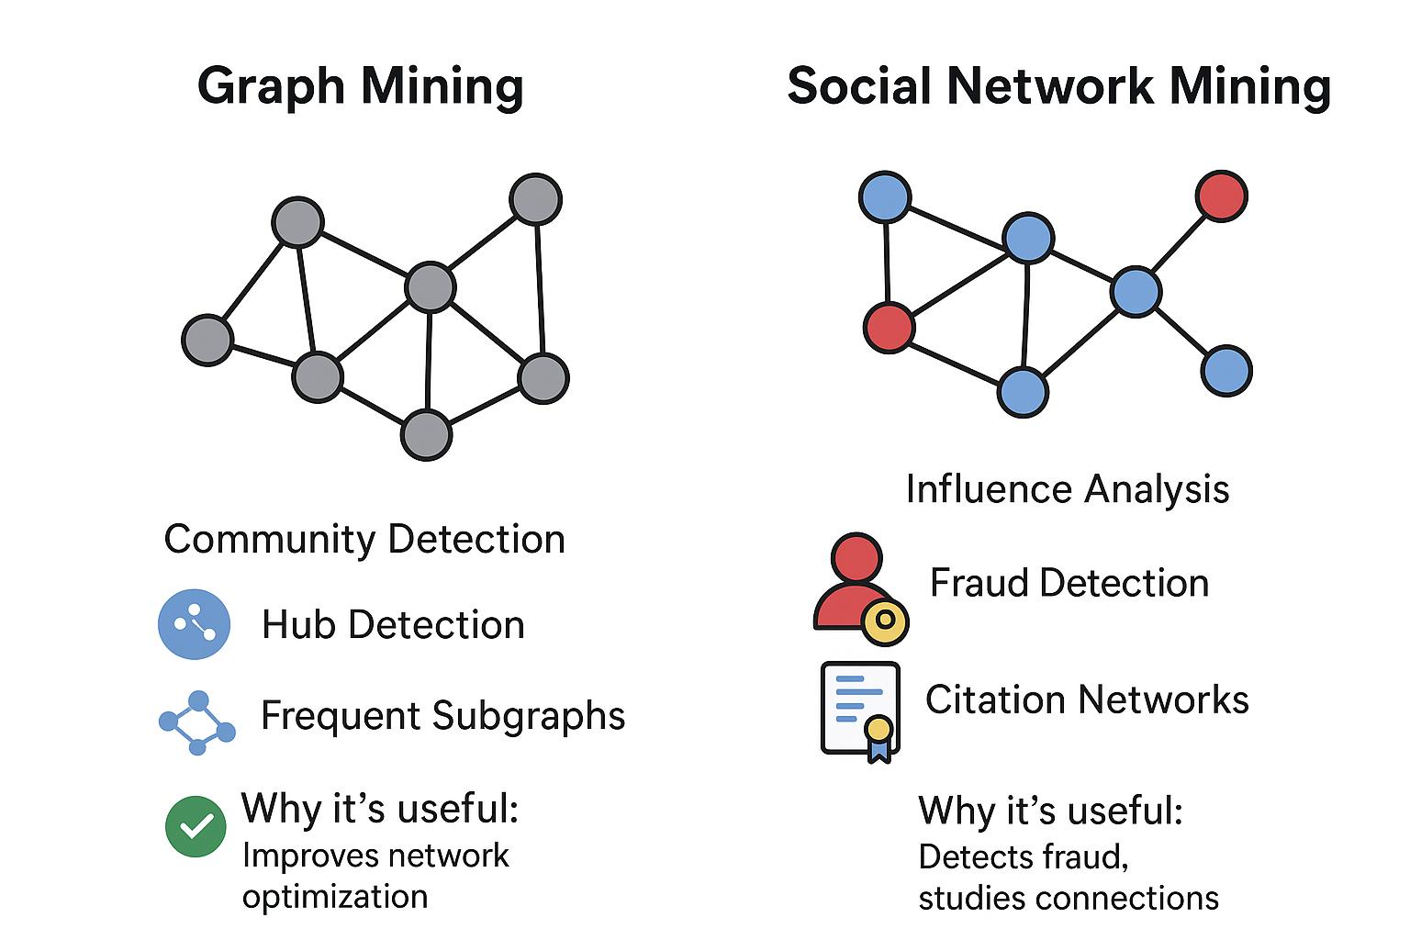

Slide 18
Deep Learning
Deep learning is a subfield of machine learning that uses multi-layered neural networks to automatically learn complex patterns and features from raw, unstructured data, making it a powerful tool in data science for tasks like image recognition, natural language processing, and predictive modeling.
How it works (Step by Step):
Input Layer → Data goes in (is this a cat or dog?).
Hidden Layers → Multiple layers of neurons process and transform the data, detecting patterns.
Early layers: detect simple features (edges, colors).
Deeper layers: detect complex features (faces, objects, body).
Output Layer → Final prediction (“cat” or “dog”).

Slide 19
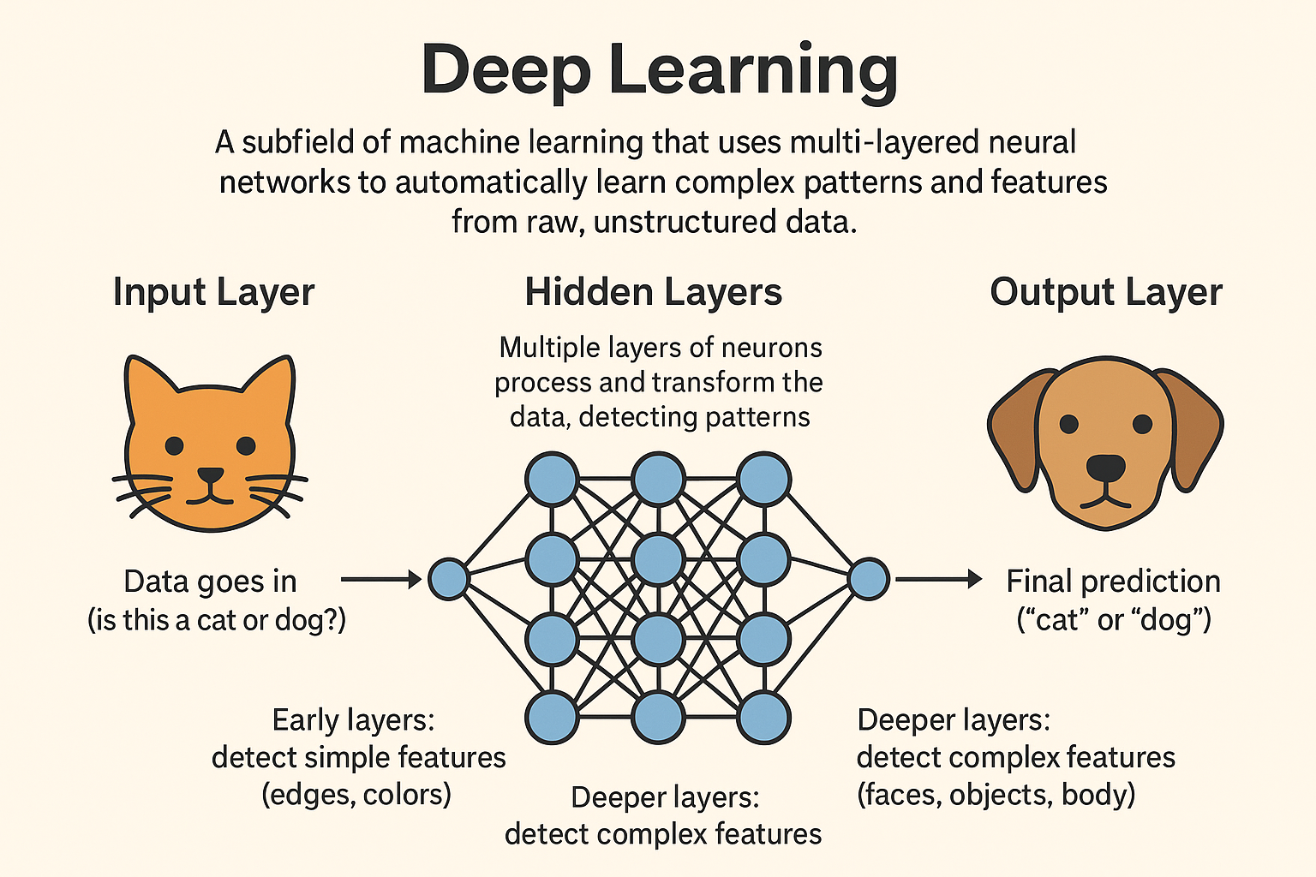

Slide 20
TEXT MINING AND NATURAL LANGUAGE PROCESSING(NLP)
Text mining in data science is the process of applying algorithms from natural language processing (NLP), machine learning, and data mining to transform vast quantities of unstructured text into structured data, enabling the discovery of hidden patterns, trends, and meaningful information.
Example: Customer Feedback Analysis
A company collects 10,000 survey responses from customers.
Text Mining is used to:
Count common words (e.g., “delivery”, “slow”, “fast”).
Find topics (e.g., shipping issues, product quality).
Detect overall trends (e.g., 65% complain about late delivery).
Output: Insights like “Most customers are unhappy with delivery speed.”

Slide 21
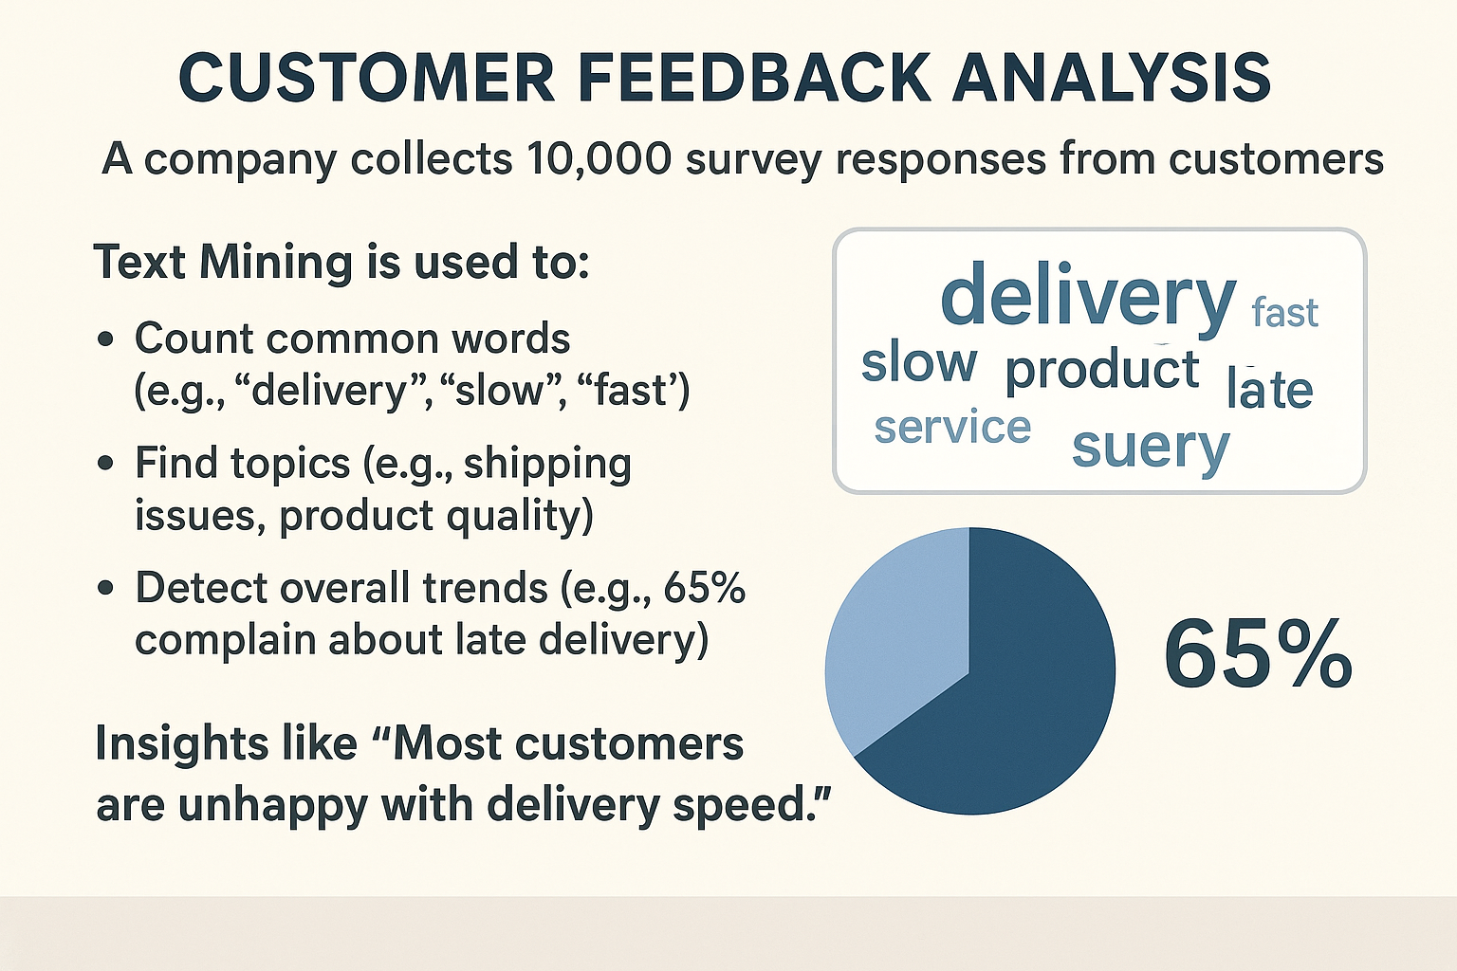
EXAMPLE

Slide 22
Natural Language Processing(NLP)
Natural Language Processing (NLP) is the application of Artificial Intelligence (AI) and machine learning to enable computers to interpret, analyze, and generate human language, extracting meaningful insights from large volumes of text and voice data.
Example: Google Translate
User types: “Good morning” in English.
NLP breaks it into tokens → [“Good”, “morning”].
NLP model understands context and grammar.
Translates into Spanish → “Buenos días”.
Output: Machine understands meaning and produces natural language.

Slide 23
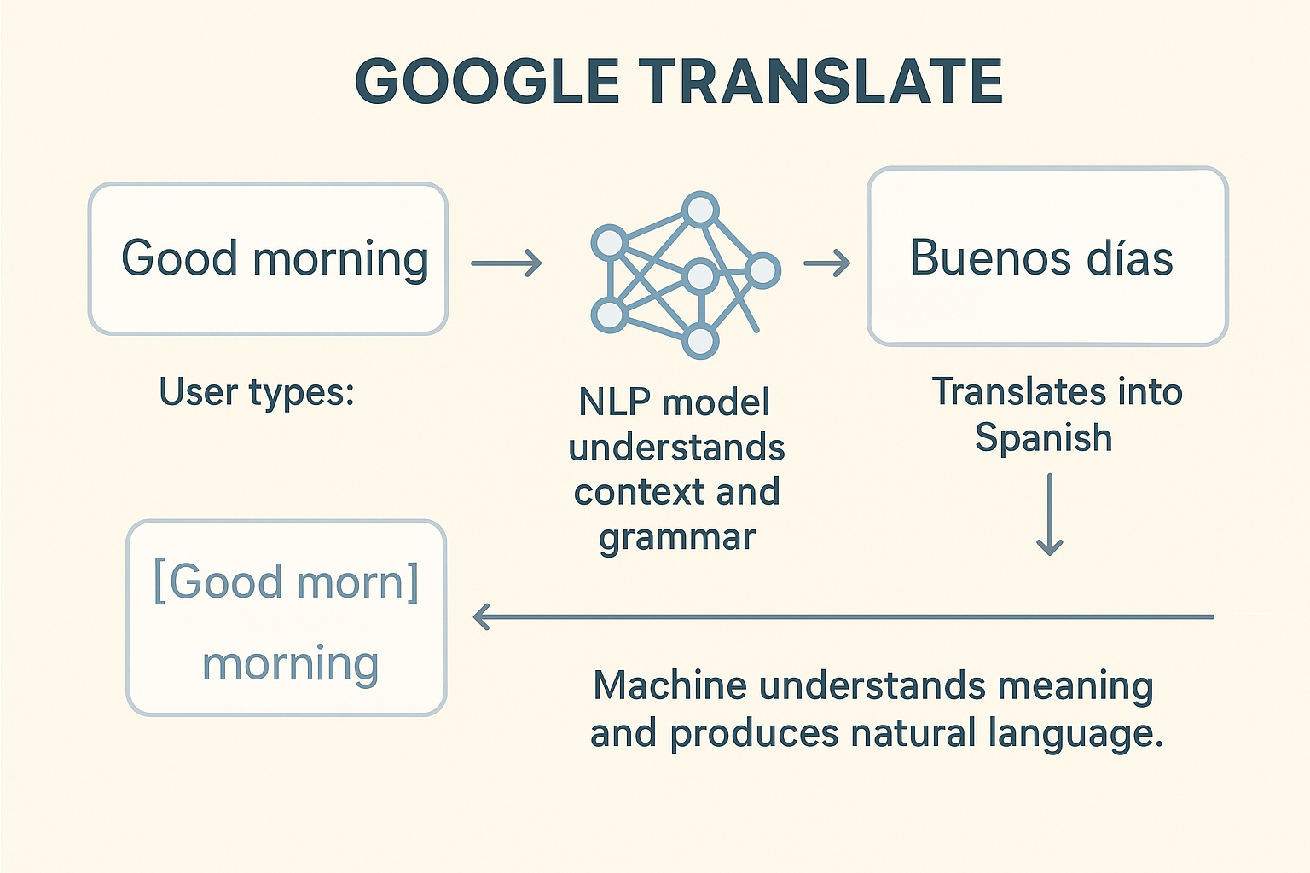
EXAMPLE

Slide 24
THANK YOU

