Slide 1
Authorization mit Oauth 2.0
06.06.2019

Slide 2
Agenda
Authentisierung vs. Autorisierung
Authorization Grant Types
Demo
Access Token
Refresh Token
Issuing an Access Token
Refreshing an Access Token
Accessing Protected Resources
Security Considerations
Notes:
45 Min : Theorie
2 h : Praxis
30 Min : Erkenntnisse
15 Min : Pause

Slide 3
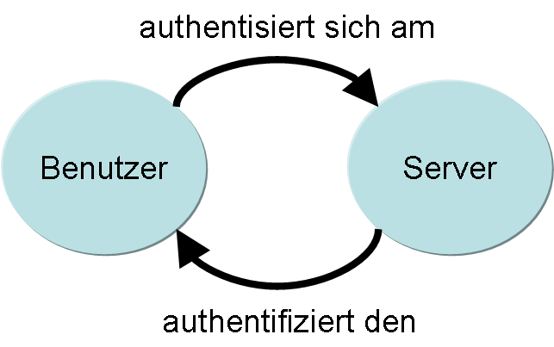
Authentisierung vs. Autorisierung
Authentisierung
Basic Authentication (username, password)
Public/Private Key Authentication
Autorisierung
OAuth 2.0
Notes:
Authorization Code:
Client

Slide 4
OAuth defines four roles
Resource Owner
Resource Server
Client
Web application (Credential are stored on a web-server)
Native application
Authorization Server

Slide 5
Authorization Grant Types
Authorization Code
Implicit
Resource Owner Password Credentials
Client Credentials
Notes:
Authorization Code:
Client leitet Resource Owner auf den Authorization Server via einen sogenannten User-Agent (Browser)
Authorization Server sendet Authoriazation Code dem Browser, der es wiederum dem Client sendet
Client sendet dem Authorization Server den Auth Code und erhält den Access Token (optional auch Refresh Token)
Client kann mit dem Access Token auf dem Resource Server Requests durchführen
Implicit
Ähnlich wie Authorization Code, nur wird direkt der Access Token gesenden, ohne zuerst den Authorization Code gesentet zu haben
Resource Owner Password Credentials
Resource Owner loggt sich direkt über die Client App
Nachteil → Der Client sieht die Resource Owner Credentials, muss sie allenfalls noch speichern
Client Credentials
Confidential Client loggt sich direkt am Authorization Server ein, um Access Tocken zu erhalten
Vertiefen auf Whiteboard
Client Credentials
Authorization Code

Slide 6
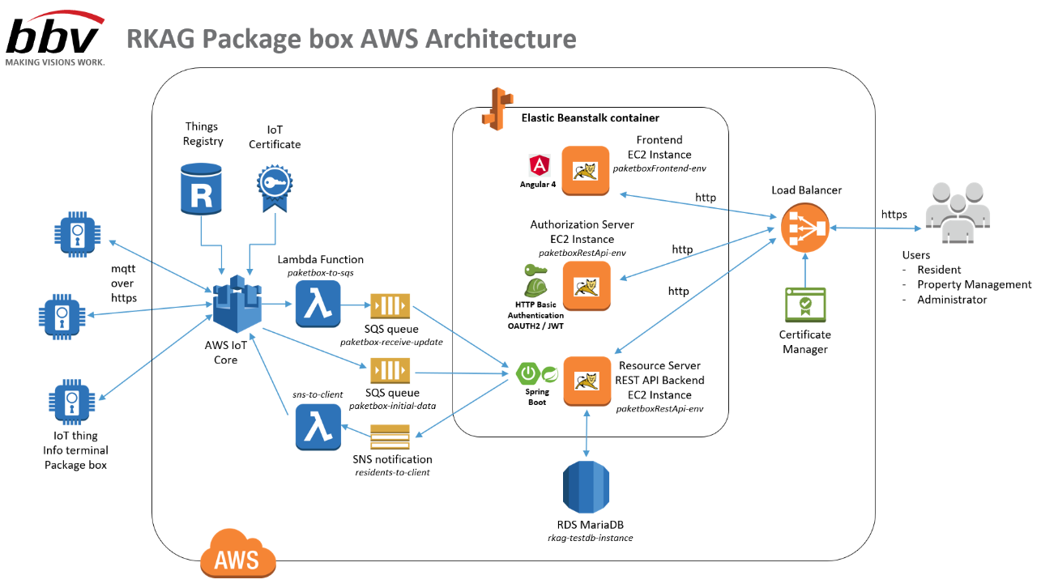
Demo
Demo mit René Koch AG Projekt “Smarte Paketfächer”
Notes:
Demo
Access Token
Refresh Token
Obtaining Authorization
Issuing an Access Token
Refreshing an Access Token
Accessing Protected Resources
Postman
Access Token Online Decoder https://jwt.io/
Swagger

Slide 7
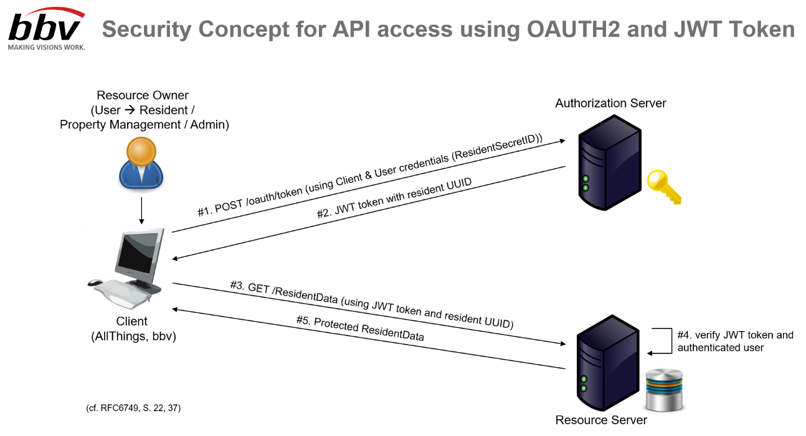
Demo
Demo mit René Koch AG Projekt “Smarte Paketfächer”
Notes:
Demo
Access Token
Refresh Token
Obtaining Authorization
Issuing an Access Token
Refreshing an Access Token
Accessing Protected Resources
Postman
Access Token Online Decoder https://jwt.io/
Swagger

Slide 8
Security Considerations
use https transport
Authorization codes MUST be short lived and single-use
Authorization Code Redirection URI Manipulation → Authorization server MUST ensure that the redirection URI used to obtain the authorization code is identical to the redirection URI provided when exchanging the authorization code for an access token
Minimize the use of password “Resource Owner Password Credentials” → Client knows Resource Owner Credentials
Ensuring Endpoint Authenticity → prevent man-in-the-middle attacks

Slide 9
Security Considerations
Phishing Attacks
Cross-site request forgery (CSRF) is an exploit in which an attacker causes the user-agent of a victim end-user to follow a malicious URI → prevent with use of “same-origin policy”, use “state” value (i.e. hash) in authorization code to bind client and authorization server
Clickjacking → Attackers use iframes to create invisible button to redirect the resource owner to another site to granting the credentials → use "x-frame-options" in header, which block sites with framing or framing by sites with other origin
For more details see [1], chapter 10

Slide 10
References
[1] RFC6749 The OAuth 2.0 Authorization Framework https://tools.ietf.org/html/rfc6749
[2] RFC8252 OAuth 2.0 for Native Apps https://tools.ietf.org/html/rfc8252
[3] https://oauth.net/2/
[4] https://www.oauth.com/oauth2-servers/device-flow/
[5] https://www.owasp.org

Slide 11

Appeal
Secure your API with

Slide 12
MAKING VISIONS WORK.
bbv Software Services AG
Heinrichstrasse 249
8005 Zürich
Telefon +41 44 315 63 63
www.bbv.ch

