Slide 1

WISHBONE TO AHB BRIDGE
Nikou Petros 1261
Tsiokanos Ioannis 1345
GROUP 3

Slide 2
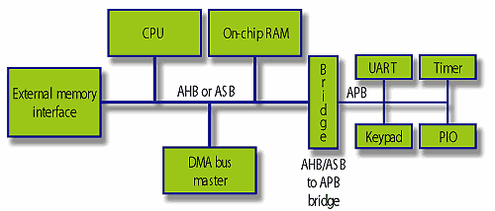
Typical AMBA Systems

Slide 3

Wishbone Definition
It’s a SOC Interconnect architecture for Portable IP cores
it’s purpose is to foster design reuse by alleviating SOC integration problems
improves portability and reliability by creating a common logical interface between IP cores
it’s not an IP core but a specification for creating IP cores.

Slide 4
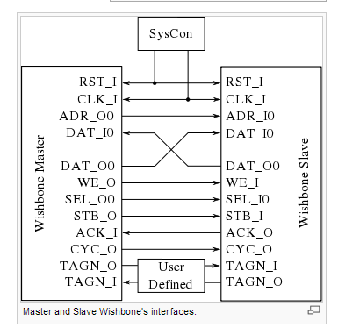

Slide 5
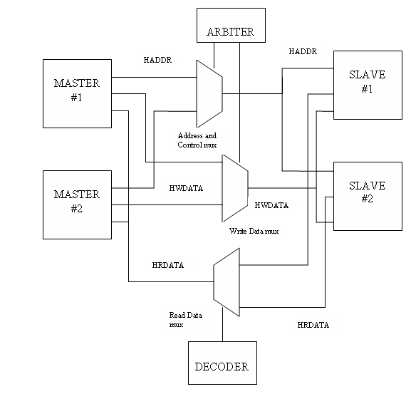
AMBA AHB design with two masters and two slaves.

Slide 6
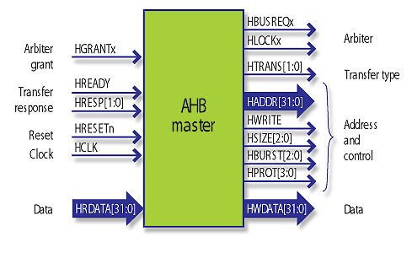
This file is a BRIDGE that is used to interconnect AHB Master and WISHBONE Slave
clk_i
WISHBONE
AHB
BRIDGE
rst_i
hclk
hresetn
hresetn
data_i
addr_i
hwrite
cyc_i
haddr
hwdata
stb_i
we_i
hsel
hburst
ack_o
htrans
data_o
hready
hrdata
hresp

Slide 7

AHB MASTER INTERFACE
HADDR[31:0]
HWDATA [31:0] WRITE DATA BUS
HRDATA[31:0]: READ DATA BUS
HWRITE[0] WRITE/READ CONTROL
HTRANS[1:0] TRANSFER TYPE
HSIZE[2:0]: SIZE OF DATA CONTROL
HREADY: SIGNAL TO BE SEND OUT To indicate bridge is ready
HRESP[1:0]: RESPONSE FROM AHB SLAVE
HBURST[2:0]: BURST CONTROL
HRESTN: AHB ACTIVE LOW RESET
HCLK: AHB CLOCK

Slide 8

WISHBONE SLAVE INTERFACE CONNECTED TO WB MASTER
clk_i Wb clk input
rst_i Wb active high reset
data_i [31:0] Wb data input
cyc_i Wb cycle input
stb_i Wb strobe input
we_i Wb write/read control
ack_o Wb aknowledge
data_o [31:0] Wb data output
sel_i [3:0] Wb selection input

Slide 9
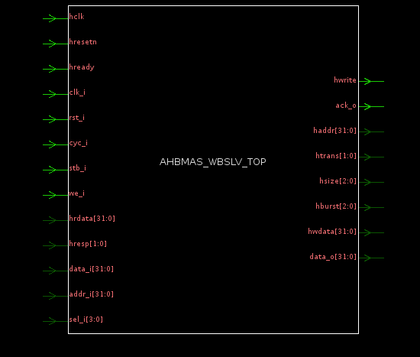
AHB MASTER TO WB SLAVE, TOP LEVEL CIRCUIT

Slide 10
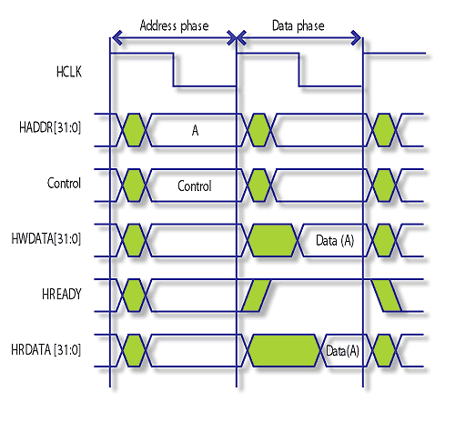
A single AHB cycle read or write transfer between master and slave
It can be seen that all AHB transfers may be divided into an address phase, where the master generates the address and control information and a data phase. In the data phase, data is transferred either from the master to the slave (a write) or from slave to the master (a read). All signals are generated from the rising edge of HCLK. The address and data phases are pipelined. The master must hold the address phase until the data phase of the previous transfer is complete. The data phase is signalled complete by the slave driving HREADY high. The master should sample the slave response only when HREADY is high. The slave does not have the opportunity to extend the address phase, it can only extend the data phase.

Slide 11
Wishbone Master Write Cycle
When we_i is HIGH, this signal indicates a write transfer and the master will broadcast data on the write data bus(data_i) when cyc_i and stb_i signal is HIGH.
At 1st clock edge the address(A1) and data (D1)is sampled by the WISHBONE slave on addr_i and data_i bus respectively.
At 1st clock edge the address(A1) and data (D1)is sampled by the WISHBONE slave on addr_i and data_i bus respectively.
At 1st clock edge ack_o is also asserted. This address sampled is transfered asynchronously to the AHB master on haddr.
At 2nd clock edge Data(D1) for this address is sampled synchronously by AHB master on to hwdata bus irrespective of hready status.
This data is written into the AHB slave synchronously on hwdata bus.
Htrans is asserted to “Non – Seq (10)” transfer type at clock edge when cyc_i and stb_i are HIGH.

Slide 12

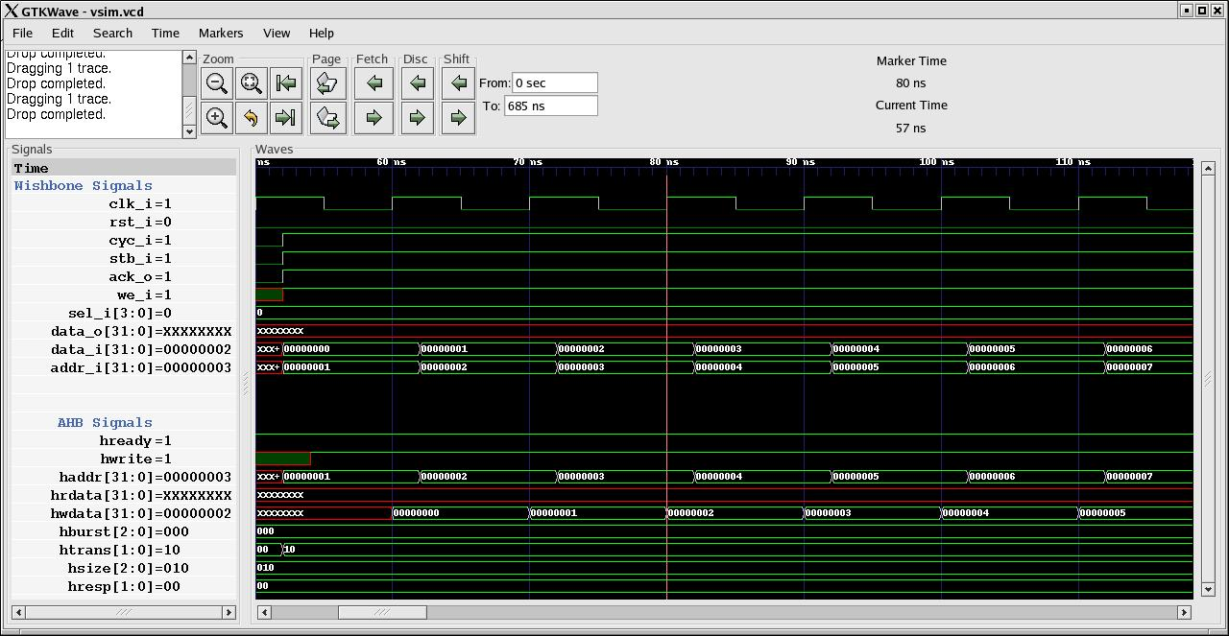
Write cycle

Slide 13
Read cycle
When we_i is LOW, this signal indicates a read transfer and the master will receive data on the read data bus (data_o) provided the ack_o signal is HIGH.
At 1st clock edge the address(A1) is sampled by the WISHBONE slave on addr_i.
This address will be transfered asynchronously to AHB master on haddr provided hready is HIGH.
At 2nd clock edge Data(D1) for this address is sampled synchronously by AHB on hrdata.
Data (D1) is latched on hrdata bus asynchronously when hready is asserted.
Data (D1) is latched on data_o asynchronously at the same time.
At 2nd clock edge ack_o is asserted.
Htrans is asserted to “Non – Seq (10)” transfer type at clock edge when cyc_i and stb_i are HIGH.

Slide 14
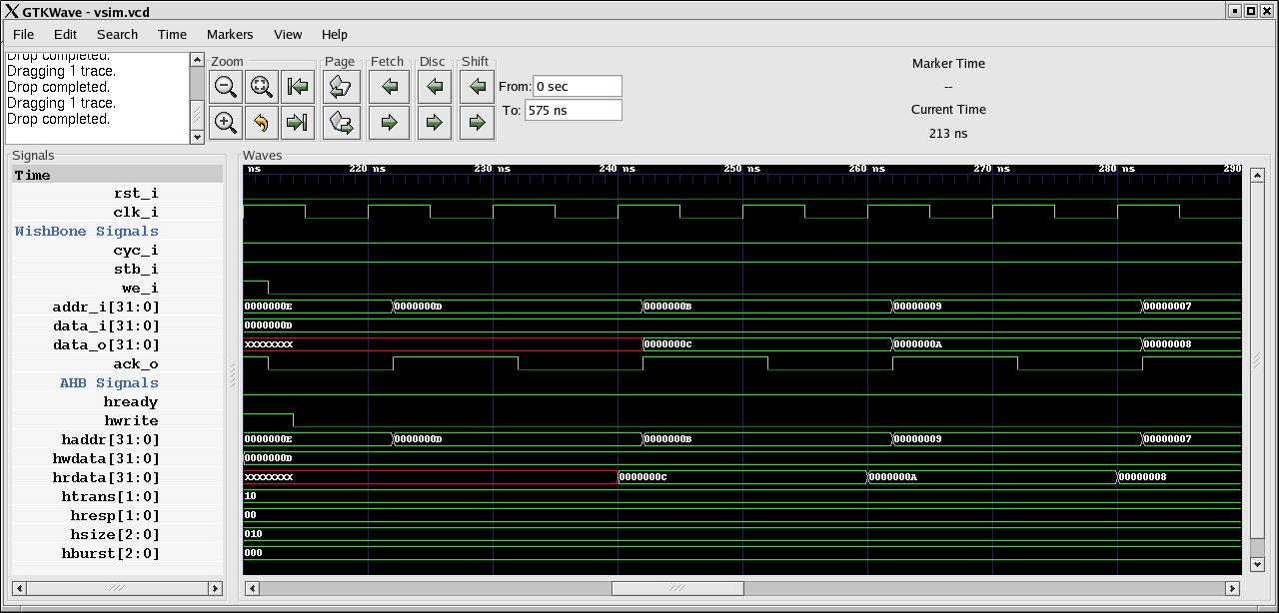
Read cycle

Slide 15
Synthesizability
This code is completely synthesizable.
The only care that has to be taken is that the AHB clock(hclk) and reset(hresetn) signals have been left unconnnected inside the design. The whole design is working on Wishbone clock and reset signals that should be provided by Wishbone master.

