Slide 1

TMA 1271
INTRODUCTION TO MACHINE ARCHITECTURE
Week 3 and Week 4
(Lecture 1 of 3)
CPU Structure
and Function

Slide 2
Topics To be Discussed - Week 3 and Week 4 (lecture 1)
Internal Structure of CPU - Requirements,blocks
Registers-user visible , control and status
Registers-Design issues(user visible)-GP/SP,no. of reg.,length/ (control/status) OS support,allocation of control information between Register or memory
Example - microprocessor register organization-Intel 8086, M68000
Instruction cycle - addition of indirect cycle
Data Flow-Fetch, Indirect and Interrupt cycles

Slide 3
Requirements placed on CPU(1)…...
CPU must:
  Fetch instructions – read instructions from memory
  Interpret instructions – decode instructions to determine what action is required
  Fetch data – execution of instruction may require reading data from memory or I/O module
  Process data – performing some arithmetic or logical operation on data
  Write data – writing data to memory or I/O module
Notes:
22

Slide 4
Requirements placed on CPU(2)
Needs to store some data temporarily
To remember the location of last instruction
store instructions and data temporarily while in execution
This means CPU needs a small internal memory - registers

Slide 5
INTERNAL STRUCTURE OF CPU(1)….
ARITMETIC AND LOGIC
UNIT
INTERNAL CPU BUS
Status flags
….
…..
REGISTERS
Shifter
Complementer
Arithmetic and
Boolean logic
CONTROL
UNIT
Control
paths

Slide 6
INTERNAL STRUCTURE OF CPU (2)
Small collection of major elements-ALU, register, control unit
ALU - actual computation or processing of data
Control unit - controls the movement of data and instructions into and out of CPU - controls the operation of ALU
Registers-minimal internal memory- set of storage locations
Internal CPU bus-transfer data between Registers and ALU

Slide 7
Registers
CPU must have some working space (temporary storage)
Called registers
Number and function vary between processor designs
One of the major design decisions
Top level of memory hierarchy - above cache and main memory - faster,smaller and more expensive as we go higher level
Two major types- user visible, control and status
No clear separation of register types
Notes:
23

Slide 8
User Visible Registers
Referenced by means of machine language that the CPU executes - programmable
General Purpose
Data
Address
Condition Codes
Notes:
24

Slide 9
General Purpose Registers
May be true general purpose-can contain the operand for any opcode
May be restricted - dedicated registers for floating point and stack operations
May be used for data or indirect addressing or displacement
Data registers - used only to hold data
  Accumulator
Address registers- general purpose or dedicated to address mode
  Segment register- holds the address of base of segment
  Index register-indexed addressing
  stack pointer -points to (Top of Stack) TOS - allows implicit addressing
Notes:
25

Slide 10
Design issues - Registers(1)…….
Whether to use completely general-purpose registers or specialize the use of registers
Make them general purpose
  Increase flexibility and programmer options Ex: B,C,D,E,H,L register in 8085
  Increase instruction size & complexity Ex. MOV B,C- two operand specifiers
Make them specialized
  Smaller (faster) instructions (operand specifier implicit). Ex.8085 Accumulator - ADD B, CMA instructions
  Less flexibility for the programmer. Ex: 8085 for an Arithmetic Or logic operation, restriction is one of the operand in accumulator
Notes:
26

Slide 11
Design issues - Registers(2)…….
Number of registers - general purpose or data plus address to be provided
affects instruction set design - more registers require more operand specifier bits
Between 8 – 32 - optimum
Fewer = more memory references
Approach finds advantage in the use of hundreds of registers - RISC systems ( Reduced Instruction Set Computer).
Notes:
27

Slide 12
Design issues - Registers(3)…….
Third issue - length of the register
Address registers -Large enough to hold full address
Data Registers - Large enough to hold full word
Often possible to combine two data registers
  contiguous registers for holding double-length values
  EX:8085 - BC,DE,HL registers - hold 16 bits of data
Notes:
28

Slide 13
Condition Code (flags)
Setting of individual bits by hardware as a result of operations
  e.g. result of last operation was zero - zero flag set
Can be read (implicitly) by programs -tested as a part of conditional branch instruction
  e.g. in 8085, JZ, JNZ,JP,JM,JPE,JPO,JC,JNC
Usually it can not be set by programs.
Usually form part of control register
some machines - user visible registers automatically saves as part of call and return
Some other machines - programmer explicitly/ manually store before branching or after branching
Notes:
29

Slide 14
Control & Status Registers
Most machines- not visible
Some machines - some visible to machine instructions operating in control or OS mode
Registers essential to instruction execution
-- Program Counter : contains the address of next instructions to be fetched
-- Instruction Register: contains the instruction most recently fetched
-- Memory Address Register: contains the address of a location in memory
-- Memory Buffer Register: contains a word of data to be written to memory or the word most recently read
Notes:
30

Slide 15
Program Status Word (PSW)
A set of bits
Includes Condition Codes and other status information
Sign of last result, Zero, Carry/borrow, Equal (logical compare ), Overflow
Interrupt enable/disable
Supervisor (whether CPU executing in supervisor or user mode - privileged instructions and accessing of certain areas of memory)
Notes:
31

Slide 16
Other Registers and Design issues
May have registers pointing to:
  Process control blocks (pointer to block of memory Of status information)
  Interrupt Vector Register ( vectored interrupt)
  System Stack pointer
  page table pointer ( with virtual memory systems)
  registers for control of I/O operations
Design issues
- OS support -register organization can be tailored to OS if designer has functional understanding of OS
- allocation of control information between Registers and memory - first few hundred or thousands words of memory for control purposes
Notes:
33

Slide 17

Example Register Organizations

Slide 18
Example Register Organizations - MC 68000
24 bit address bus - 16 bit data bus
32 bit registers - 8 data and 9 address registers
data registers - data manipulation(8,16,32 bit), index registers in addressing
Address registers-32 bit addresses , two stack pointers (supervisor,user)
32 bit Program Counter
16 bit status register-user byte (carry, overflow, zero, negative, extend), system byte (Interrupt mask(3),S indicator,trace)
very regular instruction set - with no special purpose registers

Slide 19
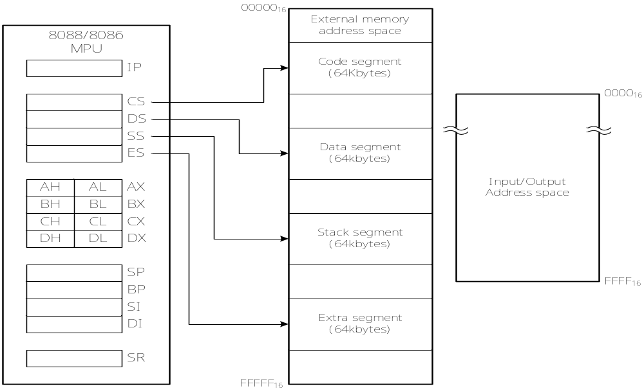
Example - Intel 8086- Memory Organization
20bit address bus and 16 bit data bus (AD0-AD15) and (A16-A19)
Two consecutive bytes in memory form word-address of LSB is the word address (Ex. Address 02H-0FH,03H-A5H, then contents of word is A50FH)
Slides adapted from tan wooi haw’s lecture notes (FOE)
The software model above illustrates the software architecture of the 8086 microprocessor

Slide 20
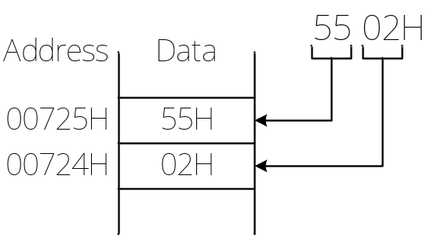
Example - Intel 8086 ( Memory Address Space & Data Organization)
The 8086 supports 1Mbyte of external memory
The memory space is organized as individual bytes of data stored at consecutive addresses over the address range 00000₁₆ to FFFFF₁₆ (or 00000H to FFFFFH)
Two consecutive bytes can be accessed as one word (16 bits) of data
The lower-addressed byte is the least significant byte of the word, and the higher-addressed byte is its most significant byte (little endian format)
For e.g. Storing 1 word 5502H in the memory:

Slide 21
Example - Intel 8086 ( Memory Address Space & Data Organization)
Words of data can be stored at either even or odd-address boundary
A word at an even-address boundary corresponds to 2 consecutive bytes, with the lower byte located at an even address (the LSB is 0)
A word stored at an even-address boundary (00000H, 00002H, 00004H etc) is said to be an aligned word
A word stored at an odd address boundary (00001H, 00003H, 00005H etc) is called misaligned word

Slide 22
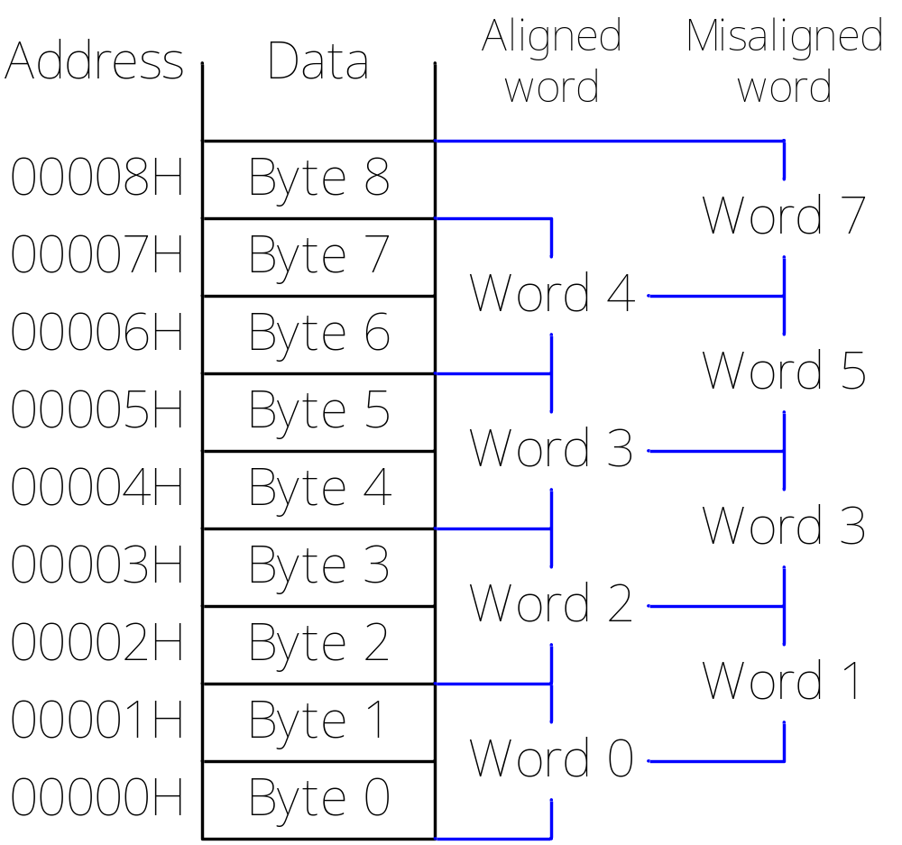
Example - Intel 8086 ( Memory Address Space & Data Organization)

Slide 23
Example – Intel 8086 (Register Organizations)
The model includes 13 16-bit registers:
i. Four segment registers (CS, DS, SS and ES)
ii. One Instruction pointers
iii. Four data registers (AX, BX, CX and DX)
iv. Two pointer registers (BP and SP)
v. Two index registers (SI and DI)
vi. In addition, there is another register called Status Register (SR), with nine of its bits implemented as status and control flags
The 8086 architecture implements independent memory and input/output address spaces
The memory address space is 2²⁰ = 1,048,576 bytes (1Mbytes) in size and the I/O address space is 2¹⁶ = 65,536 bytes (64Kbytes) in size

Slide 24
Example – Intel 8086 (Register Organizations) cont.
Segment Registers & Memory segmentation
The 8086 has 1Mbyte address space, but not all is active at one time
The 1Mbytes of memory are partitioned into segments
One segment represents an independently addressable memory locations of 64K consecutive bytes (64Kbytes per segment)
Each segment is assigned a base address (starting address)
Only 4 segments are active at one time:
code segment, stack segment, data segment, extra segment
The segments that are active are identified by the values of four segment registers:
CS, SS, DS and ES

Slide 25
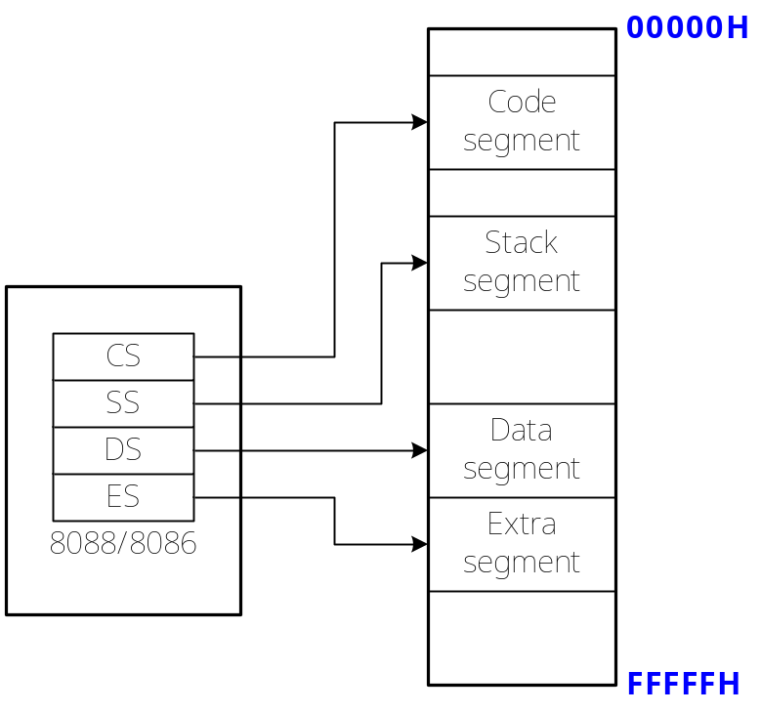
Example – Intel 8086 (Register Organizations) cont.
This gives a maximum of 256Kbytes of active memory:
i. 64Kbytes for program storage (code segment)
ii. 64Kbytes for stack (stack segment)
iii. 128Kbytes for data storage (data and extra segment)

Slide 26
Example – Intel 8086 (Register Organizations) cont.
CS (Code Segment) register
- selects the segment from which instructions of the program are fetched and executed
SS (Stack Segment) register
- selects the segment to be used as a stack
DS (Data Segment) register
- selects the segment in which data are to be processed by the MPU are stored
ES (Extra Segment) register
- selects a second 64Kbyte segment for data storage
The segment registers are user accessible (their value can be changed using software)
Therefore, to gain access to another part of memory, simply change the value of the appropriate registers

Slide 27
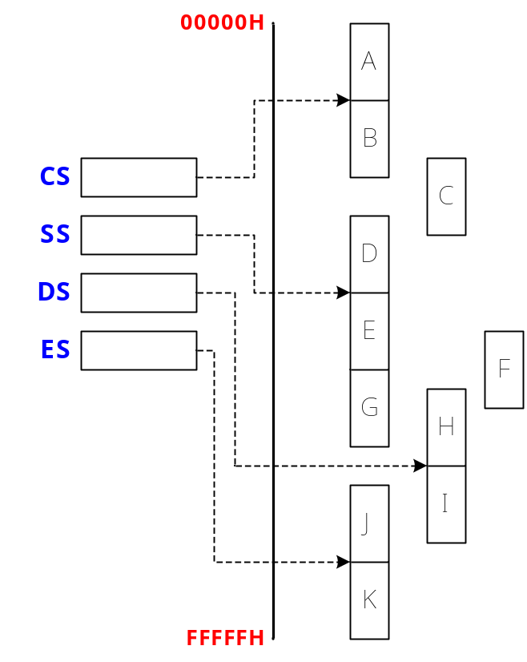
Example – Intel 8086 (Register Organizations) cont.
Segments can be contiguous (adjacent), disjointed or overlapping
For e.g., A and B are contiguous, B & C are overlapping, B and D are disjointed
Can you give examples of segments that are contiguous, overlapping or disjointed?

Slide 28
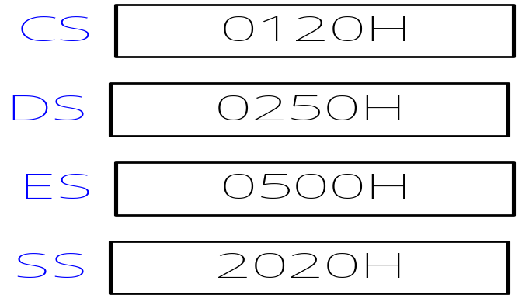
Example – Intel 8086 (Register Organizations) cont.
One restriction of the segment base address: only the upper 4 hexadecimal digit of the address can be changed (these 4 digits are the values inside the segment registers)
Examples of valid base addresses are 00000H, 00010H, 00020H etc.
E.g. Determine the segment base addresses of the code segment, data segment, extra segment and stack segment if the contents of the segment registers are as shown below.

Slide 29
Example – Intel 8086 (Register Organizations) cont.
Instruction Pointer
Instruction Pointer (IP) is a 16-bit register that identifies the location of the next instruction to be fetched from the current code segment (depends on CS)
It contains the offset of the next instruction instead of its actual address
IP and CS are both 16-bit registers, but a 20-bit address is needed to access memory
The offset in IP is combined with the code segment base address in CS to generate the address of the next instruction (denoted as CS:IP)
Every time an instruction is fetched from memory, 8088/8086 updates its IP by incrementing it by two (to the address of the next instruction)
To change the active code segment, just load the new value in CS register

Slide 30
Example – Intel 8086 (Register Organizations) cont.
Data Registers
8088/8086 has four general purpose data registers:
i. A - Accumulator register
ii. B - Base register
iii. C - Count register
iv. D - Data register
During program execution, they hold the frequently accessed values or results
All general purpose data registers can be used as the source or destination of an operand during arithmetic operations (e.g. ADD) or logic operations (e.g. AND).
The advantage of storing these data in internal registers instead of memory is that they can be accesses much faster

Slide 31
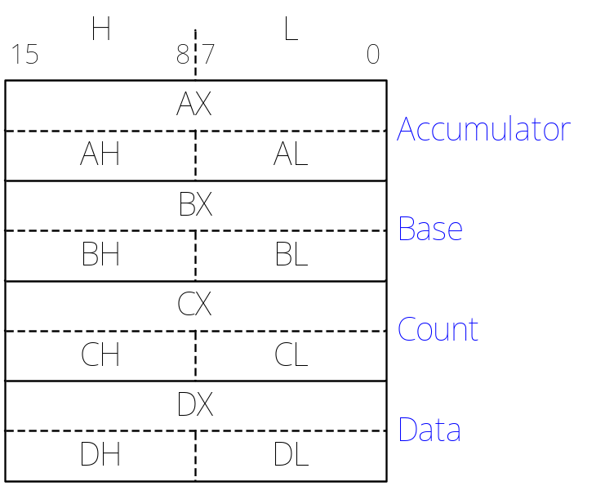
Example – Intel 8086 (Register Organizations) cont.
Each of these registers can either be accessed as a whole (16 bits) or as two 8-bit registers
An X after the register letter identifies the reference of a register as a word (16 bits)
On the other hand, when referencing one of these registers on 8-bit basis, the register name is followed by the letter H or L, identifies the high byte or low byte.
Each 16-bit data register can be further divided into 2 8-bit registers. Can you give an example?

Slide 32
Example – Intel 8086 (Register Organizations) cont.
Pointer and Index Register
There are four other general-purpose registers:
i. Two pointer registers
- Base Pointer (BP) and Stack Pointer (SP)
ii. Two index registers
- Source Index (SI) and Destination Index (DI)
These registers store offset address, which represents the displacement of a storage location in memory from the segment base address (value in segment registers)
They are used as pointer or index to select a specific location within a 64Kbyte segment
Index registers are used to refer to data in memory relative to data segment or extra segment

Slide 33
Example – Intel 8086 (Register Organizations) cont.
Pointer registers are used to access memory locations relative to the stack segment
The value held inside these registers can be read, loaded or modified through software
Unlike data registers, the pointer and index registers can only be accessed on 16-bit basis

Slide 34
Example – Intel 8086 (Register Organizations) cont.
Status Register
The status register (also called flags register), is a 16-bit register within 8088/8086
Only 9 bits of this register are used
X
X
X
X
OF
DF
IF
TF
SF
ZF
X
AF
X
PF
X
CF
Flag register of 8086

Slide 35
Example – Intel 8086 (Register Organizations) cont.
6 status flags: carry flag (CF), parity flag (PF), auxiliary carry flag (AF), zero flag (ZF), sign flag (SF) and overflow flag (OF)
The logic state of these flags indicate conditions that are produced as the result of executing an instruction
Carry flag (CF): CF is set (1) if there is a carry out or borrow in for the most significant bit of the result when executing an instruction; otherwise, CF is cleared (0)
Parity flag (PF): PF is set (1) if the result produced by an instruction has even parity (even number of 1); otherwise, PF is cleared (0)
Auxiliary carry flag (AF): AF is set (1) if there is a carry-out from the low nibble into the high nibble or a borrow-in from the high nibble into the low nibble of the lower byte in a 16-bit word; otherwise, AF is cleared (0)
Zero flag (ZF): ZF is set (1) if the result of an instruction is zero; otherwise, ZF is cleared (0)

Slide 36
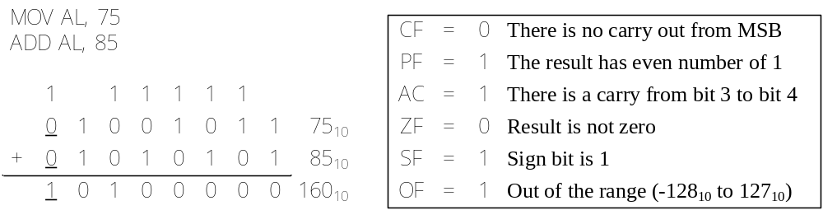
Example – Intel 8086 (Register Organizations) cont.
Sign flag (SF): The MSB of the result is copied into SF. Thus, SF is set (1) is the result is a negative number or cleared (0) if it is positive.
Overflow flag (OF): When OF is set, it indicates that the signed result is out of range. If the result is not out of range, OF remains reset
E.g. Consider executing the following instructions:

Slide 37
Example – Intel 8086 (Register Organizations) cont.
Another 3 bits are known as Control Flags: direction flag (DF), interrupt enable flag (IF) and trap flag
Trap flag (TF): If TF is set (1), the 8088/8086 goes into single-step mode of operation (for program debugging)
Interrupt flag (IF): If IF is set (1), the maskable interrupt is enabled. Otherwise, the maskable interrupt is disabled
Direction flag (DF): This flag determines the direction of string operations; if DF is set (1), string data is transferred from high address to low address; otherwise, the string data is transferred from low address to high address

Slide 38
Example – Intel 8086 (Register Organizations) cont.
Generating memory address
A segment base and an offset describe a logical address
Both segment base and offset are 16-bit quantities (since all registers are 16 bits long)
However, the physical address used to access memory is 20 bits
Generation of physical address involves combining a 16-bit offset (either in IP, BX, SI, DI, BP or SP) and a 16-bit segment base value in one of the segment registers (CS, SS, DS or ES)
In fetching an instruction, the segment base value is always the code segment (CS) register, the offset value is always the instruction pointer
Thus, the physical address of next instruction is CS:IP

Slide 39
Example – Intel 8086 (Register Organizations) cont.
In accessing a data in the memory, the segment value is typically in the data segment (DS) and the offset value is given by source index register (SI) for reading, and destination index register (DI) for writing
The physical address is therefore DS:SI (read) or DS:DI (writing)
Segment-override prefix can be used to change the segment from which the variable is accessed; for e.g. change the default segment to extra segment (ES)
To access data in the stack (temporary storage area in memory), the physical address is formed by combining the values in stack register (SS) with stack pointer (SP), which is SS:SP

Slide 40
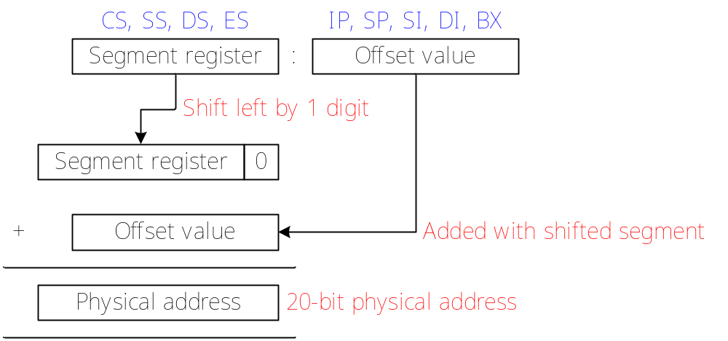
Example – Intel 8086 (Register Organizations) cont.
The physical address is generated as shown below:

Slide 41
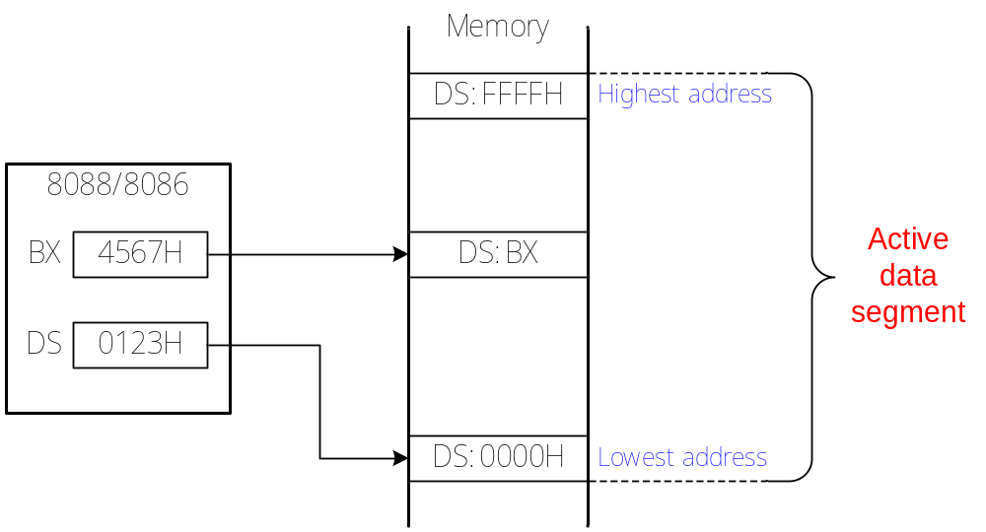
Example – Intel 8086 (Register Organizations) cont.
E.g. Find the physical address of the data at logical address DS:BX, as well as the physical addresses of the lowest byte and the highest byte of the active data segment.
Physical address of DS:BX  01230H + 4567H = 05797H
Physical address of lowest and highest bytes: 01230H, 1122FH

Slide 42
Example – Intel 8086 (Register Organizations) cont.
E.g. What would be the offset required to map to physical address location 002C3H if the contents of the corresponding segment register are 002AH?
Different logical addresses may be mapped to the same physical address
E.g. Consider the logical address 0010:0051, 0012:0031, 0001:0141 and 0000:0151, are they referring to the same physical address?

Slide 43
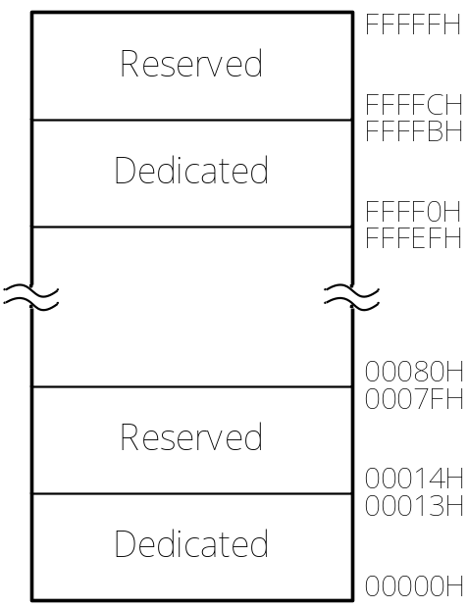
Example – Intel 8086 (Register Organizations) cont.
Any part of the 8088/8086’s 1Mbyte address space can be used to store data or program
However, some address locations have dedicated functions and should not be used
The following diagram shows the reserved, dedicated-use and general-use parts of 8088/8086 address space

Slide 44
Example – Intel 8086 (Register Organizations) cont.
The dedicated locations from 00000H to 00013H are used to store pointers for 8088/8086 internal interrupts
The reserved locations from 00014H to 0007FH are used to stored pointers for user-defined interrupts
The address space from 00080H to FFFEFH is general-use memory where data and program instructions are stored
The address space from FFFF0H to FFFFBH are dedicated to functions such as storage of hardware reset jump instruction (FFFF0H is where the 8088/8086 begins execution after receiving a reset)
The address space FFFFCH to FFFFFH are reserved for future products and should not be used

