Slide 1
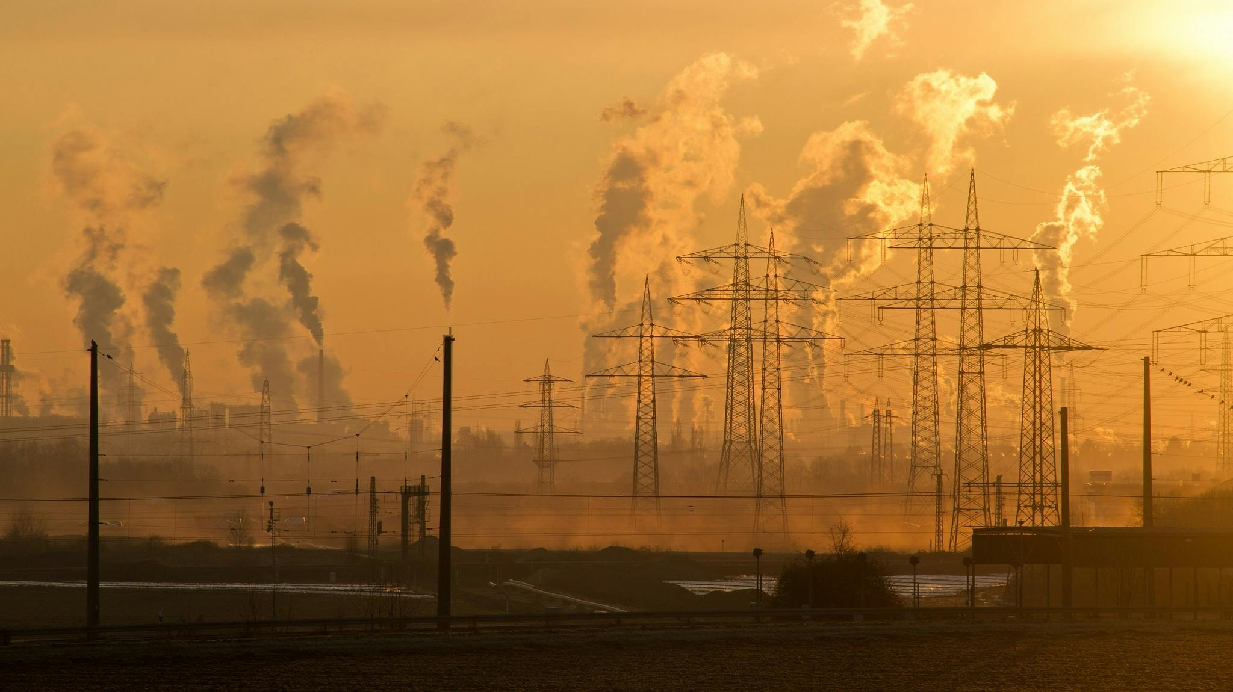
AEROSENSE

Slide 2
ZOEO
Members:
Padmajaa Sridhar-Shiv Nadar University Chennai
Jayashre K-Shiv Nadar University Chennai
Harshitha R S-Shiv Nadar University Chennai
Mridulla.K.Madhu-Shiv Nadar University Chennai 7824806660

Slide 3

Problem Statement: Air Quality Monitoring and Prediction
Objective: Develop an AI system for continuous air quality monitoring and prediction.
Outcome: Actionable measures to protect resident health from poor air quality.
Goal: Enhance public health.

Slide 4
Solution description

Slide 5

Techical architecture

Slide 6
Visual diagram

Slide 7
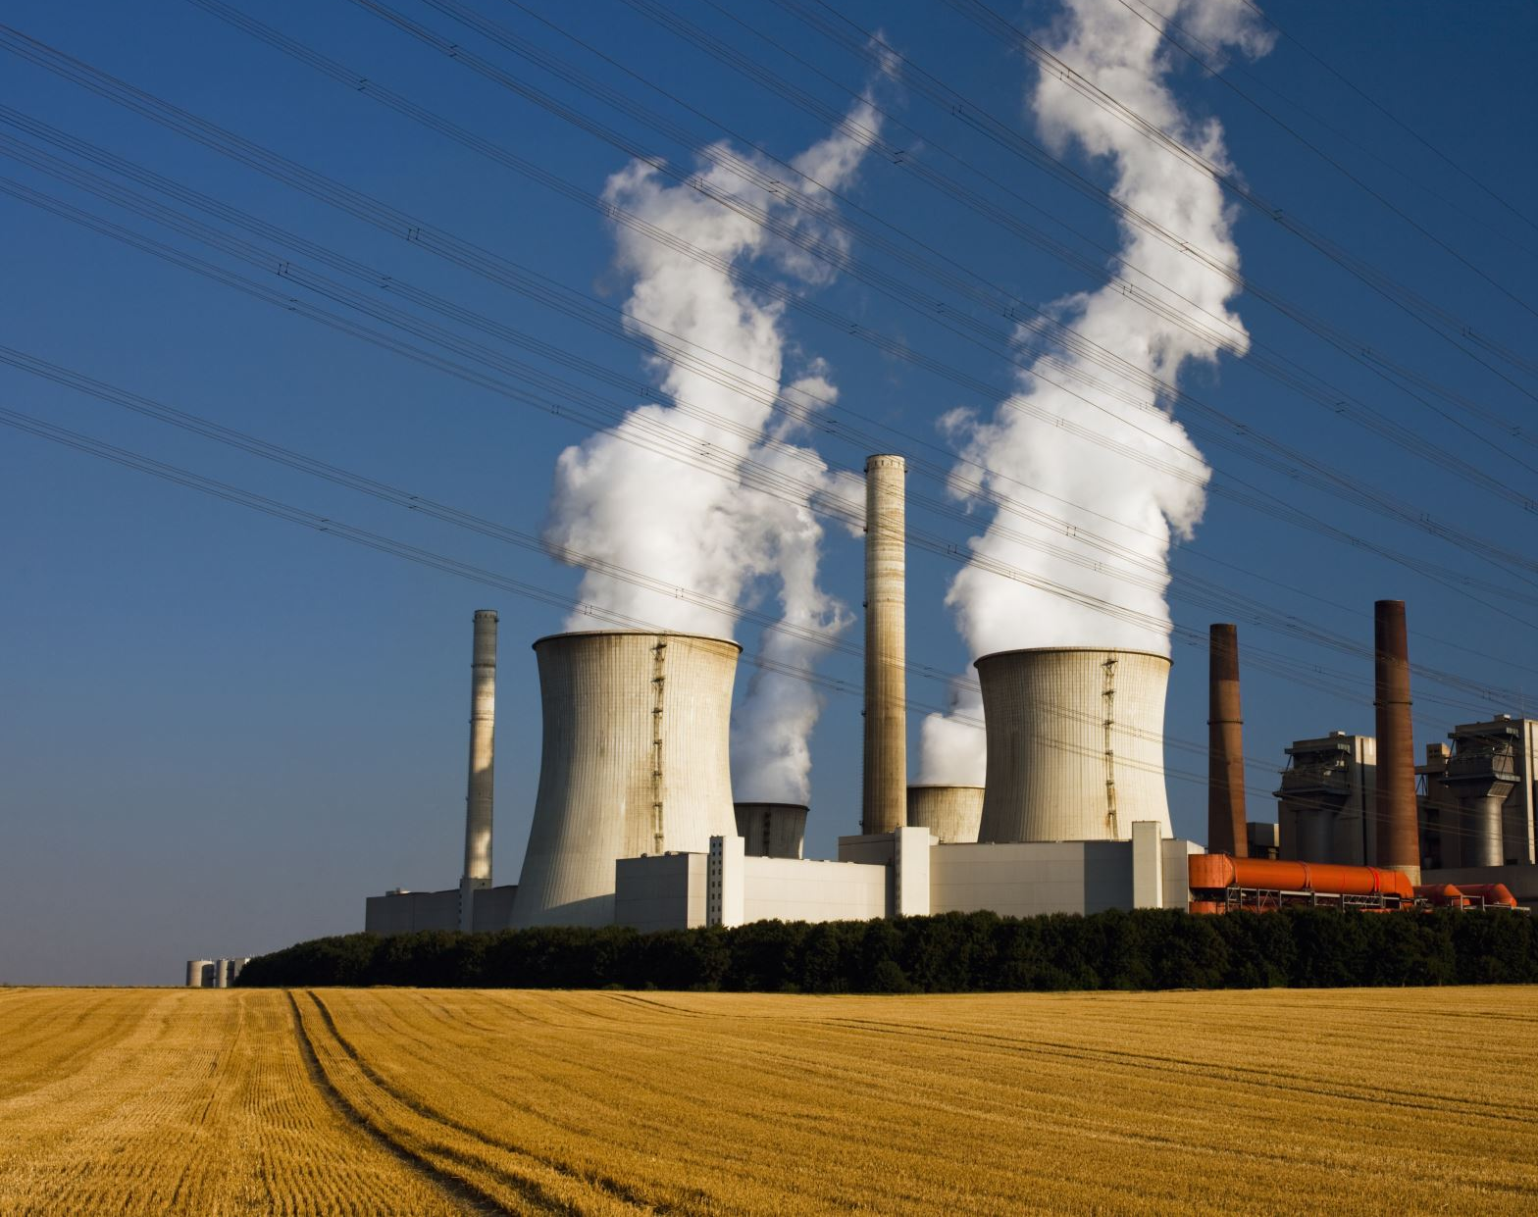
Social economic and ecological impact

Slide 8

Integration with existing ecosystem

Slide 9

Future potential

Slide 10

Intel Libraries,Frameworks & Performance Improvemnets

