Slide 1
HACKSTORM: INTEL® AI PC EDITION

Slide 2
TEAM DETAILS
Team Name: Definox
Team Members: Jayashre – jaya2004kra@gmail.com
Manufacturing
Theme: AI Driven Solutions for Industry 4.0
FactoryDefectAI: Optimizing defect detection with Intel® AI stack for Industry 4.0

Slide 3


PROBLEM STATEMENT
Problem Statement
Traditional manufacturing relies on manual visual inspections for defect detection, which are slow, error-prone, and resource-heavy. This process is inefficient and struggles to keep up with the demands of high-speed production lines.
Impact
As a result, defects often go undetected, impacting product quality, leading to consumer dissatisfaction and potential costly recalls. In resource-constrained environments, human inspections are unfeasible, and real-time detection is critical to maintain efficiency and scalability in modern factories.

Slide 4



MOTIVATION/STATS/REFERENCES
Industry 4.0 and AI
The rise of Industry 4.0 demands AI-driven solutions to enhance manufacturing precision, speed, and cost-effectiveness. AI-powered defect detection transforms quality control, automating processes that were previously manual and error-prone.
AI solutions can offer greater scalability and reliability, enabling predictive maintenance and real-time decision-making.
Defect Detection Impact
30% of manufacturing defects go undetected using traditional visual inspection methods, leading to poor product quality and increased operational costs (Source: Industry Report on AI in Manufacturing, 2023).
AI-based defect detection can improve detection rates by over 50%, reducing downtime, human error, and resource wastage (Source: McKinsey & Company).
Edge AI enables real-time processing on-site, minimizing latency, optimizing throughput, and significantly improving operational efficiency.
Market Growth
AI in manufacturing is expected to grow at a CAGR of 37% from 2023 to 2028, highlighting a rapid shift toward automation and AI adoption (Source: MarketsandMarkets, 2023).

Slide 5
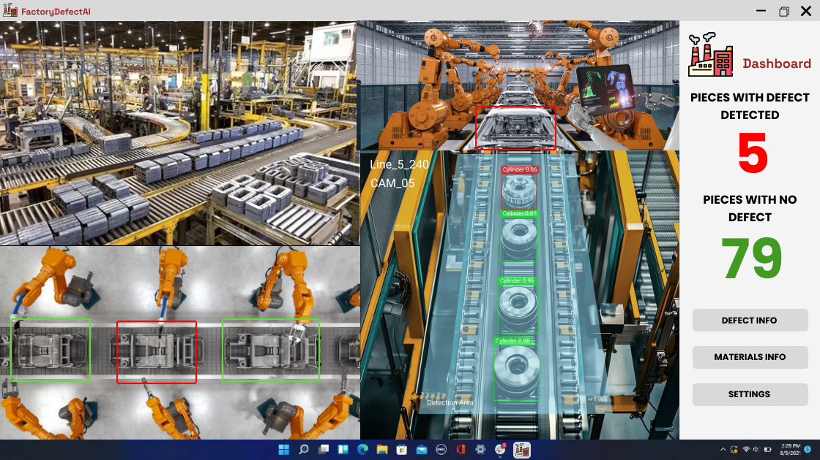
PROPOSED SOLUTION/ARCHITECTURE
Overview
Solution Architecture
Deploy Edge AI on Intel® AI PC, leveraging Intel® OpenVINO™ Toolkit for real-time defect detection.
Utilize Intel®/dpt-large for depth estimation to detect surface and internal defects from multiple angles.
Image Capture: Multi-angle image capture using high-resolution cameras.
Data Preprocessing: Preprocess images with Intel® AI Analytics Toolkit (e.g., resizing, normalization).
Defect Detection Model: Deep learning model for defect detection, optimized with OpenVINO™ for faster inference.
Intel®/dpt-large for depth analysis to identify internal vs. surface defects.
Edge Deployment: Process on Intel® AI PC for minimal latency and improved throughput.
Result Display: Real-time defect severity shown on the dashboard for quick decisions.

Slide 6



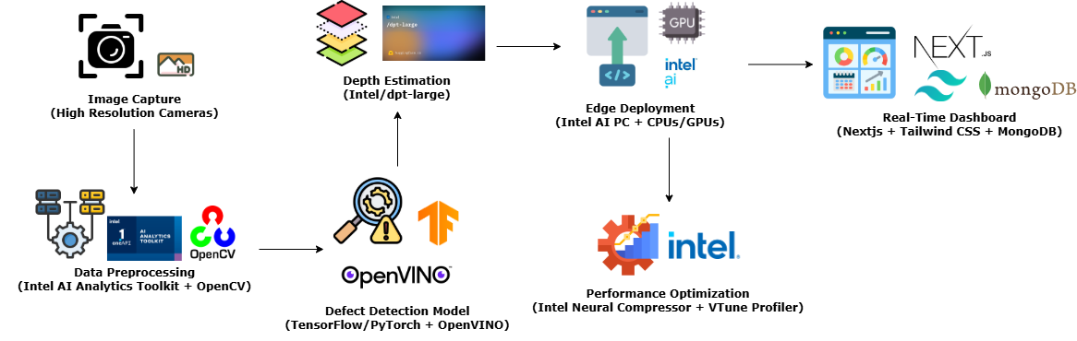
TECH STACK
Hardware
Software
Intel® AI PC for real-time edge processing.
Intel® CPUs/GPUs (for model inference and AI task execution).
Intel® Distribution of OpenVINO™ Toolkit: Optimizes AI models for inference.
Intel®/dpt-large: Depth estimation for multi-angle inspections.
Intel® AI Analytics Toolkit: Data preprocessing, model analytics.
Intel® Neural Compressor: Post-training model optimization.
Intel® Developer Cloud: For model training and prototyping.
Intel® VTune™ Profiler: Performance profiling and optimization.
Frameworks
TensorFlow/PyTorch for model training.
OpenCV for image processing and feature extraction.
Prototype Link
Prototype Showcase: https://youtu.be/Dp58JsgqvUU
Deployment: https://factory-defect-ai.vercel.app/

Slide 7
ASSUMPTIONS
Hardware: The solution assumes access to Intel® AI PC or equivalent edge devices with sufficient compute power for real-time AI inference.
Data Availability: Sufficient labeled data from manufacturing processes to effectively train and validate the defect detection model.
Real-Time Performance: The AI model will be optimized for low-latency, real-time inference on edge devices.
Network Constraints: The solution will function in environments with limited or intermittent internet connectivity, relying on local edge processing.
Scalability: Designed to scale across multiple machines or factory lines, maintaining efficiency and minimal overhead.

Slide 8


NOVELTY AND EXPECTED RESULTS
Novelty
Expected Results
Real-time Defect Detection with AI at the Edge: The solution utilizes Intel® AI Stack (OpenVINO™ and Intel®/dpt-large) for high-performance AI inference directly on the edge device, ensuring immediate feedback with minimal reliance on cloud resources.
Depth Estimation and Multi-Angle Inspection: By integrating depth estimation with multi-angle product inspection, this solution goes beyond surface-level defect detection, offering more comprehensive and accurate results, setting it apart from traditional systems.
Edge Deployment: Unlike conventional systems that rely on centralized cloud servers, this solution leverages edge computing, ensuring faster, more reliable defect detection even in environments with limited or unstable connectivity. This enables real-time decision-making with minimal latency.
Enhanced Accuracy: The use of Intel® OpenVINO™-optimized AI models enhances detection precision, making defect identification more reliable, even in complex and fast-moving production lines.
Reduced Latency: Real-time processing on the Intel® AI PC ensures that defects are detected with near-instantaneous response times, critical for high-speed manufacturing, where delays can lead to significant losses.
Operational Efficiency: Automating the defect detection process eliminates human error, reduces inspection time, and accelerates production cycles, leading to higher throughput and reduced operational costs.
Scalability: This solution can be easily expanded across multiple production lines or manufacturing plants. Its scalable architecture ensures that as production grows, the defect detection system can handle increased demand without sacrificing speed or accuracy, improving overall factory productivity.

Slide 9
Thank you
Team Name: Definox
Team Members: Jayashre – jaya2004kra@gmail.com
Manufacturing
Theme: AI Driven Solutions for Industry 4.0
FactoryDefectAI: Optimizing defect detection with Intel® AI stack for Industry 4.0

