Slide 1

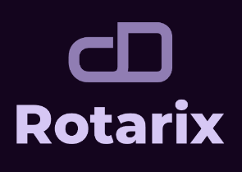



st
Hack Vortex 2025
Viva Institute of Technology Mumbai
Rotarix: AI-Powered, Quantum-Resistant Key Rotation for Next-Gen Security
:
TEAM NAME JNR
INSITUTION : Shiv Nadar University, Chennai
: Cybersecurity
TRACK THEME
: Jayashre (TL), Nidhi Gummaraju, Roahith R
TEAM MEMBERS

Slide 2




ABOUT TEAM
JNR
Jayashre K
Nidhi Gummaraju
Roahith R

Slide 3









PROBLEM STATEMENT
In 2017, Equifax, one of the largest credit reporting agencies, experienced a catastrophic data breach exposing sensitive information of approximately 147 million individuals. A significant factor contributing to this breach was poor key rotation practices and the use of weak encryption protocols, which allowed attackers to bypass encryption and access unprotected data.
Current Key Rotation Challenges:
Need for Smarter Solution:
Predictable & Manual – Static schedules make rotations easy targets for attackers.
AI-Driven Rotation – Adaptive, risk-based key updates for real-time security.
Compliance Hassles – Meeting PCI-DSS, GDPR, HIPAA is tough with outdated methods.
Quantum-Resistant Crypto – Future-proof encryption against emerging threats.
Quantum Threats – Future quantum attacks could break existing encryption.
Zero-Trust & Auditability – Immutable logs & no blind trust in any entity.

Slide 4


ABSTRACT
Rotarix is an AI-powered, quantum-resistant key rotation system that enhances security by dynamically adjusting key lifetimes based on risk levels. Unlike traditional fixed-interval rotations, Rotarix uses machine learning to predict threats, ensuring proactive key updates. It integrates blockchain-backed auditability, multi-cloud compatibility, and post-quantum cryptography to deliver a future-proof, zero-trust security model.
Key Innovations
AI-driven key rotation based on anomaly detection
Quantum-resistant cryptographic algorithms (e.g., CRYSTALS-Kyber)
Blockchain-backed immutable audit logs
Self-healing keys & dynamic MFA adapt instantly to threats.
Zero-trust access control

Slide 5
HOW IT DIFFERS FROM THE EXISTING SYSTEM
Feature
Traditional Key Rotation
Rotarix (Our
Proposed Solution)
Rotation Method
Fixed Time-Based
AI-Driven, Adaptive
Threat Response
Delayed
Real-Time Detection & Response
Quantum Resistance
No
Yes (Post-Quantum Cryptography)
Auditability
Centralized Logs
Blockchain-Based Immutable Logs
Security Model
Static
Zero-Trust & Dynamic

Slide 6
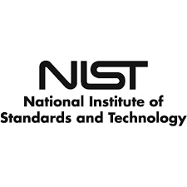
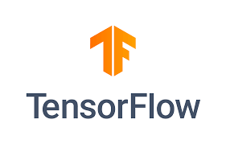





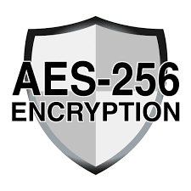






COMPONENTS USED / SOFTWARE TOOLS
AI/ML
Blockchain
Security Framework
(for anomaly detection)
(immutable key logs)
Cryptography
Key
Management
Database
(quantum-resistant keys)
(for secure key storage)

Slide 7
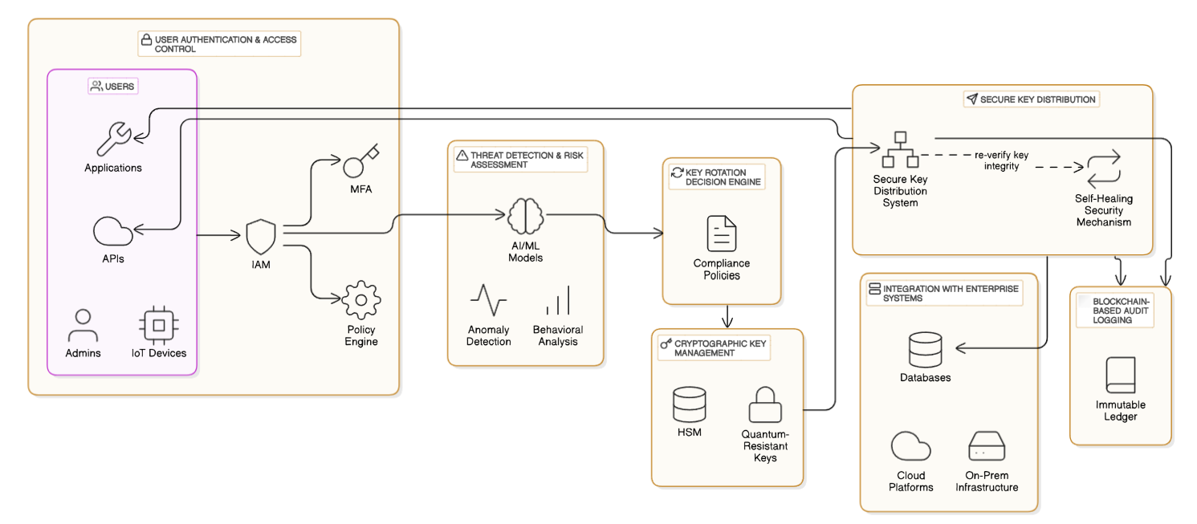
ARCHITECTURE DIAGRAM

Slide 8
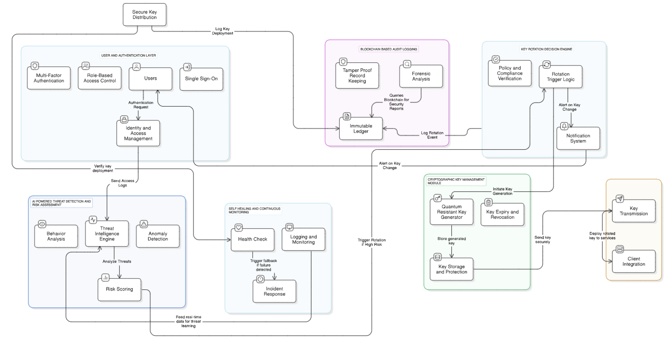

BLOCK DIAGRAM

Slide 9
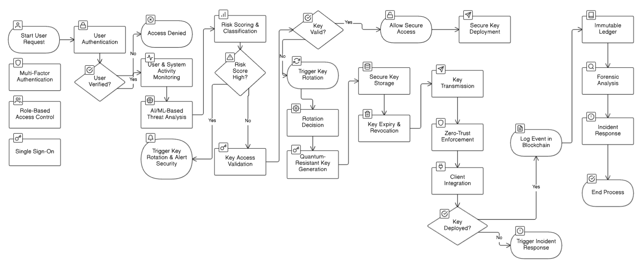
FLOW CHART

Slide 10






METHODOLOGY
Risk-Based Key Rotation: AI-driven models analyze real-time threat levels to trigger key rotation dynamically.
Quantum-Resistant Encryption: Integrates CRYSTALS-Kyber and AES-256 to future-proof against quantum attacks.
Immutable Key Logs: Blockchain ensures tamper-proof logging of key rotations for transparency and auditability.
Zero-Trust Authorization: Access control enforced with multi-factor authentication and contextual verification.
Automated Anomaly Detection: Machine learning detects suspicious activity and initiates proactive security measures.
Efficient Key Lifecycle Management: Secure generation, storage, rotation, and revocation of cryptographic keys.

Slide 11



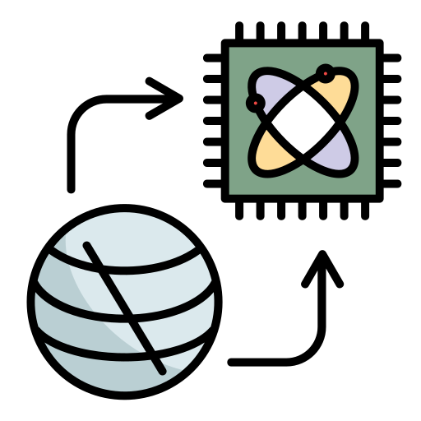
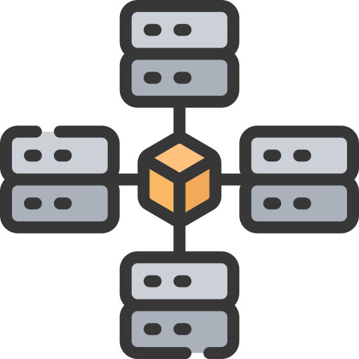




IMPLEMENTATION
Real-World Implementation
Enterprise & Finance: Automates key management for compliance and secure transactions.
Government & Defense: Protects sensitive data from cyber and quantum threats.
Healthcare:
Secures patient records
and integrates with
DevOps pipelines.
Future Impact
Quantum-Resistant Security:
Adapts encryption for evolving threats.
Decentralized Key Management:
Eliminates single points of failure.
Self-Healing Security:
Detects and mitigates key compromise in real-time.
AI-Driven Automation: Predicts risks and rotates keys autonomously.
IoT & Smart Devices:
Scales for lightweight, secure key rotation.
Global Standards & Compliance:
Shapes future cryptographic security frameworks.

Slide 12
PROS AND CONS
PROS
CONS
AI-driven, adaptive security against evolving threats
Prepares for quantum computing risks
Blockchain-backed audit trail ensures transparency
Seamless integration with cloud security tools
Complies with security standards (GDPR, HIPAA, PCI-DSS)
Higher computational cost due to AI and quantum-resistant encryption
Requires integration with existing enterprise security systems
Blockchain storage costs for audit logs

Slide 13
CONCLUSION
🔑 Rotarix transforms key management with AI, quantum-resistant security, and blockchain-based auditability. By proactively rotating cryptographic keys based on risk, it eliminates predictability, enhances compliance, and future-proofs security infrastructure.
Future Score
Expanding AI models for real-time attack prevention
Enhancing post-quantum security with newer encryption techniques
Scaling for IoT & edge computing security
THANK YOU!!

