Slide 1

Basic Details of the Team and Problem Statement
Ministry/Organization Innovation:
National Technical Research Organization, NTRO
PS Code: 1446
Problem Statement Title: Creating a flexible GUI-based hardening script for Ubuntu to align with organizational security policies
Team Name: PenGUIn
Team Leader Name: Adithya A
Institute Code: U – 1153
Institute Name: Shiv Nadar University, Chennai
Theme Name: Scripting/Software Development

Slide 2
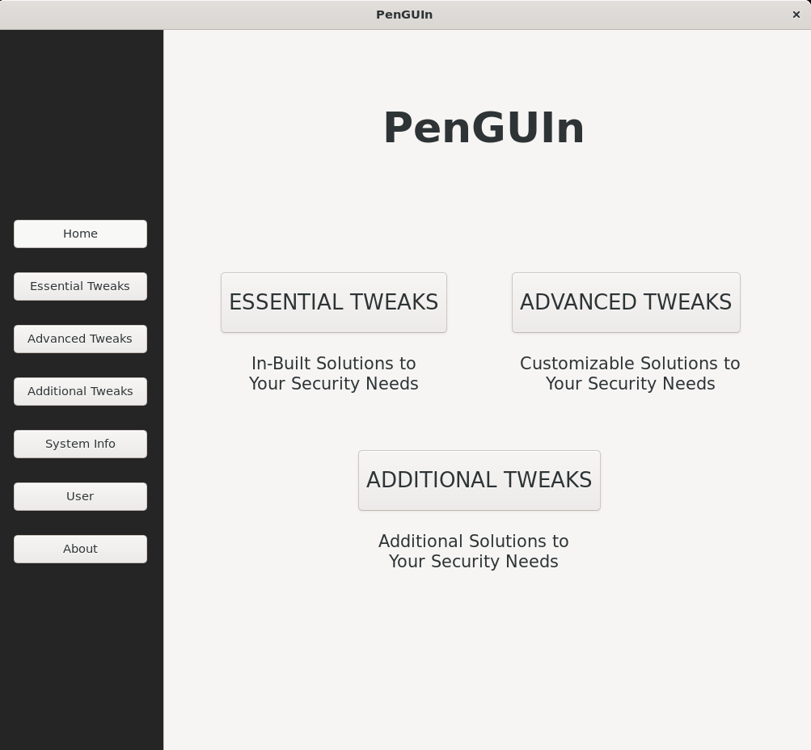
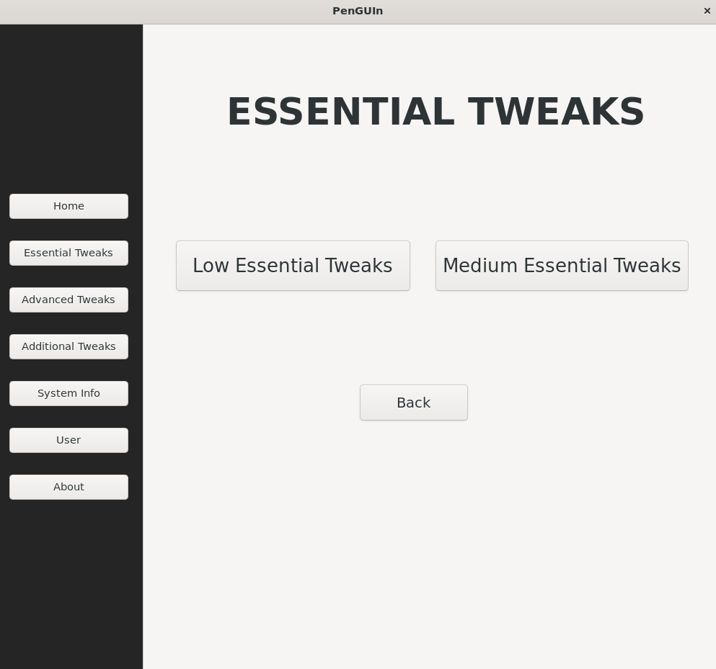
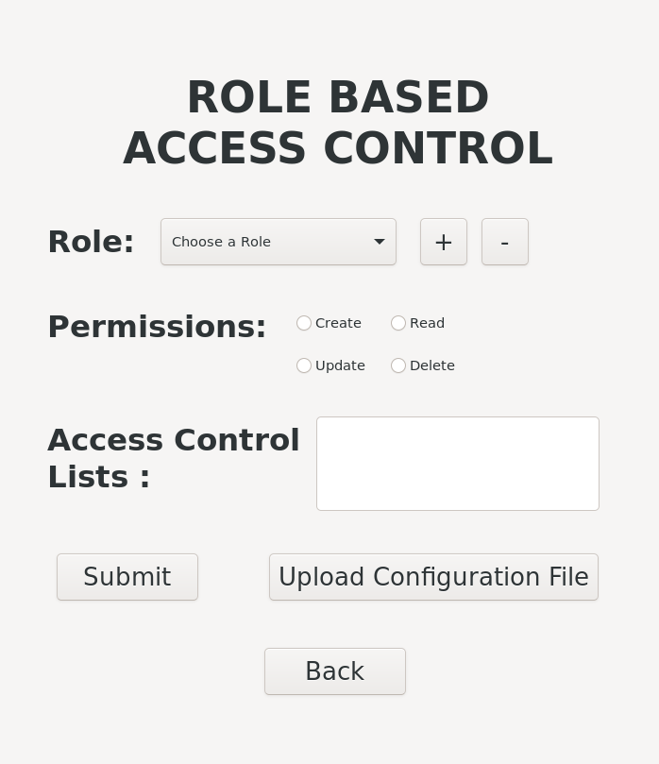
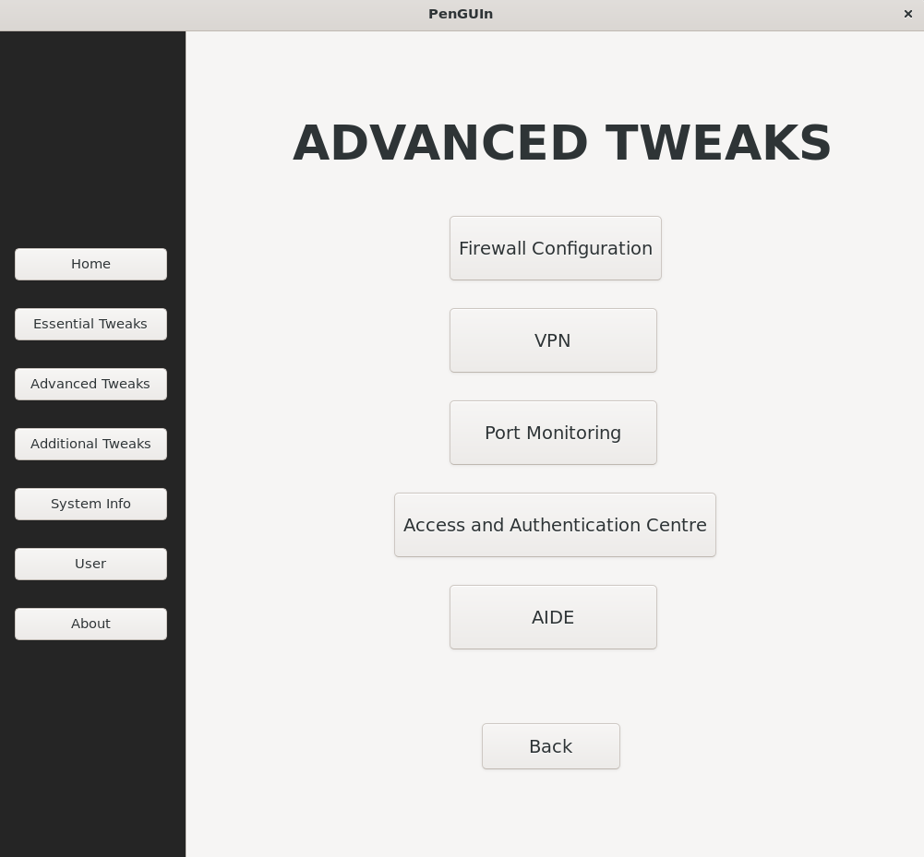
Our Solution
TECHNOLOGY STACK:
Bash Scripting
GTK : Graphical User Interfaces
PyGTK: GTK Programs in Python
SQLite
User-Friendly Linux app with GUI for simplified OS hardening.
Simplified application usage, eliminating the need to type complex scripts.
Essential, Advanced and add-on options for diverse security needs.
Modular design for User Selected options.
Key security measures: Blocking SSH, TOR and USB ports.
Streamlined one click USB blocking.
Tor Exit node Blocking (Using Iptables).
Essential Mode serves as an in-built solution to meet your primary security requirements, offering two distinct modes for minimal hardening and complete hardening.
Customize security options with ease in advanced mode, where common security features are accessible with just one click or minimal user interaction.
Additional Tweaks offer one-click cache cleaning, temporary files deletion and update checker
Main Frame
Essential Tweaks Frame
Sample User Input Model
Additional Tweaks Frame

Slide 3
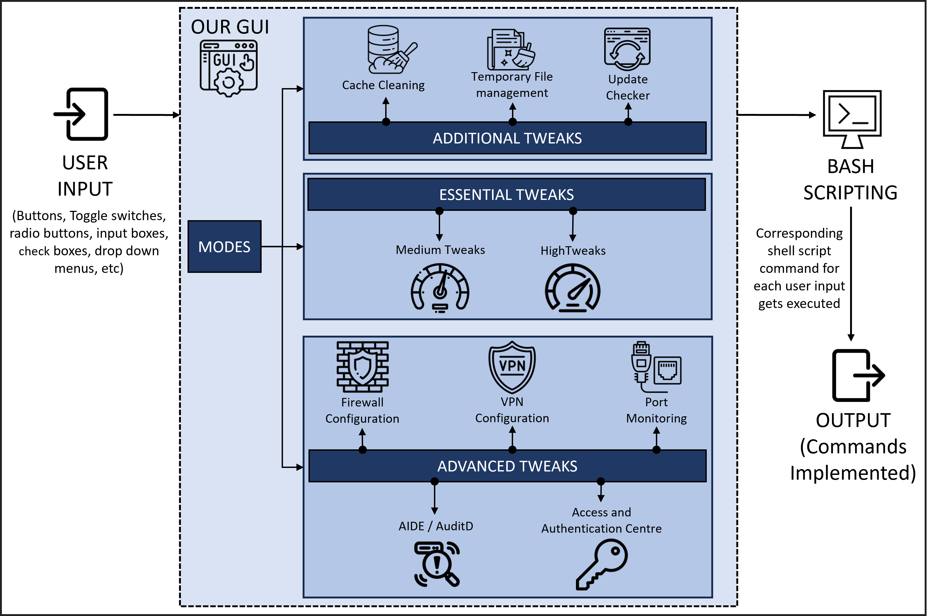
Approach
OUR APPROACH:
AIDE's GUI simplifies file integrity checks for root users by toggling the '--check' command.
Every user in the organization, will be notified to change their password every 30 days once.
It establishes an SSH connection to the desired system by typing the required IP.
The Update Checker will update all of the libraries and packages.
DEPENDENCIES/SHOWSTOPPER:
Ensure GUI security updates are regularly performed by developers.
Enforce ROLE-Based access control in the GUI for authorized actions by company users.
Security policies of the concerned company and the OS itself.
Software dependencies: AIDE and FAILtoBAN to be downloaded along with this application.

Slide 4
Team Members
Team Leader: Adithya A
Branch: B. Tech Stream: Computer Science and Engineering Year: II
Team Member 1: Deepthi I
Branch: B. Tech Stream: Computer Science and Engineering Year: II
Team Member 2: H Saadhvi Sree
Branch: B. Tech Stream: Computer Science and Engineering Year: II
Team Member 3: Jayashre
Branch: B. Tech Stream: Computer Science and Engineering Year: II
Team Member 4: Raahul R
Branch: B. Tech Stream: Computer Science and Engineering Year: II
Team Member 5: Roahith R
Branch: B. Tech Stream: Computer Science and Engineering Year: II
Team Mentor: Dr. Sathyanarayanan Srinivasan
Category: Academic Expertise: Operating systems, Theory of computing and distributed systems Domain Experience: 8+ years

