Slide 1
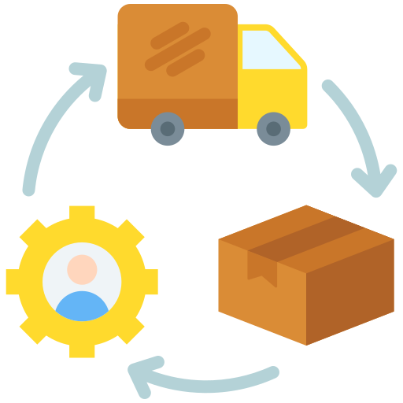
QUIPY
OMEGA X
Adithya A | Jayashre | Nitin Karthick R P | Roahith R

Slide 2


Problem Statement
Accessing and interpreting customer data from internal databases can be difficult for organizations at times. Walmart, for example, creates over 2.5 petabytes of data per hour. Businesses need to manage and use this data more effectively if they want to stay competitive.
OBJECTIVE
Develop a chat interface that leverages a Large Language Model (LLM) to read and interpret client data from an internal database. This interface will enable organization members to query the database and receive accurate, contextually relevant responses about the data.
There is a clear need for a streamlined and intuitive solution that enables organization members to query databases and receive accurate insights quickly, all through a user-friendly interface. Everyone should be able to easily access the necessary data with this approach, even those with less technical expertise. By simplifying data access, employees can focus on higher-value tasks and make well-informed decisions.​

Slide 3
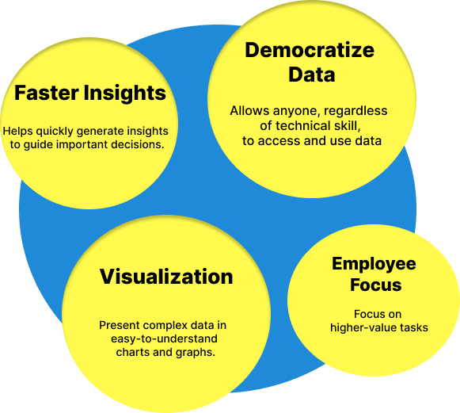

Solution
Our idea is to create QUIPY, an AI-driven chatbot that will enhance the way businesses engage with their data. QUIPY features a user-friendly interface and employs advanced natural language processing backed by LLMs to assist users in accessing and understanding complex data.
Simply use natural language to interact with data; no complicated code or data science knowledge is required.
Find hidden trends and patterns in your data quickly to help guide strategic decisions.
Convert complicated data into comprehensible graphs and charts to help with effective insight communication.
Save time and effort by using AI-powered features to automatically spot patterns, anomalies, and correlations.
Users may concentrate on higher-value tasks by being able to handle massive datasets and increasing data volumes without compromising performance.

Slide 4
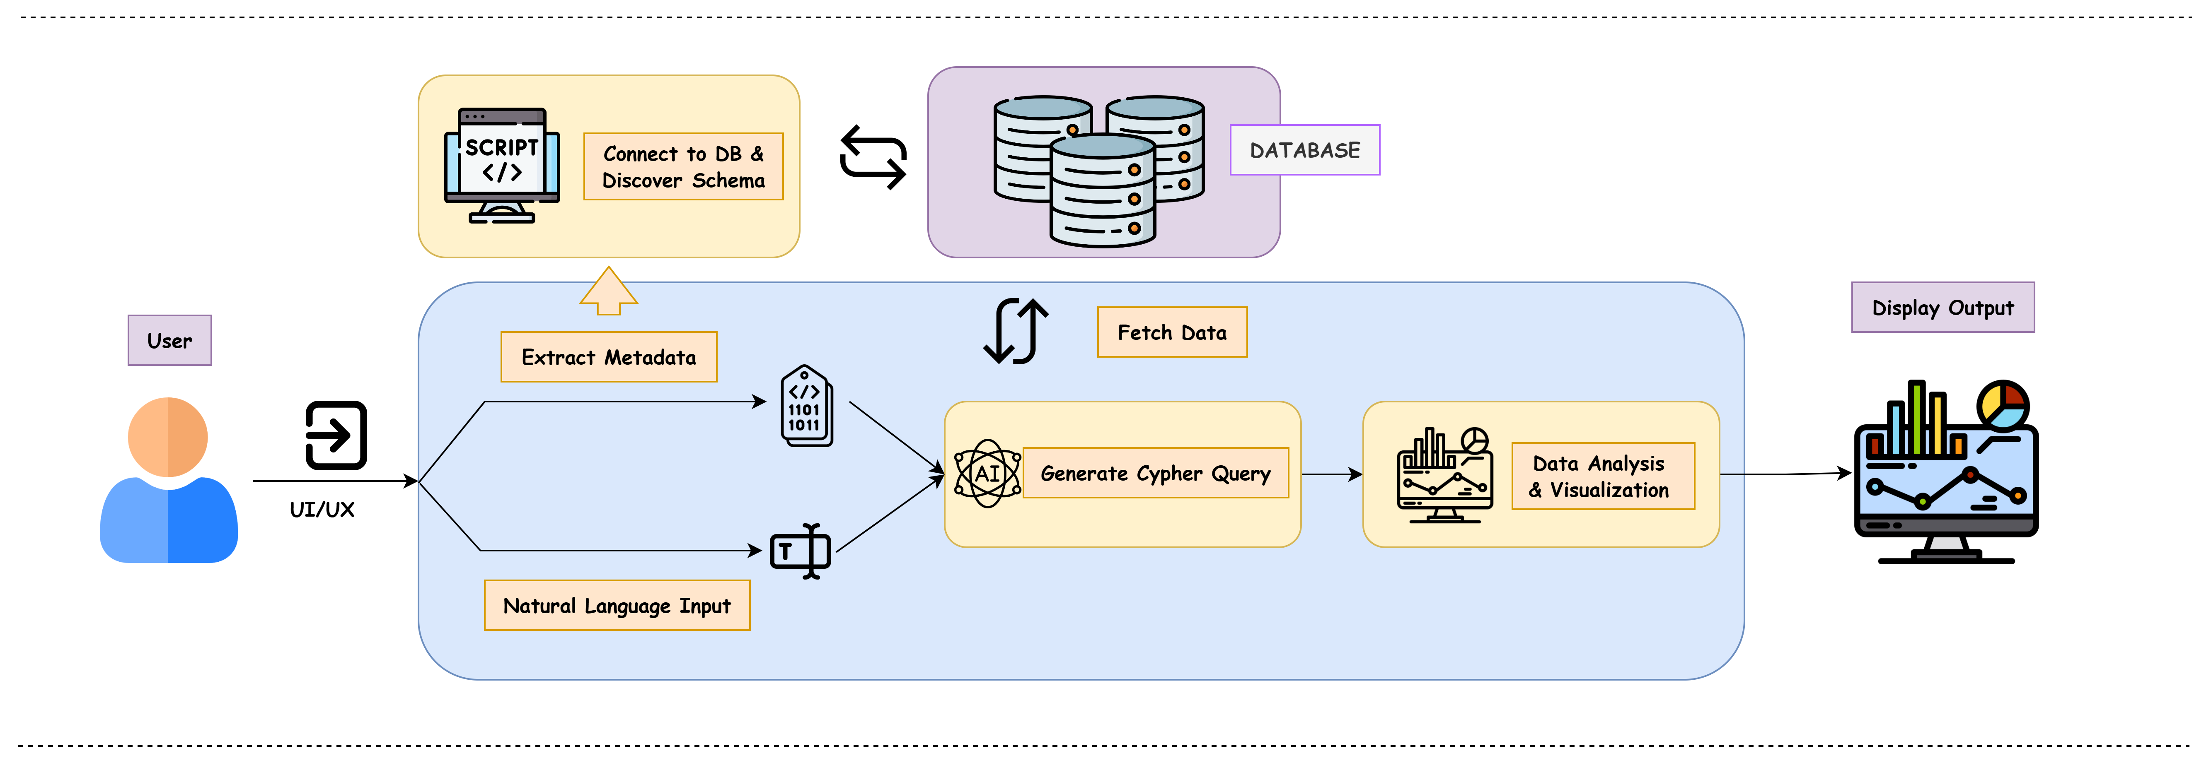
Methodology
We start by establishing a reliable connection to the target database, allowing for the extraction of detailed metadata, including schema information, table structures, and data relationships. This metadata is then enriched with additional context, such as business definitions and data quality indicators, to enhance its usability and understanding by an LLM.
Users can input queries in natural language through a user-friendly interface, where the LLM interprets their intent, refines the queries, and generates precise SQL or other database-specific queries.
Once the data is retrieved, it is processed and, if necessary, cleaned to ensure high quality.
The processed data undergoes statistical analysis to identify patterns and insights, which are then visualized using tools like Matplotlib, Seaborn, or Tableau. The final output is presented in a clear format, and an interactive dashboard is created to allow users to explore and monitor specific metrics or entities over time.

Slide 5








Tech Stack
Neo4j
Django
LLAMA
Python
HTML
CSS
JavaScript
ReactJS

