Slide 1

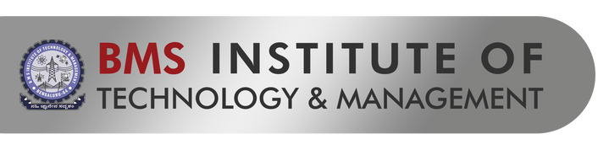



CODE
RED
25
CODE TILL YOU DROP...
SentinelAI: Real-Time Autonomous Cybersecurity for IoT Networks
Problem Statement Code: CR06
Team Name: Simpsons
Team Leader Name: Roahith R
Institution Name: Shiv Nadar University, Chennai

Slide 2


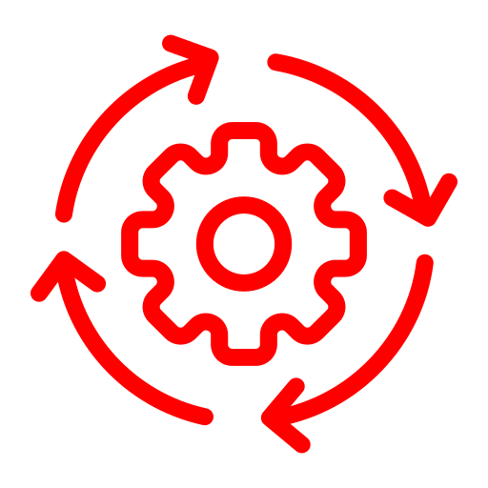
SentinelAI Overview: Revolutionizing IoT Cybersecurity
Key Features
AI-Powered Threat Intelligence: A self-learning system using federated learning to detect zero-day vulnerabilities.
Decentralized and Trustless Communication: Blockchain secures communication, preventing data tampering even in edge devices.
Quantum-Resistant Security: Post-quantum cryptographic protocols to future-proof IoT systems.
Edge-Based Protection: Autonomous agents at the edge for faster response and reduced latency.
Customizable Defense: Configurable rules to adapt to various industries like healthcare, smart cities, and manufacturing.
Overview
A next-generation cybersecurity framework for IoT, integrating AI, blockchain, and quantum-resistant cryptography to provide proactive, adaptive, and scalable protection for IoT nodes in real-time.
Use Cases
Preventing ransomware attacks in smart home ecosystems.
Securing Industrial IoT (IIoT) systems in manufacturing plants.
Enabling secure V2V communication in autonomous vehicles.
Safeguarding wearable medical devices from breaches.

Slide 3



Technology Stack and Business Potential: The Backbone of SentinelAI
Tech Stack
Why SentinelAI Stands Out?
AI/ML: Self-supervised learning models for anomaly detection.
Blockchain: Permissioned blockchain for scalable and private data sharing.
Quantum Security: Lattice-based cryptographic algorithms.
IoT Middleware: Lightweight protocols like CoAP and MQTT.
Languages & Frameworks: Python, TensorFlow, Hyperledger Fabric.
Predictive Security: Detects and neutralizes threats before they occur using advanced AI models.
Real-Time, Edge-Based Defense: Localized protection minimizes dependency on cloud resources.
Multi-Layered Security: Combines AI, blockchain, and cryptography for robust, end-to-end protection.
Scalability: Adaptable to networks with thousands of devices.
Plug-and-Play: Easy integration with existing IoT infrastructure.
Market Potential
Market Demand: IoT cybersecurity market to reach $40B by 2030.
Target Industries:
Healthcare: Safeguarding patient data.
Smart Cities: Securing public infrastructure.
Logistics: Enhancing supply chain security.

Slide 4
Process Flow: How SentinelAI Defends IoT in Real-Time
An innovative, multi-layered cybersecurity solution blending AI, blockchain, and quantum security for real-time IoT protection.

Slide 5
TEAM DETAILS
Team Leader Name: Roahith R
Student ID: 22110XXX
Institution Name: Shiv Nadar University, Chennai
Phone Number: +91XXXXX XXXXX
Email ID:
Member 1 Name : Nidhi Gummaraju
Member 2 Name : Jayashre

