Slide 1
SentinelAI
Team Name
Simpsons
Smart Security for Smarter Devices
Problem Statement : CR06 - Autonomous Cybersecurity for
Real-Time IoT Node Protection

Slide 2
In-Short
The rise of the Internet of Things (IoT) has revolutionized industries by connecting everyday devices to the digital world. However, this rapid growth brings with it new security challenges, making it crucial to develop robust cybersecurity frameworks to protect IoT networks from evolving threats.
Why US ?
Our Approach
Industry-specific security tailored modular approach to IoT environments.
Device category-based threat detection and mitigation.
Real-time automated recovery with minimal disruption.
Scalable, lightweight framework ensuring device performance.
Increasing adoption of IoT devices across industries
Detection, isolation, and recovery.
Minimized Service Disruption
Immediate isolation and recovery in case of a breach.
IoT cybersecurity market to reach $40B by 2030.

Slide 3
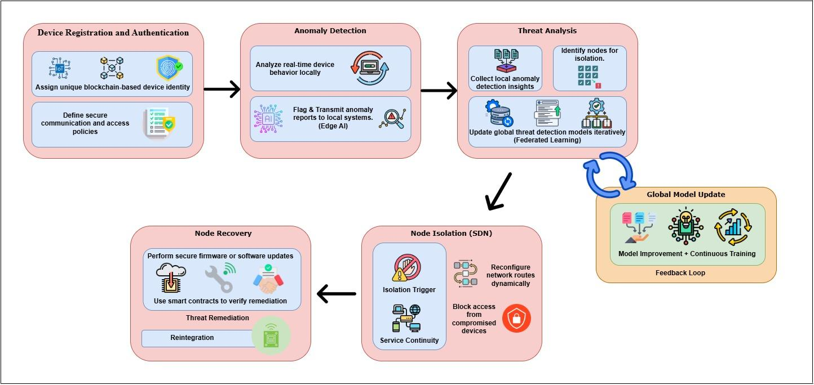
PROCESS FLOW

Slide 4
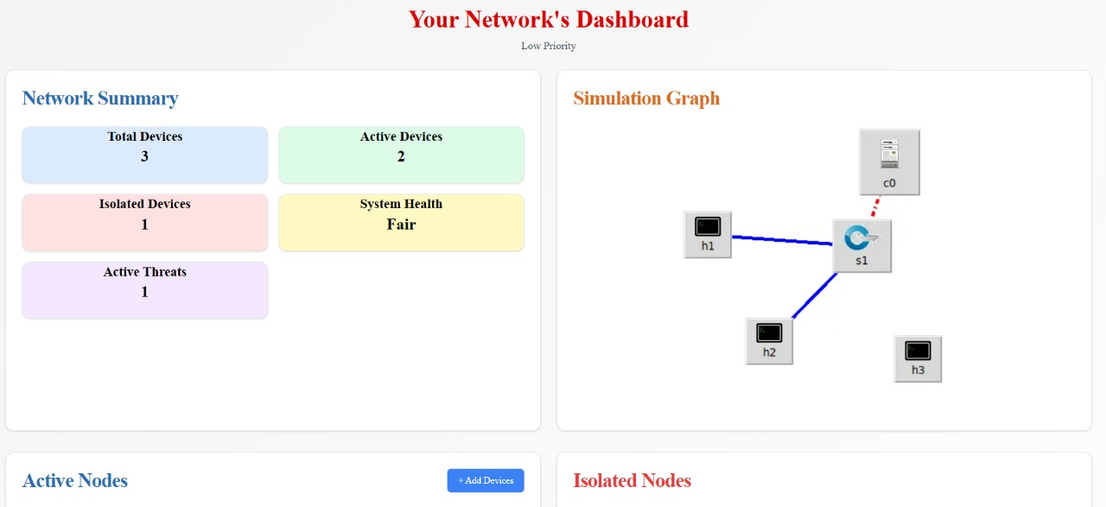
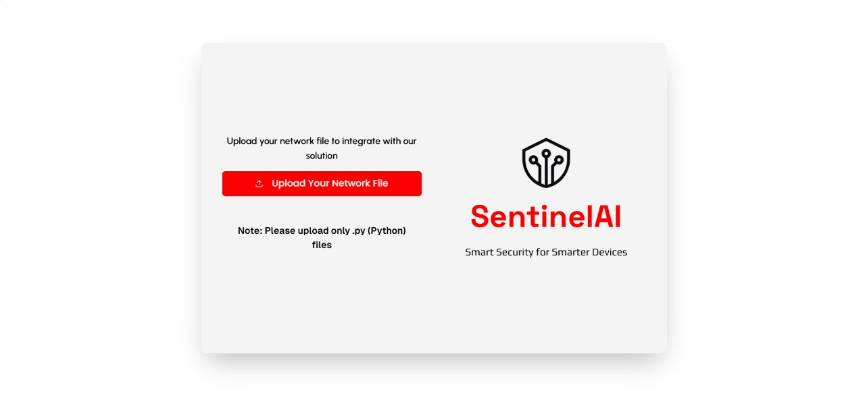
1. Device Registration and Authentication
All device registrations are recorded on a blockchain for traceability and tamper-proof security, ensuring that any unauthorized additions can be detected.
During the registration process, each IoT device is securely added to the network by its unique Device ID.
Devices are classified into low, medium, and high risk categories based on their data sensitivity and role in the IoT network.
Extract Mininet layout, register devices on the blockchain.

Slide 5
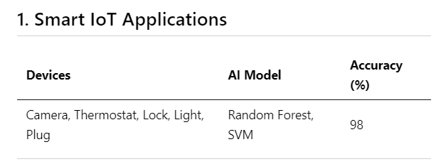
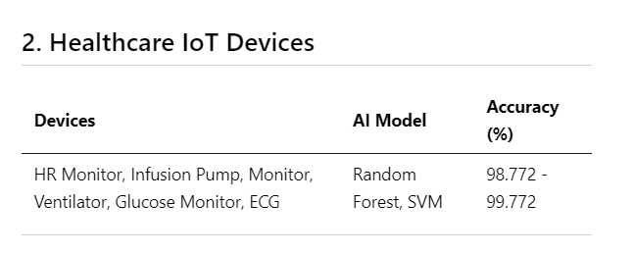
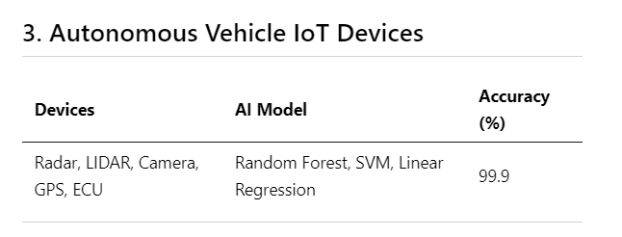
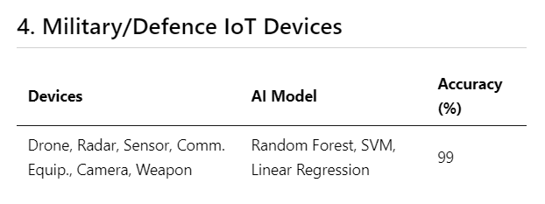
Anomaly Detection & Threat Analysis
Algorithms Used: Random Forest, Support Vector Machines (SVM), and Linear Regression
Developed tailored models for Home IoT, Defense, Healthcare, and Autonomous Vehicles, addressing the unique security challenges of each sector.
Models adapt dynamically to evolving threats, ensuring real-time protection
Federated Leaming
Decentralized model training on devices.
Aggregates updates for continuous improvement.
Adapts models to specific use cases without central data

Slide 6
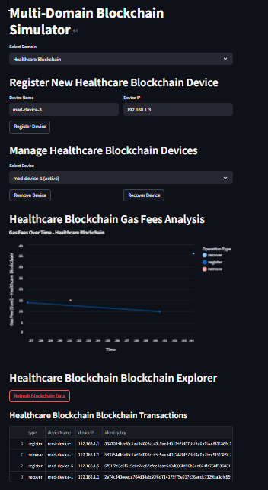
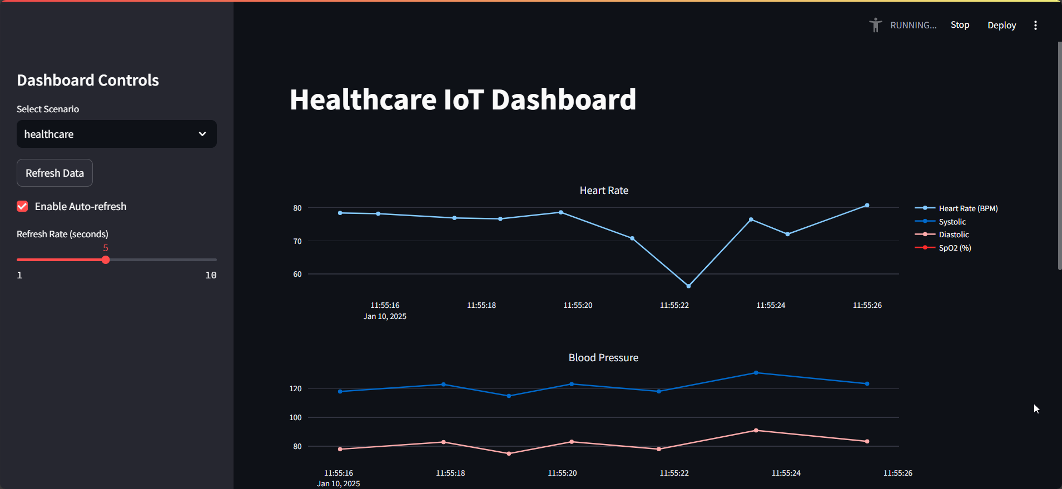
Node Isolation & Recovery
Node Isolation : Isolate compromised nodes to prevent disruption.
Recovery Process
  - Generate new identity keys for isolated nodes.
  - Reset status to ‘normal’ and update blockchain.
Continuous Monitoring & Metrics:
  - Track recovery status and performance metrics.
  - Measure recovery rate and isolation efficiency.

