Slide 1




SentinelAI
Vertex Innovate
Smart Security for Smarter Devices
(Team Member 1 pic
)
Team Name
Simpsons
Roahith R
Jayashre K
Nidhi Gummaraju

Slide 2
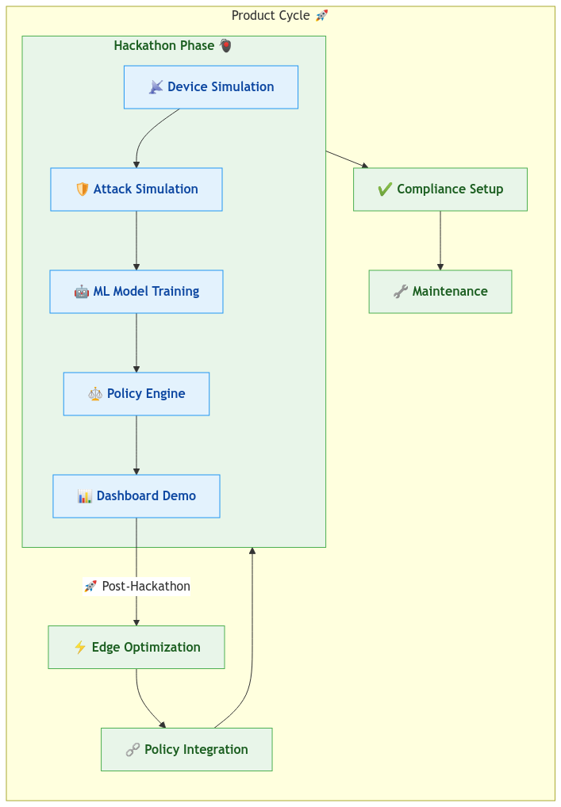
Index
Challenge Statement
Concept of the Solution
Novelty / Scope of Solution
Pros and Cons of the solution
Technical Description
Implementation Plan
Validation/Testing/Analysis
Cost Estimate
Assumptions
References

Slide 3
Challenge Statement
Understanding of the problem
With the exponential growth of IoT, security threats like DDoS attacks, MITM, data breaches, and malware infections are increasing. Traditional security measures struggle to keep pace due to scalability issues, lack of real-time threat detection, and device constraints. The challenge is to develop a lightweight, scalable, and proactive cybersecurity solution for IoT devices.

Slide 4

Concept of the Solution
SentinelAI is an AI-powered autonomous security framework that provides:
✔ Real-time anomaly detection on IoT devices
✔ Automated threat mitigation & dynamic isolation
✔ Blockchain-backed firmware verification to prevent malicious updates
✔ Federated learning-driven adaptive security
Our Use Case: Imagine a smart hospital where connected ventilators, patient monitors, and medication dispensers operate 24/7. A single cyberattack could disrupt critical medical functions, putting lives at risk. SentinelAI ensures real-time anomaly detection, automated isolation of compromised devices, and blockchain-verified firmware updates, ensuring continuous and secure operation without human intervention.
STAGES
Device Registration and Authentication
Anomaly Detection & Threat Analysis
Node Isolation &
Recovery

Slide 5
Novelty/Scope of the Solution
Novelty:
✅ Edge-based AI security – Detect threats on-device, reducing response time
✅ Blockchain-verified firmware updates – Prevents unauthorized modifications
✅ Dynamic isolation – Compromised devices are quarantined instantly
✅ Federated learning for evolving threat intelligence – Improves accuracy continuously
Scope:
✔ Industry Applications – Healthcare, Smart Cities, Logistics, Military, Automotive
✔ Scalability – Works for both consumer & enterprise IoT networks

Slide 6
Pros and Cons of the Solution
Pros:
✔ Enterprise-friendly integration: Designed to seamlessly work with existing IoT ecosystems, reducing operational overhead.
✔ Proactive security: SentinelAI stops attacks before they cause damage, reducing costly downtime and service disruptions.
✔ Fully autonomous – minimal human intervention
✔ Cost-efficient: Reduces need for manual security intervention, lowering operational expenses.
✔ Scalable and lightweight
Cons:
⚠ Initial implementation requires integration with existing IoT ecosystems
⚠ Edge computing hardware dependency

Slide 7
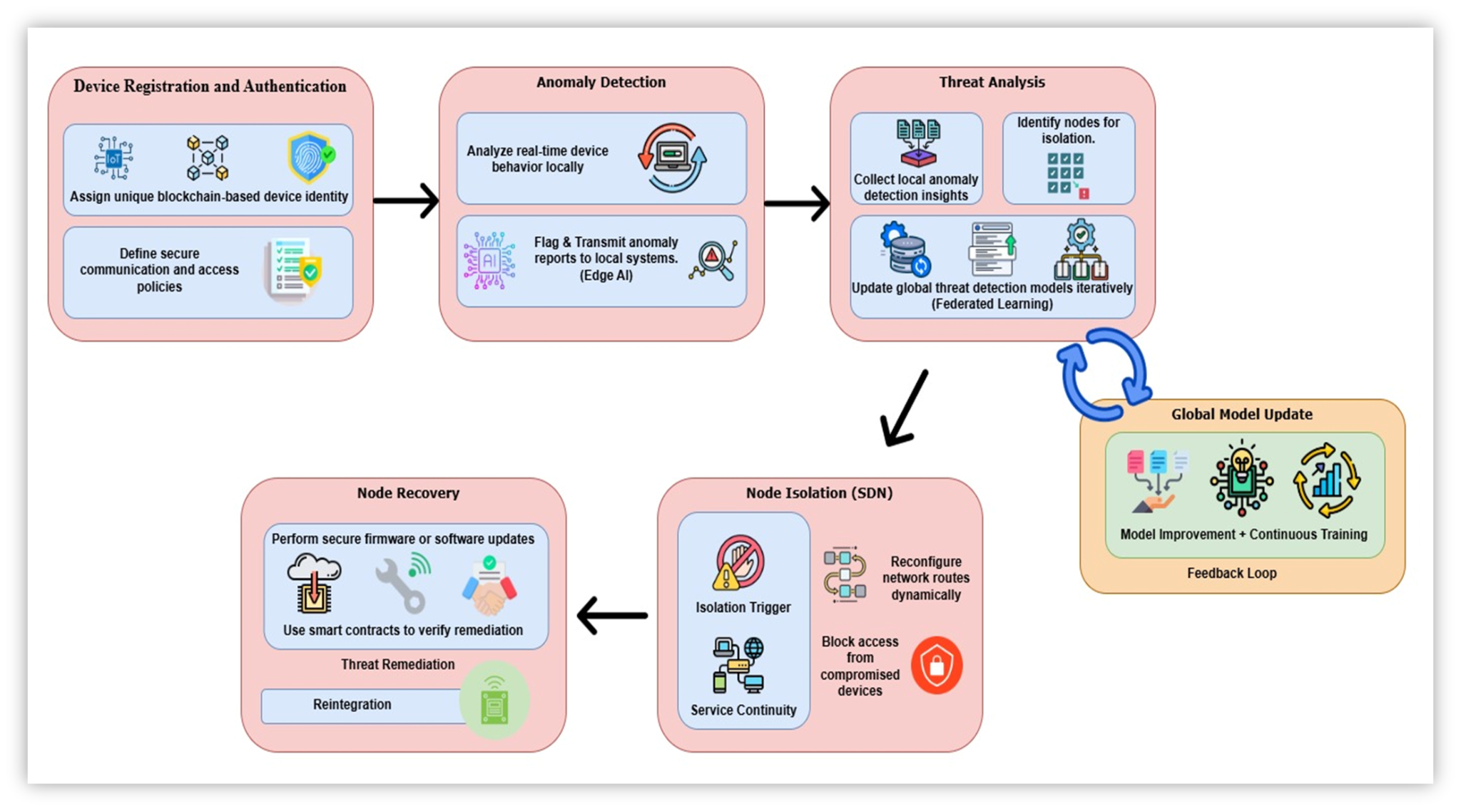
Technical Description
How It Works:
Edge AI detects anomalies locally, preventing cyber threats before they spread.
Blockchain-backed security ensures only trusted firmware updates are applied.
SDN dynamically isolates compromised nodes to prevent lateral spread of attacks.
Federated learning continuously adapts security models to emerging threats.
🛠 Tech Stack:
IoT & Edge AI: MQTT, CoAP, 🧠 TensorFlow Lite
Blockchain & Security: Ethereum, ⚙️ Solidity
SDN & Networking: OpenFlow
Cloud & Backend: FastAPI, 🗄 MongoDB

Slide 8
Implementation Phase
Phase 1:
✔ Develop & integrate AI-based anomaly detection models
✔ Deploy blockchain-based authentication & firmware validation
Phase 2:
✔ Implement SDN-based isolation and automated recovery mechanisms
✔ Test in simulated IoT environments
Phase 3:
✔ Real-world deployment & industry-specific adaptations
✔ Optimize federated learning for adaptive security

Slide 9
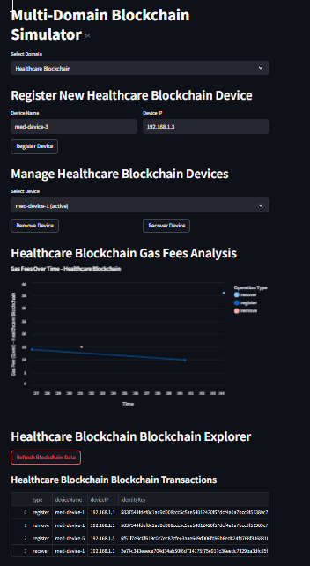
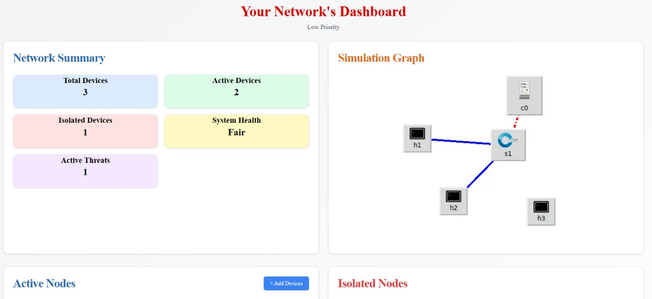
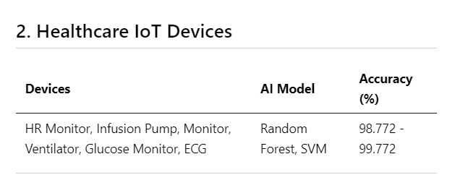
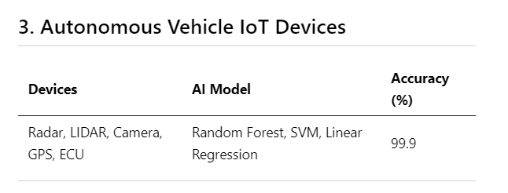
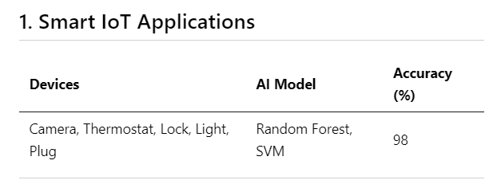
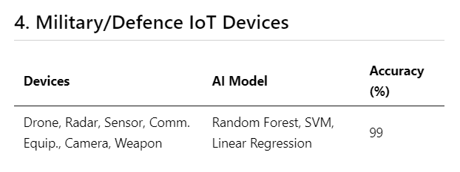
Results
90%+ threat detection accuracy.
Sub-5ms response time for isolation.
Zero data integrity compromise during firmware updates.

Slide 10
Assumptions
✔ IoT devices have reliable network connectivity to ensure seamless communication with cloud and edge nodes.
✔ Energy consumption of IoT devices is optimized to support continuous operation without frequent recharging or maintenance.
✔ Blockchain transaction latency is low enough for real-time or near-real-time processing of updates.
✔ SDN controllers can dynamically allocate bandwidth based on IoT device requirements.
✔ Edge computing resources are available to offload AI inference when needed, reducing cloud dependency.
✔ All devices and nodes comply with standard security protocols to prevent unauthorized access.

Slide 11
Cost Estimate
AI Model Development – ₹3L
Blockchain Integration – ₹2.5L
Edge Computing & SDN Implementation – ₹3L
Testing & Security Audits – ₹1.5L
Infrastructure & Maintenance – ₹1L
Total Estimated Cost: ~₹11L (Highly optimized for cost-effectiveness)
Revenue Streams:
✔ Subscription-Based Model – Affordable security plans starting at ₹499/month for small businesses
✔ Enterprise Licensing – Custom security solutions for ₹2L+/year
✔ OEM & Government Partnerships – Integration with IoT manufacturers & smart city initiatives

Slide 12
References
Security Framework for IoT Devices against Cyber-attacks
IoTPredictor: A security framework for predicting IoT device behaviours and detecting malicious devices against cyber attacks
Machine learning techniques for IoT security: Current research and future vision with generative AI and large language models

Slide 13
Thank You

