Slide 1
A Program for Elsie, a 4-bit Computer
Or, Your Code Really Looks Like This

Slide 2
What is a computer program?
It’s a set of computer instructions that accomplish a task

Slide 3
Elsie is a tiny computer with a 4-bit bus

Slide 4
Elsie can:
Move a number from memory into the A register (where math can happen)
Add a number to the A register
Move the result back into memory

Slide 5
Elsie, like all digital computers, only understands ones and zeros

Slide 6
All our computers work very much like Elsie

Slide 7
Writing a program for Elsie shows us what programs really look like and how they run.

Slide 8
What does a program for Elsie look like?

Slide 9
# this is a line comment
# (first thing’s first!)

Slide 10
# these are the only instructions # Elsie knows
load # move data value into regA
add # add data value to regA
store # store contents of regA
goto # this one we skip for now

Slide 11
# this program adds 1 + 2 and # stores the result in # memory location 10
load 1
add 2
sto 10

Slide 12
How does Elsie know what to do?

Slide 13
When Elsie powers up, the hardware starts reading 4 binary bits (a nybble) at a time.

Slide 14
Each instruction fits in one nybble.

Slide 15
Elsie has an Instruction Pointer, a register that knows where the next instruction is.

Slide 16
Let’s have a look at Elsie

Slide 17
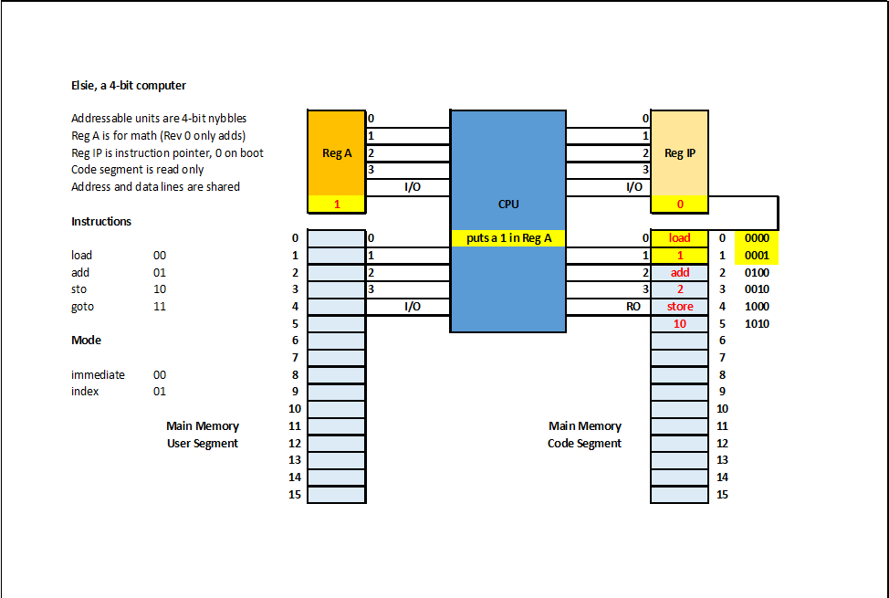

Slide 18
Back to the 4-bit nybbles Elsie’s been reading all this time

Slide 19
Elsie’s hardware endlessly feeds the CPU 4-bit nybbles in pairs

Slide 20
The first nybble is the instruction. The second nybble is data for that instruction to use.

Slide 21
Elsie’s hardware: 1. fetches a 4-bit instruction nybble,
2. fetches a 4-bit data nybble, 3. executes the instruction with the data, and 4. repeats as long as power is on.

Slide 22
On Elsie, each instruction has a 2-bit ID called an opcode:
load = 00
add = 01
sto = 10
goto = 11

Slide 23
Each 4-bit instruction nybble also contains a 2-bit mode that we skip for now
opcode | mode (always 00 for now)

Slide 24
Back to our program..

Slide 25
# this program adds 1 + 2 and # stores the result in # memory location 10
load 1
add 2
sto 10

Slide 26
# this program is # much easier to read # with line comments!
load 1 # put a 1 in register A
add 2 # add 2 to register A
sto 10 # store the result

Slide 27
But Elsie only knows ones and zeros so we must translate

Slide 28
We know the 2-bit opcode for each instruction, and

Slide 29
We know the data for each instruction.

Slide 30
To Elsie, our program looks like this
load 1 0000 0001
add 2 0100 0010
sto 10 1000 1010

Slide 31
(This translation to ones and zeros is what compilers do.)

Slide 32
Elsie’s CPU is wired to execute each instruction.

Slide 34
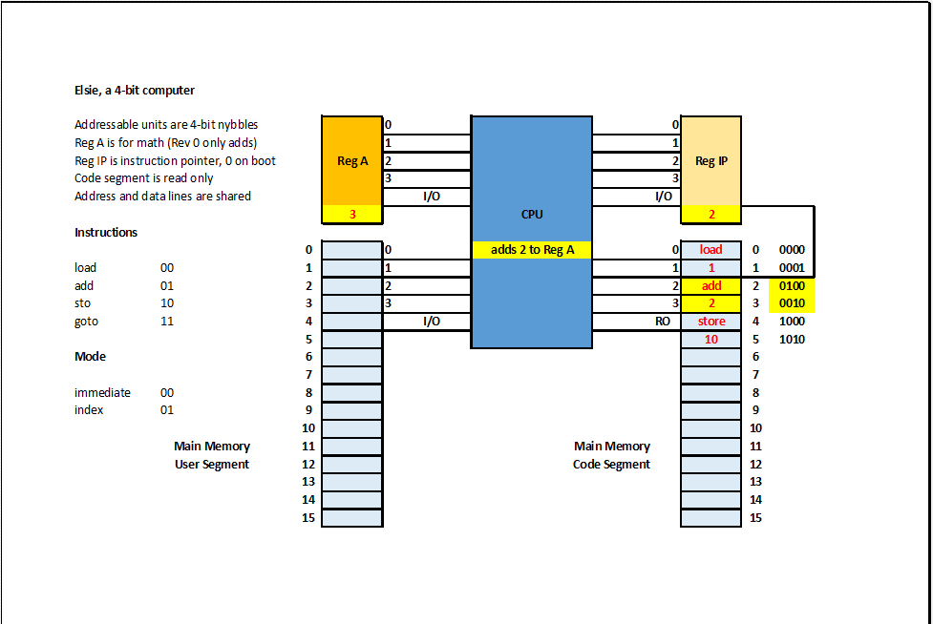

Slide 35
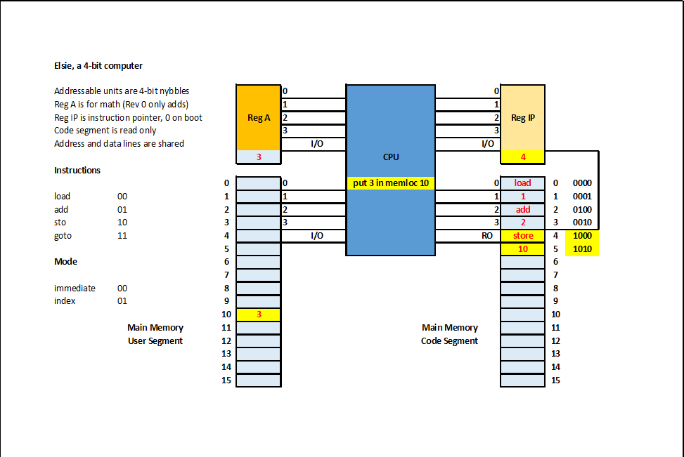

Slide 36
What do real computer instructions look like?

Slide 37
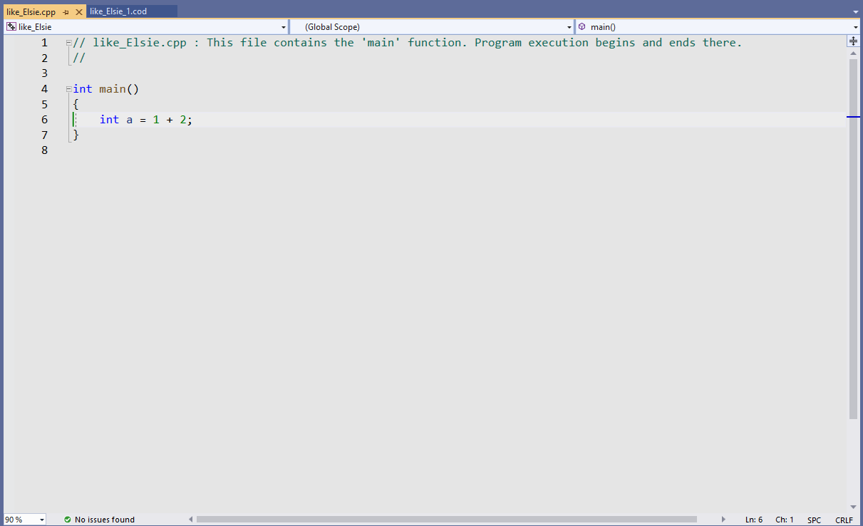
A similar program in C++:

Slide 38
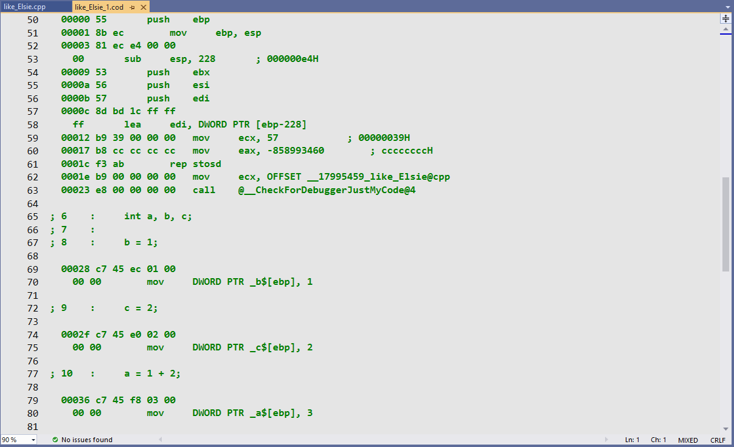
Now the real computer instructions:

Slide 39
Not too different from Elsie’s code, eh?
load 1 0000 0001
add 2 0100 0010
sto 10 1000 1010

