Slide 1
CS230: Digital Logic Design and Computer Architecture
Lecture 22: DRAM Organization and Controller
https://www.cse.iitb.ac.in/~biswa/courses/CS230/autumn23/main.html

Slide 2
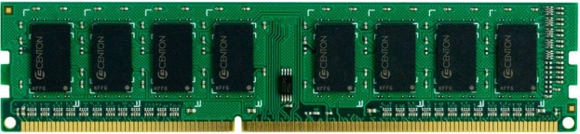
DRAM Organization
Channel
Rank 1 with 8 chips
DIMM
Rank
Rank 0 with 8 chips
Chip
Bank
Row
Column

Slide 3
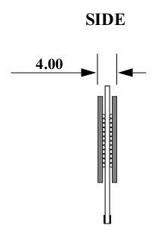
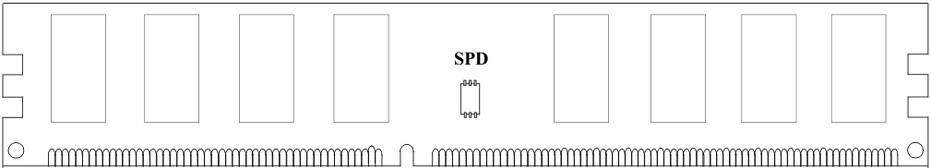
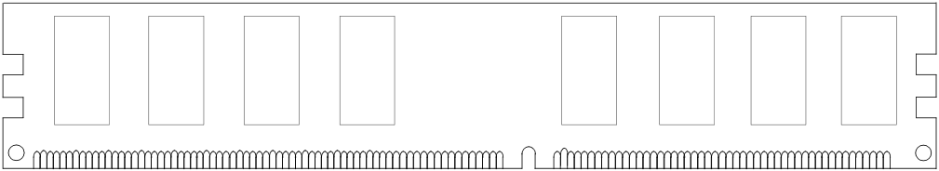
Rank
DIMM (Dual in-line memory module)
Side view
Front of DIMM
Back of DIMM
Rank 0: collection of 8 chips
Rank 1

Slide 4
Ranks, Banks, Rows, Columns
Rank 0
Rank 1
Bank 0
Bank 1
DIMM
Bank 2
Bank 3
Multiple Chips

Slide 5
Ranks, Banks, Rows, Columns
Rank 0
Chip
Bank 0
Bank 1
16
64 bits
16
Bank
16
Bank 2
Bank 3
16
Row
X16 device (DRAM width, # output pins)
Column
16-bit interface: 16 bits from each chip in one go

Slide 6
Ranks, Banks, Rows, Columns
Each rank has 64-bit wide data bus
If a rank is of width x8 then # DRAM chips ??
What about x4, # DRAM chips ??
If a rank is of width x8 then # DRAM chips ?? 8
What about x4, # DRAM chips ?? 16

Slide 7
Row Decoder and Row buffer (Sense Amplifier)
2KB
Each bank has a row buffer
Row Decoder
Stores the last used row
Row Buffer
Column mux

Slide 8
An Example
2Gb * 8 DRAM Chips (one side of the rank)
Total 16 chips + 2 chips for ECC (for both the ranks)
64 bit + 8 bit ECC interface (72 bit wide DIMM)
Transferring a 64B cache line will take 8 transfers of 8B each
8B will come from 8 chips (8 bits from one chip)
1 bit from each DRAM array assuming 8 DRAM arrays per bank

Slide 9
DRAM to LLC interaction
Physical memory space
Chip 0
Chip 1
Rank 0
Chip 7
0xFFFF…F
. . .
...
<0:7>
<8:15>
<56:63>
0x40
64B
cache block
Data <0:63>
0x00

Slide 10
DRAM to LLC interaction
Physical memory space
Chip 0
Chip 1
Rank 0
Chip 7
0xFFFF…F
. . .
Row 0
Col 0
...
<0:7>
<8:15>
<56:63>
0x40
64B
cache block
Data <0:63>
0x00

Slide 11
DRAM to LLC interaction
Physical memory space
Chip 0
Chip 1
Rank 0
Chip 7
0xFFFF…F
. . .
Row 0
Col 0
...
<0:7>
<8:15>
<56:63>
0x40
64B
cache block
Data <0:63>
8B
0x00
8B

Slide 12
DRAM to LLC
Physical memory space
Chip 0
Chip 1
Rank 0
Chip 7
0xFFFF…F
. . .
Row 0
Col 1
...
<0:7>
<8:15>
<56:63>
0x40
8B
64B
cache block
Data <0:63>
8B
0x00
8 cycles (DRAM IO): 1 cycle transfers 8 bytes from a column

Slide 13
DRAM Address Mapping (One Channel)
2GB DRAM, 8 Banks, 16K rows, 2K Columns per bank
Cache Interleaving: Consecutive cache blocks in consecutive banks
Row (14 bits)
High Column
Bank (3 bits)
Low Col.
Byte in bus (3 bits)
8 bits
3 bits
Row Interleaving: Consecutive rows in consecutive banks
Row (14 bits)
Bank (3 bits)
Column (11 bits)
Byte in bus (3 bits)

Slide 14
Row Access
A “DRAM row” is also called a “DRAM page”
“Sense amplifiers” also called “row buffer”
Each address is a <row,column> pair
Access to a “closed row”
Activate command opens row (placed into row buffer)
Read/write command reads/writes column in the row buffer
Precharge command closes the row and prepares the bank for next access
Access to an “open row”
No need for activate command

Slide 15
Row Buffer hit/miss/conflict
Access Address:
(Row 0, Column 0)
Columns
(Row 0, Column 1)
(Row 0, Column 85)
(Row 1, Column 0)
Row address 0
Row address 1
Row decoder
Rows
Row Buffer
CONFLICT !
HIT
Row 1
HIT
Row 0
Empty
Column address 0
Column mux
Column address 0
Column address 1
Column address 85
Data

Slide 16
DRAM Timing Constraints
tRAS: Row address strobe latency
tRP: Precharge latency
tCAS: Column address strobe latency
tRC: Row cycle time: tRAS+tRP

Slide 17
Row (Page) Policies
Open Page (do not get confused with an OS page)
After an access: Keep the page in the row-buffer
Consecutive accesses to the same page : Row-buffer Hit
On an access to different page: Close the row and open the new one
Closed page:
After an access: Close the page if there are no accesses to the same row in the request queue.
Consecutive accesses to different page : Low latency
On an access to different page: No need to close the row

Slide 18
10K view on the latency
Page Empty: ACT + CAS
Page Hit: CAS
Page Miss: PRE+ACT+CAS

Slide 19
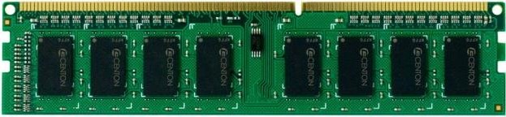
DRAM Controller
LLC
DRAM
Controller
Addr. Mapper
RQ WQ
CQ
CQ
CQ
CQ
Command Scheduler
Command and Address bus
Frequency 800MHz
1066MHz
1333MHz
Double Data Rate (DDR)
Data bus (burst length= eight beats each of 64-bits)
Frequency 1600MHz
2133MHz
2666MHz

Slide 20
Reads and Writes(Writebacks)
Reads are critical to performance
Write Queue stores writes and the writes are serviced after # writes reach a threshold
Why?
The direction of the data bus changes from reads to writes. So ??
DRAM controller creates DRAM commands from based on the requests at read Q and write Q

Slide 21
DRAM Scheduling
Based on
Row-buffer locality, Source of the request, Loads/Stores
Load criticality
Satisfy all the timing constraints. Around 60
FR-FCFS
Prefers requests with Row hits (column-first) FR: First Ready

Slide 22
DRAM Bandwidth
Names | Memory clock | I/O bus clock | Transfer rate | Theoretical bandwidth
DDR-200, PC-1600 | 100 MHz | 100 MHz | 200 MT/s | 1.6 GB/s
DDR-400, PC-3200 | 200 MHz | 200 MHz | 400 MT/s | 3.2 GB/s
DDR2-800, PC2-6400 | 200 MHz | 400 MHz | 800 MT/s | 6.4 GB/s
DDR3-1600, PC3-12800 | 200 MHz | 800 MHz | 1600 MT/s | 12.8 GB/s
DDR4-2400, PC4-19200 | 300 MHz | 1200 MHz | 2400 MT/s | 19.2 GB/s
DDR4-3200, PC4-25600 | 400 MHz | 1600 MHz | 3200 MT/s | 25.6 GB/s
DDR5-4800, PC5-38400 | 300 MHz | 2400 MHz | 4800 MT/s | 38.4 GB/s
DDR5-6400, PC5-51200 | 400 MHz | 3200 MHz | 6400 MT/s | 51.2 GB/s

