Slide 1
CS230: Digital Logic Design and Computer Architecture
Lecture 23: DRAM Controller and Cache Coherence
https://www.cse.iitb.ac.in/~biswa/courses/CS230/autumn23/main.html

Slide 2
10K view on the latency
Page Empty: ACT + CAS
Page Hit: CAS
Page Miss: PRE+ACT+CAS

Slide 3

Rowhammer
Row of Cells
Wordline
Row
Victim Row
Row
Aggressor Row
V_{LOW}
Closed
V_{HIGH}
Opened
Row
Victim Row
Row
Repeatedly opening and closing a row induces disturbance errors in adjacent rows
Advanced Computer Architecture

Slide 4
Rowhammer
Row of Cells
Wordline
Row
Victim Row
Row
Aggressor Row
V_{LOW}
Closed
V_{HIGH}
Opened
Row
Victim Row
Row
“It’s like breaking into an apartment by repeatedly slamming a neighbor’s door until the vibrations open the door you were after” – Motherboard Vice

Slide 5
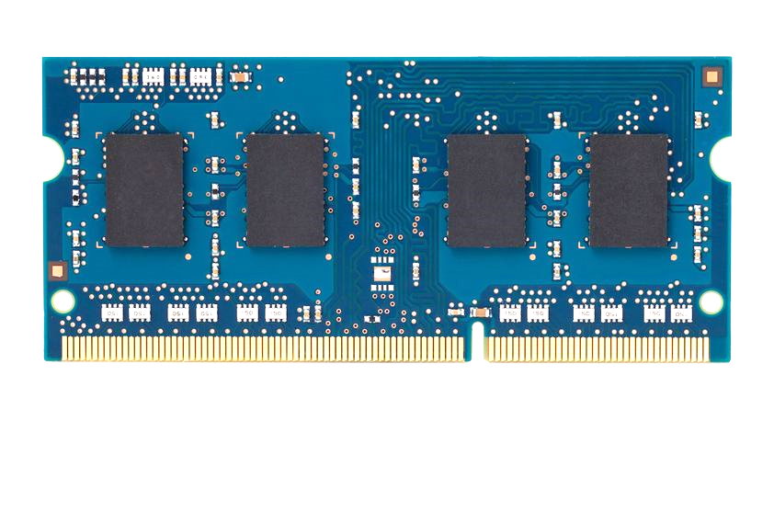
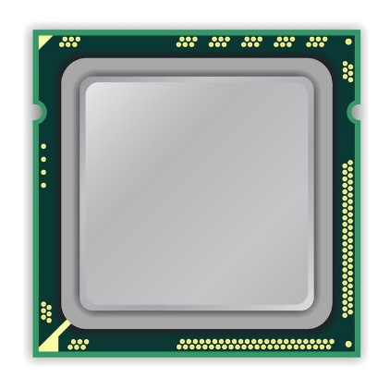
The Code Please
x86 CPU
DRAM Module
DDR3
Avoid cache hits
Flush X from cache
Avoid row hits to X
Read Y in another row
111111111
X
111111111
111111111
111111111
Y
111111111
111111111
Advanced Computer Architecture

Slide 6
The code please
loop:
mov (X), %eax
mov (Y), %ebx
clflush (X)
clflush (Y)
mfence
jmp loop
001110111
111111111
X
111111111
1111
111111111
101111101
110001011
111111111
Y
1111
111111111
011011110
111111111

Slide 7

Solution: DRAM Refresh
But intelligently ☺
Baseline: Once in 63ms
Need for a Rowhammer tracker, and then mitigator
Advanced Computer Architecture

Slide 8
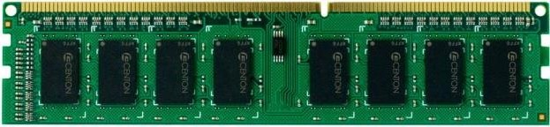
DRAM Controller
LLC
DRAM
Controller
Addr. Mapper
RQ WQ
CQ
CQ
CQ
CQ
Command Scheduler
Command and Address bus
Frequency 800MHz
1066MHz
1333MHz
Double Data Rate (DDR)
Data bus (burst length= eight beats each of 64-bits)
Frequency 1600MHz
2133MHz
2666MHz

Slide 9
Reads and Writes(Writebacks)
Reads are critical to performance
Write Queue stores writes and the writes are serviced after # writes reach a threshold
Why?
The direction of the data bus changes from reads to writes. So ??
DRAM controller creates DRAM commands from based on the requests at read Q and write Q

Slide 10
DRAM Scheduling
Based on
Row-buffer locality, Source of the request, Loads/Stores
Load criticality
Satisfy all the timing constraints. Around 60
FR-FCFS
Prefers requests with Row hits (column-first) FR: First Ready

Slide 11
DRAM Bandwidth
Names | Memory clock | I/O bus clock | Transfer rate | Theoretical bandwidth
DDR-200, PC-1600 | 100 MHz | 100 MHz | 200 MT/s | 1.6 GB/s
DDR-400, PC-3200 | 200 MHz | 200 MHz | 400 MT/s | 3.2 GB/s
DDR2-800, PC2-6400 | 200 MHz | 400 MHz | 800 MT/s | 6.4 GB/s
DDR3-1600, PC3-12800 | 200 MHz | 800 MHz | 1600 MT/s | 12.8 GB/s
DDR4-2400, PC4-19200 | 300 MHz | 1200 MHz | 2400 MT/s | 19.2 GB/s
DDR4-3200, PC4-25600 | 400 MHz | 1600 MHz | 3200 MT/s | 25.6 GB/s
DDR5-4800, PC5-38400 | 300 MHz | 2400 MHz | 4800 MT/s | 38.4 GB/s
DDR5-6400, PC5-51200 | 400 MHz | 3200 MHz | 6400 MT/s | 51.2 GB/s

Slide 12
Cache Coherence
P1
P2
P3
Cache
Bus
LLC/DRAM
sum=0

Slide 13
Cache Coherence
P1
P2
P3
rd &sum
sum =0
V
DRAM
sum=0

Slide 14
Cache Coherence
P1
P2
P3
rd &sum
sum=0
V
sum=0
V
DRAM
sum=0

Slide 15
Cache Coherence
wr sum
(sum = 3)
P1
P2
P3
sum=0
sum=0
V
3
V
D
DRAM
sum=0

Slide 16
Cache Coherence
P1
wr &sum
(sum = 7)
P2
P3
sum=3
D
sum=0
7
V
D
DRAM
sum=0

Slide 17
The Problem
Err!
Voila
P1
P2
P3
rd &sum
print sum=3
print sum=7
sum=3
D
sum=7
D
DRAM
sum=0

Slide 18
The Problem
If multiple cores cache the same block, how do they ensure they all see a consistent state?
Solution:
1. Write Propagation: All writes eventually become visible to other cores.
2. Write Serialization: All cores see write to a cache line in same order.
Need a protocol to ensure (1) and (2) called cache coherence protocol

Slide 19

Invalidate/Update
Invalidate –
Write to a cache line, and simultaneously broadcast invalidation of address to all others
Other cores clear/invalidate their cache lines
Update –
Write to a cache line, and simultaneously broadcast written data to all others
Other cores update their caches if data was present

Slide 20
A Simple MSI protocol
Extend single valid bit per line to three states:
M(odified): only one cache, memory not updated.
S(hared): one or more caches, and memory copy is up-to-date
I(nvalid): not present
Read - Read request on bus, transitions to S
Write - ReadEx request, transitions to M state

Slide 21
State-transitions: Processor side (Master core)
PrRd/ –
PrWr/ –
PrRd/ –
PrWr/BusRdX
M
S
PrWr/BusRdX
PrRd/BusRd
I

Slide 22
Bus-side (Rest of the cores)
BusRd/ –
M
BusRd/Flush
S
BusRdX/Flush
BusRdX/ –
I
BusRd/ –
BusRdX/ –

Slide 23
MSI Protocol
P1
P2
P3
Cache
Snooper
Snooper
Snooper
Bus
DRAM
X=1

Slide 24
MSI Protocol
P1
P2
P3
rd &X
BusRd
Snooper
Snooper
Snooper
DRAM
X=1

Slide 25
MSI Protocol
P1
P2
P3
X=1
S
Snooper
Snooper
Snooper
DRAM
X=1

Slide 26
MSI Protocol
P1
P2
P3
wr &X
(X=2)
X=1
2
S
M
Snooper
Snooper
Snooper
DRAM
X=1

Slide 27
MSI Protocol
P1
P2
P3
rd &X
X=2
M
Snooper
Snooper
Snooper
BusRd
DRAM
X=1

Slide 28
MSI Protocol
P1
P2
P3
X=2
M
S
X=2
S
Snooper
Snooper
Snooper
Flush
DRAM
X=1
2
Cancel DRAM read

Slide 29
MSI Protocol
P1
P2
P3
wr &X
X=3
X=2
S
I
X=2
3
S
M
Snooper
Snooper
Snooper
BusRdX
LLC
X=2

Slide 30
MSI Protocol
P1
P2
P3
rd &X
X=2
3
I
S
X=3
M
S
Snooper
Snooper
Snooper
BusRd
Flush
DRAM
Update DRAM as well
X=2
3

Slide 31
MSI Protocol
P1
P2
P3
rd &X
X=3
S
X=3
S
Snooper
Snooper
Snooper
DRAM
X=3

Slide 32
Summary: For your practice
Proc Action | State P1 | State P2 | State P3 | Bus Action | Data From
R1 | - | - | - | BusRd | Mem
W1 | - | - | - | BusRdX | Mem
R3 | - | - | - | BusRd | P1 cache
W3 | - | - | - | BusRdX | Mem
R1 | - | - | - | BusRd | P3 cache
R3 | - | - | - | - | -
R2 | - | - | - | BusRd | Mem

Slide 33
Summary: For your practice
Proc Action | State P1 | State P2 | State P3 | Bus Action | Data From
R1 | S | - | - | BusRd | Mem
W1 | M | - | - | BusRdX | Mem
R3 | S | - | S | BusRd | P1 cache
W3 | I | - | M | BusRdX | Mem
R1 | S | - | S | BusRd | P3 cache
R3 | S | - | S | - | -
R2 | S | S | S | BusRd | Mem

