Slide 1
Which Automatic Image Registrations Can a Microscopist Trust?
Figures. Frank Cai, 2026-2027

Slide 2
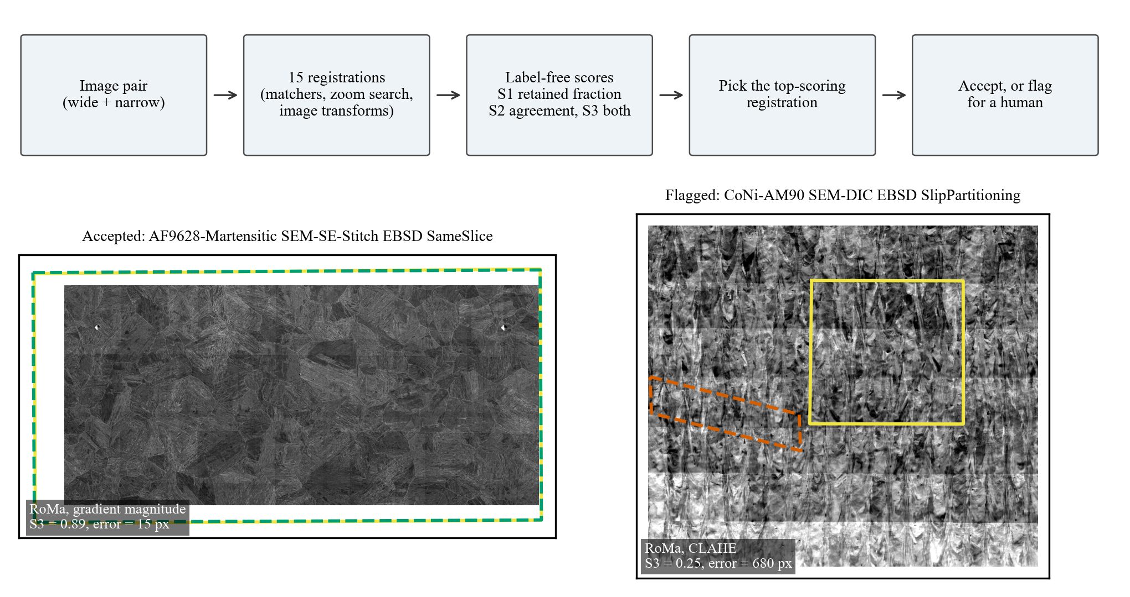
Figure 1. Top: the triage procedure. Every image pair is registered 15 ways; each registration gets label-free scores; the top-scoring registration is kept, and accepted or flagged for a human by its score. Bottom: two benchmark pairs chosen by a rule fixed in advance (the accepted pair with the highest combined score S3 among pairs where the best single method failed, and the flagged pair with the lowest S3). Each panel shows the wide image, the true outline of the narrow image (yellow) and where the selected registration placed it (dashed; green, accepted; vermillion, flagged). Images from the AmalgaMatch benchmark, Durmaz et al., CC BY 4.0.

Slide 3
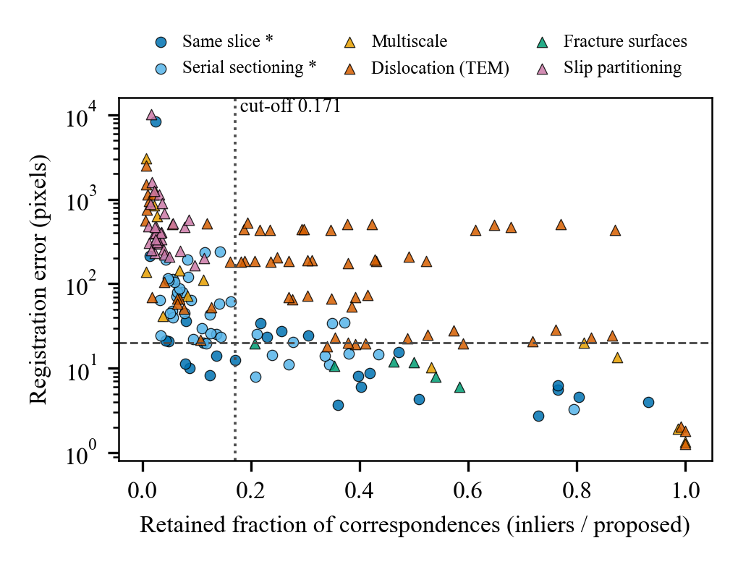
Figure 2. Registration error of MatchAnything-RoMa against its retained fraction (correspondences kept by robust fitting divided by those proposed) for all 187 pairs, by task group. The dashed line marks the 20-pixel success criterion; the dotted line is the cut-off chosen on the two starred groups and applied unchanged to the others. Failed registrations are plotted at their error; the vertical axis is logarithmic.

Slide 4
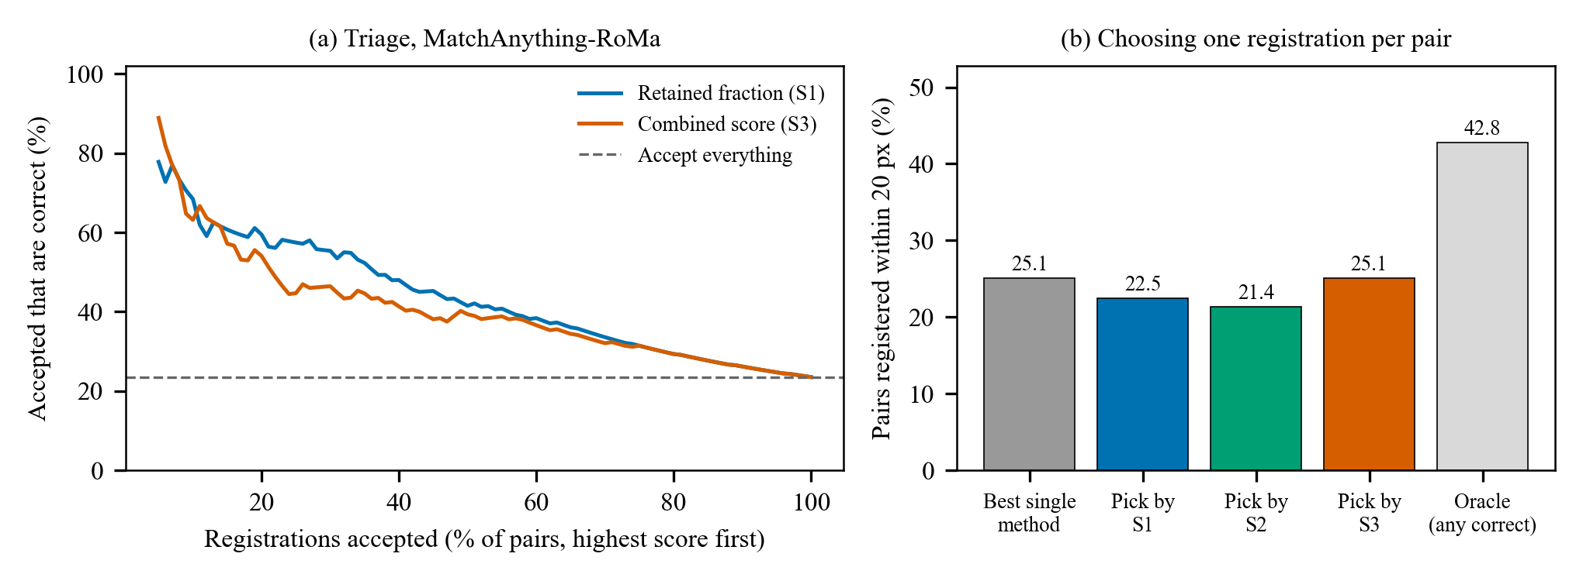
Figure 3. (a) Share of accepted registrations that are correct when pairs are accepted in order of score, for the retained fraction (S1) and the combined score (S3), against accepting everything (dashed). (b) Pairs registered within 20 pixels by the best single method (MatchAnything-RoMa in the zoom search), by choosing one of the 15 registrations per pair with each score, and by an oracle that always picks a correct registration when one exists.

