Slide 1
Polymorph-Resolving Retrieval
of Molecular Crystals from
Powder X-Ray Diffraction
A contrastive pattern↔structure model that tells same-molecule crystal forms apart
Frank Cai
Purdue University, West Lafayette, IN · frankyc11223@gmail.com
2026 IEEE MIT Undergraduate Research Technology Conference · Paper ID 69 · Track 4A
Notes:
[~20 s] Hi, I'm Frank Cai from Purdue. This talk is about identifying which crystal form of a molecule you have, straight from its powder X-ray diffraction pattern, including the hard case where the candidates are the same molecule.

Slide 2
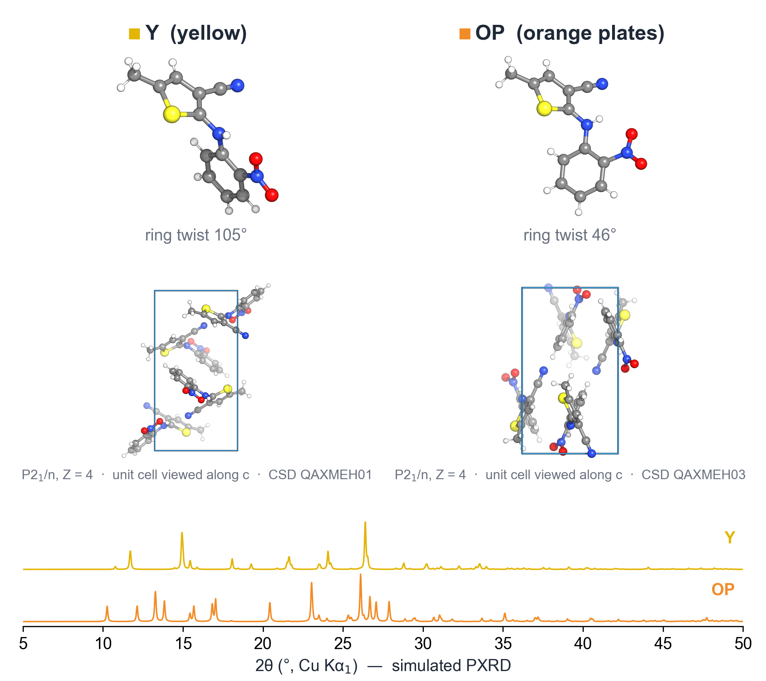
THE PROBLEM
Same molecule, different crystal: polymorphs
■ Polymorphs are different packings of the same molecule
■ Same chemical formula, often the same space group
■ Only the packing differs, which shows up as shifts in PXRD peak positions and intensities
■ It matters: ritonavir (an HIV drug) had to be pulled when a less soluble form appeared in production
ROY: same formula, same space group (P2₁/n).
Only the PXRD pattern tells Y and OP apart.
Cai · Polymorph-Resolving Retrieval from PXRD · IEEE MIT URTC 2026
2 / 11
Notes:
[~50 s] Polymorphs are the same molecule packed differently. This is ROY, a molecule with many polymorphs named by their colour. The yellow and orange-plate forms have the same formula and the same space group; the molecule just twists differently, 105 versus 46 degrees, and packs differently. Their simulated powder patterns, at the bottom, are clearly different. That is the only signal that separates them. This matters in practice: ritonavir's marketed form was withdrawn when a less soluble polymorph appeared in manufacturing. (Structures: CSD QAXMEH01 and QAXMEH03.)

Slide 3
THE GAP
Existing models lean on composition and symmetry
■ Classical search-match: correlate the pattern against a reference library
■ XCCP (155k inorganic crystals) and XtalNet (MOFs): contrastive PXRD↔structure retrieval
■ Both lean on composition and space-group cues, and that signal disappears for polymorphs
■ No prior work tests retrieval with the composition held fixed
Our task: within-family retrieval
Query: one polymorph's PXRD pattern
Library: only its sibling polymorphs
Pick the packing that produced it
A composition/symmetry retriever is at chance by construction
Chance = 0.380
(average over family sizes)
Cai · Polymorph-Resolving Retrieval from PXRD · IEEE MIT URTC 2026
3 / 11
Notes:
[~50 s] The usual tool is search-match: correlate against a library. Recent contrastive models such as XCCP and XtalNet do learned retrieval, but on inorganic crystals and MOFs, and they lean on composition and symmetry; XCCP reports 93% space-group ID. For polymorphs those cues are gone. So the task here is within-family retrieval: the query is one polymorph's pattern, the library is only its siblings. Anything that uses only formula or symmetry scores 0.380, the family-size chance rate.

Slide 4
APPROACH
Method: a CLIP-style dual encoder
PXRD pattern
5–50° 2θ, 2,251 pts
1D ResNet
wide kernels + global pooling
Shared 256-d
embedding
match = cosine
similarity
Symmetric InfoNCE
pull matched pairs together
push the other B−1 apart
Crystal structure
atoms + unit cell
Atom-set Transformer
periodic coords + lattice token
■ Train on 247,089 CSD molecular crystals; patterns are re-simulated on the fly, so no pattern is seen twice
■ Retrieval: embed the query pattern, rank library structures by cosine similarity
Cai · Polymorph-Resolving Retrieval from PXRD · IEEE MIT URTC 2026
4 / 11
Notes:
[~50 s] Two encoders map into one embedding space. The pattern side is a 1D residual CNN: a diffractogram is a 1D signal where local peak shape carries the physics. The structure side is a permutation-invariant Transformer over atoms with a lattice token, because peak positions are set by the unit cell. Training uses the CLIP symmetric InfoNCE loss: each pattern should match its own structure and not the other structures in the batch. At test time we rank structures by cosine similarity.

Slide 5
APPROACH
Physics-based augmentation, polymorph-aware training
Randomized measurement model (every epoch)
Making the model resolve polymorphs
■ 2θ zero offset (sample displacement)
■ Isotropic lattice strain (thermal / compositional)
■ Caglioti + Scherrer peak broadening
■ March–Dollase preferred orientation
■ Polynomial + amorphous-hump background
■ Poisson counting noise
■ Hard negatives: sibling polymorphs share a batch, so the loss must use packing, not formula
■ Family-safe split: whole families stay in one split, on top of a scaffold split
■ Verified: 0 of 10,795 families cross a split boundary
CSD: 315,060 molecular crystals → 10,795 polymorph families · split 247,089 / 30,887 / 30,886 · test: 1,077 families, 2,835 targets · 60 epochs
Cai · Polymorph-Resolving Retrieval from PXRD · IEEE MIT URTC 2026
5 / 11
Notes:
[~45 s] Two design choices. First, augmentation: every training pattern is re-simulated through a randomized instrument model with displacement, strain, broadening, texture, background and noise, so the query looks like a real measurement and not like the clean library entry. Second, polymorph-aware training: sibling polymorphs are put in the same batch as hard negatives, and whole families go into a single split, so no sibling of a test structure is ever seen in training. I checked: zero of 10,795 families leak across splits.

Slide 6
RESULT
The model resolves polymorphs well above chance
0.561
0.380
1.48×
XRD-CLIP
within-family top-1
composition-only
chance
lift over
chance
Top-2 0.843 · Top-5 0.949 · MRR 0.738 (1,077 held-out families, 2,835 queries)
Honest context: on a perfectly clean query, plain correlation scores 1.0 because the query is a byte-identical copy of the library entry. The real test is a query that carries measurement effects the library doesn't.
Cai · Polymorph-Resolving Retrieval from PXRD · IEEE MIT URTC 2026
6 / 11
Notes:
[~40 s] On clean patterns the model picks the right polymorph 56% of the time against a 38% chance floor, a 1.48x lift, and it's in the top two 84% of the time. One caveat up front: on a perfectly clean query, plain correlation gets 100% because the query is literally the library entry. That's not a realistic setting. What matters is what happens when the measured pattern carries real instrument effects.

Slide 7
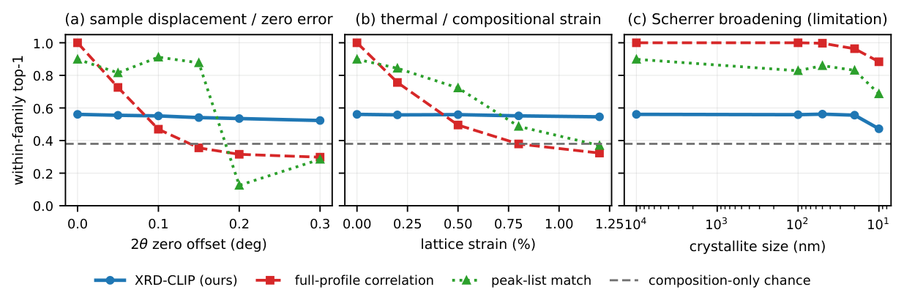
ROBUSTNESS
Robust to the effects that break search-match
■ Peak shifts (a, b): the model stays flat (0.561 → 0.523) while correlation collapses (1.0 → 0.298)
■ Limitation (c): severe broadening at 10 nm crystallites, where correlation (0.884) beats the model (0.472)
Cai · Polymorph-Resolving Retrieval from PXRD · IEEE MIT URTC 2026
7 / 11
Notes:
[~55 s] Here we degrade the query one dial at a time; the library stays clean. Blue is our model, red is full-profile correlation, green is peak-list matching, dashed is chance. Under sample displacement and lattice strain, which are the shifts that break search-match in real labs, the model is flat while correlation drops below chance. Panel c is the honest limitation: severe Scherrer broadening keeps peak positions, and correlation handles that better than we do.

Slide 8
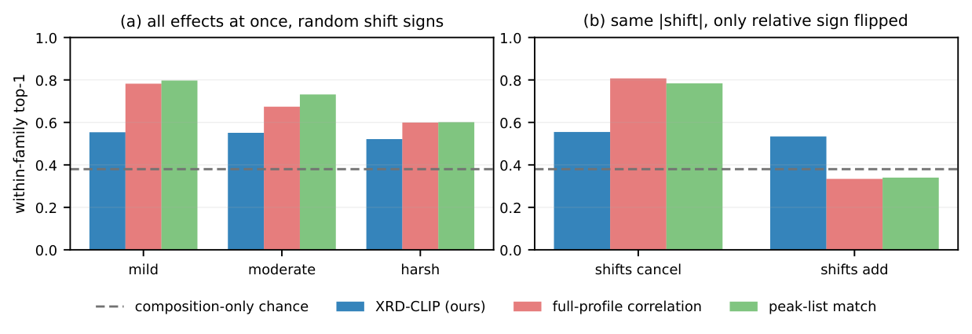
ROBUSTNESS
When shifts add, classical methods fall to chance
■ Displacement and lattice expansion shift peaks in opposite directions. Same sizes, relative sign flipped:
■ Correlation 0.807 → 0.334, peak-list 0.784 → 0.340 (chance); model 0.555 → 0.534
Cai · Polymorph-Resolving Retrieval from PXRD · IEEE MIT URTC 2026
8 / 11
Notes:
[~55 s] With everything applied at once (panel a), classical methods look decent. But that's partly luck: sample displacement and thermal expansion shift peaks in opposite directions, so they can cancel. Panel b is the control: same shift sizes, only the relative sign flipped. When the shifts add, correlation and peak-list both drop to chance, while the model barely moves. In a real sample you don't know in advance which case you're in, and roughly half the time it's the bad one. The model's invariance doesn't depend on the sign.

Slide 9
ANALYSIS
Ablations: where the robustness comes from
Within-family top-1 | Full aug (main) | No shift/strain aug | No aug (clean)
Clean | 0.561 | 0.553 | 0.557
Pure shift @ 0.1° | 0.552 | 0.549 | 0.552
Field (mild) | 0.554 | 0.560 | 0.380
Field (harsh) | 0.521 | 0.528 | 0.379
Shifts add | 0.534 | 0.530 | 0.379
Peak-shift invariance is EMERGENT
Dropping shift/strain augmentation changes nothing: the CNN with global pooling is built to tolerate shifts
Profile robustness is LEARNED
Trained on clean patterns, the twin drops to chance once real instrument effects appear, so this is not fingerprint leakage
Same architecture, data, and 60-epoch schedule; only the augmentation changes. Chance = 0.380.
Cai · Polymorph-Resolving Retrieval from PXRD · IEEE MIT URTC 2026
9 / 11
Notes:
[~55 s] Two ablations answer where this comes from. Remove only the shift and strain augmentation: nothing changes, so shift invariance comes from the architecture. Remove all augmentation: the model still works on clean and pure-shift queries, but falls to exactly chance once broadening, texture, noise and background appear. That answers the obvious objection, 'isn't this just memorizing simulated fingerprints?' If it were, the clean-trained twin would still work. It doesn't, so the augmentation is teaching real generalization.

Slide 10
SCOPE
Sim-to-real spot check and limitations
Real experimental patterns (Cu-Kα₁)
Limitations → next steps
■ Racemic ibuprofen (IBPRAC04): true structure ranks 1,872 of 30,887 (top 6.1%) from a real measured pattern the model never saw
■ Phenobarbital Forms I/II: the determination is not in the library, so no rank applies; no plausible false match surfaced
■ Small N: a spot check, not a benchmark
■ Evaluation is mostly on the physics simulator → scale to tens of real molecular patterns
■ Concedes severe broadening to correlation
■ Top-1 0.561 leaves headroom → low/high-angle encoder split, Rietveld reranking
■ Molecular (CSD) only; inorganic and MOFs are already covered
Cai · Polymorph-Resolving Retrieval from PXRD · IEEE MIT URTC 2026
10 / 11
Notes:
[~40 s] As a first look at transfer, I took real published powder patterns. For ibuprofen, a real pattern the model never saw puts the true structure in the top 6% of a 30,000-structure library, which is good but not top-1. This is a spot check, not a benchmark, and most of the evaluation is still on the simulator. The model also concedes heavy broadening, and 56% top-1 leaves room to improve.

Slide 11
CONCLUSION
Takeaways
New task
Robust result
Understood mechanism
Polymorph-resolving PXRD retrieval on CSD molecular crystals, where composition/symmetry methods are at chance by construction
0.561 vs 0.380 chance, and it holds under peak shifts that send classical search-match to chance, whatever their sign
Shift invariance is architectural; instrument-profile robustness is learned from physics-based augmentation, not leakage
Thank you. Questions?
Frank Cai · frankyc11223@gmail.com
Cai · Polymorph-Resolving Retrieval from PXRD · IEEE MIT URTC 2026
11 / 11
Notes:
[~25 s] To sum up: a new polymorph retrieval task where formula and symmetry don't help; a model that resolves polymorphs above chance and stays robust where classical search-match fails; and ablations that show why. Next, the same retriever could rank candidates for PXRD-conditioned crystal structure generation. Thank you, I'm happy to take questions.

