Slide 1

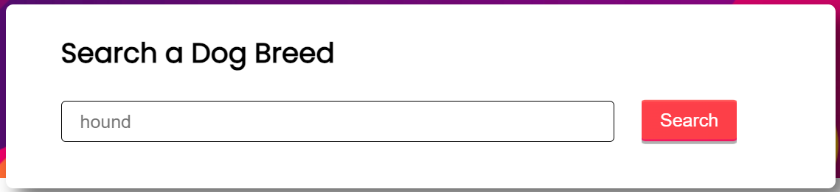
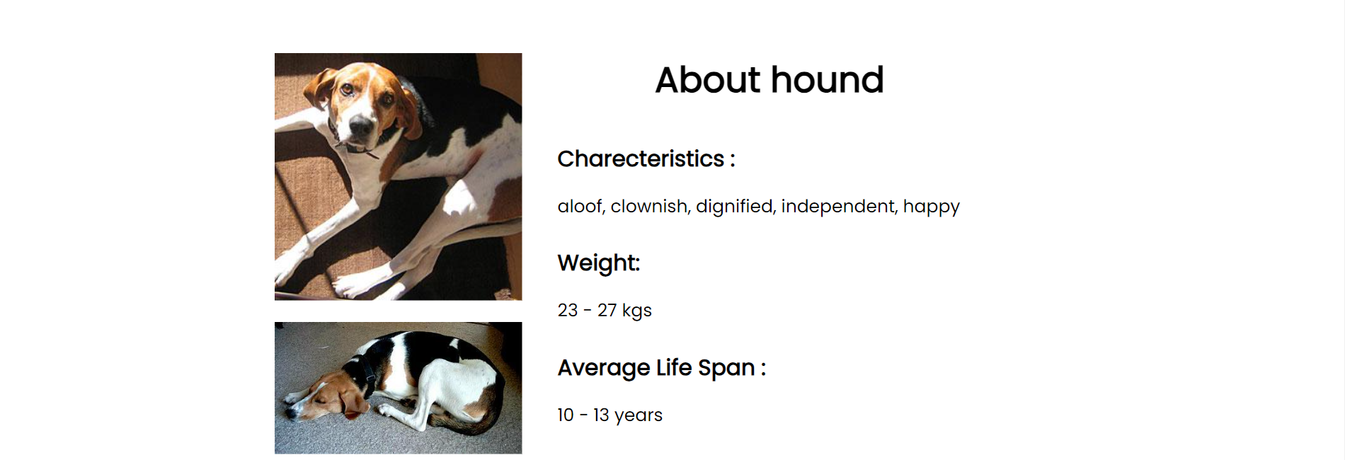
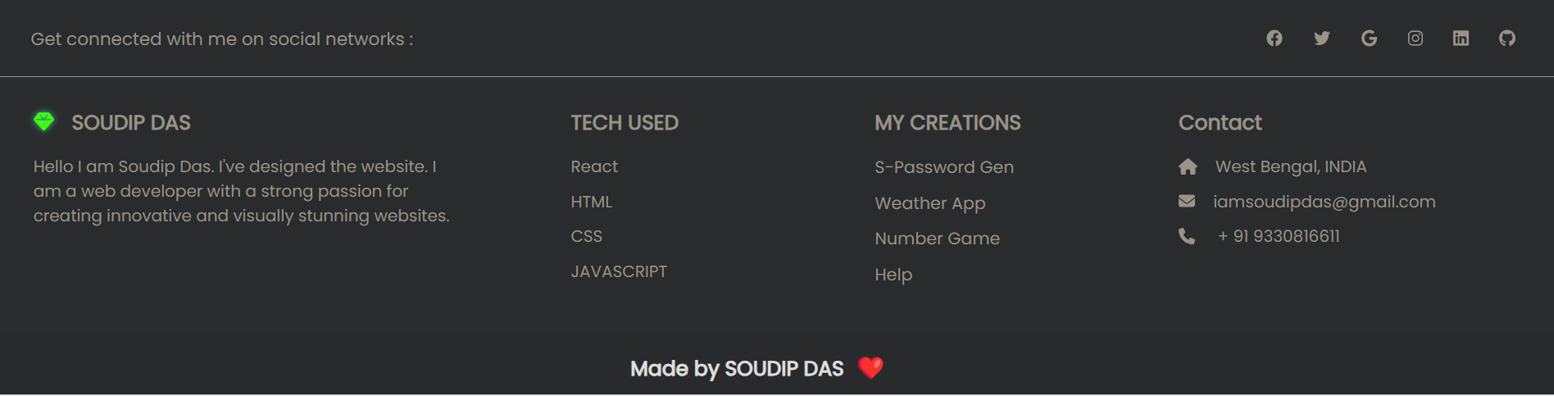
Index.js
App.js
Top.js
App.js
Mid.js
Bottom.js
Footer.js

Slide 2
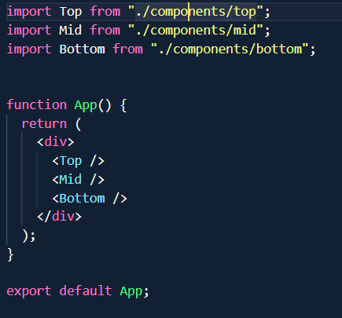
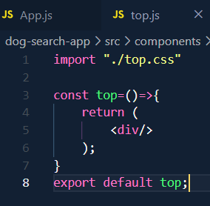
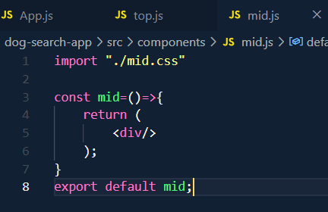
First go to create-react-app.dev and find the commands :
npx create-react-app my-app
cd my-app
npm start
Then analyse the wireframe or structure and how many components will be required.
Then deleted the unnecessary App.css , logo.svg n’all.
Goto app.js and return the root components, For example : In the dog app I identified main 4 components : top, mid and bottom and footer (ss e nai seta)
So in return of app.js i done this and also imported them :
6. Then I created those indicidual files and their respective css in components folder . And imported the css and returned a dummy div

Slide 3
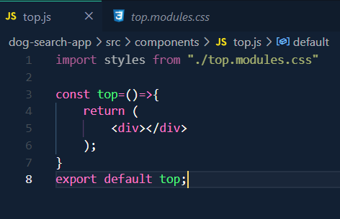
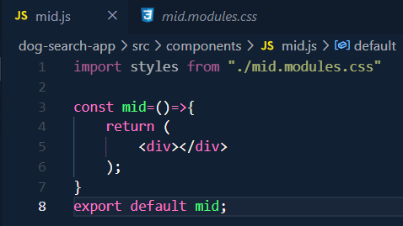
Then ami changes korlam css module er jnno.

Slide 4
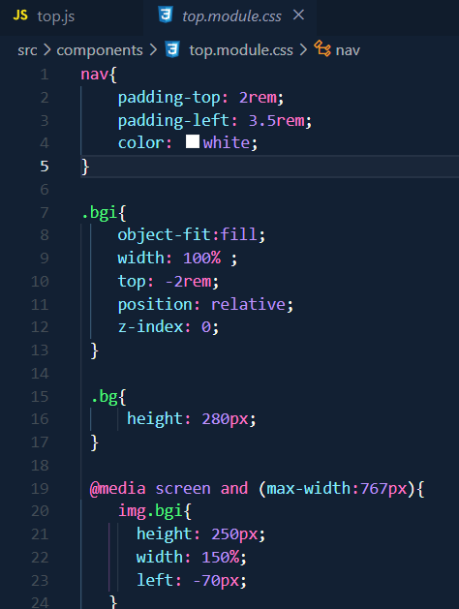
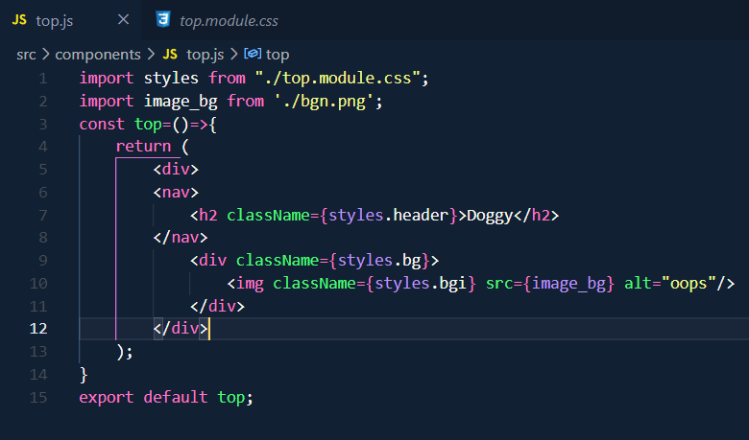
CREATING THE STRUCTURE
First top er kaj dhorlam, so css ta liklam top-er
Next ami oi css gulo k main structure e add korlum
IMP NOTE : Dek image emni emni add kora jay na (locally r khetre) so ami ota k import kore then add korlam

Slide 5
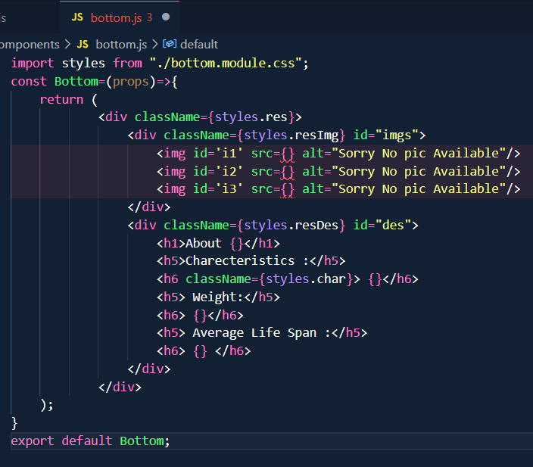
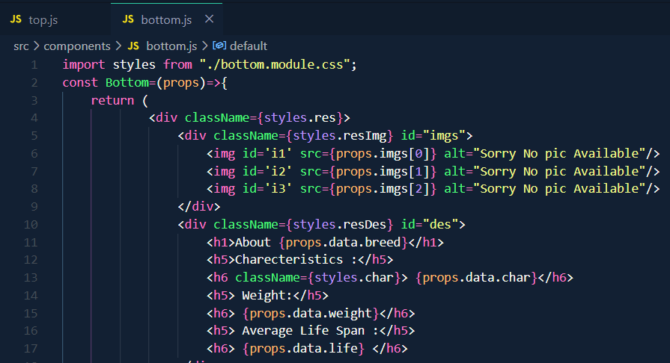
Age bottom.js banalamsame vabe css bania then structure banalam
Ebar logic laga, dek ei jayga gulo te ki ki ante lagbe?
1. images and 2. data.
To tar mane 2 to prop asbe, ekta hlo image (array hisabe) ar onno ta hlo data (maybe object hisabe anbo karon dek characteristic, weight , age e gulo k key value pair hisabe patale subidha hbe)
Faka rakchi oi jayga gulo j kan gulo te dynamic data asbe
Dek imagine korechi j evabe data gulo prop kore patiachi ekane :
Img array bole prop.img[0] evabe accpt krche. Ar data ta object tai prop.data.property e vabe likechi

Slide 6
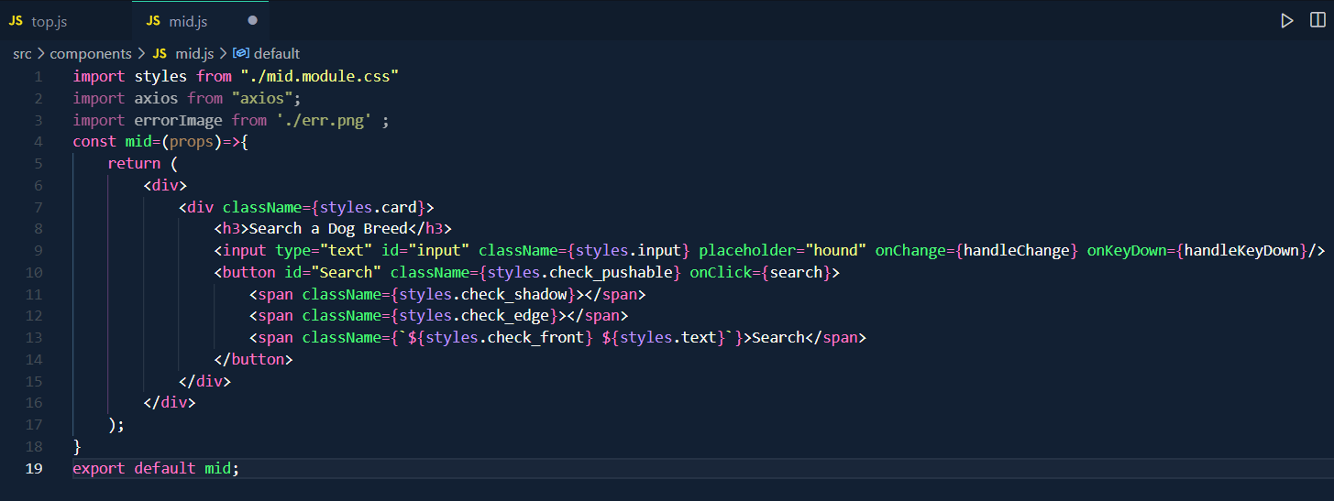
Ebar dek amar kaj holo mid er structure banana ar upor upor daka j ki chai:
Dek eta e main section amar. Ekane api call korte hbe. Tar jnno axios import korchi. Ebar dek search button ta tiple search func ta call hbe (seta banaini ekno) tai onClick e orm rekechi. R dek ekane to amra getElement kore oi input er modhe deoa user er valu ta pete pari na tai ekane onChange event dia ekta func call korechi j ta sai kaj ta kore nebe ar oi enter tiple search call hy setar jnno oi onKeydown er leka ta korechi

Slide 7
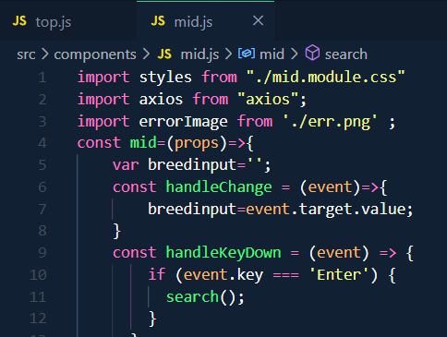
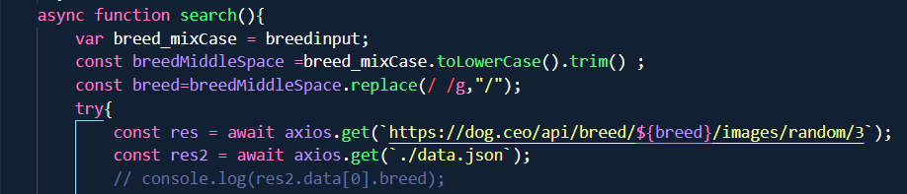
Ebr ami oi enter marle search hbe oi func ta ar input div ta k monitor krbe sei func ta banalam
Dek ei handlechange func ta input ta k monitor krche. onChange e ache j hetu tai user ja likbe every keystroke e oi breedinput ta update hbe, ebar ami search func bania eta kai patate parbo
Dek e vabe api call kore
Ar dek evabe local data json ta fetch kore
Local json dia data fetch korte gele seta k public folder e rakte hoy
Prothome ato ta korlam. Dek local data j ta fetch krche seta res2.data[0].property evabe paoa jabe

Slide 8

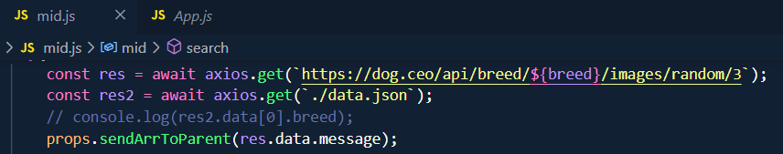
Er pore amr main kaj ki?
Ei j image gulo palam seta k bottom.js e patabo, seta to directly o vabe jay na child to child so parent er through te patate hbe. So eke first e parent e patabo then parent dia bottom tay patabo.
Ar search func ta baki ekno karon ekno amra all datar theke required breed ta extract korini + error handling o korini
Parent e patanor jnno amra jani j parent e ekta func create kore seta k props hisabe child e patate hy ar child seta te tar data ta patay
Dek e vabe parent e func baniachi seta k child e pass koralam prop hisabe
Last line ta dek evabei patalam parent k oi images array ta

Slide 9
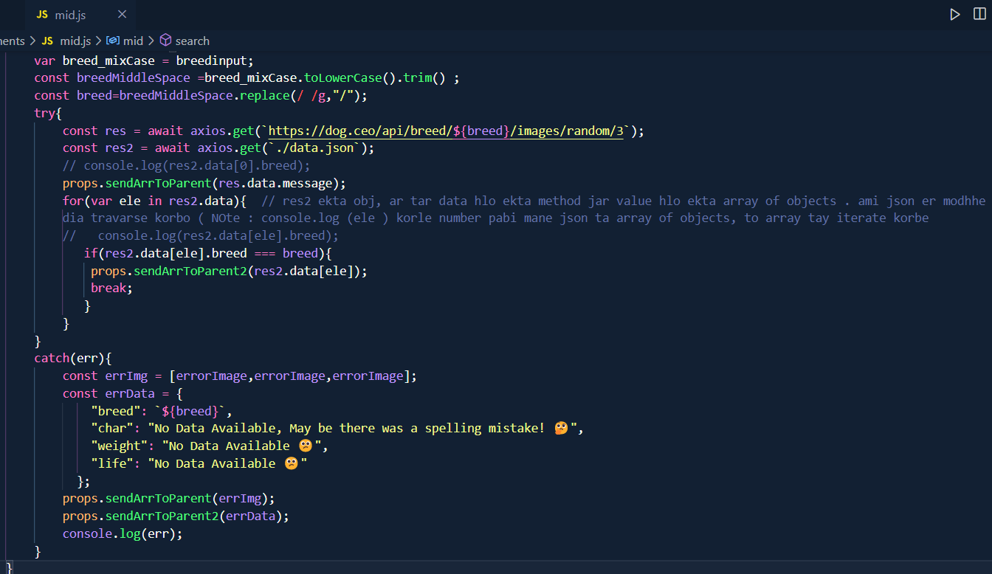
Evabe parent k data o patalam
Error hole ekta image dakabe seta k import korechi, ekane sei image takai 3 bar nia array kore niachi. Pore etakai patachhi parent er kache
Same vabe breed na khuje pele ei object ta baniachi seta patachhi parent k.

Slide 10
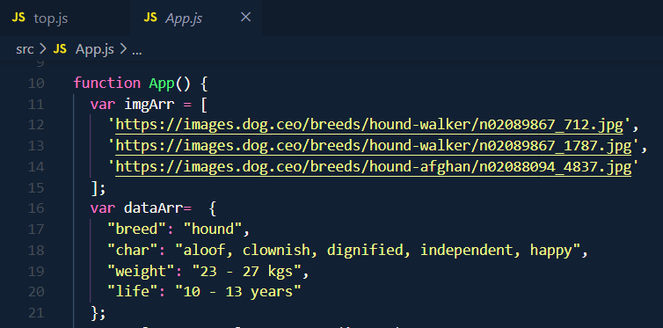
Son basically parent er kkhetre logic ta ki : Dek erm sob khetre parent ei main data storage structure banabo. Mane jamon er khetre app.js -ei declare kore rakbo images ar data r array/object gulo. Seta ke tarpor bottom e prop hisabe patia debo karon okanai lagbe. Ar oi mid ta , parent er ei data structure gulo k update korbe.
Mane bapar ta erm hbe j jkn site ta first render he tkn oi parent e ja value dia data structure gulo baniachi segulo bottom e pass hoa render hbe jate amr initial oi hound er placeholder data guo jano paye jai. Er por user jkn search krbe onno jinis seta mid theke app.js e gia oi data structure e update hoa jabe , tarpor seta bottom e pass hoa notun vabe re render hbe.
E dek eta app.js er data structure gulo. E gulo initial erme thakbe until user kichu search krche

Slide 11

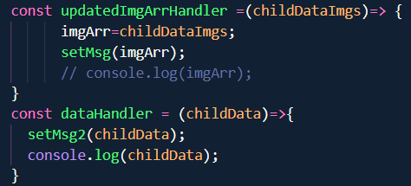
Ar dek re render bapar ache jkn tkn to states lagbai. Dek ekane data o update hbe ar image o tai 2 rkm state use krchi ekane.
E bar valo kore boj ki kothay hbe : dek sob ses e data update jabe bottom.js e. tai oi state gulo bottom e patalam
Ar setState gulo kkn hbe? Jkn jkn child data patabe parent e. Ei j child ei func prop e data patiachilo
E dek func gulo banalam . Ar dek child er data extract kore seta k setState e deoa hochhe. Jar fole seta oi bottom e patano state gulo k update korche (setState to state k update kore temni)
Mane basically new image ar data gulo k first e extract krhe child er theke then bottom e pass krche

