Slide 1


It’s Dangerous To Go Alone
BATTLING THE INVISIBLE MONSTERS IN TECH
Julie Pagano @juliepagano
PyCon2014

Slide 2

–CODING–

Slide 3
Ways to Improve
Testing
Design patterns Software craftsmanship Tools
more...

Slide 4
We’re missing something

Slide 5

–CODING–

Slide 6

–CODING–

Slide 7

–CODING–

Slide 8

–CODING–

Slide 9

These issues create hurdles to success

Slide 10

communal
What we do is

Slide 11

We need to talk about this
Ignoring it makes it worse

Slide 12
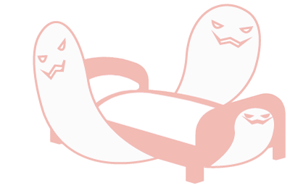
adult version of the
monsters under the bed

Slide 13
–SELECT–
ISSUES
TOOLS

Slide 14
–SELECT–
ISSUES
TOOLS

Slide 15
Impostor
Syndrome

Slide 16
Impostor Syndrome
“A psychological phenomenon in which people are unable to internalize their accomplishments.”

Slide 17
coding involves regular failure

Slide 18
Average Person
failure
success

Slide 19
Impostor Syndrome
failure
success

Slide 20
Impostor Syndrome
success
failure

Slide 21
Victories diminish in importance.
Failures loom large.

Slide 22
Impostor Syndrome can impact anyone

Slide 23

I was just lucky

Slide 24
I’m not that smart

Slide 25
I’m not a good programmer

Slide 26

I’m a FRAUD

Slide 27
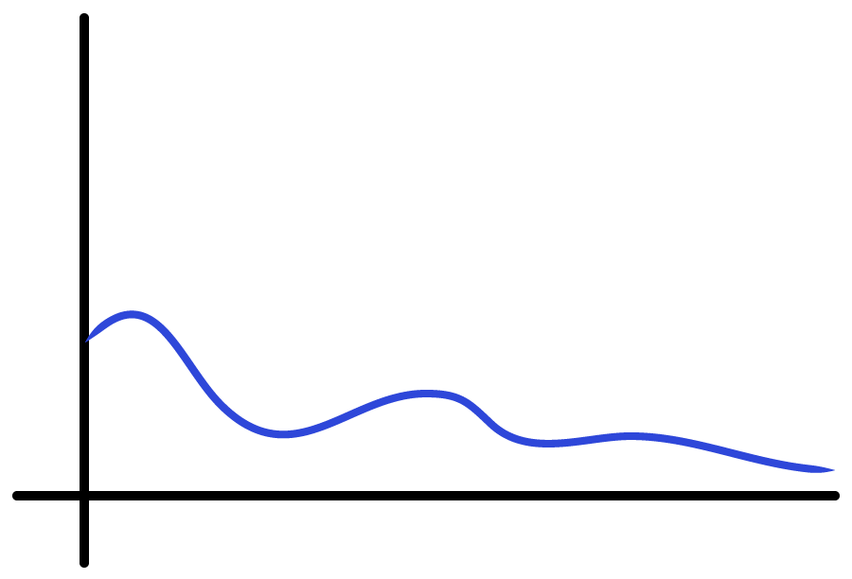
Average Person
INSECURITY
CAREER

Slide 28
Average Person
INSECURITY
new job
CAREER

Slide 29
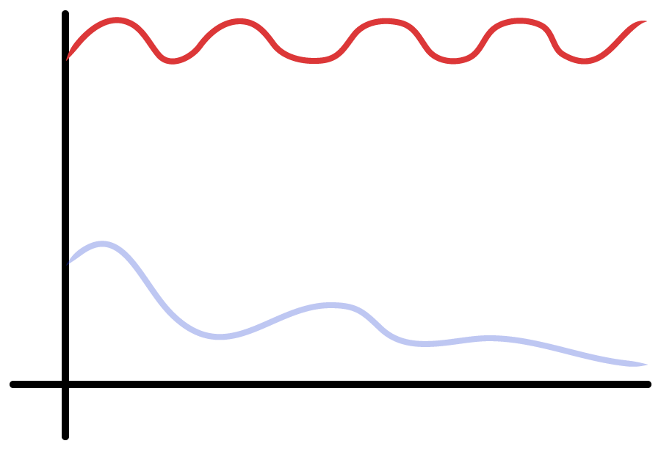
Impostor Syndrome
INSECURITY
CAREER

Slide 30
people with impostor syndrome
hold themselves back

Slide 31
Do not share knowledge

Slide 32
Do not collaborate

Slide 33
Do not help with OSS

Slide 34
Do not apply for jobs

Slide 35
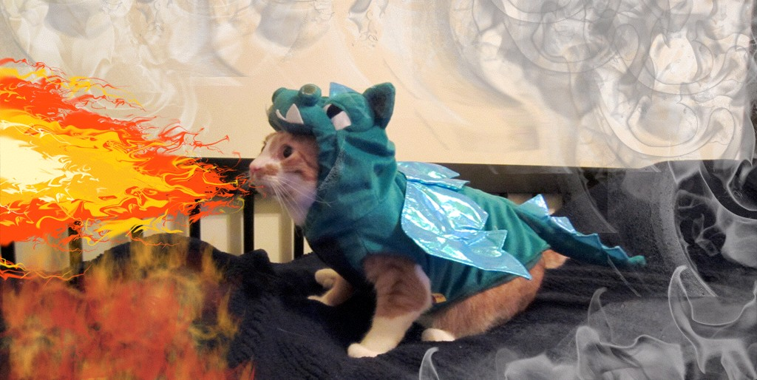
You shouldn’t feel like you have to slay a dragon to get a job.

Slide 36
Start small. Remain small. End up small.

Slide 37
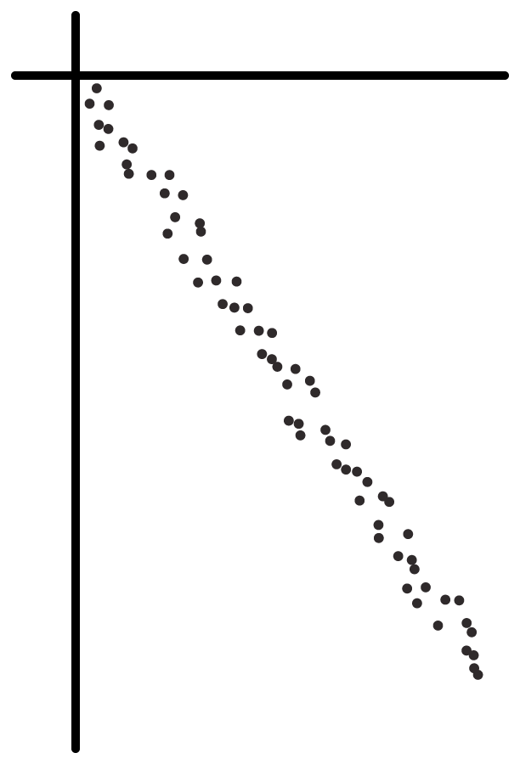
Perceived Ability
Actual Ability

Slide 38
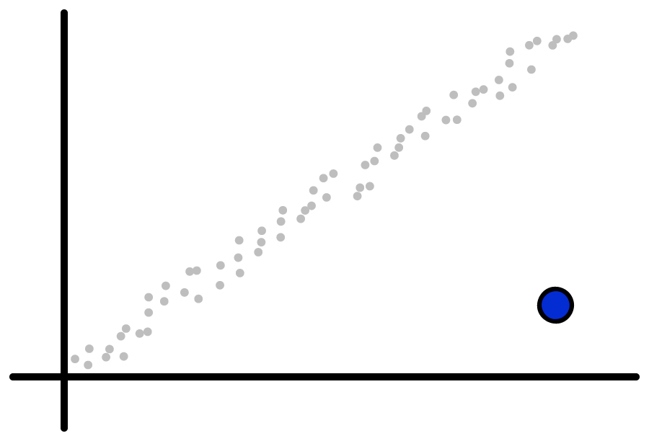
Perceived Ability
Impostor Syndrome
Actual Ability

Slide 39
Dunning-Kruger Effect

Slide 40
Dunning-Kruger Effect
“A cognitive bias in which unskilled individuals suffer from illusory superiority, mistakenly rating their ability much higher than average.”

Slide 41
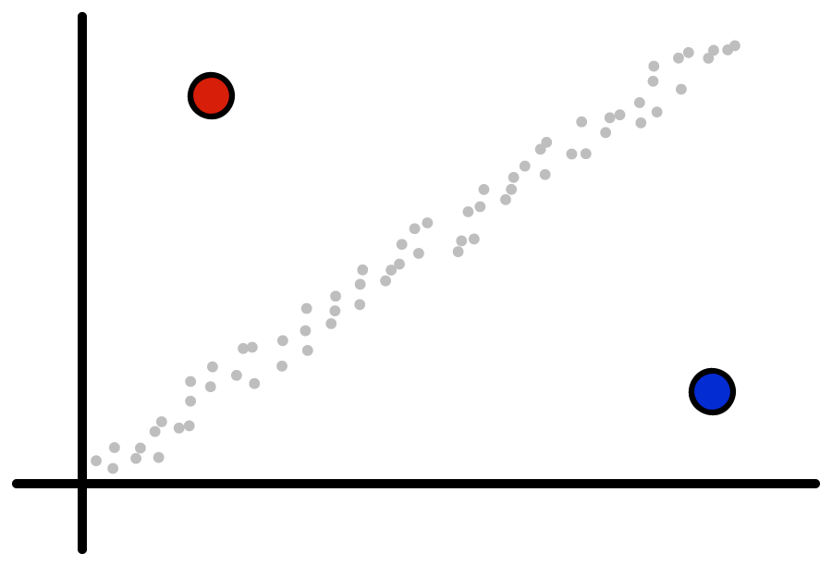
Dunning-Kruger Effect
Perceived Ability
Impostor Syndrome
Actual Ability

Slide 42
people with impostor syndrome
push themselves too hard

Slide 43


Slide 44


Burnout

Slide 45

Burnout
“Long-term exhaustion and diminished interest in work.”

Slide 46

–CODING–

Slide 47
GAME OVER

Slide 48
GAME OVER

Slide 49
–SELECT–
ISSUES
TOOLS

Slide 50




IT’S DANGEROUS TO GO ALONE! TAKE THESE.
+

Slide 51

Build a Party

Slide 52

Track Measurable Progress

Slide 53
Look for Positives
+ + + +

Slide 54
Look for Positives
help others find positives
+ + + +

Slide 55
Avoid Negatives
-

Slide 56
Avoid Negatives
avoid creating negative spaces
-

Slide 57

No feigning surprise No well-actually’s No backseat-driving No subtle sexism
(or racism, homophobia, etc.)

Slide 58

Help Others

Slide 59

Kill Your Heroes
not literally

Slide 60
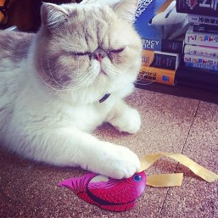
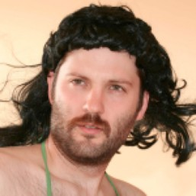
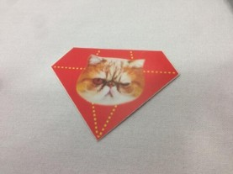
Aaron Patterson
A wild Tenderlove appears!

Slide 61
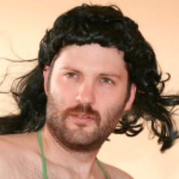
I get insanely nervous when I give presentations

Slide 62
Fake It ‘til You Make It

Slide 63
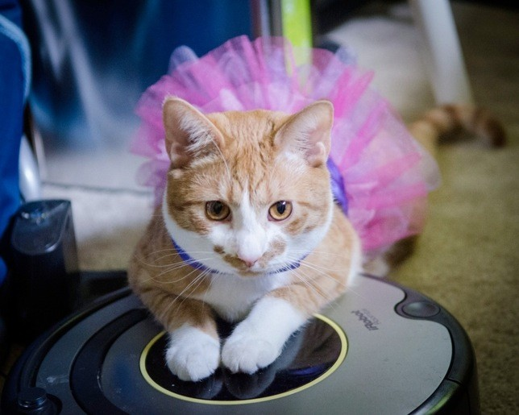
The secret to life is pretending you know what you’re doing.

Slide 64
Talk about it

Slide 65
Help yourself

Slide 66
Help others

Slide 67
Enjoy coding

Slide 68
Join our online support group
bit.ly/impostor-syndrome-support

Slide 69

Feedback, please!
Julie Pagano
@juliepagano

Slide 70
References
Impostor Syndrome - http://en.wikipedia.org/wiki/ Impostor_syndrome
Dunning-Kruger effect - http://en.wikipedia.org/wiki/ Dunning%E2%80%93Kruger_effect
All The Things! - http://hyperboleandahalf.blogspot.com/ 2010/06/this-is-why-ill-never-be-adult.html
Hacker School Social Rules - https:// www.hackerschool.com/manual#sub-sec-social-rules
Aaron Patterson at SCRC12 - http://www.confreaks.com/ videos/1137-scrc2012-open-source-how-to-give-back

Slide 71
Attribution
Road barrier from the noun project - http://thenounproject.com/noun/road- barrier/#icon-No4357
Conversation designed by Anna Weiss from The Noun Project - http:// thenounproject.com/noun/conversation/#icon-No1680
Ghost designed by Emily Haasch from The Noun Project - http:// thenounproject.com/noun/ghost/#icon-No9345
Bed from noun project - http://thenounproject.com/noun/bed/#icon-No12395
Group designed by Benny Forsberg from The Noun Project - http:// thenounproject.com/noun/group/#icon-No14947
Handshake designed by Marc Nadue from The Noun Project - http:// thenounproject.com/noun/handshake/#icon-No10714
Scale designed by Stephanie Wauters from The Noun Project - http:// thenounproject.com/noun/scale/#icon-No10409

Slide 72
Additional Resources
Ruby Rogues #107 Syndrome with Tim Chevalier - http://rubyrogues.com/107-rr-impostor-syndrome- with-tim-chevalier/
Geek Feminism Wiki - http:// geekfeminism.wikia.com/wiki/Impostor_syndrome
Kicking impostor syndrome in the head: lessons from AdaCamp DC and SF - http://adainitiative.org/ 2013/06/kicking-impostor-syndrome-in-the-head- lessons-from-adacamp-dc-and-sf/
Overcoming Impostor Syndrome - https:// medium.com/tech-talk/bdae04e46ec5

