Slide 1

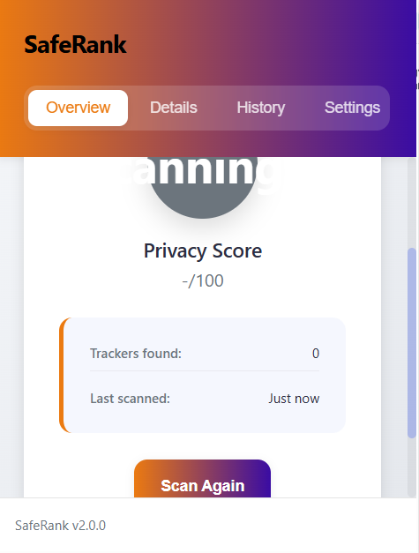
SafeRank
Chrome Extension
WOMEN SAFETY

Slide 2

Problem
Statement
The Challenge Women Face Online
Targeted harassment & stalking due to tracking-based ads.
Invasive trackers collect browsing history, preferences, and sensitive information.
Women searching for health, safety, or social issues are at risk of exposure and profiling.
Current privacy tools are too technical, confusing, or lack awareness features.

Slide 3

Why It
Matters
Online tracking enables digital violence (e.g., stalkers using data trails).
Privacy breaches amplify vulnerability in social and professional spaces.
Women deserve equal access to safe digital environments.
Building awareness of trackers empowers informed decisions.

Slide 4
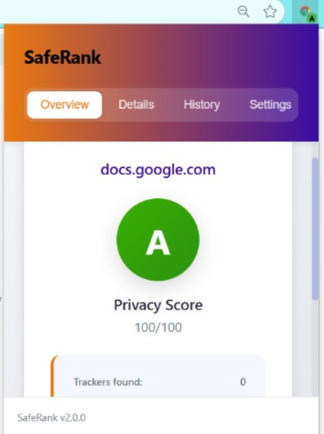
SafeRank
Chrome Extension
Our
Solution
Privacy Score Analyzer – Chrome Extension (SafeRank)
Automatically scans websites for trackers, cookies, fingerprinting.
Assigns a clear A–F privacy grade.
Gives users control and awareness about where they browse.

Slide 5
SafeRank
Chrome Extension
Extension’s
Main Features
1
🔍 Comprehensive Tracker Detection
2
Privacy Scoring System
HTML, JS, cookies, localStorage, fingerprinting.
Weighted, color-coded, easy to interpret.
3
User-Friendly Interface
4
Real-Time Badge Display
Quick overview, detailed breakdown, history log.
Shows privacy score on the extension icon.
🔐 Privacy-First Design
6
Fast Response Time
5
Works 100% locally → No data leaves the browser.
The responsive Time is 20ms which is really fast and quick.

Slide 6

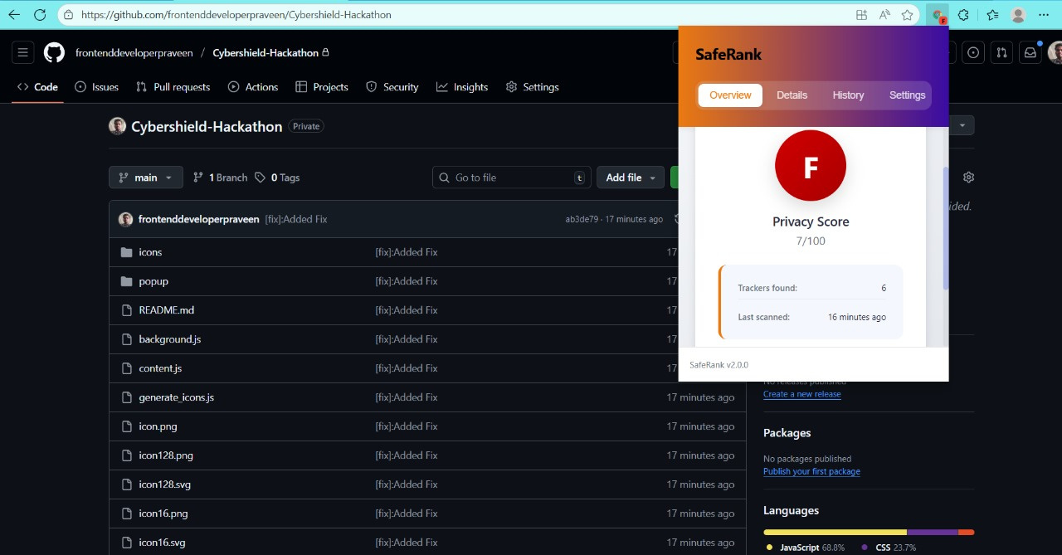
🟢 Privacy Score - Scans all the trackers of the website and estimate a score.
🔴 Auto Tracker Block - Block all the known trackers make the surf private and secure.
🟠 Details - Details about all the tracker
in the website
⚫ AutoScanning - Uses shodan API internally to check is the website is a phishing website.
🔵 Request and Redirect AutoBlock - If the website is fishy, Extension will restrict the user from accessing the website

Slide 7
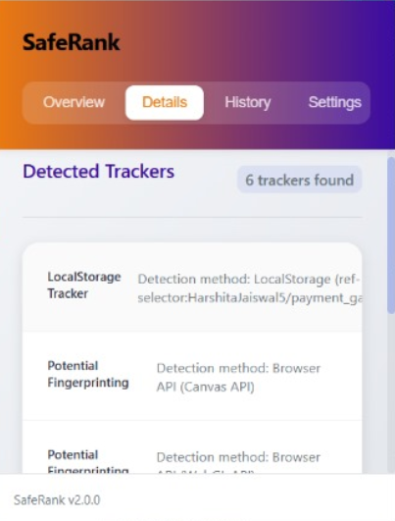
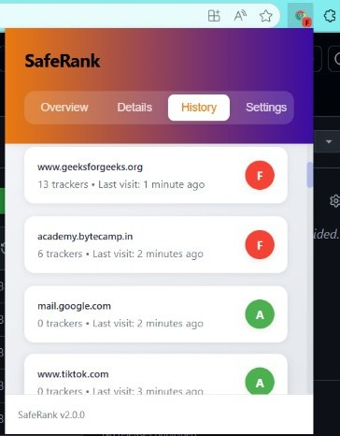
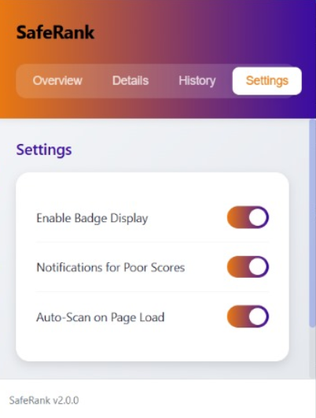
Mockups
SafeRank
Chrome Extension

Slide 8

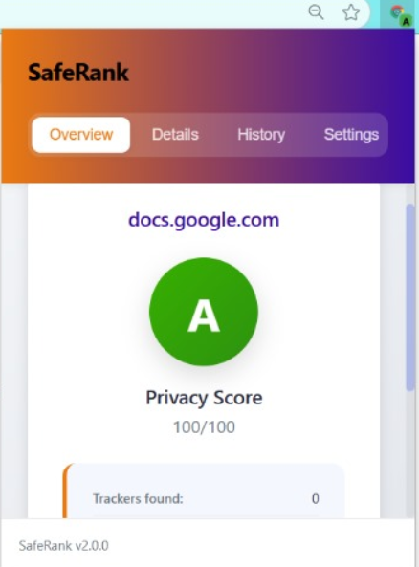
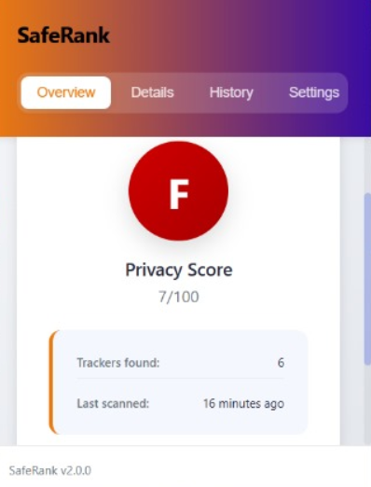
SafeRank
Chrome Extension
Demo Flow
Open any website (eg. a shopping site).
Click on the extension icon.
See privacy grade instantly (A–F).
Explore details: trackers, cookies, fingerprinting.
Compare scores across browsing history.

Slide 9
SafeRank
Chrome Extension
Technical Architecture
Manifest V3 Chrome Extension.
Content Script: Scans web pages.
Background Service Worker: Manages data, scoring, history.
Popup UI: Displays score + tracker breakdown.
APIs Used:
webRequest → Monitor site requests.
scripting → Inject scanner scripts.
storage → Save scores/history.
activeTab → Analyze current tab.
SafeRank
Chrome Extension

Slide 10
Made By:
PRAVEEN KR 23BAI10410
NARMADA NATARAJAN 23BAI11088
SafeRank
WOMEN SAFETY
Chrome Extension

