Slide 1
Splice Event Annotation
cortar, GENEie, SpliceVault, FRASER, etc.

Slide 2
Decision Tree

Slide 3
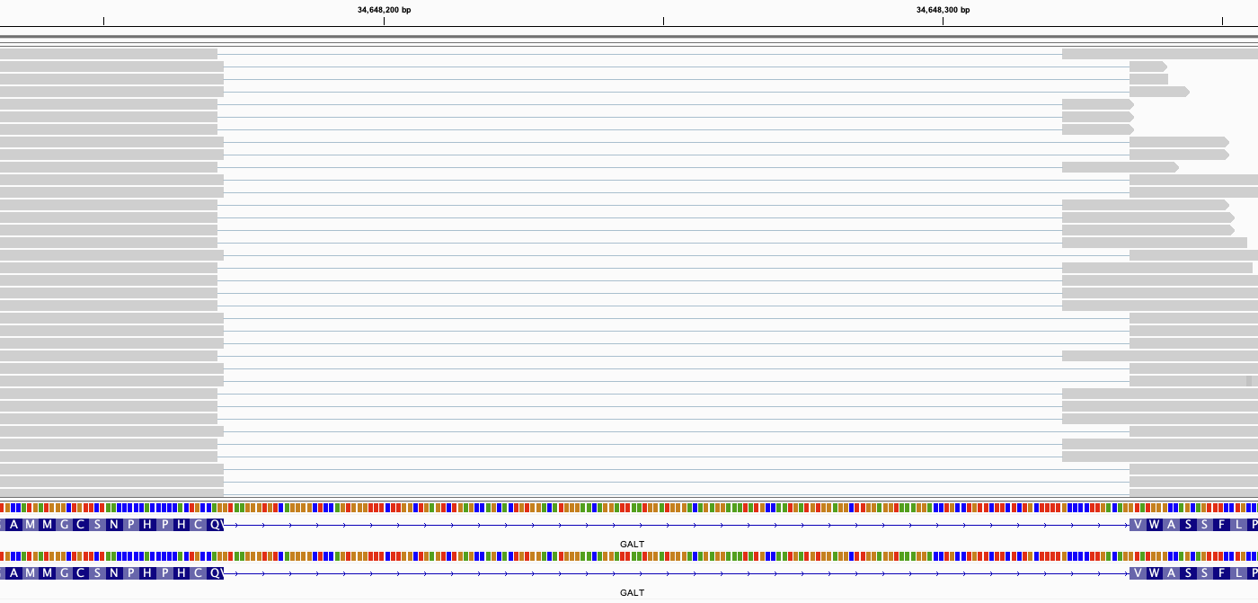
Exonic donor (takes final exon G) and intronic acceptor (new AG)
GCCA
taGCCAG
GCCAG
cagGTATG

Slide 4
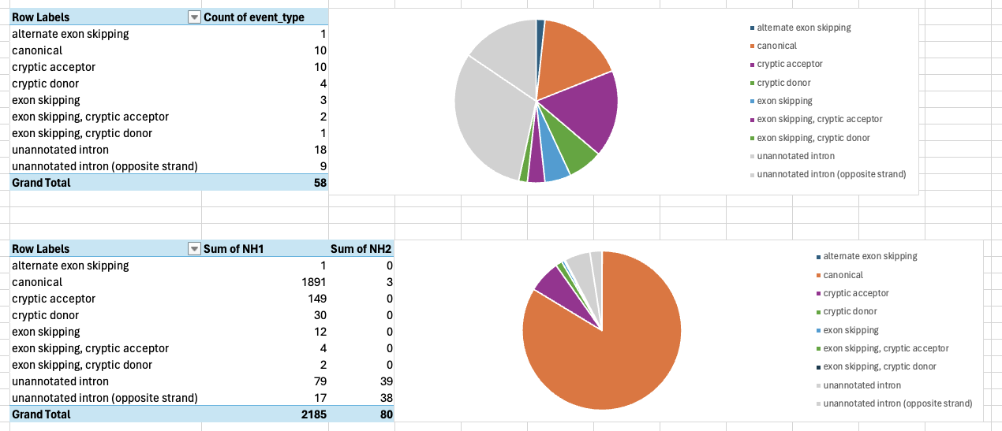
GALT
Junctions Identified
Reads per Junction

Slide 5
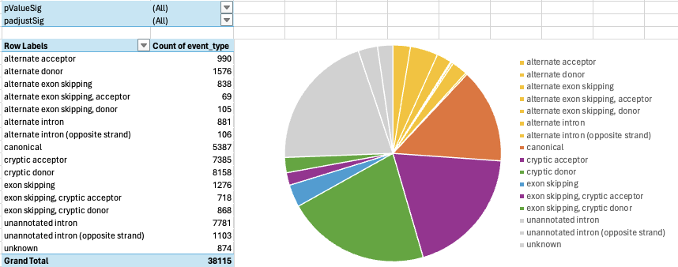
FRASER for Family IK
All Junctions Identified

Slide 6
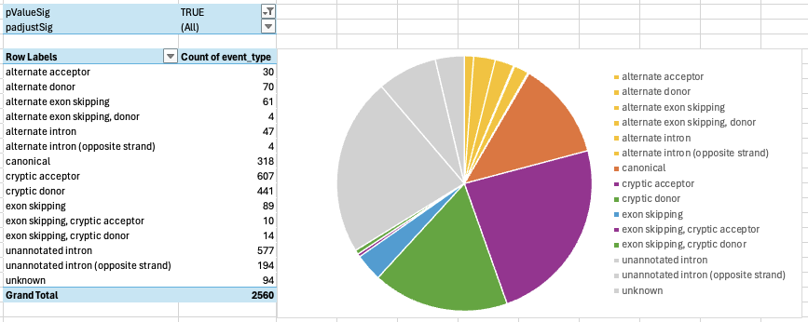
FRASER for Family IK
All Significant Junctions Identified (not adjusted for FDR)

Slide 7
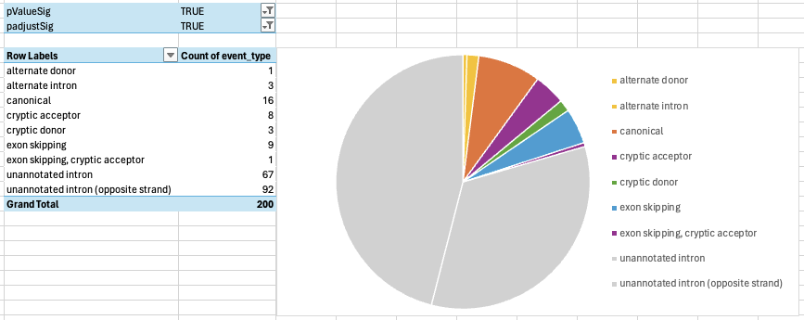
FRASER for Family IK
All Significant Junctions Identified (adjusted for FDR)

