Slide 1
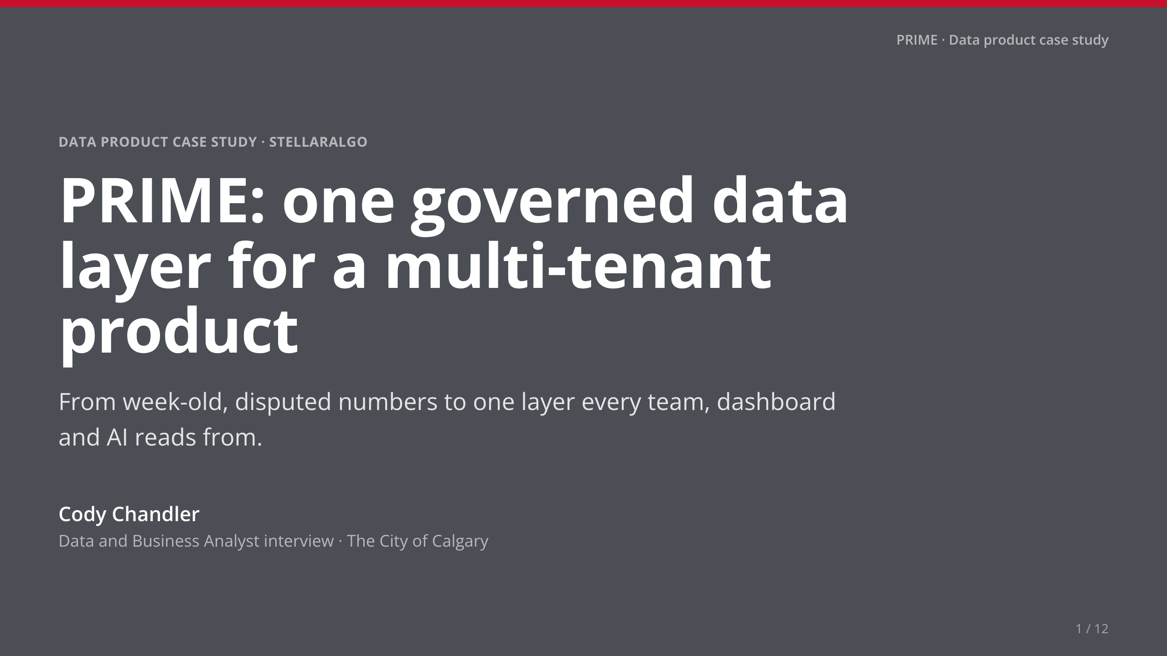
Notes:
• [Your story: one line on who you are.]
• Then: 'I'll tell this as a STAR story. Each part answers your questions in order.'

Slide 2
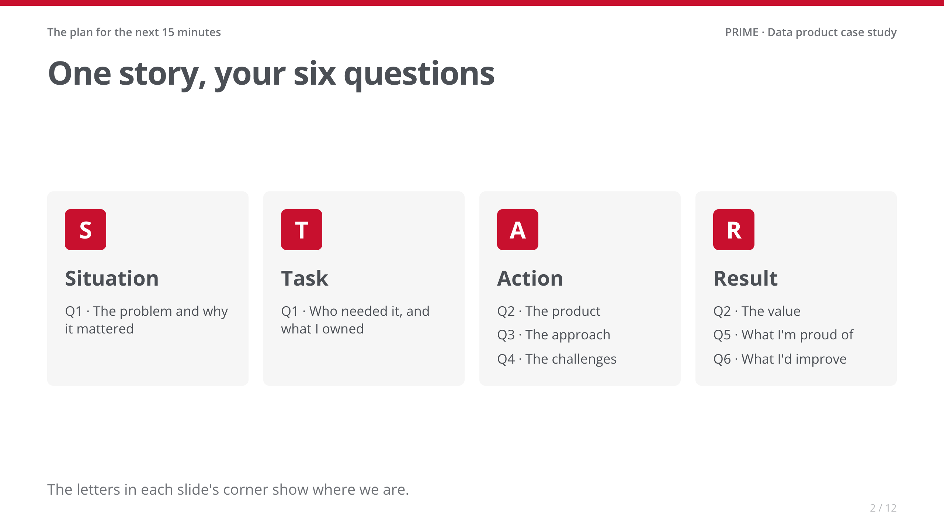
Notes:
• Thirty seconds. Don't read the boxes; just point at the letters.

Slide 3
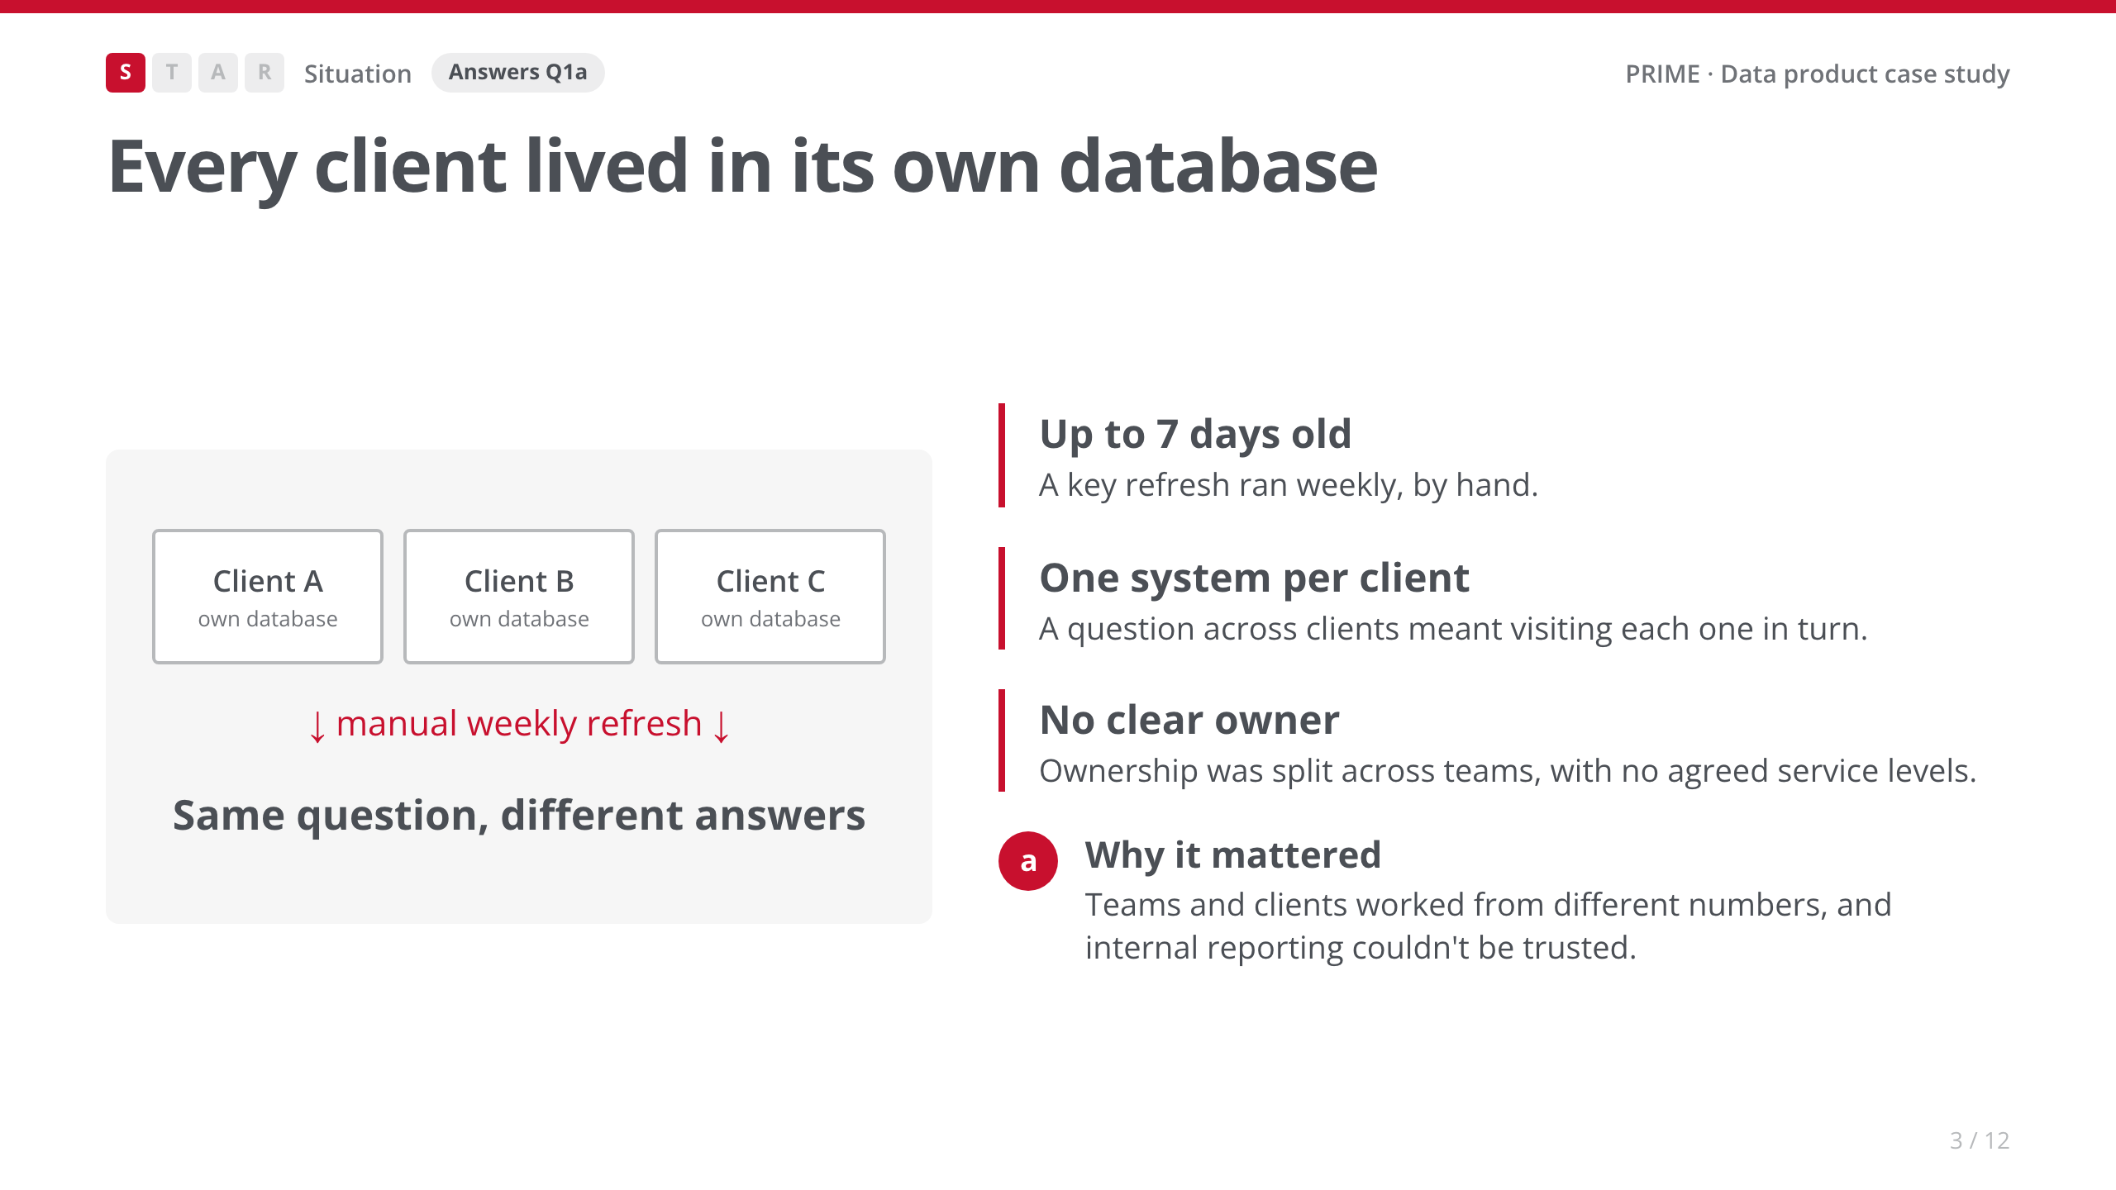
Notes:
• The multi-tenant design was right for the product, but it made internal reporting hard.
• [Your story: one concrete moment when inconsistent numbers hurt: a client call, a leadership report.]

Slide 4
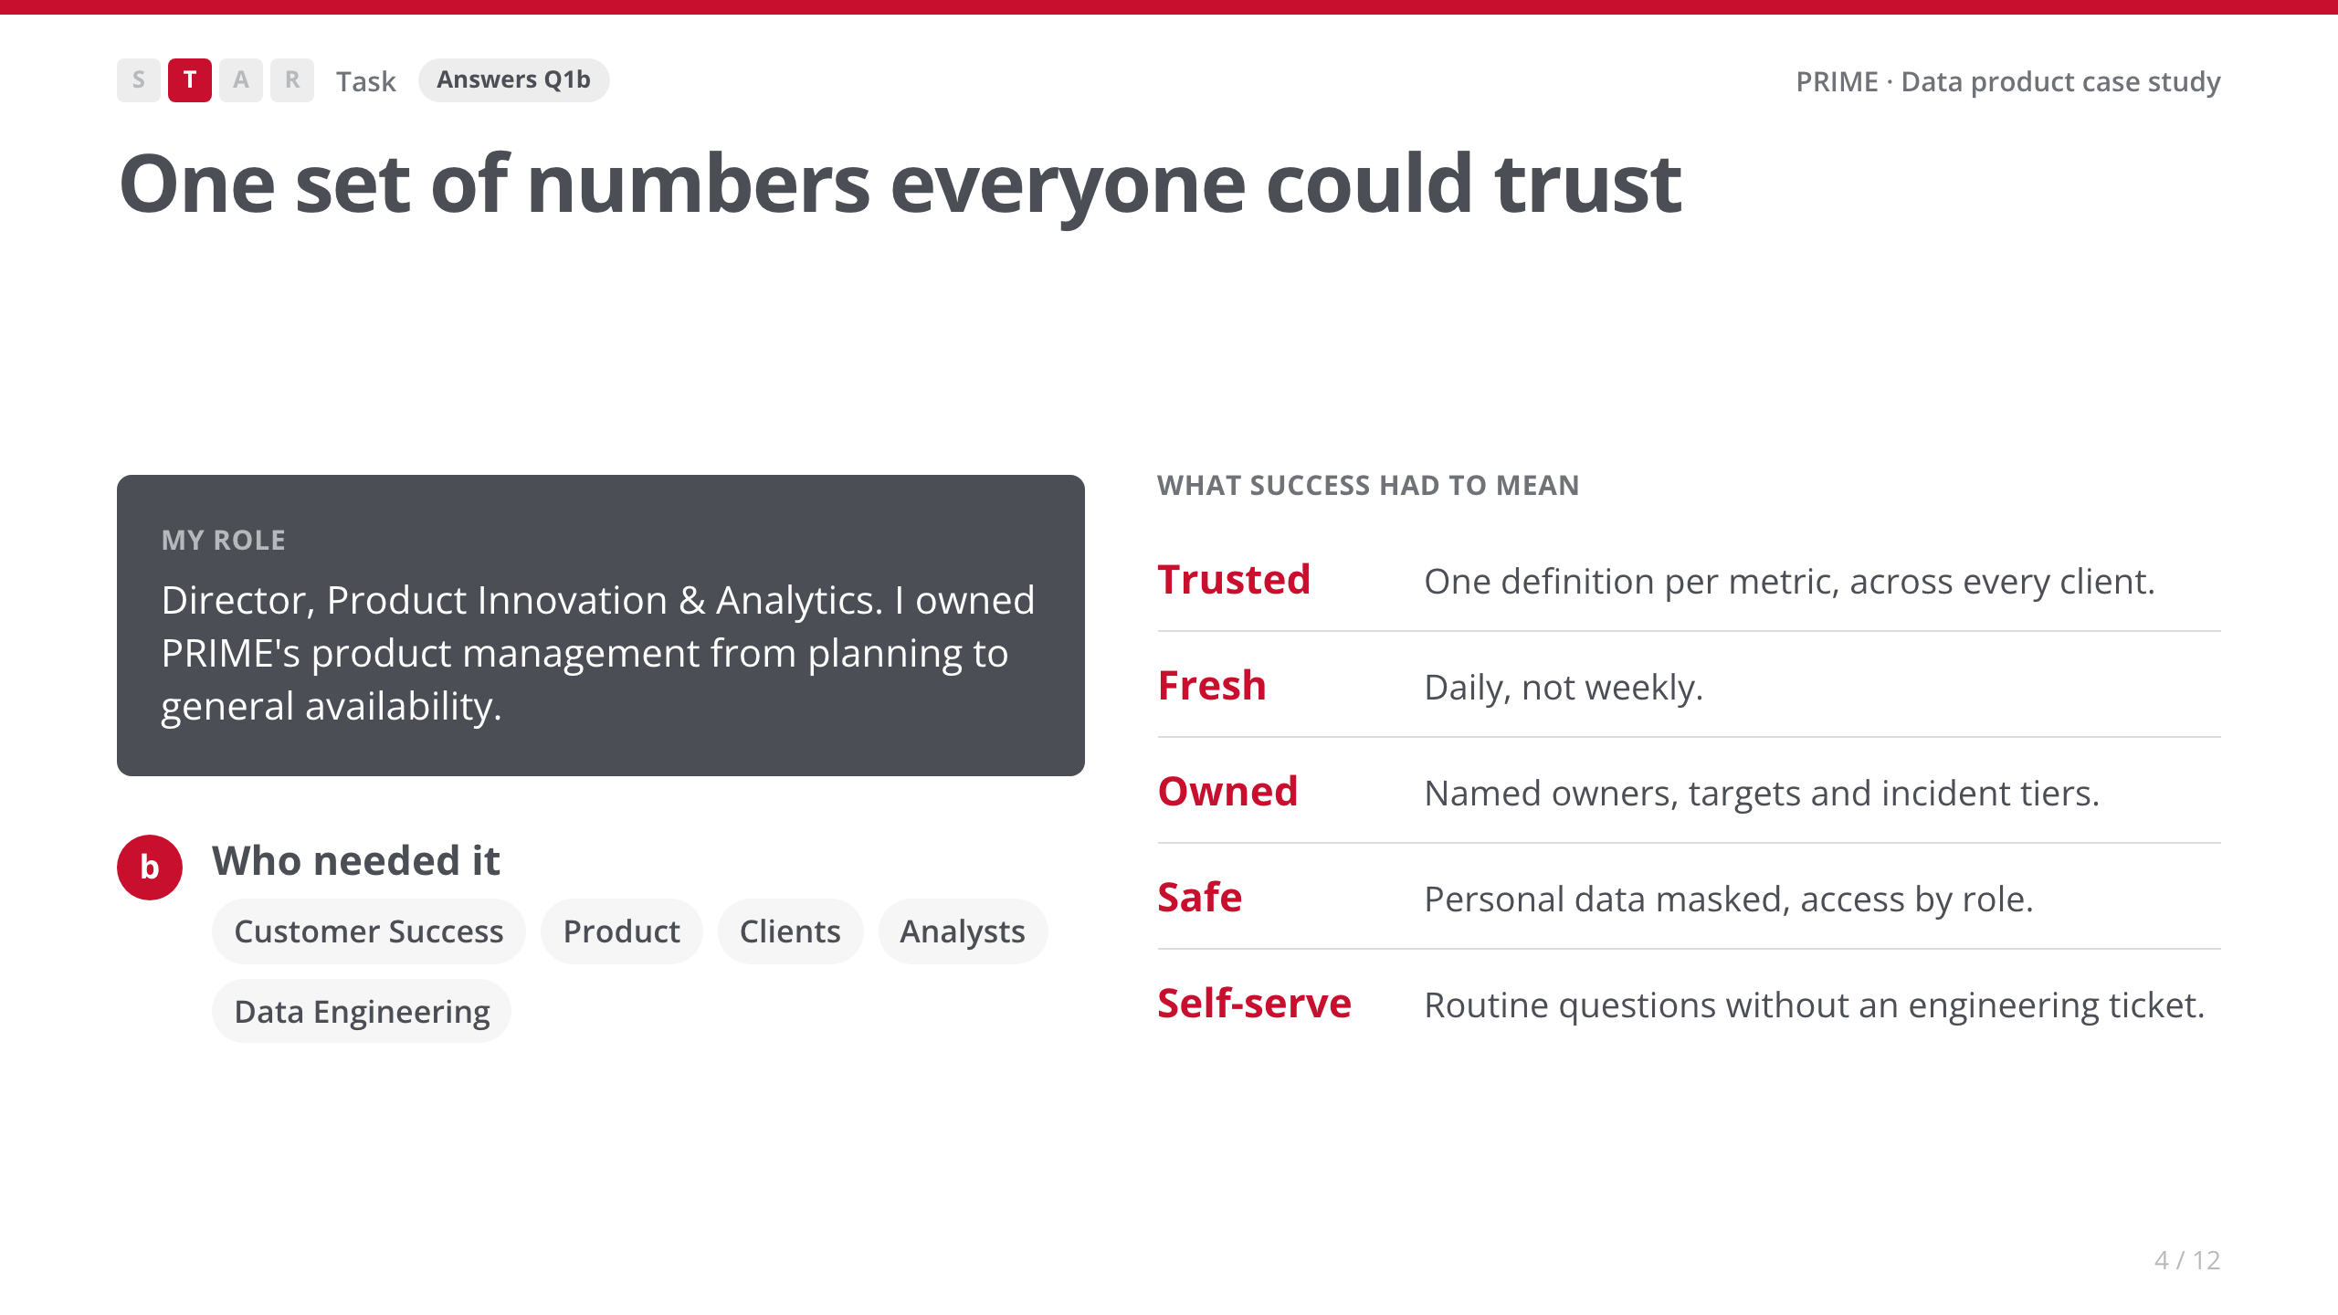
Notes:
• [Your story: how you gathered requirements. Who you talked to, and what they asked for most.]
• Say: 'These five became the checklist. I'll come back to each one in the results.'

Slide 5
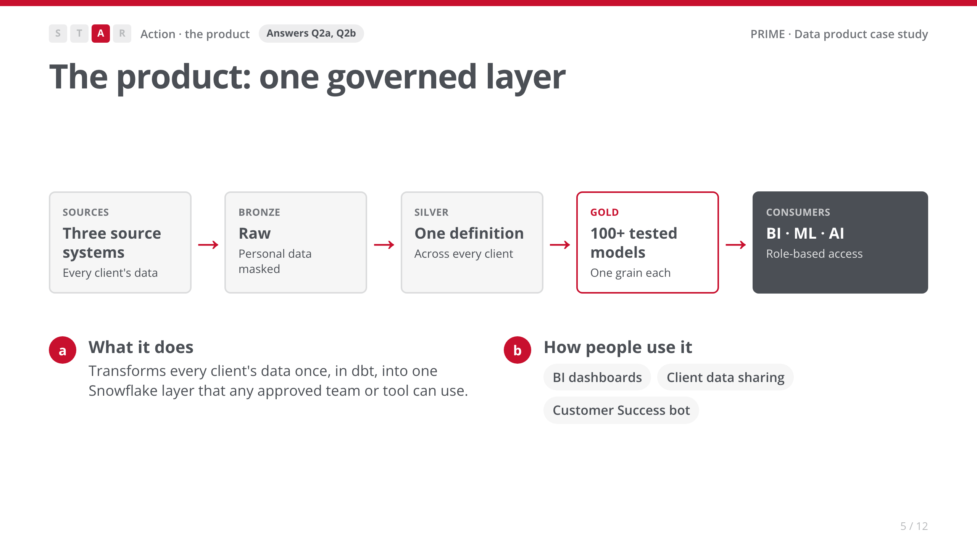
Notes:
• Walk the flow left to right in one breath. The point: transform once, use everywhere.
• My part: product owner. I worked with Data Engineering and Customer Success, with a small product pod.

Slide 6
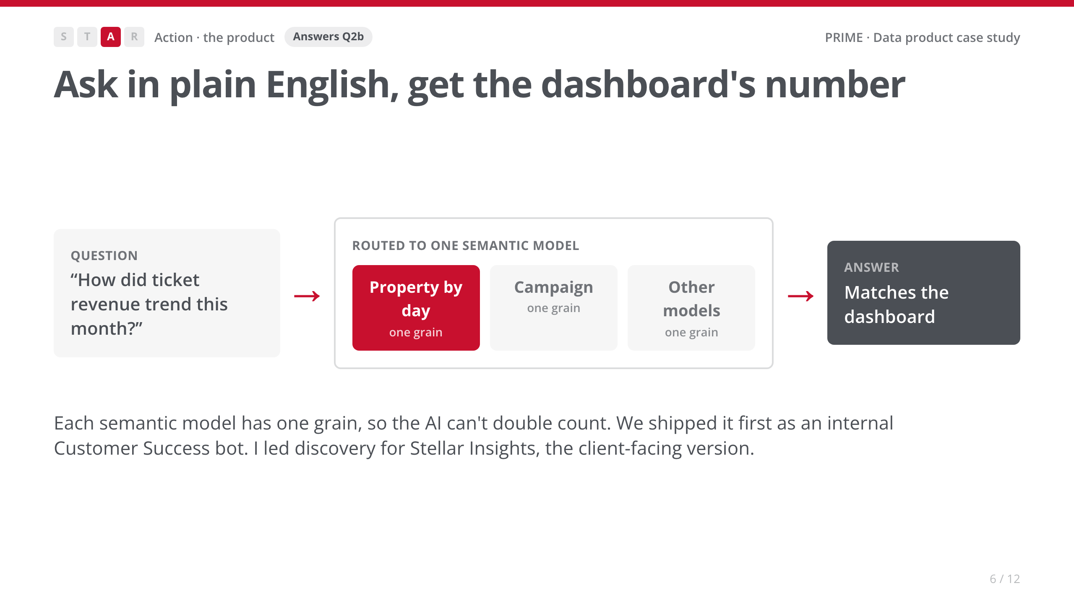
Notes:
• This is the 'show the product' moment. Trace the arrows once.
• The example question is illustrative. [Your story: a real question the CS bot answered.]

Slide 7
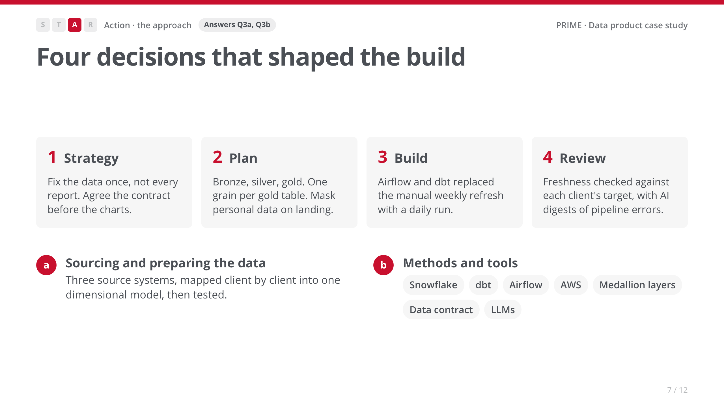
Notes:
• Strategy first, tools last. The panel cares more about the why than the stack.
• [Your story: the real build order, and what you'd sequence the same way again.]

Slide 8
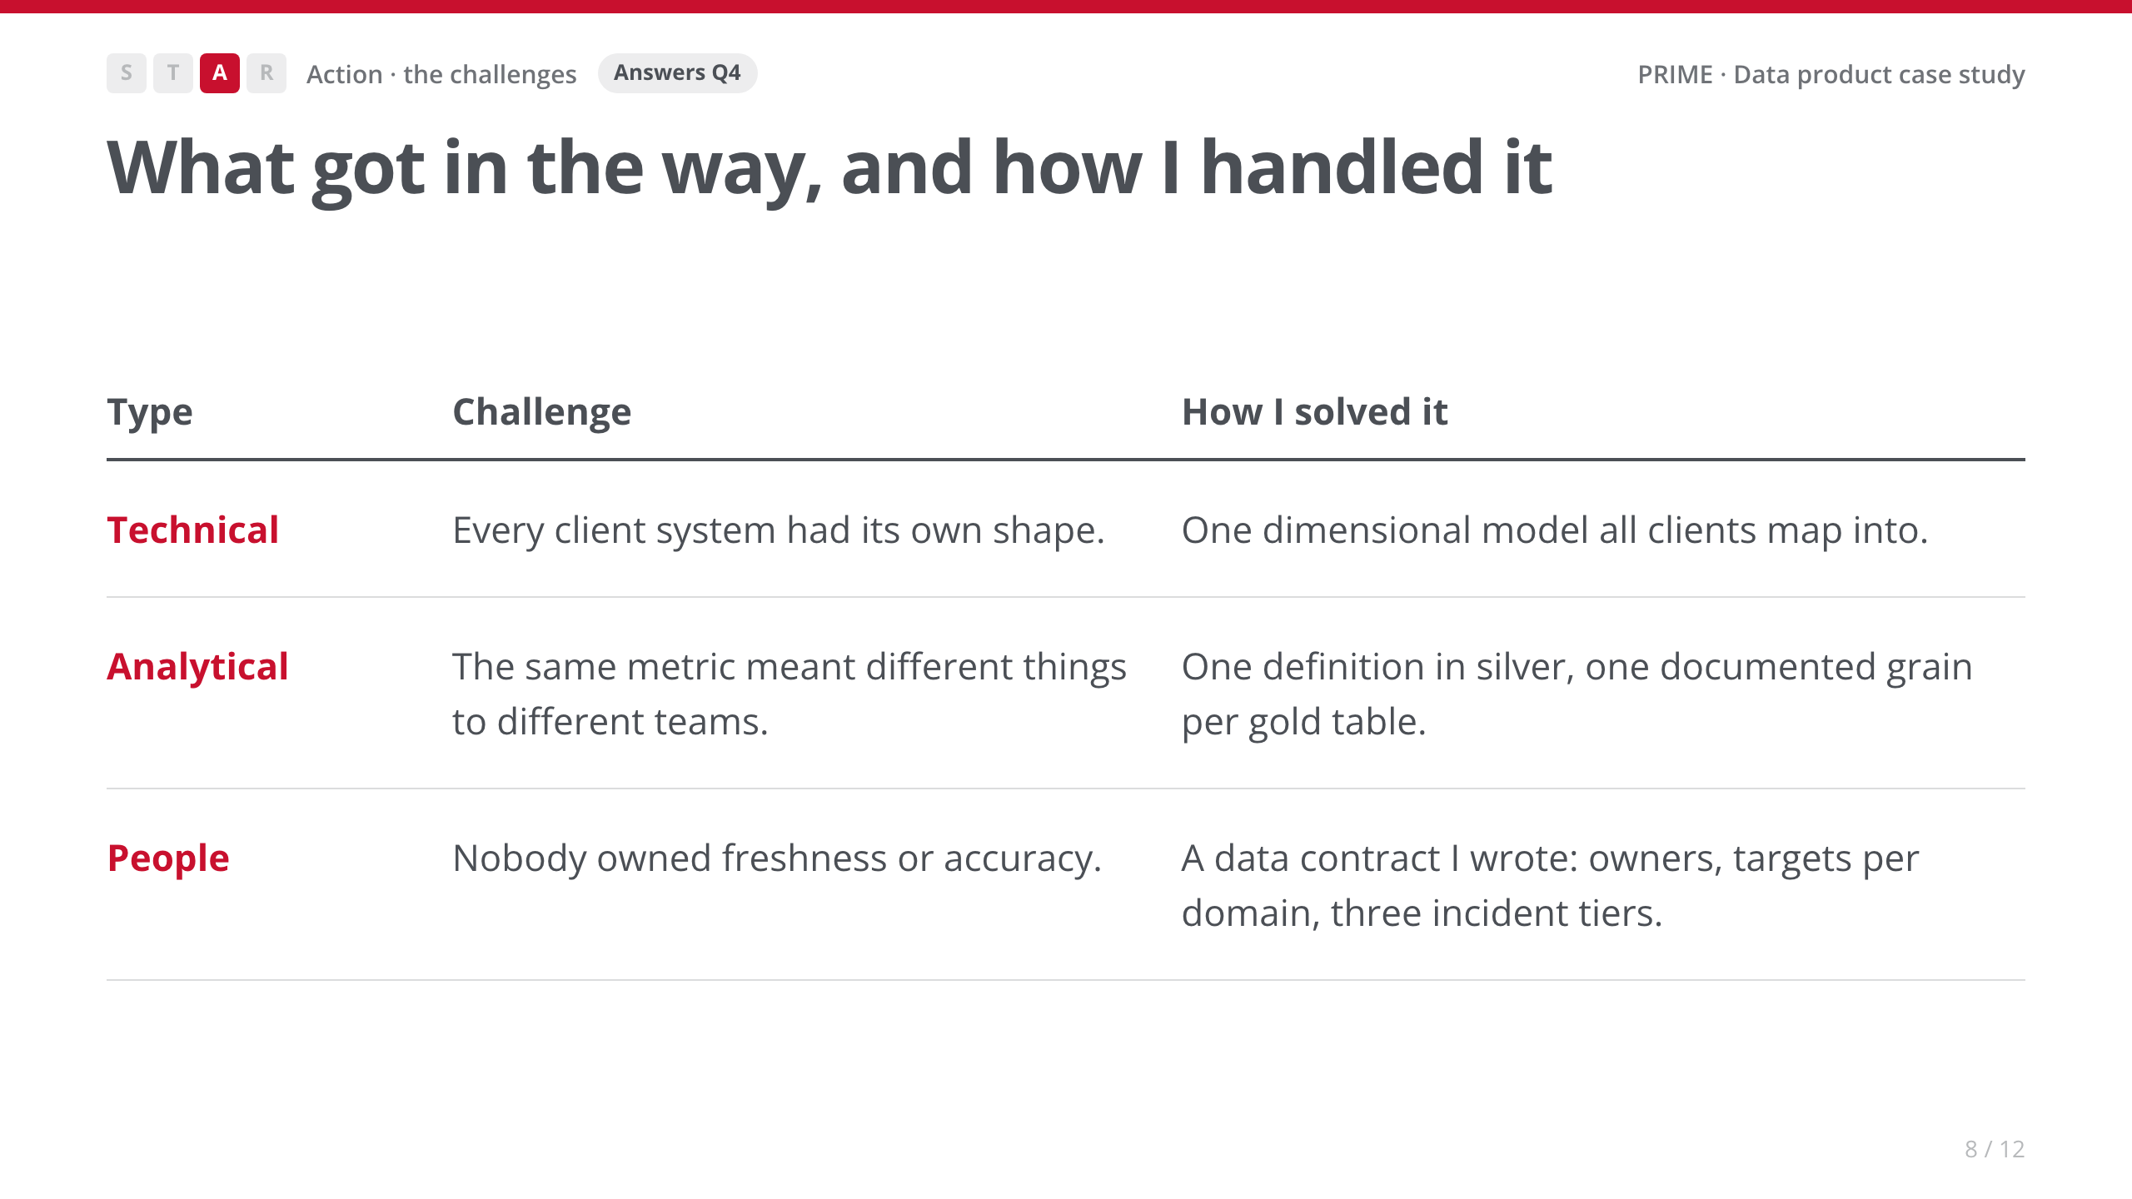
Notes:
• Spend most of the time on the People row. It's the one an analyst role at the City will relate to.
• [Your story: the conversation that got the data contract agreed. Who pushed back, and what changed their mind?]

Slide 9
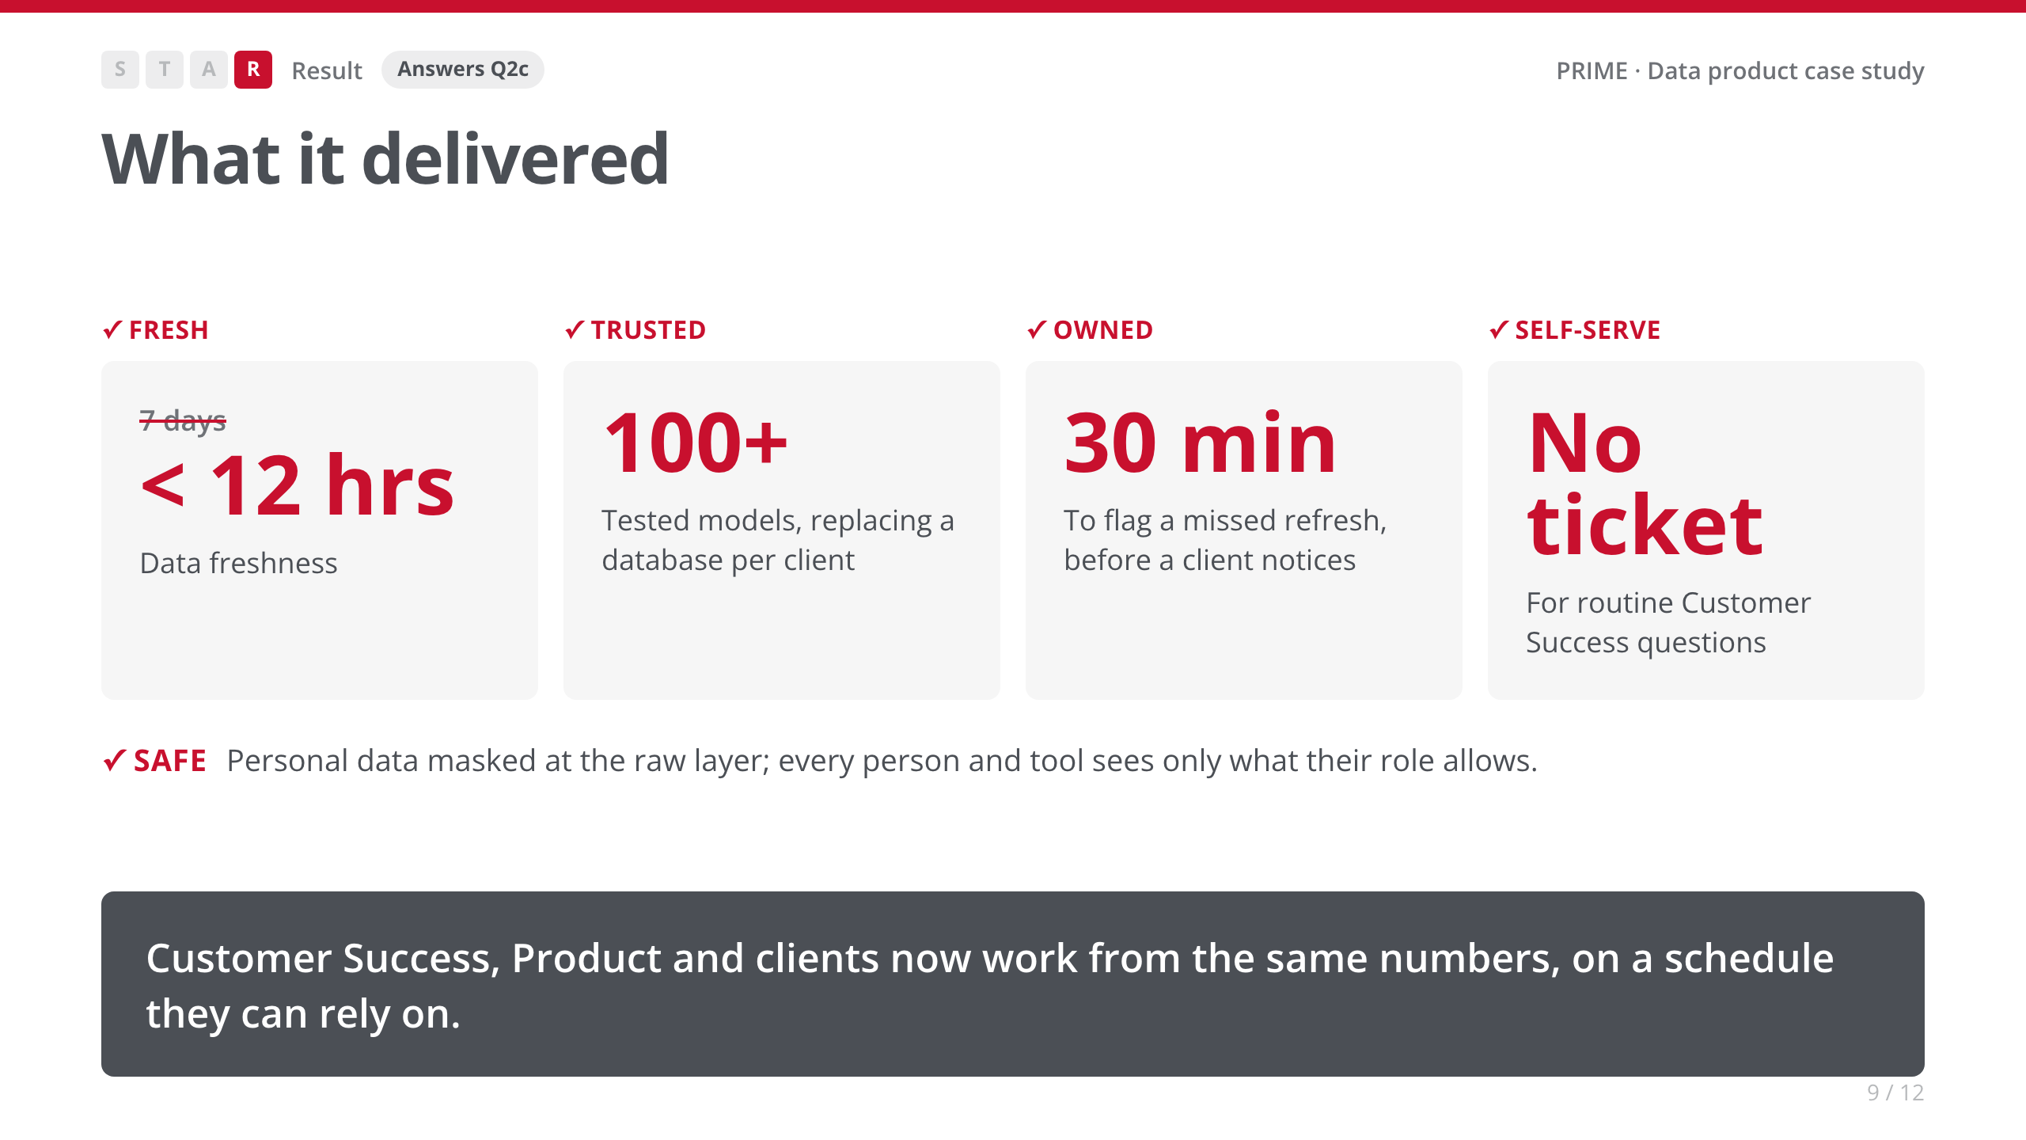
Notes:
• Tie each result back to the checklist from Task.
• [Your story: an adoption or time-saved number. A real number beats 'no ticket'.]

Slide 10
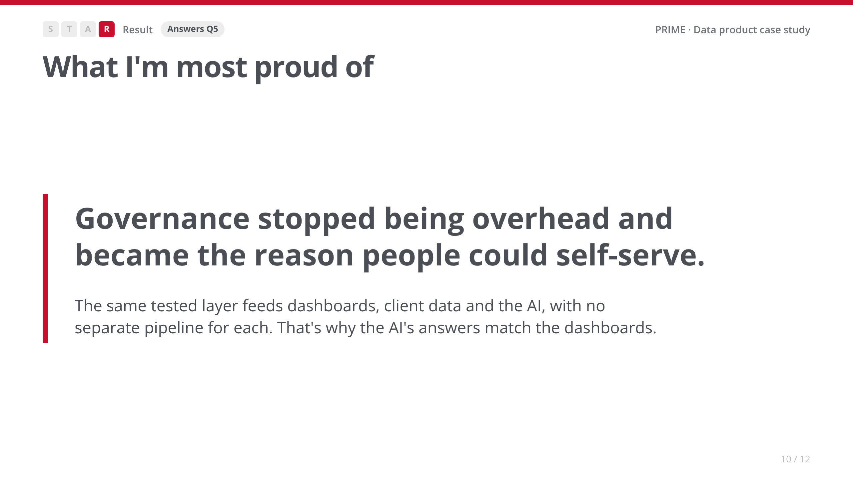
Notes:
• Slow down here. This is the line to remember.
• [Your story: the first time a team trusted an answer without double-checking it.]

Slide 11
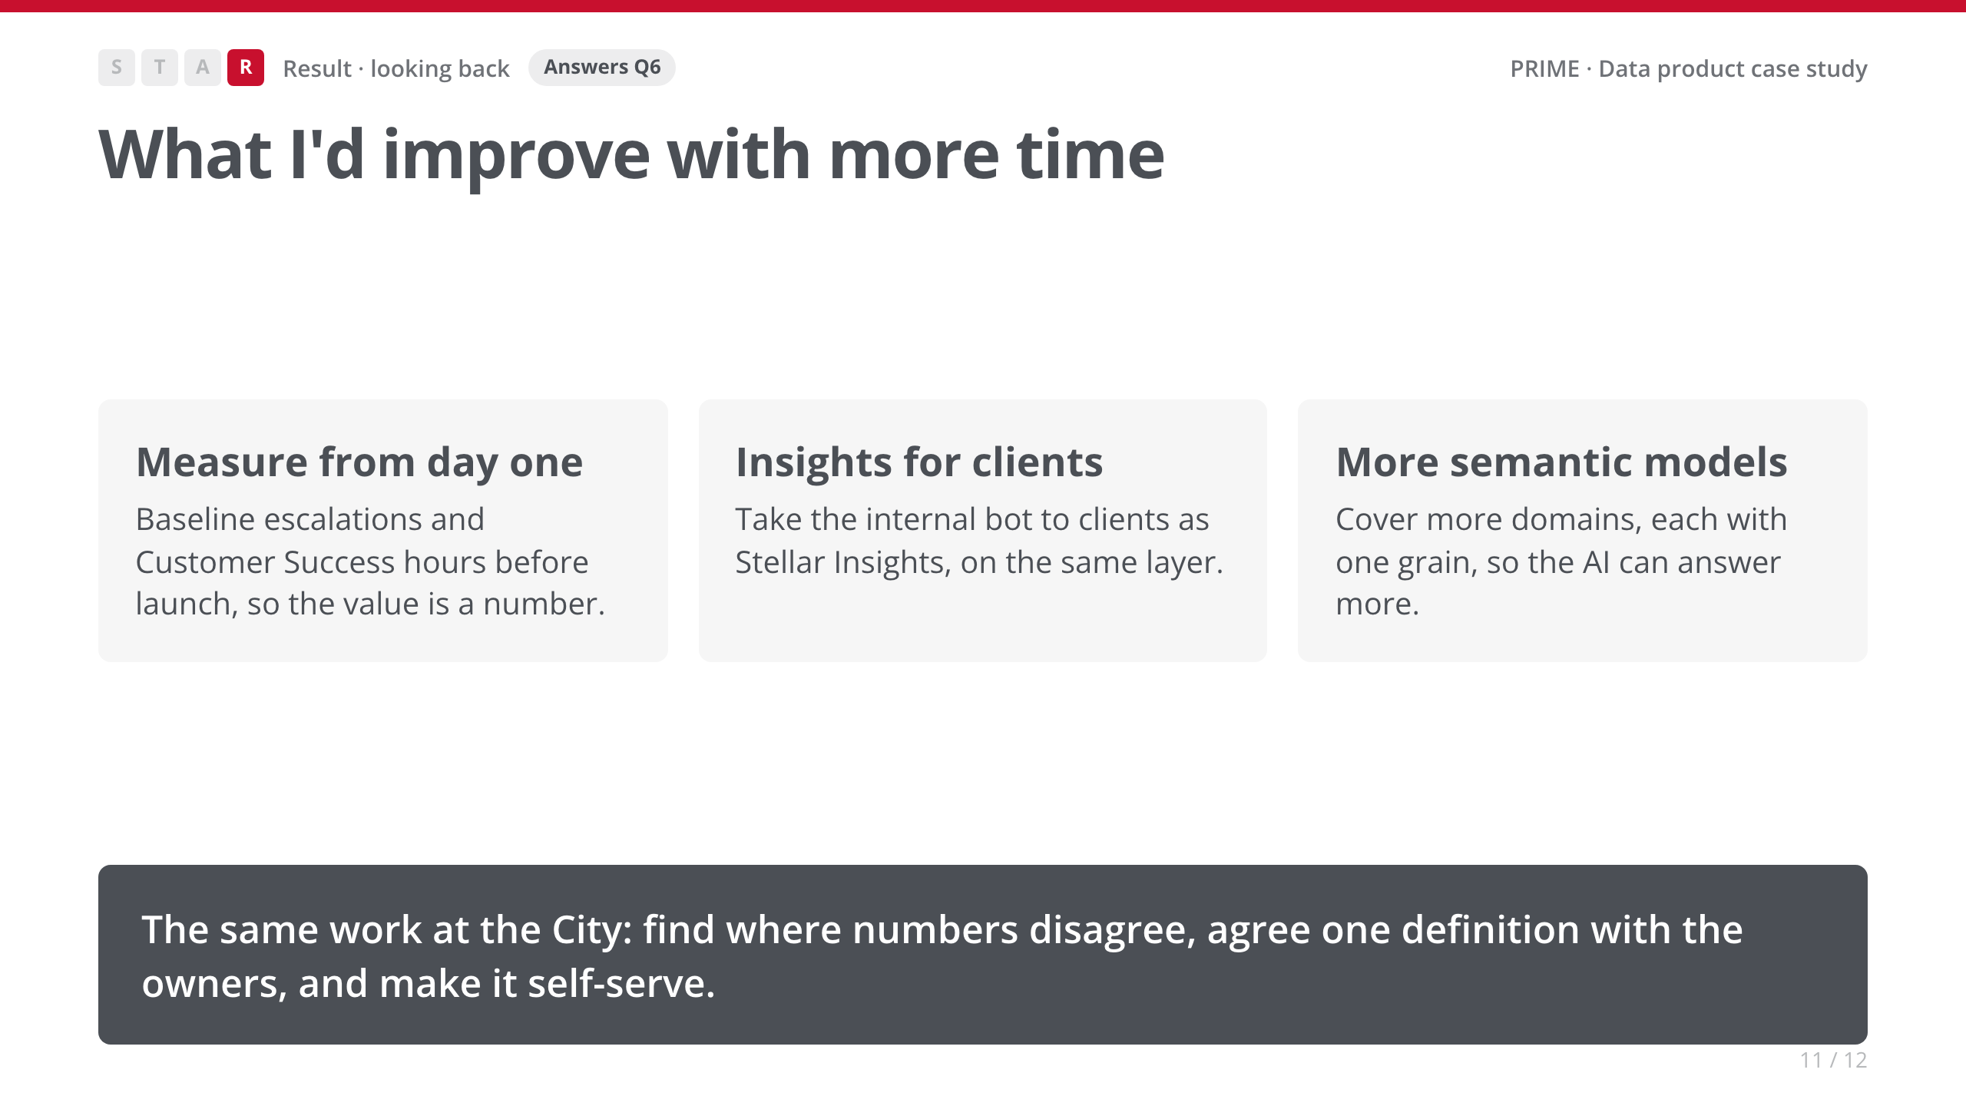
Notes:
• [Your story: swap in whatever you'd genuinely do differently.]
• Land the closing line slowly. It's the bridge to the role.

Slide 12
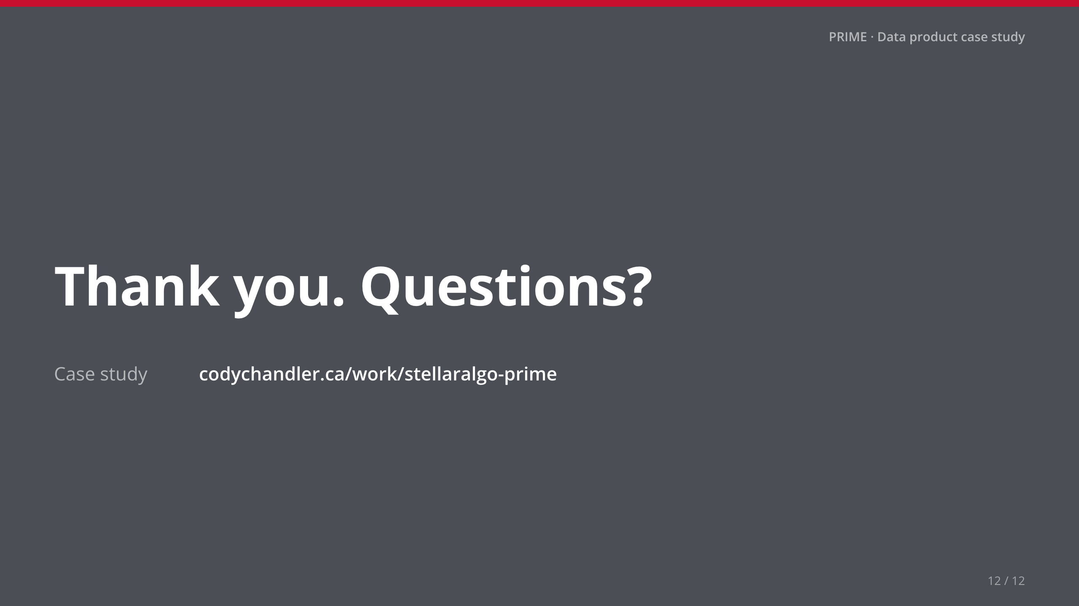
Notes:
• Stop talking. Leave this up for questions.

