Slide 1
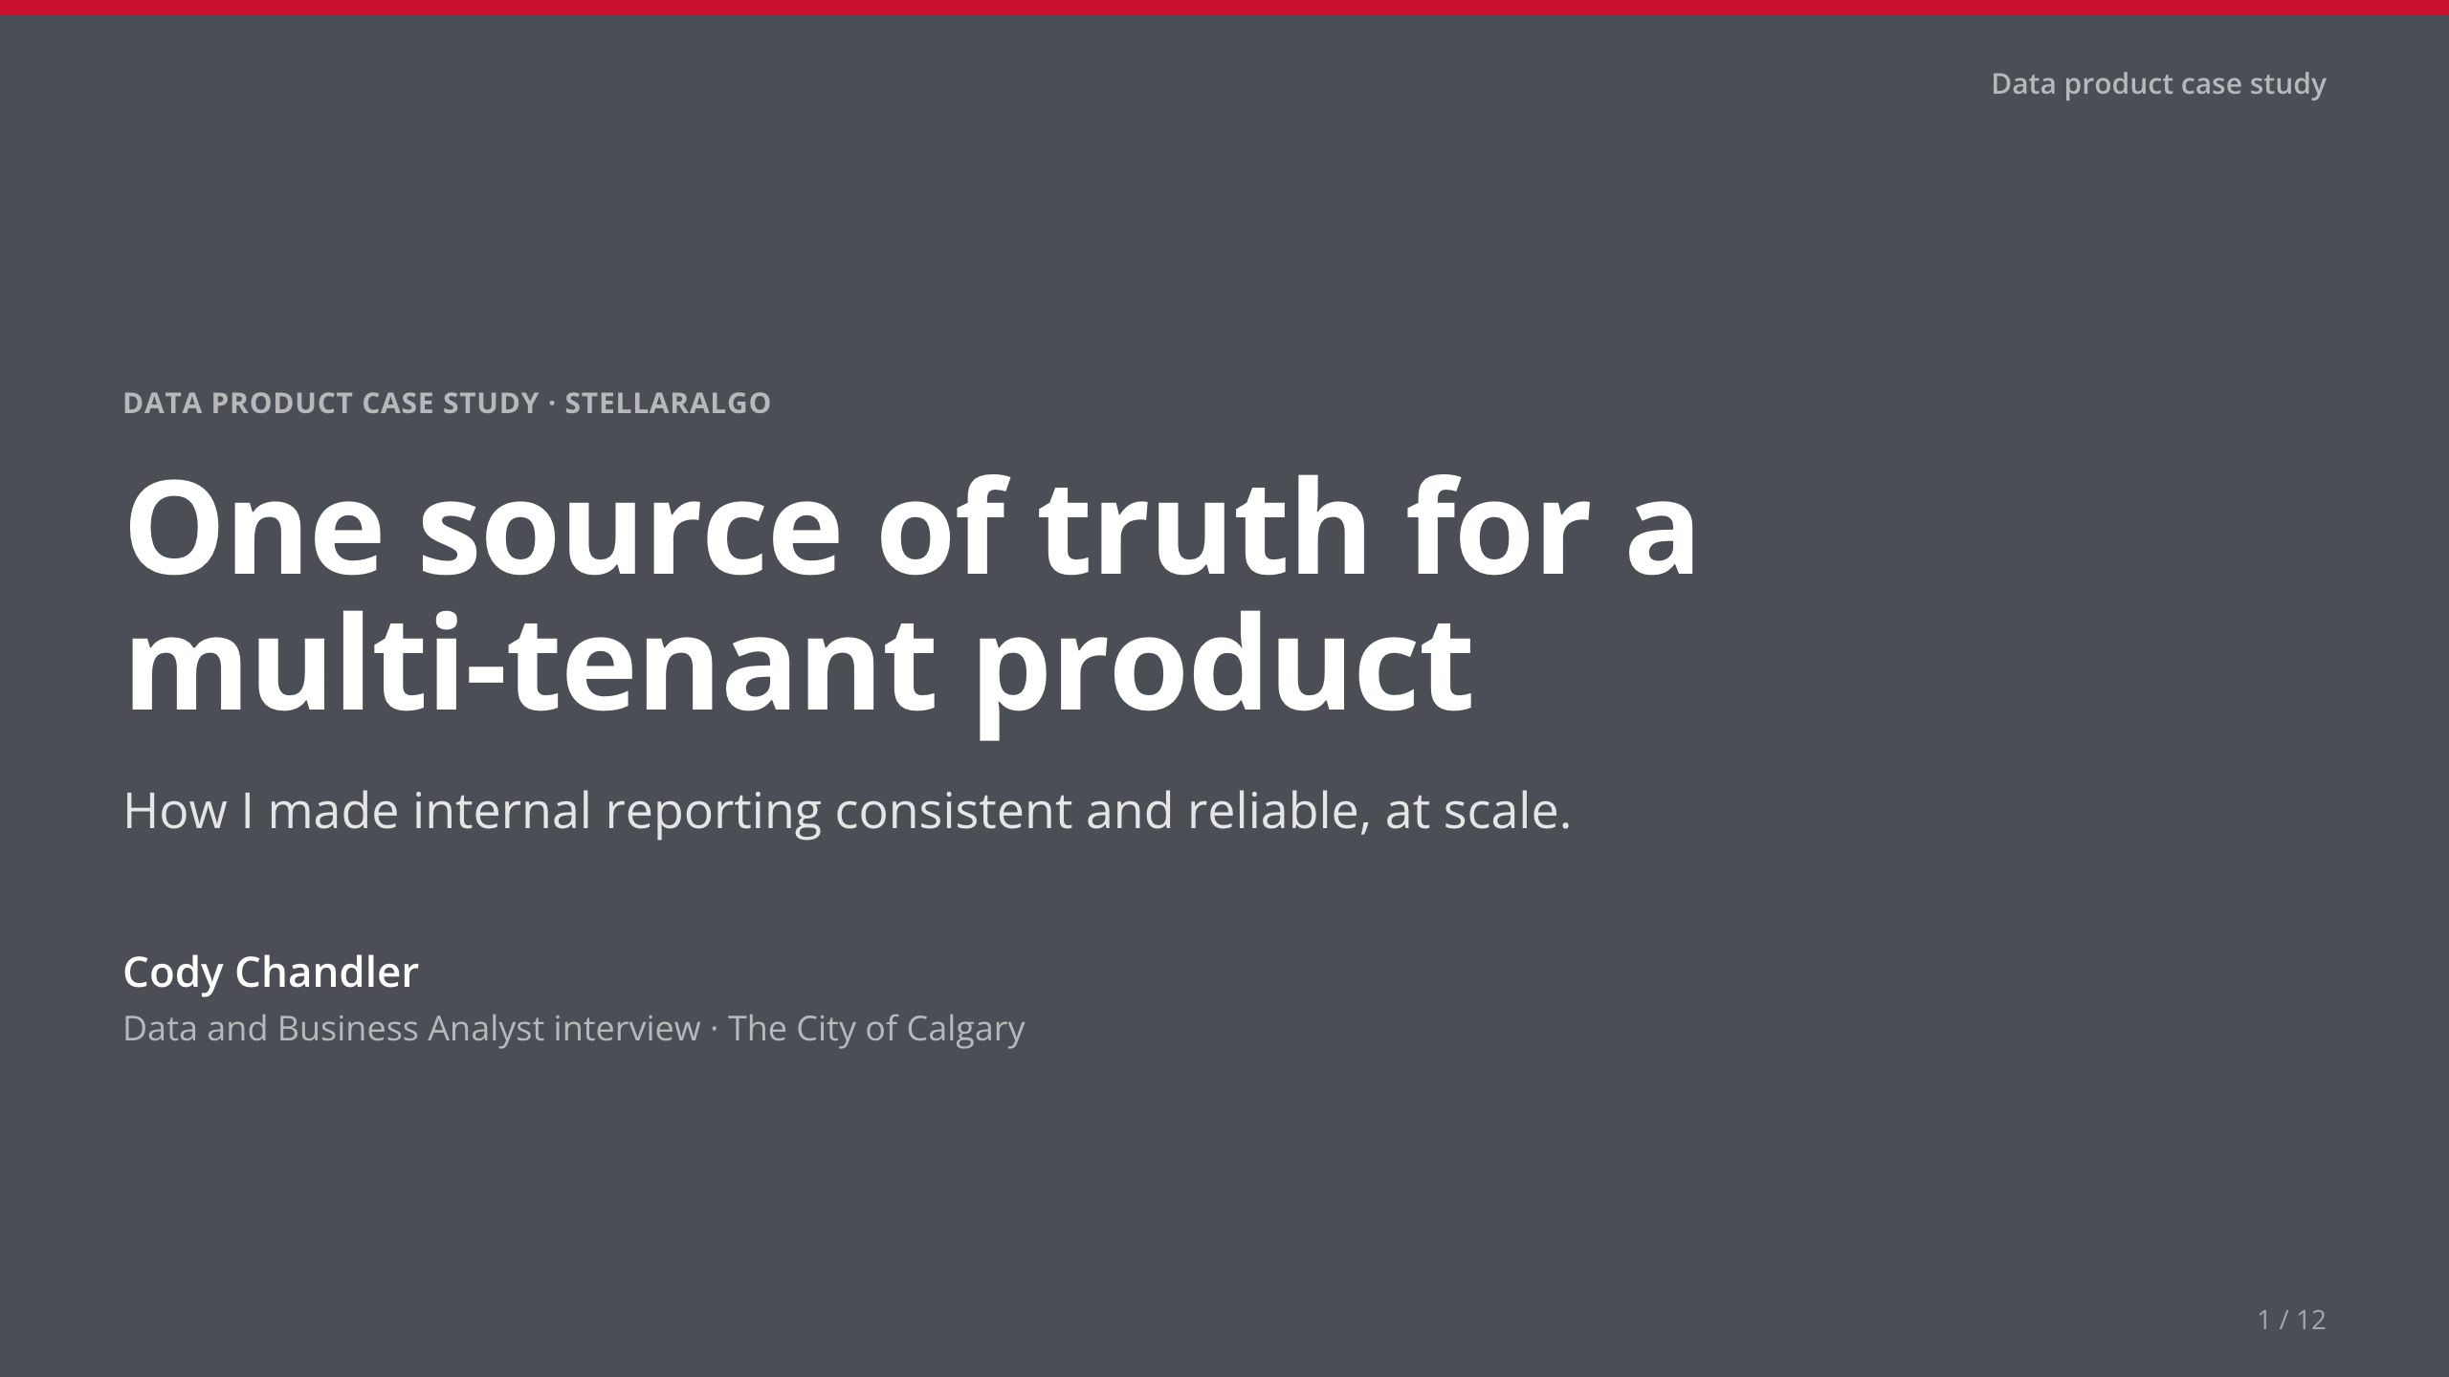
Notes:
• [Your story: one line on who you are.] Then: 'I'll answer your six questions in order, then show it live.'

Slide 2
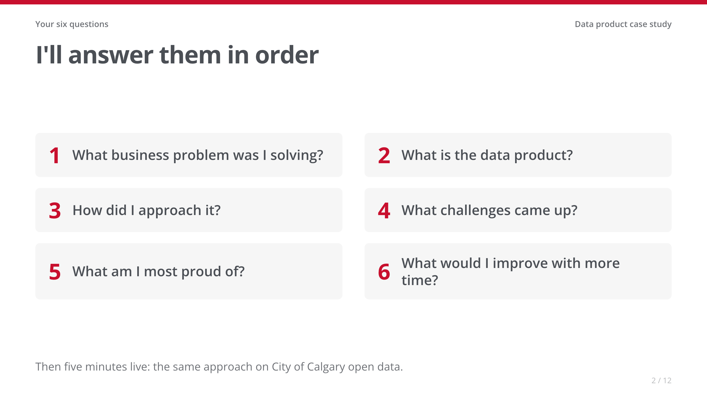
Notes:
• Fifteen seconds. Every slide title is one of their questions.

Slide 3
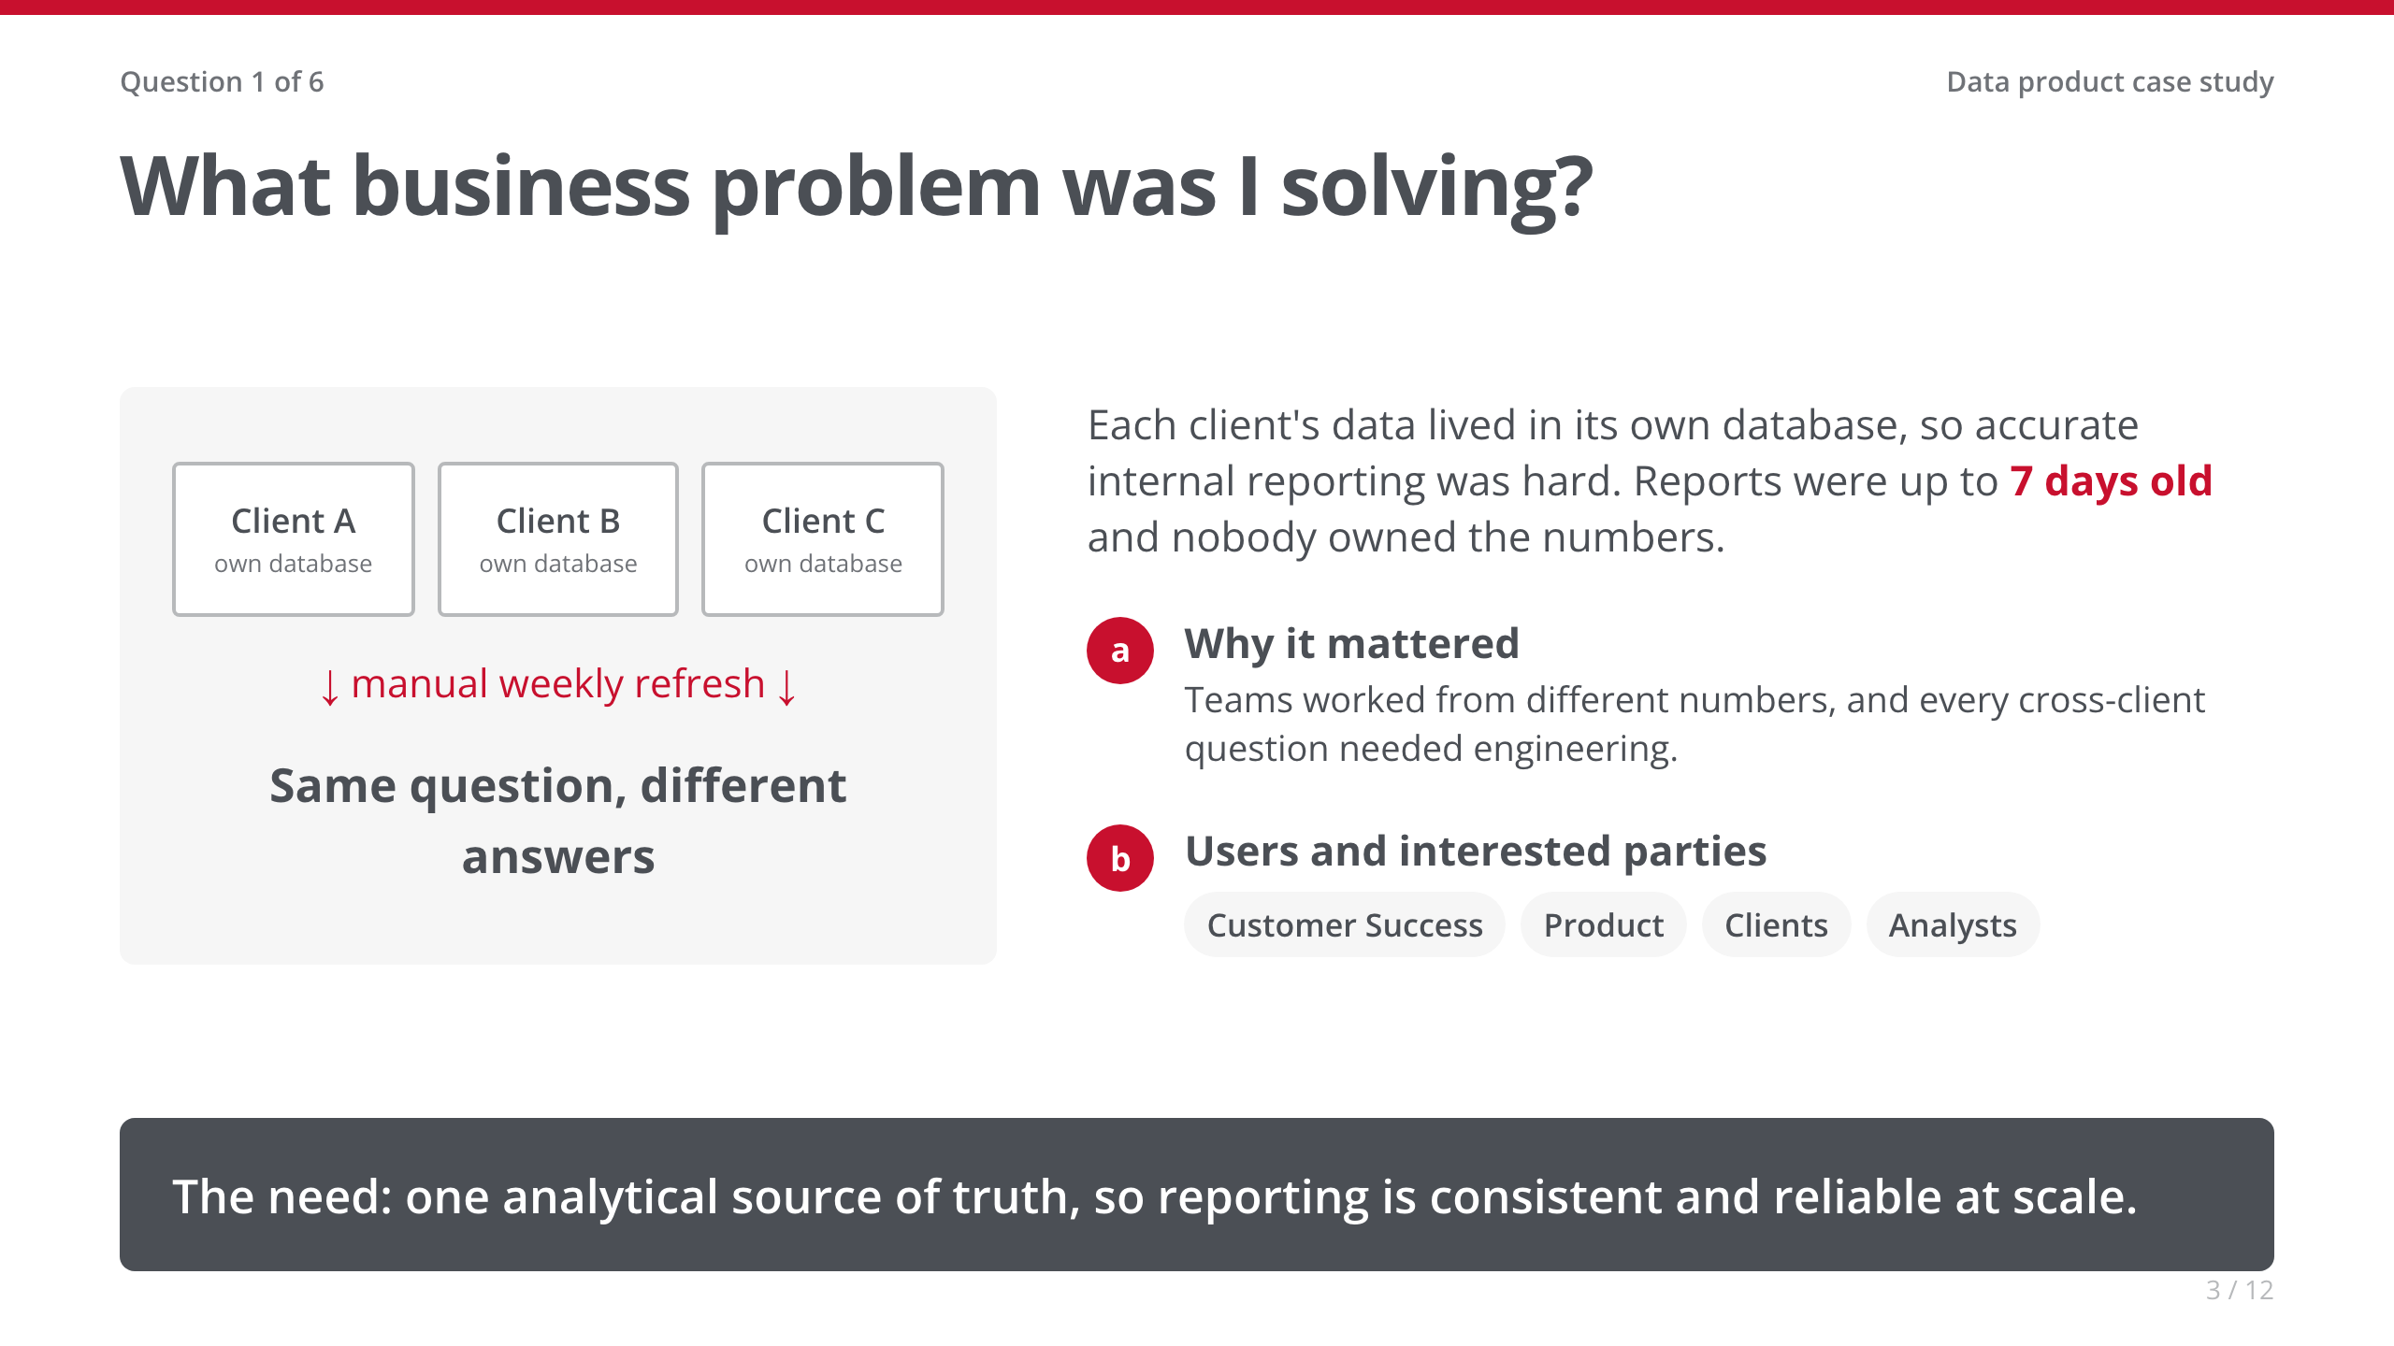
Notes:
• Keep it to the business pain, not the tech.
• My role: Director, Product Innovation & Analytics. I owned the product from planning to general availability.
• [Your story: one concrete moment when inconsistent numbers hurt.]

Slide 4
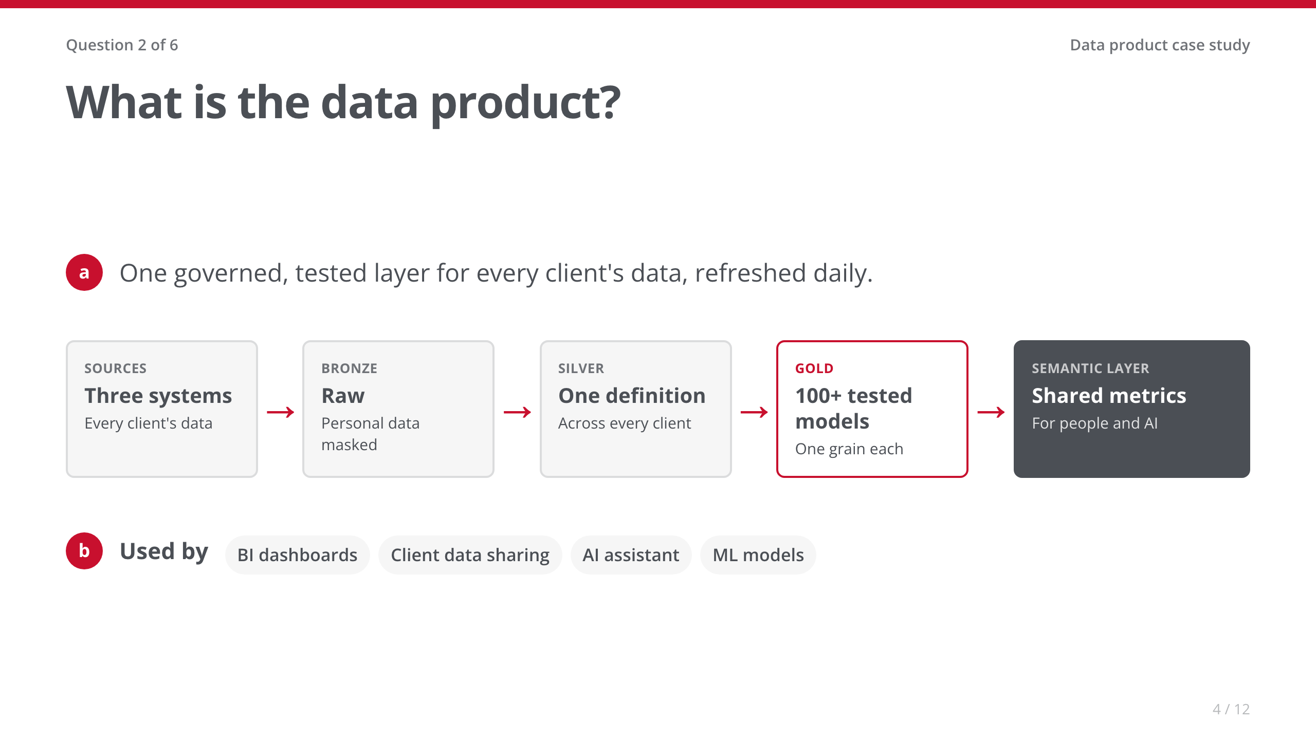
Notes:
• Left to right, once: three sources, transformed once, one set of shared metrics, every consumer.
• Governance is built in: personal data masked on landing, access by role, and a data contract.

Slide 5
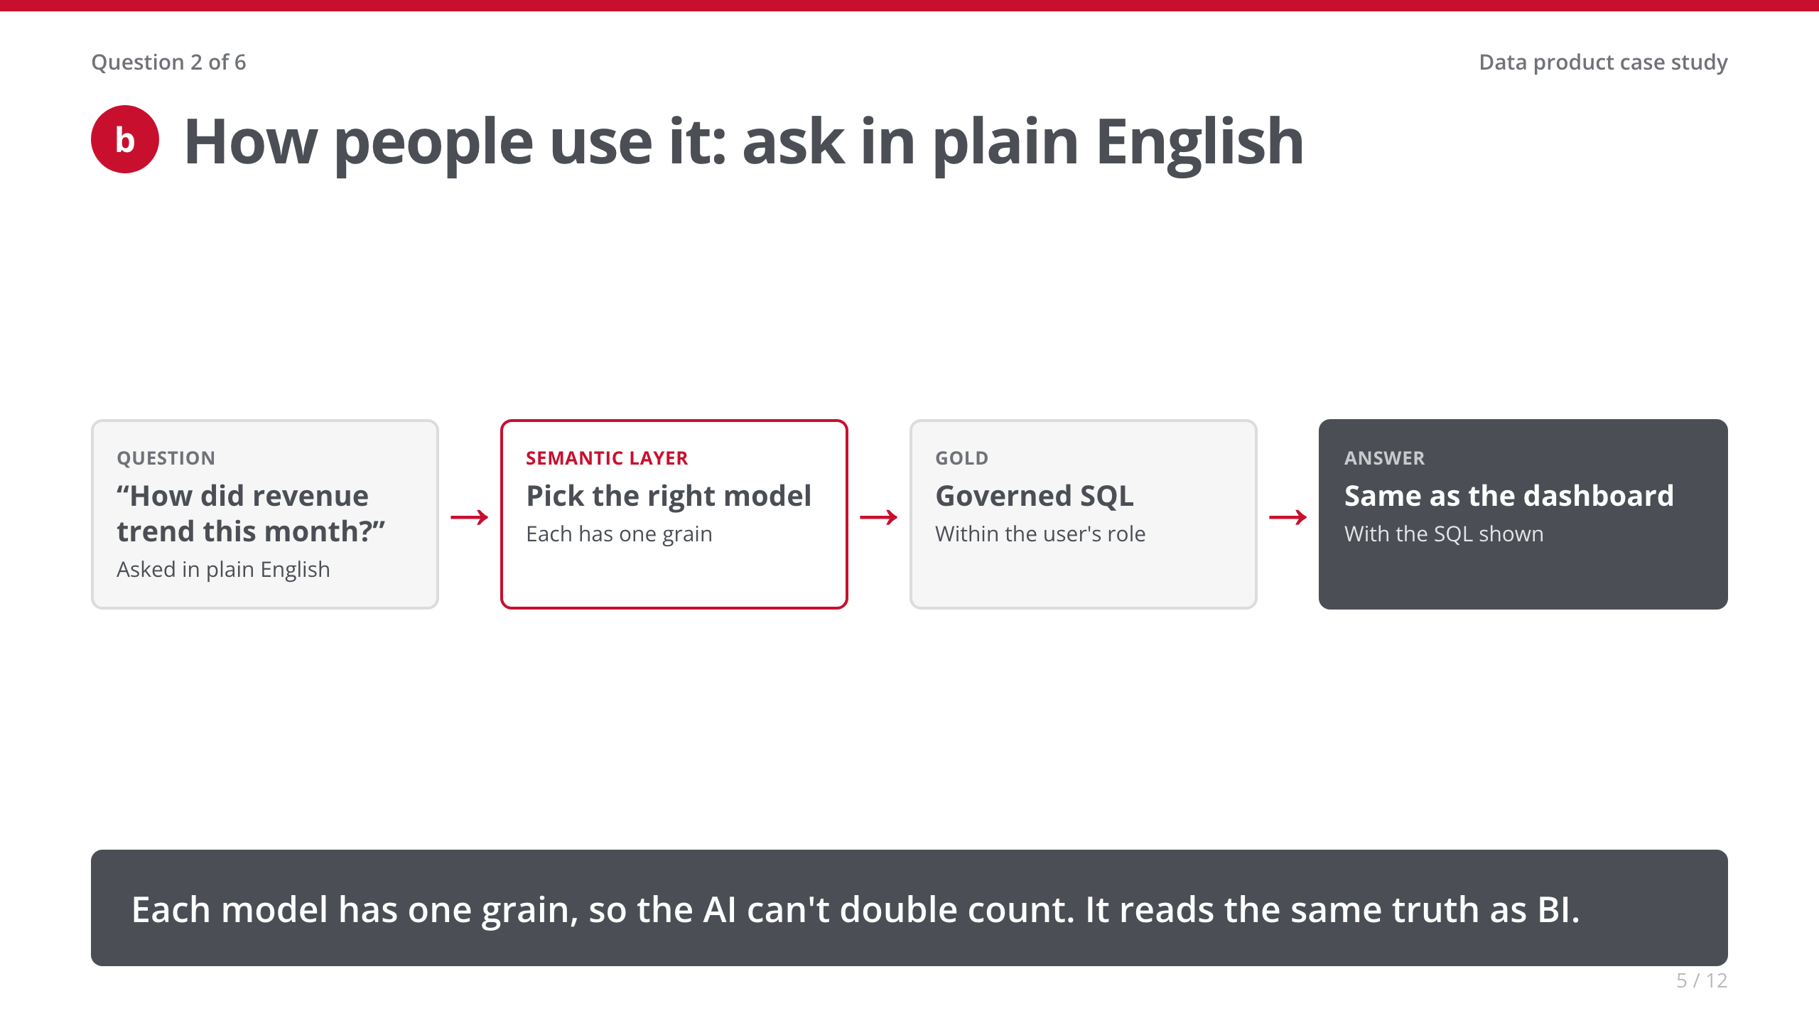
Notes:
• The technical heart: 'An AI that guesses the grain double counts. One grain per model means it can't.'
• Shipped first as an internal Customer Success bot; I led discovery for the client-facing version.
• The example question is illustrative. [Your story: a real question the bot answered.]

Slide 6
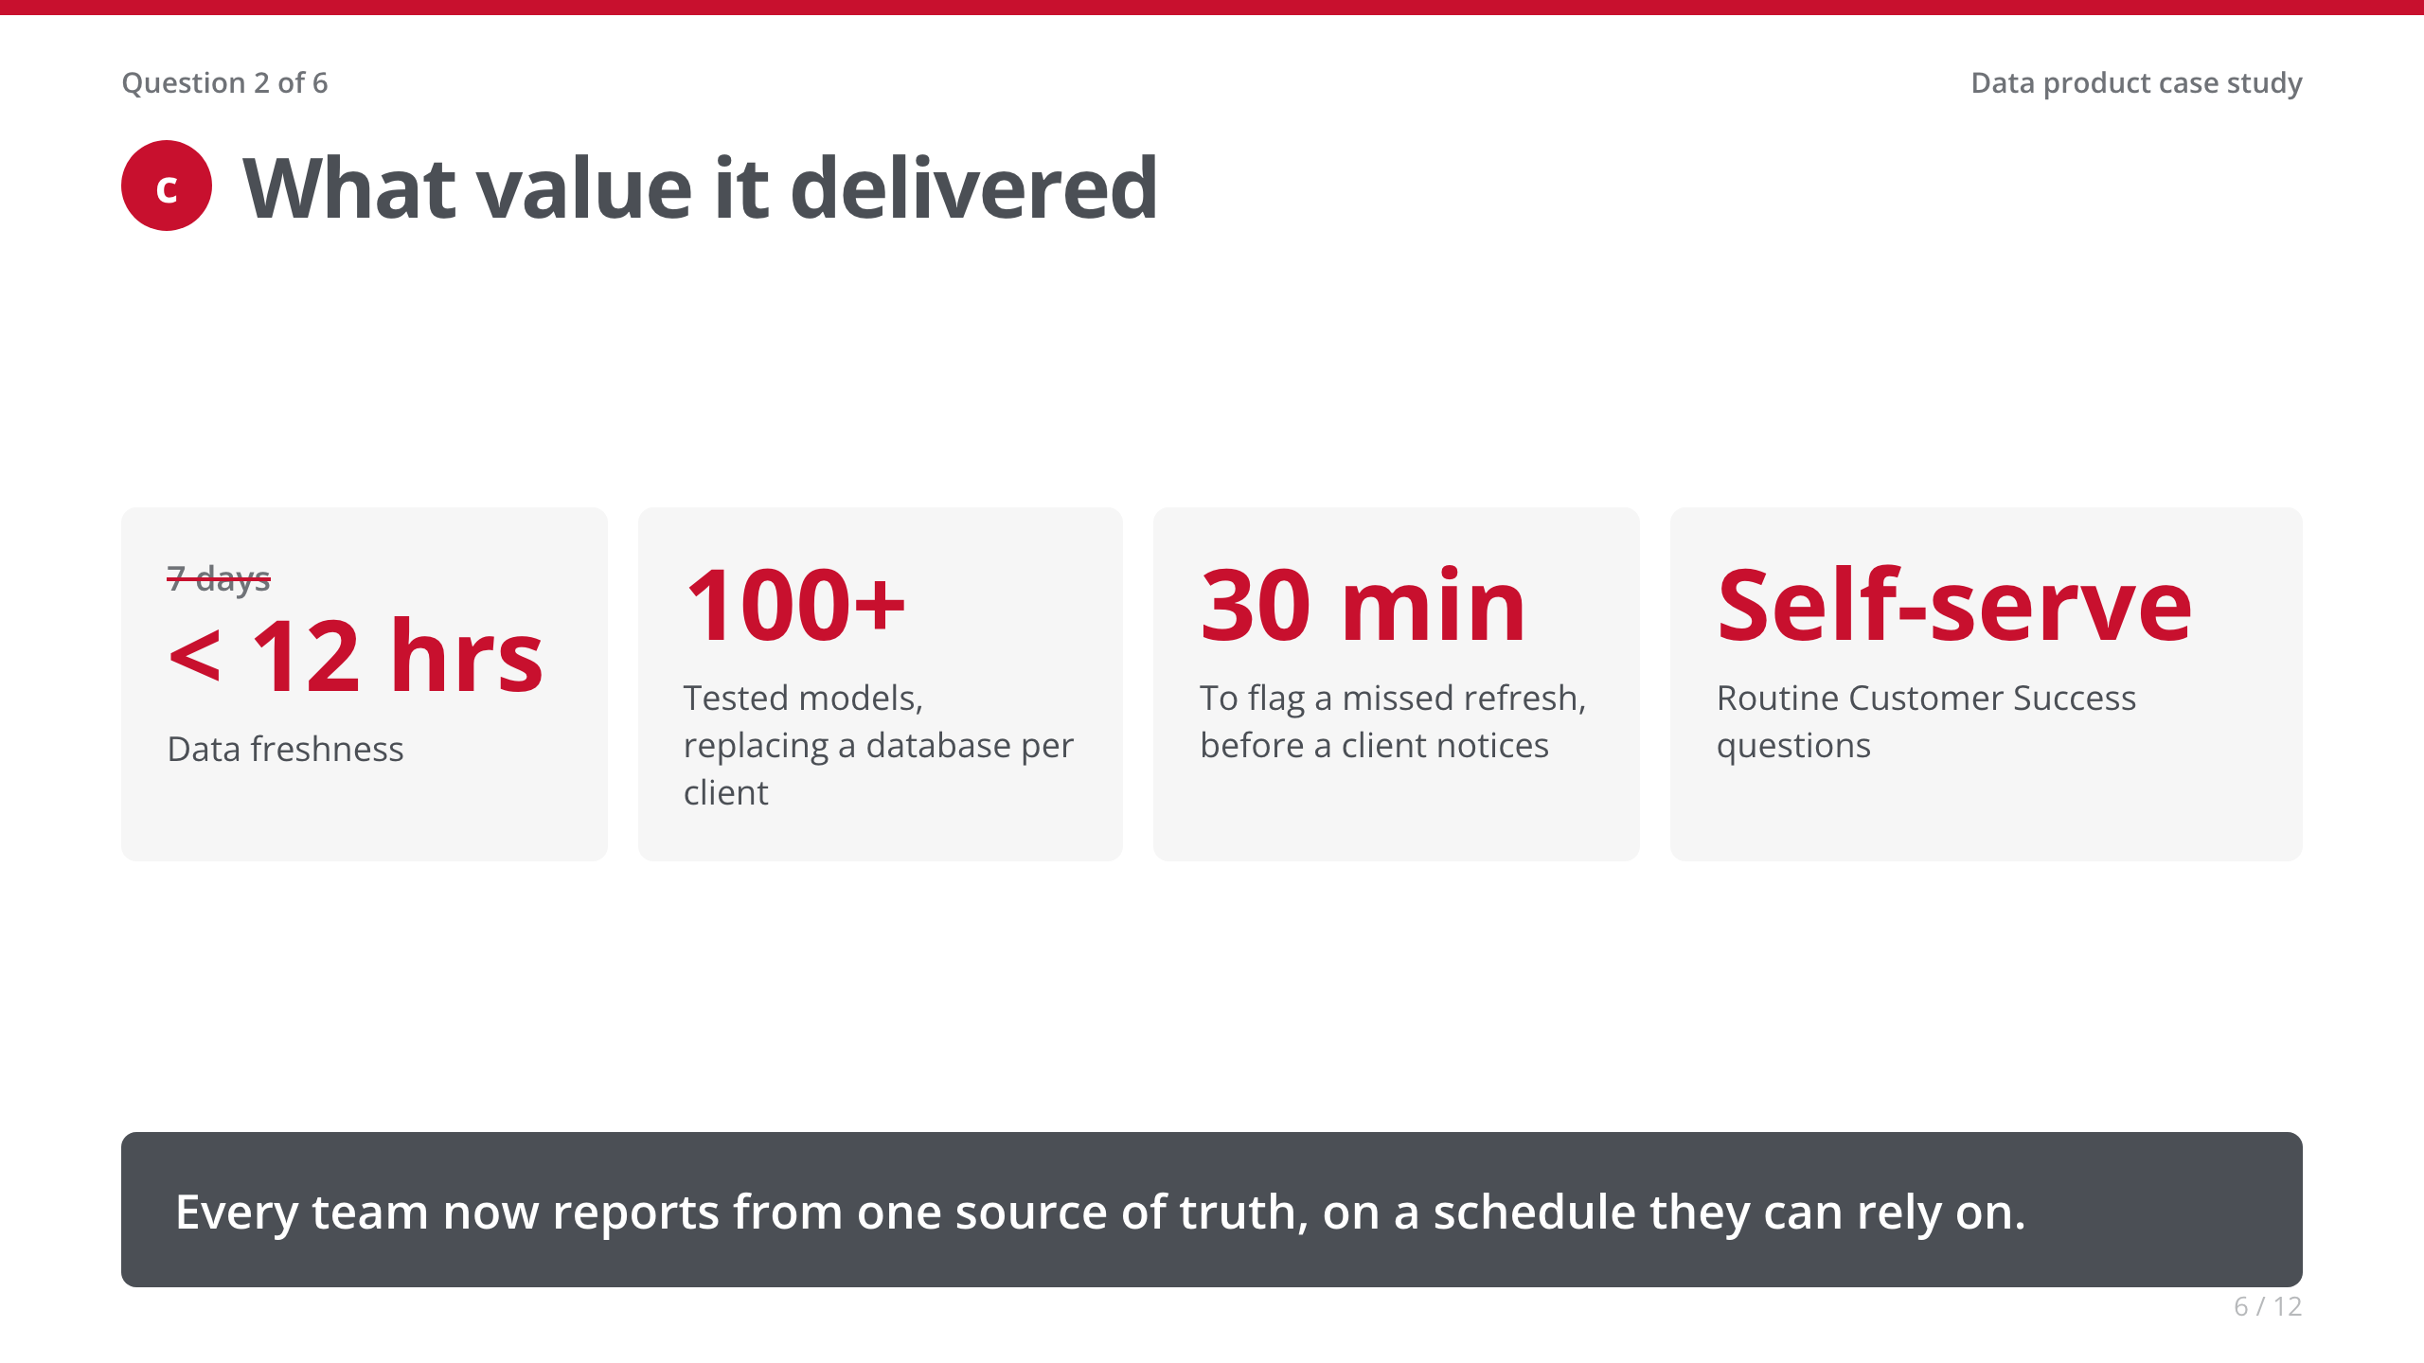
Notes:
• Ten seconds per number. The banner is the answer to question 1.
• [Your story: an adoption or time-saved number.]

Slide 7
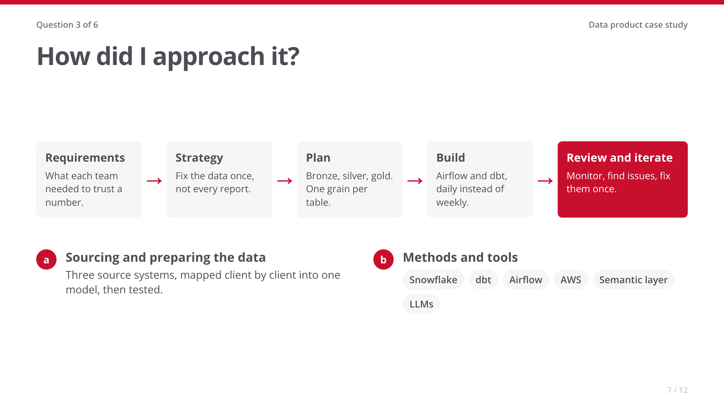
Notes:
• One breath across the strip. The why matters more than the stack.
• [Your story: how you ran requirements, and the real build order.]

Slide 8
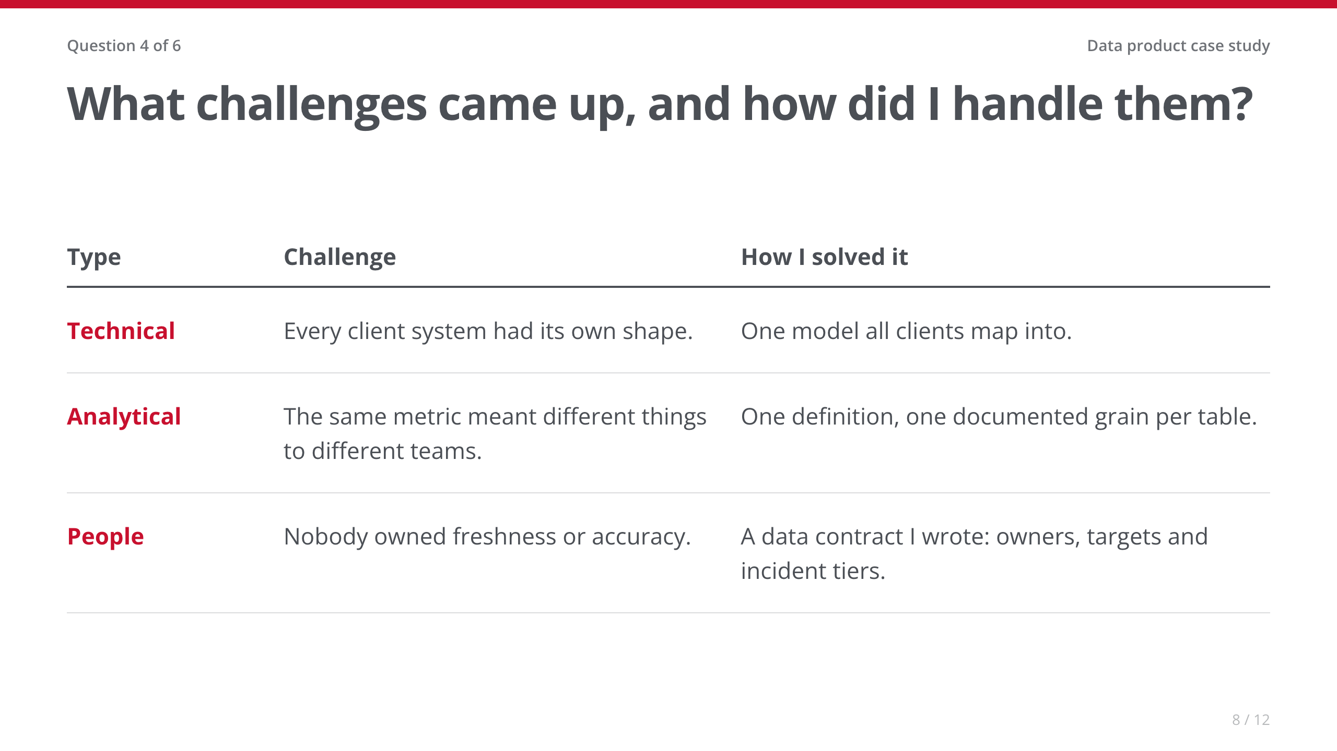
Notes:
• Spend most of the time on the People row. It's the one the City will relate to.
• [Your story: the conversation that got the data contract agreed. Who pushed back, and what changed their mind?]

Slide 9
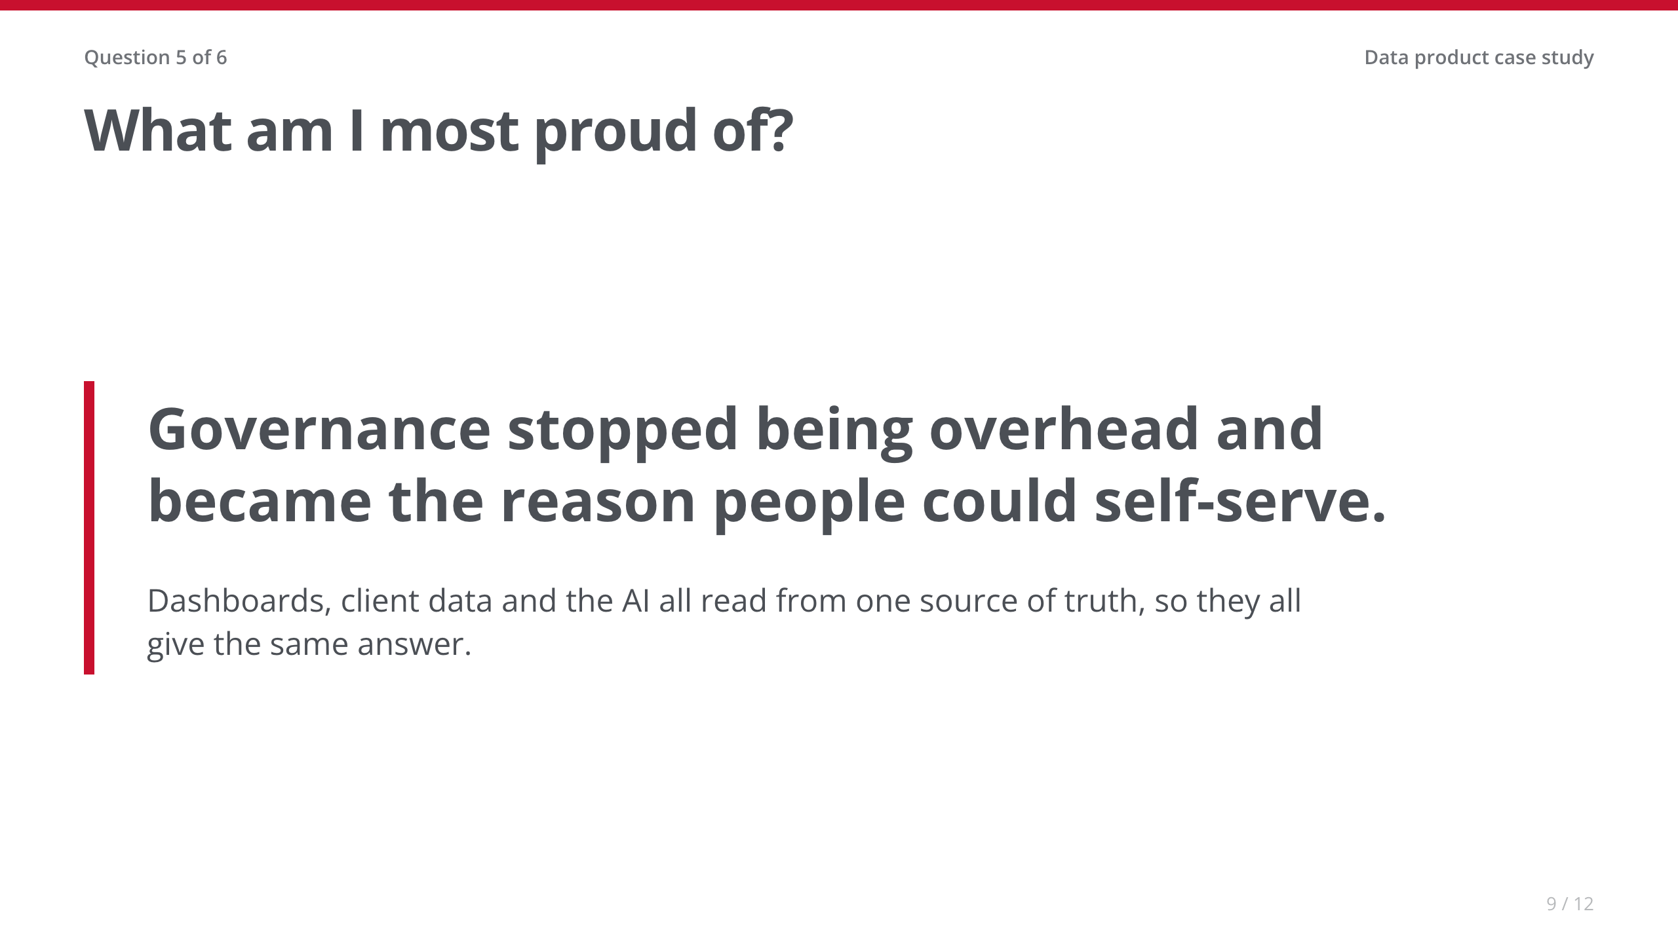
Notes:
• Slow down. This is the line to remember.
• [Your story: the first time a team trusted an answer without double-checking it.]

Slide 10
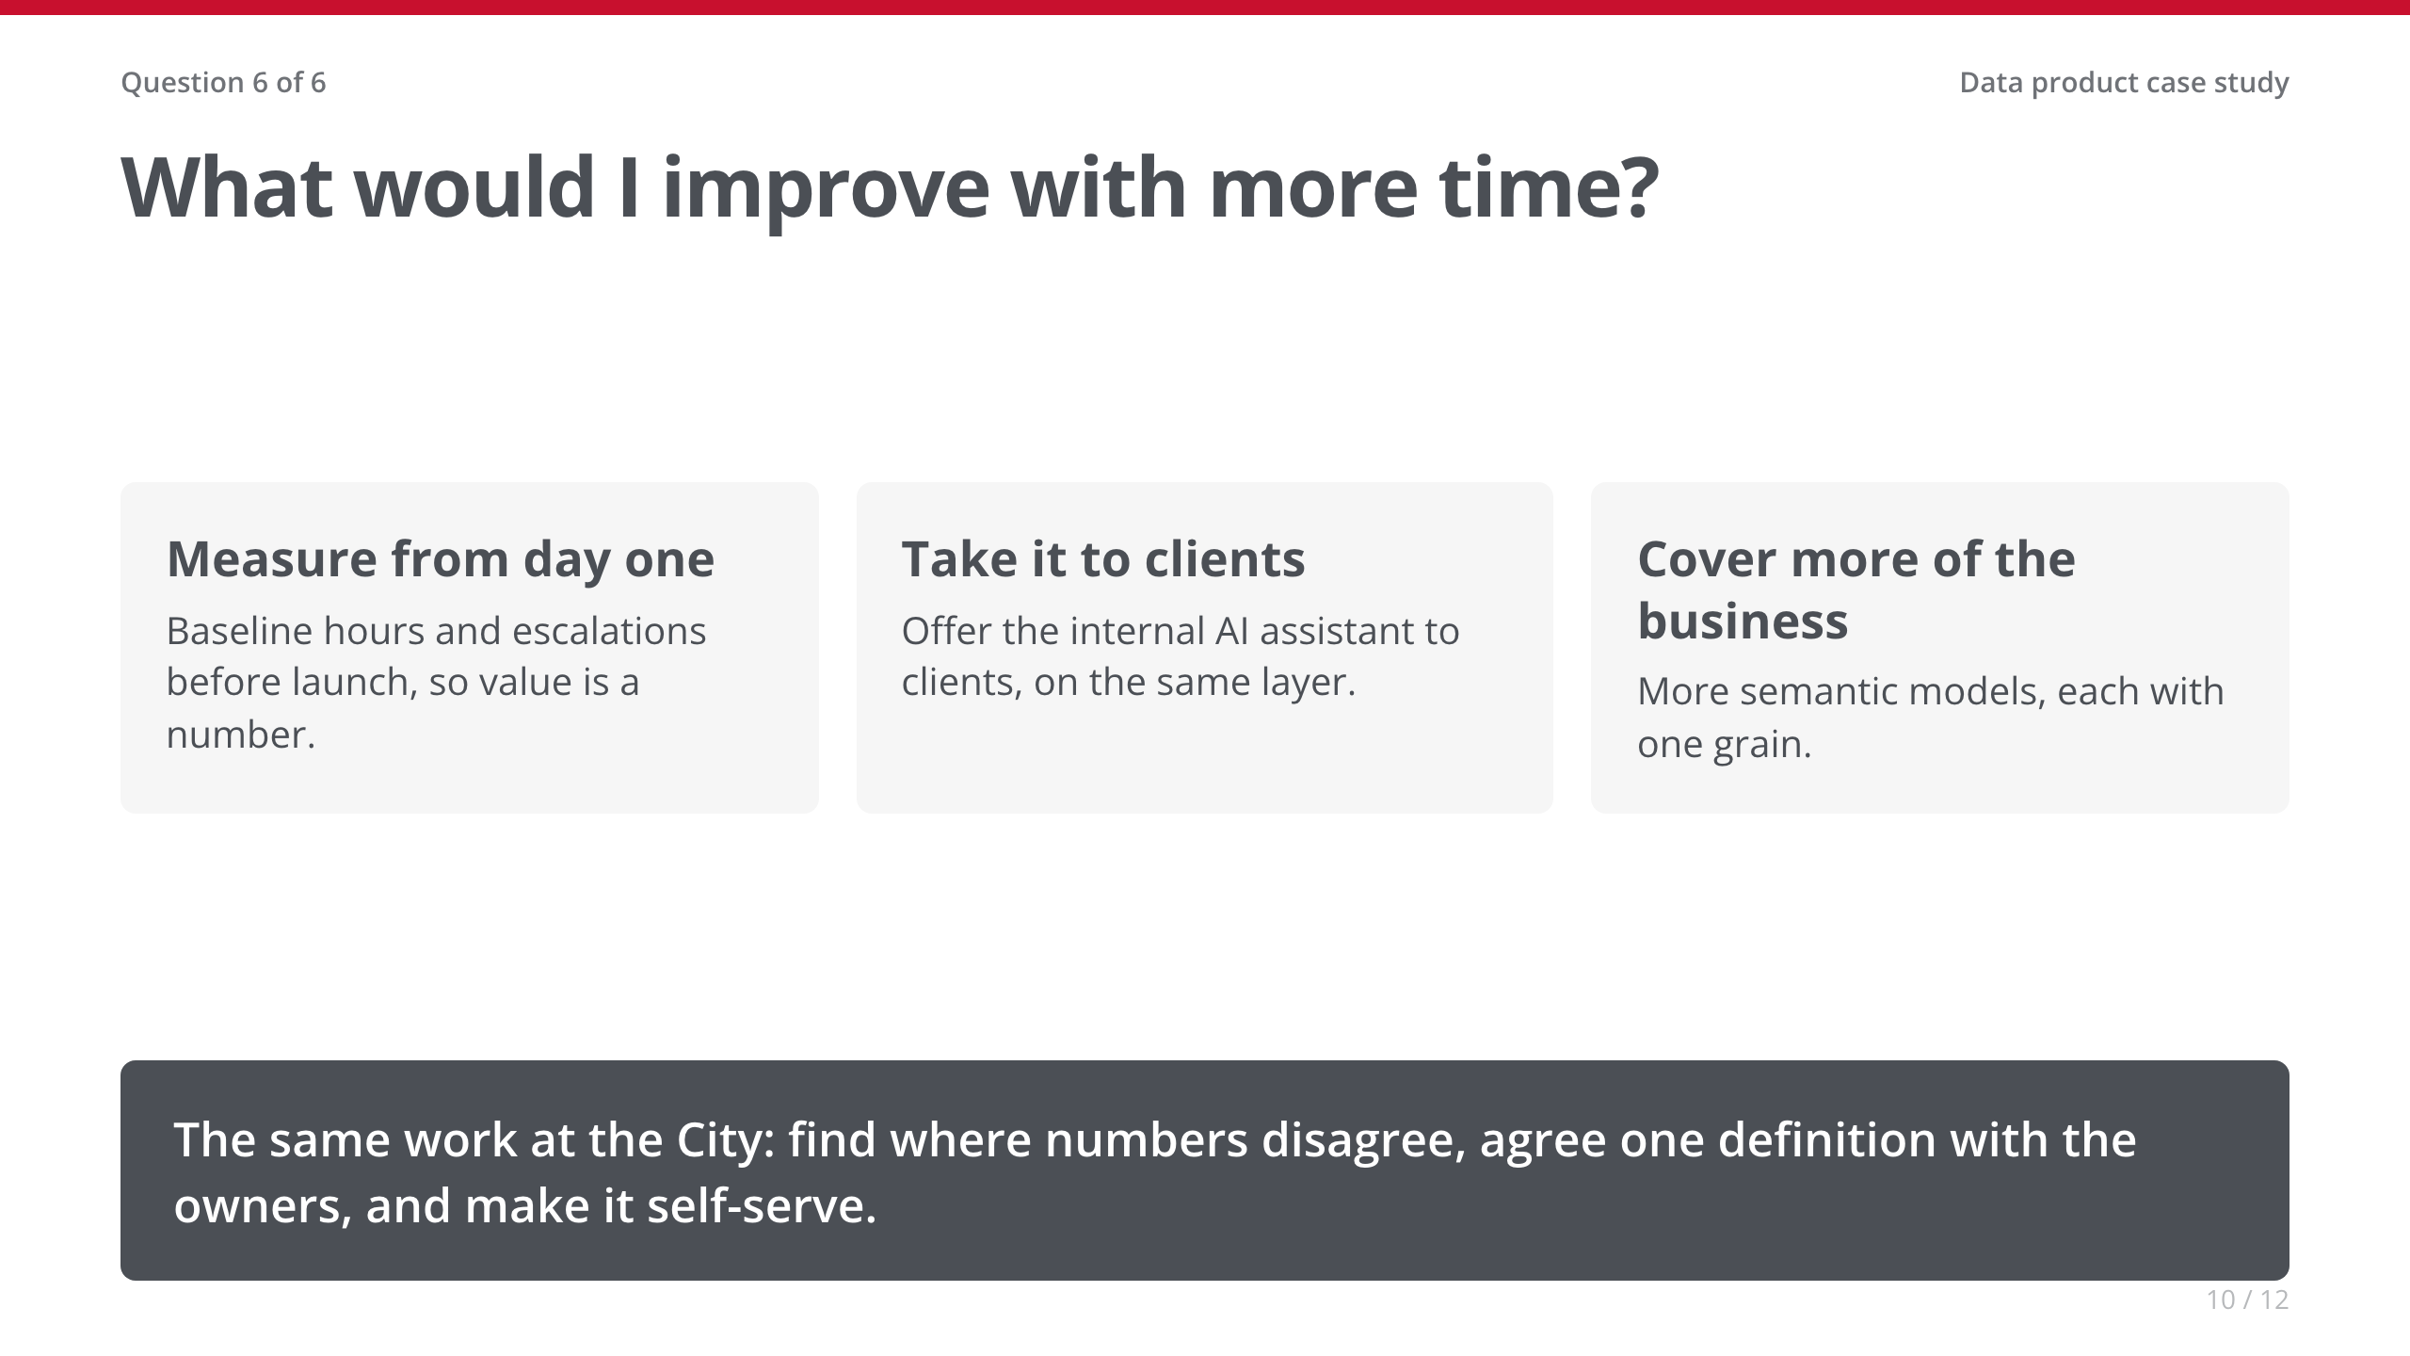
Notes:
• [Your story: swap in whatever you'd genuinely do differently.]
• Transition: 'I can't show you StellarAlgo's data, so I rebuilt the same approach on the City's open data.'

Slide 11
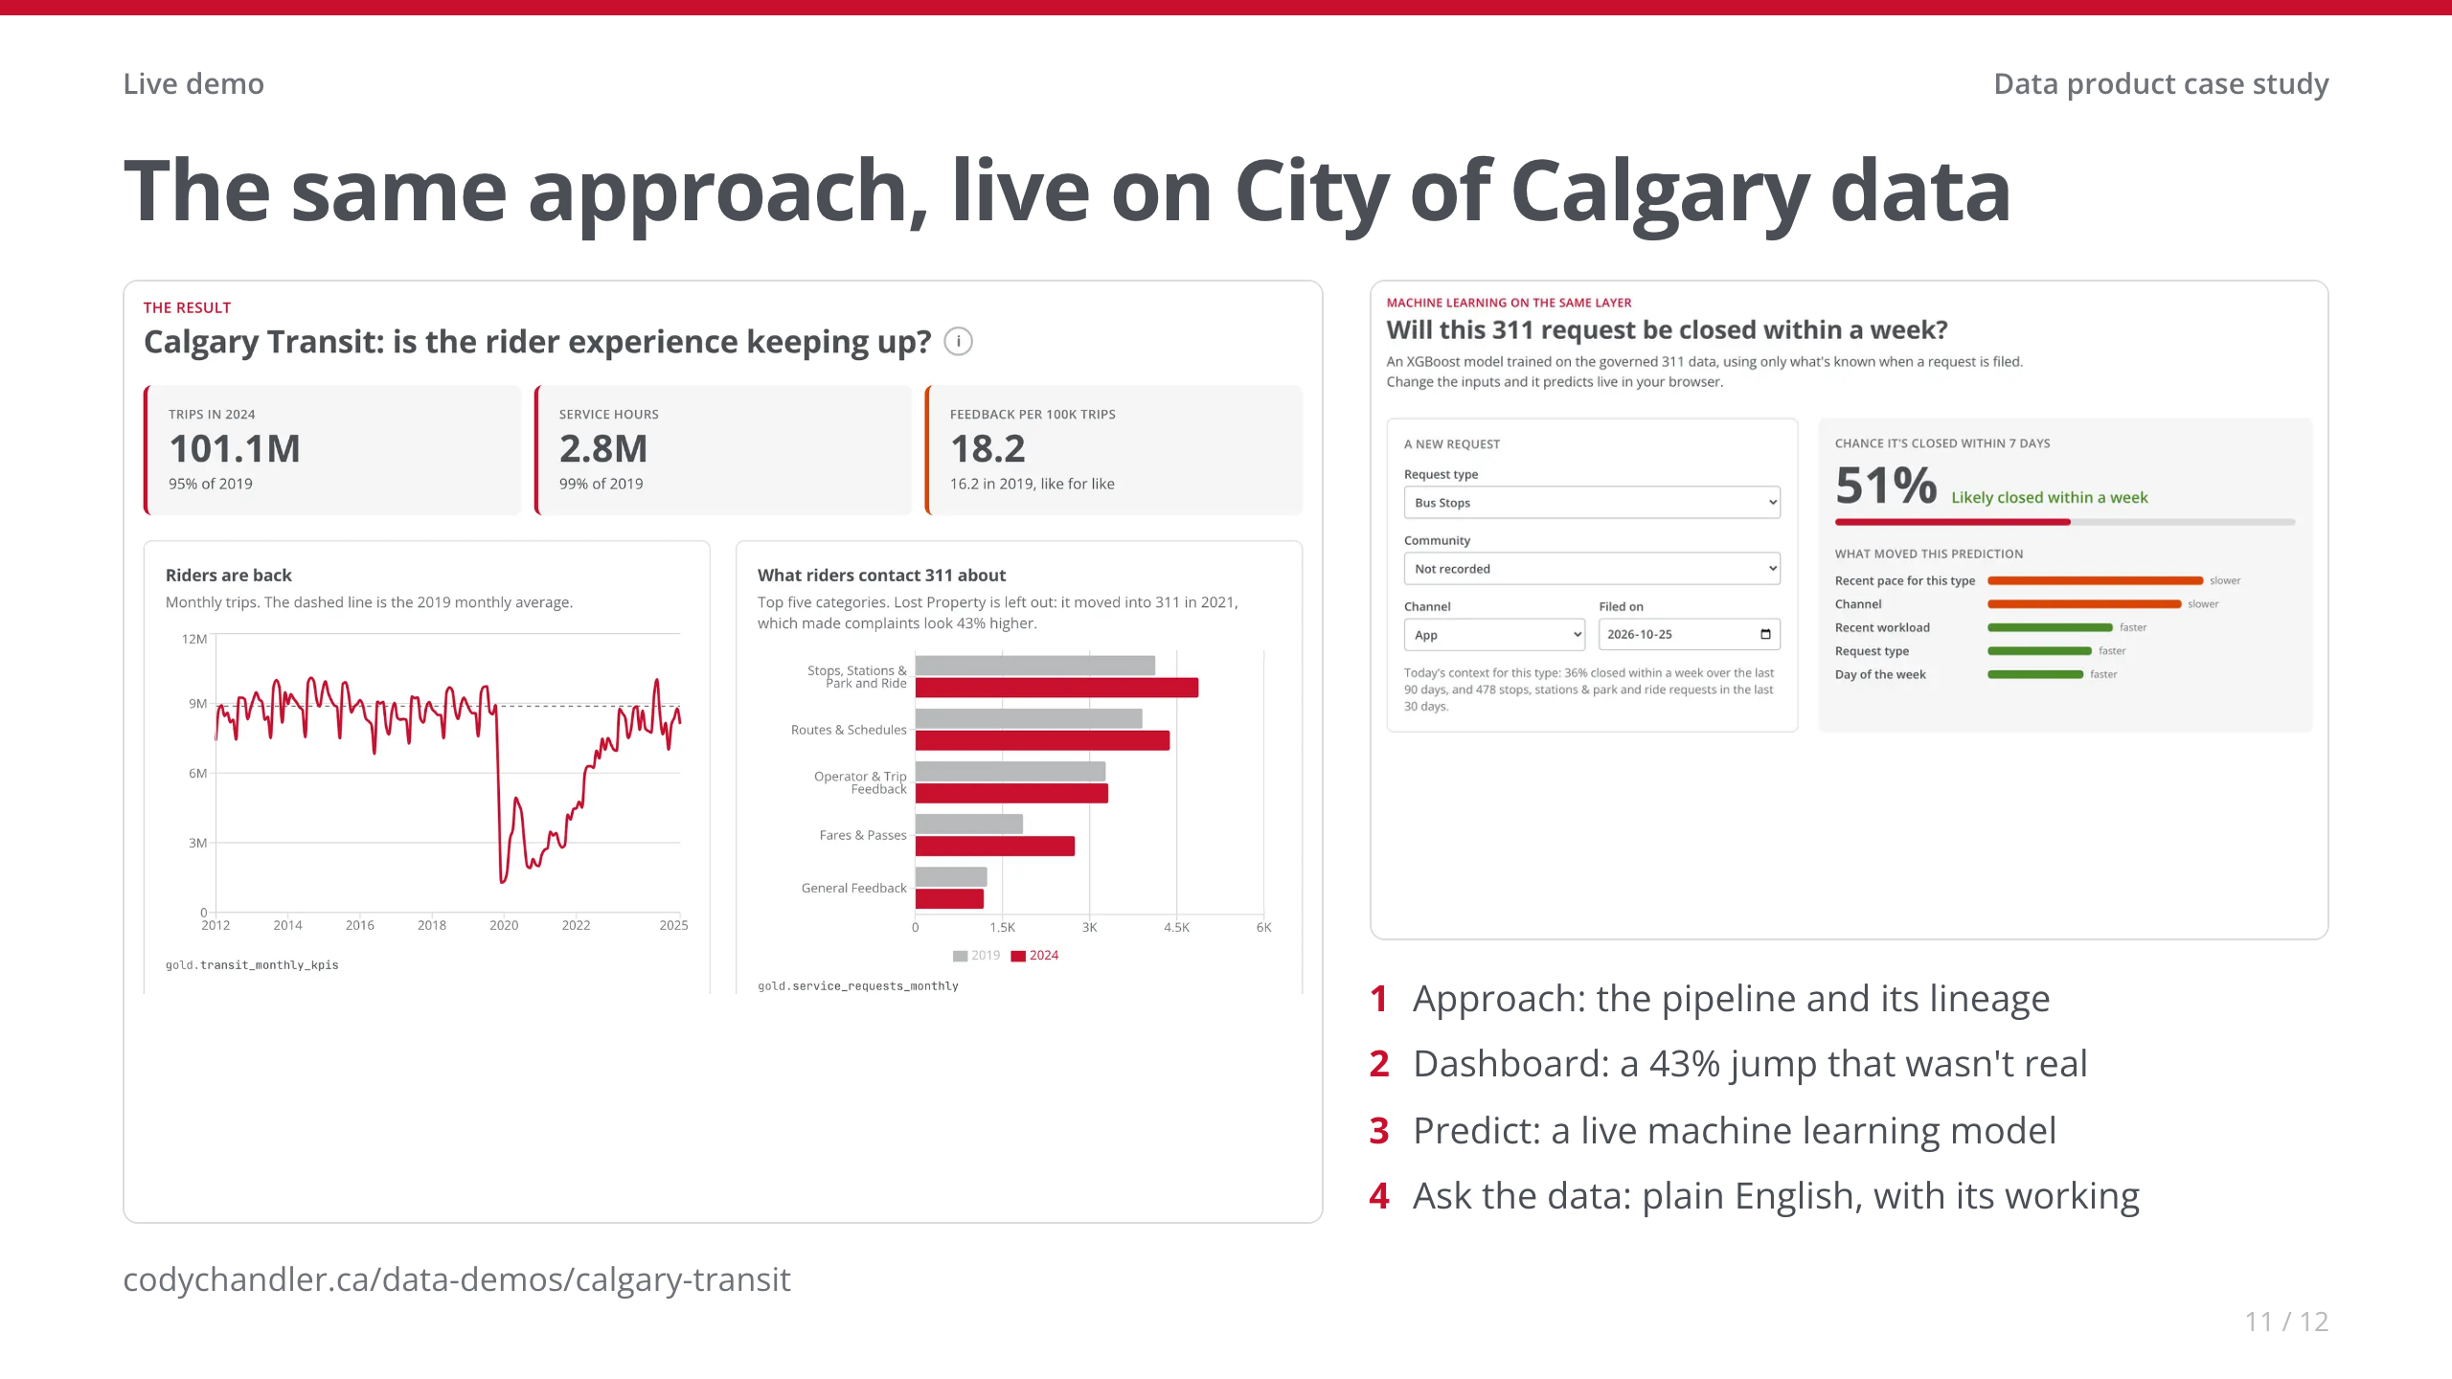
Notes:
• LIVE (5 min). Open the site before the interview. If the internet fails, these screenshots carry it.
• 1 · Approach page, lineage graph: 'Same layers as StellarAlgo: three City datasets, tested in dbt, run daily by Airflow.' (45 s)
• 2 · Dashboard: read the ⓘ headline. Then the 311 chart: 'My first cut said complaints per trip were up 43%. Lost Property moved into 311 in 2021. I fixed it once, in the data, so every consumer gets it right. Like for like it's 12%.' (1.25 min)
• 3 · Predict: Advertising and Communications (usually low), then Transit Pass Programs (usually high). 'Tested on 2025, a year it never saw, it catches more slow requests than the rule of thumb.' (1 min)
• 4 · Ask: 'How has ridership recovered since the pandemic?' While it works: 'it writes SQL against the same gold tables.' Read the answer, glance at the chart, open 'Show how this was answered'. Payoff: 'Same number as the dashboard. One source of truth.' (1.5 min)
• Close: 'That's the work I'd bring to the City.' Then the last slide.

Slide 12
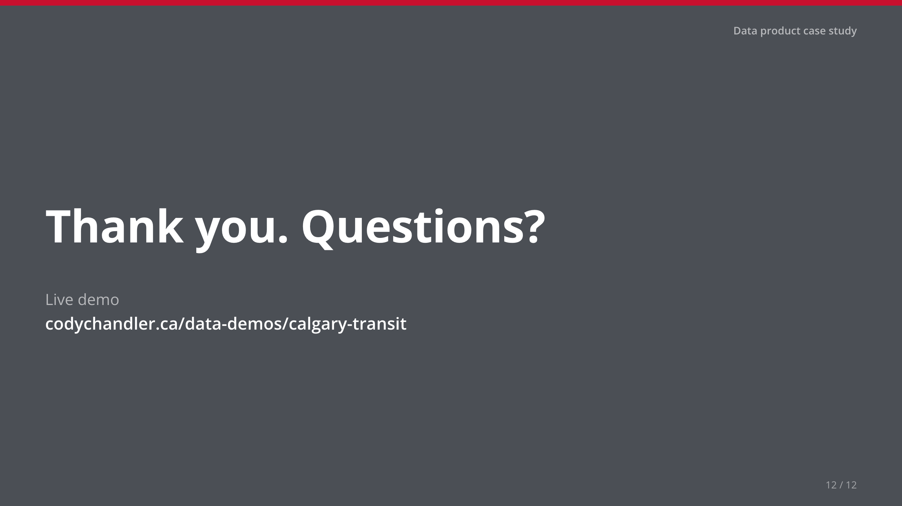
Notes:
• Stop talking. Leave this up for questions.

