Slide 1
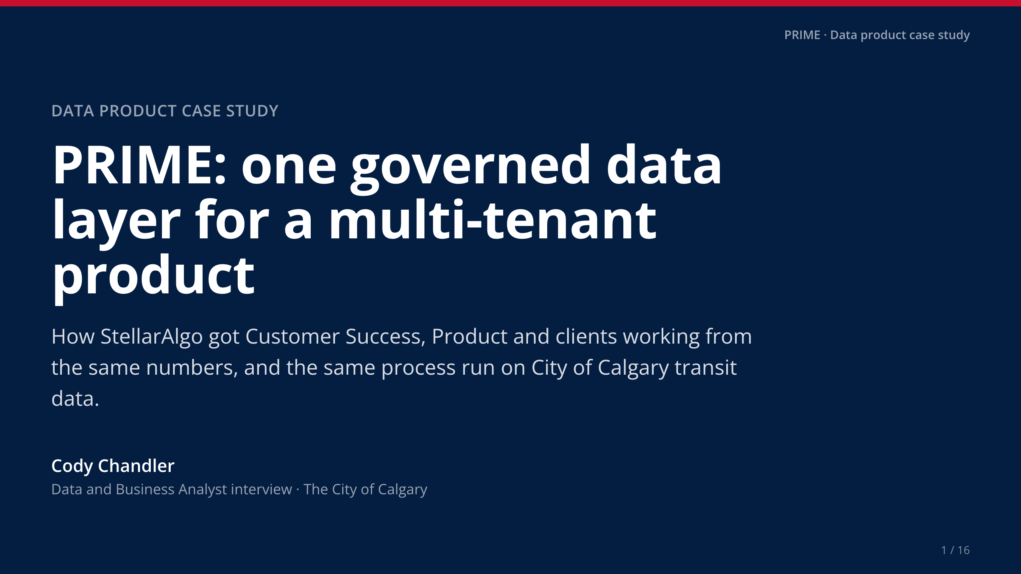
Notes:
• Thank the panel. One line on who you are: [Your story: one sentence on your background].
• Frame: a data product I led end to end, then the same process on the City's own open data, live.

Slide 2
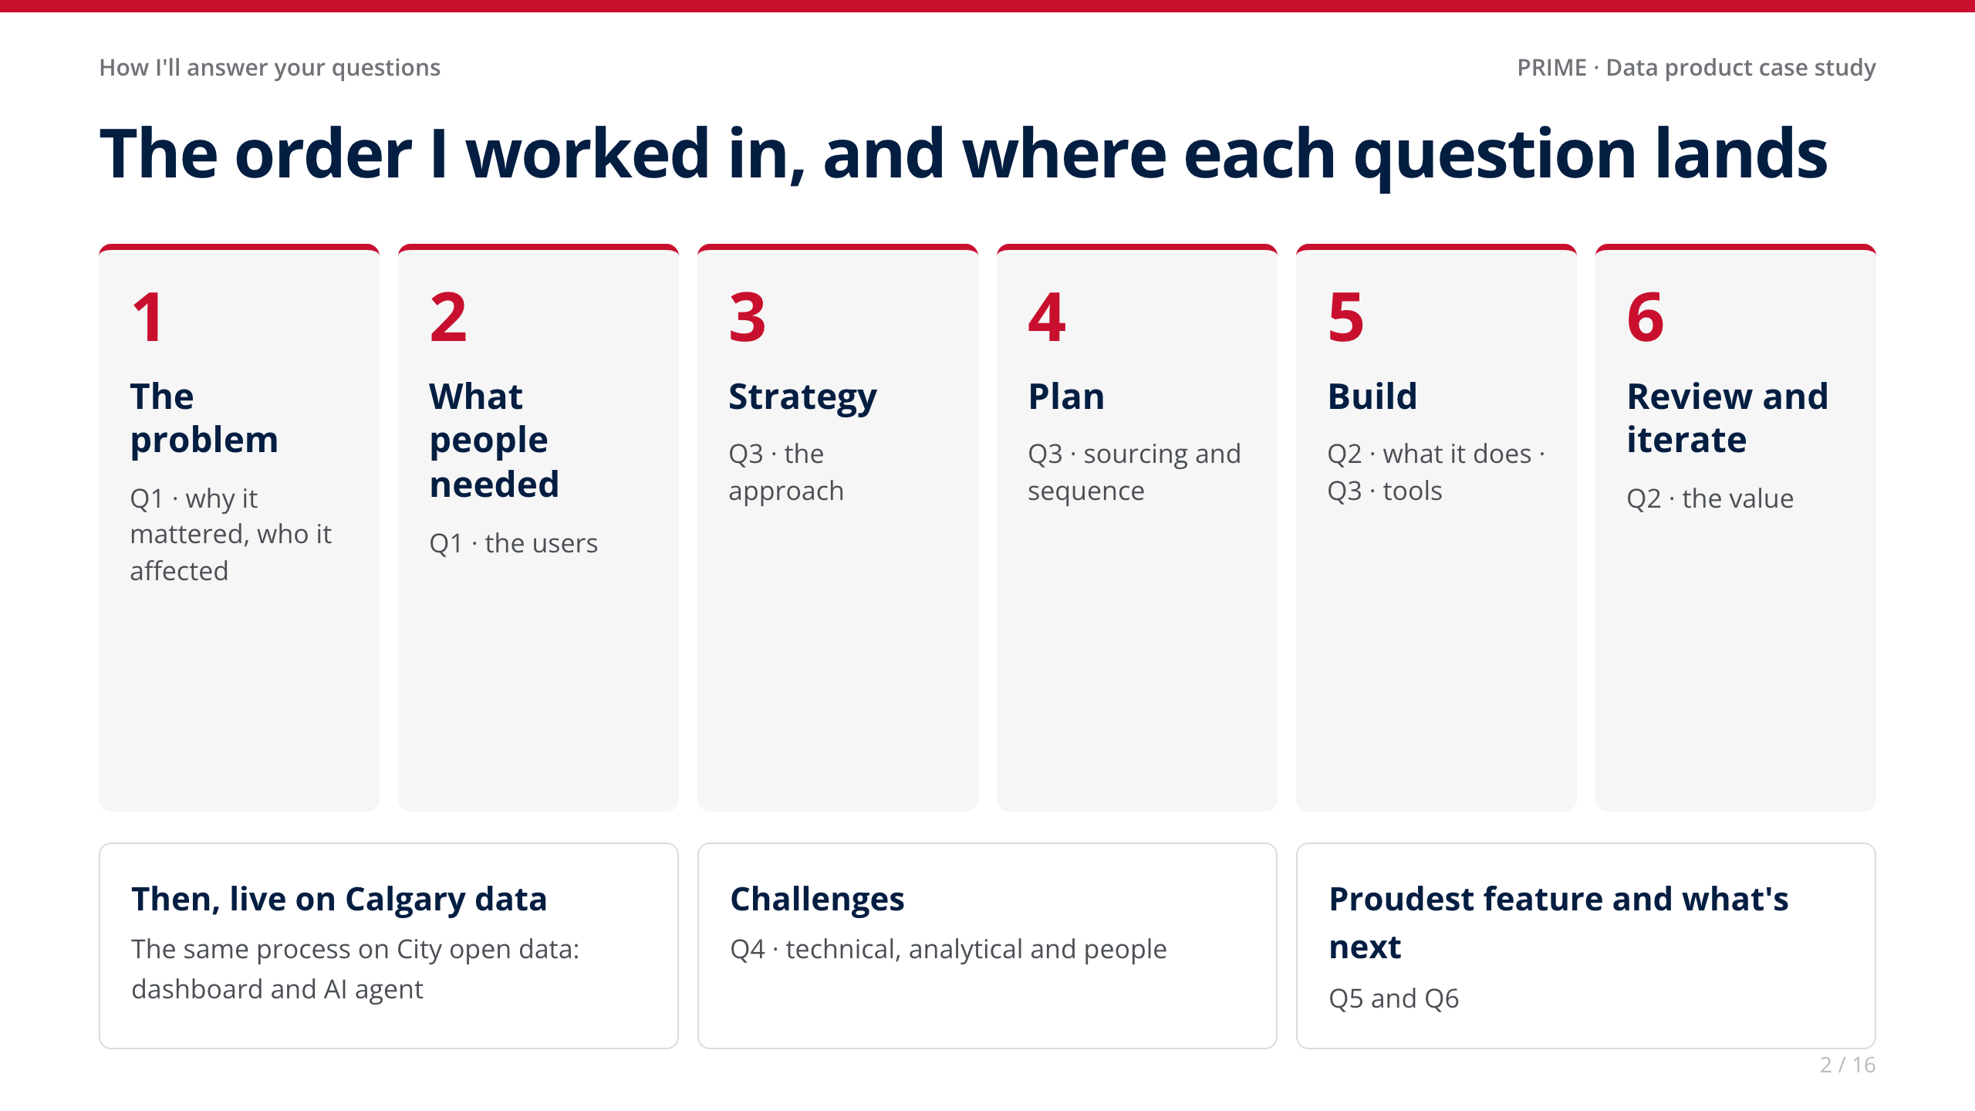
Notes:
• Twenty seconds. The tag in the top-left of every slide tells the panel which question it answers.

Slide 3
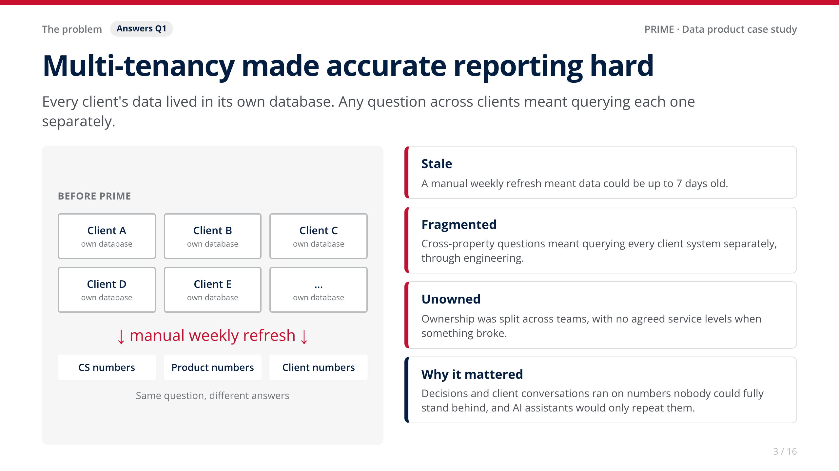
Notes:
• [Your story: one concrete moment where inconsistent numbers caused a real problem with a client or internally.]
• Bridge to the City: siloed client databases look a lot like departments that each run their own system. The questions that matter cut across them.

Slide 4
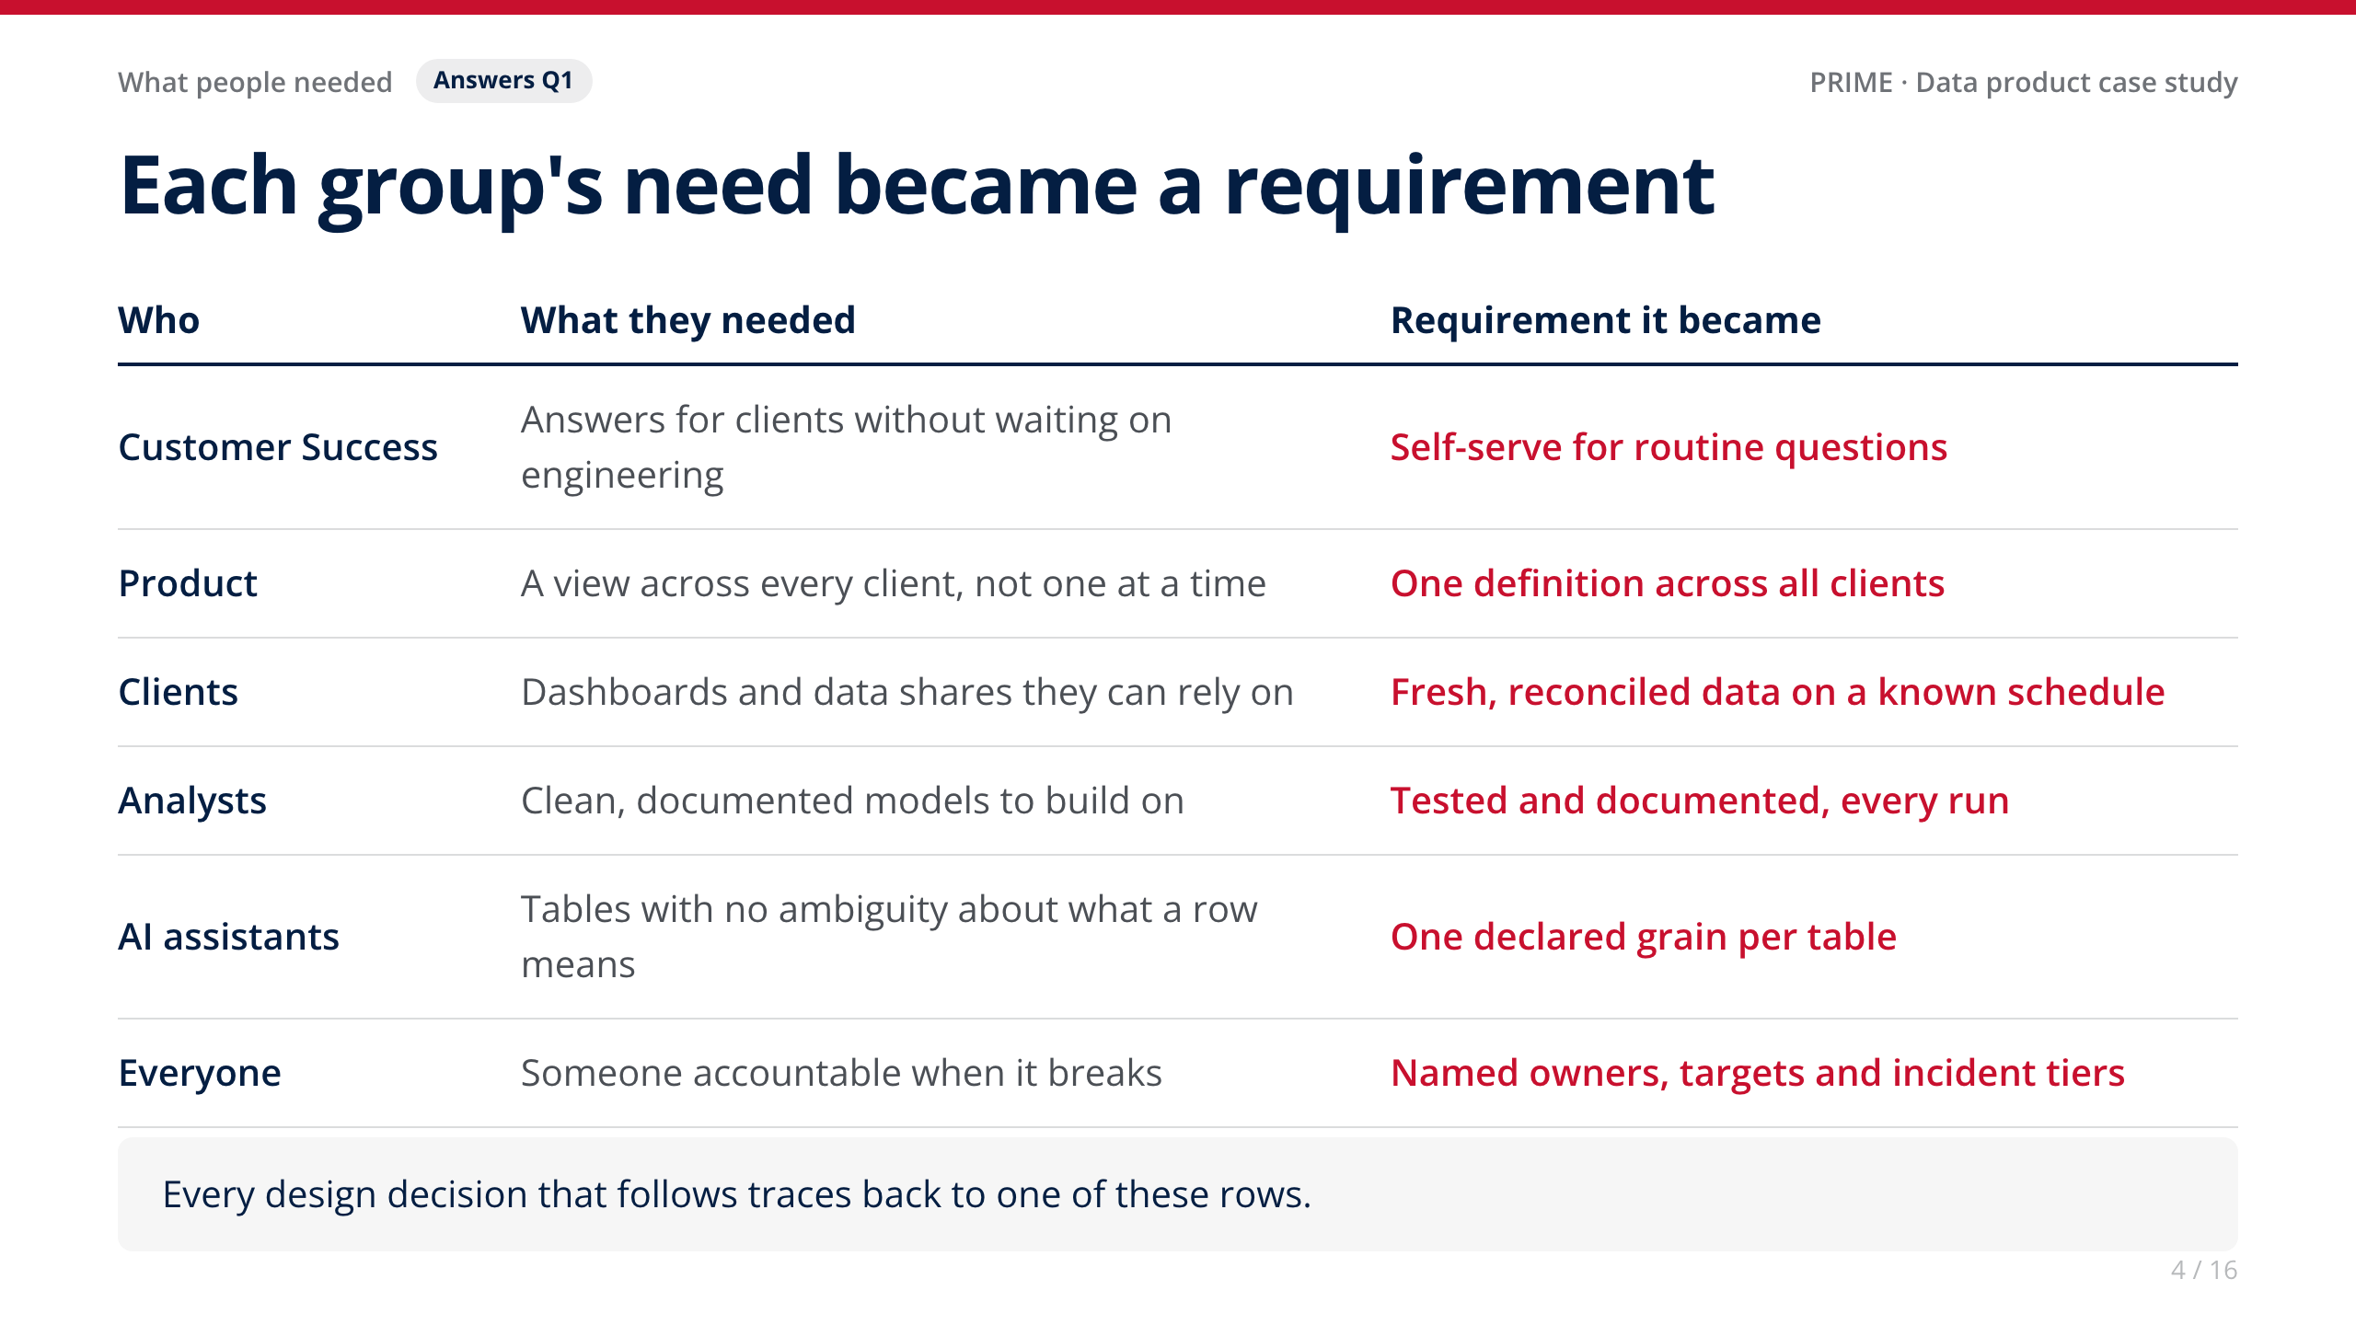
Notes:
• [Your story: how you gathered these. Interviews, shadowing CS, reviewing the engineering ticket queue, client feedback?]
• The point to land: I didn't start from the technology. Every design choice traces back to one of these rows.

Slide 5
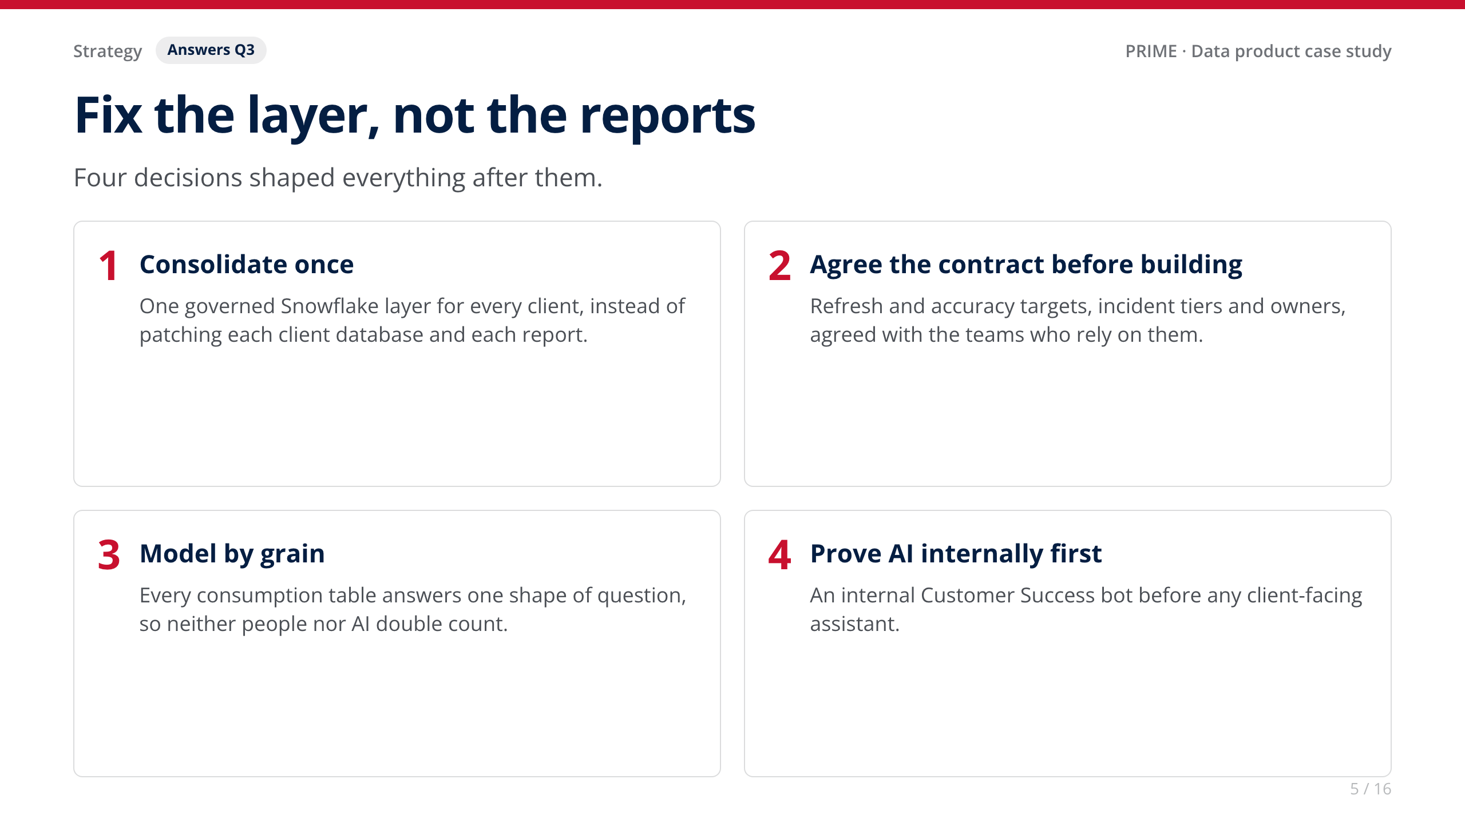
Notes:
• Tie each decision back to a requirement on the previous slide: consolidate → one definition; contract → owners and freshness; grain → AI; internal first → trust before scale.
• [Your story: any option you considered and rejected, e.g. fixing reports one by one.]

Slide 6
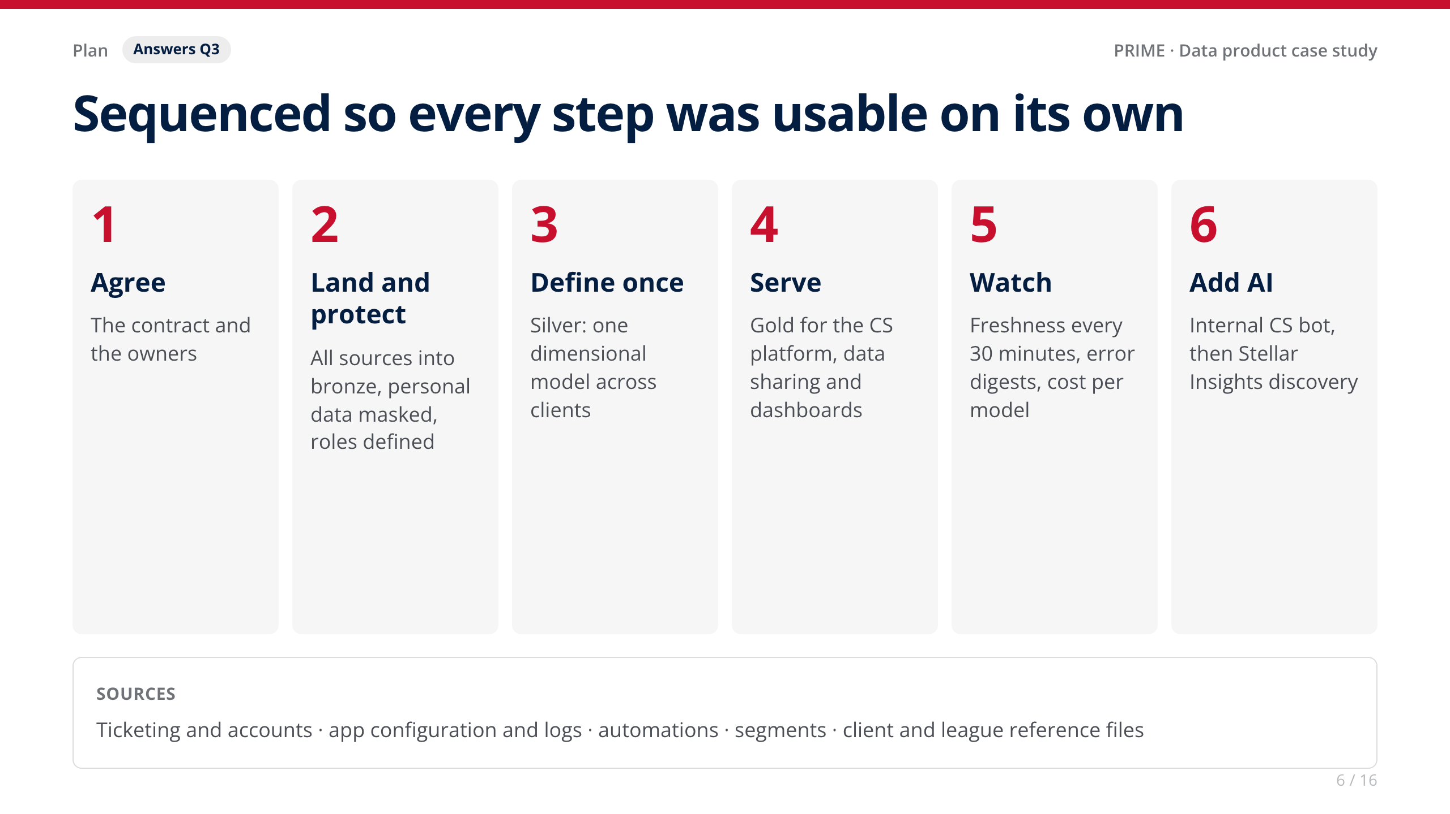
Notes:
• [Your story: confirm the real order and roughly how long each step took.]
• Why this order: each step delivers something people can use, so value shows up before the whole thing is finished.

Slide 7
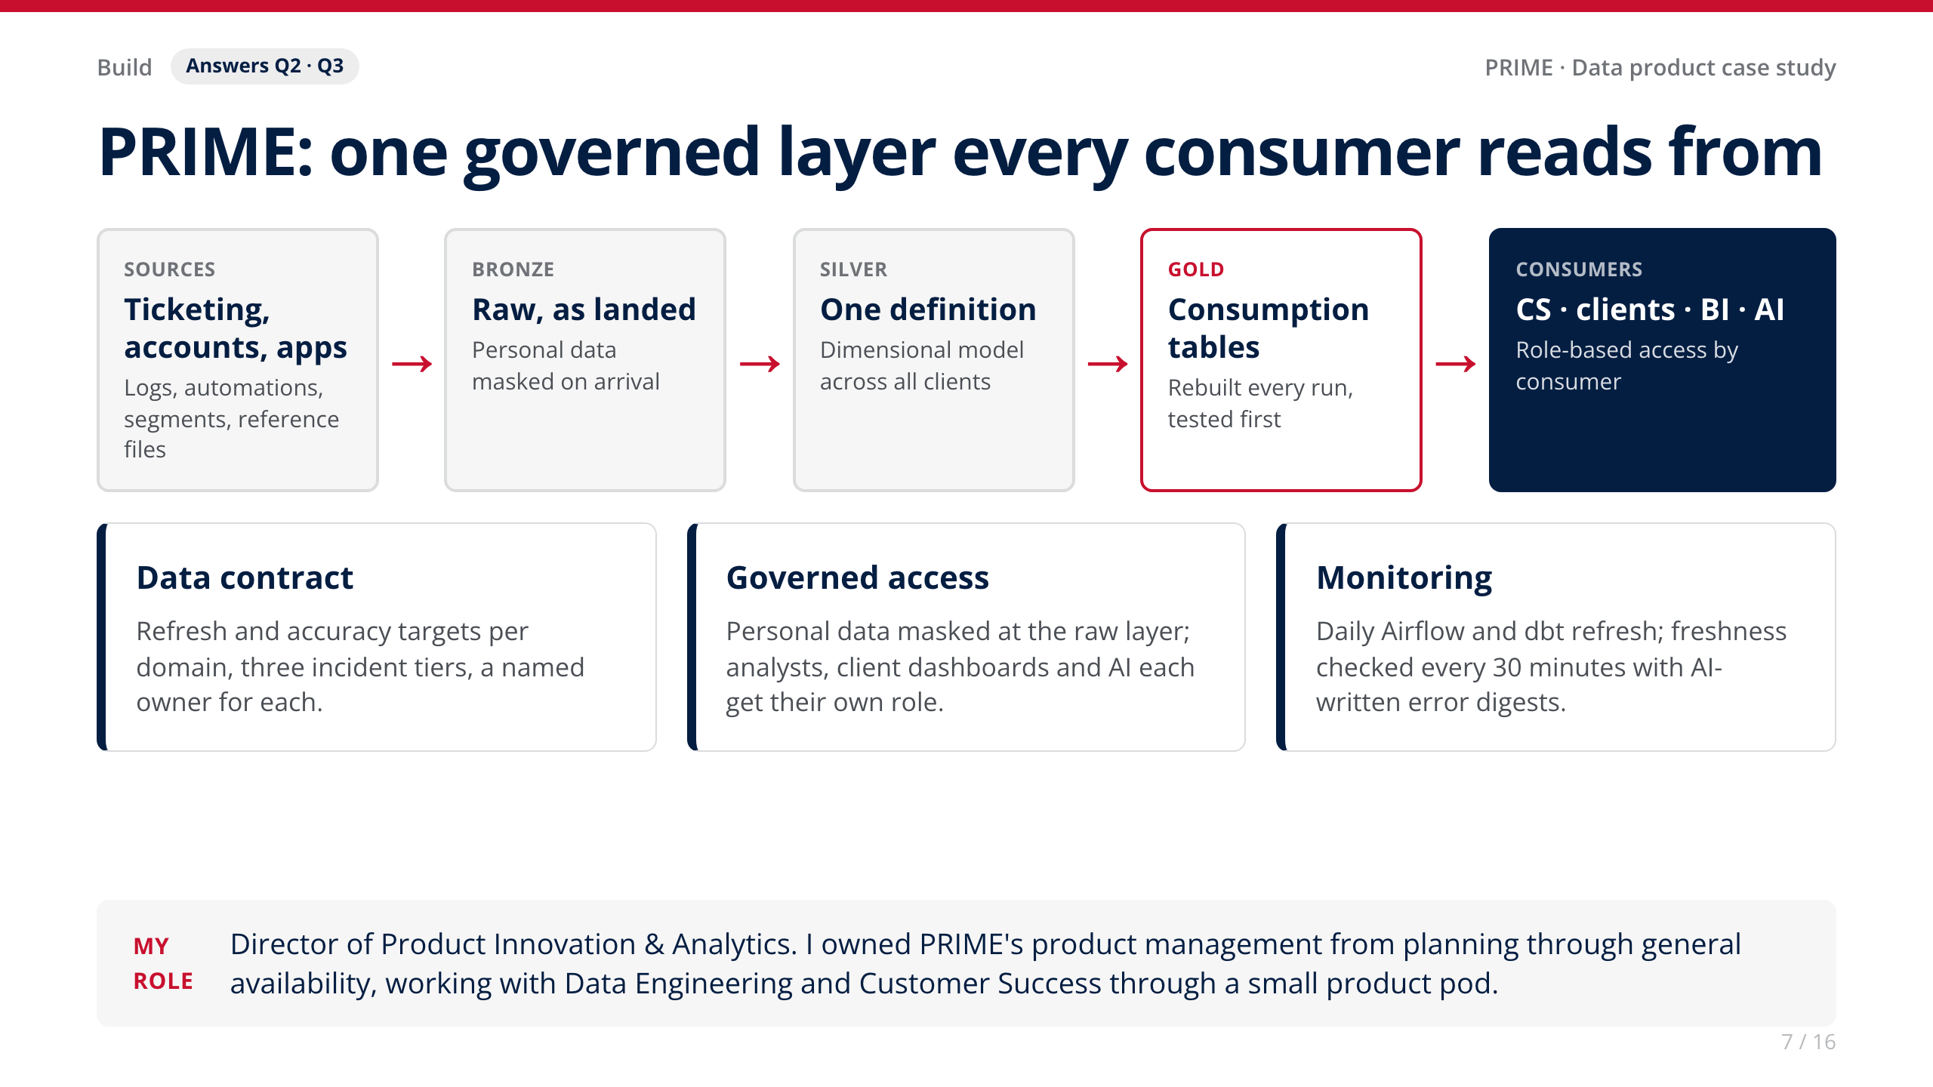
Notes:
• Tools: Snowflake, dbt (100+ tested models), Airflow, AWS, a semantic layer and LLMs.
• [Your story: what you personally decided as product owner, and how you kept the pod aligned.]

Slide 8
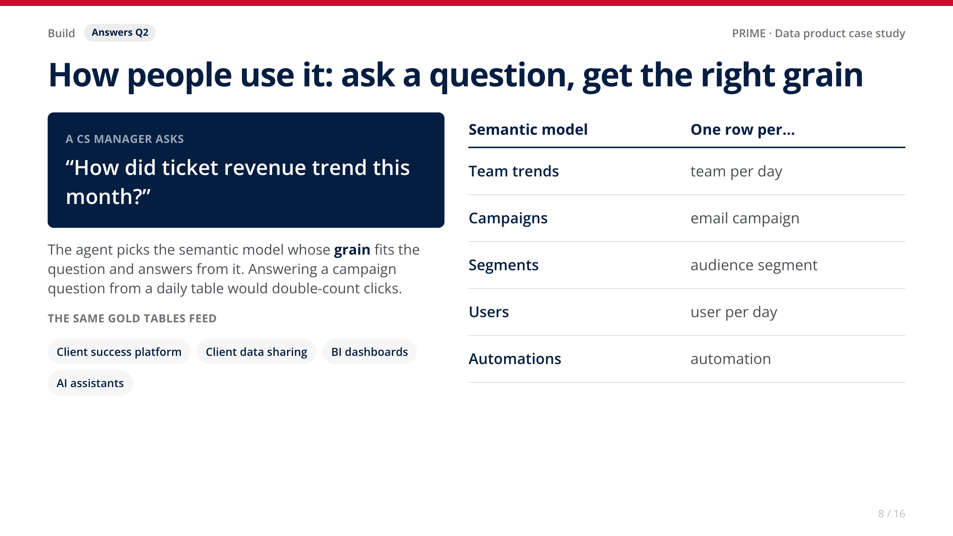
Notes:
• Keep it quick: the live version of this is coming on Calgary data.

Slide 9
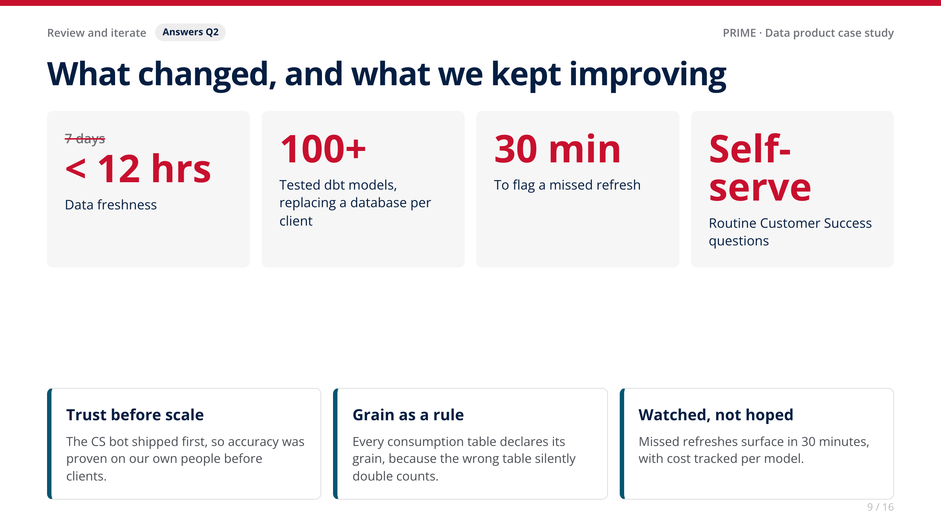
Notes:
• Value: CS, Product and clients work from the same numbers on a reliable schedule, and routine questions no longer need an engineering ticket.
• [Your story: feedback from users that changed the design, and any adoption or time-saved numbers you can share.]

Slide 10
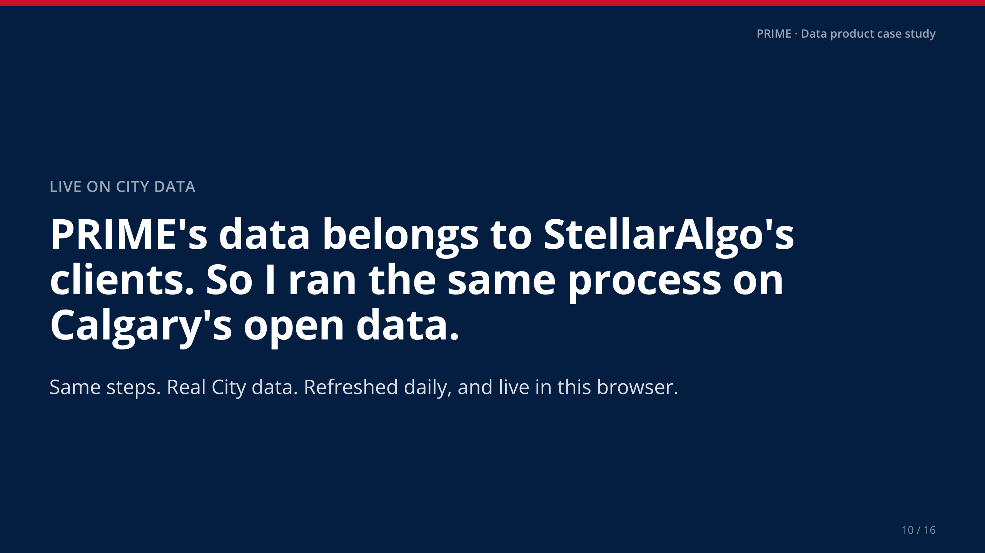
Notes:
• Say it plainly: I can't show client data, so here is the same process on data you know.

Slide 11
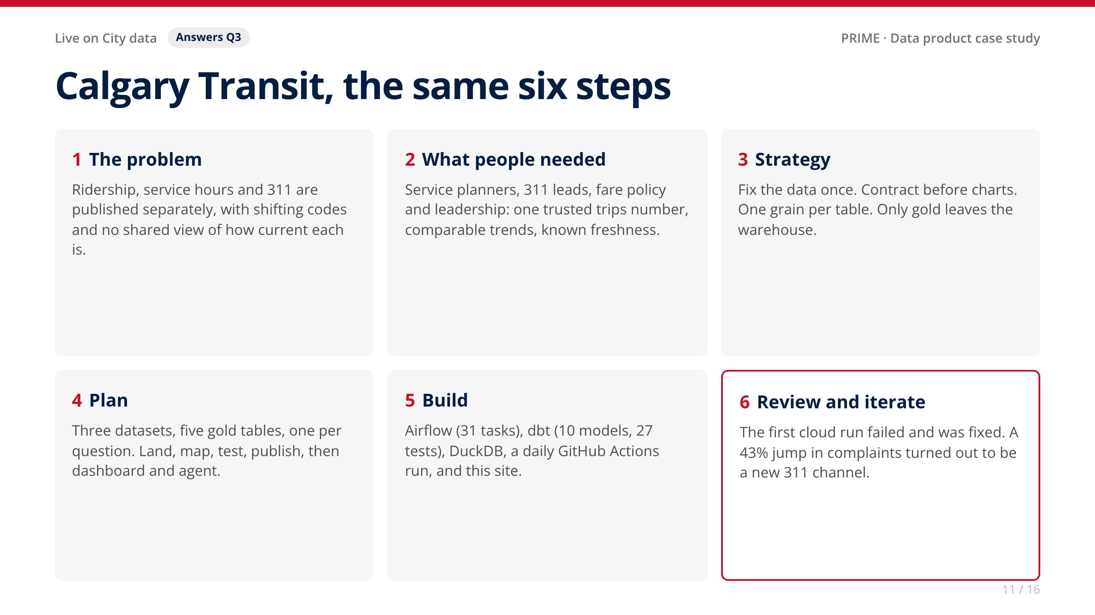
Notes:
• The users here are my assumption of who'd use this at the City; in a real engagement I'd confirm them in short interviews.
• The full version of this is the Approach page on the site.

Slide 12
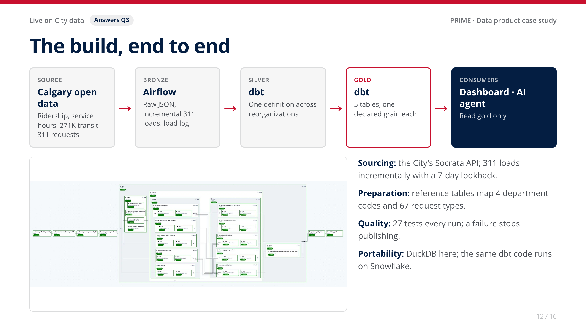
Notes:
• LIVE DEMO (about 90 seconds): switch to the Dashboard. Read the headline: riders back to 95% of 2019 on 99% of the service, feedback per trip up 12%. Then the 'what riders contact 311 about' chart: fares and passes, stops and stations.
• If the room has no internet, the slides still carry the story.

Slide 13
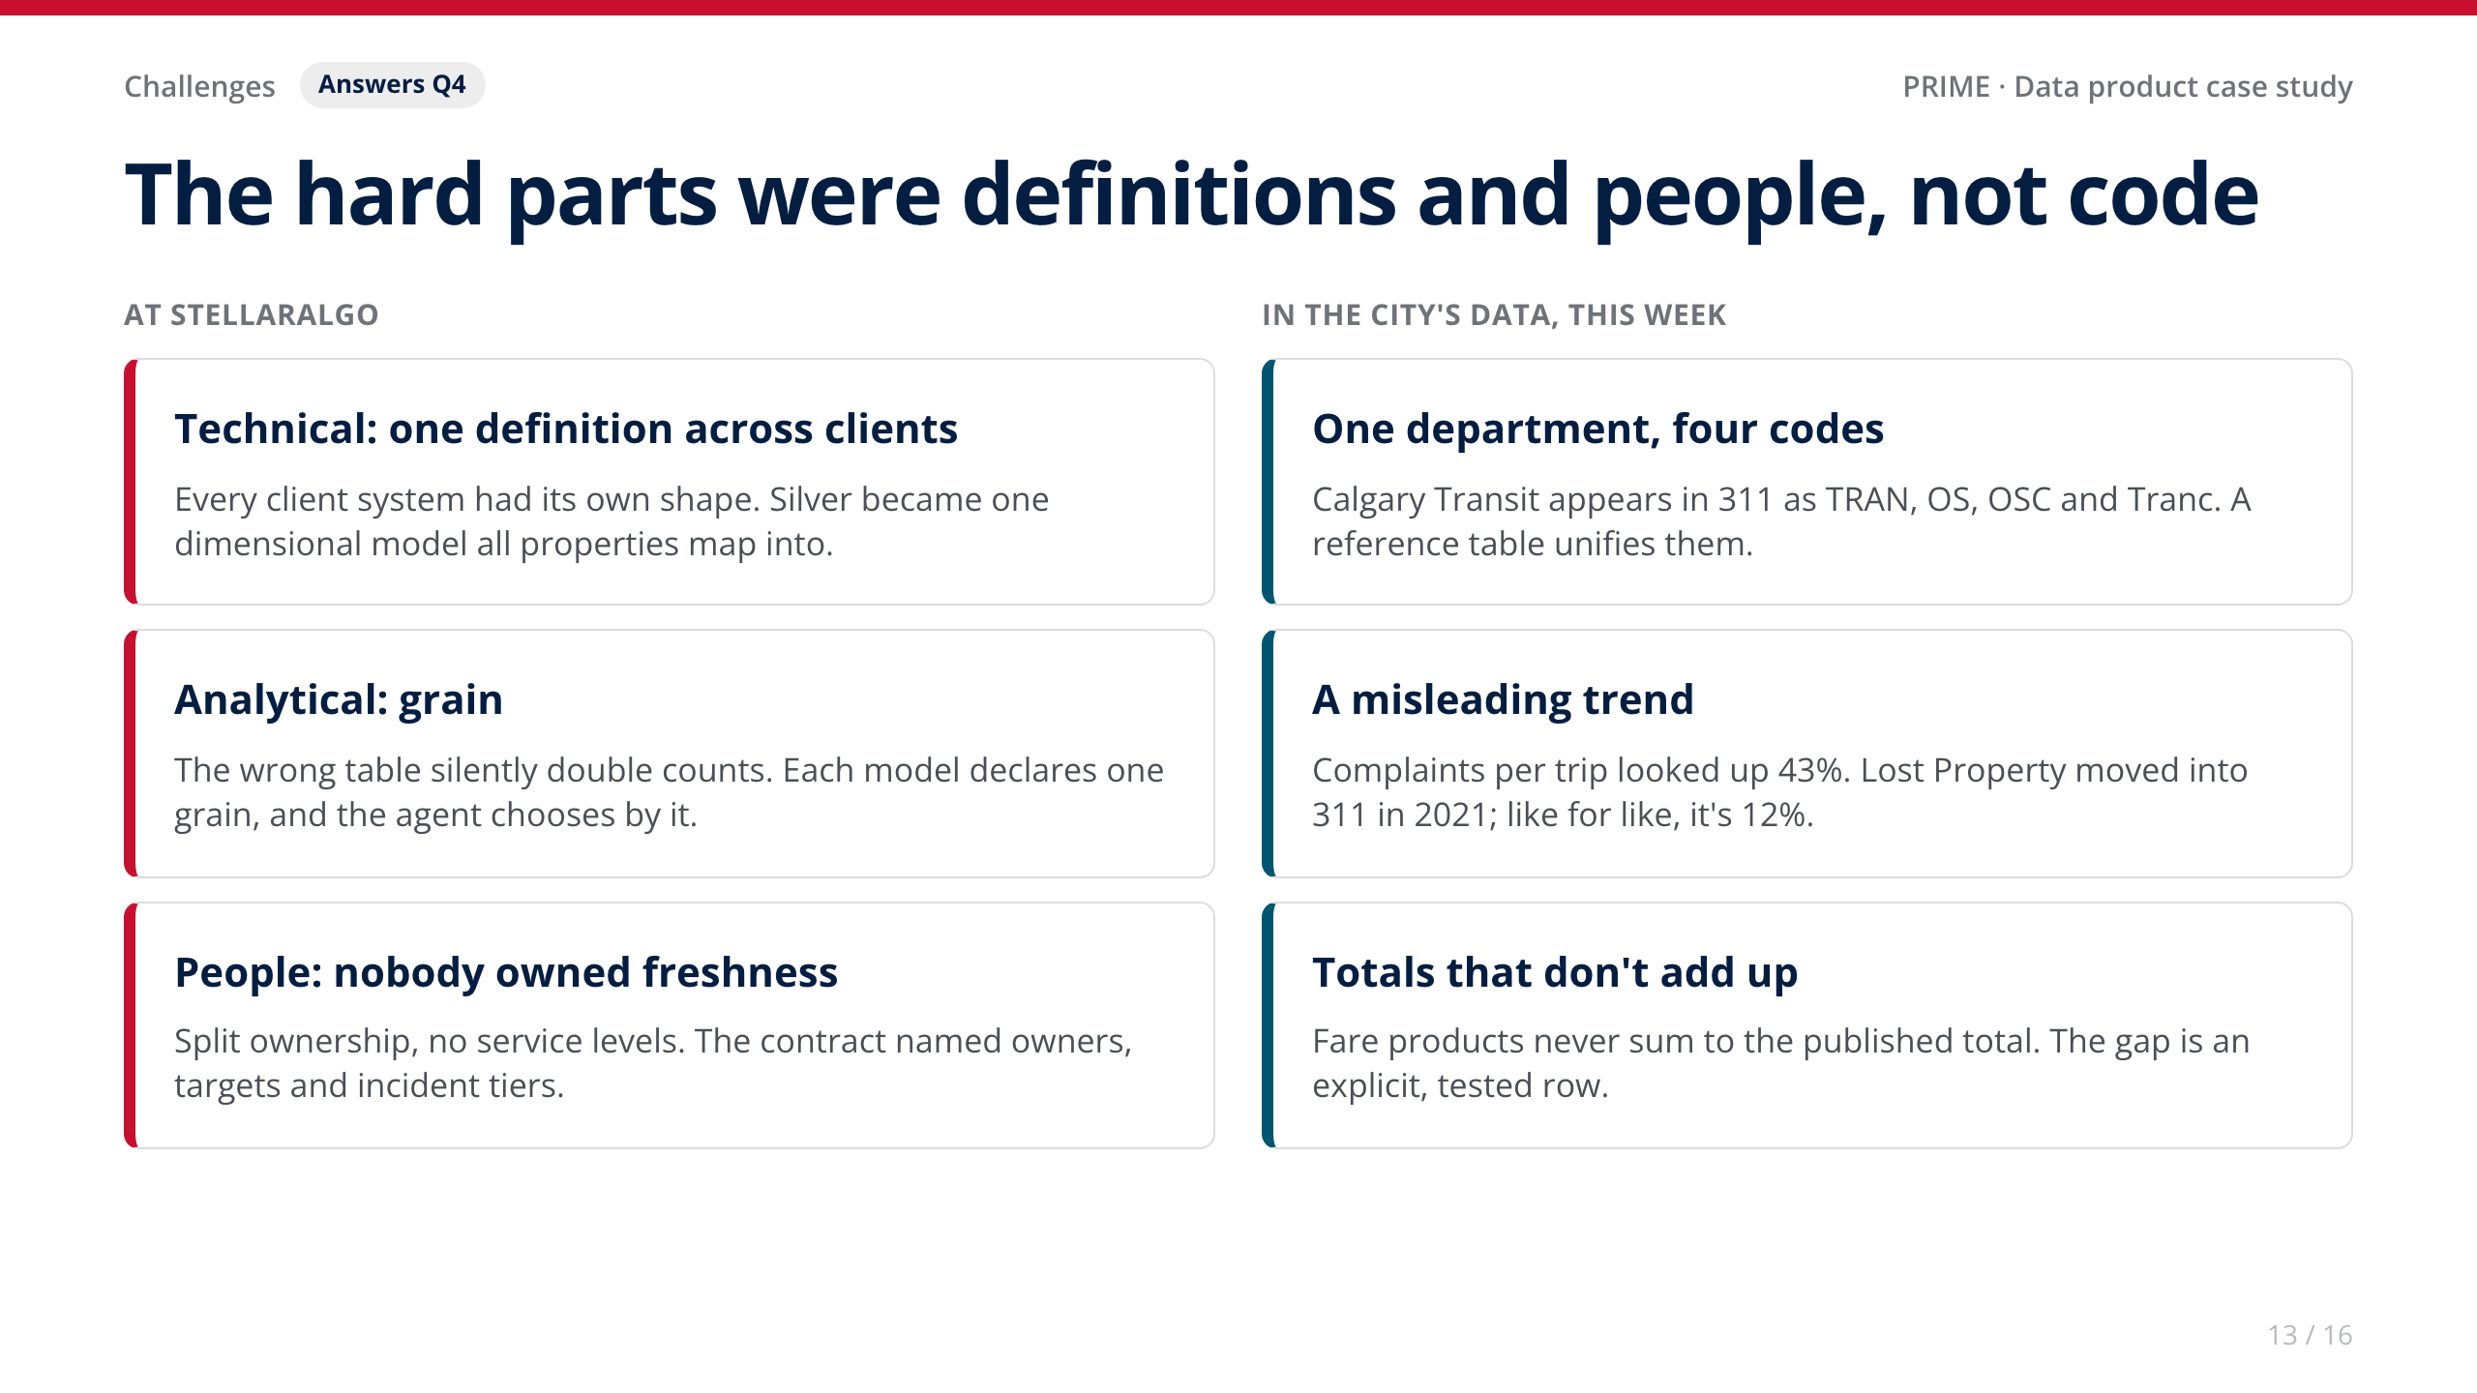
Notes:
• [Your story: the stakeholder conversation that got the data contract agreed. Who pushed back, and what changed their mind?]
• The Lost Property catch is the best analytical example: a second look at a number that seemed too dramatic, then a governed fix so nobody repeats the mistake, including the AI.

Slide 14
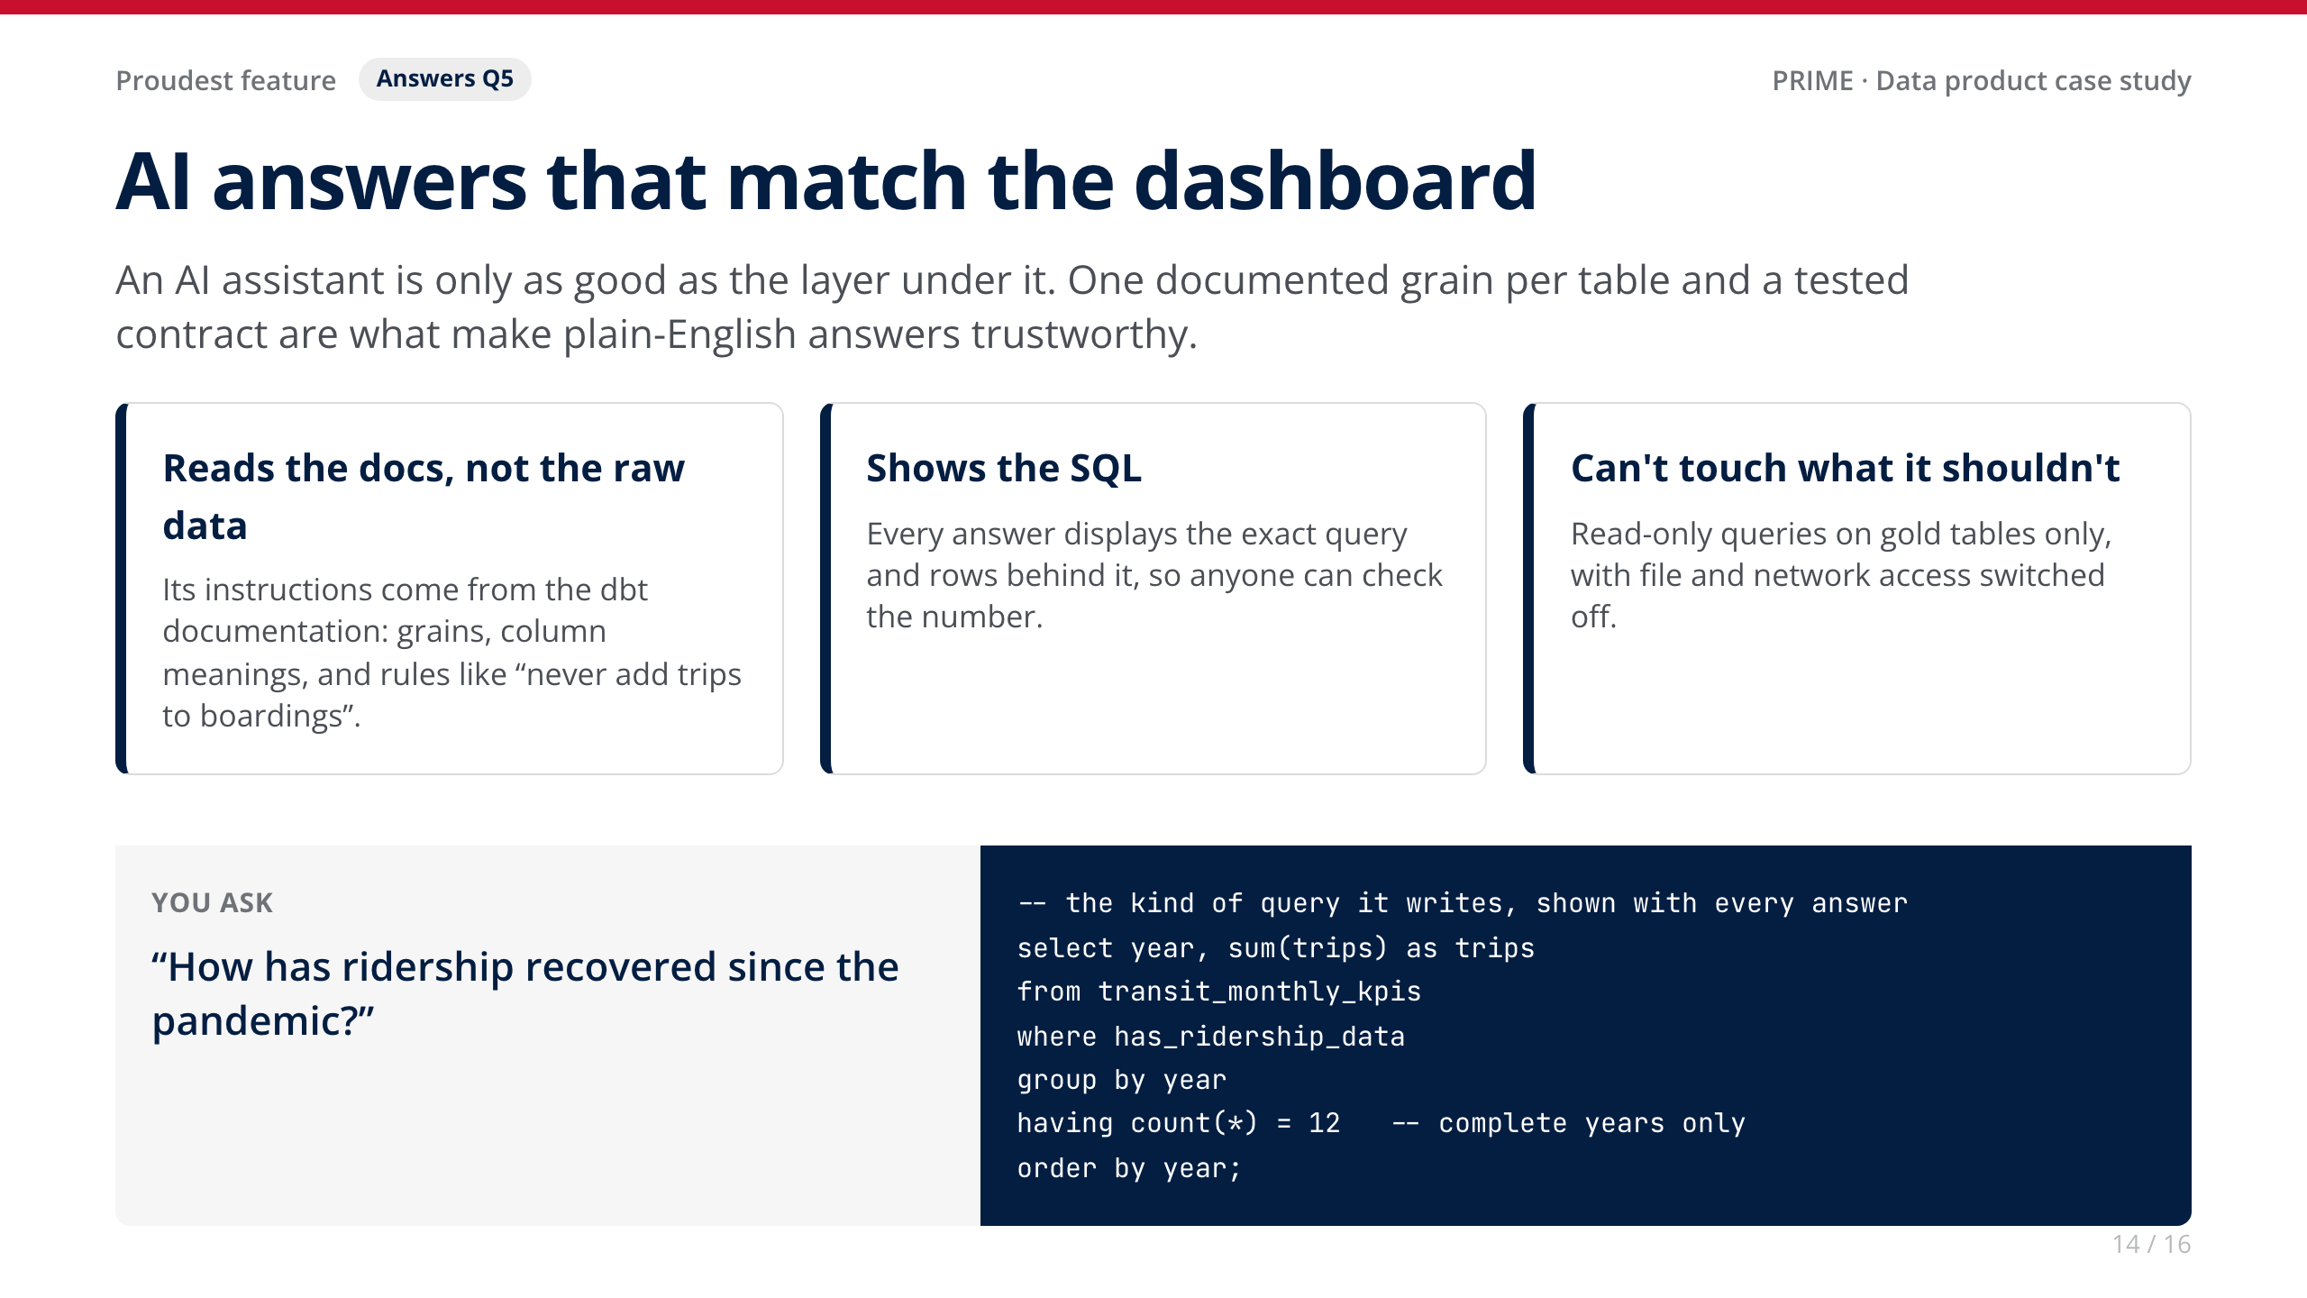
Notes:
• LIVE DEMO (about 60 seconds): open Ask the data and click 'How has ridership recovered since the pandemic?'. Show the SQL, then point at the same number on the dashboard.
• Why it's the proudest part: it's where governance stops being overhead and becomes the reason people can self-serve.

Slide 15
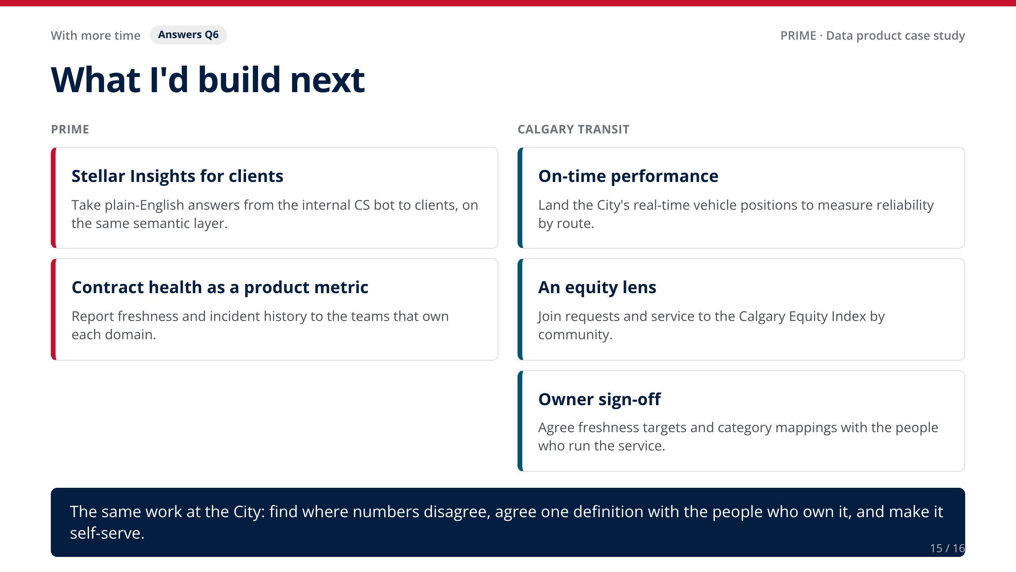
Notes:
• [Your story: anything you'd change about PRIME in hindsight.]
• Land the closing line slowly; it's the bridge to the role.

Slide 16
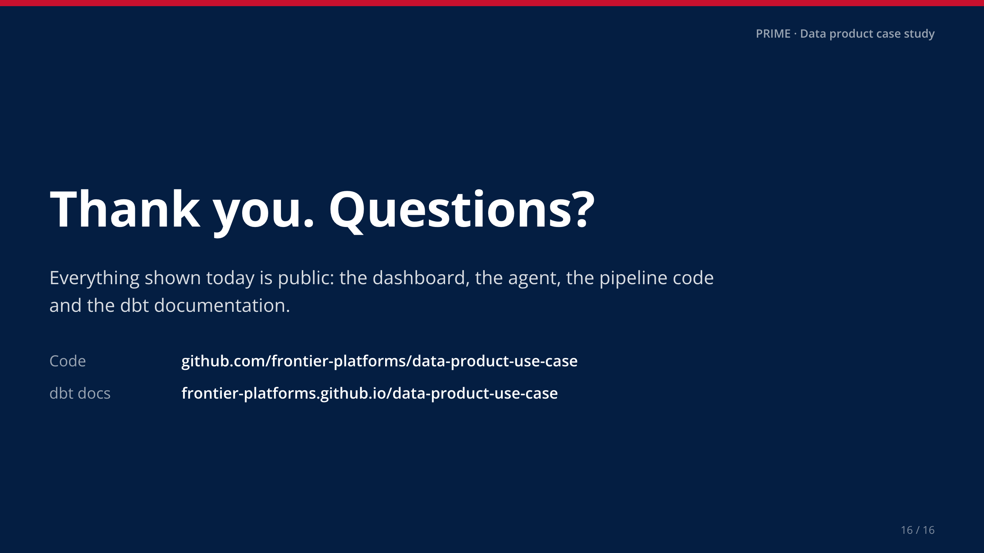
Notes:
• Stop talking. Leave this slide up during questions.

