Slide 1












Denver Dev Day – May 4, 2018
please complete your Microsoft Developer Community Survey: https://aka.ms/denverdevday18

Slide 2


UWP and You
Converting to, and Building Universal Windows Platform Apps
Matt Dixon
Managing Director/Founder/Mountain Biker/Hockey Dad
Front Range Systems

Slide 3

Overview
In this session you will learn:
The Basics of UWP
Converting an Existing app to UWP
How to Create a new UWP app
Native Windows API calls
Fluent Design
References
Notes:
Test notes

Slide 4
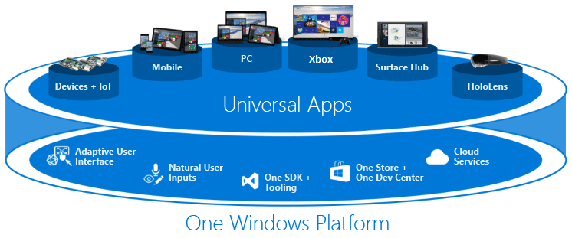
UWP Basics
Notes:
Test notes

Slide 5

Package app for UWP
Notes:
Test notes

Slide 6

Create a new UWP app
Notes:
Test notes

Slide 7
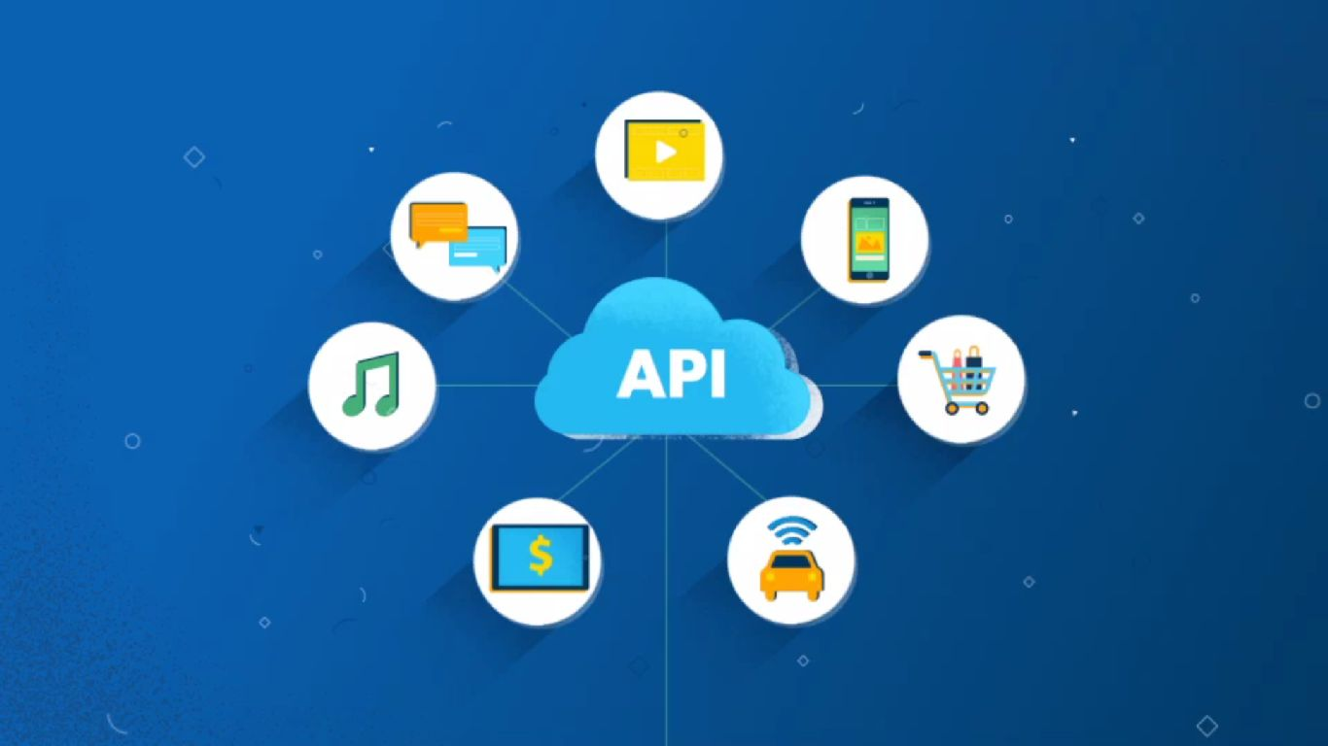
Native API calls
Notes:
Test notes

Slide 8

Fluent Design
Notes:
Test notes

Slide 9
Resources
http://bit.ly/frs-uwp/
Notes:
Test notes

