Slide 1
Steering Behaviours for Autonomous Agents
Dr Bryan Duggan
Dublin Institute of Technology

Slide 2
Introduction
Normally a five week course (part of game AI)
Maths prerequisites
Coordinate geometry
Vectors
Matrices
Physics
There will be code
https://github.com/skooter500/XNA-3D-Steering-Behaviours-for-Space-Ships
And now a short video…

Slide 3
What are Steering Behaviours?
A framework for controlling autonomous agents
Means of locomotion
Largely independent
Can be combined/turned on and off as the scenario changes
Can be prioritised
Improvisational and reactive
Applications in games, movies and robotics
Useful in modelling space simulations, nature, crowd scenes
Amazingly fun, addictive and totally magical to code

Slide 4

History
Invented by Craig Reynolds in 1983
Flocks, herds and schools: A distributed behavioral model (SIGGRAPH, 1987)
Cited 5625 times!
Stanley and Stella in Breaking the Ice (1987)
Not bumping into things, (SIGGRAPH, 1988)
Batman Returns (1992) (army of penguins)
Steering behaviors for autonomous characters (GDC, 1999)
Always presentations at the Games AI Summit at the GDC
Used in many commercial games/movies
Standard part of any game AI course

Slide 5
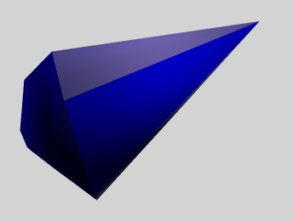
What is an autonomous agent?
Maintains some state about itself
Gets updated and drawn
Behaviours are enabled and then the agent behaves autonomously
Can sense it’s environment and respond
An instance of a class

Slide 6
State
Position (A Vector)
Velocity (A Vector)
Mass (A Scalar)
Look, Up, Right (A Normal)
World Transform (A Matrix)
Quaternion (if you like!)
Force, Acceleration (Vectors, calculated each frame)
TimeDelta (A scalar, calculated each frame)
Max_force, max_speed (Scalars, don’t change)
List of behaviours

Slide 7
Integration
force = steeringBehaviours.calculate();
acceleration = force / mass;
velocity += acceleration * timeDelta;
speed = velocity.Length();
position += velocity * timeDelta;
if (speed > 0.001f) look = velocity.Normalize();

Slide 8
Rotation in 2D/3D
In 2D
Calculate the rotation from the look vector
In 3D
Use a quaternion and full Hamiltonian integration or…
Apply “banking” to fake it
Add some of the acceleration to the up vector
Blend in over a number of frames

Slide 9
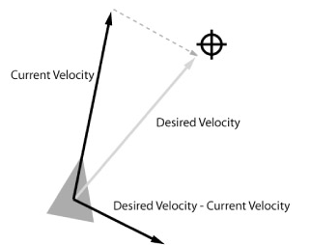
Seek
desiredVelocity = targetPos - agent.Position;
desiredVelocity.Normalize();
desiredVelocity *= agent.maxSpeed;
return (desiredVelocity - fighter.velocity);

Slide 10
Flee
Flee is the opposite of seek. Instead of producing a steering force to steer the agent toward a target position, flee creates a force that steers the agent away.
The only difference is that the desiredVelocity is calculated using a vector pointing in the opposite direction (agent.Position - targetPos instead of targetPos - agent.Position).
Flee can be easily adjusted to generate a fleeing force only when a vehicle comes within a certain range of the target.

Slide 11
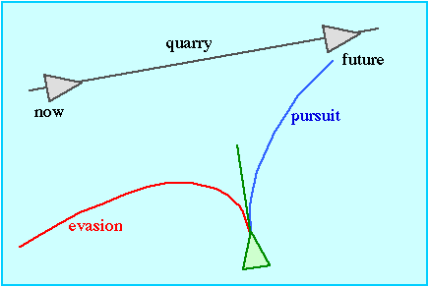
Pursue and Evade
Based on underlying Seek and Flee
Pursue – Predict future interception position of target and seek that point
Evade – Use future prediction as target to flee from

Slide 12
Pursue
dist = (agent.Target.Position - agent.Position).Length();
lookAhead = (dist / agent.maxSpeed);
target = agent.Target.Position + (lookAhead * agent.Target.velocity);
return seek(target);

Slide 13
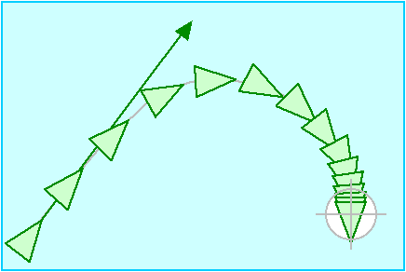
Arrive
Goal to arrive at target with zero velocity
Arrival behaviour is identical to seek while the character is far from its target.
This behaviour causes the character to slow down as it approaches the target, eventually slowing to a stop coincident with the target
Outside the stopping radius this desired velocity is clipped to max_speed, inside the stopping radius, desired velocity is ramped down (e.g. linearly) to zero.

Slide 14
targetOffset = target - agent.Position;
distance = targetOffset.Length();
rampedSpeed = maxSpeed * (distance / slowingDistance)
clippedSpeed = minimum (ramped_speed, max_speed)
desiredVelocity = (clippedSpeed / distance) * targetOffset
return (desiredVelocity - agent.Velocity);

Slide 15
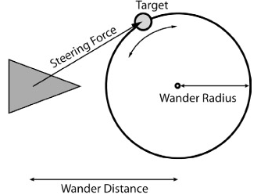
Wander

Slide 16
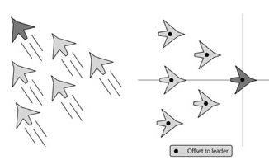
Offset pursuit
Offset pursuit is useful for all kinds of situations. Here are a few:
Marking an opponent in a sports simulation
Docking with a spaceship
Shadowing an aircraft
Implementing battle formations

Slide 17
Offset Pursuit
target = Transform(offset, agent.Leader.worldTransform);
dist = (target - agent.Position).Length();
lookAhead = (dist / agent.maxSpeed);
target = target + (lookAhead * agent.Leader.velocity);
return arrive(target);

Slide 18
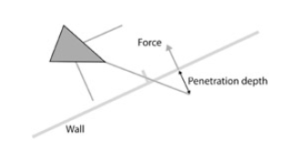
Wall avoidance (flat things)
Create the feelers
Take the default look vector * depth of the feeler
Rotate it to create left, right ( Y Axis - yaw), up and down (X Axis - pitch) feelers
Transform to world space (* the world transform)
Find out if each feeler penetrates the planes
n.p + d
If < 0, then it penetrates, so...
Calculate the distance
distance = abs(dotproduct (point, plane.normal) - plane.distance);
Calculate the force
n * distance
Do this for each feeler and sum the forces

Slide 19
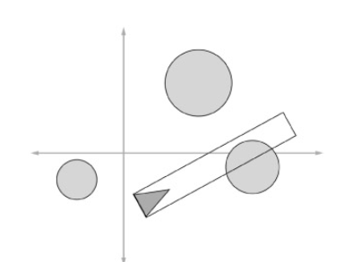
Obstacle Avoidance
Steers a vehicle to avoid obstacles lying in its path.
Any object that can be approximated by a circle or sphere
This is achieved by steering the vehicle so as to keep a rectangular area — a detection box, extending forward from the vehicle — free of collisions.
The detection box's width is equal to the bounding radius of the vehicle, and its length is proportional to the vehicle's current speed — the faster it goes, the longer the detection box

Slide 20
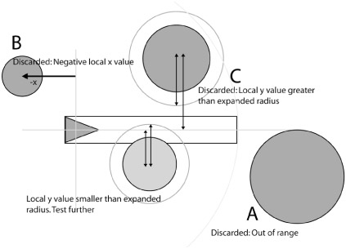
Obstacle avoidance

Slide 21
The algorithm
Calculate the box length
minLength + (speed / maxSpeed * minLength)
Tag obstacles in range of the box length
For each tagged obstacle
Transform into local space of the agent
Multiply by inverse world transform
Discard obstacles with +Z value as they will be behind the agent
Expand the radius of the obstacle by half the agent radius
Discard obstacles with an X or Y <> expanded radius
Generate a ray from the origin and the basis vector
We are in local space remember!
Calculate the intersection point.
Only consider the nearest intersecting obstacle
Generate the forces
Lateral on the X of the centre point of the agent
Lateral on the Y of the centre point of the agent
Breaking force on the Z of the centre point of the agent
Transform by the agents world transform

Slide 22

A note on obstacle avoidance
The most complicated of all the behaviours to code
Lots of clever optimisations
Ends up being several pages of code
But beautiful!
Intersection of a ray and a sphere
(p – c).(p - c) - r² = 0
p(t) = p0 + tu
a = u.u
b = 2u(p0 – pc)
c = (p0 – c).(p0 – c) - r2

Slide 23
Combining steering behaviours
Sum
Weighted sum
* Weighted prioritised truncated running sum
Prioritised dithering

Slide 24
Flocking
* Separation
* Cohesion
* Alignment
Wander
Sphere Constrain
Obstacle avoidance
Flee

Slide 25
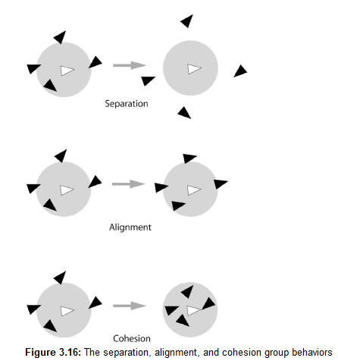
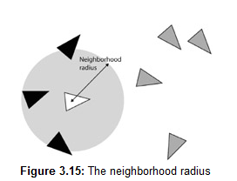

Slide 26
Seperation
for (int i = 0; i < tagged.Count; i ++ )
{
entity = tagged[i];
if (entity != null)
{
toEntity = agent.pos - entity.pos;
steeringForce += (Normalize(toEntity) / toEntity.Length());
}
}
return steeringForce;

Slide 27
Cohesion
foreach (Entity entity in tagged)
{
if (entity != agent)
{
centreOfMass += entity.Position;
taggedCount++;
}
}
if (taggedCount > 0)
{
centreOfMass /= taggedCount;
steeringForce = seek(centreOfMass));
}
return steeringForce;

Slide 28
Alignment
foreach (Entity entity in tagged)
{
if (entity != agent)
{
steeringForce += entity.look;
taggedCount++;
}
}
if (taggedCount > 0)
{
steeringForce /= (float) taggedCount;
steeringForce = steeringForce - agent.look;
}
return steeringForce;

Slide 29
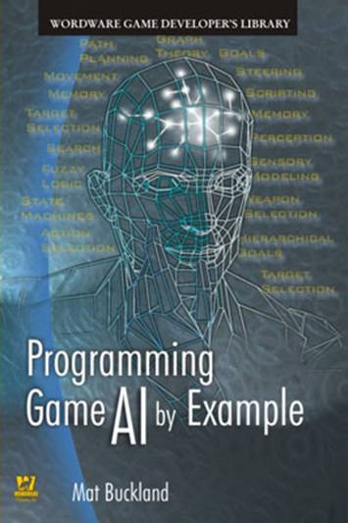
More information
http://www.red3d.com/cwr/steer/
https://github.com/skooter500/
http://www.youtube.com/skooter500
http://opensteer.sourceforge.net/
http://arges-systems.com/blog/2009/07/08/unitysteer-steering-components-for-unity/
http://natureofcode.com/

Slide 30
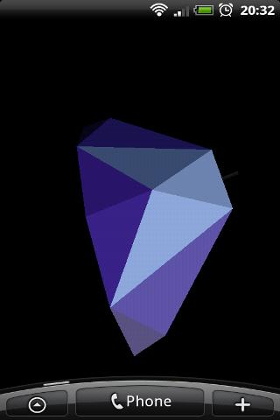
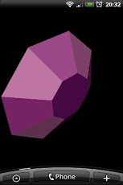
Thanks to
Andy Duplain
Neural Technologies Ltd
for the Elite models

