Slide 1
4. Artificial Neural Networks
4.1 Introduction
  Robust approach to approximating real and discrete-valued target functions
  Biological Motivations
    Using ANNs to model and study biological learning processes
    Obtaining highly effective Machine Learning algorithms by mirroring biological processes

Slide 2
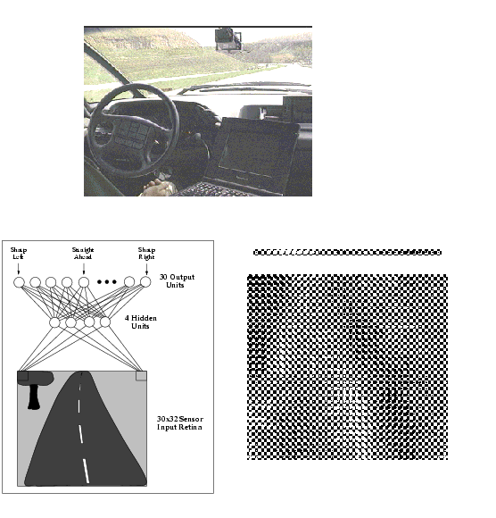
4. Artificial Neural Networks
4.2 Neural Network Representation
Example: ALVIIN
Steering an
autonomous vehicle
driving at normal
speed on public
highways

Slide 3
4. Artificial Neural Networks
4.3 Appropriate Problems for ANNs
  Instances are represented by many attribute-value pairs
  Training examples may contain errors
  Long training times are acceptable
  Fast evaluation of the learned target function may be required
  Ability to understand the target function not important

Slide 4
4. Artificial Neural Networks
4.4 Perceptrons
  o(x₁,x₂...,x_{n}) = 1 if w₀+ w₁ x₁+.. + w_{n} x_{n} > 0
  -1 otherwise
  o(x) = sgn(w.x) (x₀=1)
  Hypothesis Space: H = {w | w ∈ℜ^{n+1}}

Slide 5
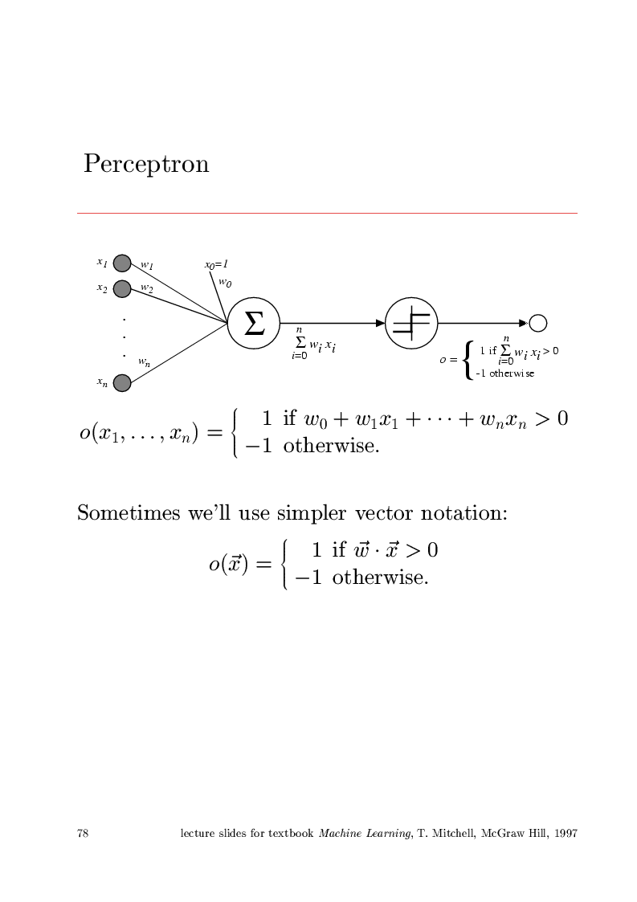
4. Artificial Neural Networks

Slide 6
4. Artificial Neural Networks
Representational Power
  Perceptrons can represent all the primitive Boolean functions AND, OR, NAND (¬AND) and NOR (¬OR)
  They cannot represent all Boolean functions (for example, XOR)
  Every Boolean function can be represented by some network of perceptrons two levels deep

Slide 7
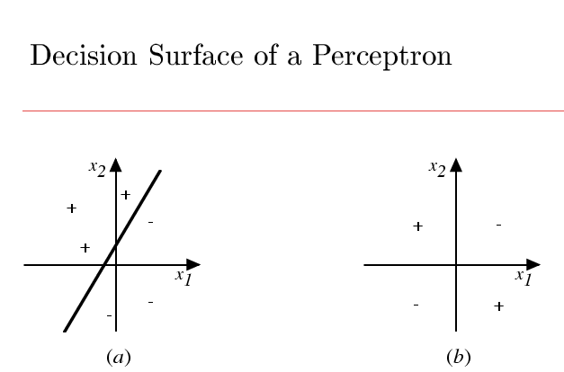
4. Artificial Neural Networks

Slide 8
4. Artificial Neural Networks
The Perceptron Training Rule
  w_{i} ← w_{i} + Δw_{i} Δw_{i} = η (t - o) x_{i}
  t: target output for the current training example
  o: output generated by the perceptron
  η: learning rate

Slide 9
4. Artificial Neural Networks
Gradient Descent and Delta Rule
  Unthresholded perceptrons
  w_{i} ← w_{i} + Δw_{i} Δw_{i} = η ∂E/∂w_{i}
  E(w) = ½ ∑_{D} (t-o)² ∂E/∂w_{i} = ∑_{D} (t-o) x_{i}
  Delta (Adaline, Widrow-Hoff, LMS) Rule:
  w_{i} ← w_{i} + Δw_{i} Δw_{i} = η (t-o) x_{i}

Slide 10
4. Artificial Neural Networks
Remarks
  The perceptron training rule converges after a finite number of iterations to a hypothesis that perfectly classifies the data, provided the examples are linearly separables
  The delta rule converges only asymptotically toward the minimum error hypothesis, but regardless of the data linear separability

Slide 11
4. Artificial Neural Networks
4.5 Multilayer Networks and the BP Algorithm
  ANNs with two or more layers are able to represent complex nonlinear decision surfaces
  Differentiable Threshold (Sigmoid) Units
  o = σ(w.x) σ(y) = 1/(1+e^{-y})
  ∂σ/∂y = σ(y) [1-σ(y)]

Slide 12
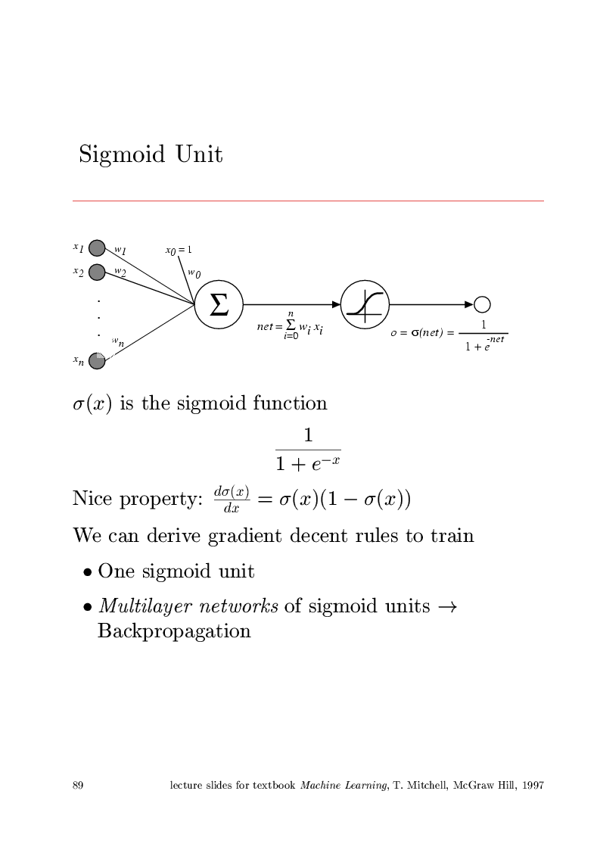
4. Artificial Neural Networks

Slide 13
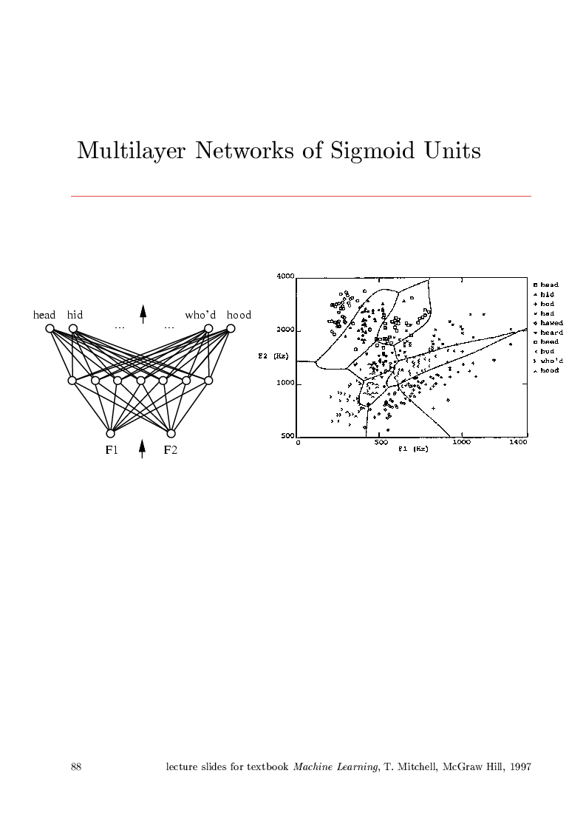
4. Artificial Neural Networks

Slide 14
4. Artificial Neural Networks
The BackPropagation Algorithm
  x_{ji}: i-th input to unit j
  w_{ji}: weight associated with the i-th input to unit j
  net_{j}= ∑_{i} w_{ji} x_{ji} : weighted sum of inputs for unit j
  o_{j} : output computed by unit j
  t_{j} : target output for unit j
  DS(j) : DownStream(j), set of units whose inputs include the output of unit j

Slide 15
4. Artificial Neural Networks
  o=σ(w.x) σ(y)=1/(1+e^{-y}) ∂σ/∂y= σ(y).[1-σ(y)]
  E(w) = ½ ∑_{D} ∑_{k∈outputs} (t_{k}-o_{k})² = ∑_{D} E_{d}
  ∂E_{d}/∂w_{ji} = ∂E_{d}/∂net_{j} . x_{ji}

Slide 16
4. Artificial Neural Networks
  Case 1: Output Units k
  ∂E_{d}/∂net_{k}= ∂E_{d}/∂o_{k} × ∂o_{k}/∂net_{k} ≡ -δ_{k}
  ∂E_{d}/∂o_{k} = - (t_{k}-o_{k}) ∂o_{k}/∂net_{k}= o_{k}(1- o_{k})
  ⇒ Δw_{kj} = - η ∂E_{d}/∂w_{kj} = η (t_{k}-o_{k}) o_{k}(1- o_{k}) x_{kj}

Slide 17
4. Artificial Neural Networks
  Case 2: Hidden Units j
  ∂E_{d}/∂netj = ∑_{r∈DS(}j₎ ∂E_{d}/∂net_{r} × ∂net_{r}/∂netj
  = - ∑_{r∈DS(}j₎ δ_{r} × ∂net_{r}/∂oj × ∂oj/∂netj
  = - ∑_{r∈DS(}j₎ δ_{r} wrj oj (1-oj)
  ⇒ δj = - oj (1- oj) ∑_{r∈DS(}j₎ δ_{r} wrj
  Δwj i = - η ∂E_{d}/∂w_{ji} = η δj xji

Slide 18
4. Artificial Neural Networks
Remarks on the BP Algorithm
  Implements a gradient descend search
  Heuristics
  Momentum term
  Stochastic gradient descend
  Training multiple networks

Slide 19
4. Artificial Neural Networks
Representational Power of FeedForward ANNs
  Boolean functions: exactly with two layers and enough hidden neurons
  Continuous functions: bounded functions can be approximated with arbitrarily small error with two layers (sigmoid hidden units and linear output units)
  Arbitrary functions: can be approximated to arbitrary accuracy with three layers (two hidden layers with sigmoid units plus linear output units)

Slide 20
4. Artificial Neural Networks
Hypothesis Space search and inductive Bias
  Hypothesis Space: n-dimensional Euclidean space of network weights
  Inductive Bias: Smooth interpolation between data points
Hidden Layer Representation
  Encoding of information
  Discovering of new features not explicit in the input representation

Slide 21
4. Artificial Neural Networks
Generalization, Overfitting and Stopping Criterion
  What is an appropriate condition for terminating the
  weight update loop?
  Hold-out Validation
  k-fold Cross Validation

Slide 22
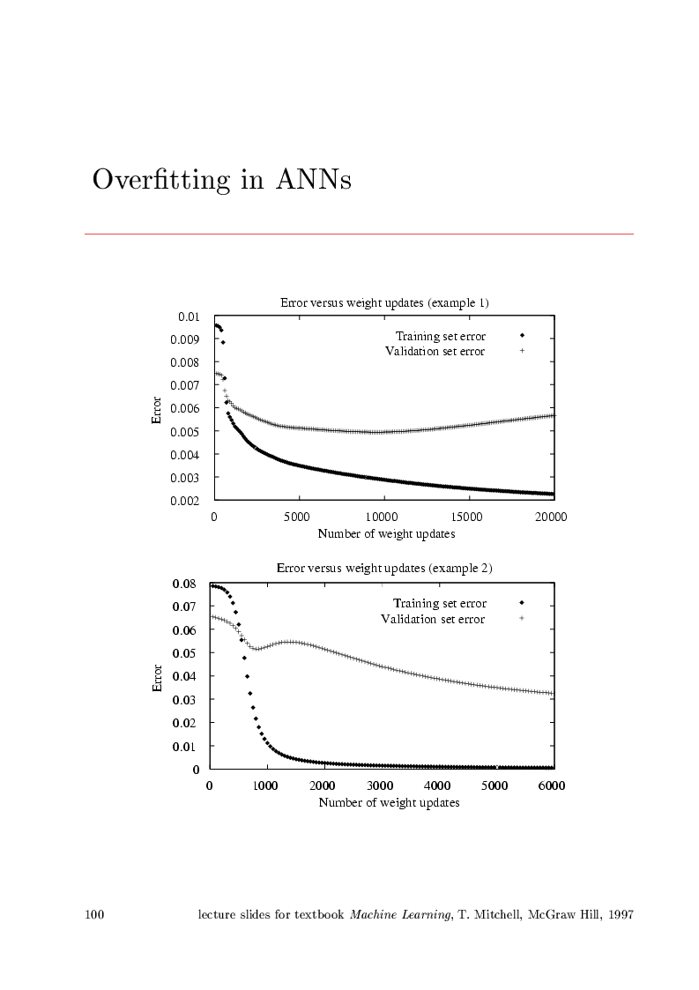
4. Artificial Neural Networks
Overfitting in ANNs

Slide 23
4. Artificial Neural Networks
4.7 Example: Face Recognition
  The Task
    Classifying camera images of faces of 20 different people, including 32 images per person, varying the person’s expression (happy, sad, angry, neutral), the direction in which they are looking (left, right, straight ahead, up), and whether or not they are wearing sunglasses
    There are also variation in the background behind the person, the clothing worn by the person and the position of the face within the image

Slide 24
4. Artificial Neural Networks
    Each image has a 120x128 resolution, with pixels in a greyscale intensity from 0 (black) to 255 (white)
  Task: Learning the direction in which the person is facing
  Design Choices
    Input encoding: 30x32 coarse intensity values
    Output encoding: 4 distinct output units

Slide 25
4. Artificial Neural Networks
  Network structure: i : h: o
  i = 30x32 h = 3 to 30 o = 4
  Learning parameters:
  learning rate = 0.3 momentum = 0.9

Slide 26
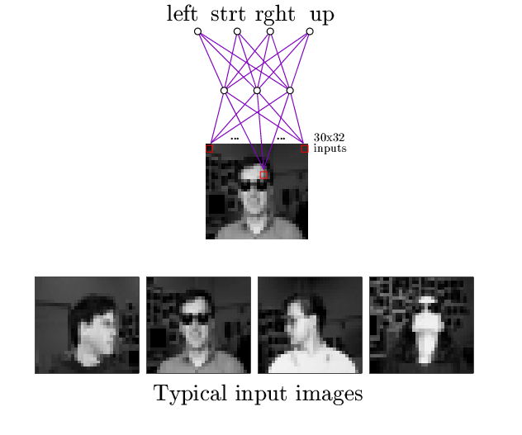
4. Artificial Neural Networks

Slide 27
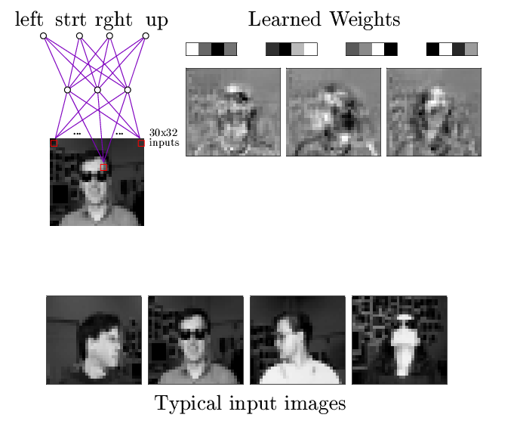
4. Artificial Neural Networks

Slide 28
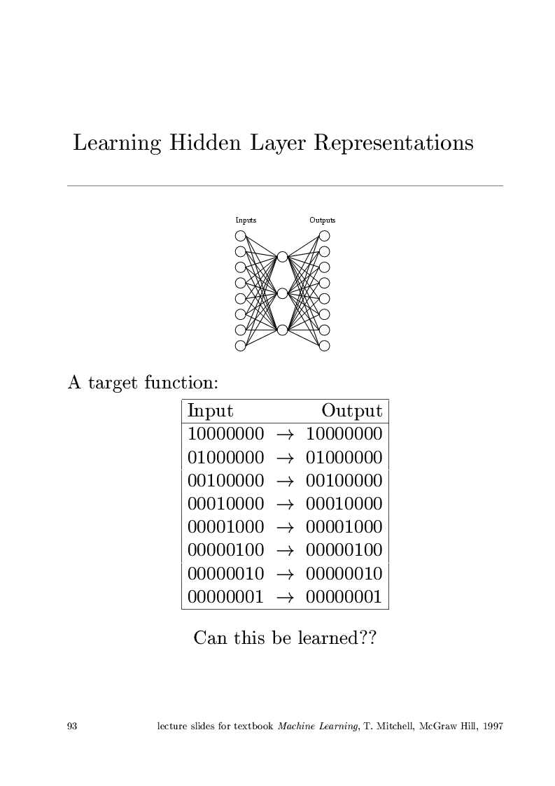
4. Artificial Neural Networks
  What is the learned hidden representation?

Slide 29
4. Artificial Neural Networks
4.8 Advanced Topics
  Alternative Error functions
  Weight Decay
  E(w) = ½ ∑_{D} ∑_{k∈outputs}(t_{k}-o_{k})² + γ ∑ij (wji)²
  Cross Entropy
  -∑_{D} t lno + (1-t) ln(1-o)

Slide 30
4. Artificial Neural Networks
  Alternative Error Minimization Procedures
    Line search
    Conjugate gradient
  Dynamically Modifying Network Structure
    Cascade-Correlation Algorithm
    Optimal Brain Damage

Slide 31
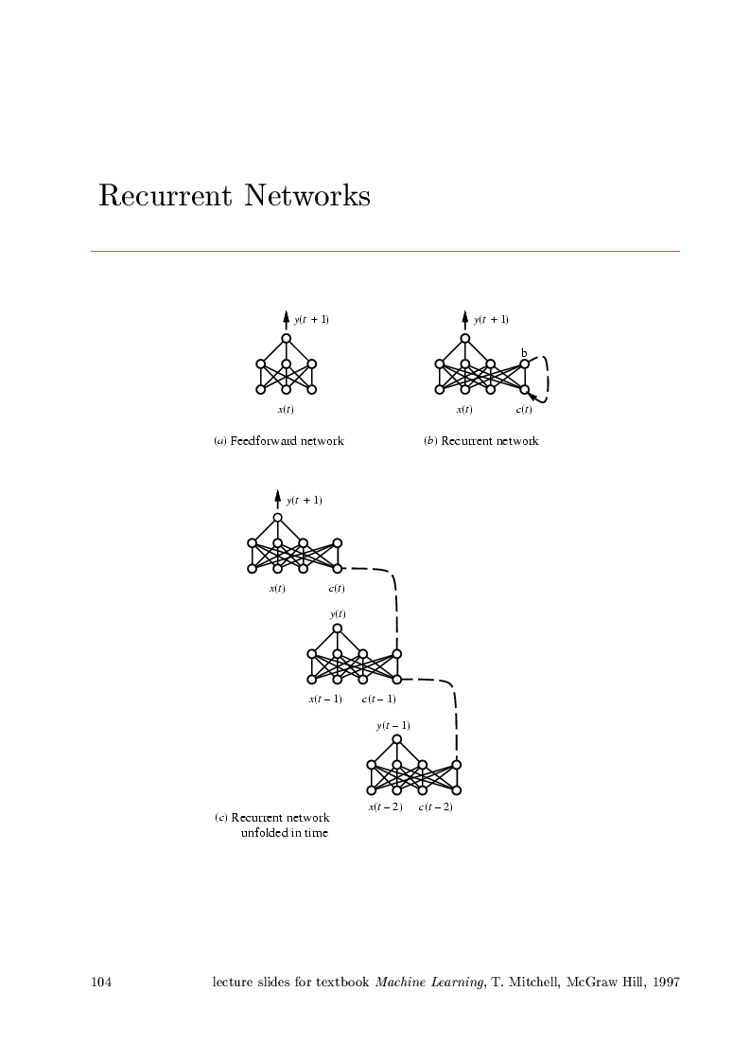
4. Artificial Neural Networks
  Recurrent Networks
    Backpropagation-Through-Time Algorithm

