Slide 1
Review Based analysis of mobile phones
Group Members:
Asjid Ahmed Muhammad Suleman
P17-6124 P17-6147
Supervisor:
Zeshan Khan

Slide 2
Table of contents
Introduction
Motivation
Goals Achieved
Confusion Matrix
Accuracy
Technical Difficulties
FYP-2 Goals

Slide 3
Introduction
System will take the given features and will analyze the mobiles reviews according to given features and output the top suggestions.

Slide 4
Motivation
A web application that provides best mobile phone suggestions based on specific selected features. It will save time by automating analysis of reviews.

Slide 5
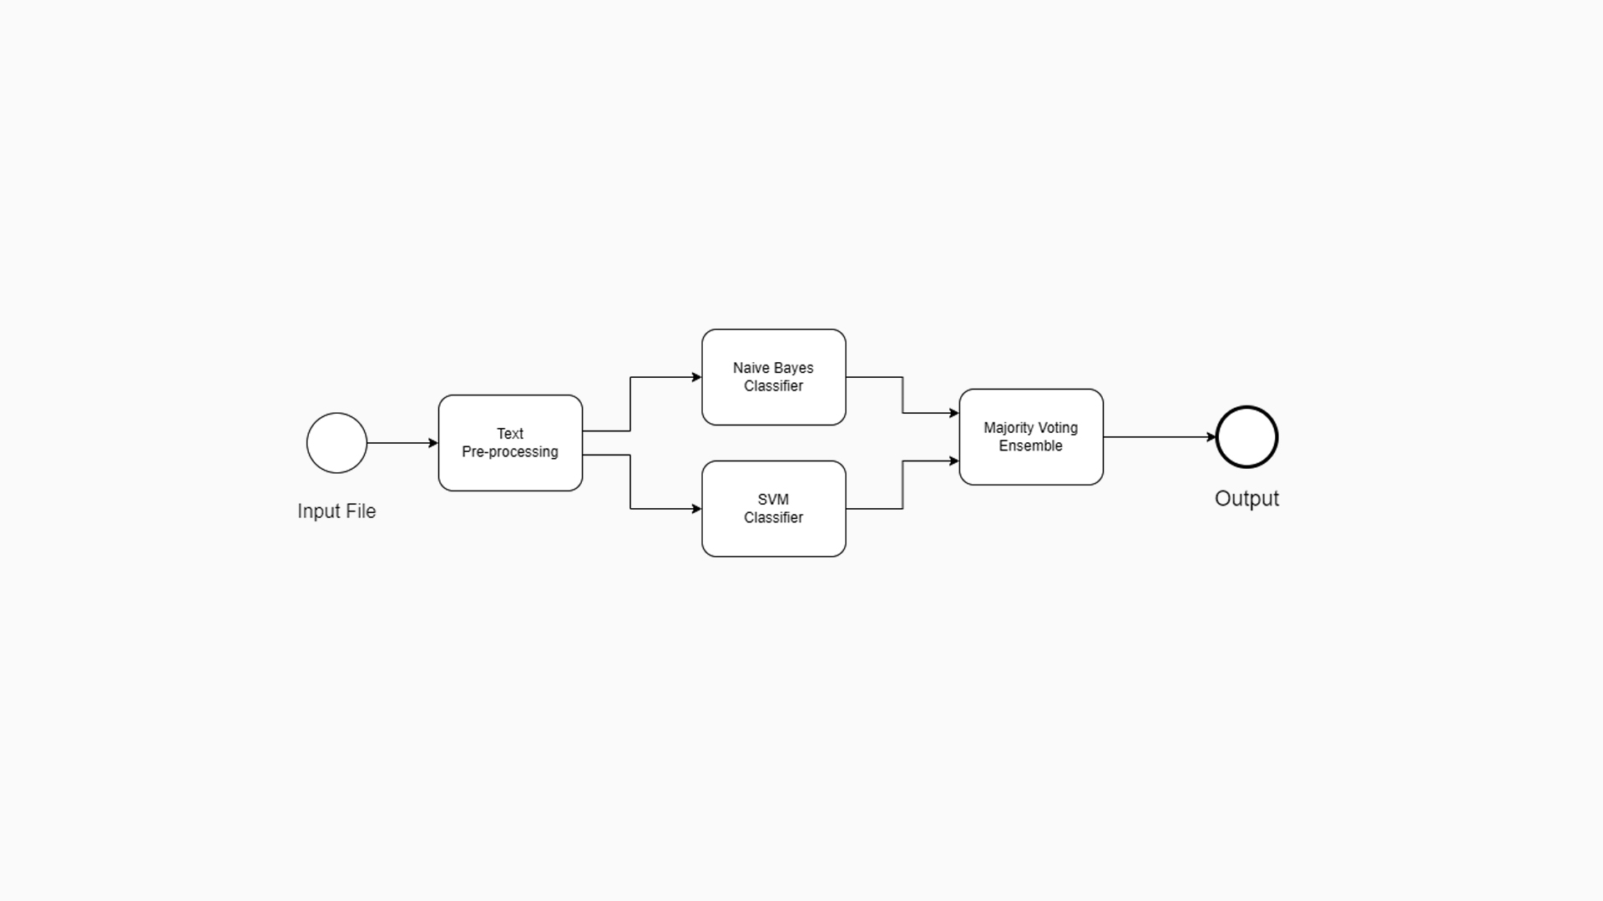
Goals Achieved

Slide 6
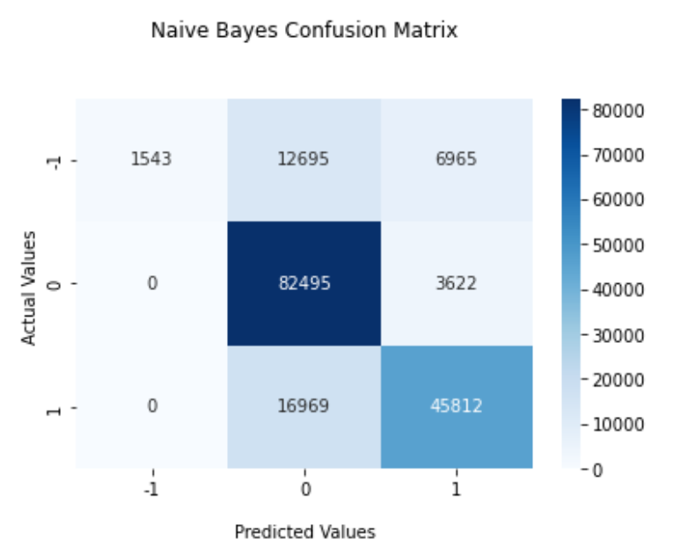
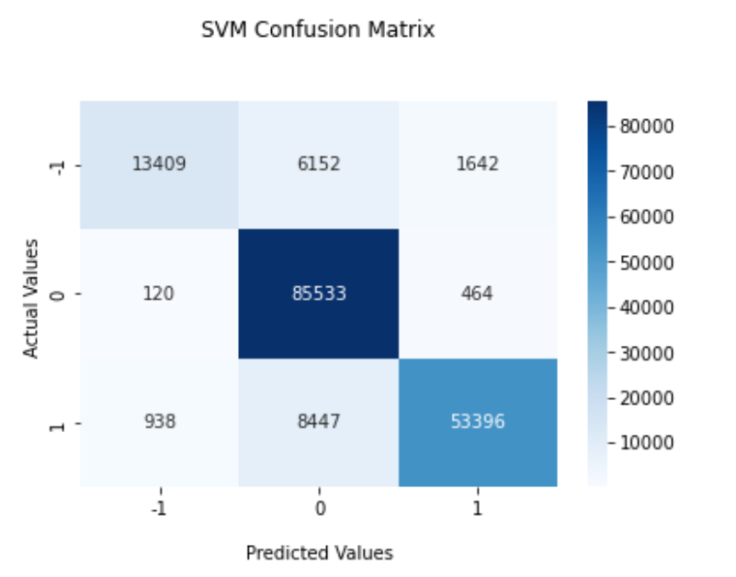
Confusion Matrix

Slide 7
Accuracy
Naïve Bayes = 0.76 = 76%
SVM = 0.89 = 89%
Majority Voting Ensemble = 0.83 = 83%

Slide 8
Technical difficulties
Data-set
Slang
Emoticons and special characters
Grammatical mistakes

Slide 9
Fyp-2 goals
Feature based ranking
Fake reviews detection
Improve accuracy

Slide 10
Questions?

