Slide 1
Ten usability heuristics
Jakob Nielsen

Slide 2
Ten usability heuristics
Match between system and the real world
Consistency and standards
Visibility of system status
User control and freedom
Error prevention
Help users recognize, diagnose, and recover from errors
Recognition rather than recall
Flexibility and efficiency of use
Aesthetic and minimalist design
Help and documentation

Slide 3
Ten usability heuristics
Match between system and the real world
  The system should speak the users' language, with words, phrases and concepts familiar to the user, rather than system-oriented terms.
Consistency and standards
  Users should not have to wonder whether different words, situations, or actions mean the same thing. Follow platform conventions.
Visibility of system status
  The system should always keep users informed about what is going on, through appropriate feedback within reasonable time.

Slide 4
Ten usability heuristics
User control and freedom
  Users often choose system functions by mistake and will need a clearly marked "emergency exit" to leave the unwanted state without having to go through an extended dialogue. Support undo and redo.
Error prevention
  Even better than good error messages is a careful design which prevents a problem from occurring in the first place. Either eliminate error-prone conditions or check for them and present users with a confirmation option before they commit to the action.
Help users recognize, diagnose, and recover from errors
  Error messages should be expressed in plain language (no codes), precisely indicate the problem, and constructively suggest a solution.

Slide 5
Ten usability heuristics
Recognition rather than recall
  Minimize the user's memory load by making objects, actions, and options visible. The user should not have to remember information from one part of the dialogue to another. Instructions for use of the system should be visible or easily retrievable whenever appropriate.
Flexibility and efficiency of use
  Accelerators -- unseen by the novice user -- may often speed up the interaction for the expert user such that the system can cater to both inexperienced and experienced users. Allow users to tailor frequent actions.
Aesthetic and minimalist design
  Dialogues should not contain information which is irrelevant or rarely needed. Every extra unit of information in a dialogue competes with the relevant units of information and diminishes their relative visibility.

Slide 6
Ten usability heuristics
Help and documentation
  Even though it is better if the system can be used without documentation, it may be necessary to provide help and documentation. Any such information should be easy to search, focused on the user's task, list concrete steps to be carried out, and not be too large.

Slide 7
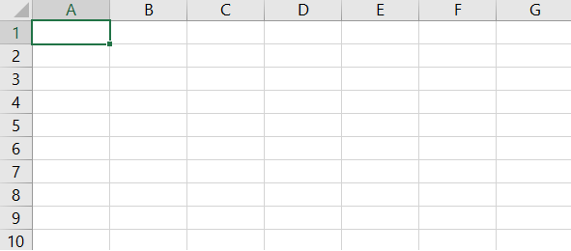
#1: Match between system and the real world
Computer science language: [0][0], [0][2]
Excel speaks users’ language: [A][1], [B][3]
Nielsen’s Heuristics @coursera

Slide 8


#1: Match between system and the real world
Use metaphors (but be careful they may mislead)
Nielsen’s Heuristics @coursera

Slide 9
#2: Consistency and standards
Users should not have to wonder whether different words, situations, or actions mean the same thing. Follow platform conventions.

Slide 10
#2: Consistency and standards
Principle of least surprise
  Similar things should look and act similar
  Different things should look different
  Users should not have to wonder whether different words, situations, or actions mean the same thing (follow platform conventions)
Consistent language and graphics
  Same visual appearance across the system
  Same information/controls in same location on all windows
Consistent effects
  Commands, actions have same effect in equivalent situations

Slide 11
#3: Visibility of system status
The system should always keep users informed about what is going on, through appropriate feedback within reasonable time.

Slide 12
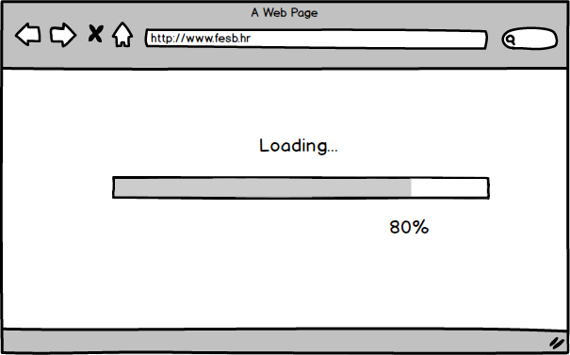
#3: Visibility of system status
Introduction to Heuristics Evaluation @uxdesign.cc

Slide 13
#3: Visibility of system status
Response times - important limits
  < 0.1 second - seems instantaneous
  0.1-1 seconds - user notices, but no feedback needed
  1-5 seconds - display busy cursor
  > 1-5 seconds - display progress bar
Response Times: The 3 Important Limits, [J. Nielsen’14]

Slide 14
#4: User control and freedom
Users often choose system functions by mistake and will need a clearly marked "emergency exit" to leave the unwanted state without having to go through an extended dialogue. Support undo and redo.

Slide 15
#4: User control and freedom
Users don’t like to feel trapped by the computer
  Should offer an easy way out of as many situations as possible
  Provide clearly marked exits
Strategies:
  Cancel button
  Universal undo
  Interrupt (especially for lengthy operations)
  Quit (for leaving the program at any time)
  Defaults (for restoring default properites)

Slide 16
#5: Error prevention
Even better than good error messages is a careful design which prevents a problem from occurring in the first place. Either eliminate error-prone conditions or check for them and present users with a confirmation option before they commit to the action.

Slide 17
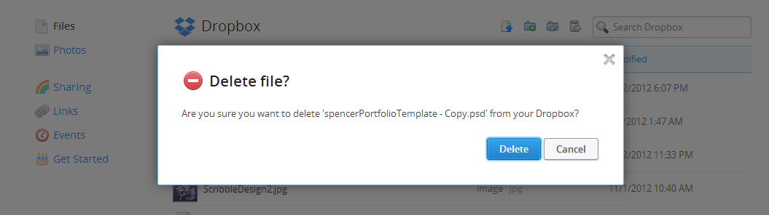
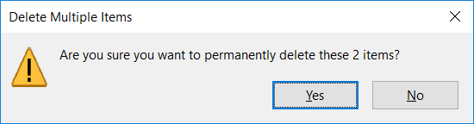
#5: Error prevention
Design for errors
  Double-check with users
Blog by the Mad Hatter
Nielsen’s Heuristics @coursera

Slide 18
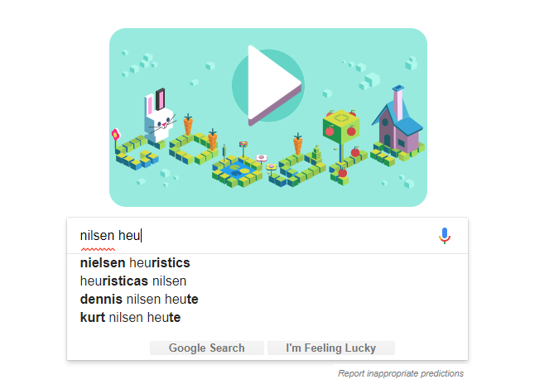
#5: Error prevention
Design for errors
  Remove memory burdens

Slide 19


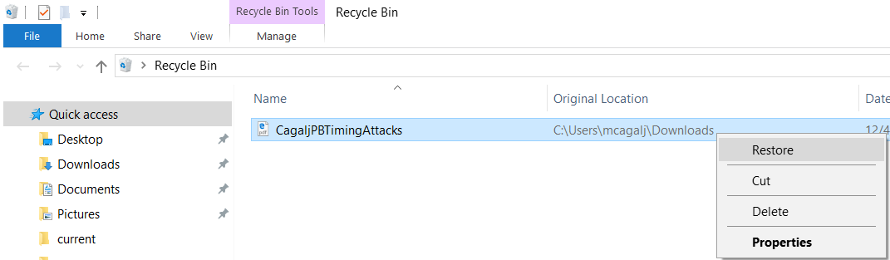

#5: Error prevention
Design for errors
  Support Undo and Redo

Slide 20
#6: Help users recognize, diagnose, and recover from errors
Error messages should be expressed in plain language (no codes), precisely indicate the problem, and constructively suggest a solution.

Slide 21
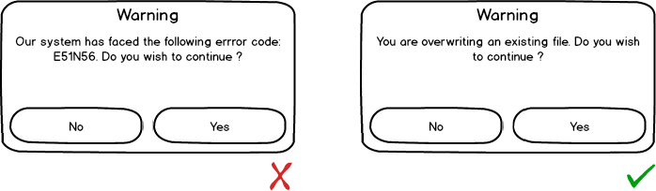
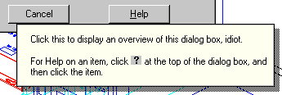
#6: Help users recognize, diagnose, and recover from errors
Deal with errors in a positive manner (be polite, speak human-readable language)
Introduction to Heuristics Evaluation @uxdesign.cc

Slide 22
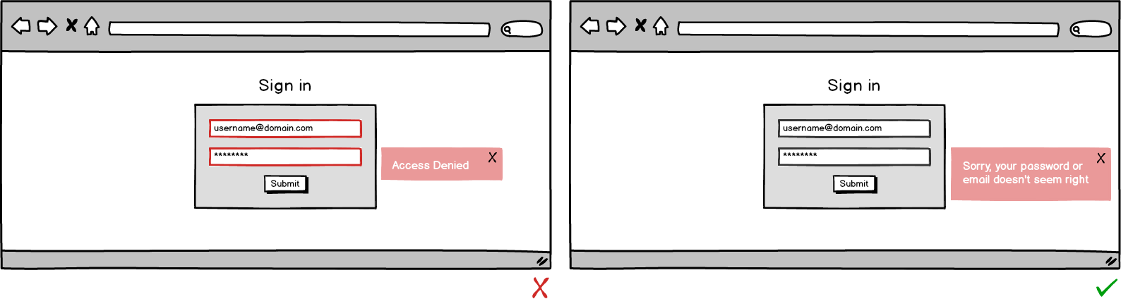
#6: Help users recognize, diagnose, and recover from errors
Deal with errors in a positive manner (be polite, speak human-readable language)
Introduction to Heuristics Evaluation @uxdesign.cc

Slide 23
#7: Recognition rather than recall
Minimize the user's memory load by making objects, actions, and options visible. The user should not have to remember information from one part of the dialogue to another. Instructions for use of the system should be visible or easily retrievable whenever appropriate.

Slide 24
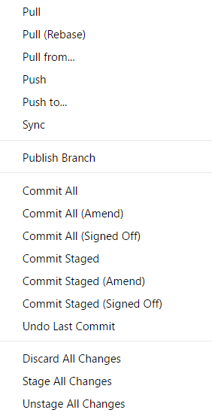
#7: Recognition rather than recall
Short-term memory can hold around 5-7 elements
  Easy to overload
  CLI vs GUI
C:\> git add -A -- c:\Users\mcagalj\...\index.js
C:\> git commit --quiet --allow-empty-message --file
C:\> git status -z -u
C:\> git symbolic-ref --short HEAD
C:\> git remote --verbose
C:\> git config --get commit.template
C:\> git push

Slide 25
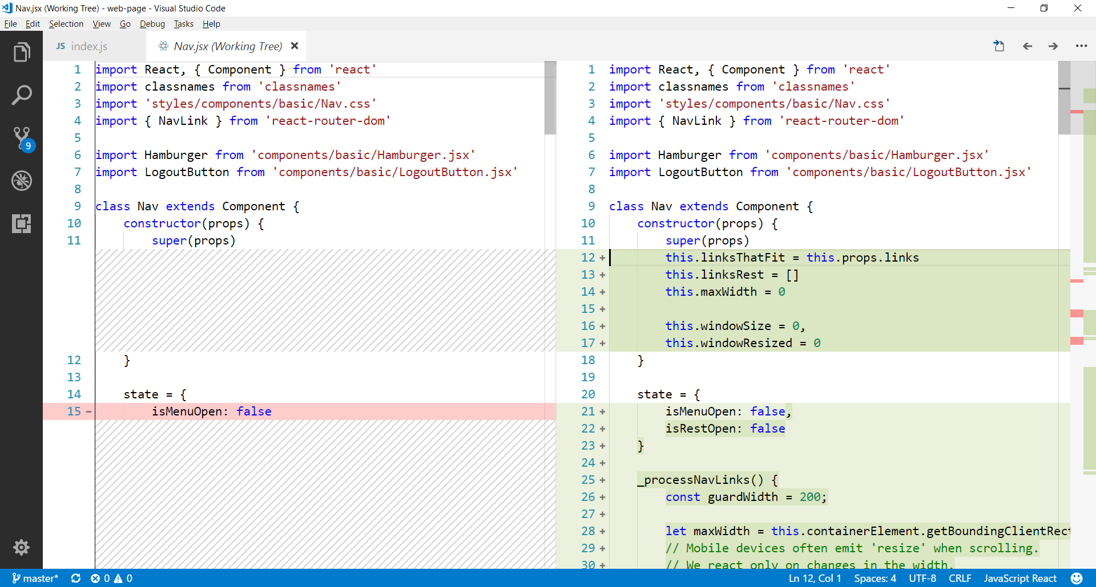
#7: Recognition rather than recall

Slide 26
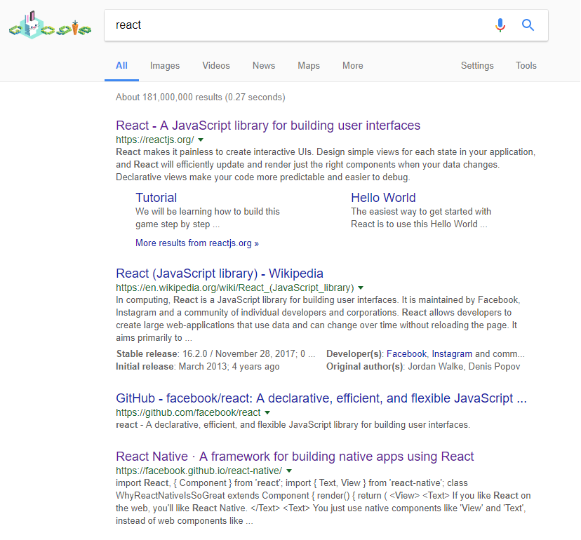
#7: Recognition rather than recall
Visited links

Slide 27
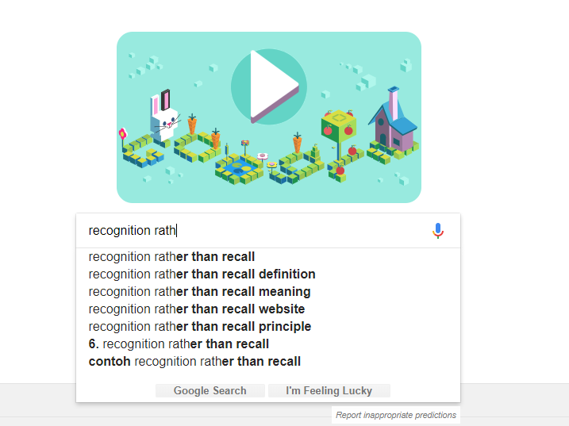
#7: Recognition rather than recall

Slide 28
#8: Flexibility and efficiency of use
Accelerators -- unseen by the novice user -- may often speed up the interaction for the expert user such that the system can cater to both inexperienced and experienced users. Allow users to tailor frequent actions.

Slide 29
#8: Flexibility and efficiency of use
Provide easily-learned shortcuts for frequent operations
  Keyboard accelerators
  Command abbreviations
  Bookmarks
  History (command line interfaces)
  Templates e.g. ppt

Slide 30
#9: Aesthetic and minimalist design
Dialogues should not contain information which is irrelevant or rarely needed. Every extra unit of information in a dialogue competes with the relevant units of information and diminishes their relative visibility.

Slide 31
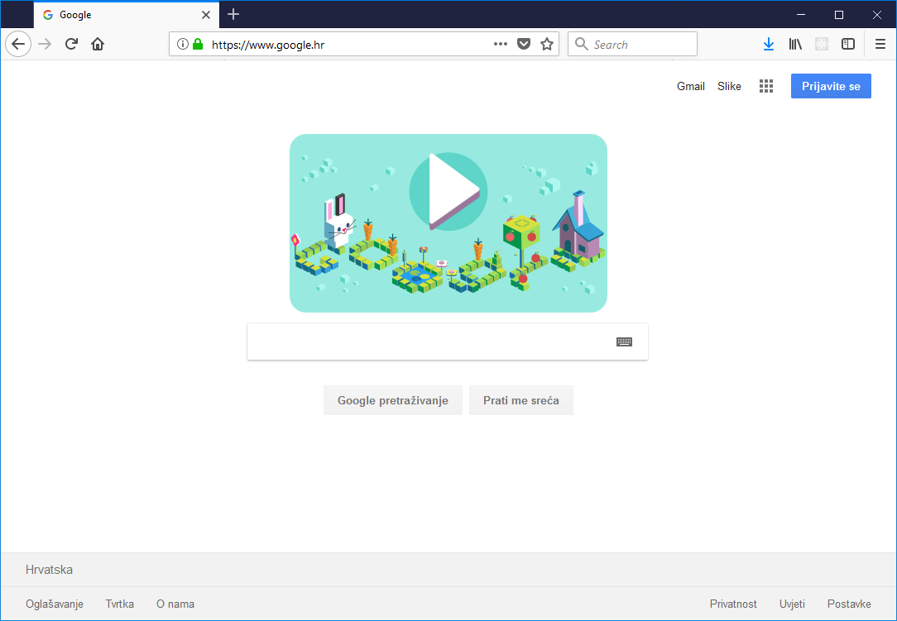
#9: Aesthetic and minimalist design
Less is more
  Omit extraneous info, graphics, features
  Provide only relevant data

Slide 32
#10: Help and documentation
Even though it is better if the system can be used without documentation, it may be necessary to provide help and documentation. Any such information should be easy to search, focused on the user's task, list concrete steps to be carried out, and not be too large.

Slide 33
#10: Help and documentation
Users don’t read manuals ☺
But manuals and online help are vital when user is frustrated or in crisis
Help should be:
  Searchable
  Context-sensitive
  Task-oriented
  Concrete
  Short

Slide 34
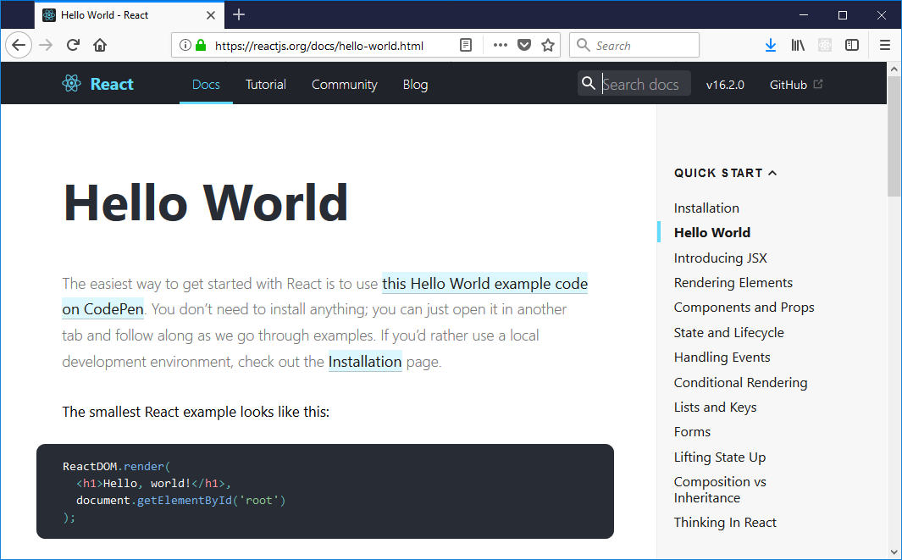
#10: Help and documentation

