Slide 1
# Data Science Project
Genetic Variant Classification
Group #5
Chenyu Huang

Slide 2
Clinvar Dataset
Intro
Labels
Good / Bad?
Human Genetic Variants
37 Features
24 Categorical
13 Numerical
65188 Variants
2 Labels
0 -> not conflicting
1 -> conflicting
Clinic 1
1
Clinic 2
0
Variant 1
1
……
1
(conflicting)
Clinic n
1
Clinic 1
1
Clinic 2
1
Variant 2
0
……
1
(non –
conflicting)
Clinic n
1

Slide 3
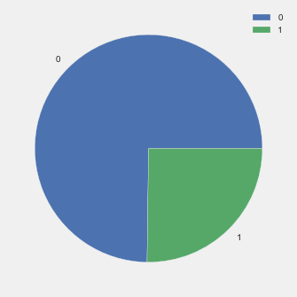
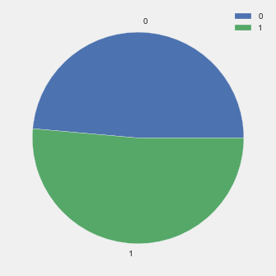
Exploratory Data Analysis
Omit ‘Null’ values
Balance Data
Resampling
Scale Data
Normalized Numerical Data so that they are within [0, 1] for lower computation cost
For some algorithms, map categorical data to numerical value

Slide 4
Questions
1. Weight of Features
Question:
Evaluate the importance of all these features, find the most important one and analyze why is it so important.
Methodology:
Random Forest (Bootstrapping)
Variants Classification
Question:
Estimate how many variants will have conflicting classifications, why are they considered to have conflicting classifications?
Methodology:
Logistic Regression, Decision Tree
2. Weight of Features
Question:
Evaluate the importance of all these features, find the most important one and analyze why is it so important.
Methodology:
Random Forest (Bootstrapping)
2. Variants Classification
Question:
Estimate how many variants will have conflicting classifications, why are they considered to have conflicting classifications?
Methodology:
Logistic Regression, Decision Tree
3. Variants Clustering
Question:
Cluster with classification label unknown
Methodology:
K-means Clustering

Slide 5
Q2: Weight of Features – Feature Selection
Method: Random Forest
Random Subset
of Features
Bootstrapped Dataset 1
Decision Tree 1
Bootstrapped Dataset 2
Decision Tree 2
Dataset
Random Forest
……
……
Bootstrapped Dataset i
Decision Tree i
Main Idea:
Fix 1 feature in the subset, randomly pick the remaining features
Evaluate the importance of this fixed feature according to the average Acc
Reference: https://www.youtube.com/watch?v=J4Wdy0Wc_xQ

Slide 6
Q2: Weight of Features
Method: Random Forest
Relative Frequency of variant of a gene
Feature Number = 5
Attribute | Acc | Interpretation
AF_EXAC | 0.736 | Allele frequencies from ExAC
CLNVI | 0.731 | The Variant's clinical sources reported as tag-value pairs of database and variant identifier
cDNA_position | 0.728 | Relative Position of base pair in cDNA sequence
BIOTYPE | 0.724 | Biotype of transcript or regulatory feature
STRAND | 0.724 | Defined as + (forward) or - (reverse).

Slide 7
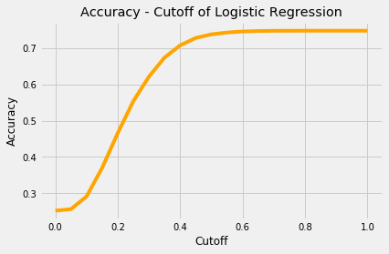
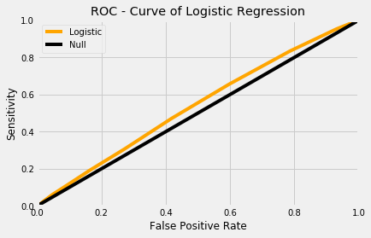
Q1: Variants Classification
Method 1: Logistic Regression
Mapped Categorical Data to Numerical Values
Simply used sklearn
Performance
Acc = 73.7% | cutoff >= 0.5
AUC = 0.538

Slide 8
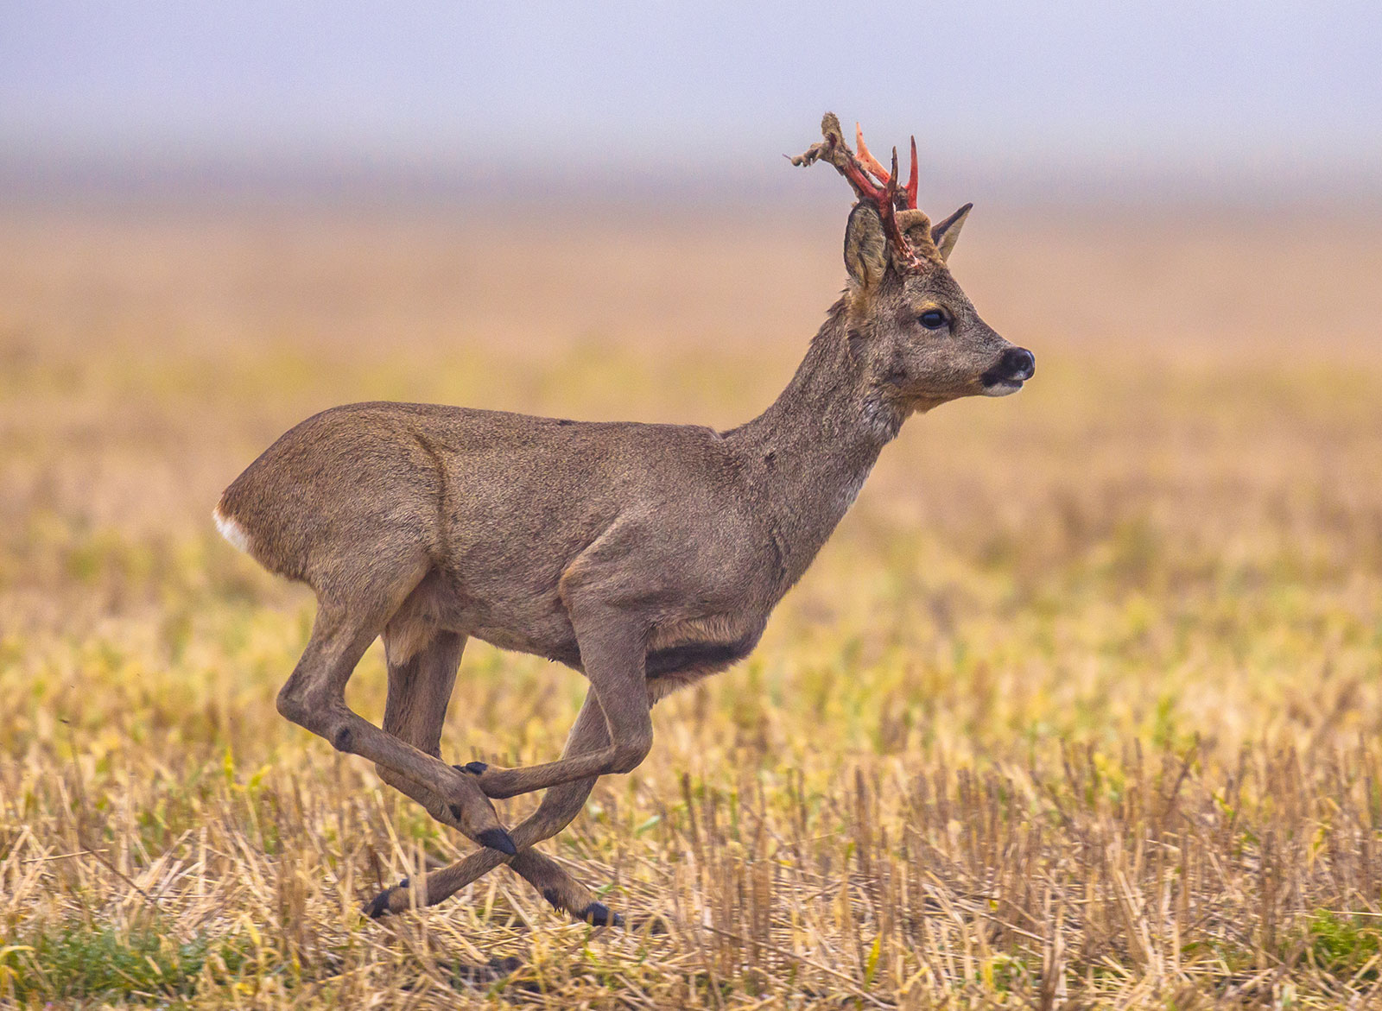
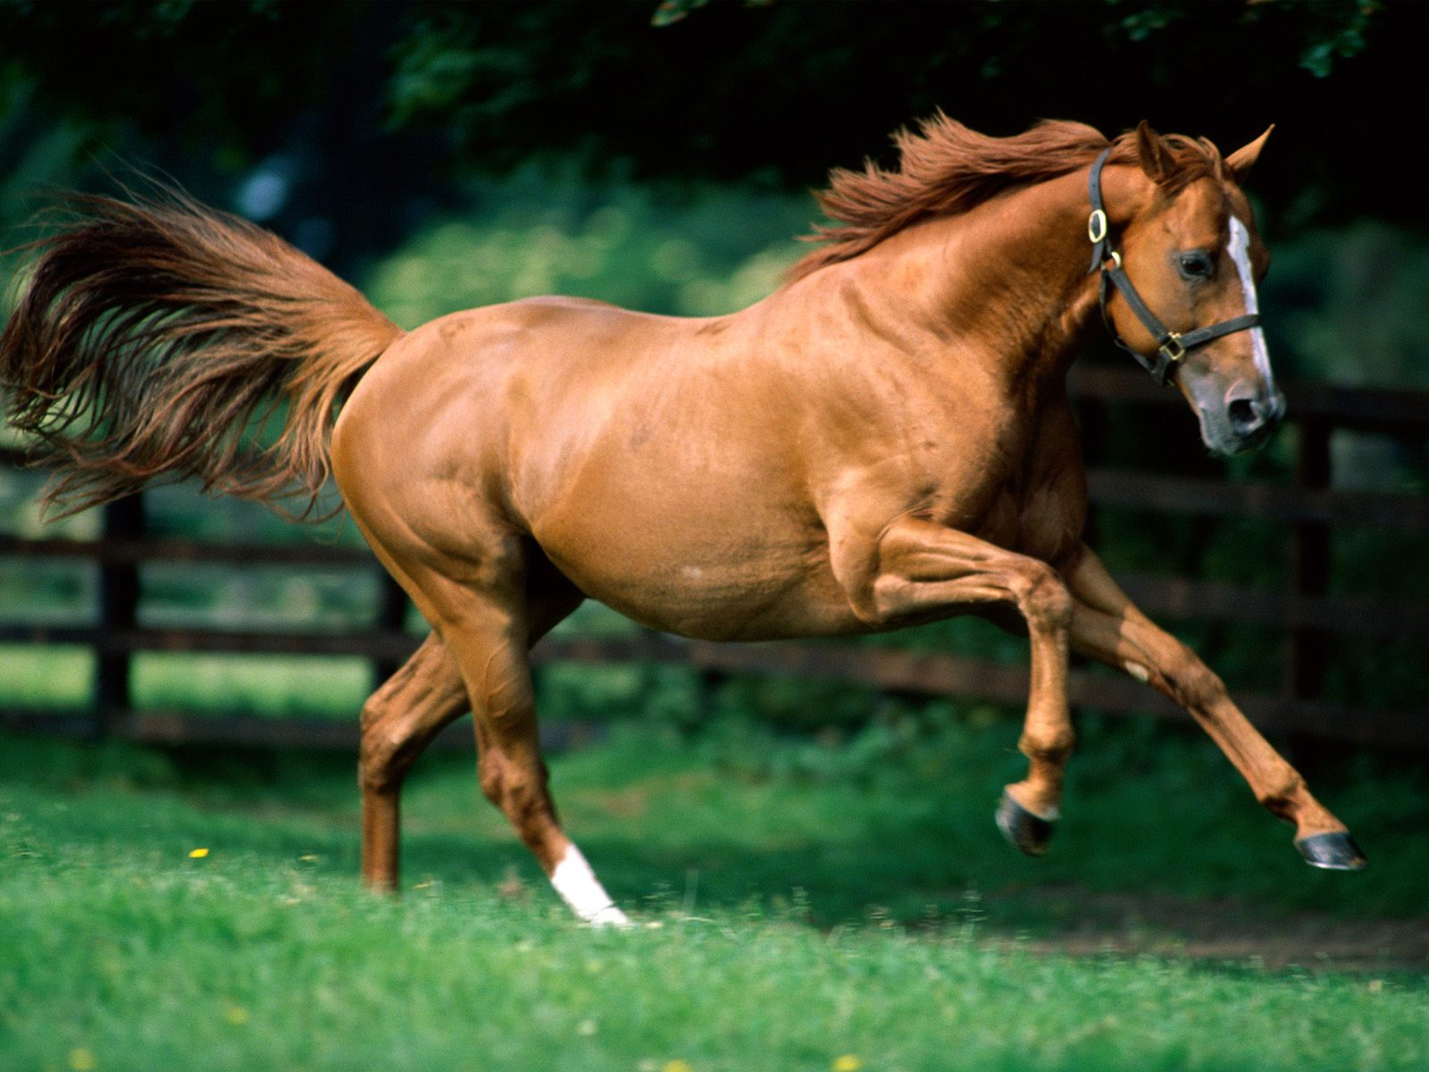

Q1: Variants Classification
Method 2: Decision Tree
What if
We cannot see the whole picture
We are only allowed to ask yes or no questions
After several rounds we will be able to tell them apart
Does it have corns?
no
yes
Horse
Deer
Reference: https://ocw.mit.edu/courses/sloan-school-of-management/15-097-prediction-machine-learning-and-statistics-spring-2012/lecture-notes/MIT15_097S12_lec08.pdf

Slide 9
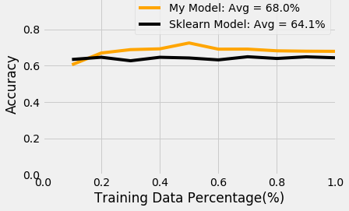
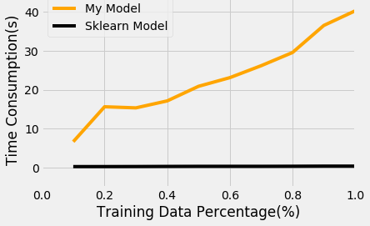
Q1: Variants Classification
Method 2: Decision Tree
My Model V.S. sklearn Model
a) Accuracy
b) Time
 | My Model | Sklearn | Logistic
Avg ACC(%) | 68% | 64% | 73.7%
Avg Training Time(s) | 23.1 | 0.38 | 0.31

Slide 10
Q1: Variants Classification
Method 2: Decision Tree
Acc – Cutoff curve
ROC Curve

Slide 11
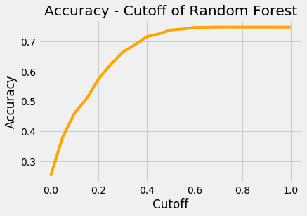
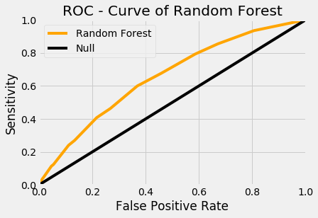
Recall Q1: Variants Classification
Method 3: Random Forest
Acc – Cutoff curve
ROC Curve
 | MyDT | SklearnDT | Logistic | RandomForest
Avg ACC(%) | 68% | 64% | 73.7% | 74%
Avg Training Time(s) | 23.1 | 0.38 | 0.31 | 72.6s

Slide 12
Recall Q1: Variants Classification
Method 4: Adaboost
AoS = Amount of Say
Given according to its misclassification rate
Boosting
AoS = 8
AoS = 2
Boosting
AoS = 1
AoS = 7
Boosting
Reference: https://www.youtube.com/watch?v=LsK-xG1cLYA

Slide 13
Recall Q1: Variants Classification
Method 4: Adaboost
Acc – Cutoff curve
ROC Curve

Slide 14
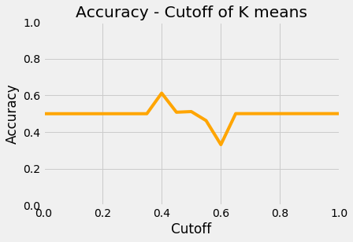
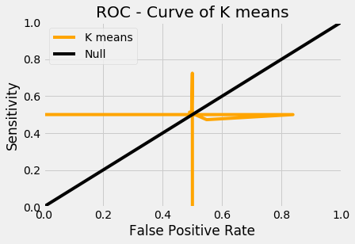
Q3: Variants Clustering
Method: K-means
Acc – Cutoff curve
ROC Curve
Reference: https://www.youtube.com/watch?v=4b5d3muPQmA

Slide 15
Q3: Variants Clustering
Method: K-means
Why not WORKING!!
Recall
Categorically Similar
37 Features
24 Categorical
13 Numerical
Mapping
Numerically Similar
37 Numerical
Before Map | After Map | Normalized
‘A’ | 0 | 0
‘B’ | 1 | 0.25
‘C’ | 2 | 0.5
‘D’ | 3 | 0.75
‘E’ | 4 | 1
Similarity of Indices -> Random!
65% of the features are categorical

Slide 16
Conclusions:
Tree-based Classifiers works better when there are lots of Categorical Data
COMPARE GRAPH
2. Importance of Preprocess and Feature Engineering
3. S

Slide 17
# Thank you !
Group #5
Chenyu Huang

