Slide 1
Data Science Project
Group #5
Chenyu Huang

Slide 2
Clinvar Dataset:
Human Genetic Variants
37 Features
24 Categorical
13 Numerical
65188 Variants
2 Labels
0 -> not conflicting
1 -> conflicting

Slide 3
Dataset Preprocessing
Omit ‘Null’ Value when making decision
Oversampling Imbalanced Data
SMOTE sampling
Normalization
Normalized Numerical Data so that they are within [0, 1] for lower computation cost
For some algorithms, map categorical data to numerical value

Slide 4
Questions
Variants Classification
Estimate how many variants will have conflicting classifications, why are they considered to have conflicting classifications?
Methodology: Logistic Regression, Decision Tree
Weight of Features
Evaluate the importance of all these features, find the most important one and analyze why is it so important.
Methodology: Bootstrapping -> Random Forest
Variants Clustering
Redo Question 1 with classification label unknown, compare the 2 results.
Methodology: K-means Clustering

Slide 5
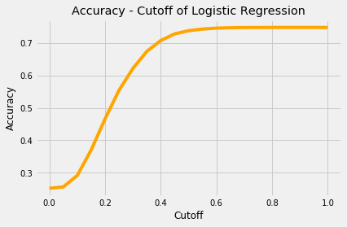
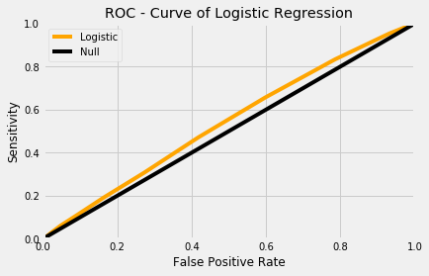
Q1: Variants Classification
Method1: Logistic Regression
Mapped Categorical Data to Numerical Values
Simply used sklearn
Performance
Acc = 74.7% | cutoff = 0.95
AUC = 0.538

Slide 6
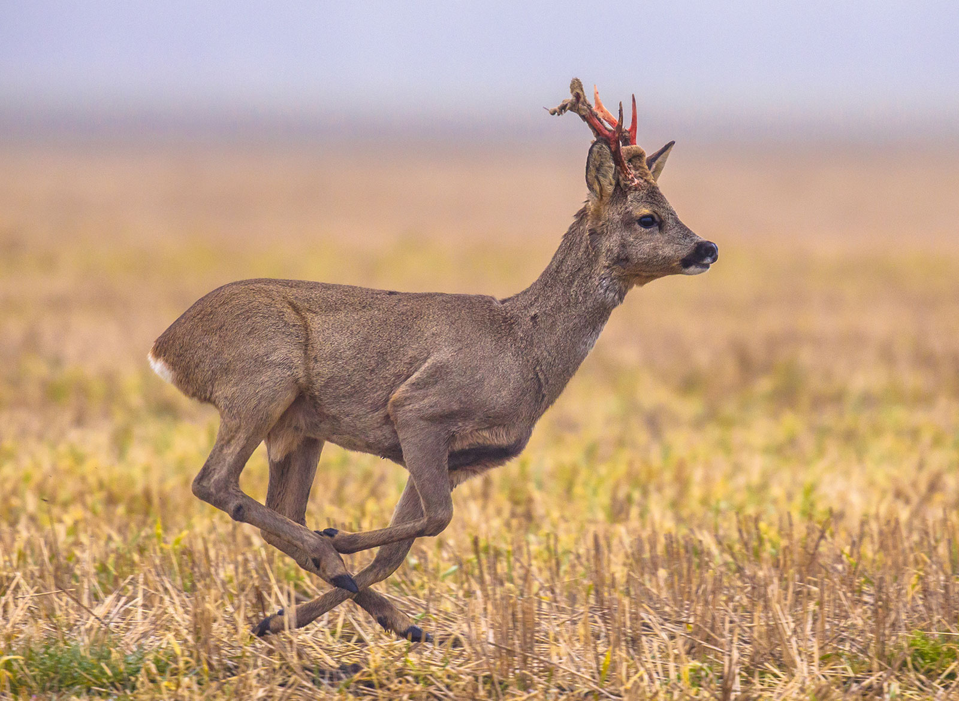
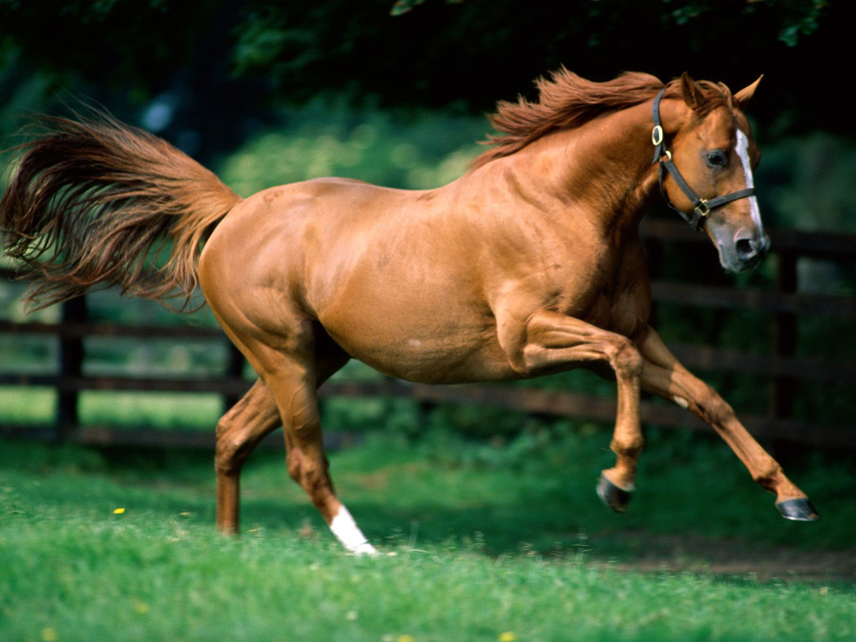
Q1: Variants Classification
Method2: Decision Tree
What if
We cannot see the whole picture
We are only allowed to ask yes or no questions
After several rounds we will be able to tell them apart

Slide 7
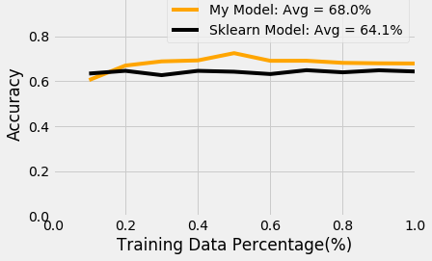
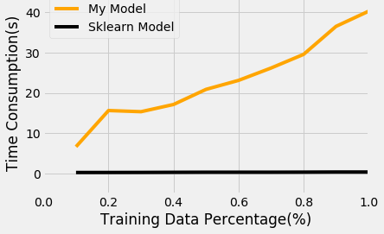
Q1: Variants Classification
Method2: Decision Tree
Figure-1 Comparison between my model and sklearn model
a) Accuracy
b) Time
 | My Model | Sklearn | Logistic
Avg ACC(%) | 68% | 64% | 74%
Avg Training Time(s) | 23.1 | 0.38 | 0.31

Slide 8
Q1: Variants Classification
Method2: Decision Tree

Slide 9
Q2: Weight of Features
Method: Random Forest
Subset of Features
Bootstrapped Dataset 1
Decision Tree 1
Bootstrapped Dataset 2
Decision Tree 2
Dataset
Random Forest
……
……
Bootstrapped Dataset i
Decision Tree i
Main Idea:
Fix 1 feature in the subset, randomly pick the remaining features
Evaluate the importance of this fixed feature according to the average Acc

Slide 10
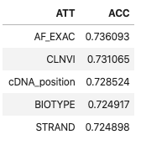
Q2: Weight of Features
Method: Random Forest
Feature Number = 5

Slide 11
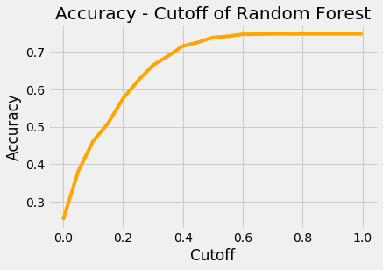
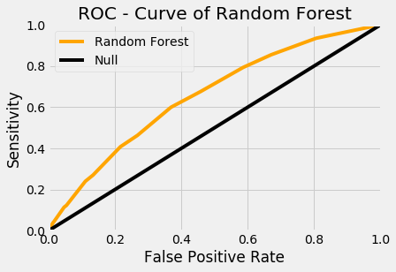
Q1: Variants Classification
Method: Random Forest

Slide 12
Q3: Variants Clustering
Method: K-means

