Slide 1

Lecture 3
PICARD-CHEBYSHEV METHODS
JOHN L. JUNKINS & ROBYN M. WOOLLANDS
Five Part Lecture Series
Picard-Chebyshev Numerical Integration
Applications in Astrodynamics
Texas A&M University
Department of Aerospace Engineering
College Station, TX 77840
Spring 2017

Slide 2

JUNKINS & WOOLLANDS
Picard-Chebyshev Lecture Series
#3 Picard-Chebyshev Methods
FIVE PART LECTURE SERIES
Lecture | Title | Presenter
1 | Orthogonal Approximation | Junkins
2 | Numerical Quadrature | Junkins
3 | Picard-Chebyshev Methods & Theoretical Convergence | Woollands
4 | Accelerated Picard Iteration & Adaptive Segmentation | Woollands
5 | Gravity Approximations | Junkins
2

Slide 3
JUNKINS & WOOLLANDS
Picard-Chebyshev Lecture Series
#3 Picard-Chebyshev Methods
CONTENTS
Picard iteration
Picard iteration is a successive path approximation technique for solving differential equations.
Least Squares
Review of least squares from lecture 1 (vector problem)
Discuss the least squares operator
Picard-Chebyshev Initial Value Problem Derivation/Algorithm (First Order)
Thoroughly derive the Picard-Chebyshev first order IVP algorithm
Discuss the first integration operator (P₁)
Present two examples to demonstrate the method (MATLAB code is available)
Picard-Chebyshev Initial Value Problem Derivation/Algorithm (Second Order)
Derive the Picard-Chebyshev second order IVP algorithm
Discuss the second integration operator (P₂)
Present two examples to demonstrate the method (MATLAB code is available)
Picard-Chebyshev Boundary Value Problem Derivation/Algorithm
Three types of BVPs
Derive the Picard-Chebyshev second order BVP algorithm
Present three examples to demonstrate the three methods (MATLAB code is available)
Convergence Picard-Chebyshev Algorithm
Discuss convergence for the IVP and TPBVP algorithms (MATLAB code is available)
3

Slide 4
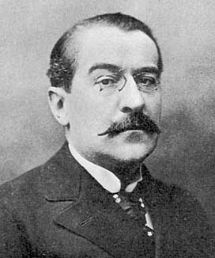
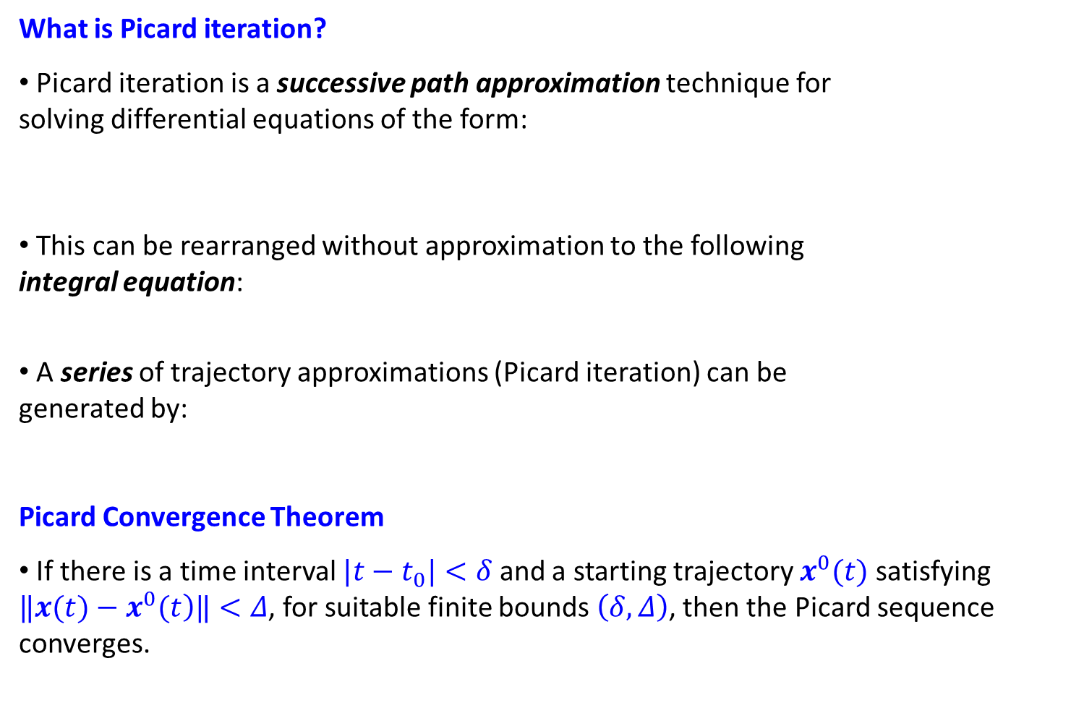
JUNKINS & WOOLLANDS
Picard-Chebyshev Lecture Series
#3 Picard-Chebyshev Methods
PICARD ITERATION
What is Picard iteration?
Picard iteration is a successive path approximation technique for
solving differential equations of the form:
This can be rearranged without approximation to the following
integral equation:
A series of trajectory approximations (Picard iteration) can be
generated by:
Picard Convergence Theorem
If there is a time interval $|t−t_{0}|<δ$ and a starting trajectory $x^{0}(t)$ satisfying $‖\left.x(t)−x^{0}(t\right)‖<Δ$, for suitable finite bounds $\left(δ,Δ\right)$, then the Picard sequence converges.
Picture Credit: Wikipedia
Charles Emile Picard
(1856-1941)
4
Notes:
Robyn:
Emphasize that x and f are row vectors, this turns out to be more convenient (than column vectors)
in the developments that follow.

Slide 5
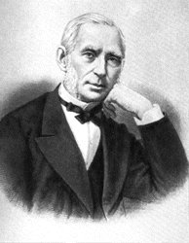

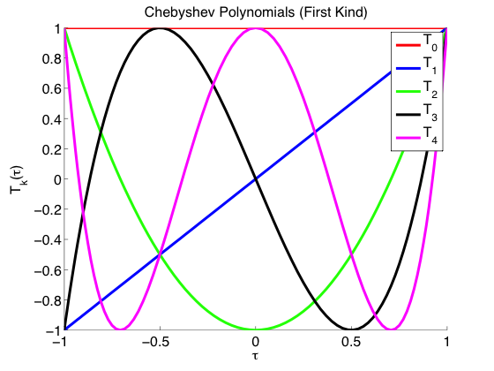
JUNKINS & WOOLLANDS
Picard-Chebyshev Lecture Series
#3 Picard-Chebyshev Methods
PICARD–CHEBYSHEV METHODS
Picard-Chebyshev methods combine the techniques of two great mathematicians…
Picture Credit: Wikipedia
Picture Credit: Wikipedia
Charles Emile Picard
(1856-1941)
Pafnuty Chebyshev
(1821-1894)
Developed the path approximation method for solving differential equations
Developed orthogonal Chebyshev polynomials
Recall
Lecture 1
Chebyshev polynomials are used to approximate the integrate in the Picard iteration sequence.
5
Notes:
Robyn:
In words, you can say that the integrand could be approximated as a linear combination of orthogonal functions, such as Fourier series. You could mention Boyd
As one author that concludes, consistent with our studies that the cosine node distribution associated with the Chebyshev orthogonality conditions make these basis functions very attractive. Mention the Runge phenomena demonstrated in Lecture 1 examples.

Slide 6
JUNKINS & WOOLLANDS
Picard-Chebyshev Lecture Series
#3 Picard-Chebyshev Methods
FIRST ORDER METHOD
Recall Picard Iteration
Recall Least Squares Approximation
Scalar system:
n-dimensional system (use row vectors)
(Lecture 1)
Approximation with Chebyshev polynomials
N = order of Chebyshev series
n = # of state variables
M +1 = # of sample (node) points
Least squares coefficients
Least squares coefficients
6
Notes:
Robyn:
You have a subsequent (row) matrix named [T(tau)] on slides 7, 9, … that is not consistent with the above Phi = T
usage.

Slide 7
JUNKINS & WOOLLANDS
Picard-Chebyshev Lecture Series
#3 Picard-Chebyshev Methods
FIRST ORDER METHOD
From the previous slide…
Expand
Expanding the Chebyshev series above leads to:
Integrate
The following relationship exists for Chebyshev polynomials and their integrals:
Substituting the above leads to
7

Slide 8
JUNKINS & WOOLLANDS
Picard-Chebyshev Lecture Series
#3 Picard-Chebyshev Methods
FIRST ORDER METHOD
From the previous slide…
Matrix Form
(N+1) × n
N = order of Chebyshev series
n = # of state variables
M +1 = # of sample (node) points
1 × n
1 × n
1 × (N+1)
Let us look more closely at this matrix of the integrand fit least squares coefficients…
Solution
Initial condition vector
8

Slide 9

JUNKINS & WOOLLANDS
Picard-Chebyshev Lecture Series
#3 Picard-Chebyshev Methods
FIRST ORDER METHOD
Matrix of Least Squares Coefficients
N = order of Chebyshev series
n = # of state variables
M +1 = # of sample (node) points
(N+1) × n
(N+1) × N
t → τ scale factor
N × (M+1)
LEAST SQUARES OPERATOR
$$\left[S\right]$$
N × n
(M+1) × n
9

Slide 10
JUNKINS & WOOLLANDS
Picard-Chebyshev Lecture Series
#3 Picard-Chebyshev Methods
FIRST ORDER METHOD
Matrix Form
(N+1) × n
N = order of Chebyshev series
n = # of state variables
M +1 = # of sample (node) points
1 × n
1 × n
1 × (N+1)
LEAST SQUARES OPERATOR
1 × (N+1)
1 × n
1 × n
(N+1) × N
(M+1) × n
N × (M+1)
10

Slide 11
JUNKINS & WOOLLANDS
Picard-Chebyshev Lecture Series
#3 Picard-Chebyshev Methods
FIRST ORDER METHOD
Chebyshev Series for L.H.S
Matrix Form
(N+1) × n
N × (M+1)
1 × (N+1)
1 × n
1 × (N+1)
1 × n
(N+1) × N
(M+1) × n
Solution coefficients
Constant terms
11

Slide 12


JUNKINS & WOOLLANDS
Picard-Chebyshev Lecture Series
#3 Picard-Chebyshev Methods
FIRST ORDER METHOD
Absorb Constant
Equate coefficients of $T_{k}$
Recall Constant $C(−1)=x(−1)−\left[\begin{matrix}\left.T_{0}(−1\right) & ⋯ & \left.T_{N}(−1\right)\end{matrix}\right][S][A]\left[F^{i−1}\right][W2]$
$$W_{2}$$
12

Slide 13
JUNKINS & WOOLLANDS
Picard-Chebyshev Lecture Series
#3 Picard-Chebyshev Methods
FIRST ORDER METHOD
From the previous slide…
Final Expression for Coefficients
13

Slide 14
JUNKINS & WOOLLANDS
Picard-Chebyshev Lecture Series
#3 Picard-Chebyshev Methods
FIRST ORDER METHOD
Recall the summation equation
Expression for Coefficients
Matrix Representation
LEAST SQUARES OPERATOR
(N+1) × n
(N+1) × N
(M+1) × n
N+1 × n
N × (M+1)
N+1 × n
(N+1) × (N+1)
(N+1) × (N+1)
INTEGRATION OPERATOR
(N+1) × N
14

Slide 15
JUNKINS & WOOLLANDS
Picard-Chebyshev Lecture Series
#3 Picard-Chebyshev Methods
FIRST ORDER ALGORITHM
Dynamics & Initial Conditions
M = N
Time and τ
M > N
Picard Iteration
Iterate
Convergence
Update
15

Slide 16
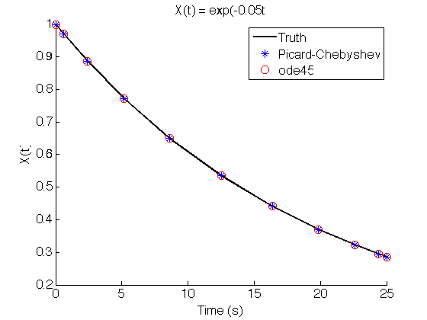
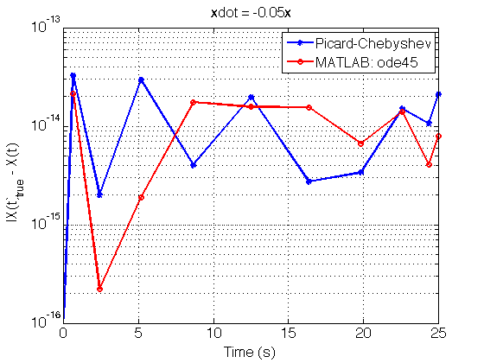
JUNKINS & WOOLLANDS
Picard-Chebyshev Lecture Series
#3 Picard-Chebyshev Methods
EXAMPLE 1
First Order Example:
This simple first order example is solved using the Picard-Chebyshev technique and MATLAB’s ode45. The is an analytic solution to the problem that we use to check the accuracy of the integrators. The code required for generating the above figures is available for use as a learning tool: run_lecture3_example1a_ivpI.m and run_lecture3_example1b_fvpI.m.
16

Slide 17
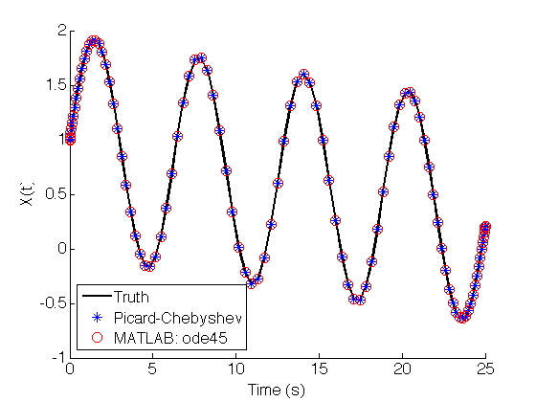
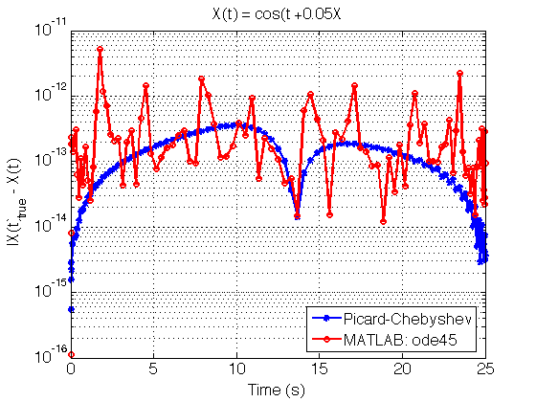
JUNKINS & WOOLLANDS
Picard-Chebyshev Lecture Series
#3 Picard-Chebyshev Methods
EXAMPLE 2
First Order Example:
This simple first order example is solved using the Picard-Chebyshev technique and MATLAB’s ode45. The is an analytic solution to the problem (see Bai’s PhD) that we use to check the accuracy of the integrators. The code required for generating the above figures is available for use as a learning tool: run_lecture3_example2_ivpI.m.
17

Slide 18
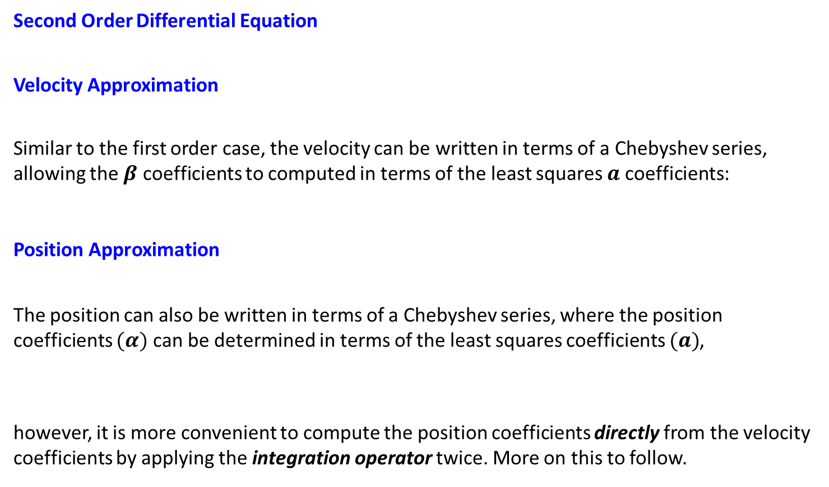
JUNKINS & WOOLLANDS
Picard-Chebyshev Lecture Series
#3 Picard-Chebyshev Methods
SECOND ORDER METHOD
Second Order Differential Equation
Velocity Approximation
Similar to the first order case, the velocity can be written in terms of a Chebyshev series, allowing the $β$ coefficients to computed in terms of the least squares $a$ coefficients:
Position Approximation
The position can also be written in terms of a Chebyshev series, where the position coefficients $(α)$ can be determined in terms of the least squares coefficients $(a)$,
however, it is more convenient to compute the position coefficients directly from the velocity coefficients by applying the integration operator twice. More on this to follow.
18

Slide 19
JUNKINS & WOOLLANDS
Picard-Chebyshev Lecture Series
#3 Picard-Chebyshev Methods
SECOND ORDER METHOD: STEP 1
Velocity Integration
Expression for Velocity Coefficients
Matrix Representation for Velocity
LEAST SQUARES OPERATOR
N × n
N × (N-1)
(M+1) × n
N × n
(N-1) × (M+1)
N × n
N × N
N × N
N × (N-1)
INTEGRATION OPERATOR
19

Slide 20
JUNKINS & WOOLLANDS
Picard-Chebyshev Lecture Series
#3 Picard-Chebyshev Methods
SECOND ORDER METHOD: STEP 2
Position Integration
Expression for Position Coefficients
Matrix Representation for Position
INTEGRATION OPERATOR
(N+1) × n
(N+1) × N
N × n
(N+1) × n
(N+1) × n
(N+1) × (N+1)
(N+1) × (N+1)
Velocity Coefficients
(N+1) × N
20

Slide 21
JUNKINS & WOOLLANDS
Picard-Chebyshev Lecture Series
#3 Picard-Chebyshev Methods
SECOND ORDER ALGORITHM
Dynamics & Initial Conditions
Velocity Matrices
Time and τ
Picard Iteration
Position Matrices
Iterate
Convergence
Update
21

Slide 22
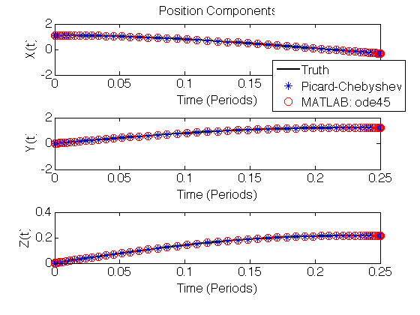
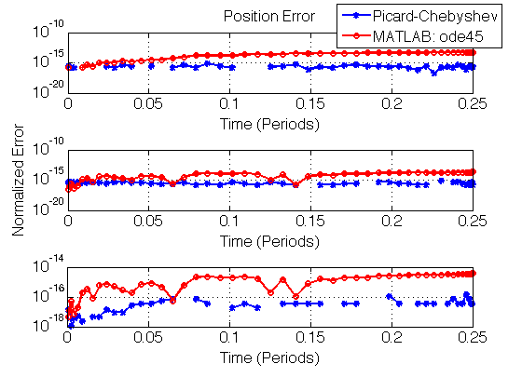
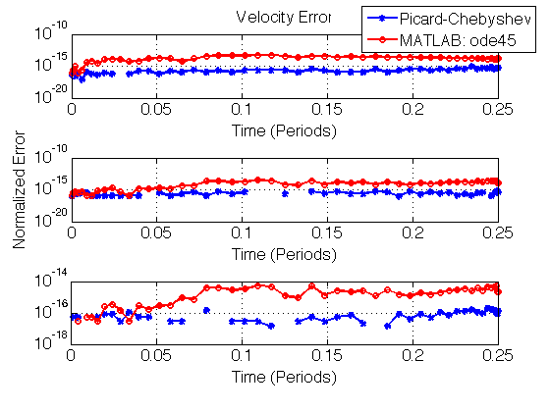
JUNKINS & WOOLLANDS
Picard-Chebyshev Lecture Series
#3 Picard-Chebyshev Methods
EXAMPLE 3
Second Order Example: Two-body Problem
There is an analytical solution to the two-body problem in Celestial mechanics. In this example we demonstrate how the second order Picard-Chebyshev technique is used to integrate a second order system of differential equations. The code for generating the above figures is available for use as a learning tool: run_lecture3_example3_ivpII.m.
22

Slide 23
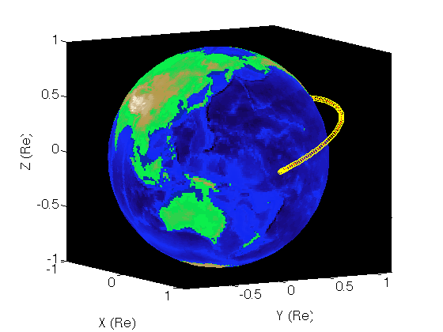
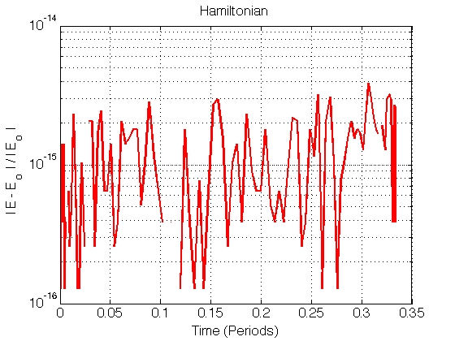
JUNKINS & WOOLLANDS
Picard-Chebyshev Lecture Series
#3 Picard-Chebyshev Methods
EXAMPLE 4
Second Order Example: Perturbed Two-body Problem
There is no analytical solution to the perturbed problem. We used a spherical harmonic degree & order 40 gravity model. One approach to check the solution accuracy is to compute the Hamiltonian at each point and check if it is conserved to the desired tolerance over the orbit (near machine precision of 15 digits in this case). For a non-conservative system other methods such as the reverse test and Zadunaisky's technique (Berry & Healy 2003) must be utilized. The code for generating the above figures is available for use as a learning tool: run_lecture3_example4b_ivpII.m and run_lecture3_example4c_fvpII.m.
23

Slide 24
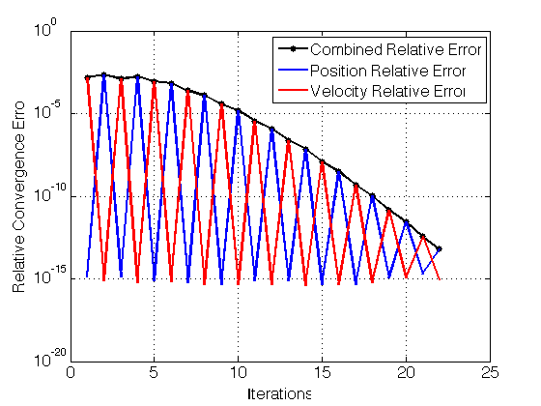
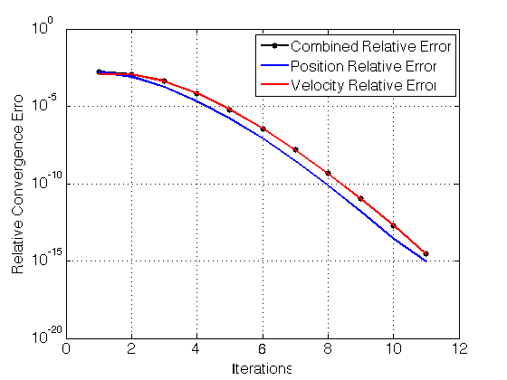
JUNKINS & WOOLLANDS
Picard-Chebyshev Lecture Series
#3 Picard-Chebyshev Methods
First Order vs Second Order
First Order Algorithm
Second Order Algorithm
The naturally second order system is solved in first order form using the first order Picard-Chebyshev algorithm (left). Position and velocity are updated on alternate iterations and thus the total number of iterations is about twice as many as solving the naturally second order system with the second order Picard-Chebyshev algorithm (right). run_lecture3_example4a_ivpI.m.
24

Slide 25
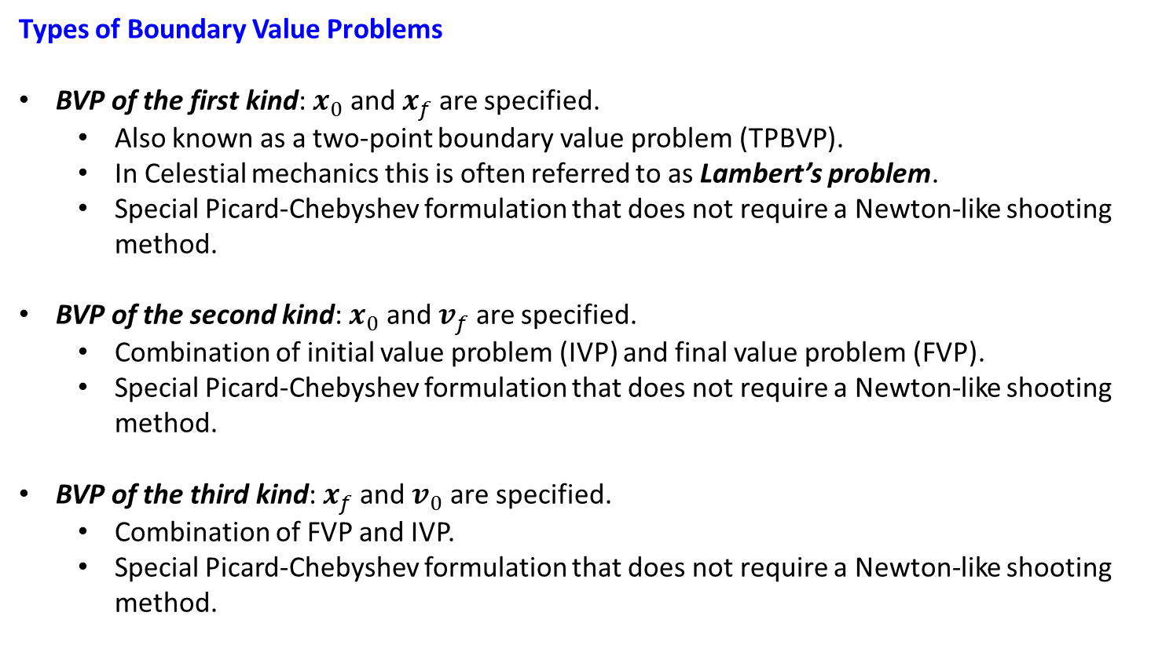
JUNKINS & WOOLLANDS
Picard-Chebyshev Lecture Series
#3 Picard-Chebyshev Methods
BOUNDARY VALUE PROBLEMS
Types of Boundary Value Problems
BVP of the first kind: $x_{0}$ and $x_{f}$ are specified.
Also known as a two-point boundary value problem (TPBVP).
In Celestial mechanics this is often referred to as Lambert’s problem.
Special Picard-Chebyshev formulation that does not require a Newton-like shooting method.
BVP of the second kind: $x_{0}$ and $v_{f}$ are specified.
Combination of initial value problem (IVP) and final value problem (FVP).
Special Picard-Chebyshev formulation that does not require a Newton-like shooting method.
BVP of the third kind: $x_{f}$ and $v_{0}$ are specified.
Combination of FVP and IVP.
Special Picard-Chebyshev formulation that does not require a Newton-like shooting method.
25

Slide 26
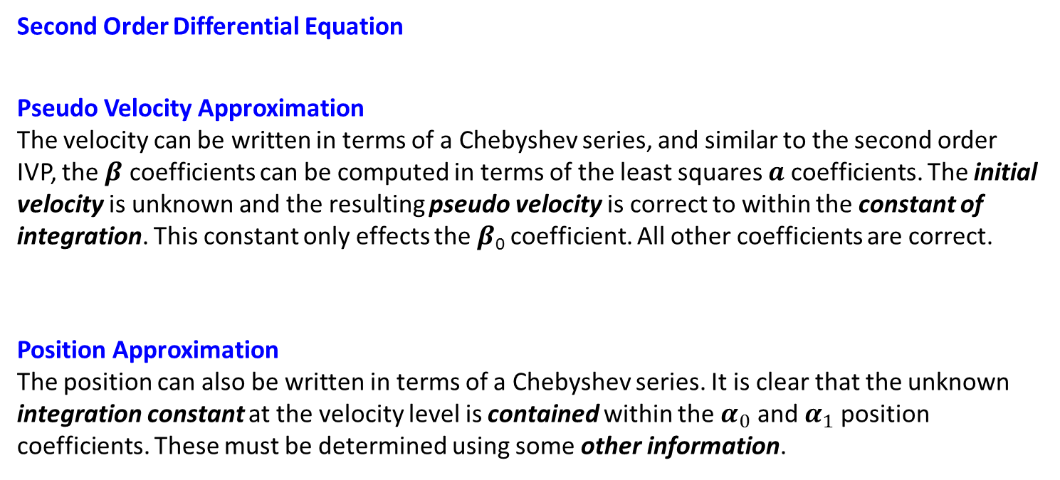
JUNKINS & WOOLLANDS
Picard-Chebyshev Lecture Series
#3 Picard-Chebyshev Methods
TWO-POINT BOUNDARY VALUE PROBLEM
Second Order Differential Equation
Pseudo Velocity Approximation
The velocity can be written in terms of a Chebyshev series, and similar to the second order IVP, the $β$ coefficients can be computed in terms of the least squares $a$ coefficients. The initial velocity is unknown and the resulting pseudo velocity is correct to within the constant of integration. This constant only effects the $β$₀ coefficient. All other coefficients are correct.
Position Approximation
The position can also be written in terms of a Chebyshev series. It is clear that the unknown integration constant at the velocity level is contained within the $α_{0}$ and $α_{1}$ position coefficients. These must be determined using some other information.
26

Slide 27
JUNKINS & WOOLLANDS
Picard-Chebyshev Lecture Series
#3 Picard-Chebyshev Methods
STEP 1: PSEUDO VELOCITY
Pseudo Velocity (correct to within a constant)
Expression for Pseudo Velocity Coefficients
Matrix Representation for Pseudo Velocity
LEAST SQUARES OPERATOR
N × n
N × (N-1)
(M+1) × n
(N-1) × (M+1)
N × N
N × N
N × (N-1)
INTEGRATION OPERATOR
27

Slide 28
JUNKINS & WOOLLANDS
Picard-Chebyshev Lecture Series
#3 Picard-Chebyshev Methods
STEP 2: PSEUDO POSITION
Pseudo Position (linearly contained integration constant)
Expression for Pseudo Position Coefficients
Matrix Representation for Pseudo Position
INTEGRATION OPERATOR
(N+1) × n
(N+1) × N
N × n
(N+1) × (N+1)
(N+1) × (N+1)
Pseudo Velocity
Coefficients
(N+1) × N
28

Slide 29


JUNKINS & WOOLLANDS
Picard-Chebyshev Lecture Series
#3 Picard-Chebyshev Methods
STEP 3: VELOCITY & POSITION
Position Trajectory
Note that after integration the unknown initial velocity $\left(v_{0}\right)$ is multiplied by the scalar $w_{2}$ scale factor
Vector-matrix form
The position at the final time $(τ=1)$ is known and thus the equation can be rearranged to obtain the initial velocity.
Velocity Coefficients
Position Coefficients
$$τ=1$$
29

Slide 30
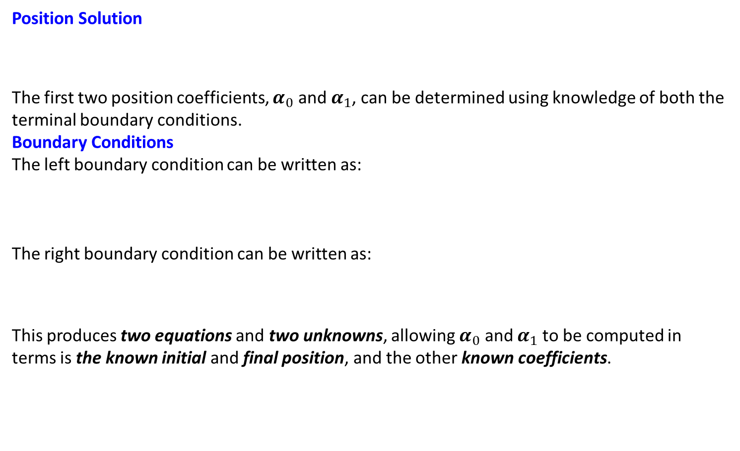
JUNKINS & WOOLLANDS
Picard-Chebyshev Lecture Series
#3 Picard-Chebyshev Methods
ALTERNATE METHOD FOR COEFFICIENTS
Position Solution
The first two position coefficients, $α_{0}$ and $α_{1}$, can be determined using knowledge of both the terminal boundary conditions.
Boundary Conditions
The left boundary condition can be written as:
The right boundary condition can be written as:
This produces two equations and two unknowns, allowing $α_{0}$ and $α_{1}$ to be computed in terms is the known initial and final position, and the other known coefficients.
We use this approach later for the Picard-Chebyshev convergence analysis!
30

Slide 31
JUNKINS & WOOLLANDS
Picard-Chebyshev Lecture Series
#3 Picard-Chebyshev Methods
ALTERNATE METHOD FOR COEFFICIENTS
Position Coefficients
Matrix Representation for Position
(N+1) × N
We use this approach later for the Picard-Chebyshev convergence analysis!
(N+1) × n
(N+1) × n
N × n
(N+1) × n
Pseudo Position
Coefficients
31

Slide 32
JUNKINS & WOOLLANDS
Picard-Chebyshev Lecture Series
#3 Picard-Chebyshev Methods
TPBVP ALGORITHM
Dynamics & Initial Conditions
Velocity Matrices
Time and τ
Picard Iteration
Position Matrices
Iterate
Convergence
Update
32

Slide 33
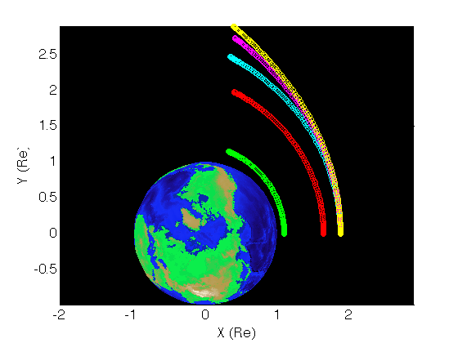
JUNKINS & WOOLLANDS
Picard-Chebyshev Lecture Series
#3 Picard-Chebyshev Methods
EXAMPLE 5
TPBVP Example: Perturbed Two-body Problem
-o- a = 8000 km, e = 0.125, t_{f} ≈ 20 mins
-o- a = 15,000 km, e = 0.3, t_{f} ≈ 39 mins
-o- a = 20,000 km, e = 0.4, t_{f} ≈ 51 mins
-o- a = 30,000 km, e = 0.6, t_{f} ≈ 51 mins
-o- a = 40,000 km, e = 0.7, t_{f} ≈ 53 mins
The Picard-Chebyshev TPBVP algorithm only converges over a fraction of an orbit (as seen above). The arcs were computed with a spherical harmonic degree & order 40 gravity model. Although the Picard-Chebyshev TPBVP has a relatively small domain of convergence (compared with the IVP) is not a Newton-like shooting method and does not require a state transition matrix. As a result it is very fast and is ideal for solving “short range” type problems. The code for generating the above figure is available for use as a learning tool: run_lecture3_example5_tpbvpII.m.
33

Slide 34


JUNKINS & WOOLLANDS
Picard-Chebyshev Lecture Series
#3 Picard-Chebyshev Methods
BVP Type II & Type III
BVP Type II $(x_{0}$ and $v_{f})$
BVP Type III $(x_{f}$ and $v_{0})$
Second order system & boundary conditions
Second order system & boundary conditions
Compute Velocity: Final Value Problem
Compute Velocity: Initial Value Problem
Compute Position: Initial Value Problem
Compute Position: Final Value Problem
34

Slide 35


JUNKINS & WOOLLANDS
Picard-Chebyshev Lecture Series
#3 Picard-Chebyshev Methods
BVP Type II & Type III
BVP Type II $(x_{0}$ and $v_{f})$
BVP Type III $(x_{f}$ and $v_{0})$
Velocity
Velocity
Position
Velocity
35

Slide 36
JUNKINS & WOOLLANDS
Picard-Chebyshev Lecture Series
#3 Picard-Chebyshev Methods
BVP II ALGORITHM
Dynamics & Initial Conditions
Velocity Matrices
Time and τ
Picard Iteration
Position Matrices
Iterate
Convergence
Update
36

Slide 37
JUNKINS & WOOLLANDS
Picard-Chebyshev Lecture Series
#3 Picard-Chebyshev Methods
BVP III ALGORITHM
Dynamics & Initial Conditions
Velocity Matrices
Time and τ
Picard Iteration
Position Matrices
Iterate
Convergence
Update
37

Slide 38
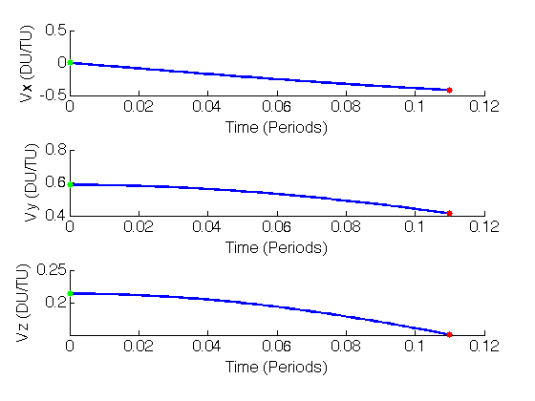
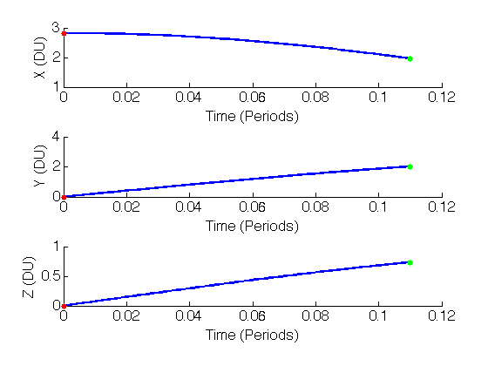
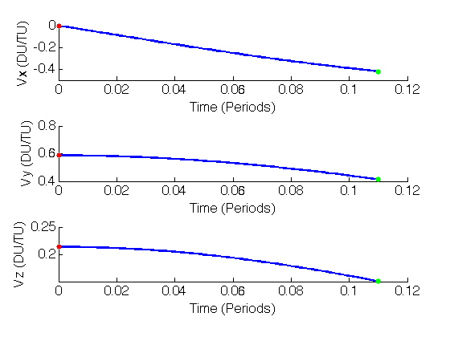
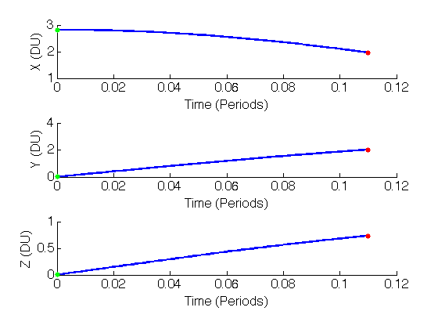
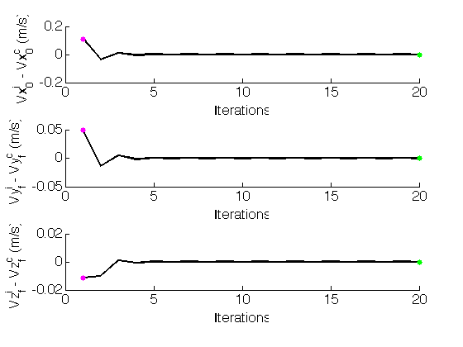
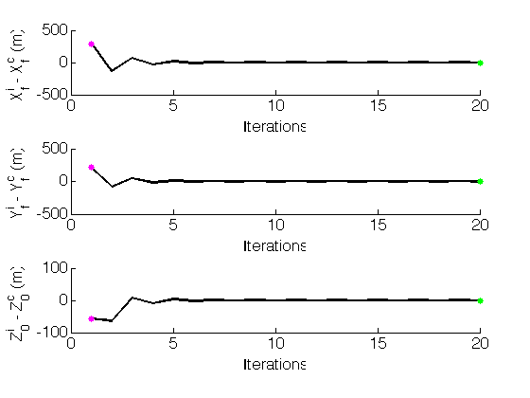
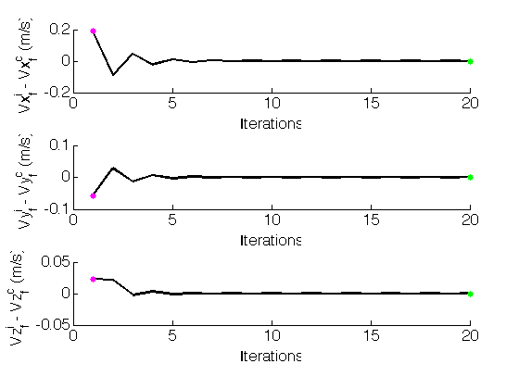
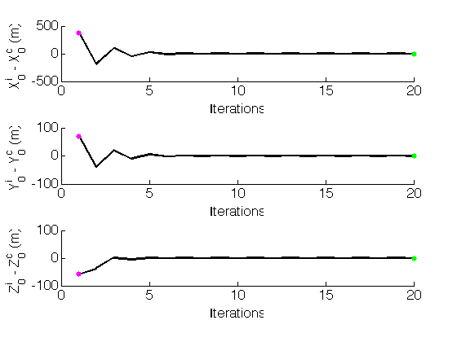
JUNKINS & WOOLLANDS
Picard-Chebyshev Lecture Series
#3 Picard-Chebyshev Methods
EXAMPLE: BVP Type II & III
BVP Type II $(x_{0}$ and $v_{f})$
BVP Type III $(x_{f}$ and $v_{0})$
Velocity Components
Position Components
Velocity Components
Position Components
LEGEND:
Specified (fixed) boundary condition
Converged boundary condition
Two-body initial guess
Initial Velocity
Final Position
Final Velocity
Initial Position
The Picard-Chebyshev BVP algorithm also converges over a fraction of an orbit (slightly less that the TPBVP). As with the TPBVP it is very fast as it is not a Newton-like shooting method and it does not require a state transition matrix. The code for generating the above figures is available for use as a learning tool: run_lecture3_example5_ivpII_fvpII.m.
38

Slide 39

JUNKINS & WOOLLANDS
Picard-Chebyshev Lecture Series
#3 Picard-Chebyshev Methods
PICARD-CHEBYSHEV CONVERGENCE: FIRST ORDER
Scalar Problem
Consider the first order linear differential equation: consider the simplest case, x is a scalar.
Picard-Chebyshev Vector Matrix Notation with t => τ
If max eigenvalue of M < 1, Picard converges over finite interval (analogous to diff eqs).
Max eigenvalues are scaled by the time of flight $t_{f}−t_{0}$ and $c:$
Note
For a linear system, given $c$ we can directly compute the domain of convergence $t_{f}−t_{0}$.
39

Slide 40
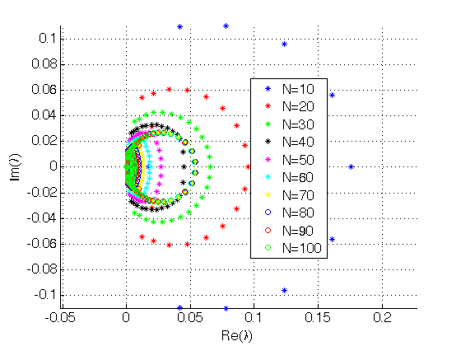
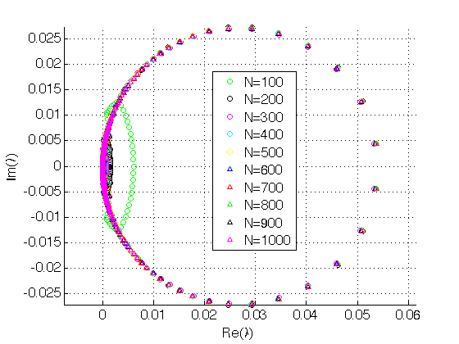
JUNKINS & WOOLLANDS
Picard-Chebyshev Lecture Series
#3 Picard-Chebyshev Methods
EIGENVALUE ANALYSIS: FIRST ORDER
Root Locus Plots for λ_{max}(TP₁A)
For N > 40, the maximum eigenvalue of the matrix product [TP₁A] or λ_{max}([TP₁A]) is attracted to a fixed point on the root locus plots above.
The code for generating the above figures is available for use as a learning tool: run_lecture3_example6_ivpI_conv.m.
40

Slide 41
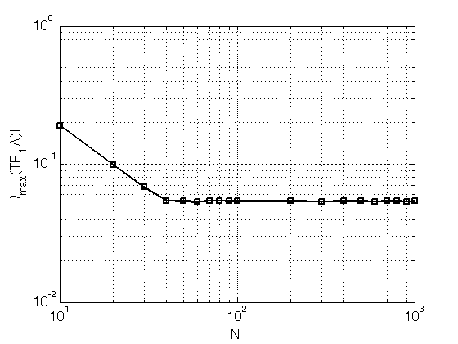
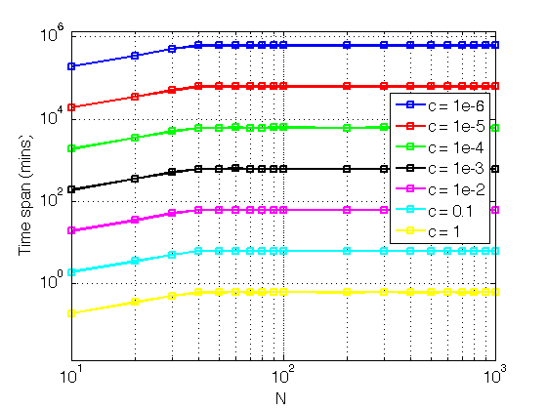
JUNKINS & WOOLLANDS
Picard-Chebyshev Lecture Series
#3 Picard-Chebyshev Methods
EIGENVALUE ANALYSIS: FIRST ORDER
MAX EIGENVALUE VS N
DOMAIN OF CONVERGENCE
The left figure shows that increasing N beyond 40 will not increase the convergence rate, however, it may improve the accuracy of the fit/solution for functions requiring M >= N > 40 to capture the higher frequency behavior accurately over a specific time interval.
Increasing N beyond 40 also does not increase the theoretical time interval over which Picard-Chebyshev numerical integration will converge for a given c.
The code for generating the above figures is available for use as a learning tool: run_lecture3_example6_ivpI_conv.m.
41

Slide 42
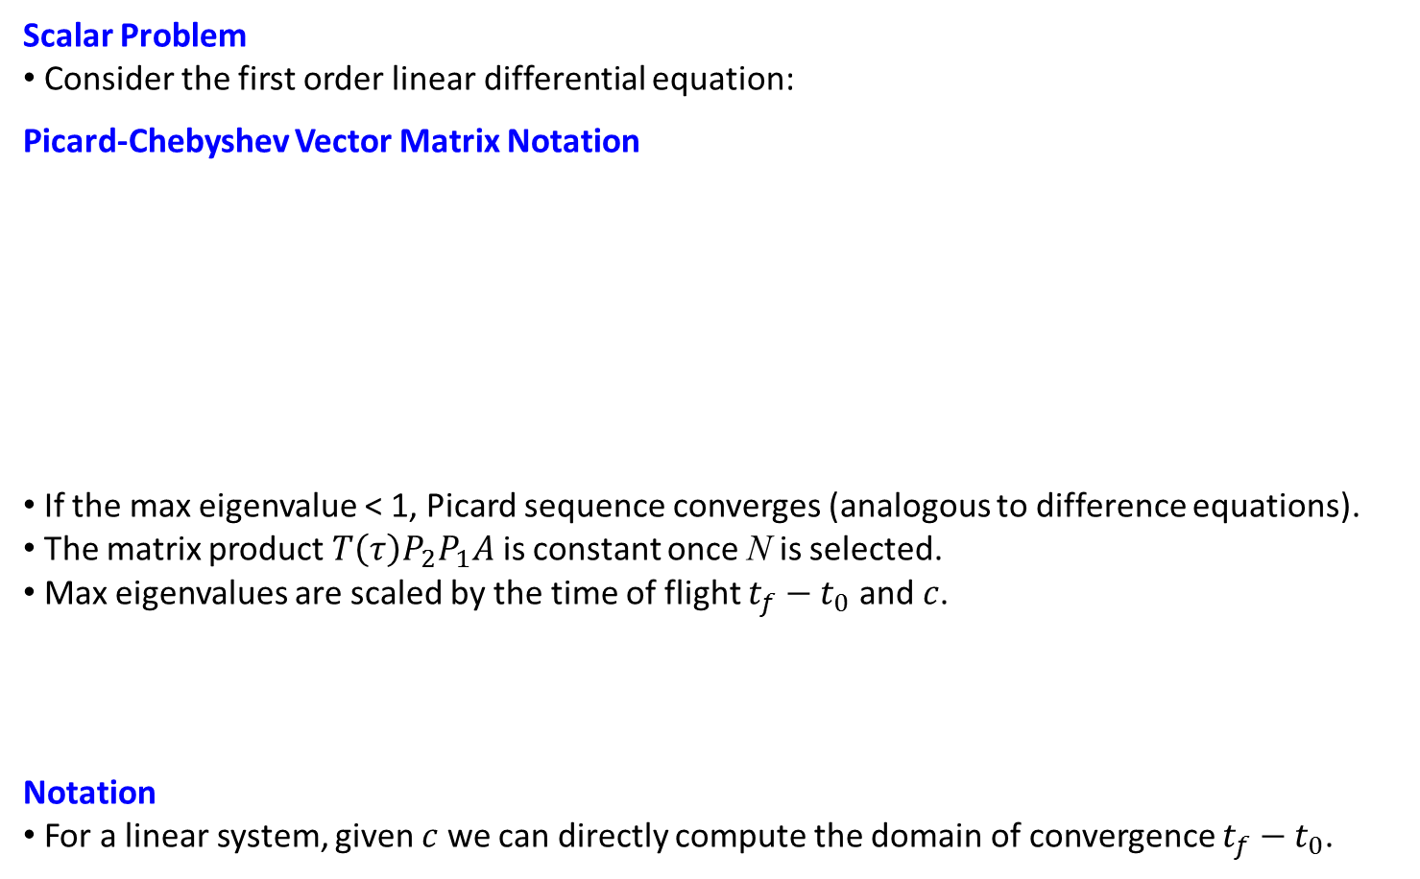
JUNKINS & WOOLLANDS
Picard-Chebyshev Lecture Series
#3 Picard-Chebyshev Methods
PICARD-CHEBYSHEV CONVERGENCE: SECOND ORDER
Scalar Problem
Consider the first order linear differential equation:
Picard-Chebyshev Vector Matrix Notation
If the max eigenvalue < 1, Picard sequence converges (analogous to difference equations).
The matrix product $T\left(τ\right)P_{2}P_{1}A$ is constant once N is selected.
Max eigenvalues are scaled by the time of flight $t_{f}−t_{0}$ and $c$.
Notation
For a linear system, given $c$ we can directly compute the domain of convergence $t_{f}−t_{0}$.
Chebyshev
matrix
Least squares
operator
Solution
Initial condition
vector
t → τ time
transformation
Integration
operators: I & II
Forcing
function
42

Slide 43
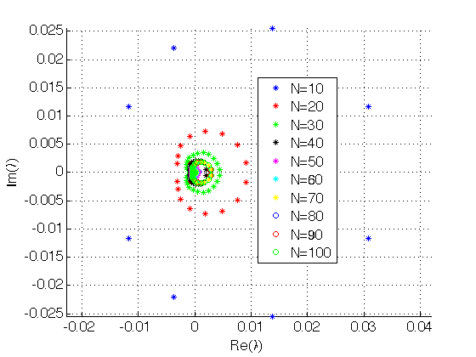
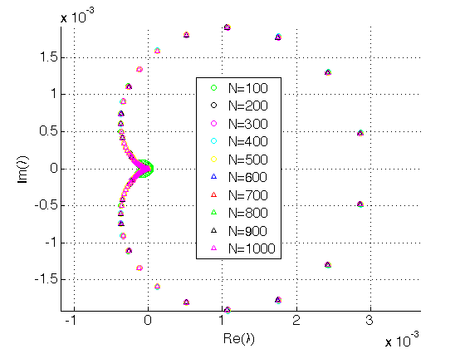
JUNKINS & WOOLLANDS
Picard-Chebyshev Lecture Series
#3 Picard-Chebyshev Methods
EIGENVALUE ANALYSIS: SECOND ORDER
Root Locus Plots for λ_{max}(TP₂P₁A)
For N > 40, the maximum eigenvalue of the matrix product [TP₂P₁A] or λ_{max}([TP₂P₁A]) is attracted to a fixed point on the root locus plots above.
Note that λ_{max}([TP₂P₁A]) for the second order system is much smaller than for the first order system, however, it is the square root of this value (as shown in the denominator on the previous slide) that is used for computing the theoretical convergence.
The code for generating the above figures is available for use as a learning tool: run_lecture3_example7_ivpII_conv.m.
39

Slide 44
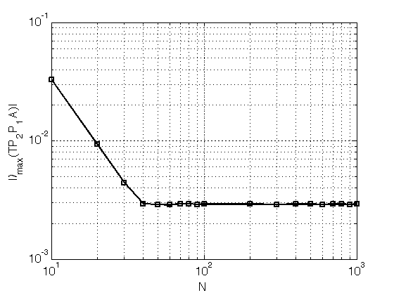
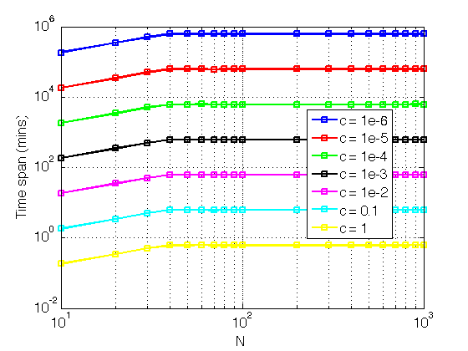
JUNKINS & WOOLLANDS
Picard-Chebyshev Lecture Series
#3 Picard-Chebyshev Methods
EIGENVALUE ANALYSIS: SECOND ORDER
MAX EIGENVALUE VS N
DOMAIN OF CONVERGENCE
The left figure shows that increasing N beyond 40 will not increase the convergence rate, however, it may improve the accuracy of the fit/solution for functions requiring M >= N > 40 to capture the higher frequency behavior accurately over a specific time interval.
Increasing N beyond 40 also does not increase the theoretical time interval over which Picard-Chebyshev numerical integration will converge for a given c.
The code for generating the above figures is available for use as a learning tool: run_lecture3_example7_ivpII_conv.m.
40

Slide 45

JUNKINS & WOOLLANDS
Picard-Chebyshev Lecture Series
#3 Picard-Chebyshev Methods
PICARD-CHEBYSHEV CONVERGENCE: TPBVP
Scalar Problem
Consider the first order linear differential equation:
Picard-Chebyshev Vector Matrix Notation
If the max eigenvalue < 1, Picard sequence converges (analogous to difference equations).
The matrix product $T\left(τ\right)P_{B}P_{2}P_{1}A$ is constant once N is selected.
Max eigenvalues are scaled by the time of flight $t_{f}−t_{0}$ and $c$.
Notation
For a linear system, given $c$ we can directly compute the domain of convergence $t_{f}−t_{0}$.
Chebyshev
matrix
Least squares
operator
Solution
Initial condition
vector
t → τ time
transformation
Integration
operators: I, II & P_{B}
Forcing
function
45

Slide 46
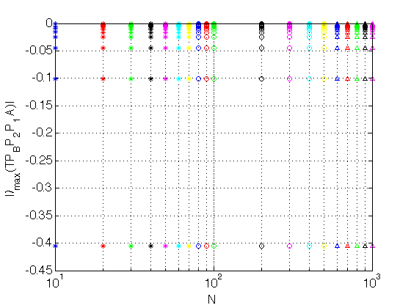
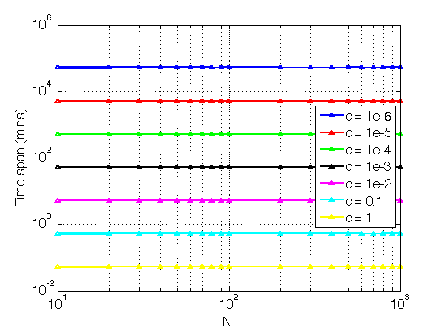
JUNKINS & WOOLLANDS
Picard-Chebyshev Lecture Series
#3 Picard-Chebyshev Methods
EIGENVALUE ANALYSIS: TPBVP
MAX EIGENVALUE VS N
DOMAIN OF CONVERGENCE
The maximum eigenvalue of the matrix product λ_{max}([TP_{B}P₂P₁A]) is constant (≈ 0.405) for increasing N, and as expected the theoretical convergence domain is also constant (top right). Note that the TPBVP theoretical domain of convergence is about an order of magnitude smaller than that for the second order IVP (bottom right).
run_lecture3_example8_tpbvp_conv.m
42

Slide 47
JUNKINS & WOOLLANDS
Picard-Chebyshev Lecture Series
#3 Picard-Chebyshev Methods
CONCLUSION
Picard iteration
Picard iteration is a successive path approximation technique for solving differential equations.
Least Squares
Reviewed of least squares from lecture 1 (vector problem)
Discussed the least squares operator
Picard-Chebyshev Initial Value Problem Derivation/Algorithm (First Order)
Thoroughly derived the Picard-Chebyshev first order IVP algorithm
Discussed the first integration operator (P₁)
Presented two examples to demonstrate the method (MATLAB code is available)
Picard-Chebyshev Initial Value Problem Derivation/Algorithm (Second Order)
Derived the Picard-Chebyshev second order IVP algorithm
Discussed the second integration operator (P₂)
Presented two examples to demonstrate the method (MATLAB code is available)
Picard-Chebyshev Boundary Value Problem Derivation/Algorithm
Three types of BVPs
Derived the Picard-Chebyshev second order BVP algorithm
Presented three examples to demonstrate the three methods (MATLAB code is available)
Convergence Picard-Chebyshev Algorithm
Discussed convergence for the IVP and TPBVP algorithms (MATLAB code is available)
43

Slide 48
JUNKINS & WOOLLANDS
Picard-Chebyshev Lecture Series
#3 Picard-Chebyshev Methods
REFERENCES
Bai, X., Modified Chebyshev-Picard Iteration Methods for Solution of Initial and Boundary Value Problems. PhD Dissertation, Texas A&M University, 2010.
Bai, X. and Junkins, J., Modified Chebyshev-Picard Iteration Methods for Orbit Propagation, Journal of the Astronautical Sciences, 2011.
Budd, N. and Junkins, J., Picard-Chebyshev Integration Operator Informal Seminar Notes and Discussions, 2016.
Fukushima, T., Picard iteration method, Chebyshev polynomial approximation, and global numerical integration of dynamical motions, The Astronomical Journal, 1997.
Bai, X. and Junkins, J., Modified Chebyshev-Picard Iteration for Solution of Boundary Value Problems, Journal of the Astronautical Sciences, 2012.
Bani-Younes, A., Orthogonal Polynomial Approximation in Higher Dimensions: Applications in Astrodynamics. PhD thesis, Department of Aerospace Engineering, Texas A&M University, College Station, TX, 2013.
Woollands, R., Regularization and Computational Methods for Precise Solution of Perturbed Orbit Transfer Problems. PhD thesis, Department of Aerospace Engineering, Texas A&M University, College Station, TX, 2016.
Schaub, H. and Junkins, J., Analytical Mechanics of Space Systems 3rd Ed., AIAA Education Series, 2014.
Berry, M. and Healy, L., Comparison of Accuracy Assessment Techniques for Numerical Integrator Comparison, Advances of the Astronautical Sciences, 2003.
48

