Slide 1
District Summary
Original analysis
Repeated analysis

Slide 2
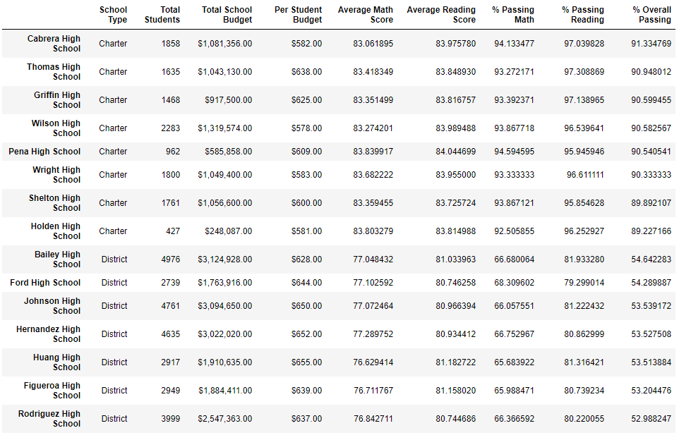
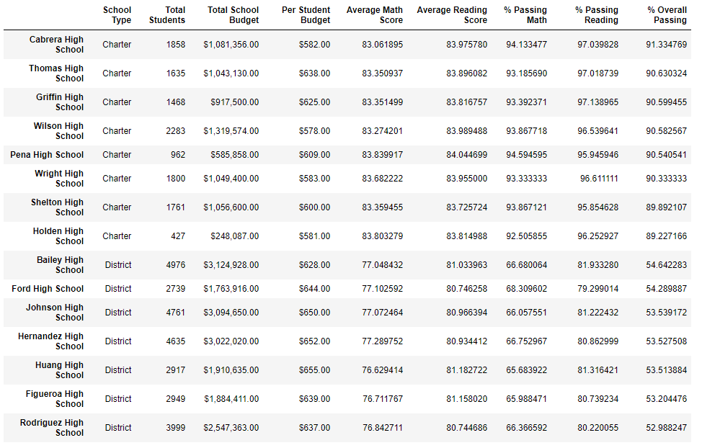
Per School Summary
Original analysis
Repeated analysis (9th grade Thomas High scores assigned NaN and score averages calculated only with 10th to 12th grade student count)
Schools ranked by overall passing percentage
Schools ranked by overall passing percentage

Slide 3
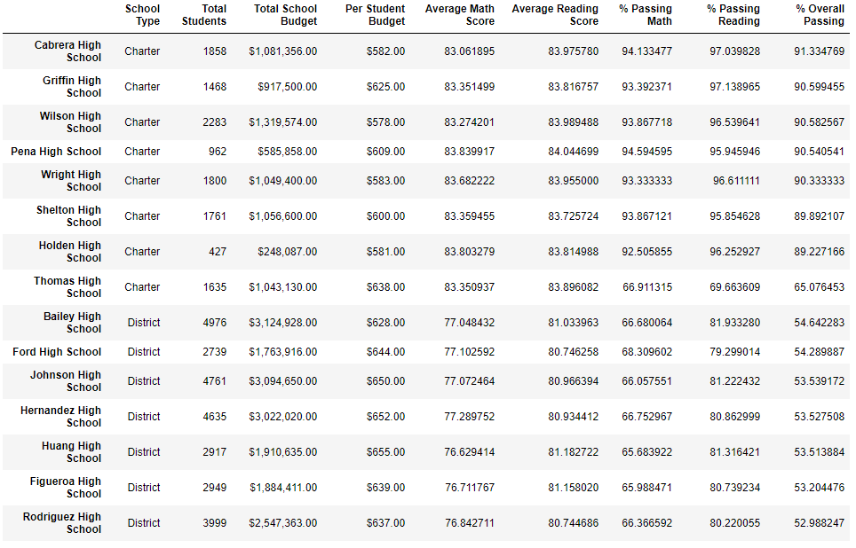
Per School Summary
Repeated analysis (9th grade Thomas High scores assigned NaN and score averages calculated with entire student count)
Repeated analysis (9th grade Thomas High scores assigned NaN and score averages calculated only with 10th to 12th grade student count)
Schools ranked by overall passing percentage
Schools ranked by overall passing percentage

Slide 4
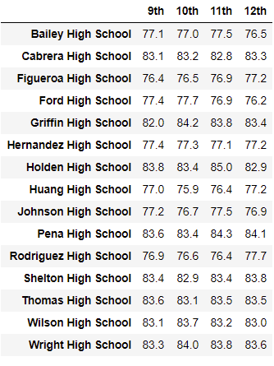
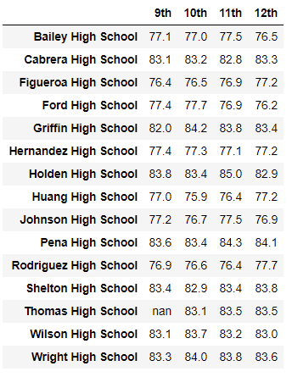
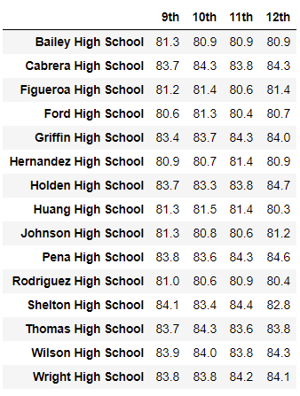
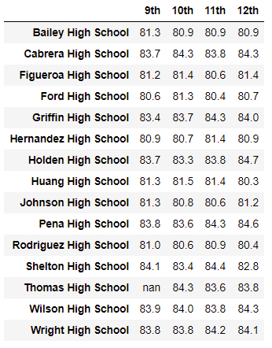
Scores by Grade Summary
Math Scores
Reading Scores
Original Analysis
Repeated Analysis
Original Analysis
Repeated Analysis

Slide 5
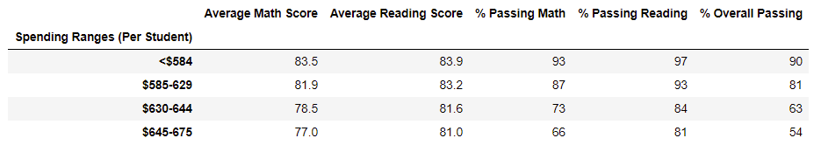
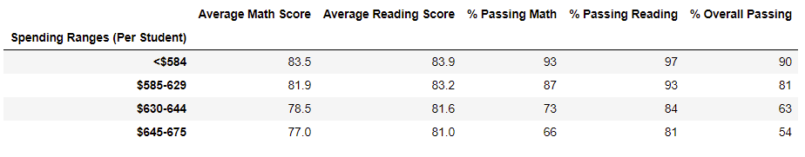
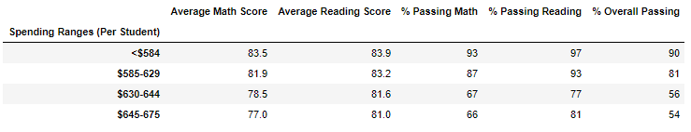
Scores by School Spending Summary
Original analysis
Repeated analysis (9th grade Thomas High scores assigned NaN and score averages calculated only with 10th to 12th grade student count)
Repeated analysis (9th grade Thomas High scores assigned NaN and score averages calculated with entire student count)

Slide 6
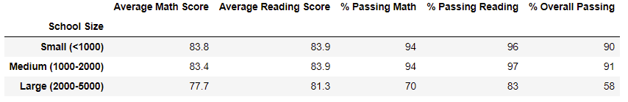
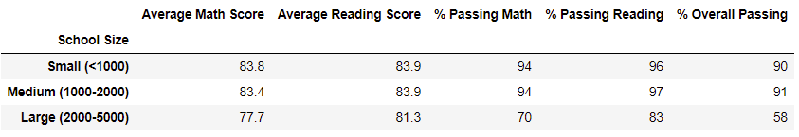
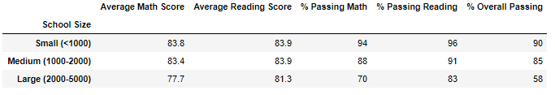
Scores by School Size Summary
Original analysis
Repeated analysis (9th grade Thomas High scores assigned NaN and score averages calculated only with 10th to 12th grade student count)
Repeated analysis (9th grade Thomas High scores assigned NaN and score averages calculated with entire student count)

Slide 7
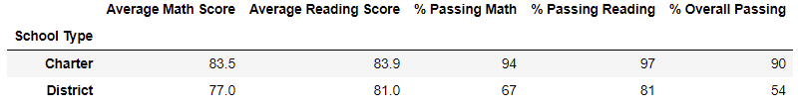
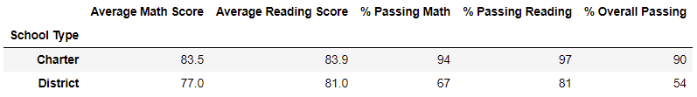

Scores by School Type Summary
Original analysis
Repeated analysis (9th grade Thomas High scores assigned NaN and score averages calculated only with 10th to 12th grade student count)
Repeated analysis (9th grade Thomas High scores assigned NaN and score averages calculated with entire student count)

