Slide 1

Specific project
Pham Duc Thang

Slide 2
SPECIFIC PROJECT
WATERFALL
AGILE
Enhancement and replacement projects
PACKAGED

Slide 3
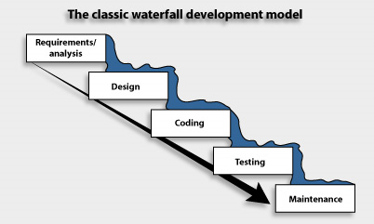
Limitations of the waterfall
What it is?
What are advantages?
What are disadvantages?
When we use waterfall development?

Slide 4
Limitations of the waterfall
What it is?
Waterfall Model methodology which is also known as Liner Sequential Life Cycle Model.
Waterfall Model followed in the sequential order, and so project development team only moves to next phase of development or testing if the previous step completed successfully.
What are advantages?
It is one the easiest model to manage. Because of its nature, each phase has specific deliverables and a review process.
It works well for smaller size projects where requirements are easily understandable.
Faster delivery of the project
Process and Results are well documented.
(Source https://www.guru99.com/waterfall-vs-agile.html)

Slide 5
Limitations of the waterfall
Easily adaptable method for shifting teams
This project management methodology is beneficial to manage dependencies.
What are disadvantages
It is not an ideal model for a large size project
If the requirement is not clear at the beginning, it is a less effective method.
Very difficult to move back to makes changes in the previous phases.
The testing process starts once development is over. Hence, it has high chances of bugs to be found later in development where they are expensive to fix.
When we use waterfall development?

Slide 6
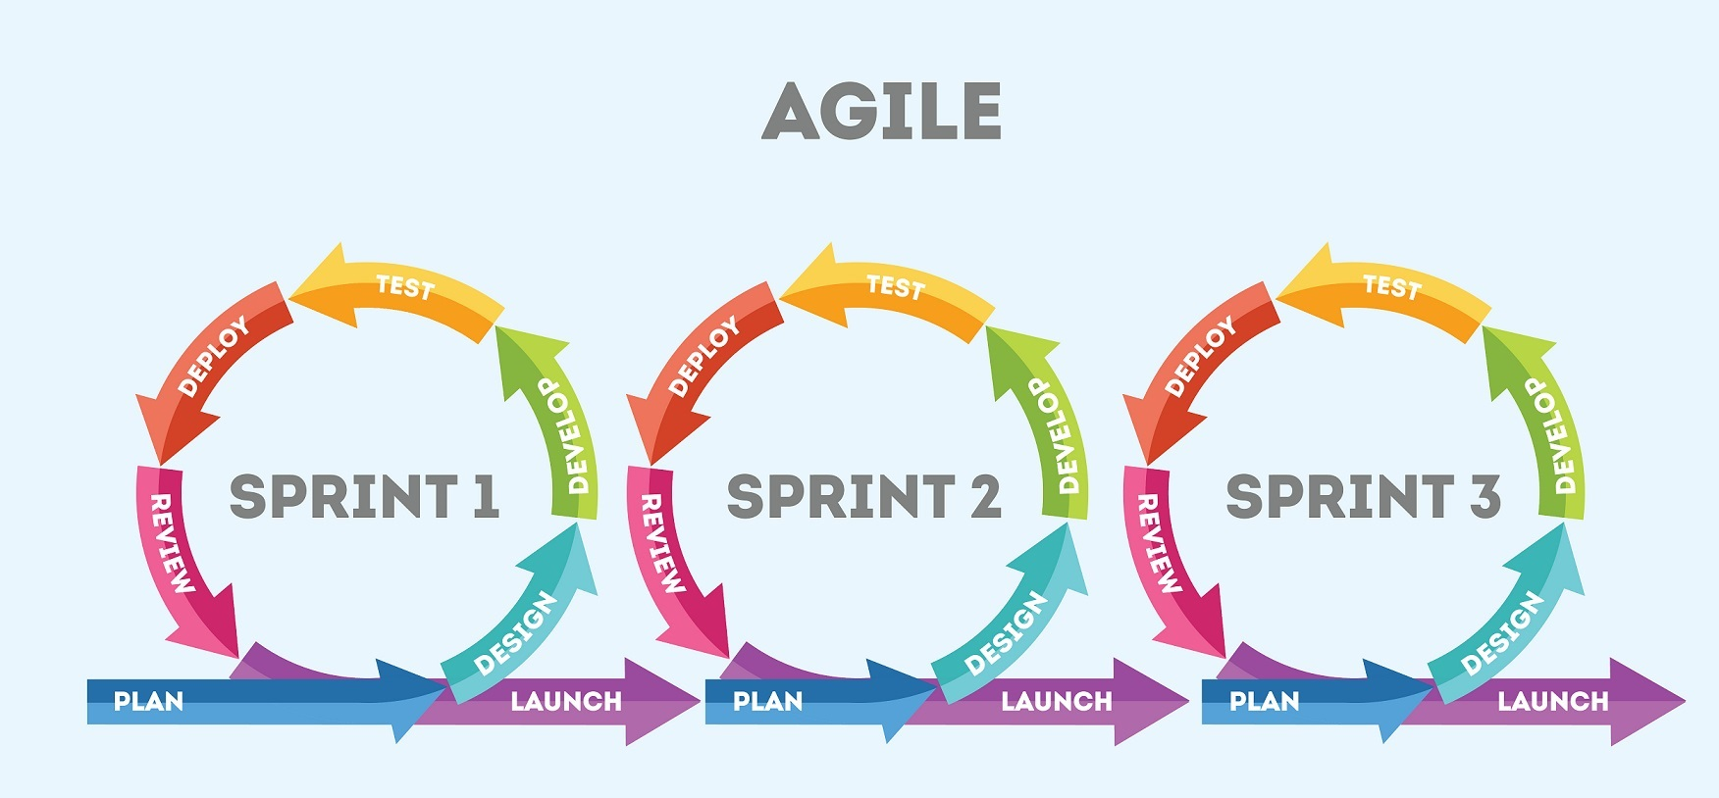
Limitations of the Agile
What it is?
What are advantages?
What are disadvantages?
When we use Agile development?

Slide 7
The agile development approach
What is agile development approach?
Agile methodology is a practice that helps continuous iteration of development and testing in the software development process.
In this model, development and testing activities are concurrent, unlike the Waterfall model.
This process allows more communication between customers, developers, managers, and testers.
What are advantages?
It is focused client process. So, it makes sure that the client is continuously involved during every stage.
Agile teams are extremely motivated and self-organized so it likely to provide a better result from the development projects.
Agile software development method assures that quality of the development is maintained

Slide 8
The agile development approach
The process is completely based on the incremental progress. Therefore, the client and team know exactly what is complete and what is not. This reduces risk in the development process.
What are disadvantages?
It is not useful method for small development projects.
It requires an expert to take important decisions in the meeting.
Cost of implementing an agile method is little more compared to other development methodologies.
The project can easily go off track if the project manager is not clear what outcome he/she wants.
When we use agile development approach?

Slide 9
Difference between Agile and Waterfall Model
Agile | Waterfall
It separates the project development lifecycle into sprints. | Software development process is divided into distinct phases.
It follows an incremental approach | Waterfall methodology is a sequential design process.
Agile methodology is known for its flexibility. | Waterfall is a structured software development methodology so most times it can be quite rigid.
Agile can be considered as a collection of many different projects. | Software development will be completed as one single project.

Slide 10
Difference between Agile and Waterfall Model
Agile | Waterfall
Agile is quite a flexible method which allows changes to be made in the project development requirements even if the initial planning has been completed. | There is no scope of changing the requirements once the project development starts.
Agile methodology, follow an iterative development approach because of this planning, development, prototyping and other software development phases may appear more than once. | All the project development phases like designing, development, testing, etc. are completed once in the Waterfall model.

Slide 11
Difference between Agile and Waterfall Model
Agile | Waterfall
Test plan is reviewed after each sprint | The test plan is rarely discussed during the test phase.
Agile development is a process in which the requirements are expected to change and evolve. | The method is ideal for projects which have definite requirements and changes not at all expected.
In Agile methodology, testing is performed concurrently with software development. | In this methodology, the "Testing" phase comes after the "Build" phase
Agile introduces a product mindset where the software product satisfies needs of its end customers and changes itself as per the customer's demands. | This model shows a project mindset and places its focus completely on accomplishing the project.

Slide 12
Difference between Agile and Waterfall Model
Agile | Waterfall
Agile methodology works exceptionally well with Time & Materials or non-fixed funding. It may increase stress in fixed-price scenarios. | Reduces risk in the firm fixed price contracts by getting risk agreement at the beginning of the process.
Prefers small but dedicated teams with a high degree of coordination and synchronization. | Team coordination/ synchronization is very limited.
Products owner with team prepares requirements just about every day during a project. | Business analysis prepares requirements before the beginning of the project.

Slide 13
Difference between Agile and Waterfall Model
Agile | Waterfall
Test team can take part in the requirements change without problems. | It is difficult for the test to initiate any change in requirements.
Description of project details can be altered anytime during the SDLC process. | Detail description needs to implement waterfall software development approach.
The Agile Team members are interchangeable, as a result, they work faster. There is also no need for project managers because the projects are managed by the entire team | In the waterfall method, the process is always straightforward so, project manager plays an essential role during every stage of SDLC.

Slide 14
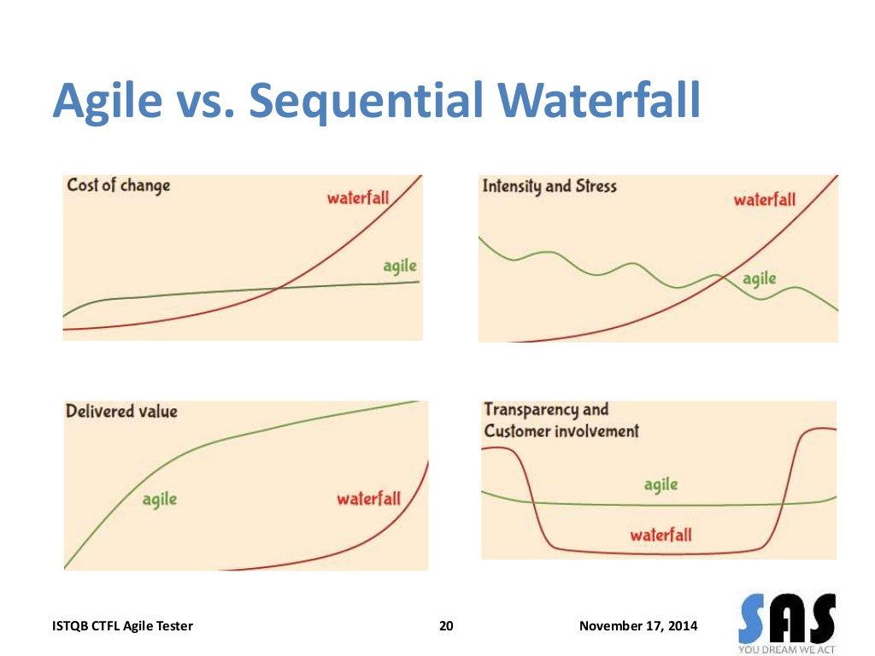

Slide 15
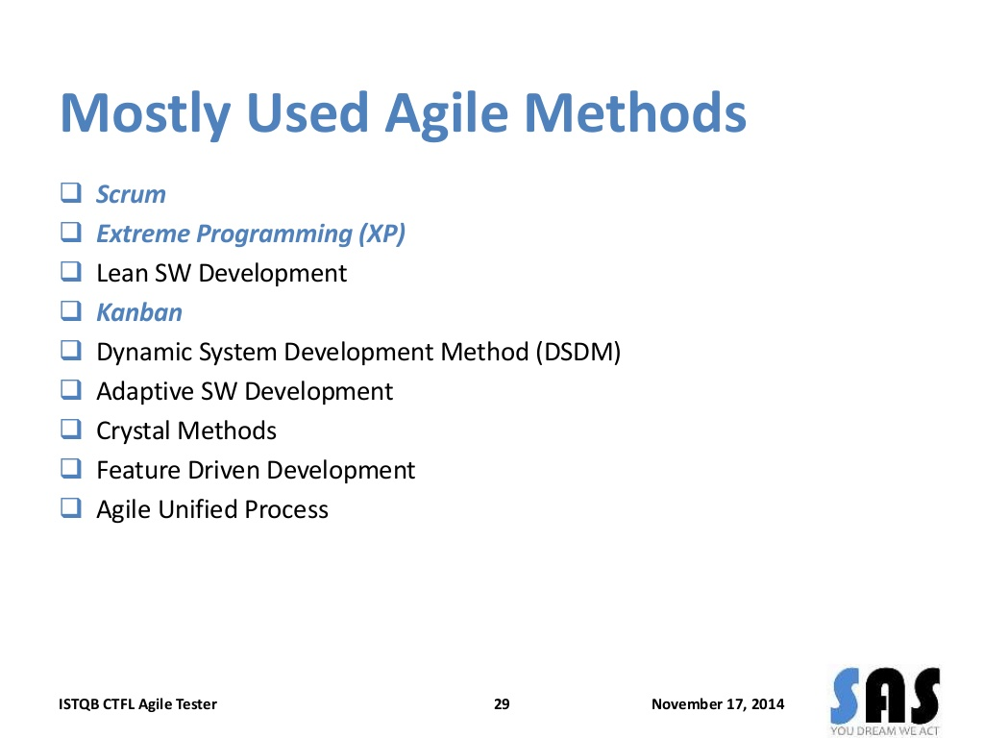

Slide 17
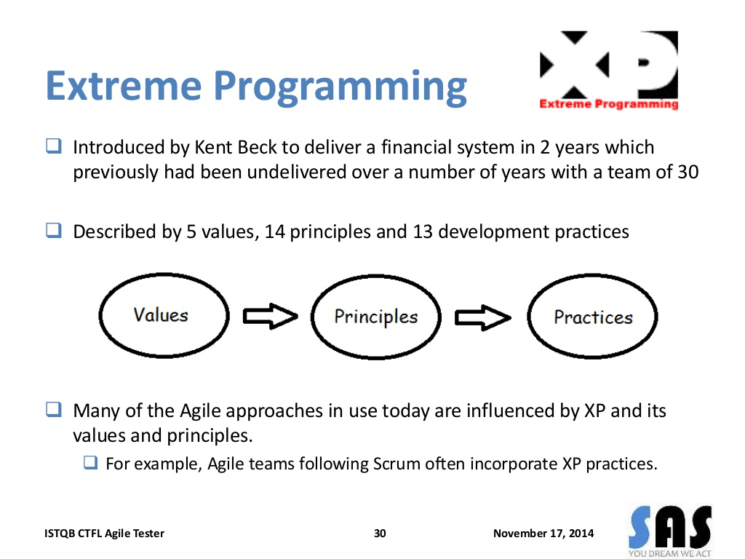

Slide 18
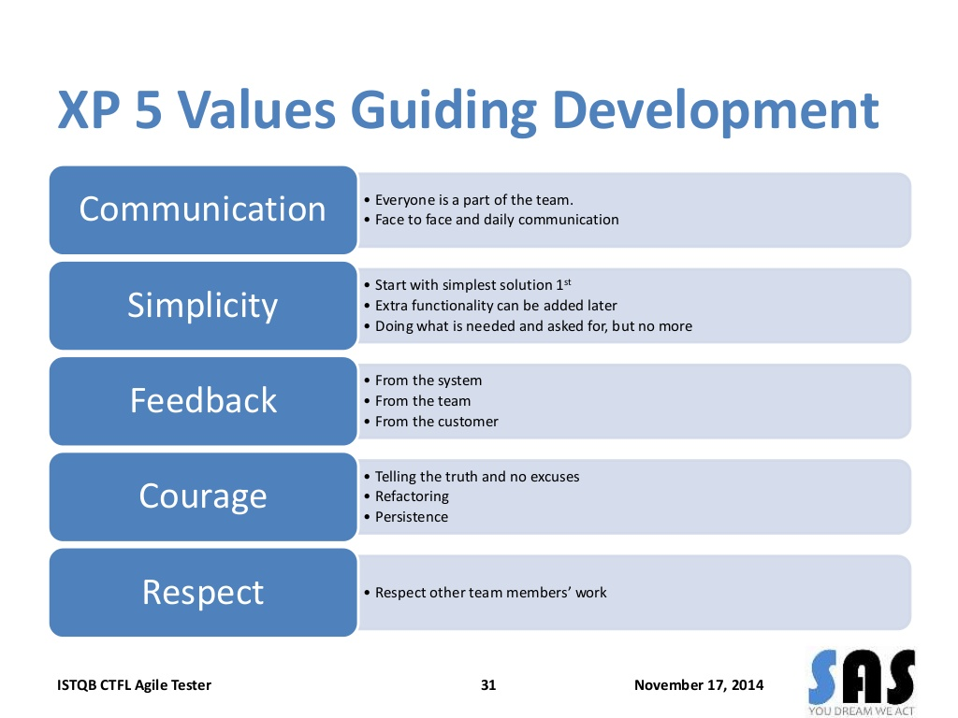

Slide 19
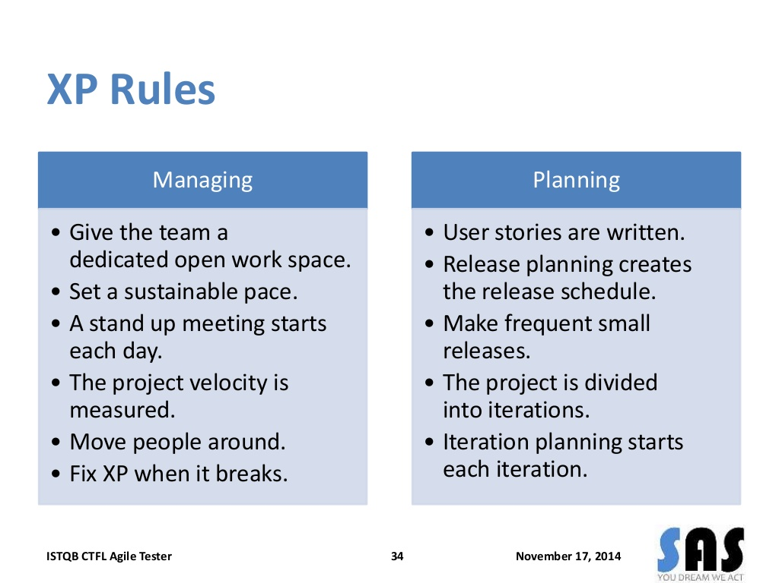

Slide 20
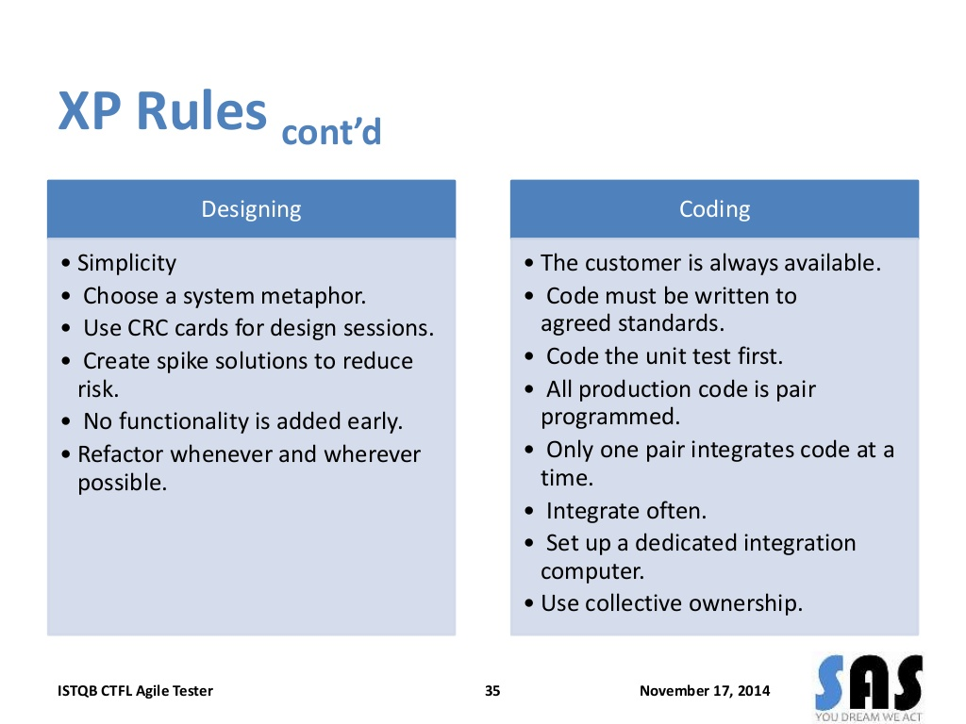

Slide 21
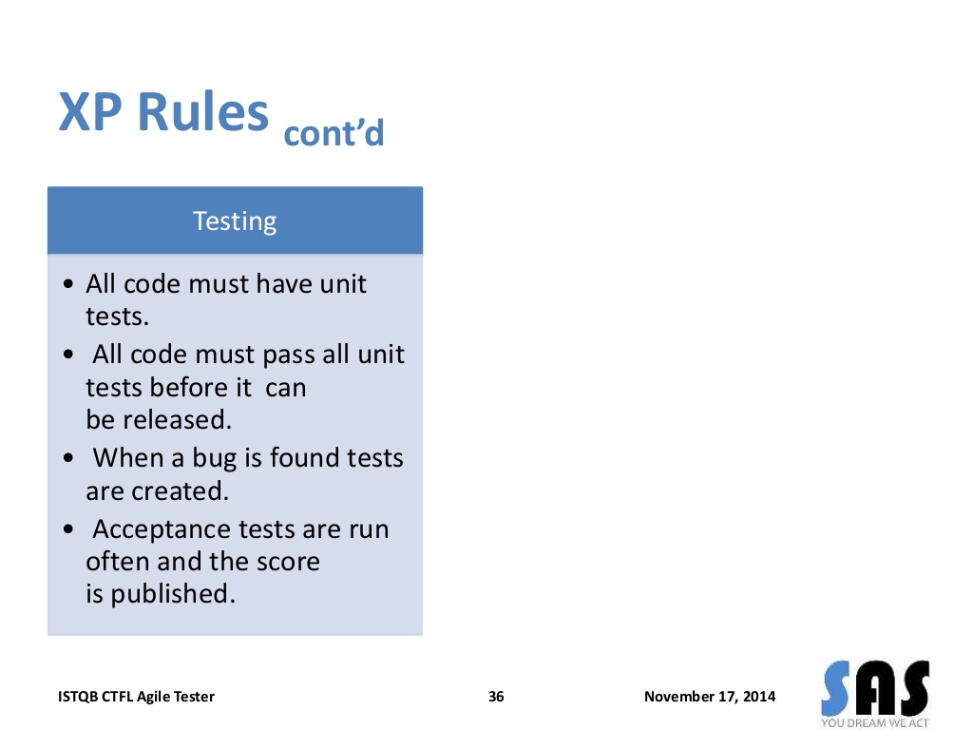

Slide 22
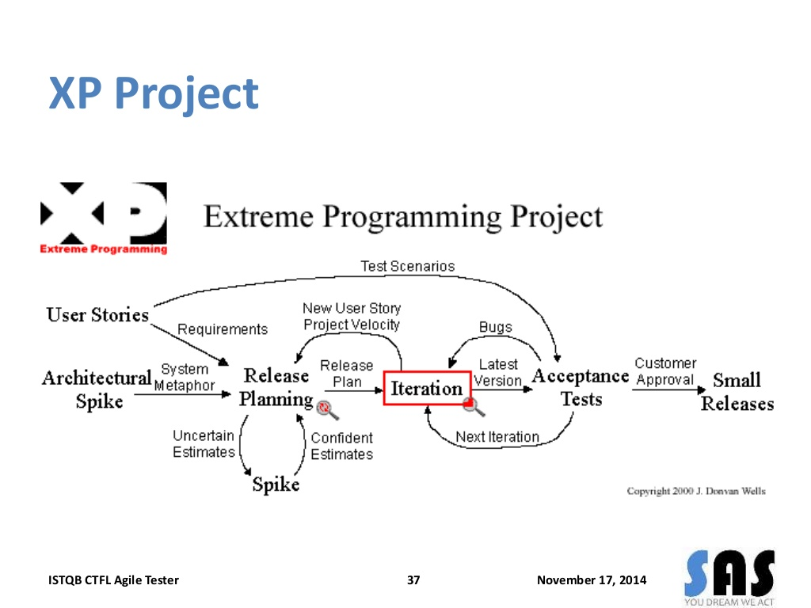

Slide 23
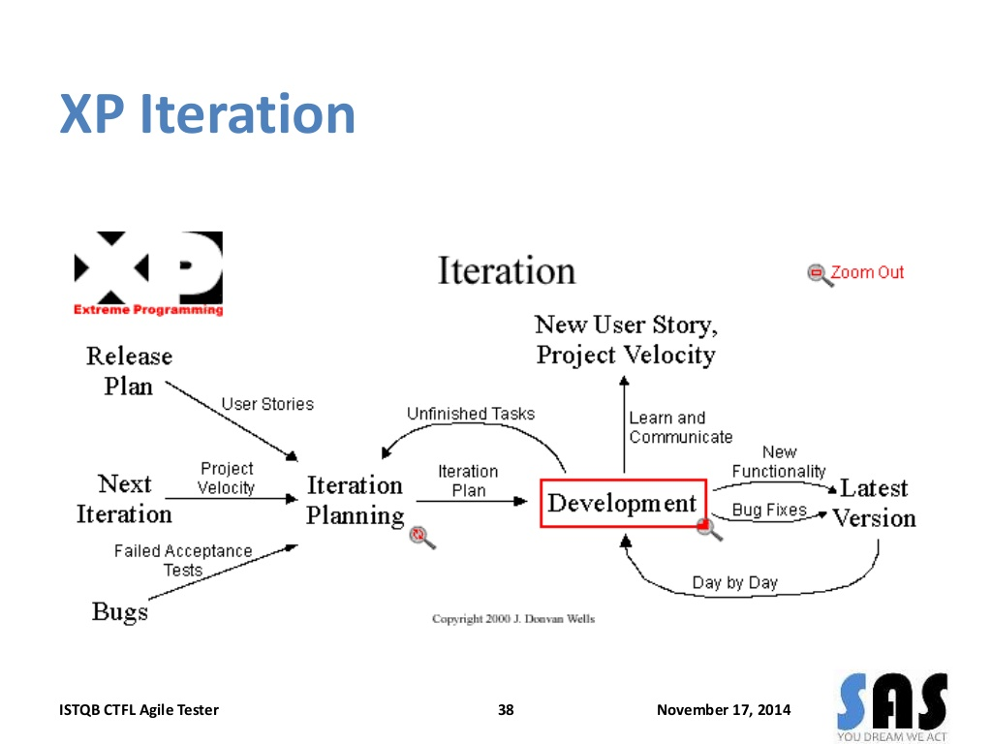

Slide 24
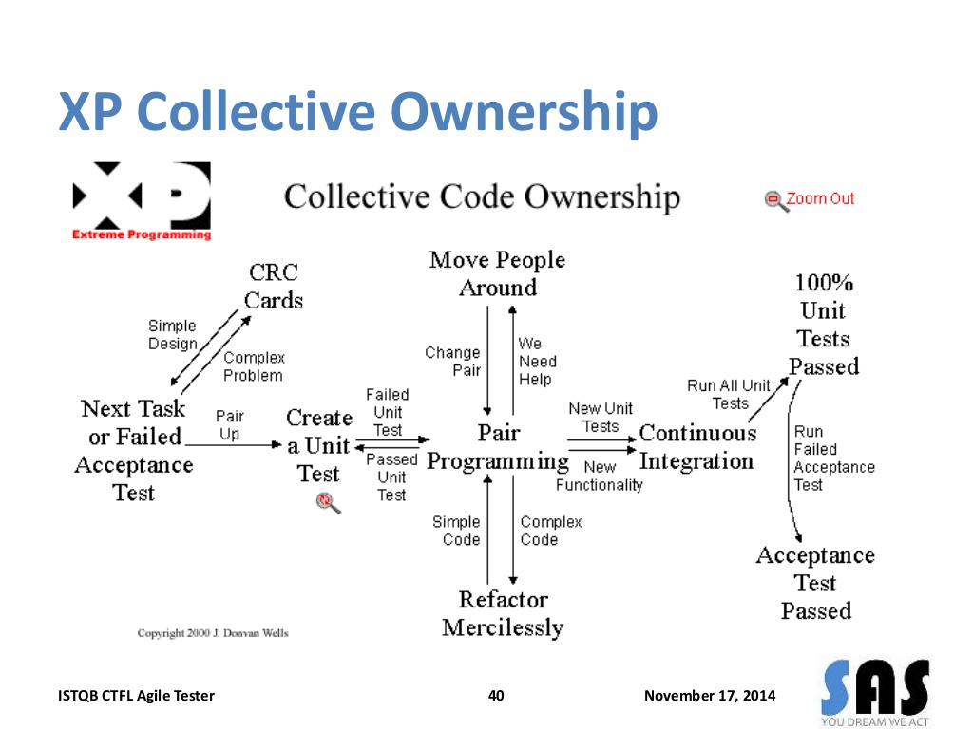

Slide 25
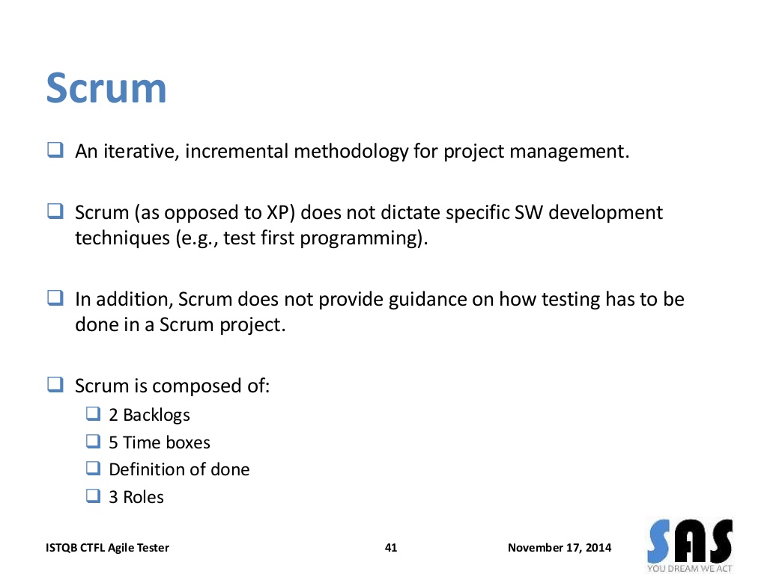

Slide 26
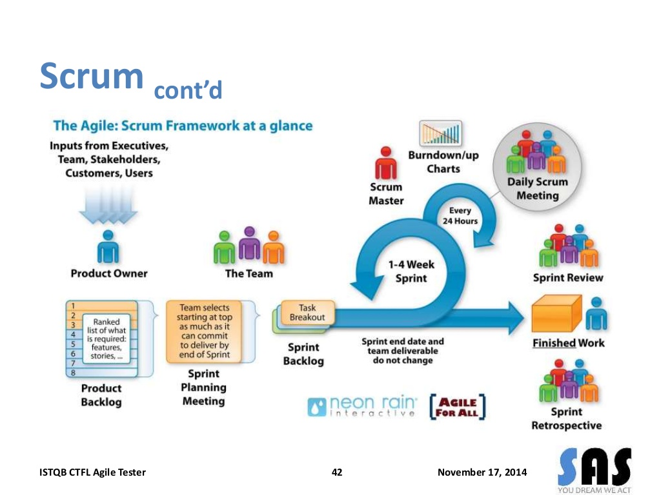

Slide 27
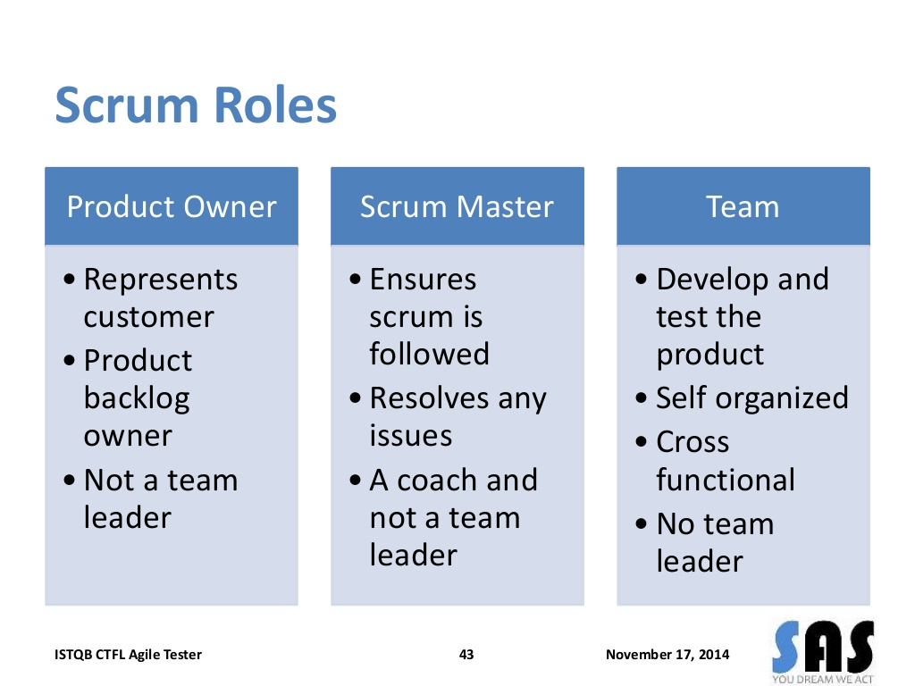

Slide 28
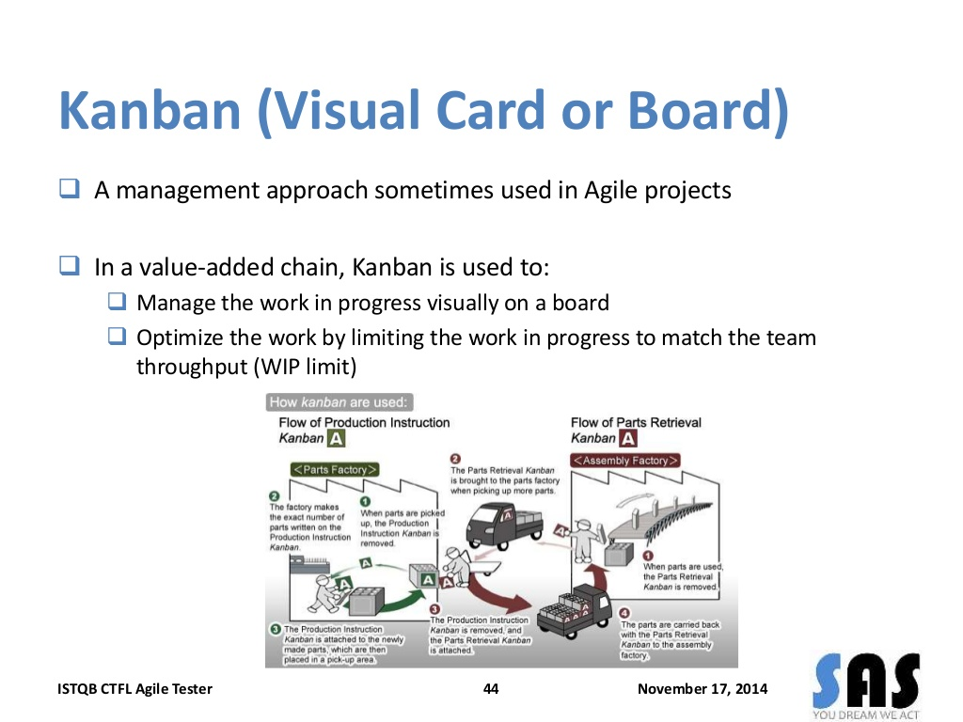

Slide 29
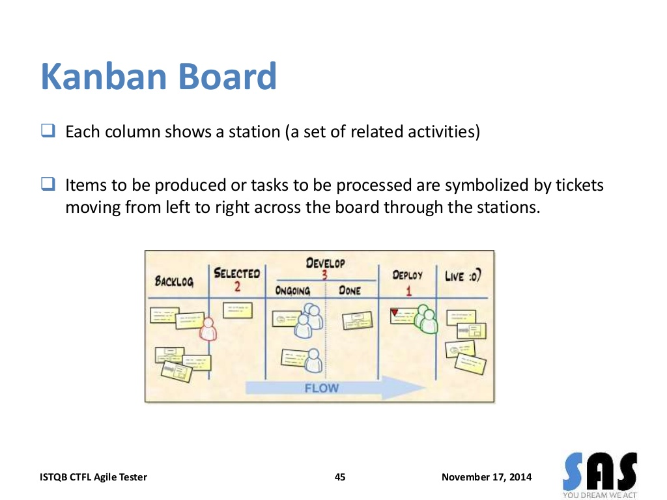

Slide 30
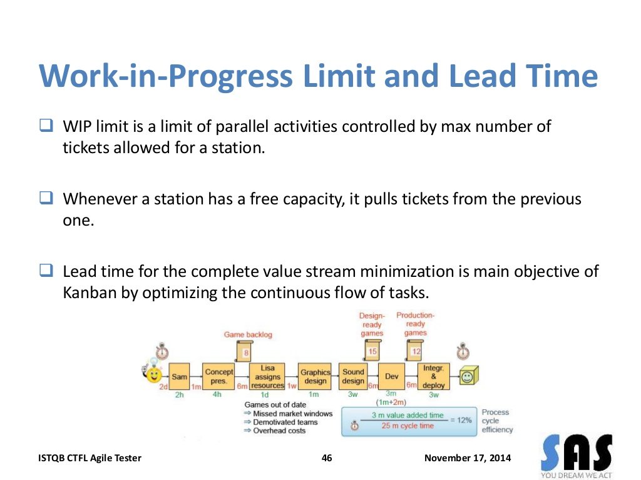

Slide 31
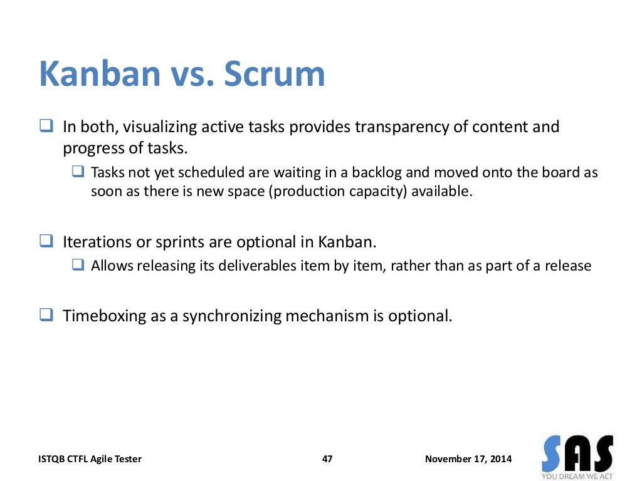

Slide 32
Enhancement and replacement projects
An enhancement project is one in which new capabilities are added to an existing system
A replacement (or reengineering) project replaces an existing application with a new custom-built system, a commercial off-the-shelf (COTS) system, or a hybrid of those

Slide 33
Enhancement and replacement projects
The changes made could degrade the performance to which users are accustomed.
Little or no requirements documentation might be available for the existing system.
Users who are familiar with how the system works today might not like the changes they are about to encounter.
You might unknowingly break or omit functionality that is vital to some stakeholder group.
Stakeholders might take this opportunity to request new functionality that seems like a good idea but isn’t really needed to meet the business objectives

Slide 34
Enhancement and replacement projects
The changes made could degrade the performance to which users are accustomed.
Little or no requirements documentation might be available for the existing system.
Users who are familiar with how the system works today might not like the changes they are about to encounter.
You might unknowingly break or omit functionality that is vital to some stakeholder group.
Stakeholders might take this opportunity to request new functionality that seems like a good idea but isn’t really needed to meet the business objectives

Slide 35
Prioritizing by using business objectives
Mind the gap
A gap analysis is a comparison of functionality between an existing system and a desired new system.
A gap analysis can be expressed in different ways, including use cases, user stories, or features. When enhancing an existing system, perform a gap analysis to make sure you understand why it isn’t currently meeting your business objectives.

Slide 36
Prioritizing by using business objectives

Slide 37
Prioritizing by using business objectives
Maintaining performance levels
Existing systems set user expectations for performance and throughput.
Stakeholders almost always have key performance indicators (KPIs) for existing processes that they will want to maintain in the new system.
A key performance indicator model (KPIM) can help you identify and specify these metrics for their corresponding business processes.
For replacement systems, prioritize the KPIs that are most important to maintain
Look for the business processes that trace to the most important KPIs and the requirements that enable those business processes;

Slide 38
When old requirements don’t exist
Which requirements should you specify?
FIGURE 21-2 Adding enhancement A to an ill-documented existing system provides some visibility into the B area.

Slide 39
When old requirements don’t exist
How to discover the requirements of an existing system?

Slide 40
Encouraging new system adoption
Why we do this?
What are advantages?
How to do this?

Slide 41
Packaged solution projects
Developing user requirements
Considering business rules
Identifying data needs
Defining quality requirements
Evaluating solutions

Slide 42
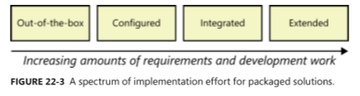
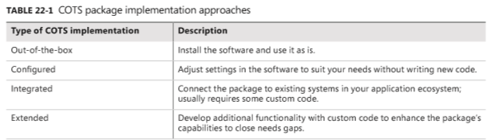
Packaged solution projects

Slide 43
Common challenges with packaged solutions
Too many candidates
Too many evaluation criteria
Vendor misrepresents package capabilities
Incorrect solution expectations
Users reject the solution

