Slide 1
Processes and Threads
Chapter 2
2.1 Processes
2.2 Threads
2.3 Scheduling
2.4 Interprocess communication

Slide 2
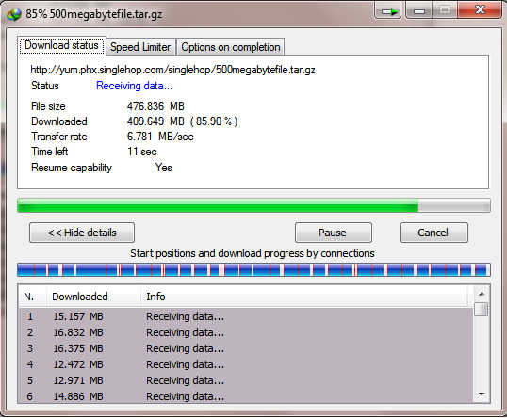

Slide 3
2.1 Processes

Slide 4
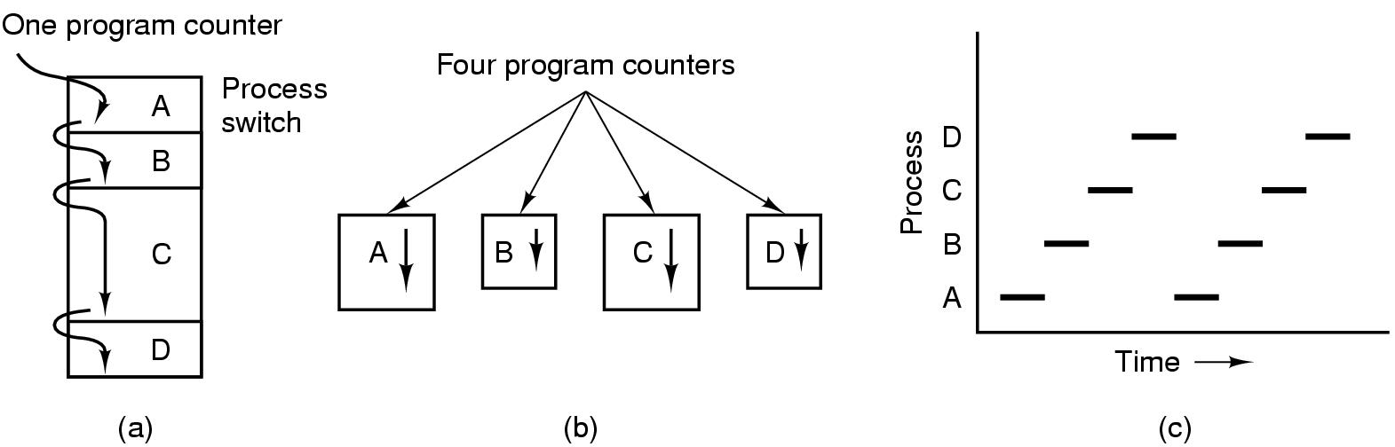
Processes The Process Model
Multiprogramming of four programs
Conceptual model of 4 independent, sequential processes
Only one program active at any instant

Slide 5
Processes Process Concept
An operating system executes a variety of programs:
Batch system – jobs
Time-shared systems – user programs or tasks
Process – a program in execution; process execution must progress in sequential fashion
A process resources includes:
Address space (text segment, data segment)
CPU (virtual)
program counter
registers
stack
Other resource (open files, child processes…)

Slide 6
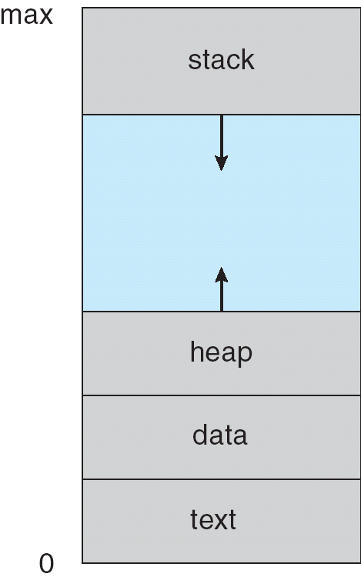
Processes Process in Memory

Slide 7
Processes Process Creation (1)
Principal events that cause process creation
System initialization
2. Execution of a process creation system Call
3. User request to create a new process
4. Initiation of a batch job

Slide 8
Processes Process Creation (2)
Address space
Child duplicate of parent
Child has a program loaded into it
UNIX examples
fork system call creates new process
exec system call used after a fork to replace the process’ memory space with a new program

Slide 9
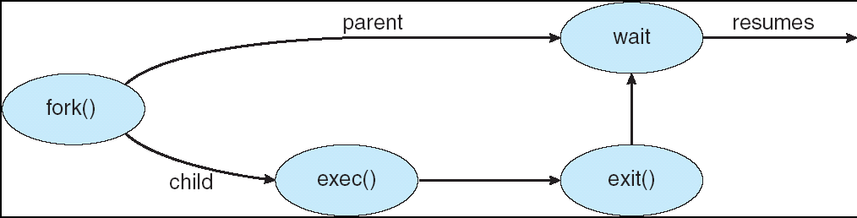
Processes Process Creation (3) : Example

Slide 10
Processes Process Termination
Conditions which terminate processes
Normal exit (voluntary)
Fatal error (voluntary)
Error exit (involuntary)
Killed by another process (involuntary)

Slide 11
Processes Process Hierarchies
Parent creates a child process, child processes can create its own process
Forms a hierarchy
UNIX calls this a "process group"
Windows has no concept of process hierarchy
all processes are created equal

Slide 12
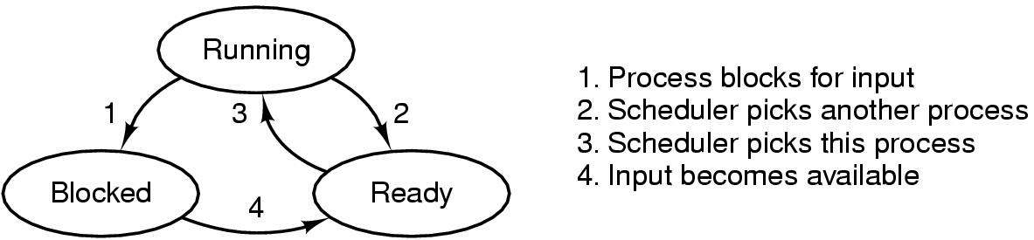
Processes Process States (1)
Possible process states
running
blocked
ready
Transitions between states shown

Slide 13
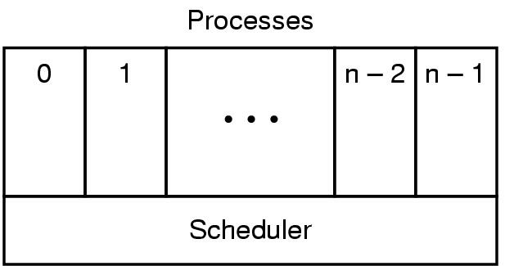
Processes Process States (2)
Lowest layer of process-structured OS
handles interrupts, scheduling
Above that layer are sequential processes

Slide 14
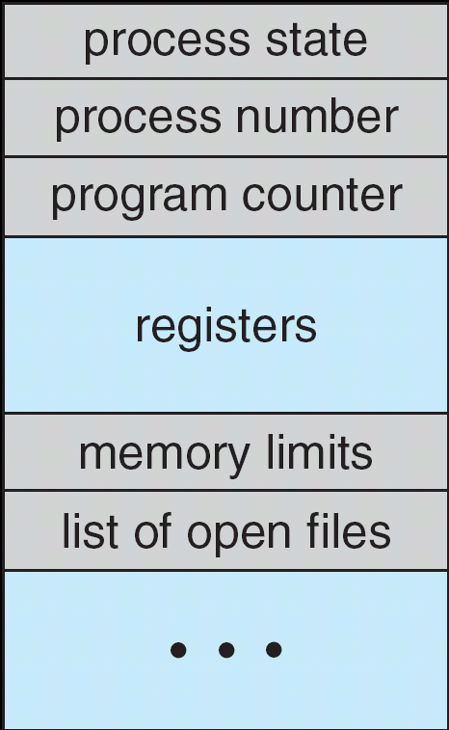
Processes Process Control Block (PCB)

Slide 15
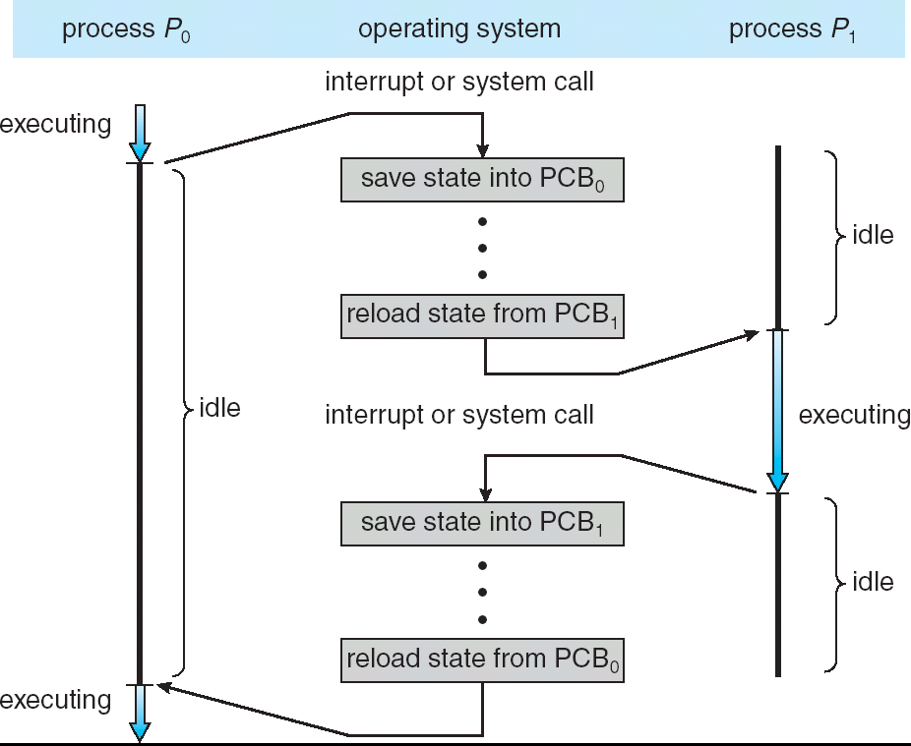
Processes context switch

Slide 16
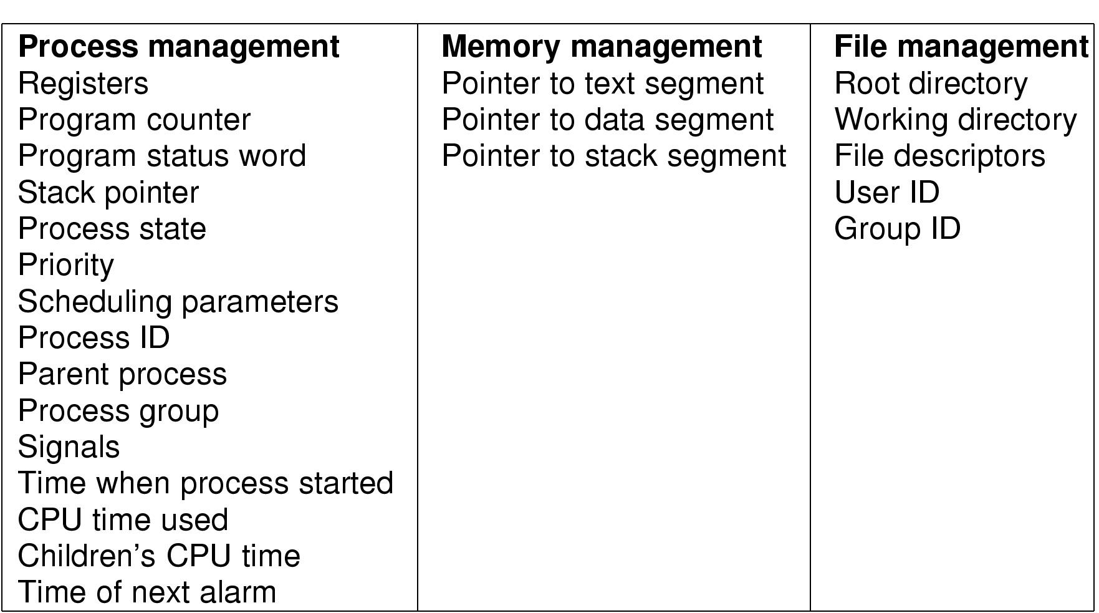
Processes Implementation of Processes (1)
Fields of a process table entry

Slide 17
2.2 Threads

Slide 18
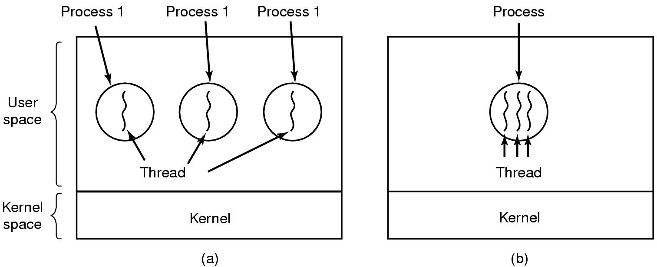
Threads The Thread Model
(a) Three processes each with one thread
(b) One process with three threads

Slide 19
Threads Process with single thread
A process:
Address space (text section, data section)
Single thread of execution
program counter
registers
Stack
Other resource (open files, child processes…)

Slide 20
Threads Process with multiple threads
Multiple threads of execution in the same
environment of process
Address space (text section, data section)
Multiple threads of execution, each thread has private set:
program counter
registers
stack
Other resource (open files, child processes…)

Slide 21
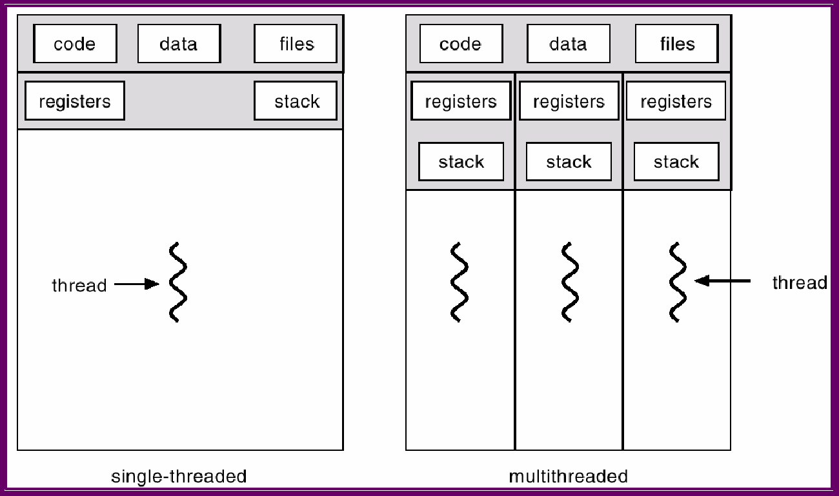
Threads Single and Multithreaded Processes
PC
PC
PC
PC

Slide 22
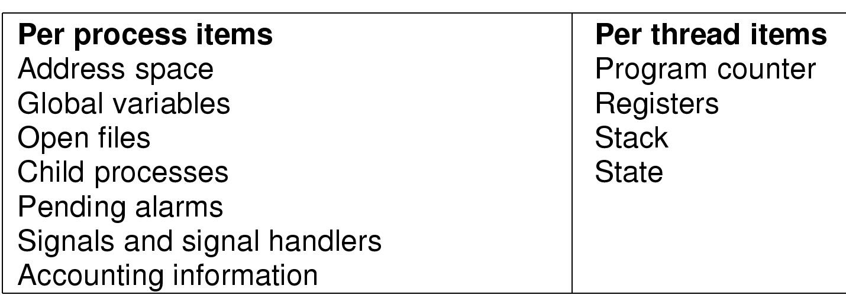
Threads Items shared and Items private
Items shared by all threads in a process
Items private to each thread

Slide 23
Threads Benefits
Responsiveness
Resource Sharing
Economy
Utilization of Multiprocessor Architectures

Slide 24
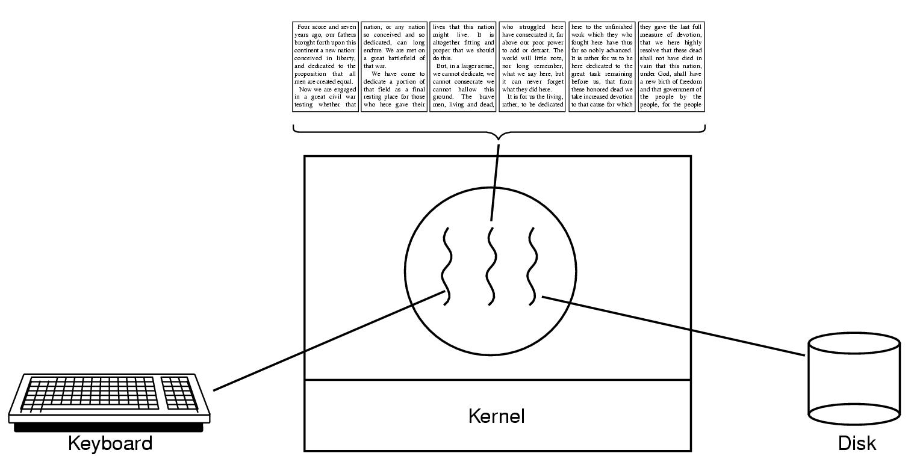
Threads Thread Usage (1)
A word processor with three threads

Slide 25
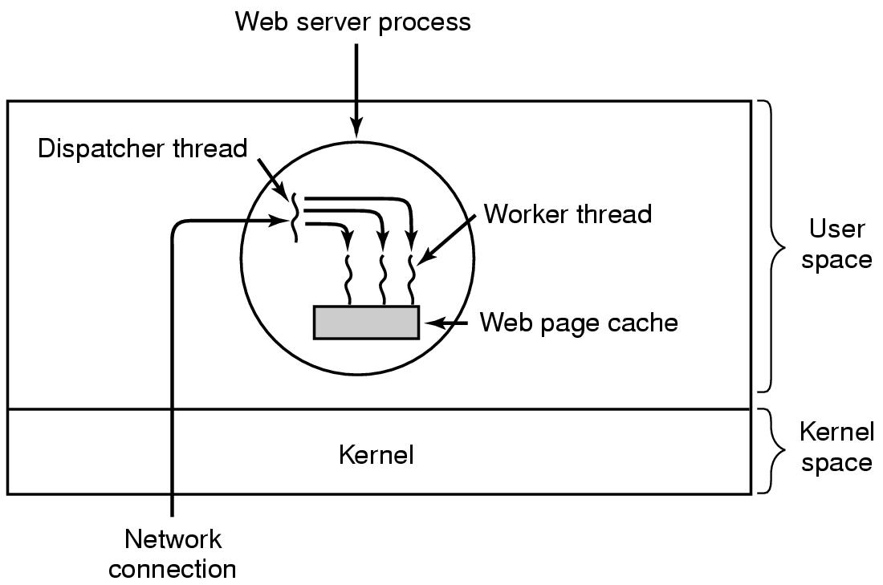
Threads Thread Usage (2)
A multithreaded Web server

Slide 26
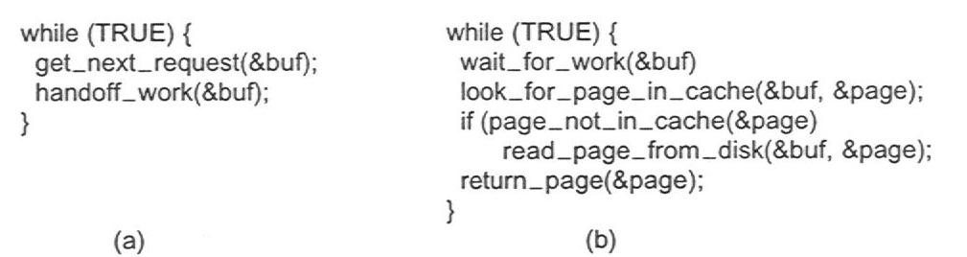
Threads Thread Usage (3)
Rough outline of code for previous slide
(a) Dispatcher thread
(b) Worker thread

Slide 27
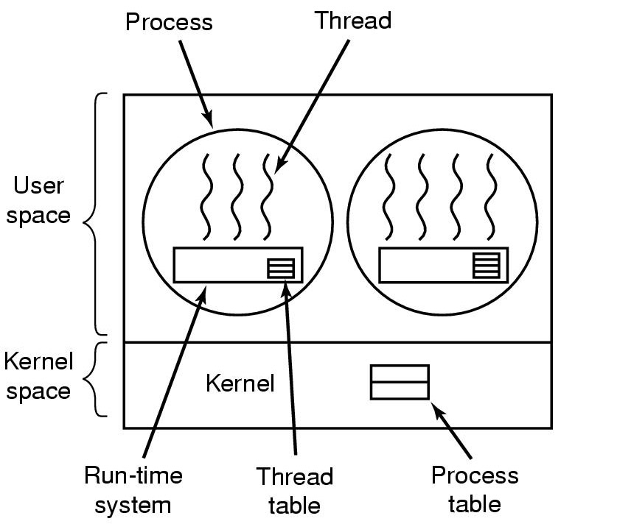
Threads Implementing Threads in User Space (1)
A user-level threads package

Slide 28
Threads Implementing Threads in User Space (2)
Thread library, (run-time system) in user space
thread_create
thread_exit
thread_wait
thread_yield (to voluntarily give up the CPU)
Thread control block (TCB) ( Thread Table) stores states of user thread (program counter, registers, stack)
Kernel does not know the present of user thread

Slide 29
Threads Implementing Threads in User Space (3)
Traditional OS provide only one “kernel thread” presented by PCB for each process.
Blocking problem: If one user thread is blocked ->the kernel thread is blocked, -> all other threads in process are blocked.
user
thread
u
u
u
u
u
u
u
u
u
thread library
thread library
thread library
PCB
PCB
PCB
kernel

Slide 30
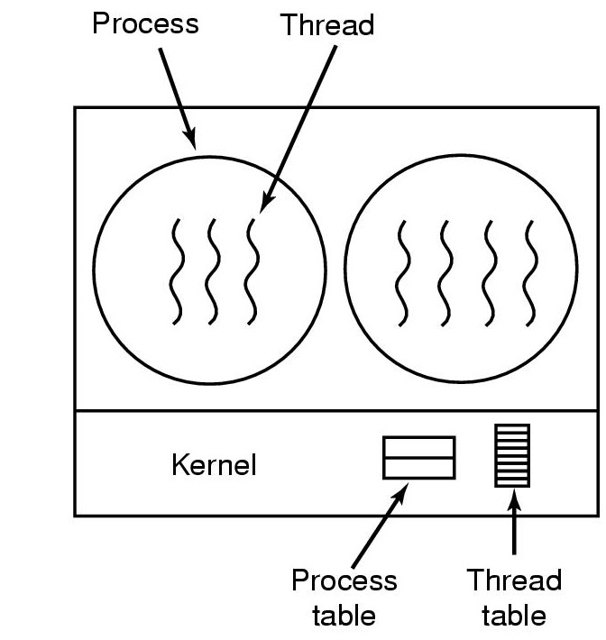
Threads Implementing Threads in the Kernel (1)
A threads package managed by the kernel

Slide 31
Threads Implementing Threads in the Kernel (2)
Multithreading is directly supported by OS:
Kernel manages processes and threads
CPU scheduling for thread is performed in kernel
Advantage of multithreading in kernel
Is good for multiprocessor architecture
If one thread is blocked does not cause the other thread to be blocked.
Disadvantage of Multithreading in kernel
Creation and management of thread is slower

Slide 32
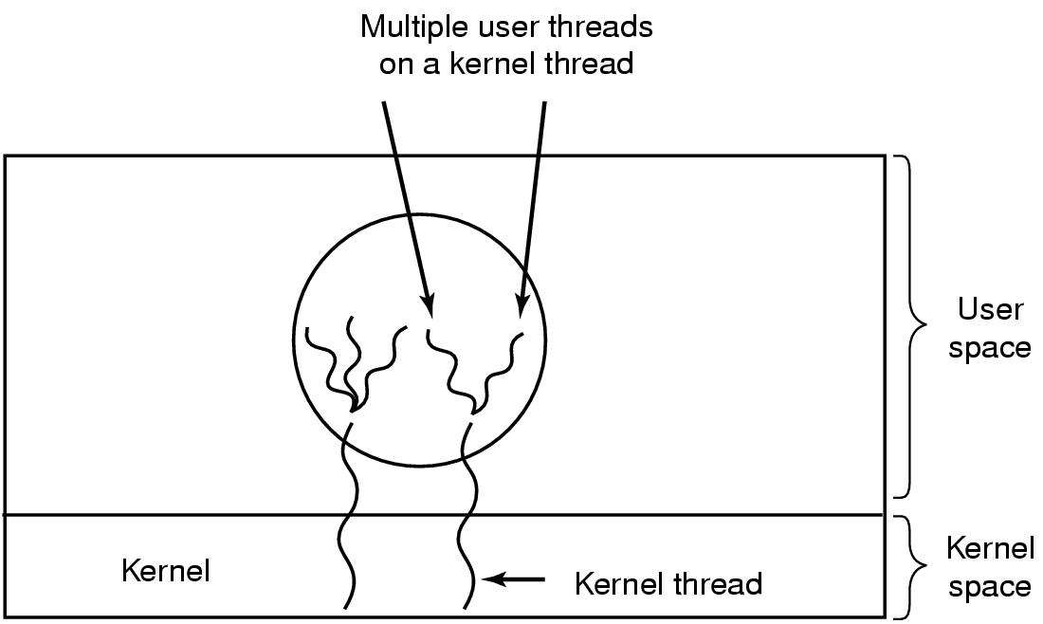
Threads Hybrid Implementations
Multiplexing user-level threads onto kernel- level threads

Slide 33
2.3 Scheduling

Slide 34
Scheduling Introduction to Scheduling (1)
Maximum CPU utilization obtained with multiprogramming
CPU–I/O Burst Cycle – Process execution consists of a cycle of CPU execution and I/O wait
CPU burst distribution

Slide 35
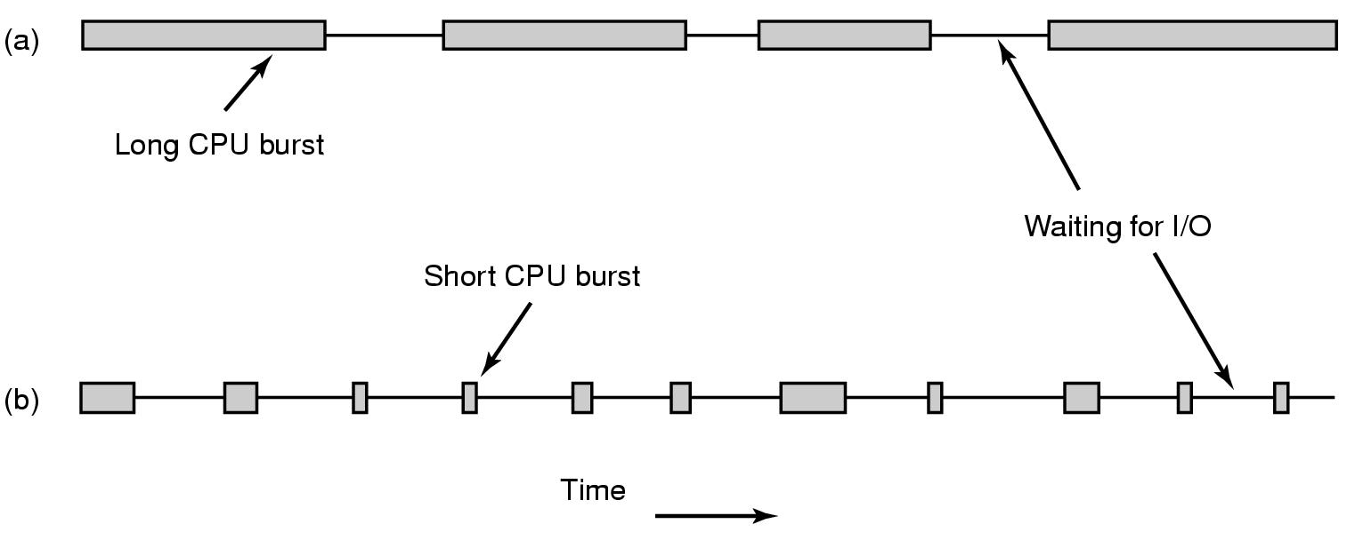
Scheduling Introduction to Scheduling (2)
Bursts of CPU usage alternate with periods of I/O wait
a CPU-bound process
an I/O bound process

Slide 36
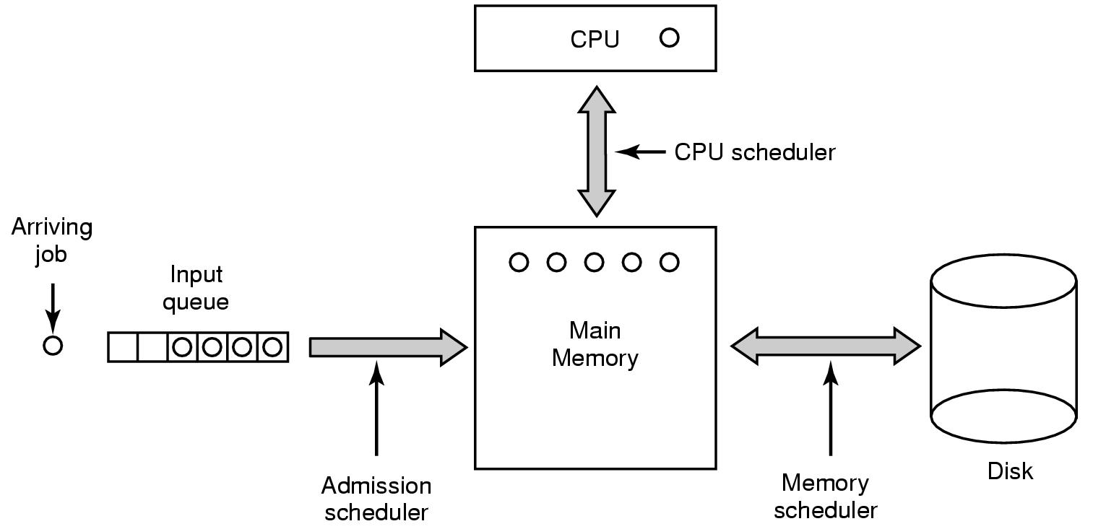
Scheduling Introduction to Scheduling (3)
Three level scheduling

Slide 37
Scheduling Introduction to Scheduling (4)
Selects from among the processes in memory that are ready to execute, and allocates the CPU to one of them
CPU scheduling decisions may take place when a process:
1. Switches from running to waiting state
2. Switches from running to ready state
3. Switches from waiting or new process is created to ready
4. Terminates
Nonpreemptive scheduling algorithm picks process and let it run until it blocks or until it voluntarily releases the CPU
preemptive scheduling algorithm picks process and let it run for a maximum of fix time

Slide 38
Scheduling Introduction to Scheduling (5)
terminated
new
admit
dispatch
exit
ready
running
interrupt
I/O or event completion
I/O or event wait
waiting

Slide 39
Scheduling Introduction to Scheduling (6)
Scheduling Criteria
CPU utilization – keep the CPU as busy as possible
Throughput – # of processes that complete their execution per time unit
Turnaround time – amount of time to execute a particular process
Waiting time – amount of time a process has been waiting in the ready queue
Response time – amount of time it takes from when a request was submitted until the first response is produced, not output (for time-sharing environment)

Slide 40
Scheduling Introduction to Scheduling (7)
Optimization Criteria
Max CPU utilization
Max throughput
Min turnaround time
Min waiting time
Min response time

Slide 41
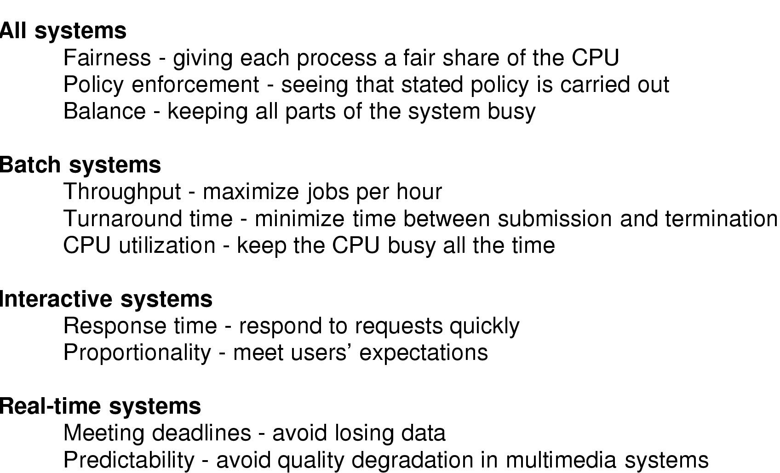
Scheduling Introduction to Scheduling (8)
Scheduling Algorithm Goals

Slide 42
Scheduling Scheduling in Batch Systems (1)
First-Come, First-Served (FCFS) Scheduling
Process Burst Time
P₁ 24
P₂ 3
P₃ 3
Suppose that the processes arrive in the order: P₁ , P₂ , P₃ The Gantt Chart for the schedule is:
Waiting time for P₁ = 0; P₂ = 24; P₃ = 27
Average waiting time: (0 + 24 + 27)/3 = 17
P₁
P₂
P₃
0
24
27
30

Slide 43
Scheduling Scheduling in Batch Systems (2)
FCFS Scheduling (Cont.)
Suppose that the processes arrive in the order
P₂ , P₃ , P₁
The Gantt chart for the schedule is:
Waiting time for P₁ = 6; P₂ = 0; P₃ = 3
Average waiting time: (6 + 0 + 3)/3 = 3
Much better than previous case
Convoy effect short process behind long process
P₂
P₃
P₁
0
3
6
30

Slide 44
Scheduling Scheduling in Batch Systems (3)
Shortest-Job-First (SJF) Scheduling
Associate with each process the length of its next CPU burst. Use these lengths to schedule the process with the shortest time
Two schemes:
nonpreemptive – once CPU given to the process it cannot be preempted until completes its CPU burst
preemptive – if a new process arrives with CPU burst length less than remaining time of current executing process, preempt. This scheme is know as the Shortest-Remaining-Time-First (SRTF)
SJF is optimal – gives minimum average waiting time for a given set of processes

Slide 45
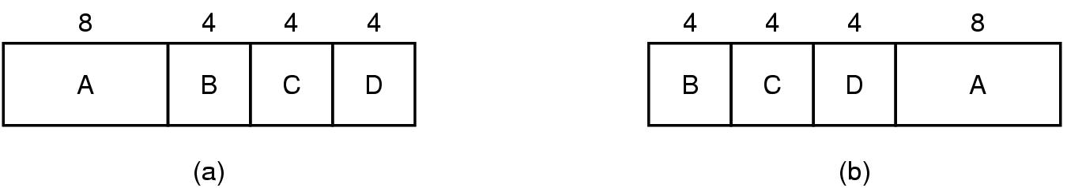
Scheduling Scheduling in Batch Systems (4)
An example of shortest job first scheduling

Slide 46
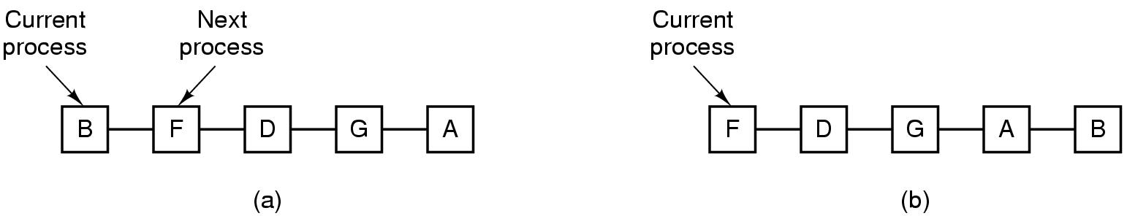
Scheduling Scheduling in Interactive Systems (1)
Round Robin Scheduling
list of runnable processes (a)
list of runnable processes after B uses up its quantum (b)

Slide 47
Scheduling Scheduling in Interactive Systems (2)
Round Robin (RR)`
Each process gets a small unit of CPU time (time quantum), usually 10-100 milliseconds. After this time has elapsed, the process is preempted and added to the end of the ready queue.
If there are n processes in the ready queue and the time quantum is q, then each process gets 1/n of the CPU time in chunks of at most q time units at once. No process waits more than (n-1)q time units.
Performance
q large ⇒ FIFO
q small ⇒ q must be large with respect to context switch, otherwise overhead is too high

Slide 48
Scheduling Scheduling in Interactive Systems (3)
Example of RR with Time Quantum = 20
Process Burst Time
P₁ 53
P₂ 17
P₃ 68
P₄ 24
The Gantt chart is: Typically, higher average turnaround than SJF, but better response
P₁
P₂
P₃
P₄
P₁
P₃
P₄
P₁
P₃
P₃
0
20
37
57
77
97
117
121
134
154
162

Slide 49
Scheduling Scheduling in Interactive Systems (4)
Priority Scheduling: A priority number (integer) is associated with each process
The CPU is allocated to the process with the highest priority
Preemptive
nonpreemptive
SJF is a priority scheduling where priority is the predicted next CPU burst time
Problem ≡ Starvation – low priority processes may never execute
Solution ≡ Aging – as time progresses increase the priority of the process

Slide 50
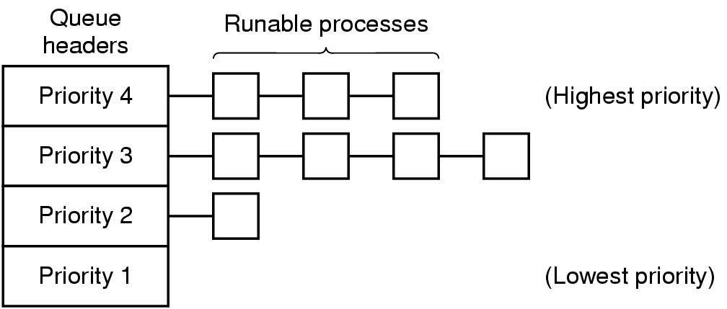
Scheduling Scheduling in Interactive Systems (5)
A scheduling algorithm with four priority classes

Slide 51
Scheduling Scheduling in Real-Time Systems (1)
Hard real-time systems – required to complete a critical task within a guaranteed amount of time
Soft real-time computing – requires that critical processes receive priority over less fortunate ones

Slide 52
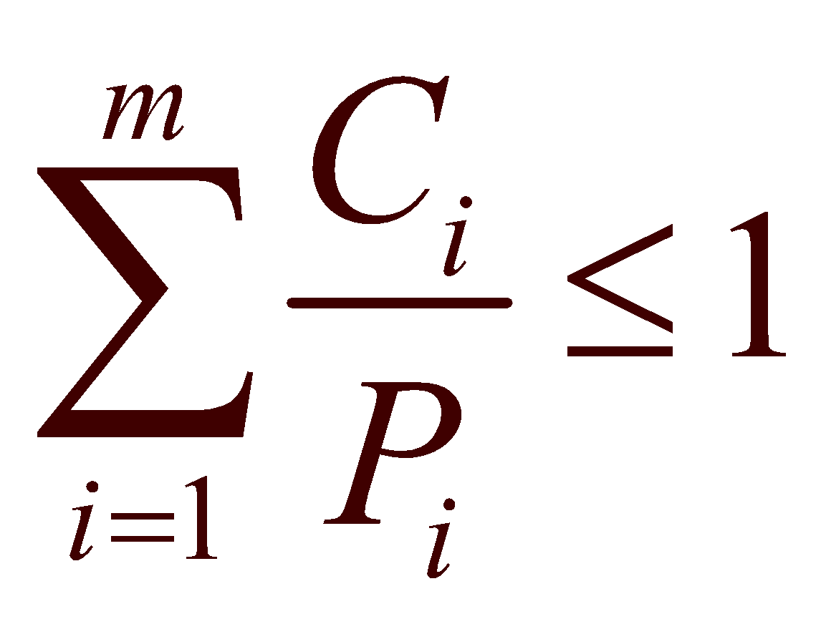
Scheduling Scheduling in Real-Time Systems(2)
Schedulable real-time system
Given
m periodic events
event i occurs within period P_{i} and requires C_{i} seconds
Then the load can only be handled if

Slide 53
Scheduling Policy versus Mechanism
Separate what is allowed to be done with how it is done
a process knows which of its children threads are important and need priority
Scheduling algorithm parameterized
mechanism in the kernel
Parameters filled in by user processes
policy set by user process

Slide 54
Scheduling Thread Scheduling (1)
Local Scheduling – How the threads library decides which thread to put onto an available
Global Scheduling – How the kernel decides which kernel thread to run next

Slide 55
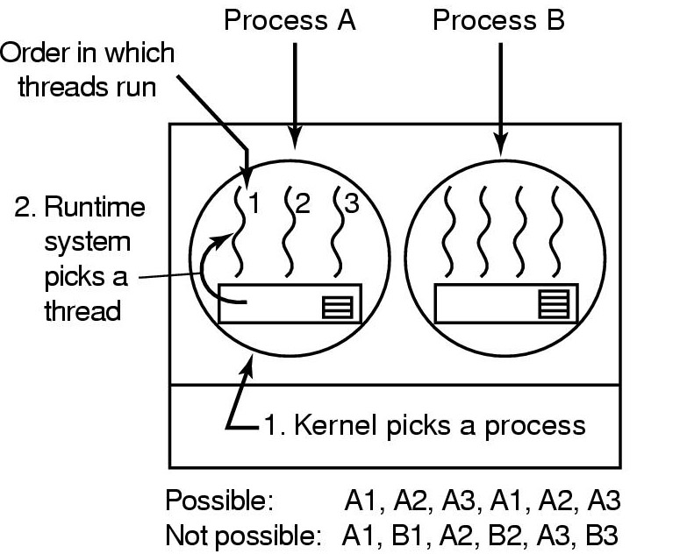
Scheduling Thread Scheduling (2)
Possible scheduling of user-level threads
50-msec process quantum
threads run 5 msec/CPU burst

Slide 56
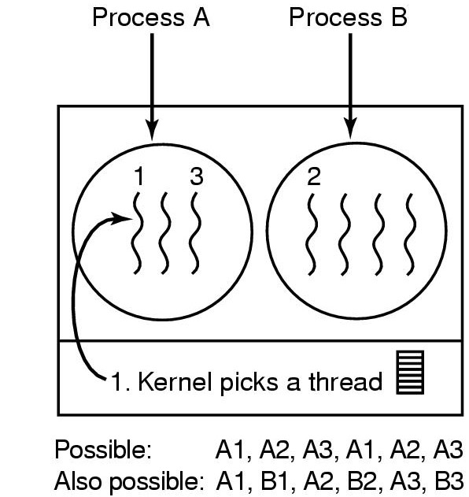
Scheduling Thread Scheduling (3)
Possible scheduling of kernel-level threads
50-msec process quantum
threads run 5 msec/CPU burst

Slide 57
2.4 Interprocess Communication

Slide 58
Cooperating Processes
Independent process cannot affect or be affected by the execution of another process
Cooperating process can affect or be affected by the execution of another process
Advantages of process cooperation
Information sharing
Computation speed-up
Modularity
Convenience

Slide 59
Problem of shared data
Concurrent access to shared data may result in data inconsistency
Maintaining data consistency requires mechanisms to ensure the orderly execution of cooperating processes
Need of mechanism for processes to communicate and to synchronize their actions

Slide 60
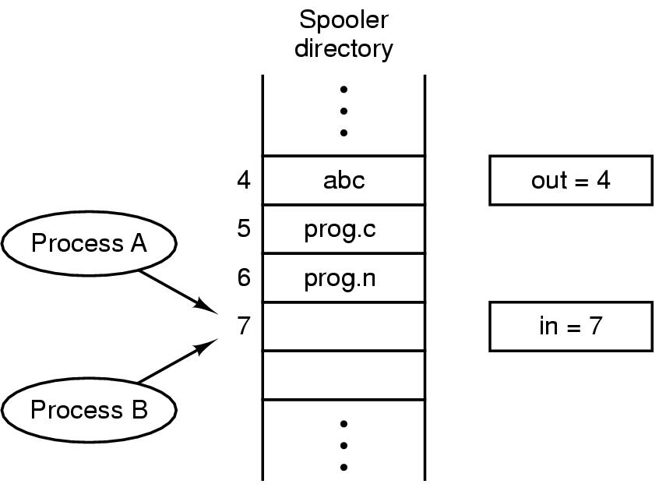
Race Conditions
Two processes want to access shared memory at same time and the final result depends who runs precisely, are called race condition
Mutual exclusion is the way to prohibit more than one process from accessing to shared data at the same time

Slide 61
Critical Regions (1)
The Part of the program where the shared memory is accessed is called
Critical Regions (Critical Section)
Four conditions to provide mutual exclusion
No two processes simultaneously in critical region
No assumptions made about speeds or numbers of CPUs
No process running outside its critical region may block another process
No process must wait forever to enter its critical region

Slide 62
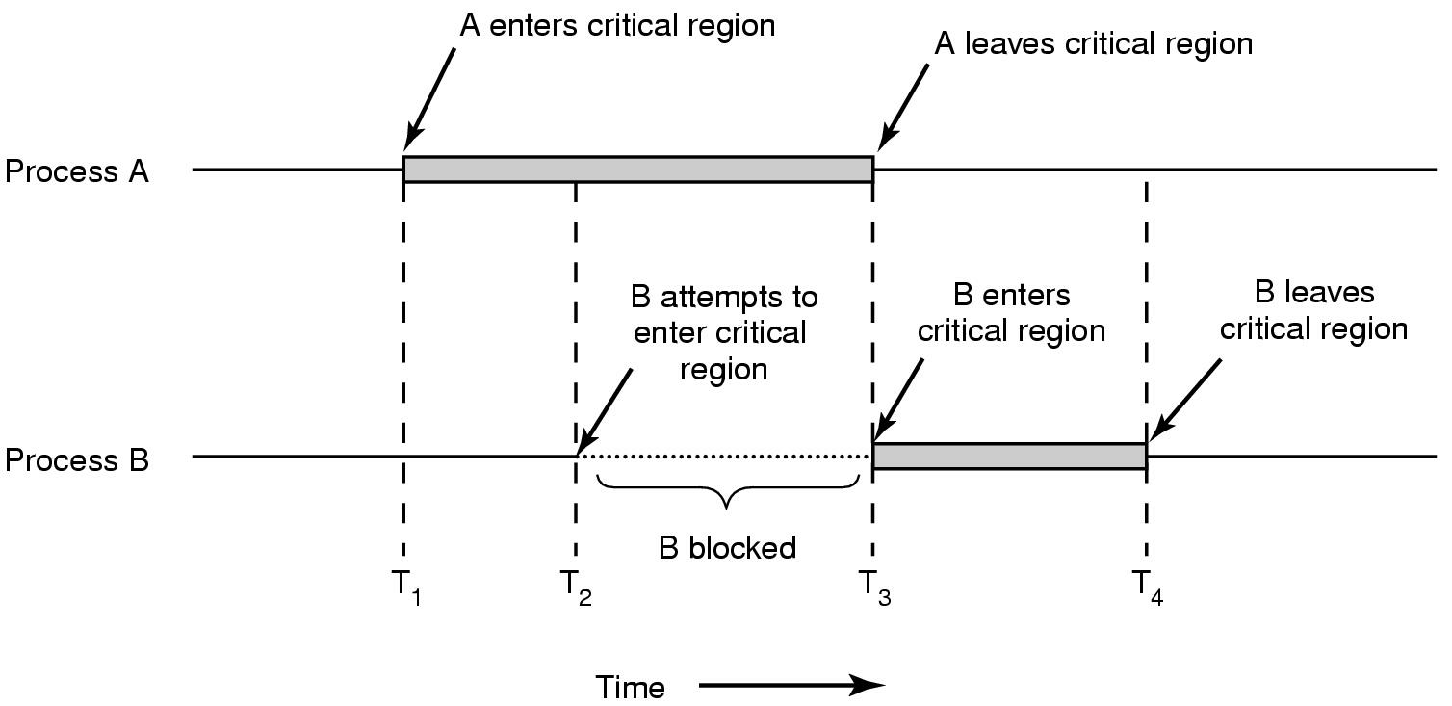
Critical Regions (2)
Mutual exclusion using critical regions (Example)

Slide 63
Solution: Mutual exclusion with Busy waiting
Software proposal
Lock Variables
Strict Alternation
Peterson's Solution
Hardware proposal
Disabling Interrupts
The TSL Instruction

Slide 64
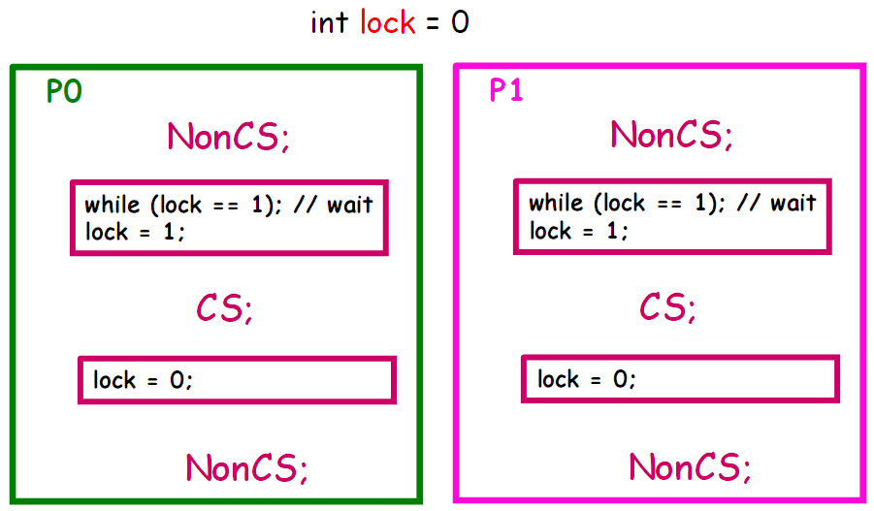
Mutual exclusion with Busy waiting Software Proposal 1: Lock Variables

Slide 65
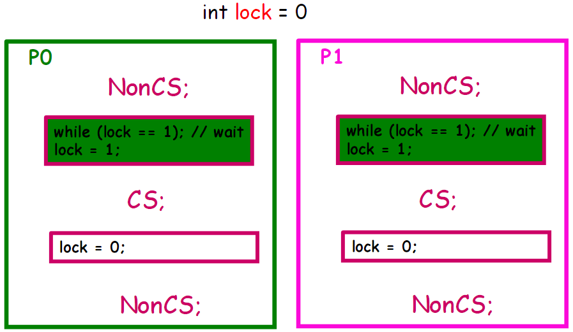
Mutual exclusion with Busy waiting Software Proposal 1: Event

Slide 66
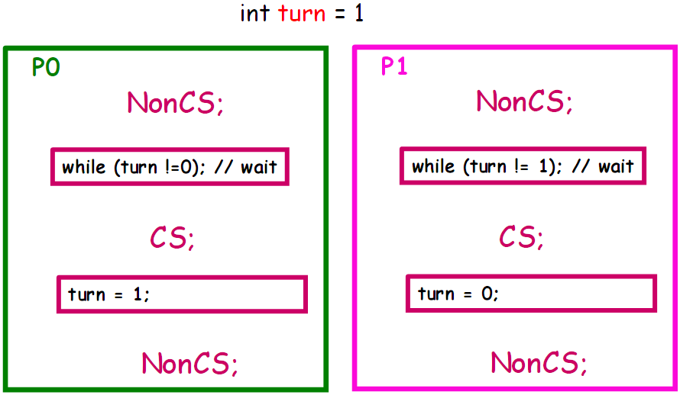
Mutual exclusion with Busy waiting Software Proposal 2: Strict Alternation

Slide 67
Mutual exclusion with Busy waiting Software Proposal 2: Strict Alternation
Only 2 processes
Responsibility Mutual Exclusion
One variable "turn“, one process “turn” come in CS at the moment.

Slide 68
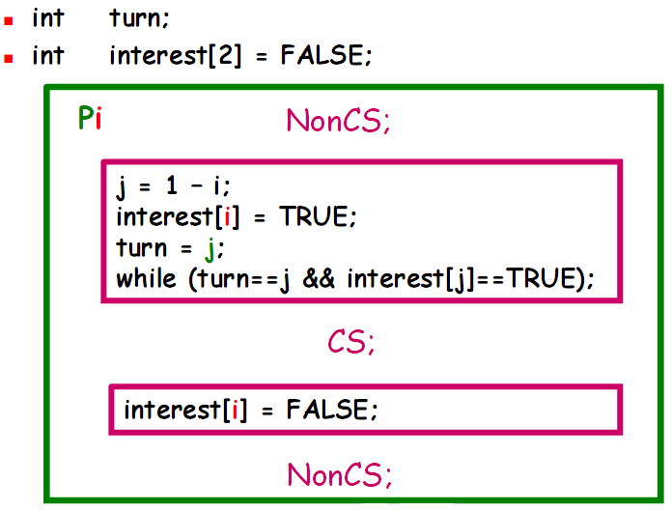
Mutual exclusion with Busy waiting Software Proposal 3: Peterson's Solution

Slide 69
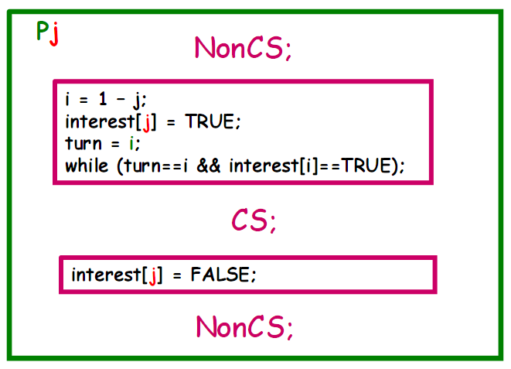
Mutual exclusion with Busy waiting Software Proposal 3: Peterson's Solution

Slide 70
Mutual exclusion with Busy waiting Comment for Software Proposal 3: Peterson's Solution
Satisfy 3 conditions:
Mutual Exclusion
Pi can enter CS when interes[j] == F, or turn == i
If both want to come back, because turn can only receive value 0 or 1, so one process enter CS
Progress
Using 2 variables distinct interest[i] ==> opposing cannot lock
Bounded Wait: both interest[i] and turn change value
Not extend into N processes

Slide 71
Mutual exclusion with Busy waiting Comment for Busy-Waiting solutions
Don't need system’s support
Hard to extend
Solution 1 is better when atomicity is supported

Slide 72
Busy waiting – Hardware Proposal
Software proposal
Lock Variables
Strict Alternation
Peterson's Solution
Hardware proposal
Disabling Interrupts
The TLS Instruction

Slide 73
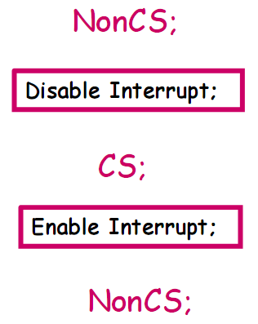
Busy waiting – Hardware Proposal 1: Disabling Interrupt
Disable Interrupt: prohibit all interrupts, including spin interrupt
Enable Interrupt: permit interrupt

Slide 74
Hardware proposal 1: Disable Interrupt
Not be careful
If process is locked in CS?
System Halt
Permit process use command privileges
Danger!
System with N CPUs?
Don't ensure Mutual Exclusion

Slide 75
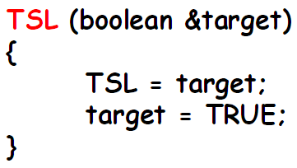
Hardware proposal 1: TSL Instruction
CPU support primitive Test and Set Lock
Return a variable's current value, set variable to true value
Cannot divide up to perform (Atomic)

Slide 76
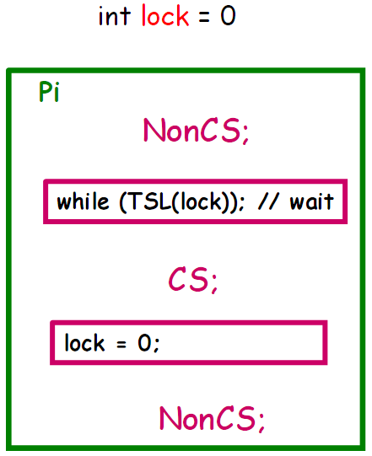
Applied TSL

Slide 77
Comment for hardware solutions in Busy-Waiting
Necessary hardware mechanism's support
Not easy with n-CPUs system
Easily extend to N processes

Slide 78
Comment for hardware solutions in Busy-Waiting
Using CPU not effectively
Constantly test condition when wait for coming in CS
Overcome
Lock processes that not enough condition to come in CS, concede CPU to other process
Using Scheduler
Wait and See...

Slide 79
Synchronous solution
Sleep & Wakeup
Semaphore
Message passing

Slide 80
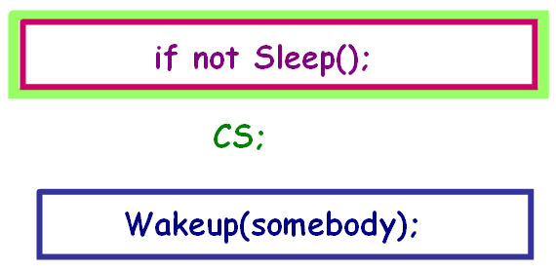
"Sleep & Wake up" solution
Give up CPU when not come in CS
When CS is empty, will be waken up to come in CS
Need support of OS
Because of changing status of process

Slide 81
"Sleep & Wake up" solution: Idea
OS support 2 primitive:
Sleep(): System call receives blocked status
WakeUp(P): P process receive ready status
Application
After checking condition, coming in CS or calling Sleep() depend on result of checking
Process that using CS before, will wake up processes blocked before

Slide 82
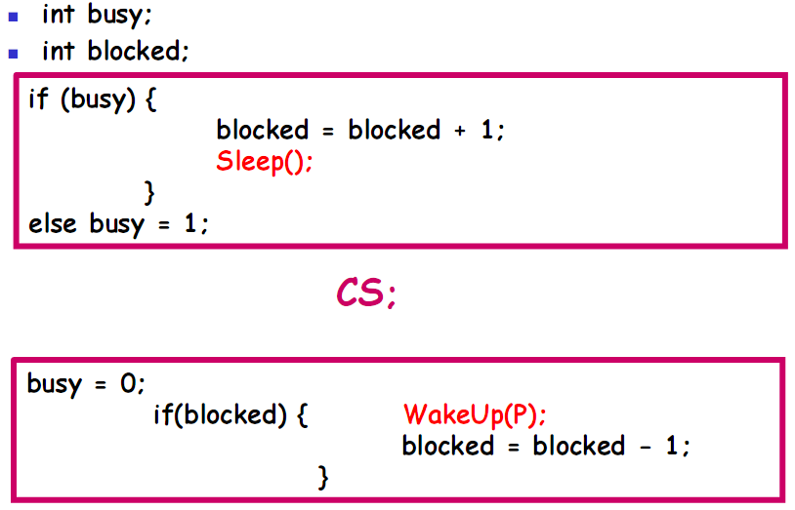
Apply Sleep() and Wakeup()

Slide 83
Problem with Sleep & WakeUp
Reason:
Checking condition and giving up CPU can be broken
Lock variable is not protected

Slide 84
Semaphore
Suggested by Dijkstra, 1965
Properties: Semaphore s;
Unique value
Manipulate with 2 primitives:
Down(s)
Up(s)
Down and Up primitives excuted cannot divide up

Slide 85
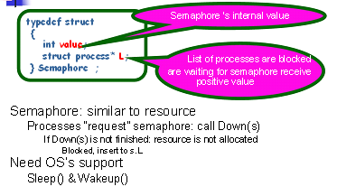
Install Semaphore (Sleep & Wakeup)

Slide 86
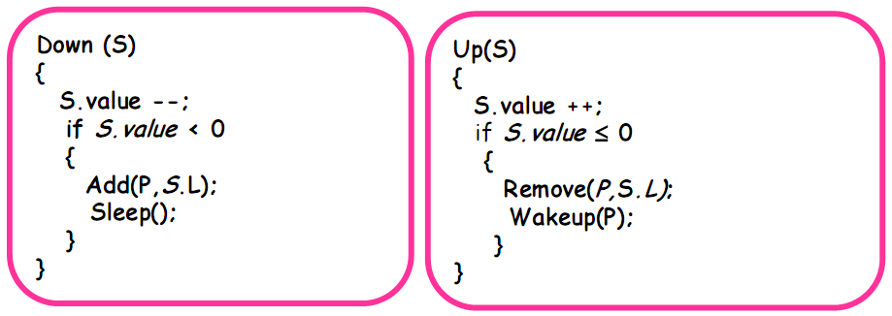
Install Semaphore (Sleep & Wakeup)

Slide 87
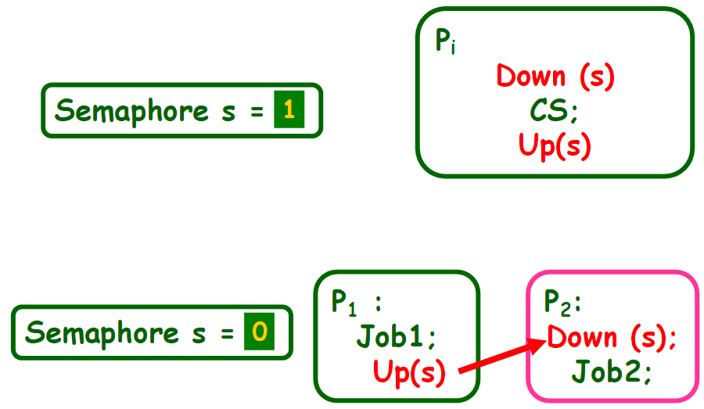
Using Semaphore

Slide 88
Monitor
Hoare (1974) & Brinch (1975)
Synchronous mechanism is provided by programming language
Support with functions, such as Semaphore
Easier for using and detecting than Semaphore
Ensure Mutual Exclusion automatically
Using condition variable to perform Synchronization

Slide 89
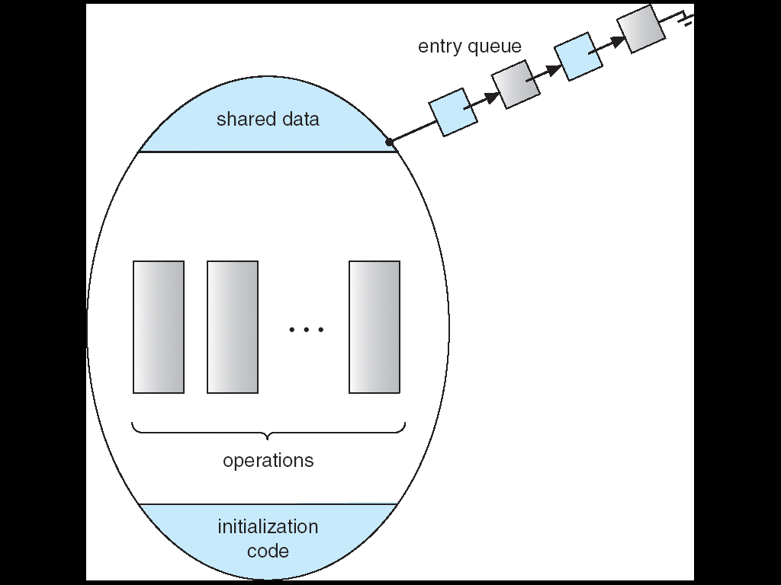
Monitor: structure

Slide 90
Monitor: structure
monitor monitor-name
{
shared variable declarations
procedure body P1 (…) {
. . .
}
procedure body P2 (…) {
. . .
}
procedure body Pn (…) {
. . .
}
{
initialization code
}
}

Slide 91
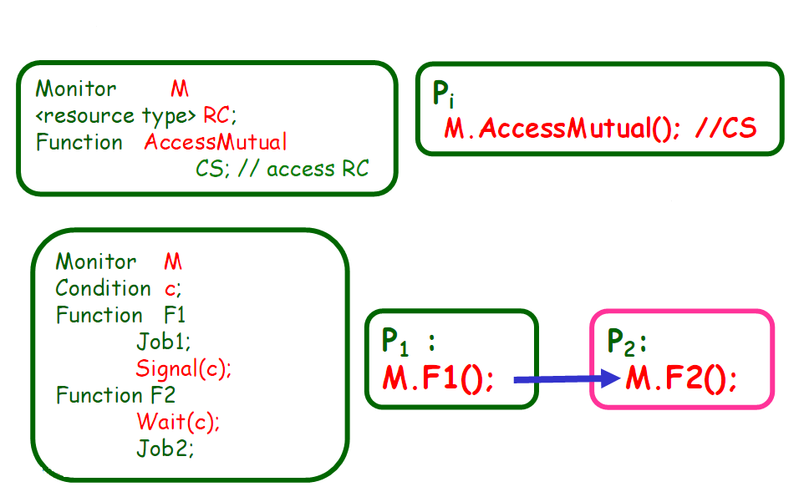
Using Monitor

Slide 92
Message Passing
Processes must name each other explicitly:
send (P, message) – send a message to process P
receive(Q, message) – receive a message from process Q
Properties of communication link
Links are established automatically
A link is associated with exactly one pair of communicating processes
Between each pair there exists exactly one link
The link may be unidirectional, but is usually bi-directional

Slide 93
Classical Problems of Synchronization
Bounded-Buffer Problem
(Producer-Consumer Problem)
Readers and Writers Problem
Dining-Philosophers Problem

