Slide 1
Array of Objects
Notes:
In a real sofware, files are ways to store data of a program. Data in a file can be binary bytes, characters, and even binary data of objects belonging to a specific class. Depending on storing formats, read from and write data to a file are different. So, the java.io package supplies APIs for managing directories and files.

Slide 2
Objectives
basic operations supported by an array.
print all the array elements(objects)
Adds an object at the given index.
Deletes an object at the given index.
Searches an object using the given index or by the value.
Updates an object at the given index.

Slide 3
Case study
Problem: A antique shop that sells antique items, namely vases, statues, and paintings. The owner can add item to inventory. The shop will keep items in the list. The owner can add a new item to it, he search also the item,….
=>For now, we want to manage the list of objects such as vases, statues, paintings in an array.

Slide 4
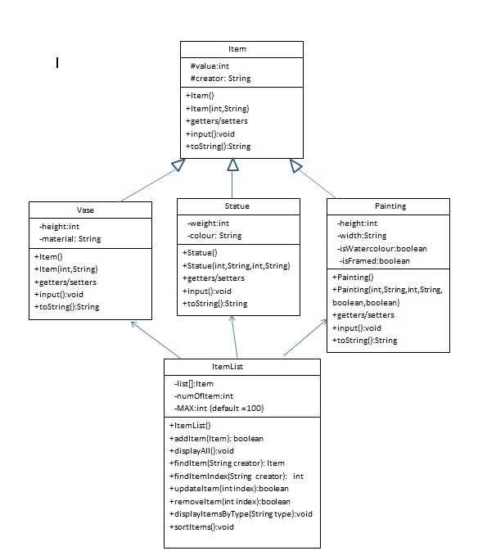
Case study

Slide 5
Case study
public class Item
{ // declare fields
protected int value; // the price of a Item (>=0)
protected String creator; // the creator who creates the item( is not empty)
//constructors
public Item(){ value=0; creator=""; }
public Item(int value, String creator){
this.value=value;
this.creator=creator;
}
//getters,setters: you is required to add more code to get/set fields of a Item object
//this method is used to input all fields of a Item object
public void input(){ //use Scanner class to input fields
//use try..catch/throws to handle exceptions }
//this method returns a string that includes value, creator of a Item object public String toString(){ //return
}
}

Slide 6
Case study
public class Vase extends Item
{
private int height;//height of a vase (>=0 and <=2000)
private String material;//material of a vase (is not empty)
//TODO: you add more your codes
//constructors
//getter
//setter
//this method is used to input all fields of a Vase object
public void input(){ //use Scanner class to input fields
//use try..catch/throws to handle exceptions
} //this method returns a string that includes value, creator, height, material of a vase object public String toString(){ //return ;
}
}

Slide 7
Case study
public class Statue extends Item
{
private int weight; //the weight of a statue object (weght>=0 and <=1000)
private String colour; ////the colour of a statue object (is not empty)
//You add more your code //constructors
//getter
//setter
//this method is used to input all fields of a statue object
public void input(){ //use Scanner class to input fields
//use try..catch/throws to handle exceptions
} //this method returns a string that includes value, creator, weight, colour of a statue object public String toString(){ //return ;
}
}

Slide 8
Case study
public class Painting extends Item
{
private int height; //the height of a painting object (height>=0 and <=2000)
private int width; //the width of a painting object (height>=0 and <=3000)
private boolean isWatercolour; //the painting object use s a watercolor or not
private boolean isFramed; //the painting object has s a frame or not
//You add more your code //constructors
//getter
//setter
//this method is used to input all fields of a painting object
public void input(){ //use Scanner class to input fields
//use try..catch/throws to handle exceptions
} //this method returns a string that includes all fields of a painting object public String toString(){ //return ;
}
}

Slide 9
Case study
public class ItemList
{ Item [] list; // an array to store all items
int numOfItem; // to store the number of items that added to the list
final int MAX=100; // is the size of the array
public ItemList(){
list=new Item[MAX];
numOfItem=0;
}
//this mothod add an Item object to the list
//input: a new item that needs to add
//output: return true/false public boolean addItem(Item item){
if( item==null || numOfItem>=MAX)
return false;
list[numOfItem]=item;
numOfItem++;
return true;
}

Slide 10
Case study
//this method prints out information of all items public void displayAll(){
if(numOfItem==0)
System.out.println("the list is empty");
for(int i=0; i< numOfItem; i++){
System.out.println(list[i]);
}
}
//this method finds the item by its creator
//return the item that is found of the first occurrence.
pulic Item findItem(String creator){
for(int i=0; i< numOfItem; i++)
if( list[i].getCreator().equals(creator))
return list[i];
return null;
}

Slide 11
Case study
//this method returns the zero_based index of the first occurrence.
pulic int findItemIndex(String creator){
for(int i=0; i< numOfItem; i++)
if( list[i].getCreator().equals(creator))
return i;
return -1;
}
//this method updates the item at the specified position in this list
//input: the index you wish to update
pulic boolean updateItem(int index){
if( index >= 0 && index < numOfItem){
list[i].input();
return true;
}
return false;
}

Slide 12
Case study
//this method removes the item at the specified position in this list.
//Shifts any subsequent elements to the left
//input: the index you wish to remove
pulic boolean removeItem(int index){
if( index >= 0 && index < numOfItem){
for(int j=index; j< numOfItem; j++ ){
list[j]=list[j+1];
}
numOfItem --;
return true;
}
return false;
}

Slide 13
Case study
//this method prints out all items that belong to the given type in the list.
public void displayItemsByType(String type){
if (type.equals("Vase")){
for(int i=0; i < numOfItem; i++)
if ( list[i] instanceof Vase) System.out.println( list[i]);
}
else if (type.equals("Statue")){
for(int i=0; i < numOfItem; i++)
if ( list[i] instanceof Statue) System.out.println( list[i]);
}
else {
for(int i=0; i < numOfItem; i++)
if ( list[i] instanceof Painting) System.out.println( list[i]);
}
}

Slide 14
Case study
//this method sorts items in ascending order based on their values.
public void sortItems(){
for(int i=0; i< numOfItem; i++)
for(int j=numOfItem-1; j>i ;j--){
if( list[i].getValue()< list[j-1].getValue()){
Item tmp=list[j];
list[j]=list[j-1];
list[j-1]=tmp;
}
}
}
}//end class

Slide 15
Case study
public class antiqueShop{
public static void main(String[] args){
Scanner sc=new Scanner(System.in);
int choice=0;
do{
System.out.println("1. add a new vase");
System.out.println("2. add a new statue");
System.out.println("3. add a new painting");
System.out.println("4. display all items");
System.out.println("5. find the items by the creator ");
System.out.println("6. update the item by its index");
System.out.println("7. remove the item by its index");
System.out.println("8. display the list of vase items ");
System.out.println("9. sorts items in ascending order based on their values ");
System.out.println("10. exit");
System.out.println("input your choice:");
choice=sc.nextInt();
switch(choice){

Slide 16
Case study
case 1:
Item tmp=new Vase();
tmp.input();
if(obj.addItem(tmp)){
System.out.println("added");
}
break; case 2:
…..
break case 3:
….
break; ….. }//end switch
} while(choice<=9); //end while
} //end class

