Slide 1

Group and team overview
Session I

Slide 2
CHAPTER OUTLINE
1. Defining teams and groups
2. Cooperation

Slide 3
Learning Objectives
Defining Teams and Groups
Define “cooperation”
Distinguish between different social value orientations
Influences on cooperation
Explain methods psychologists use to research cooperation

Slide 4
1. Defining teams and groups
Formal groups
Informal groups
What is a group?

Slide 5

Formal groups
are used to:
organize and distribute work
pool information
devise plans
coordinate activities
increase commitment
Negotiate
resolve conflicts and conduct inquests.

Slide 6
Informal groups
are used to:
to satisfy needs of affiliation
act as a forum for exploring self-concept as a means of gaining support
have an important effect on formal work tasks:
for example by exerting subtle pressures on group members to conform to a particular work rate, or as ‘places’ where news, gossip, etc., is exchanged.

Slide 7
What is a team?
Activity 1
Write your own definition of a ‘team’ (in 20 words or less). Provide an example of a team working toward an achievable goals

Slide 8

A team: as a particularly cohesive and purposeful type of work group

Slide 9
A team/work group
Sustainability
A group consciousness or identity
A sense of shared purpose
Interdependence:
Interaction
A definable membership
An ability to act together.
three or more people
identifiable by name or type

Slide 10
Activity 2
List some examples of teams of which you are a member – both inside and outside work – in your learning file. Now list some groups. What strikes you as the main differences?

Slide 11
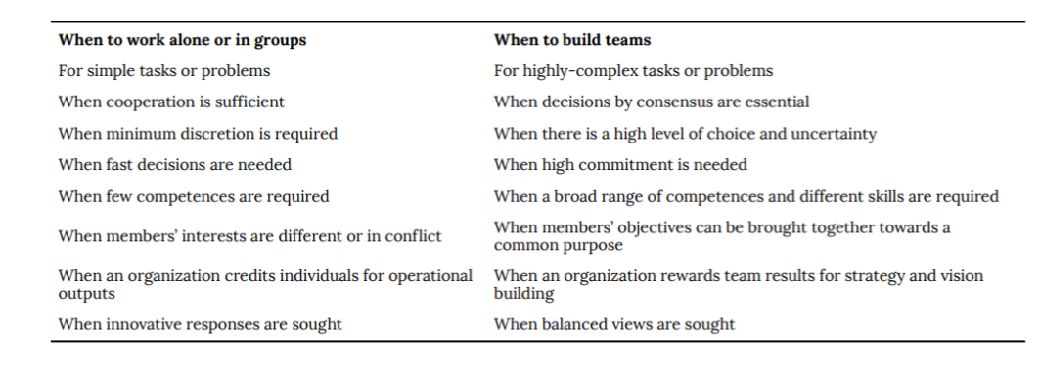
Is a team or group really needed?

Slide 12
Types of teams
Staff performing similar tasks – grouped together reporting to a single supervisor;
Junior managers – responsible for a number of supervisors and their groups
Groups of junior managers – reporting to departmental heads;
Departmental heads – reporting to senior managers, who are responsible for wide-ranging functions such as manufacturing, finance, human resources and marketing;
Senior managers – reporting to the managing director, who may then report to the Board.

Slide 13
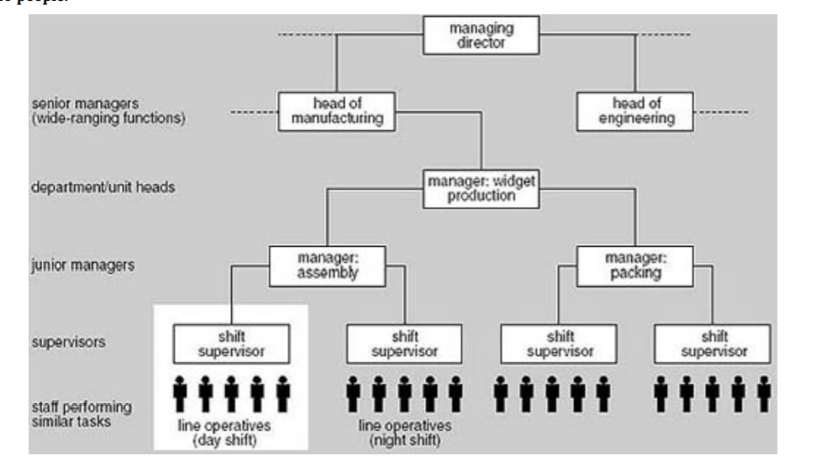
The traditional hierarchical structure
Notes:
The highlighted area shows one supervisor’s span of control: the
people who work for that supervisor

Slide 14
Activity 3
Why is it problematic for a manager to supervise too many people? How does this relate to groups, is there an ideal group size or configuration?

Slide 15
THE FUNCTIONAL TEAM
Functional lines: people working together carry out the same or similar functions
A functional team is a team in which work is carried out within such a functionally organized group

Slide 16
The project (single) team
The project, or single, team consists of a group of people who come together as a distinct organizational unit in order to work on a project or projects.
The team is often led by a project manager, though self-managing and self-organizing arrangements are also found

Slide 17
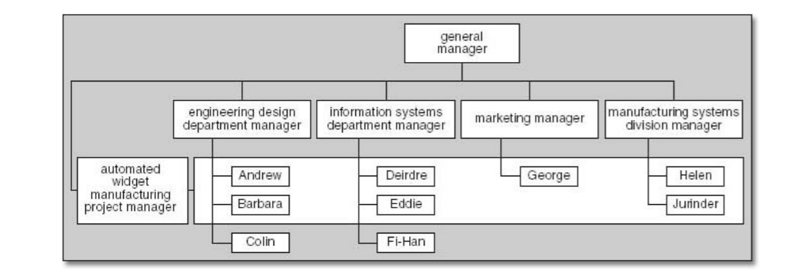
The matrix team

Slide 18
The contract team
Is brought in from outside in order to do the project work.
The client who will judge the success of the project
A variant of this is the so-called ‘outsourced supply team’: the team is physically situated remotely from the project manager

Slide 19
Mixed structures
Some members may be employed to work full time
Others may work part time
Some may be part of a matrix arrangement
Others may be part of a functional hierarchy, undertaking work on the project under their line manager’s supervision by negotiation with their project manager

Slide 20
Activity 4
What are some of the relative benefits and drawbacks to some of these team configurations? Which one is best for a large and complex problem? Which is normal for a straightforward task?

Slide 21
Modern teams
Three other important types of team:
‘self-managed teams’
‘self-organizing teams’
‘dispersed virtual teams.

Slide 22
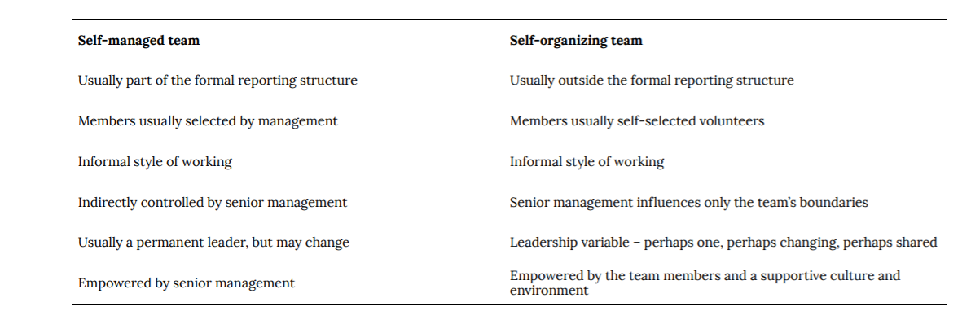
Comparing Self-managed and Self-Organizing Teams

Slide 23
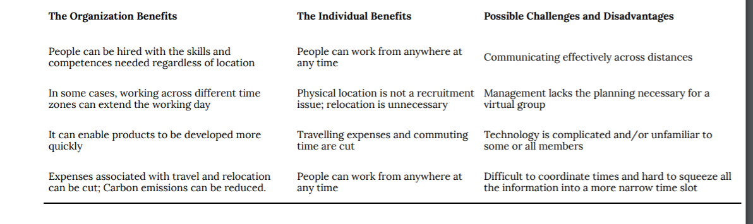
Teams have organizational and individual benefits, as well as possible challenges and disadvantages

Slide 24
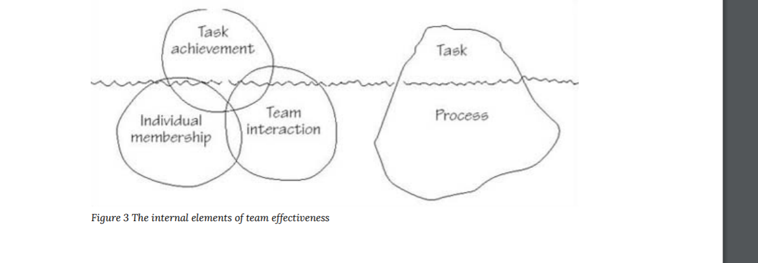
Why do (only some) teams succeed?
Notes:
The three elements could be reconfigured as an iceberg, most of which is below the water’s surface (the right-hand side of Figure 3). Superficial observation of teams in organizations might suggest that most, if not all, energy is devoted to the explicit task (what is to be achieved, by when, with what budget and what resources). Naturally, this is important. But too often the concealed part of the iceberg (how the team will work together) is neglected. As with real icebergs, shipwrecks can ensue.

Slide 25
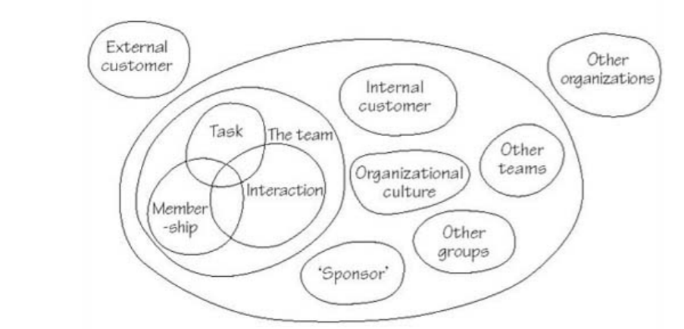
Systems map showing components influencing team effectiveness

Slide 26

2. Cooperation

Slide 27
Experiment: The Prisoner’s Dilemma
Imagine that you are a participant in a social experiment. As you sit down, you are told that you will be playing a game with another person in a separate room. The other participant is also part of the experiment but the two of you will never meet. In the experiment, there is the possibility that you will be awarded some money. Both you and your unknown partner are required to make a choice: either choose to “cooperate,” maximizing your combined reward, or “defect,” (not cooperate) and thereby maximize your individual reward. The choice you make, along with that of theother participant, will result in one of three unique outcomes to this task, illustrated below in Figure 1

Slide 28
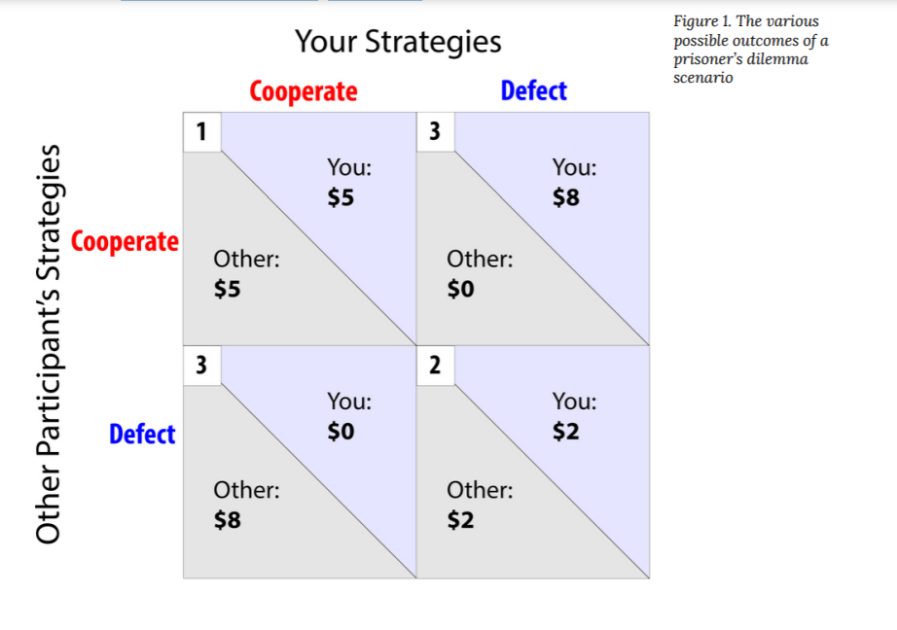

Slide 29
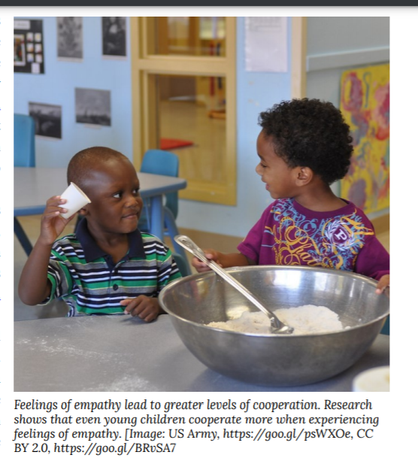
Individual Differences in Cooperation
Social Value Orientation
Empathic AbilityEmpathic Ability

Slide 30
Situational Influences of Cooperation
Communication and Commitment
Trust
Group Identification
Culture

Slide 31
Discussion Questions
1. Which groups do you identify with? Consider sports teams, home towns, and universities. How does your identification with these groups make you feel about other members of these groups? What about members of competing groups?
2. Thinking of all the accomplishments of humanity throughout history which do you believe required the greatest amounts of cooperation? Why?
3. In your experience working on group projects—such as group projects for a class—what have you noticed regarding the themes presented in this module (eg. Competition, free riding, cooperation, trust)? How could you use the material you have just learned to make group projects more effective?

Slide 32
Forming groups (homework)
5-7 members/a group
Introduce and get to know each other.
Take pictures with all members of the group with creative poses, sharing with others in the next slot.
Note: This group will be the group that will work with you on a project to practice the skill throughout the course.

Slide 33


